Slide 1
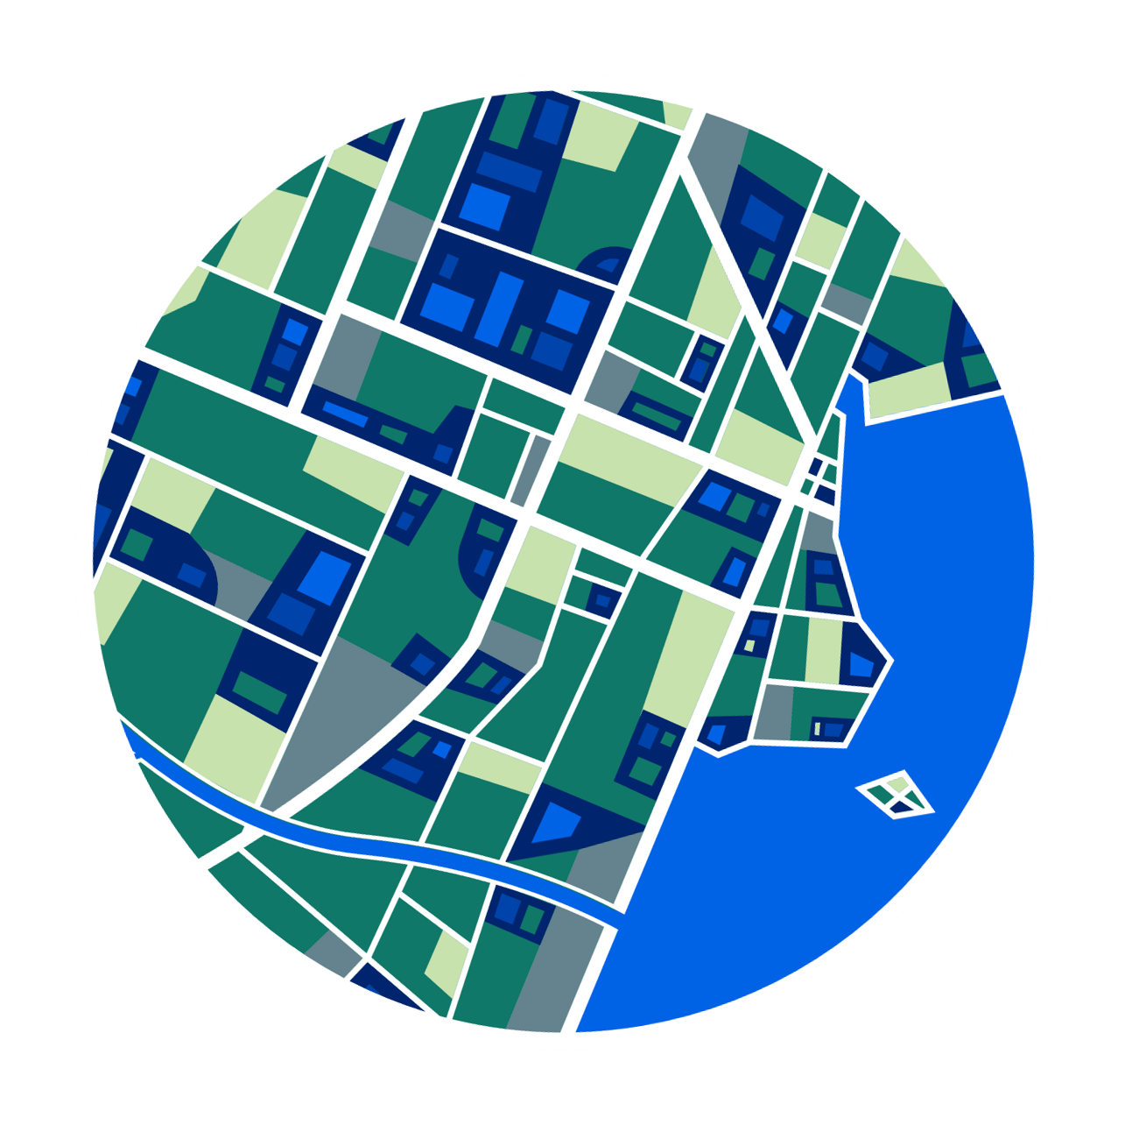

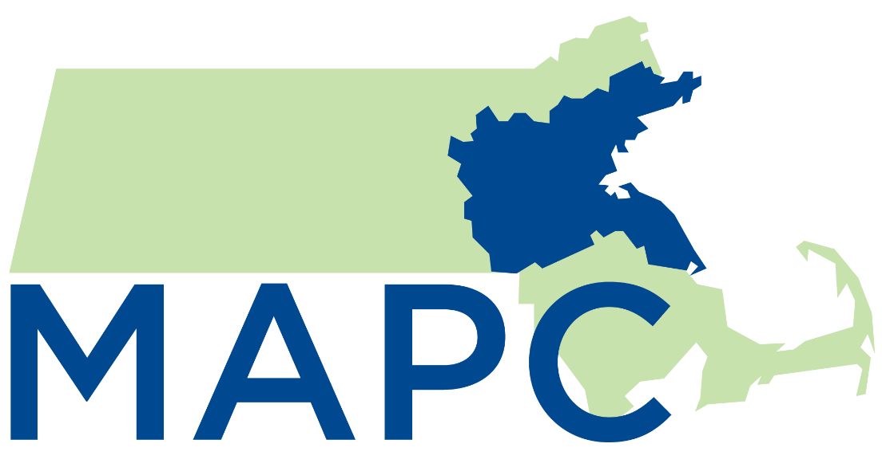
Connecting the Dots:
Bridging Data and Policy for Cultural Infrastructure in Metro Boston
Brandon Stanaway, Socioeconomic Analyst II
Abbey Judd, Senior Arts & Culture Planner
Metropolitan Area Planning Council
Supporting Community Arts & Culture with Local Data
National Neighborhood Indicators Partnership
Wednesday, September 25, 2024

Slide 2
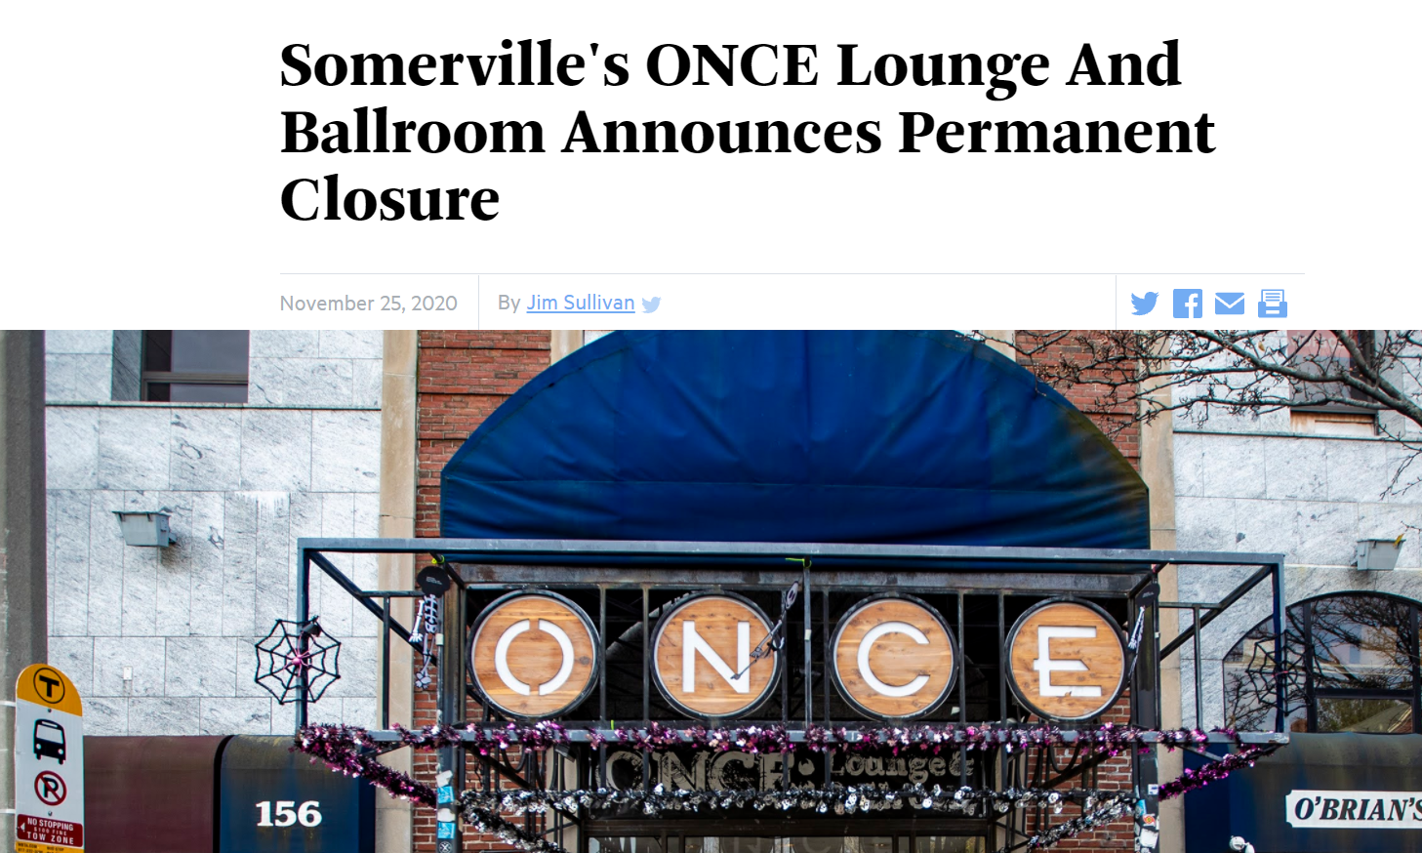
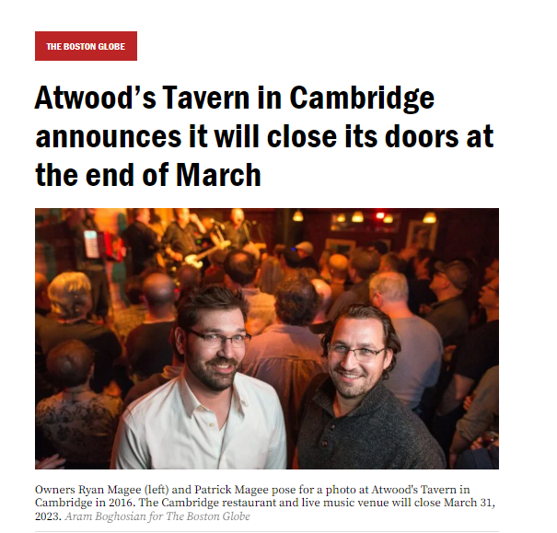
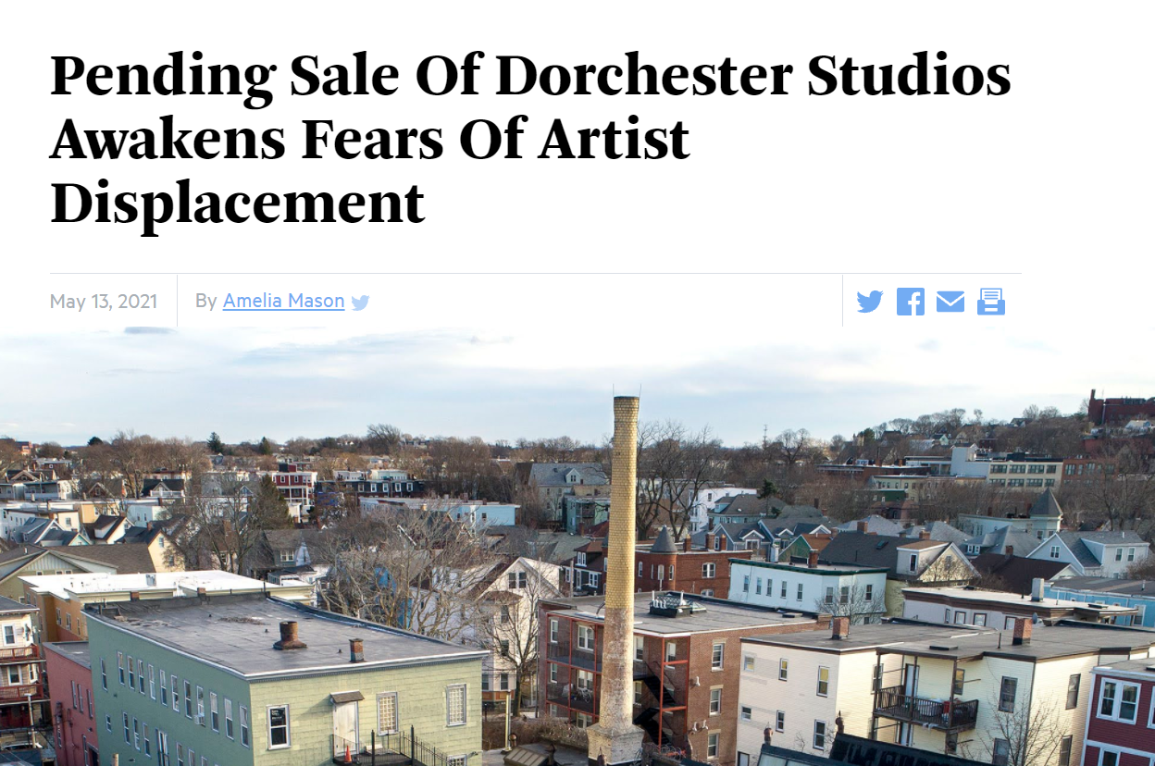
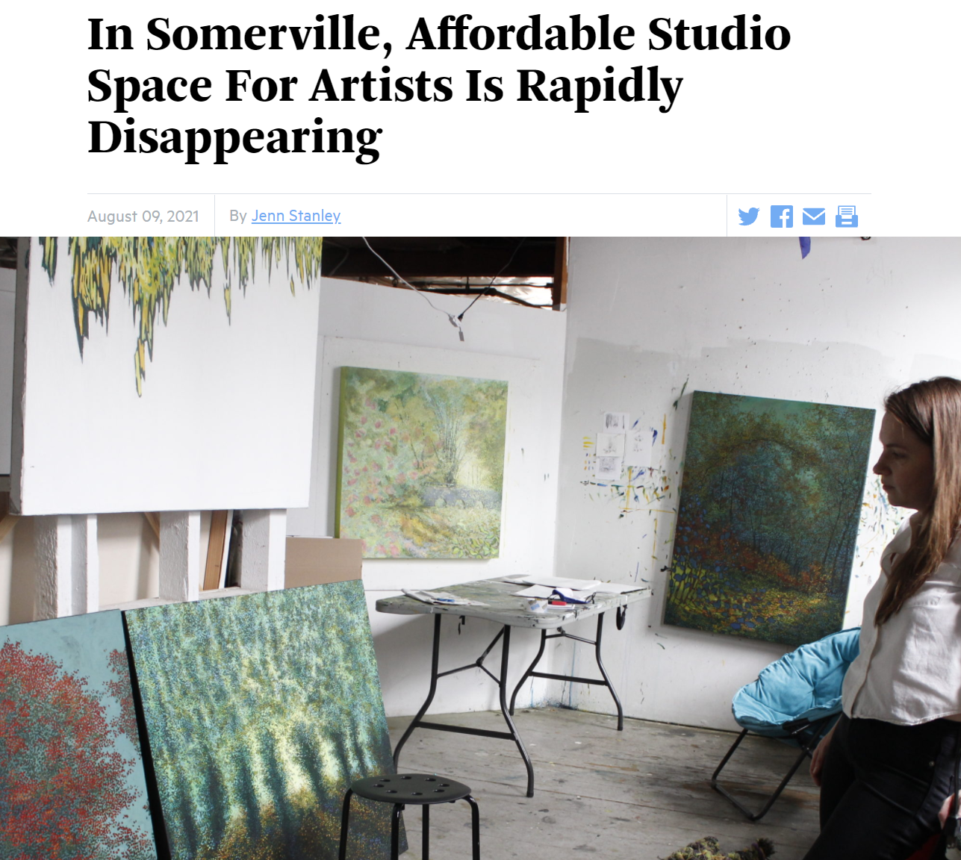
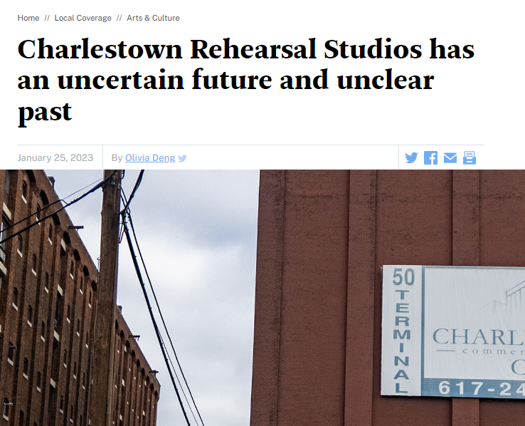
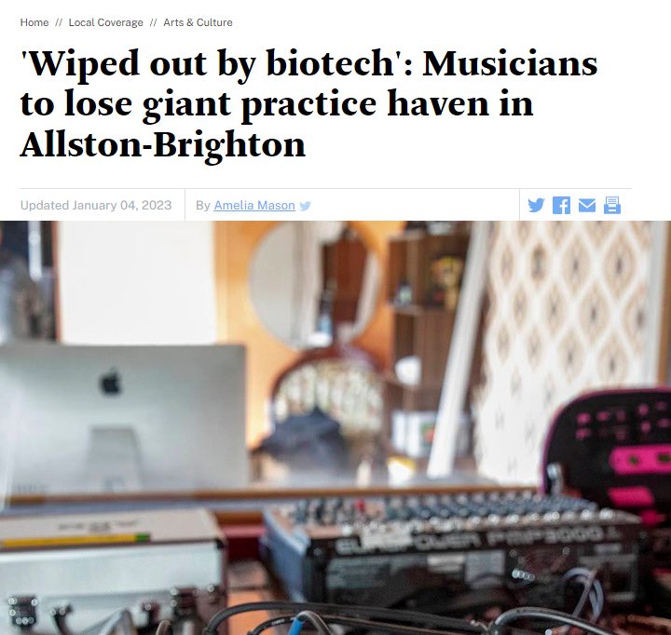
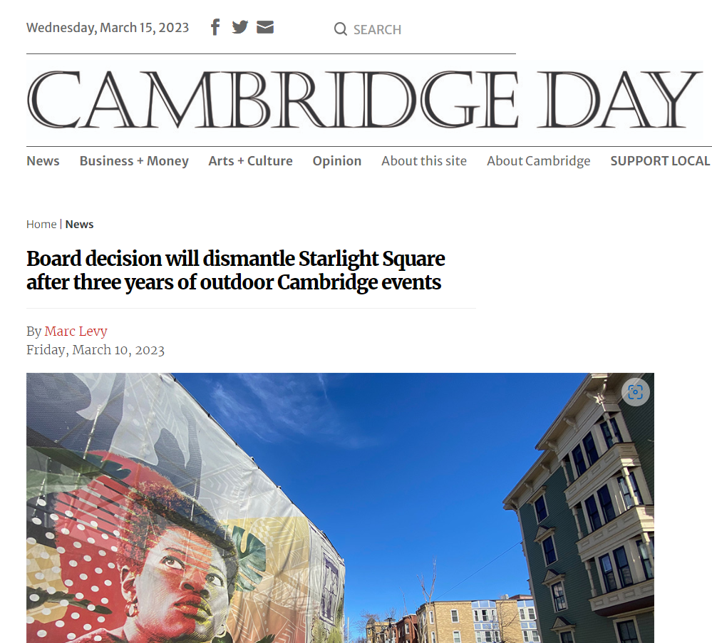
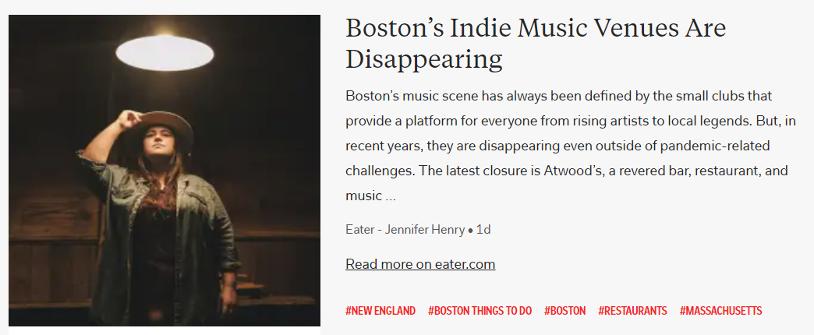
2

Slide 3

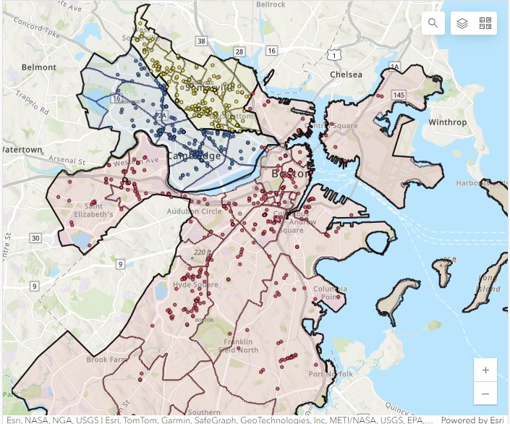
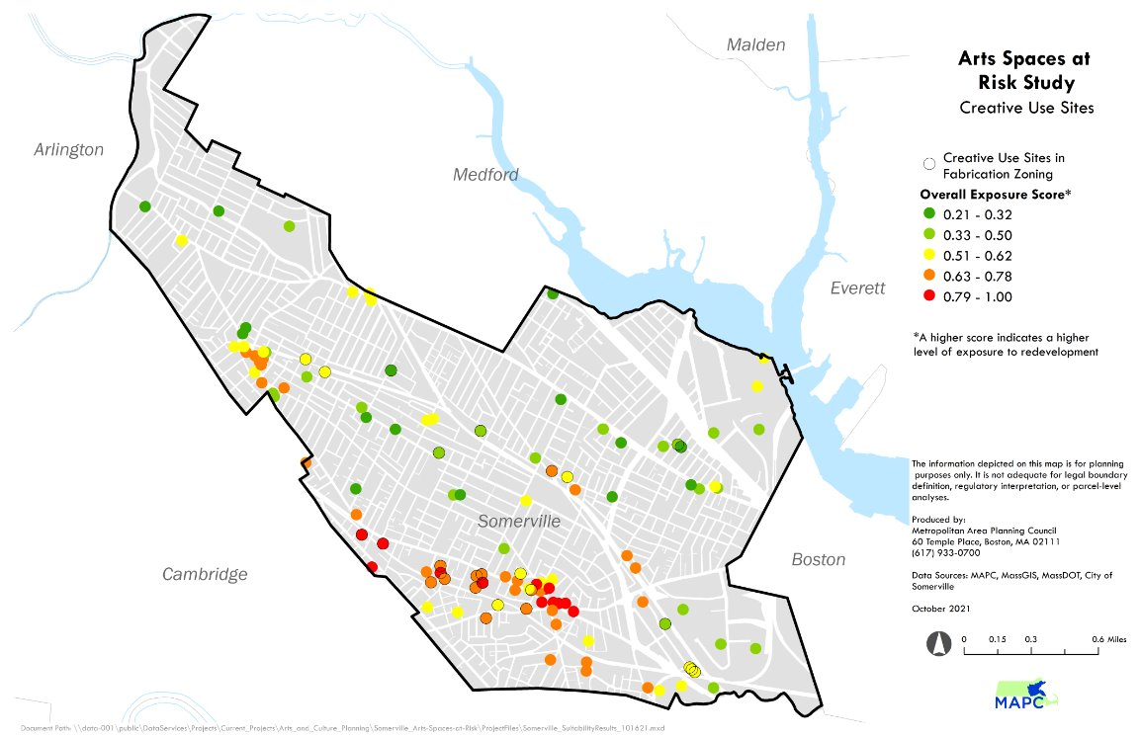
Somerville Arts Space Risk Assessment, 2019
Making Space for Art: Securing Cultural Infrastructure in Boston, Cambridge and Somerville, 2022
Building Datasets to Protect and Preserve Cultural Space

Slide 4
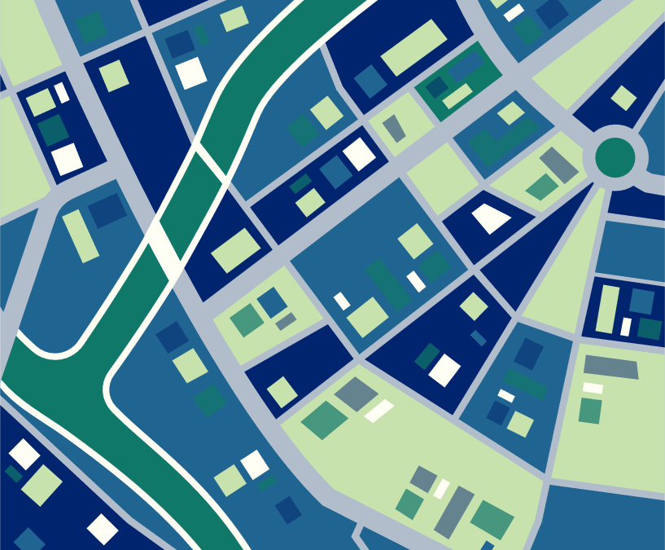
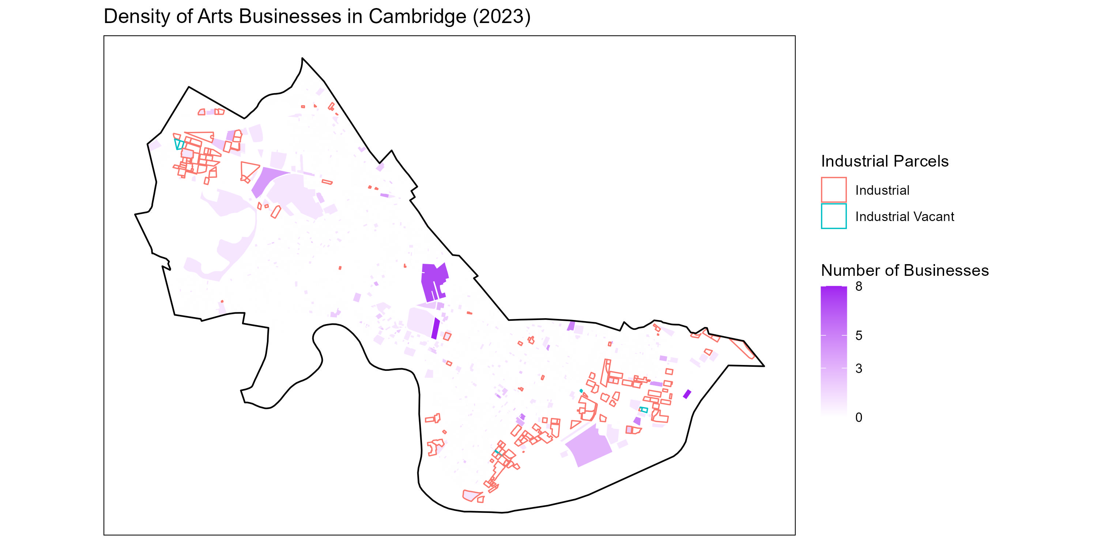
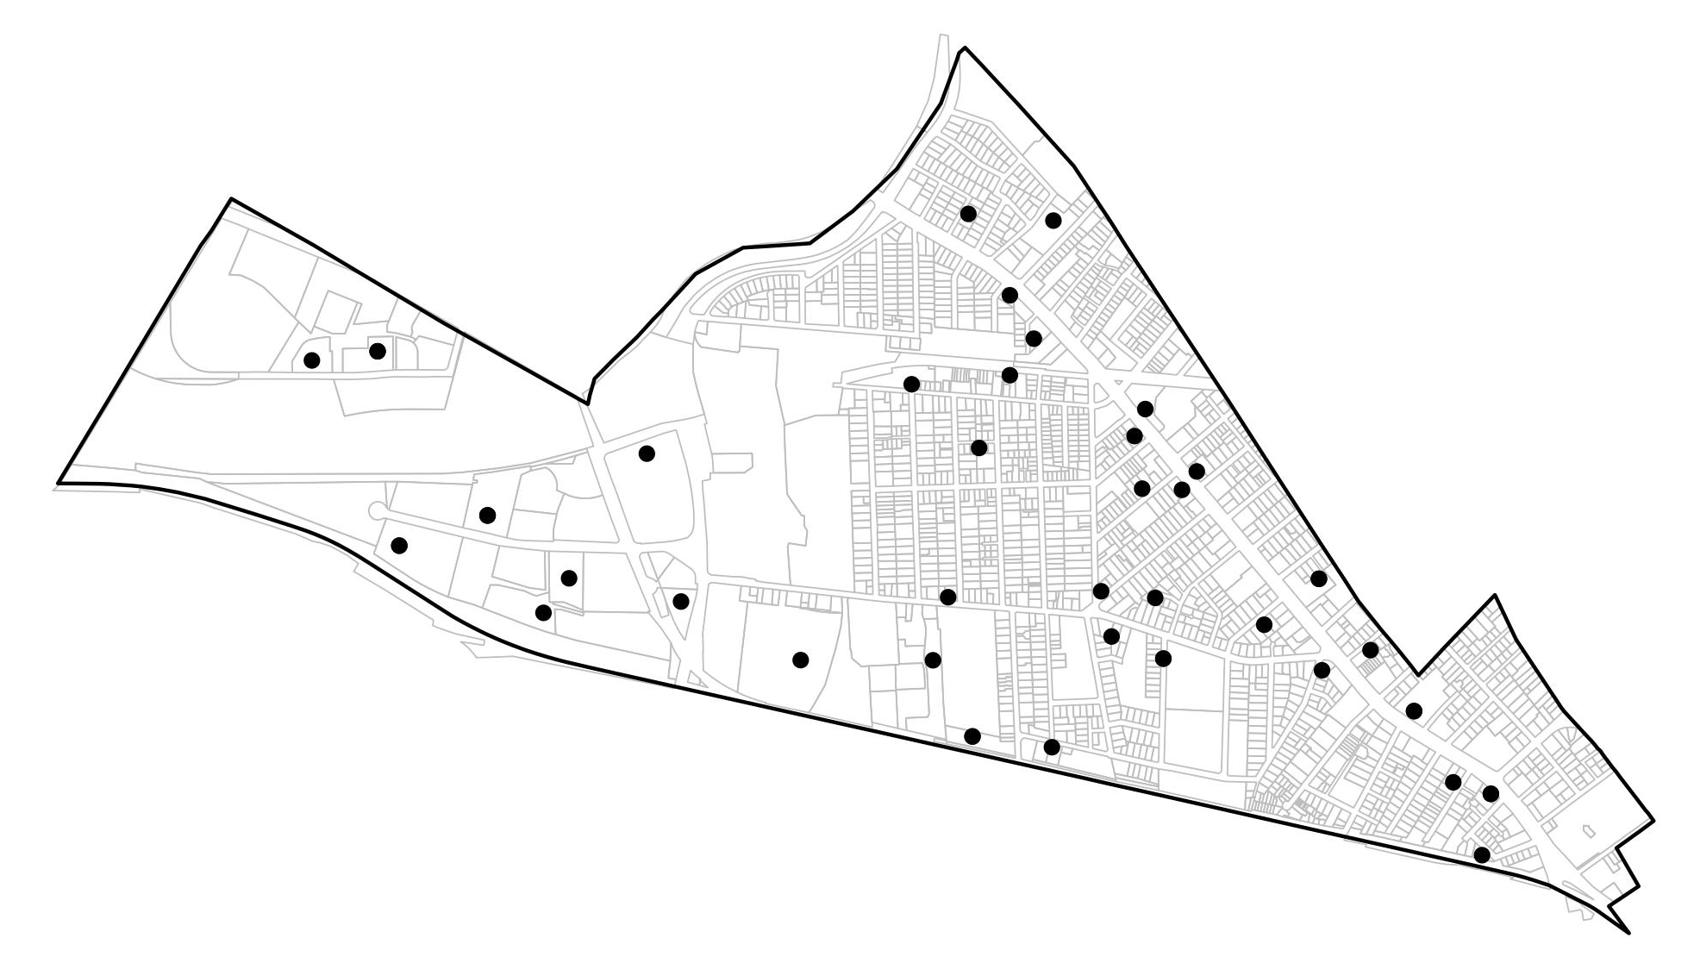
Density of Arts Businesses in Cambridge (2023)
Point Location of Arts Businesses in North Cambridge (2023) ​
Industrial Land x Creative Economy

Slide 5
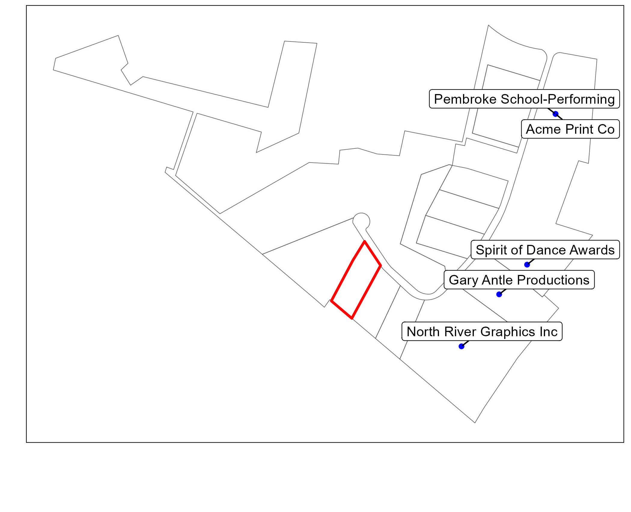
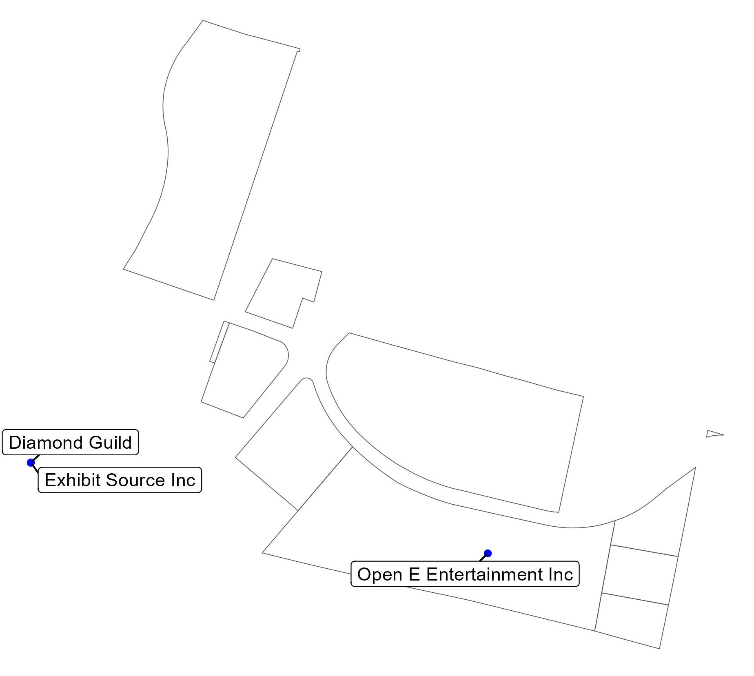
DataAxle is missing established
arts spaces, like
Norwood Space Center in Norwood, MA.
DataAxle is missing established arts businesses, like Soundcheck Studios in Pembroke, MA.
Industrial Land x Creative Economy: Missing Key Data

Slide 6
Policy Implications for Cultural Data Collection
Regional planning agencies play an essential role in maintaining and stewarding cultural data.
Cultural data is critical for communities to protect, preserve, and advocate for cultural spaces. We need more of it!
Cultural planning needs data-informed decision-making to support equitable policy development and evaluation.

