Slide 1
NNIP Partners' Meeting Oakland 2023
November 8, 2023
Notes:
To inform the details of the strategic plan…
This framework shows where we’re headed. It’s the beginning of our map.

Slide 2
Imagine a world where all neighborhoods are places where people thrive.

Slide 3
NNIP Mission
NNIP helps local communities use data to shape strategies and investments so that all neighborhoods are places where people can thrive.

Slide 4
Thank you to Urban Strategies Council for hosting!
David Harris
Rania Ahmed
Ashley Cajina
Octavia Racy
Maya Salcido White
Jacob Virges

Slide 5
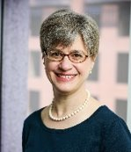
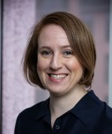
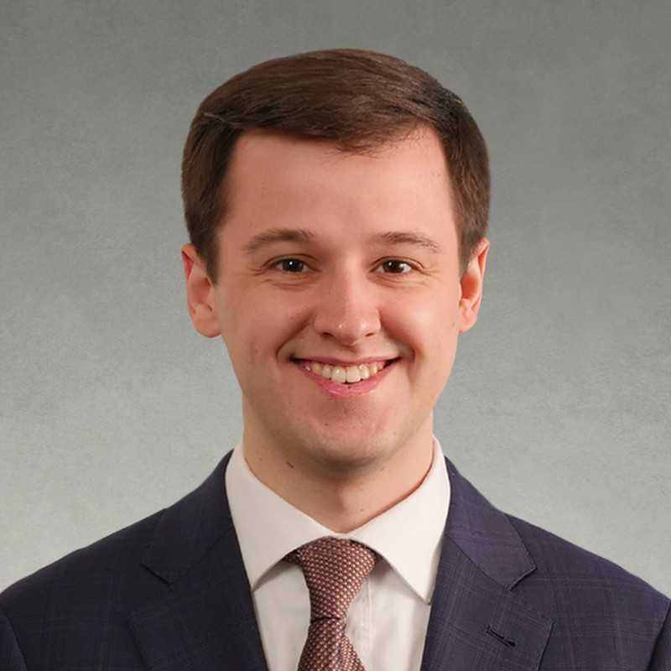
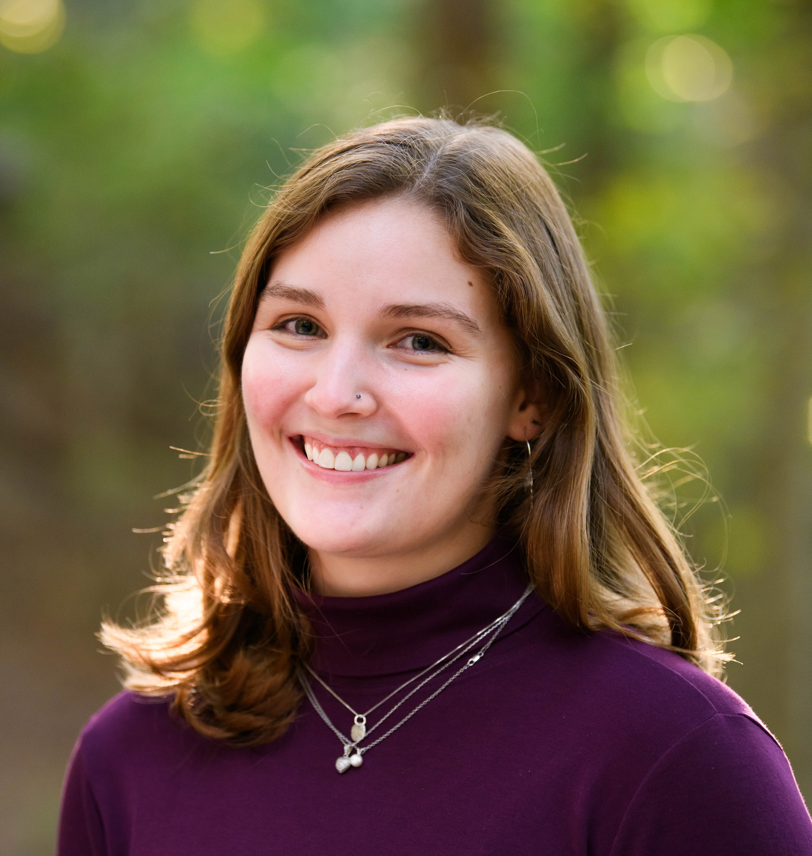
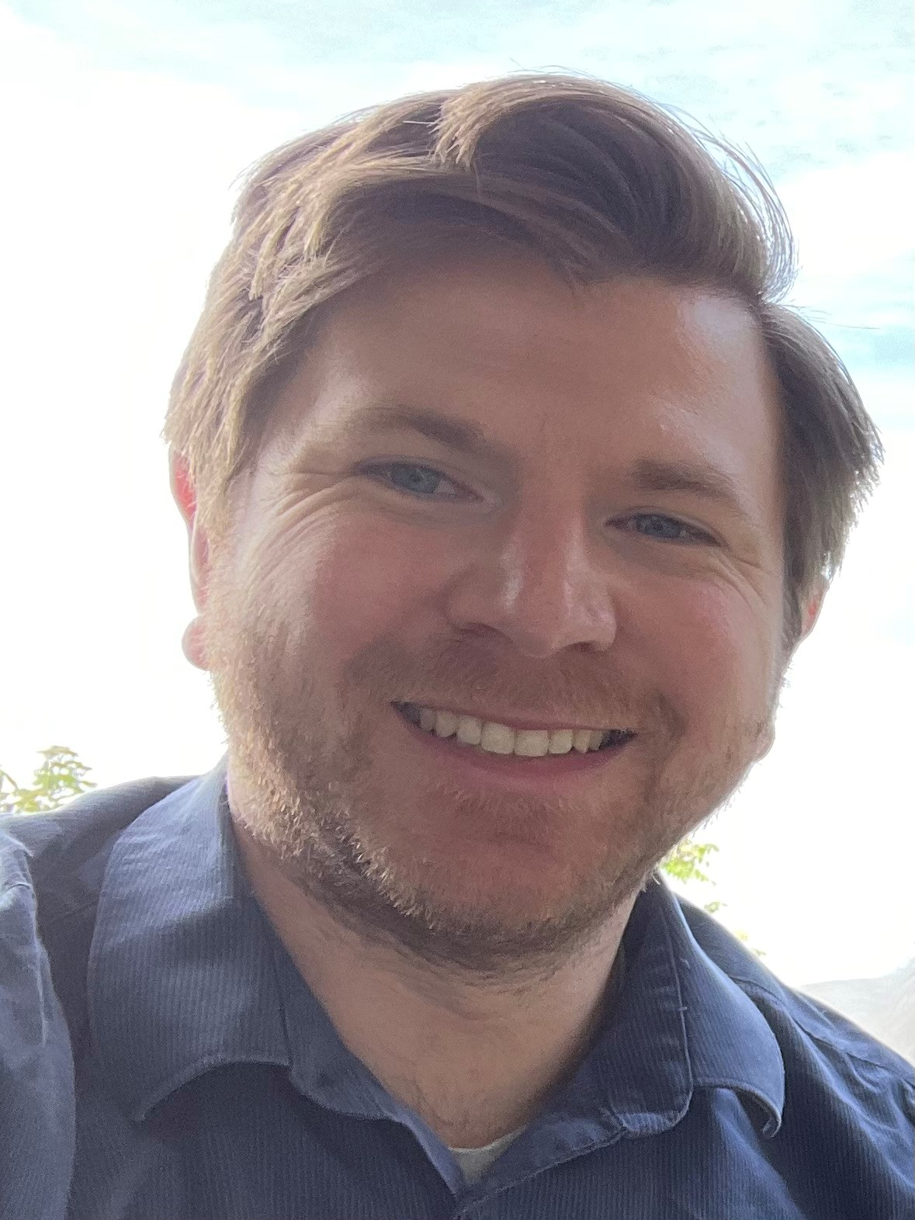
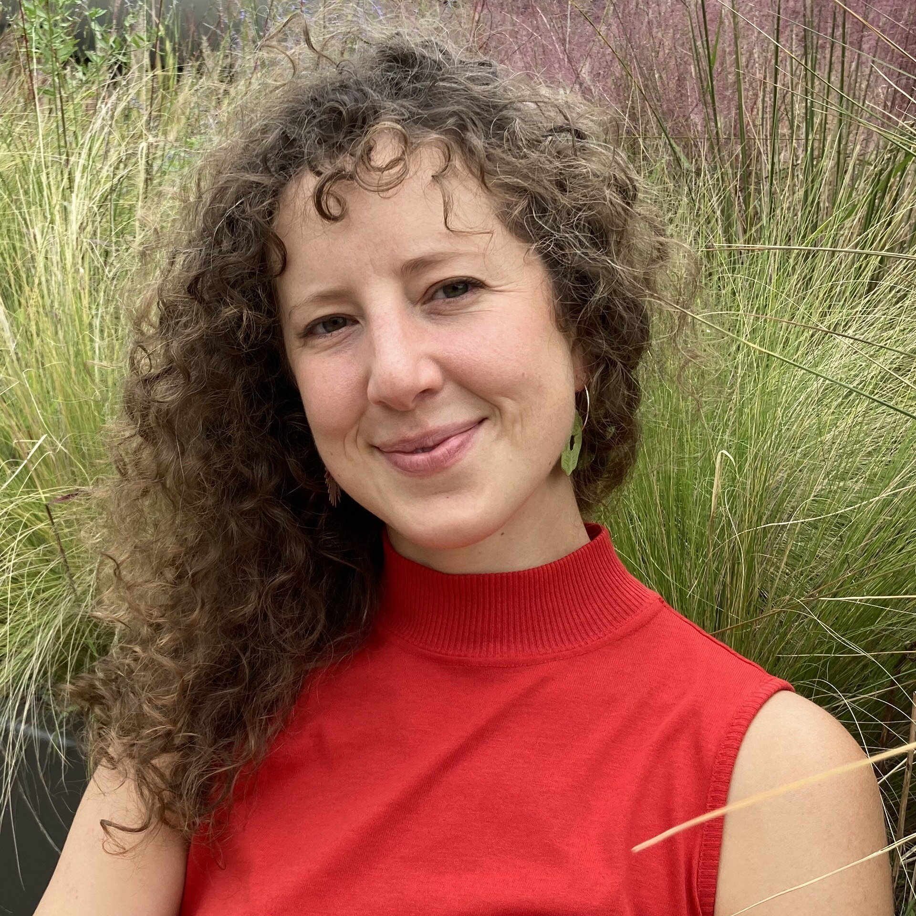
Urban Institute NNIPHQ Staff
Kathy Pettit
Leah Hendey
Cole Campbell
Elizabeth Burton
Alex Bautz
Emily Verburg

Slide 6
NNIP Leadership: Guiding the Agenda
Executive Committee 2023
Victor Amaya, Milwaukee
Amy Carroll-Scott, Philadelphia
Lamar Gardere, New Orleans
Elizabeth Monk, Pittsburgh
Geoff Smith, Chicago
Noah Urban, Detroit
Recent Members, 2021-2022
Mariko Toyoji, Seattle
Altonio Smith, Memphis
Caroline Bhalla, Los Angeles
John Killeen, Durham

Slide 7
Thank You to Partner and Alumni Speakers
25 staff speaking from 22 organizations

Slide 8
Welcome Alumni
Alameda County Public Health Department
Child Poverty Action Lab
Detroit Future City
First Five Alameda
Oakland Community Land Trust
Ohio Housing Finance Agency
One Degree
Independent Consultants

Slide 9
Welcome Guest Cities

Slide 10
Welcome Guests
California Community Foundation
City of South Bend
Hawaii Community Foundation
Microsoft Justice Reform Initiative
National League of Cities
PolicyLink
US Department of Housing and Urban Development

Slide 11
NNIP Supporters

Slide 12
Agenda and Logistics

Slide 13
Reception and Tours
Wednesday Reception from 6:00 – 7:30 pm
Oakstop, 2323 Broadway, Oakland, CA 9461
5:45 pm – Meet for bus transportation to reception
Thursday Tours: Meet at 3:15 to 3:45 to depart 3:30 to 4:00 (see handout and Yapp)
Thanks to Rania for organizing and our tour guides!!
Sign up for tours at the registration desk today!

Slide 14
Introductions: Pass the Mic

Slide 15
NNIP Code of Conduct (selected)
Be prompt in arriving to sessions and returning from breaks.
Be an active listener and contributor - your participation is critical!
Leave your title at the door and be respectful of everyone’s ideas.
Keep comments brief and on the topic being discussed.
Be open to learning about new topics, even if you don’t think they are immediately relevant to your organization.
Take advantage of breakfast, lunch, and after-hours activities to get to know fellow partners and guests.
Full list: https://bit.ly/nnipcode

Slide 16
NNIP Meeting App
https://bit.ly/NNIPOakland
Schedule
Chat
NNIPCamp
Restaurant list
List of attendees

Slide 17
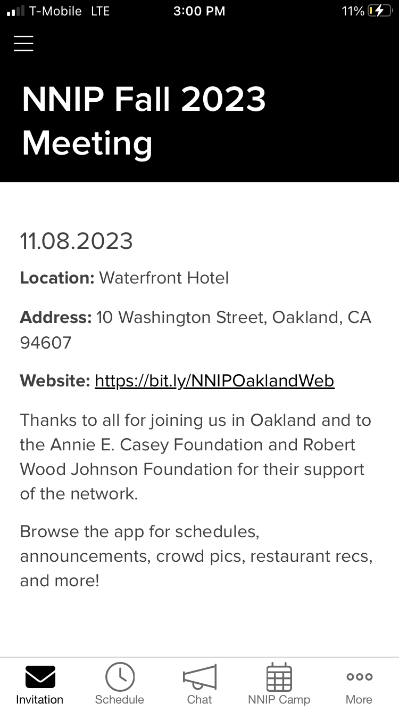
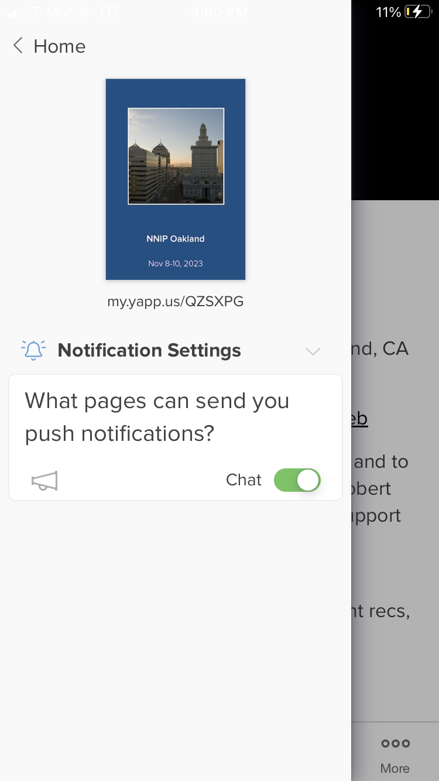
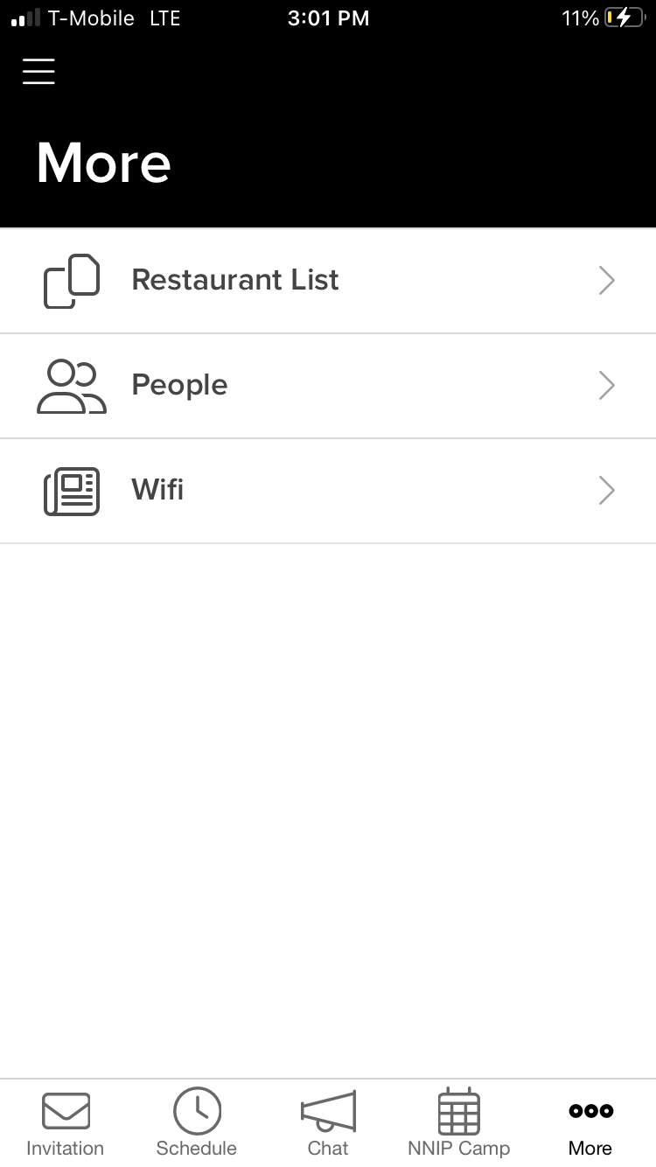
NNIP Meeting App

Slide 18
NNIP Camp Oakland

Slide 19
Together we build the agenda
Submit an idea
Vote on your favorites
Volunteer to lead if necessary
On Wednesday and Thursday we build our agenda
Check the app for the schedule

Slide 20
Voting
Online votes helped with initial impressions, but votes on-site are critical so we can make final choices
Make sure to visit the boards today and vote early to help finalize camp sessions
Voting Deadlines:
Wednesday, 1:00 pm
Thursday, 1:00 pm
Friday, 8:00 am

Slide 21
NNIP Camp Rules
Set your own agenda.
Introduce yourself.
Assign a note-taker.
Avoid planned speeches & PPTs.
Contribute & allow other to contribute.
COME AND GO AS YOU PLEASE.

Slide 22
Mentimeter Questions

