Slide 1
Welcome to the
#NNIP Los Angeles Meeting!
May 9, 2018
Notes:
Welcome – introduce myself. Welcome you on behalf of the Urban/NNIP team.
Start with logistics
We’ll be tweeting using hashtag NNIP.
Few opening remarks before introductions

Slide 2
Defining Functions of NNIP Partners
Build and operate information systems with recurrently updated data on neighborhood conditions across topics
Facilitate the practical use of indicators for community building and local policy making
Emphasize the use of information to build the capacities of low-income neighborhoods
Notes:
Many attended the intro session, but we always start out by reminding ourselves of what we have in common.
- assemble and collect ngh data
- work with local groups to USE the data
- make sure everyone has access – esp communities under stress that have traditionally not had access to data.
First, thanks to all the partners attending –50 staff from 31 cities and about 30% them here for the first time (15)
SUGGESTION FROM EVAL – HAVE GROUPS STAND UP – ALUMNI, FIRST-TIME GUESTS, POTENTIALS
And 5 alumni
Eleanor Tutt, Jake, Devon, Aaron, Josh

Slide 3

Urban Institute
Urban is dedicated to elevating the debate
on social and economic policy through
rigorous research and engagement.
We believe in the power of evidence to improve lives by
  Reducing hardship amongst the most vulnerable
  Expanding opportunities for all people
  Strengthening the effectiveness of the public sector
Notes:
Urban was started in 1968 to be an outside evaluator for War on Poverty programs. Today, we do a broader array of research for governments and foundations - our work is grounded in our original research.

Slide 4



NNIP Network Supporters
Notes:
None of this would be possible without dedicated funders - (can’t be here this time)
Cindy Guy– really partners in thinking about directions. Note Chris K
Craig Howard - program officer for NNIP and CTDC
Kresge – funder of Turning the Corner project
Introduce MS project – note Elizabeth Grossman and Kevin Miller
this builds off the relationship from our last successful partnership with MS around training
it is a planning grant to assess partners current involvement/interest in crimson justice reform, with special attention to disparate impacts on people and neighborhood of color.
we will be exploring a second stage of a pilot in-depth analysis in a MS city to advance advocacy and engagement in that city and serve as an example for others.
introduce Dean and plug camp session for them to give input.

Slide 5

Thanks to USC Price Center for Social Innovation
Photo Credit: Tim Thompson
Notes:
Also want to recognize our local partners at USC Price Center
Caroline & Megan

Slide 6
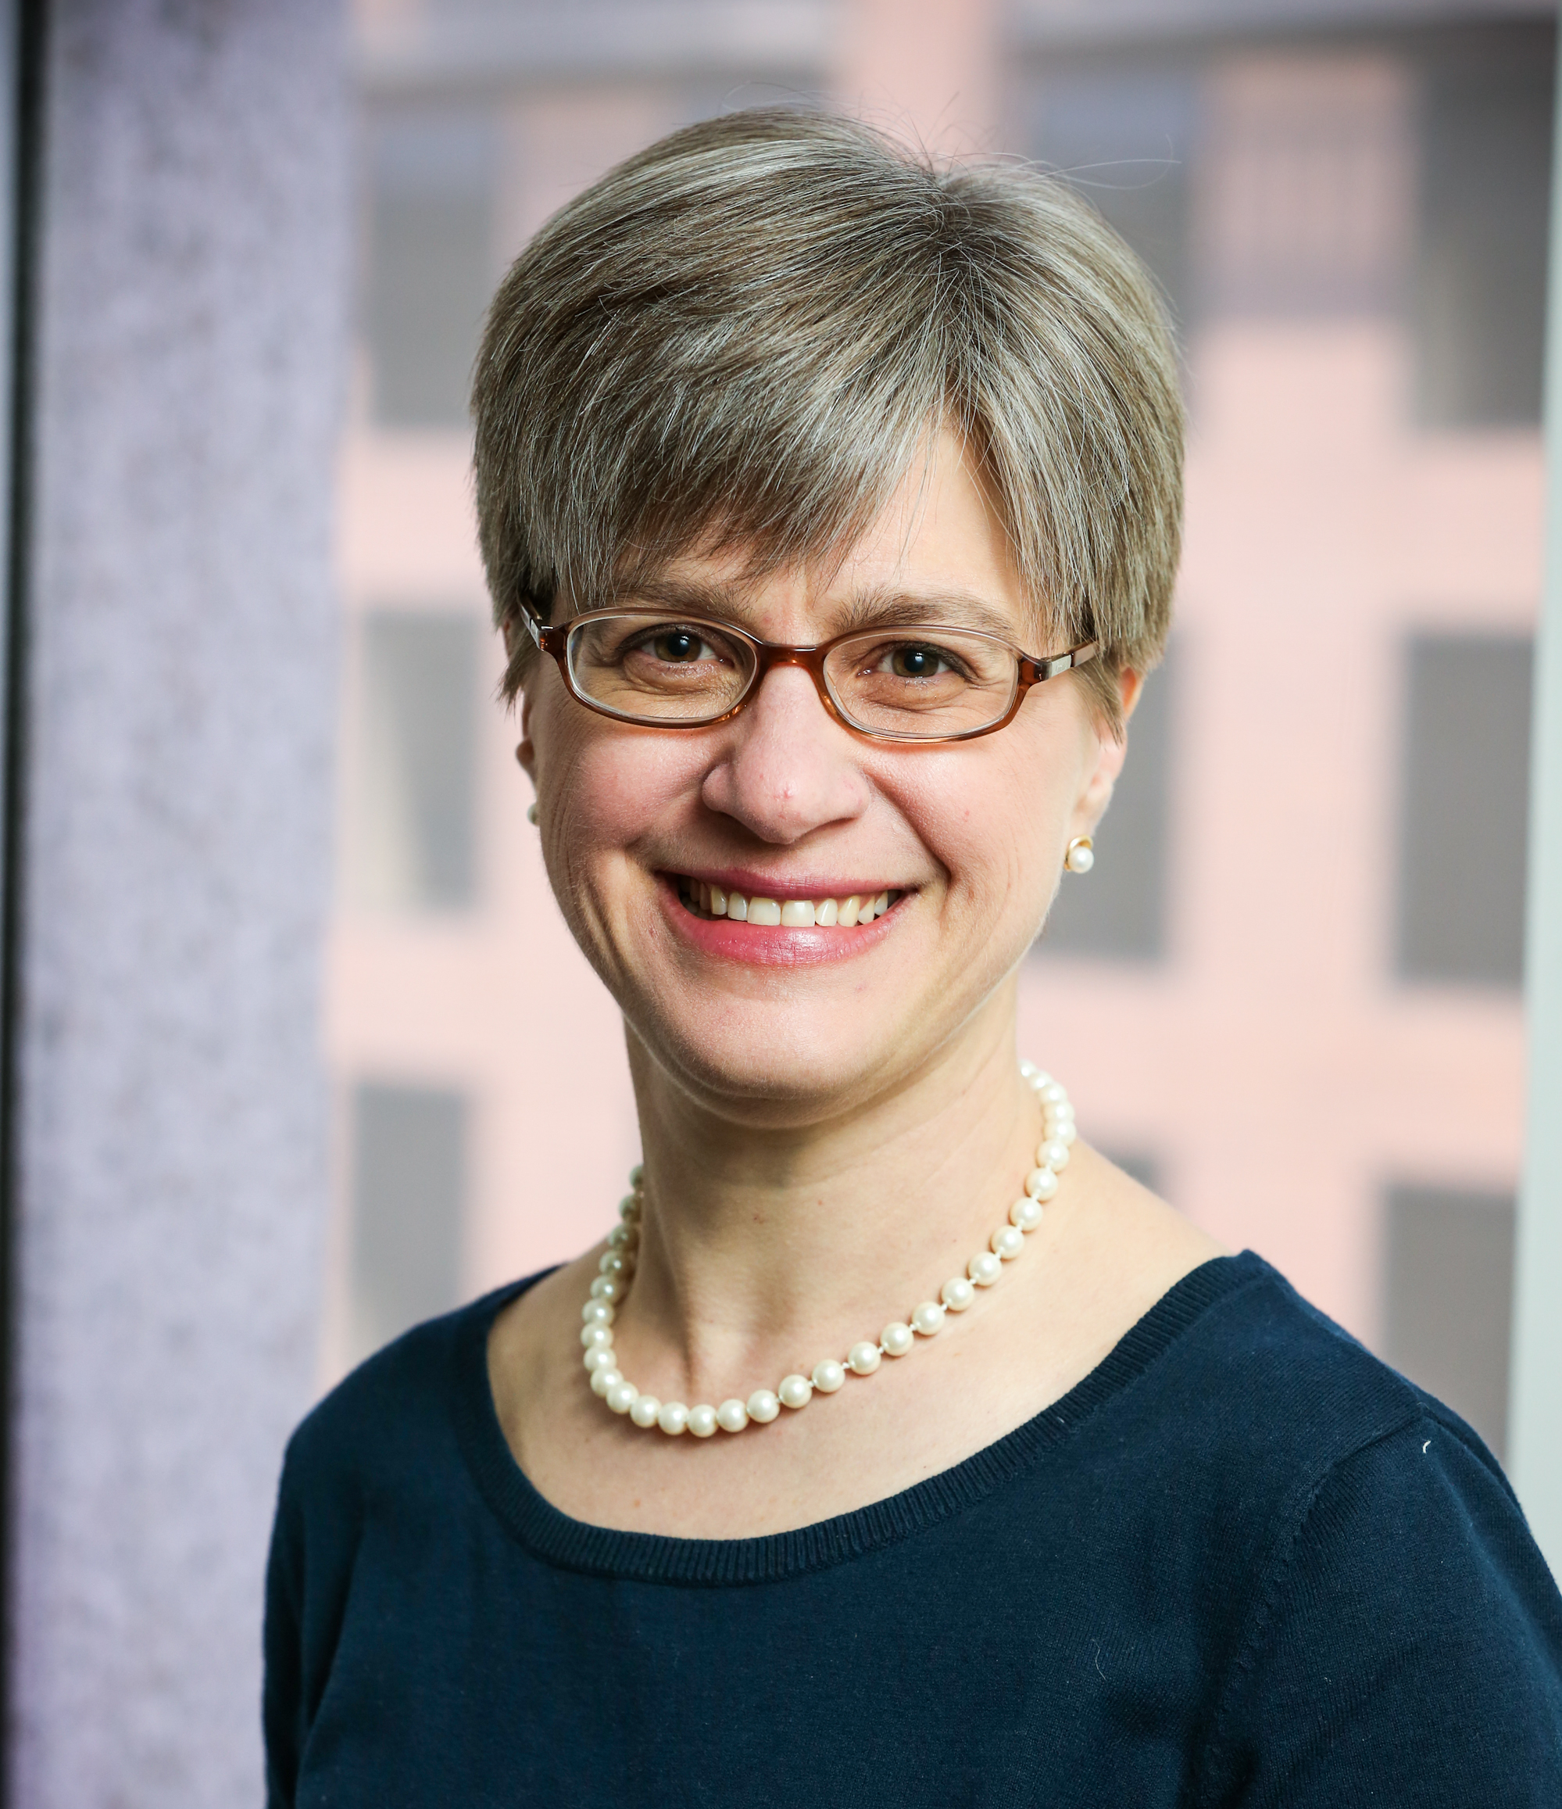
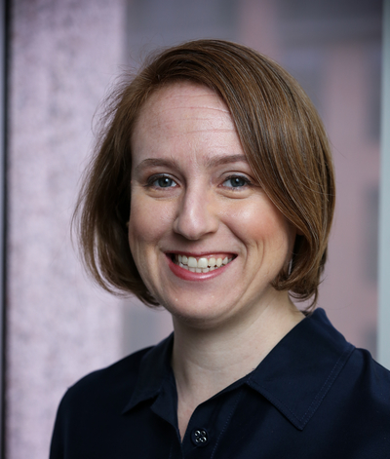
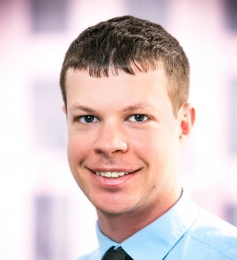
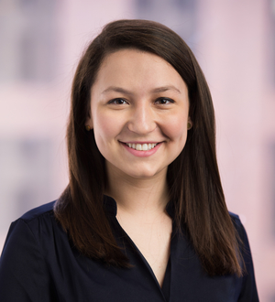
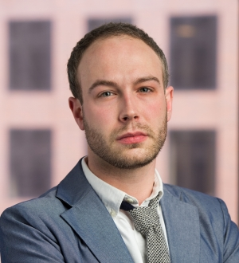
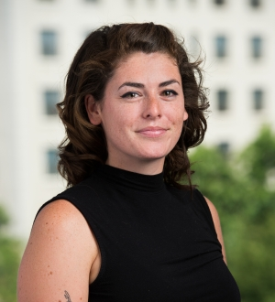
Urban Institute NNIPHQ Staff
Kathy Pettit
Leah Hendey
Rob Pitingolo
Olivia Arena
Dean Obermark
Kelley Hanni
Notes:
Note Leah and co-director

Slide 7
NNIP Leadership: Guiding the Agenda
Executive Committee 2018
John Cruz, St. Louis
Seema Iyer, Baltimore
Laura McKieran, San Antonio
Bernita Smith, Atlanta
April Urban, Cleveland
Noah Urban, Detroit
Recent Members, 2014-17
Mark Abraham, New Haven
Bob Gradeck, Pittsburgh
Jeff Matson, Twin Cities
Sheila Martin, Portland
Notes:
[Don’t read all the names] Would the Exec Comm please stand…. These are your representatives – they meet with us monthly and helped a lot with putting the program together.
Leah and I are also part of the Executive Committee.
Laura and April cycle off at the end of the year. NOTE ELECTIONS

Slide 8
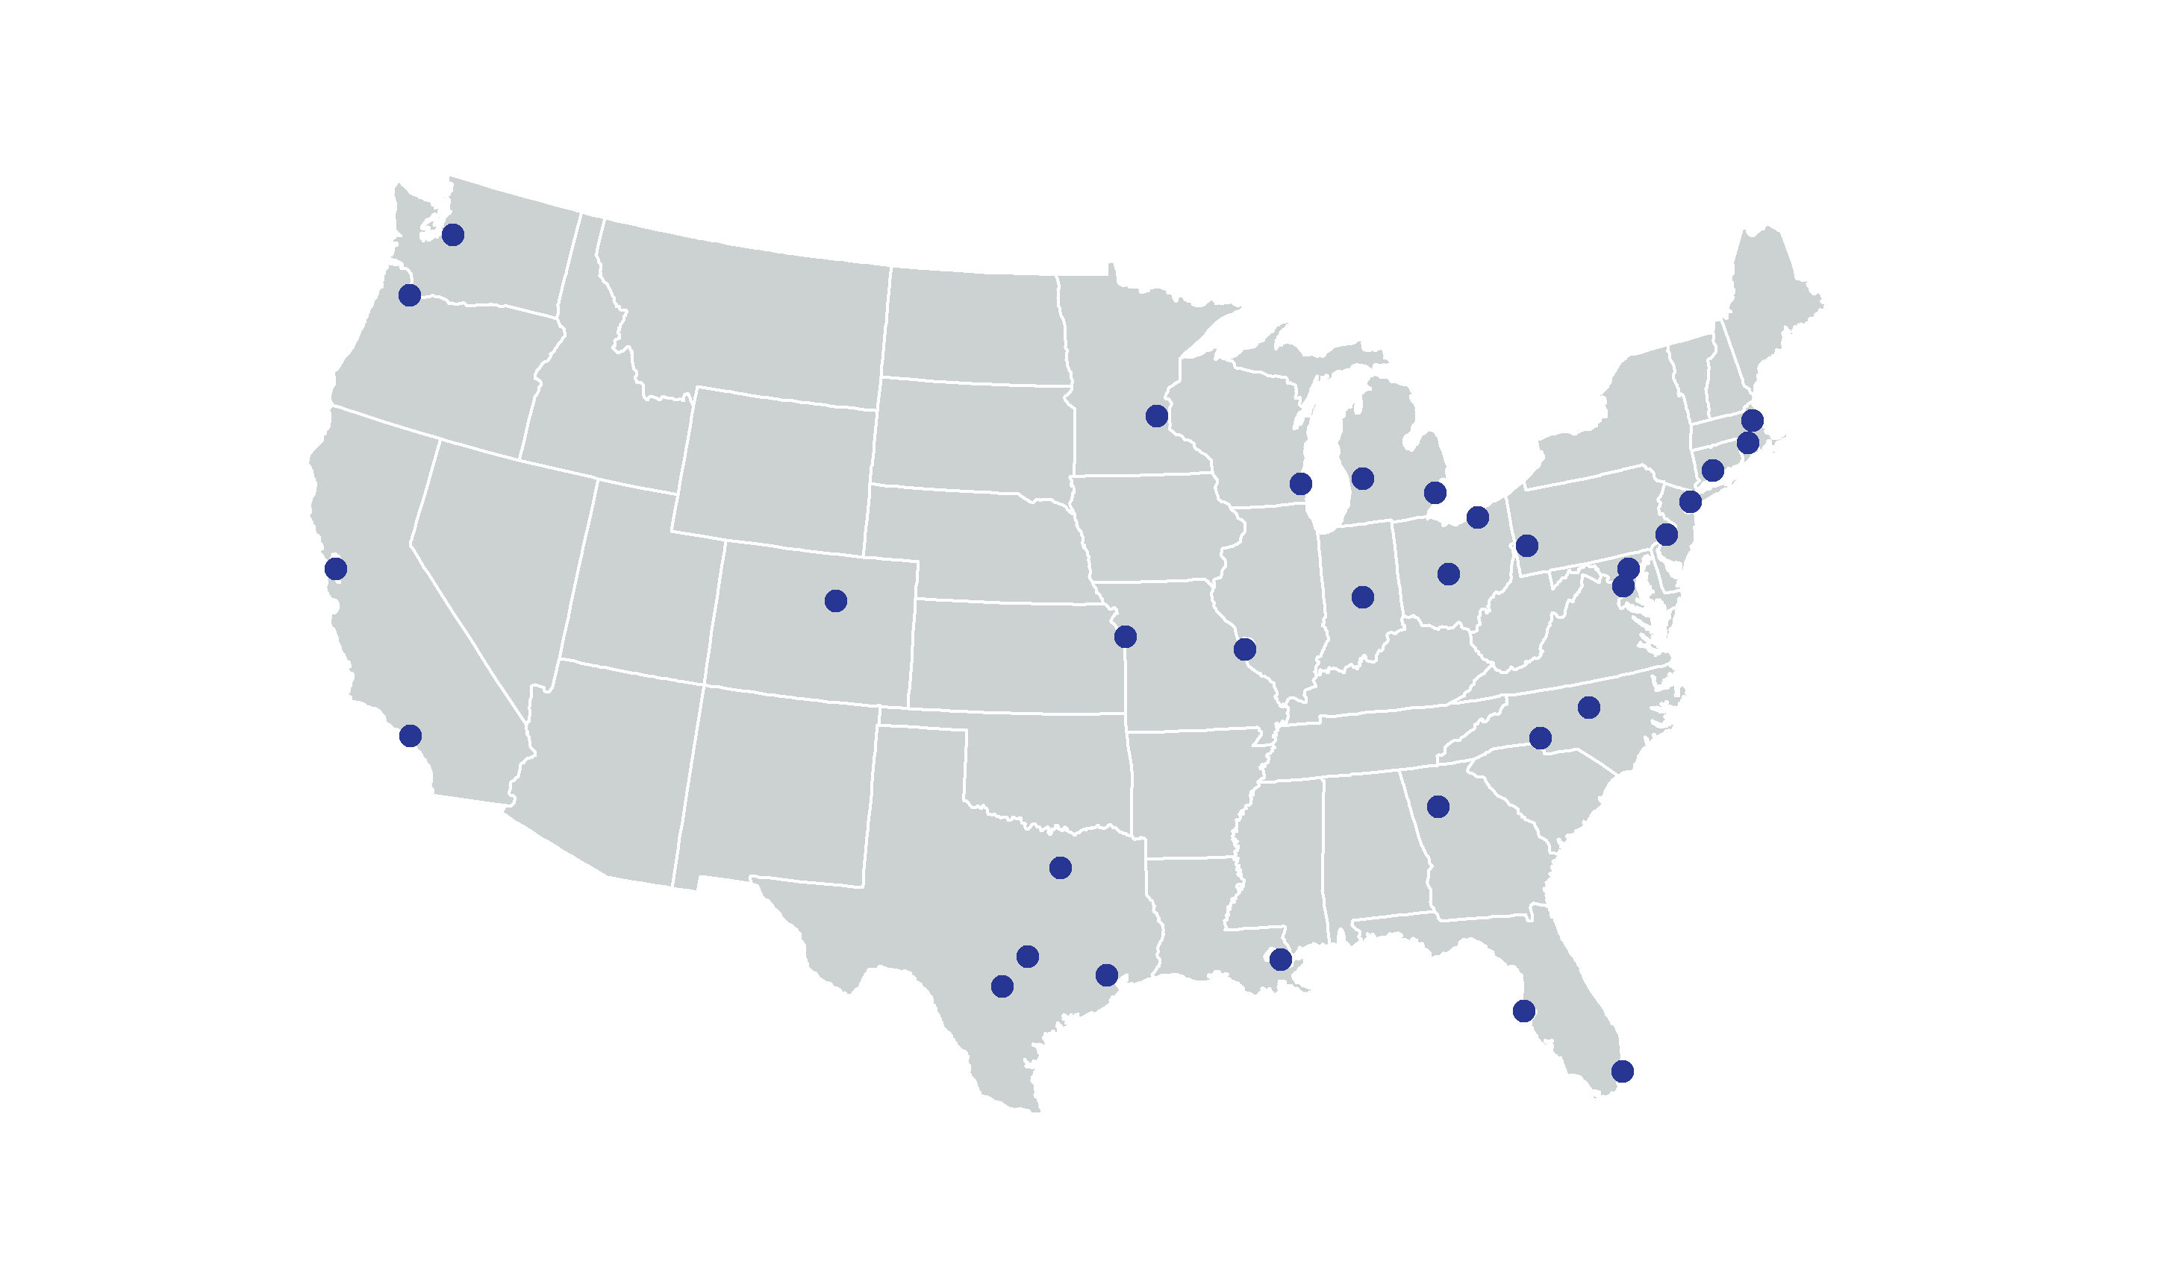

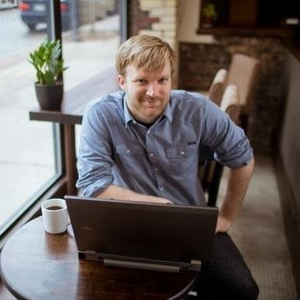
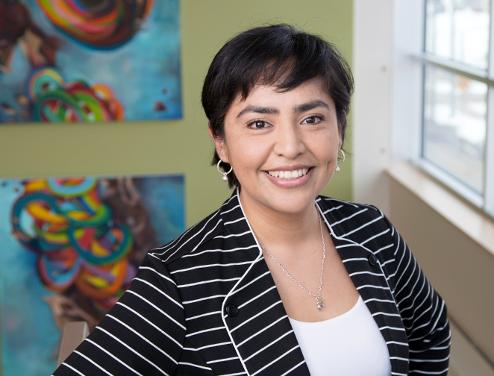
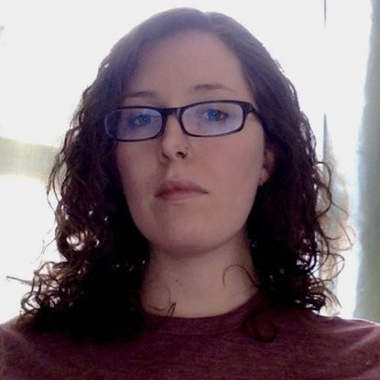
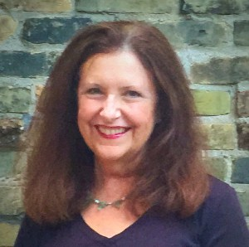
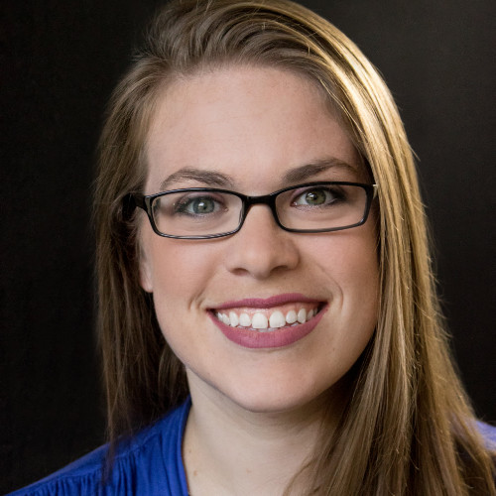



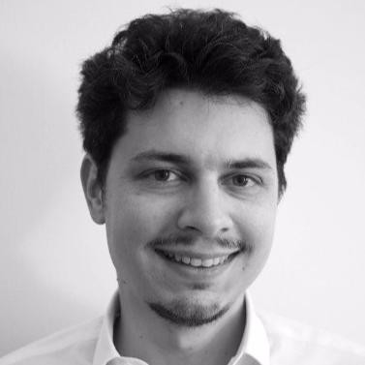

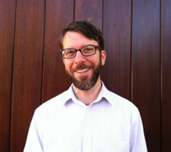



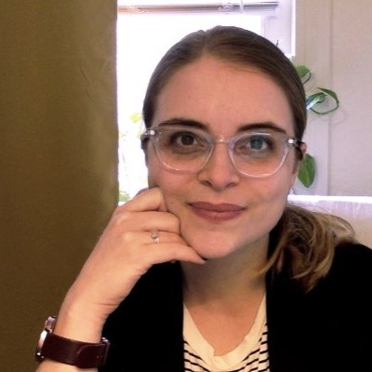
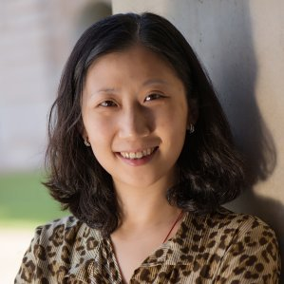
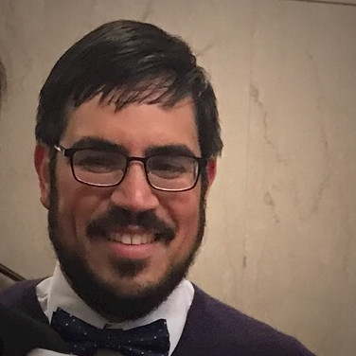

Thanks to Partner Speakers
Notes:
Our lives are made easier and the wealth of expertise in the network and generosity of sharing. Here’s the partners and alumni that you’ll hear from over the next 3 days.
Encourage you to thank them in person while we’re together

Slide 9
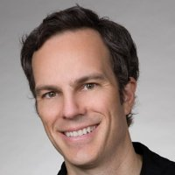

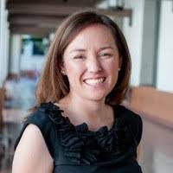
Thanks to Los Angeles Panel Speakers
Erich Yost,
US Department of Housing & Urban Development
Ben Winter,
City of Los Angeles, Office of Mayor Eric Garcetti
Jessica Monge Coria
CSH
Notes:
This afternoon – lucky to hear about the great work in Los Angeles – bios in your packet
And be sure to thank your tour guides for tonight.
Erich Yost, US Department of Housing & Urban Development
Ben Winter, City of LA, Office of Mayor Eric Garcetti
Jessica Monge Coria, Senior Program Manager at CSH
Gary Painter, USC

Slide 10
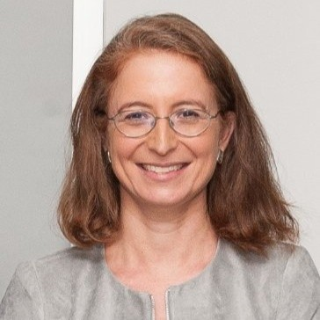
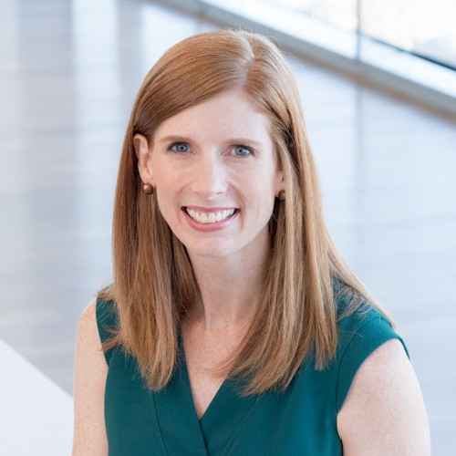
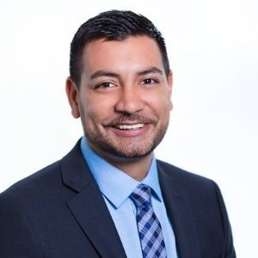


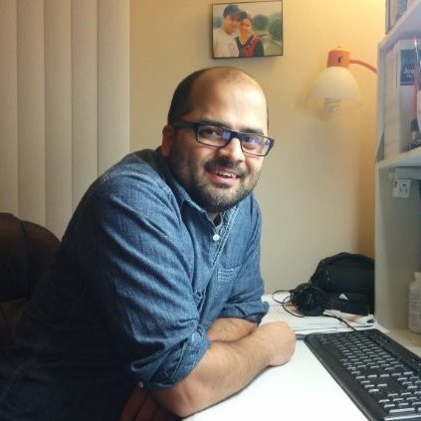
Thanks to Guest Speakers
Elizabeth Grossman
Microsoft Corporation
Elizabeth Love
Houston Endowment
Ali Tarzi
Chase Mortgage
Chris Kingsley
Annie E. Casey Fndn.
Ellie Tumbuan
ET Consulting
Sarin Adhikari
Virginia Commonwealth University
Notes:
**Another part of NNIP’s value is bringing outside expertise to the network**
Tomorrow – great funders panel, followed by Ellie and workshop on diversity.
Sarin Adhikari, Virginia Commonwealth University will participate in Friday’s ignite.
And be sure to thank your tour guides for tonight.

Slide 11
Welcome Guest Cities!
Albuquerque, NM
Chicago, IL
Hartford, CT
Honolulu, HI
Memphis, TN
Richmond, VA
Notes:
Part of the network’s mission is to foster NNIP capacities in new cities – various stages of interest in the NNIP model
there are descriptions of some of the organizations in the back of your packet.
welcome them – answer questions - ask about their work….

Slide 12
Network Activities

Slide 13
Civic Switchboard: Connecting Library and Community Information Networks
Completed exchange at the Digital Library Federation
  Houston, Indianapolis participated
Apply to Field Project awards - Deadline November 5
Check out guidebook in progress
Website: https://civic-switchboard.github.io/
Notes:
Mention DLF – ask Jie, Bob, Eleanor

Slide 14
Turning the Corner: Monitoring Neighborhood Change for Action
Five cities: Buffalo, Detroit, Milwaukee, Phoenix, Twin Cities
Local reports to be published November/December
Final products in February
  Cross-cutting lessons
  Topical themes (small business, public safety, transit-oriented development)
  Reference documents: data memo and literature directory

Slide 15
Data Governance and Security
NNIP’s Guide to Data Governance and Security
Technology for Civic Data Integration
Updated NNIP & IDS page https://www.neighborhoodindicators.org/nnip-ids
New issue area on IDS
New issue area on Data Governance and Security
Updated collection of data sharing agreements
Notes:
As part of our work to provide technical assistance on integrated data systems, we recently completed a number of products and website updates.
NNIP’s Resource Guide on Data Governance and Security provides a curated set of resources to help organizations develop robust data governance programs to protect privacy and human subjects, increase data security, and improve data management.
In partnership with MetroLab Network and Actionable Intelligence for Social Policy we released a new report on “Technology for Civic Data Integration” that helps readers understand the information architecture and tradeoffs for integrated data systems.
New page incorporating lessons learned from our experience with IDS
2 new issue areas – IDS and Data Governance, management and security. Please make sure to use these tags as you upload your publications and activities!
Thank so much to everyone who shared data sharing agreements with us – we now have around 50 examples posted or linked to our website, organized by topic area. You can find them on the data governance and security issue area page.

Slide 16
Cross-site projects – plenary and camp sessions
Mobilizing Data-Driven Local Outreach for the 2020 Census
Catalyzing Community Criminal Justice Reform with Data
Notes:
These have sessions/camp opportunities.
- Mention Casey and Microsoft

Slide 17
Introductions
Rob Pitingolo
Notes:
Have people go around with name and org?
What are the menti questions?

Slide 18
Agenda and Logistics
Notes:
Note code of conduct.
Note framing pages explaining the motivations behind each session. Walk through agenda, mentioning points below..
[TO BE UPDATED]
TODAY
Transportation – a topic that we haven’t explored together much
Lunch and ignite
Local session on housing/homelessness
Note we are experimenting with a new schedule in moving tours to Thursday – definitely want your feedback afterwards
CAMP – please vote at lunch time- Break out rooms logistics
TOMORROW
2020 Census – Kathy will give a short update
Panel of local and national funders – really fortunate to have three friends of the NNIP family to share their insights
Workshop on diversifying staff, boards, and networks – we’ll report out on our recent data collection efforts on this topic and we’ve brought an expert consultant to guide us through the workshop which will include an activity to analyze and rewrite job descriptions. We have a follow-up camp session posted to take advantage of the consultants time to ask more questions and continue the discussion.
Lunch and special themed Ignite on criminal justice projects
Camp -Break out rooms logistics
Tours – talk about in a minute
END ON FRIDAY
Social Media – Rapidly shifting field – get different perspectives on the strategies from New Orleans and Detroit.
Camp and Ignite

Slide 19
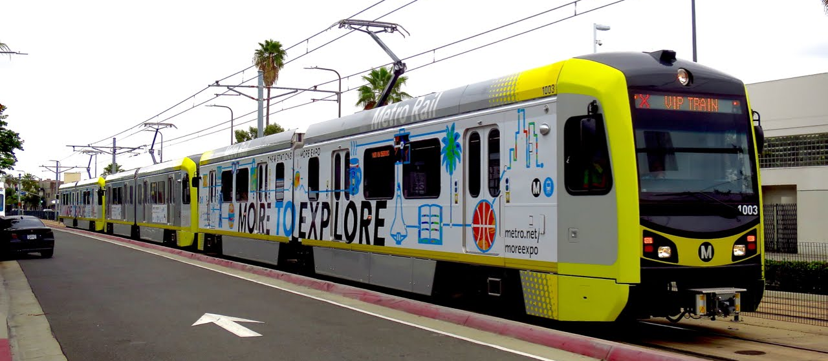
Reception and Tours
Wednesday Reception: Depart from lobby at 5:15
USC Lewis Hall, 650 Childs Way (about 3 miles away)
Take Metro Expo Line
Thursday Tours: Depart from lobby at 3:45
  HomeBoy Industries (travel by bus to location)
  Little Toyko (travel by bus to location, a little walking)
  Downtown (walking only)
Notes:
Reception is 3 miles from the hotel – NOT walkable
Note descriptions in packet
Describe tours -– about 2 hours
HomeBoy Tour – limited to 25 people – first come, first served
Note walking requirements on each
People can choose to stay out where-ever they are, but buses are coming back

Slide 20

NNIP Meeting App
my.yapp.us/NNIPLA
Schedule
List of attendees
NNIPCamp
Restaurant list
Follow #NNIP
Social Feed
Notes:
Please remember that everyone who has downloaded the app can see what you write in the chat
List of Attendees – please note that Participant list is also in back of the packet
Stay up to date on new NNIPCamp unconference sessions
Post announcements to all meeting attendees
Post crowd pictures during (and after) each day’s events
Answer daily polls
CHECKING
•Post crowd pictures during (and after) each day’s events
•Answer daily polls

Slide 21
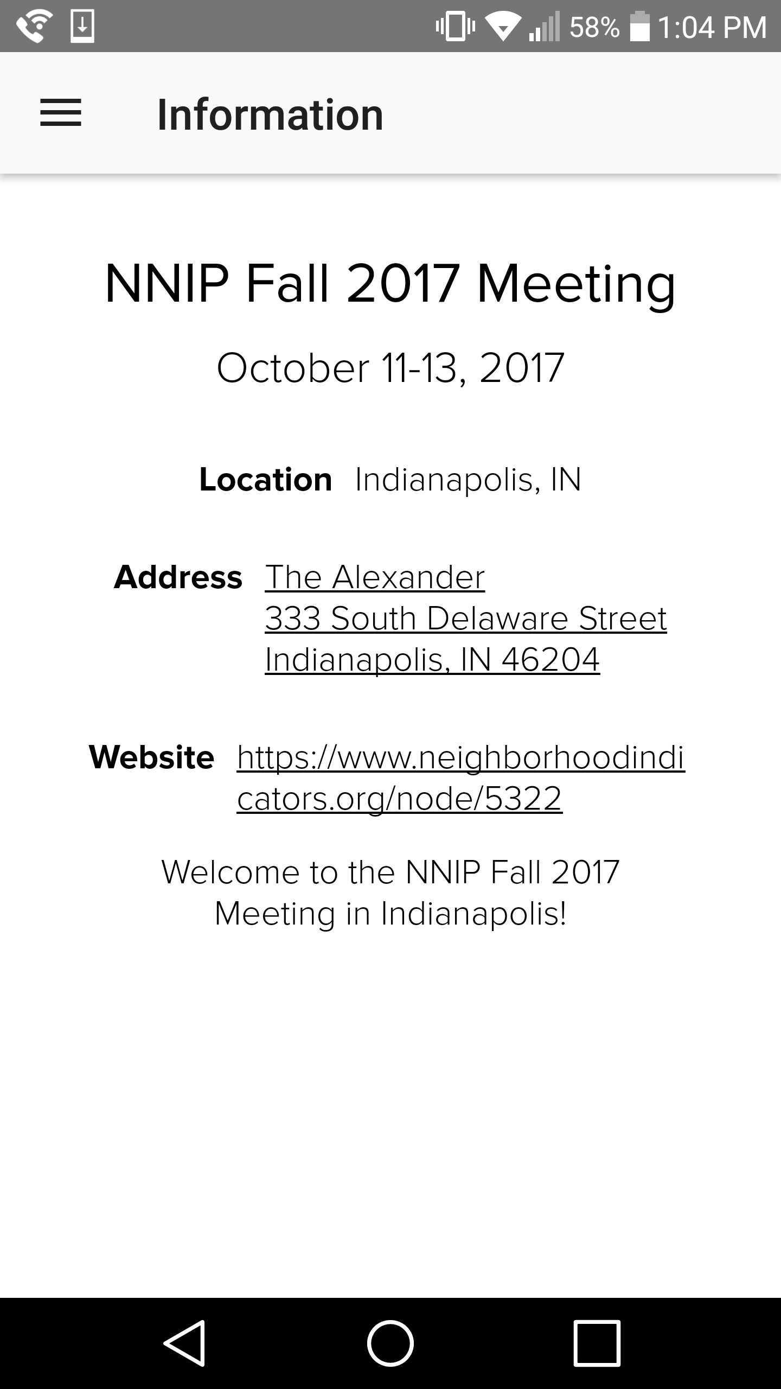
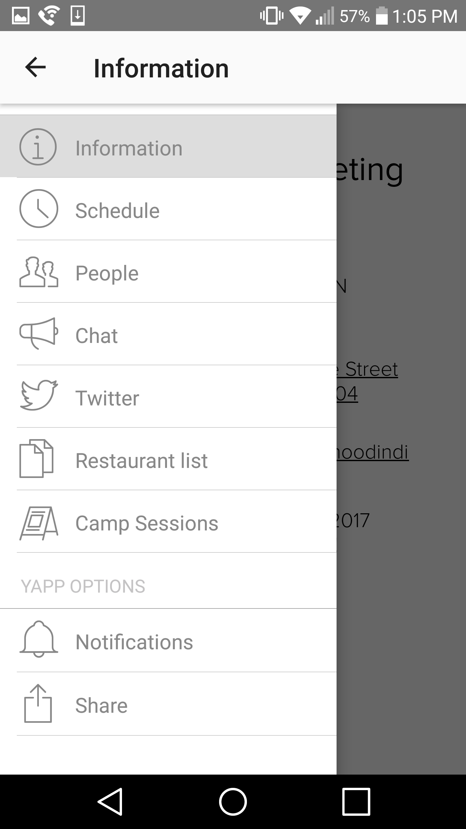
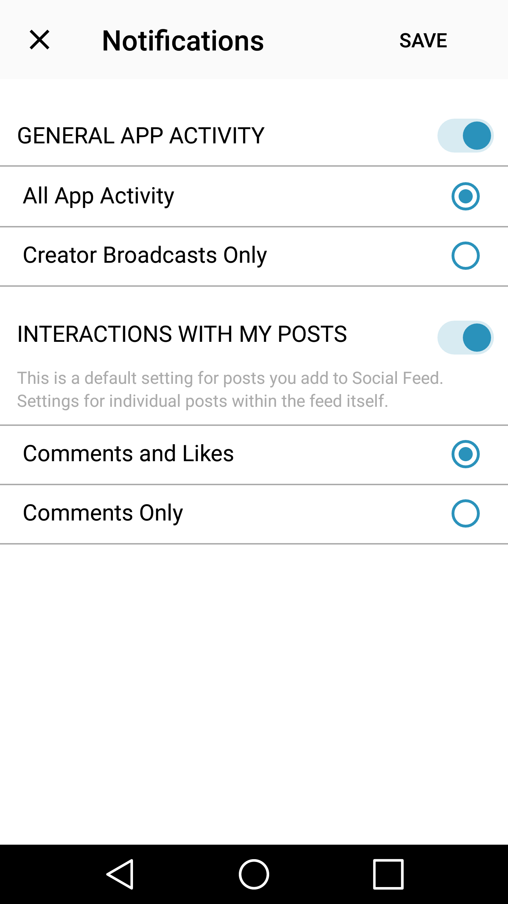
NNIP Meeting App
Step 1
Step 2
Step 3
Notes:
If you don’t want push notifications, here’s how you disable them.
I strongly suggest keeping at least “Creator Broadcasts Only” so that you can still receive alerts from NNIP HQ.
If you have trouble with this, please ask Olivia or me and we will help you.

Slide 22
NNIPCamp Los Angeles
Kelley Hanni

Slide 23
What is an unconference?
Informal gathering of collaborators
Participants set the agenda
Focused on discussion
Notes:
Go over schedule/timing
Rules are posted on cards?
UNCONFERENCE 101 – Sunlight Foundation
https://www.youtube.com/watch?v=iUEt0xOysr4

Slide 24
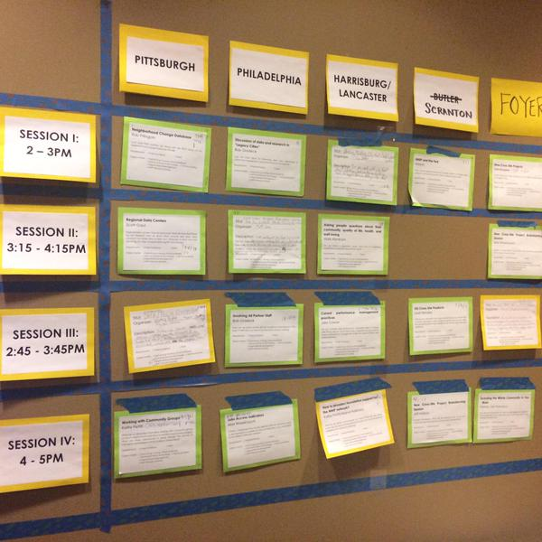
Together we build the agenda
Submit an idea
Vote on your favorites
Volunteer to lead if necessary
On Wednesday and Thursday we build our agenda
Check the app and #nnip for the schedule

Slide 25
Voting
Votes on-site are critical so we can make final choices
Make sure to visit the boards today and vote early to help finalize camp sessions
Voting Deadlines:
  Wednesday, 1:00pm
  Thursday, 1:00pm
  Friday, 9:30am
Notes:
Note we are trying something different with a camp session on Wed
Go over schedule/timing
Stress voting during lunch on Wednesday

Slide 26
NNIPCamp Rules
Set your own agenda.
Introduce yourself.
Assign a note-taker.
Avoid planned speeches & PPTs.
Contribute & allow other to contribute.
Tweet! (if everyone agrees)
COME AND GO AS YOU PLEASE.
Notes:
Rules are posted everywhere…
UNCONFERENCE 101 – Sunlight Foundation
https://www.youtube.com/watch?v=iUEt0xOysr4
Determine the twitter rules for the session with the group

Slide 27
Most Importantly
Be creative
Hallway conversations count
Have fun!

Slide 28
Welcome to the
#NNIP Los Angeles Meeting!
May 9, 2018

