Slide 1
Welcome to the
#NNIP Atlanta Meeting!
May 9, 2018
Notes:
Welcome – introduce myself. Welcome you on behalf of the Urban/NNIP team.
Start with logistics
Welcome live-stream audiences, cameras are rolling and videos will be posted afterwards. We’ll be tweeting using hashtag NNIP.
Few opening remarks before introductions

Slide 2
Defining Functions of NNIP Partners
Build and operate information systems with recurrently updated data on neighborhood conditions across topics
Facilitate the practical use of indicators for community building and local policy making
Emphasize the use of information to build the capacities of low-income neighborhoods
Notes:
Many attended the intro session, but we always start out by reminding ourselves of what we have in common.
- assemble and collect ngh data
- work with local groups to USE the data
- make sure everyone has access – esp communities under stress that have traditionally not had access to data.
TO DO – UPDATE - First, thanks to all the partners attending –60 staff from 31 cities and about 1/4 of them here for the first time (17). (missing Miami)
And 6 alumni
Amy Hawn-Nelson
Charlotte-Anne Lucas
Randy Rosso
Eleanor Tutt
Maia Woluchem
Michael Rich

Slide 3

Urban Institute
Urban is dedicated to elevating the debate
on social and economic policy through
rigorous research and engagement.
We believe in the power of evidence to improve lives by
  Reducing hardship amongst the most vulnerable
  Expanding opportunities for all people
  Strengthening the effectiveness of the public sector
Notes:
Urban was started in 1968 to be an outside evaluator for War on Poverty programs. Today, we do a broader array of research for governments and foundations - our work is grounded in our original research.

Slide 4


NNIP Network Supporters
Notes:
None of this would be possible without dedicated funders - (can’t be here this time)
Cindy Guy and Chris Kingsley– really partners in thinking about directions
Craig Howard - program officer for NNIP and CTDC
Kresge – funder of Turning the Corner project
Introduce MS project – Elizabeth Grossman and Kevin Miller

Slide 5
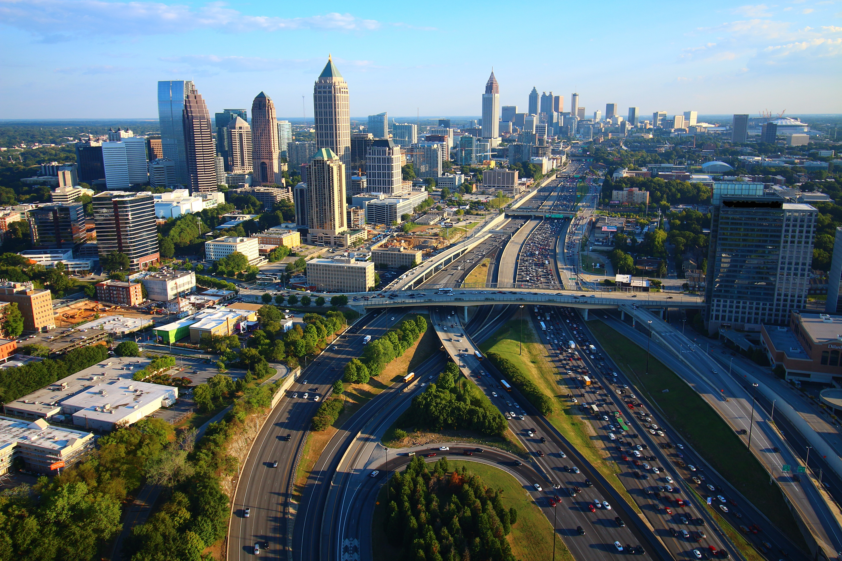
Thanks to Neighborhood Nexus and the Atlanta Regional Commission
Photo Credit: Tim Thompson
Notes:
Also want to recognize our local partners at Neighborhood Nexus and the Atlanta Regional Council
Bernita, Jim, Mike and David (board member)
A sincere thank you goes to Davina Law for wrangling vendors, hotel staff and the Neighborhood Nexus team.

Slide 6







Thank you to our local sponsors!

Slide 7
NNIP Leadership: Guiding the Agenda
Executive Committee 2017
John Cruz, St. Louis
Seema Iyer, Baltimore
Laura McKieran, San Antonio
Bernita Smith, Atlanta
April Urban, Cleveland
Noah Urban, Detroit
Recent Members, 2014-17
Mark Abraham, New Haven
Bob Gradeck, Pittsburgh
Jeff Matson, Twin Cities
Sheila Martin, Portland
Notes:
[Don’t read all the names] Would the Exec Comm please stand…. These are your representatives – they meet with us monthly and helped a lot with putting the program together.
Tom Kingsley, Leah and I are also part of the Executive Committee. Tom couldn’t make it this time
Bob and Mark cycle off at the end of the year.

Slide 8
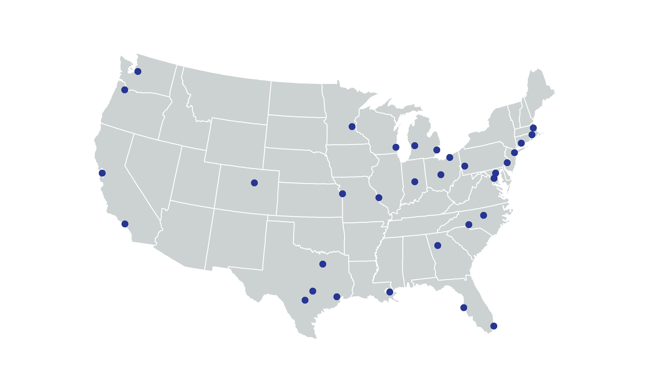
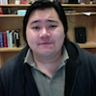
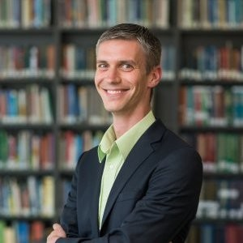
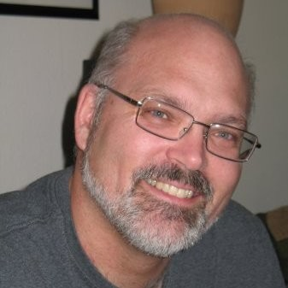
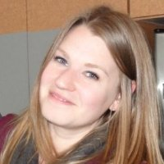
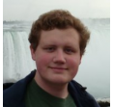
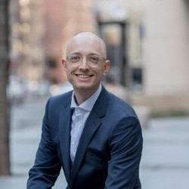
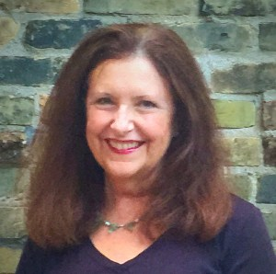
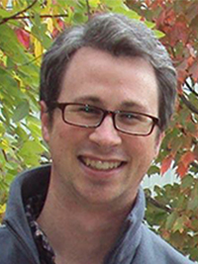
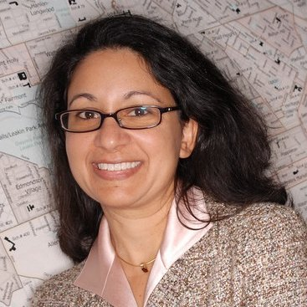
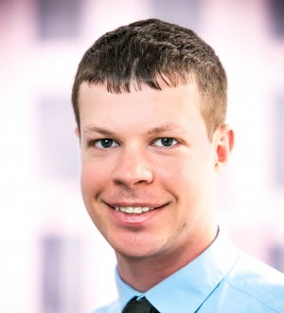
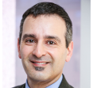
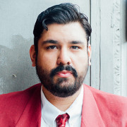
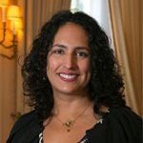

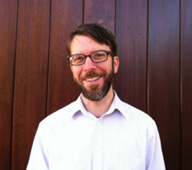
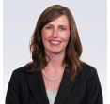
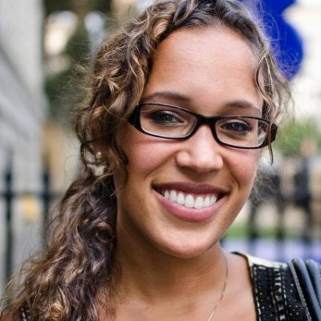
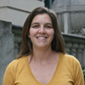
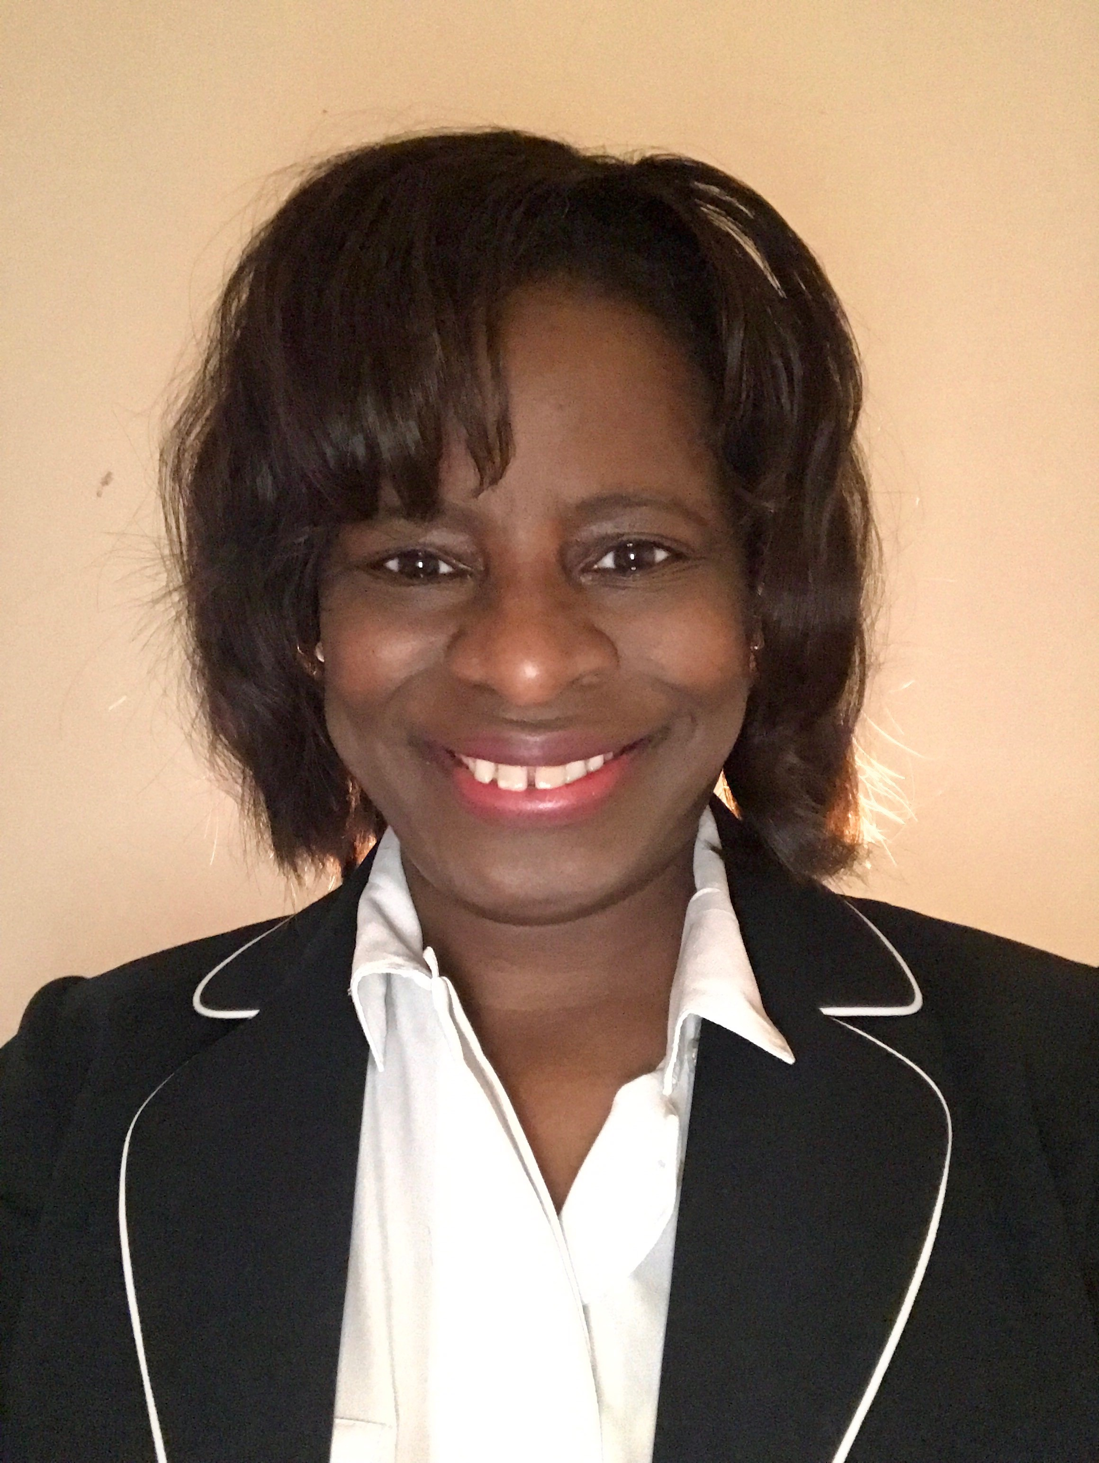
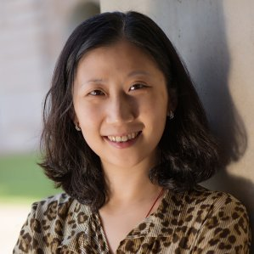
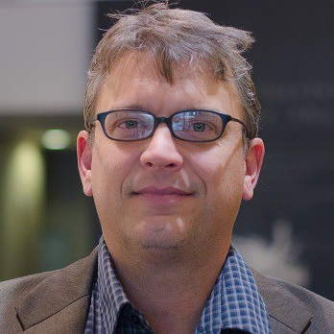
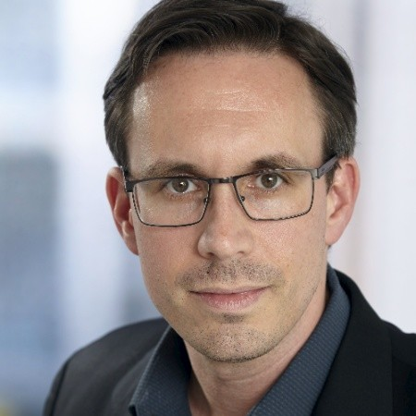
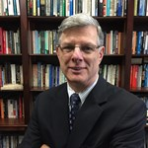
Thanks to Partner and Alumni Speakers
Notes:
Our lives are made easier and the wealth of expertise in the network and generosity of sharing. Here’s the partners and alumni that you’ll hear from over the next 3 days.
Encourage you to thank them in person while we’re together

Slide 9
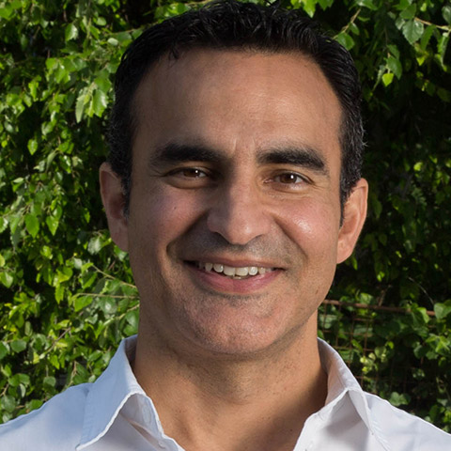
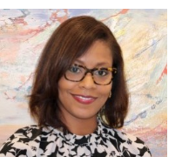
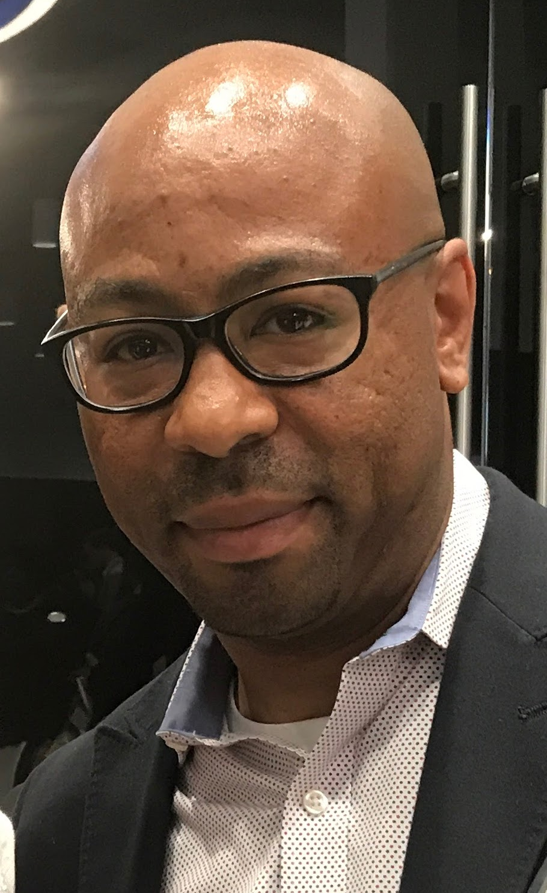
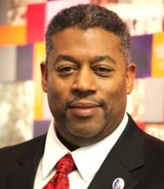
Thanks to Atlanta Speakers
Julia Lankford, Laureus Sports Foundation
Frank Fernandez
Arthur Blank Foundation
Rodney Milton, Jr., Atlanta Department
of City Planning
David Jackson, Atlanta BeltLine Partnership
Notes:
This afternoon – lucky to hear about the great work in Indianapolis – bios in your packet
And be sure to thank your tour guides for tonight.
Frank Fernandez, Arthur Blank Foundation
Rodney Milton, Jr., Atlanta Department of City Planning
Julia Lankford, Laureus Sports Foundation
David Jackson, Atlanta BeltLine Partnership
Mike Carnathan, Neighborhood Nexus
**Another part of NNIP’s value is bringing outside expertise to the network.
Geoff Smith
James Neal
Julie Nelson
Aaron Brenner
Other guests
Ash Center at Harvard Kennedy School
Federal Reserve Banks of Atl
Code for America
Peter E

Slide 10
Welcome Guest Cities!
Albuquerque, NM
Chicago, IL
Flint, MI
Greensboro, NC
Hartford, CT
Memphis, TN
Phoenix, AZ
Richmond, VA
South Bend, IN
Notes:
Part of the network’s mission is to foster NNIP capacities in new cities – various stages of interest in the NNIP model
there are descriptions of some of the organizations in the back of your packet.
welcome them – answer questions - ask about their work….
Dominic from Phoenix as part of the Turning the Corner initiative

Slide 11
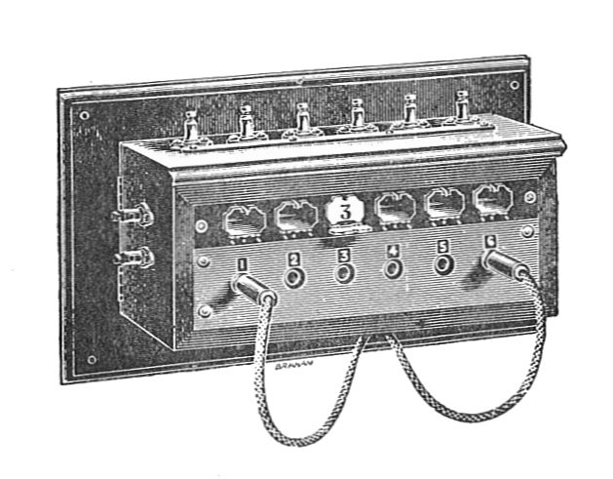

Welcome Civic Switchboard!
Charlotte, NC
Chicago, IL
Cleveland, OH
Denver, CO
Oakland, CA
Pittsburgh, PA
South Bend, IN
Notes:
10 cities participated and a few of the librarian colleagues stayed on to learn from our meeting…. Hear more tomorrow.

Slide 12
Introductions
Rob Pitingolo
Notes:
Have people go around with name and org?
What are the menti questions?

Slide 13
Agenda and Logistics
Notes:
Note code of conduct.
Note framing pages explaining the motivations behind each session. We heard you - more interactive plenary sessions. Walk through agenda, mentioning points below..
TODAY
Your Role in Fostering a Data-Driven Community – Kicking off the meeting with Inspired by work locally and through the Civic Tech and Data Collaborative
Lunch and ignite
Building a Culture of Data Use: Innovations in Program Planning and Evaluation in Indianapolis – our local session
TOMORROW
Make the NNIP Network Work for You – Leah will give a short update, but we want to use most of the time to get your ideas.
The Role of Data in Times of Crisis and Recovery – many of you have asked about the wellbeing and response-work of our Houston partner, so we’re excited Jie’s here to share their journey so far. Also really fortunate to have Denice Ross here, formerly with the Data Center in NOLA, to bring some perspective. (maybe start with Seema video if that comes through
Ignite and lunch
Hands-On Workshop on User-Centered Design – spurred by interest in some related ignites and panels – new format that we hope you’ll enjoy
Camp -Break out rooms logistics
END ON FRIDAY
Involving Students in Data Services – inspired by how rich the Camp session was in Baltimore – wanted to share with the whole group….
Camp and Ignite

Slide 14

NNIP Meeting App
my.yapp.us/NNIPATL
Schedule
List of attendees
NNIPCamp
Restaurant list
Follow #NNIP
Chat
Notes:
Please remember that everyone who has downloaded the app can see what you write in the chat
List of Attendees – please note that Participant list is also in back of the packet
Stay up to date on new NNIPCamp unconference sessions
Post announcements to all meeting attendees
Post crowd pictures during (and after) each day’s events
Answer daily polls
CHECKING
•Post crowd pictures during (and after) each day’s events
•Answer daily polls

Slide 15
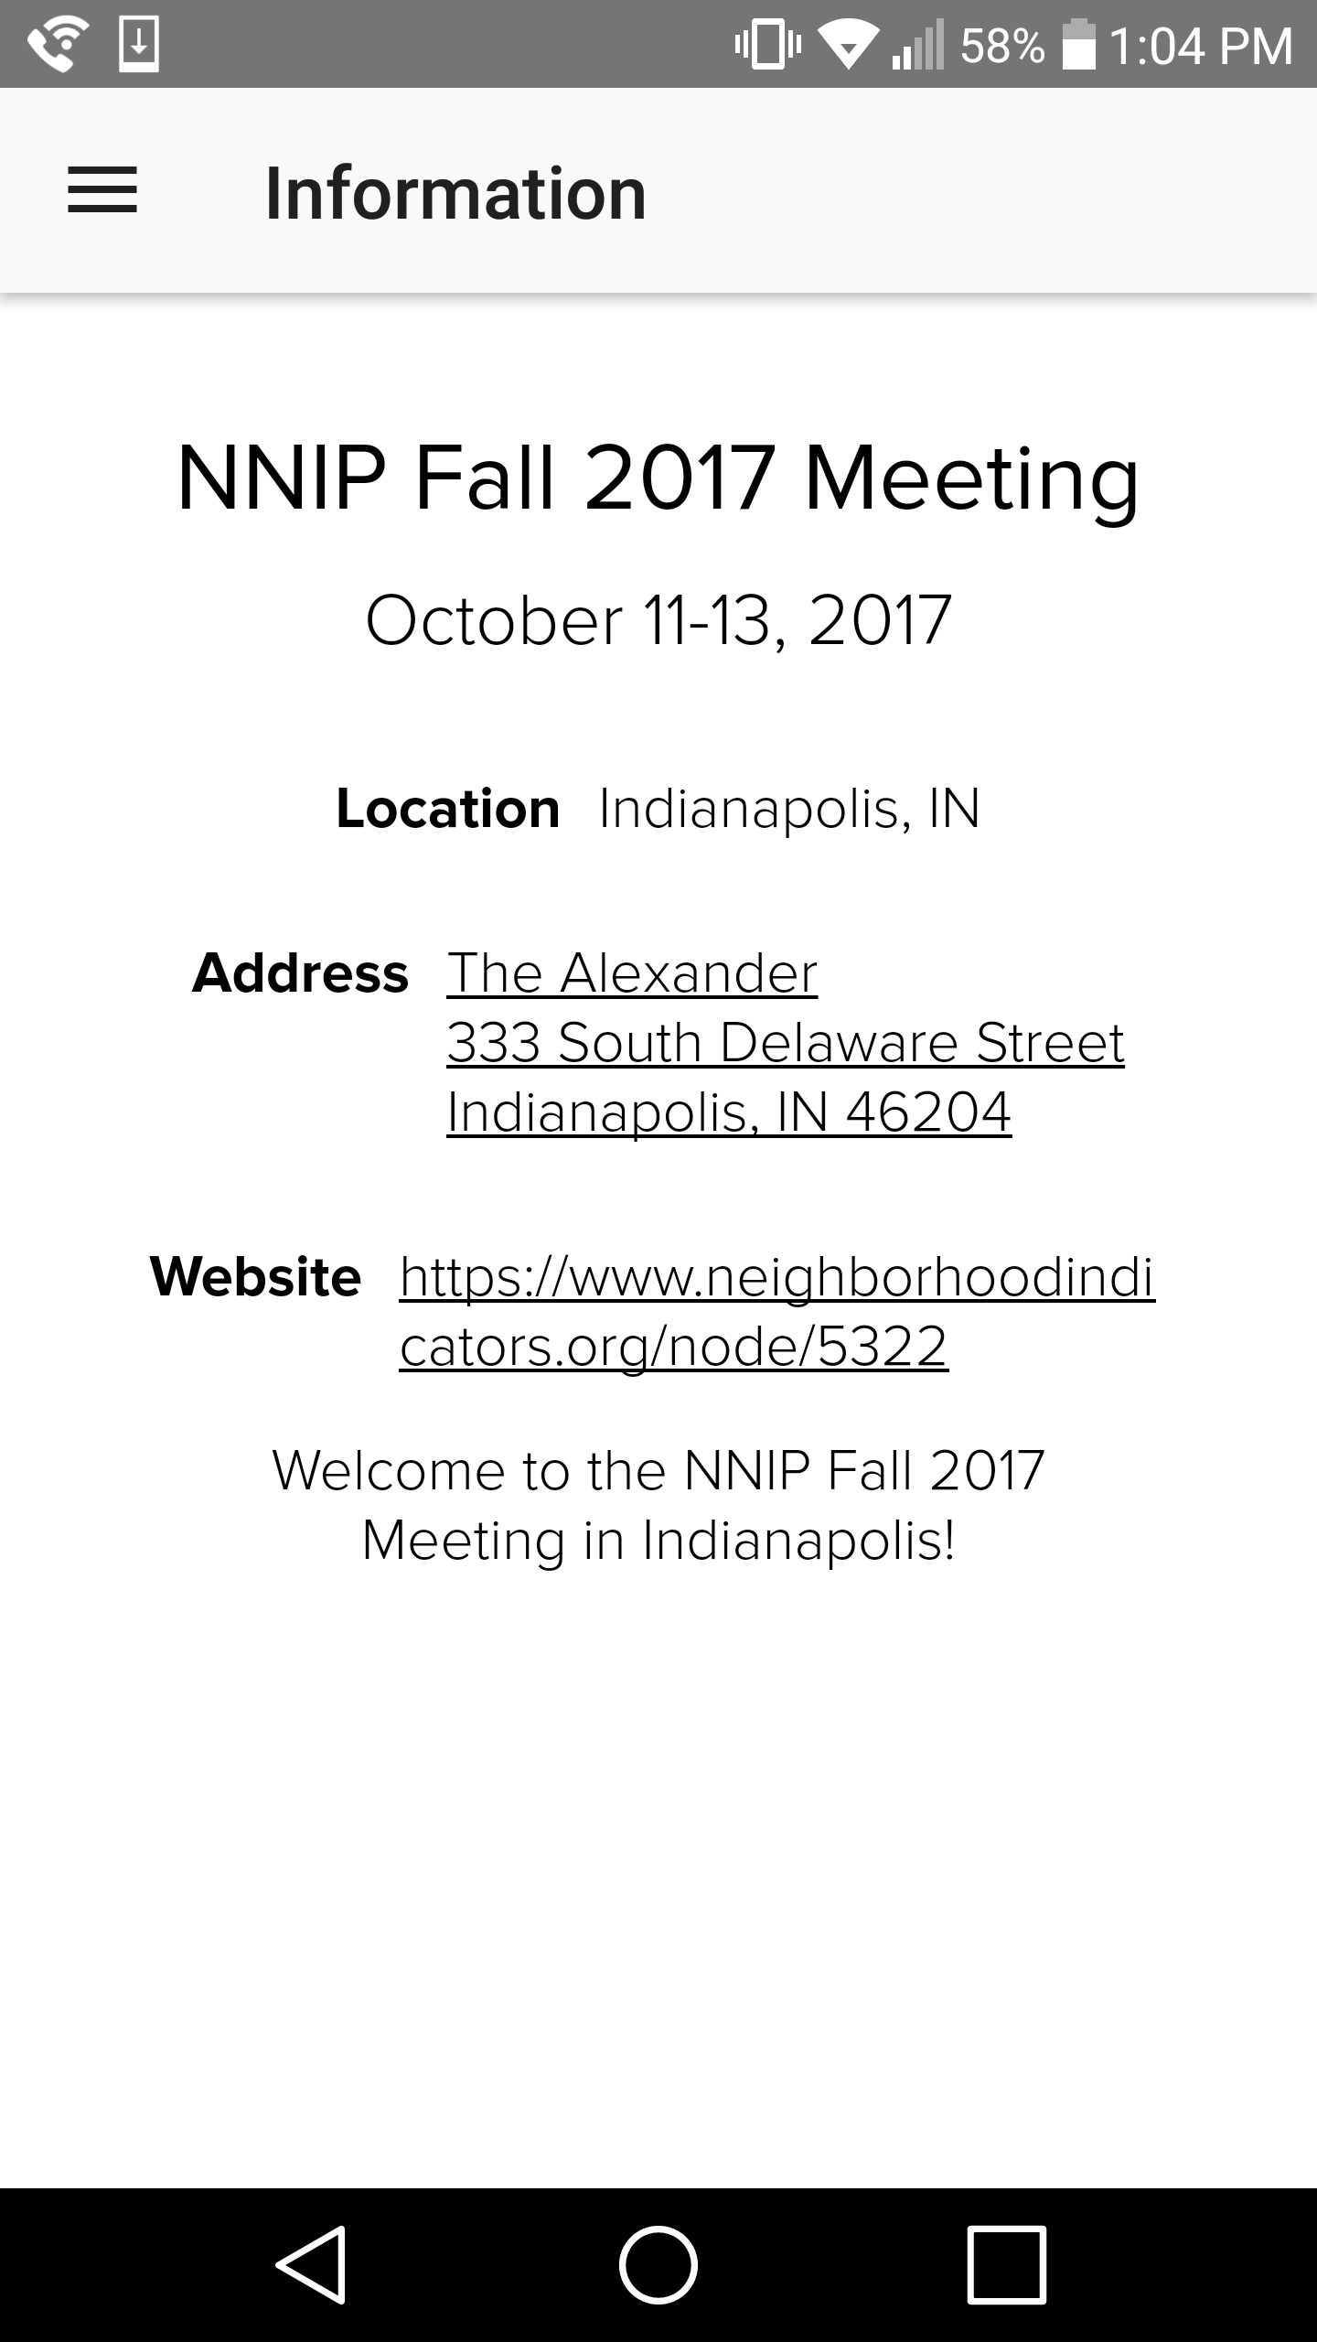
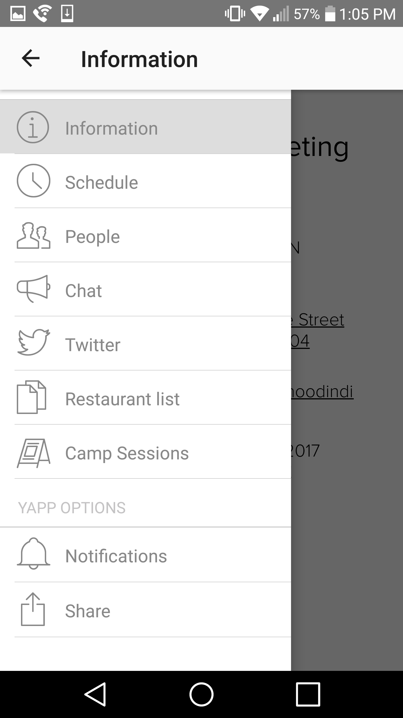
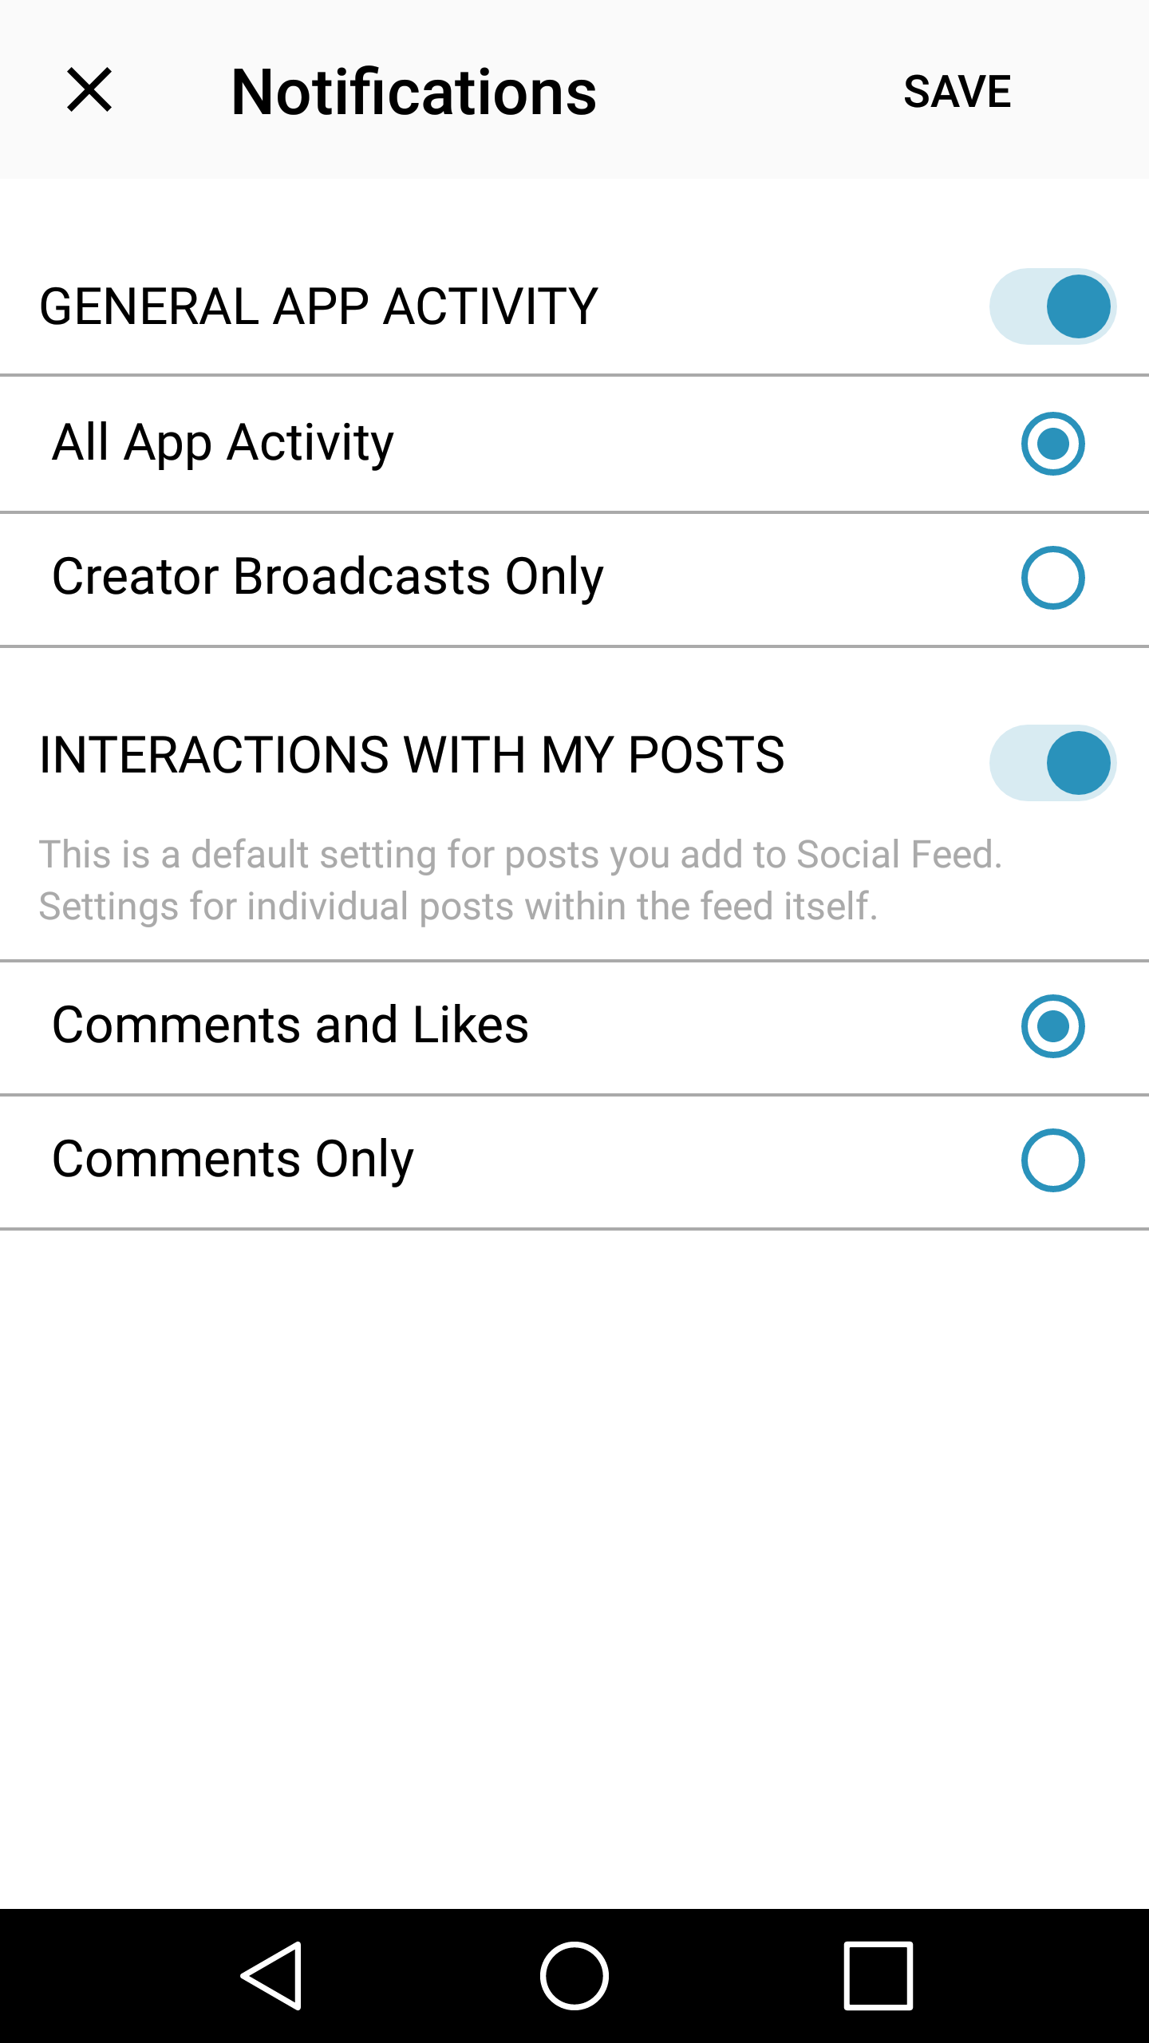
NNIP Meeting App
Step 1
Step 2
Step 3
Notes:
If you don’t want push notifications, here’s how you disable them.
I strongly suggest keeping at least “Creator Broadcasts Only” so that you can still receive alerts from NNIP HQ.
If you have trouble with this, please ask Olivia or me and we will help you.

Slide 16

Reception and Tours
Tours
Depart from lobby at 4:30
Arrive at reception at 6:30
Reception
Trees Atlanta (225 Chester Avenue SE)
NOT walkable from the hotel
Plan to use taxi or Uber if not attending tours
Buses back to hotel at 7:30, 8:00, and 8:30
Notes:
Reception is 3 miles from the hotel – NOT walkable
The East Beltline tour is a walking tour so if you’re not comfortable walking please pick one of the other two.

Slide 17
NNIPCamp Atlanta
Olivia Arena

Slide 18
What is an unconference?
Informal gathering of collaborators
Participants set the agenda
Focused on discussion
Notes:
Go over schedule/timing
Rules are posted on cards?
UNCONFERENCE 101 – Sunlight Foundation
https://www.youtube.com/watch?v=iUEt0xOysr4

Slide 19
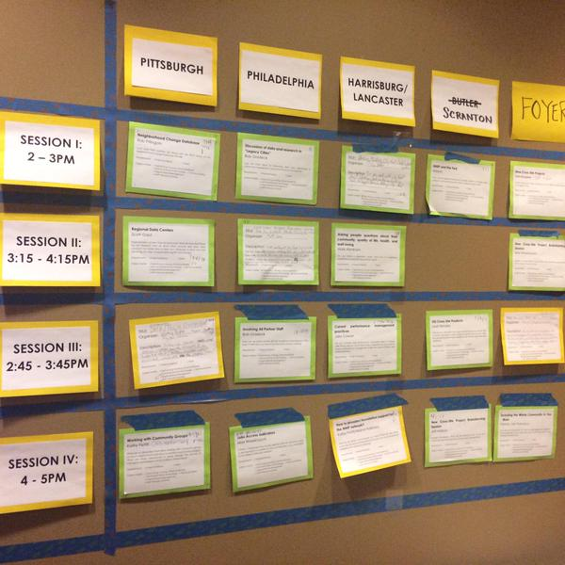
Together we build the agenda
Submit an idea
Vote on your favorites
Volunteer to lead if necessary
On Wednesday and Thursday we build our agenda
Check the app and #nnip for the schedule

Slide 20
Voting?
Votes on-site are critical so we can make final choices
Make sure to visit the boards today and tomorrow and vote to help finalize camp sessions

Slide 21
NNIPCamp Rules
Set your own agenda.
Introduce yourself.
Assign a note-taker.
Avoid planned speeches & PPTs.
Contribute & allow other to contribute.
Tweet! (if everyone agrees)
COME AND GO AS YOU PLEASE.
Notes:
Go over schedule/timing
Rules are posted everywhere…
UNCONFERENCE 101 – Sunlight Foundation
https://www.youtube.com/watch?v=iUEt0xOysr4
Determine the twitter rules for the session with the group

Slide 22
Most Importantly
Be creative
Hallway conversations count
Have fun!

Slide 23
Welcome to the
#NNIP Atlanta Meeting!
May 9, 2018

