Slide 1
Welcome to the
#NNIP Indianapolis Meeting!
October 11, 2017
Notes:
Welcome – introduce myself. Welcome you on behalf of the Urban/NNIP team.
Start with logistics
Welcome live-stream audiences, cameras are rolling and videos will be posted afterwards. We’ll be tweeting using hashtag NNIP.
Few opening remarks before introductions

Slide 2
Defining Functions of NNIP Partners
Build and operate information systems with recurrently updated data on neighborhood conditions across topics
Facilitate the practical use of indicators for community building and local policy making
Emphasize the use of information to build the capacities of low-income neighborhoods
Notes:
Many attended the intro session, but we always start out by reminding ourselves of what we have in common.
- assemble and collect ngh data
- work with local groups to USE the data
- make sure everyone has access – esp communities under stress that have traditionally not had access to data.
TO DO – UPDATE - First, thanks to all the partners attending – more than 50 staff from 28 cities and about 20% of them here for the first time (1
2). (missing KC, Prov, Miami)
And 5 alumni
Jake Cowan
Charlotte-Anne Lucas
Denice Ross
Eleanor Tutt
Greg Sanders

Slide 3



NNIP Network Supporters:
Funders and Colleagues
Notes:
None of this would be possible without dedicated funders - (can’t be here this time)
Cindy Guy– really partners in thinking about directions – conflict with internal meetings
Craig Howard - program officer for NNIP and CTDC
Kresge – funder of Turning the Corner project
Two projects we recently wrapped up since that last meeting
Office of Minority Health & Microsoft - Kevin Miller

Slide 4
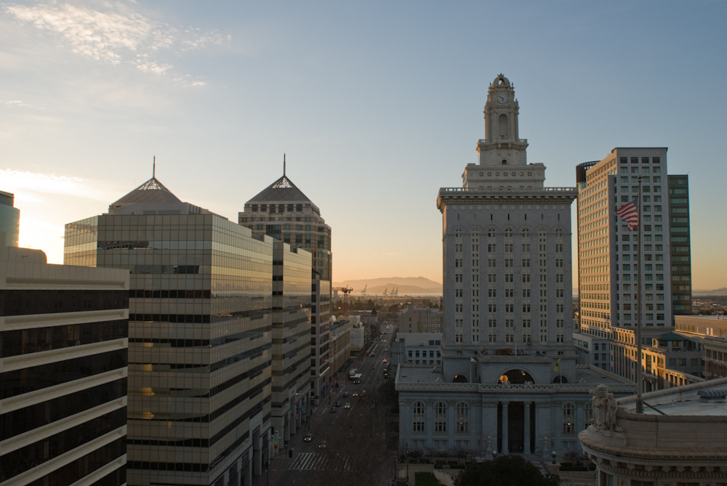
Thanks to the Polis Center!
Photo Credit: Tim Thompson
Notes:
Also want to recognize our local partners at the Polis Center, Sharon, Kelly, Ryan, and Matt.
*Who are the additional people to add aside from those three?

Slide 5


Thank you to our local sponsors!
Notes:
FILL IN

Slide 6
NNIP Leadership: Guiding the Agenda
Executive Committee 2017
Mark Abraham, New Haven
Bob Gradeck, Pittsburgh
Seema Iyer, Baltimore
Laura McKieran, San Antonio
April Urban, Cleveland
Noah Urban, Detroit
Recent Members, 2013-16
Eleanor Tutt, St. Louis
Max Weselcouch, NYC
Jeff Matson, Twin Cities
Sheila Martin, Portland
Notes:
[Don’t read all the names] Would the Exec Comm please stand…. These are your representatives – they meet with us monthly and helped a lot with putting the program together.
Tom Kingsley, Leah and I are also part of the Executive Committee. Tom couldn’t make it this time
Bob and Mark cycle off at the end of the year.
PLUG for running – call for nominees next month

Slide 7

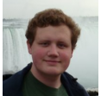
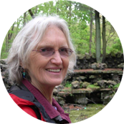
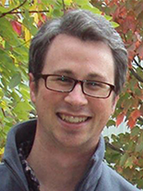
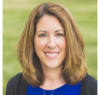
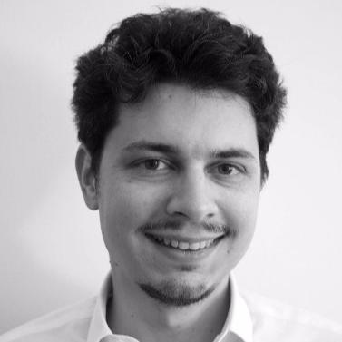
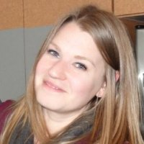
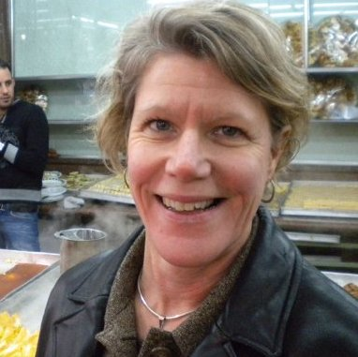
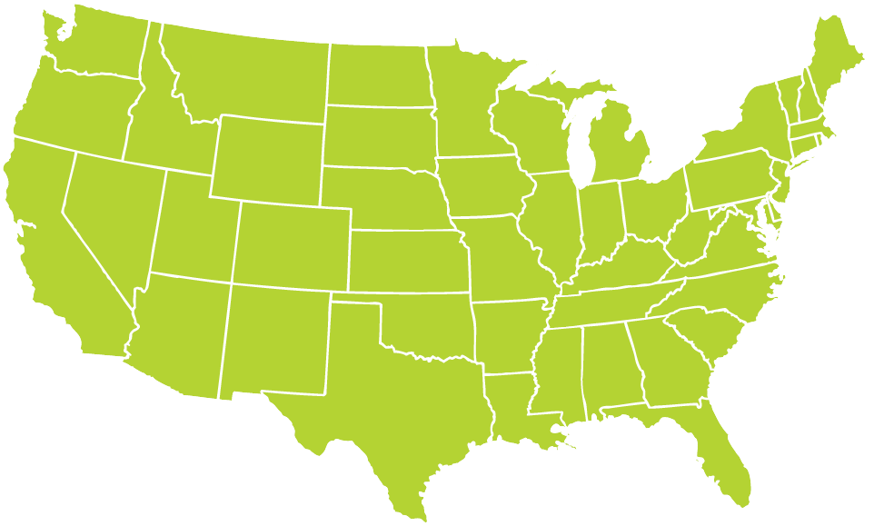

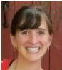
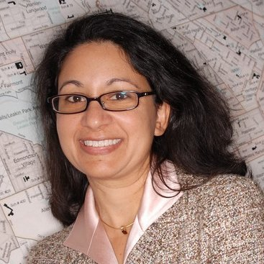
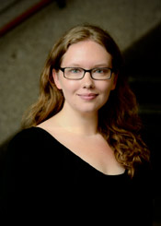
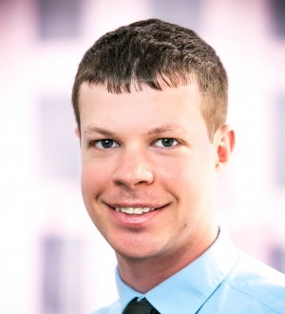
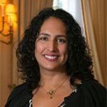
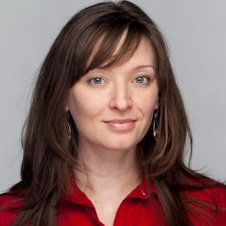

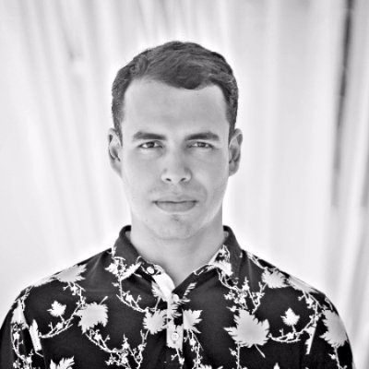
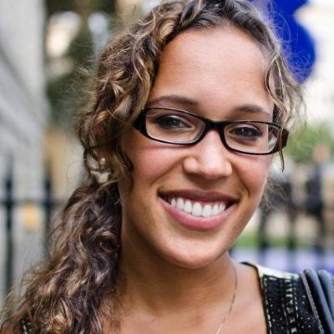
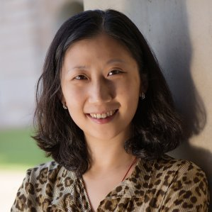

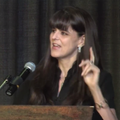
Thanks to Partner Speakers
Notes:
Our lives are made easier and the wealth of expertise in the network and generosity of sharing. Here’s the partners that you’ll hear from over the next 3 days.
Encourage you to thank them in person while we’re together

Slide 8
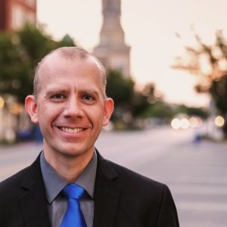
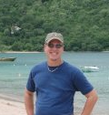
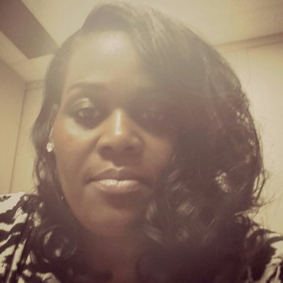
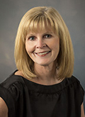
Thanks to Indianapolis Speakers
James Taylor
John H. Boner Community Center
Brad Beaubien
City of Indianapolis
Denise Luster
United Way of Central Indiana
Sue Ehinger
Parkview Health
Notes:
This afternoon – lucky to hear about the great work in Indianapolis – bios in your packet
And be sure to thank your tour guides for tonight.

Slide 9
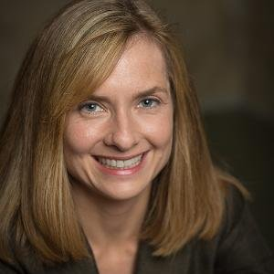
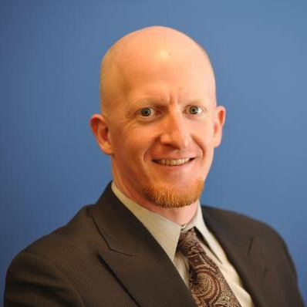
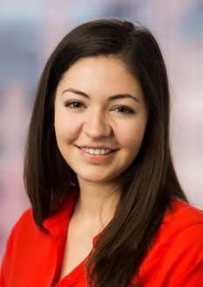
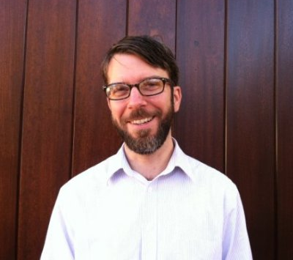
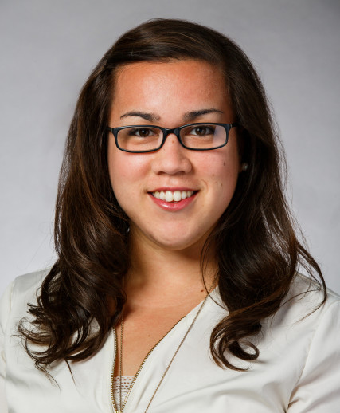
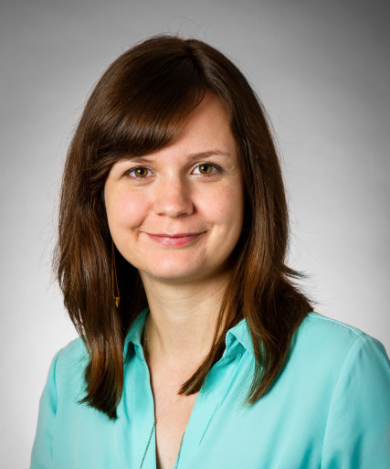
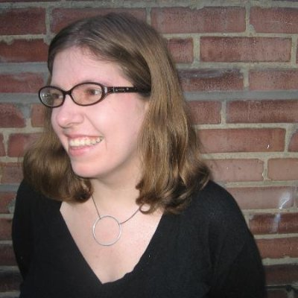
Thanks to Guest Speakers
Denice Ross
New America
Jake Cowan
Katya Abazajian
Sunlight Foundation
John Killeen
DataWorks NC
Denice Linn
Smart Chicago Collaborative
Sonja Marziano
Smart Chicago Collaborative
Eleanor Tutt
Carnegie Library of Pittsburgh
Notes:
Another part of NNIP’s value is bringing outside expertise to the network.
Other guests
Ash Center at Harvard Kennedy School
Federal Reserve Banks of Chicago
Ford Foundation
Living Cities
Trinity College
Sunlight Foundation

Slide 10
Welcome Guest Cities!
Chicago, IL
Durham, NC
Madison, WI
Memphis, TN
Phoenix, AZ
Richmond, VA
South Bend, IN
Notes:
Part of the network’s mission is to foster NNIP capacities in new cities – there are descriptions of their organizations in the back of your packet.
welcome them – answer questions - ask about their work….
Greg from Phoenix here for the first time as part of the Turning the Corner initiative

Slide 11
Introductions
Rob Pitingolo
Notes:
Have people go around with name and org?
What are the menti questions?

Slide 12
Agenda and Logistics
Notes:
Note code of conduct.
Note framing pages explaining the motivations behind each session. We heard you - more interactive plenary sessions. Walk through agenda, mentioning points below..
TODAY
Your Role in Fostering a Data-Driven Community – Kicking off the meeting with Inspired by work locally and through the Civic Tech and Data Collaborative
Lunch and ignite
Building a Culture of Data Use: Innovations in Program Planning and Evaluation in Indianapolis – our local session
TOMORROW
Make the NNIP Network Work for You – Leah will give a short update, but we want to use most of the time to get your ideas.
The Role of Data in Times of Crisis and Recovery – many of you have asked about the wellbeing and response-work of our Houston partner, so we’re excited Jie’s here to share their journey so far. Also really fortunate to have Denice Ross here, formerly with the Data Center in NOLA, to bring some perspective. (maybe start with Seema video if that comes through
Ignite and lunch
Hands-On Workshop on User-Centered Design – spurred by interest in some related ignites and panels – new format that we hope you’ll enjoy
Camp -Break out rooms logistics
END ON FRIDAY
Involving Students in Data Services – inspired by how rich the Camp session was in Baltimore – wanted to share with the whole group….
Camp and Ignite

Slide 13

NNIP Meeting App
my.yapp.us/NNIPindy
Schedule
List of attendees
NNIPCamp
Restaurant list
Follow #NNIP
Chat
Notes:
Please remember that everyone who has downloaded the app can see what you write in the chat
List of Attendees – please note that Participant list is also in back of the packet
Stay up to date on new NNIPCamp unconference sessions
Post announcements to all meeting attendees
Post crowd pictures during (and after) each day’s events
Answer daily polls
CHECKING
•Post crowd pictures during (and after) each day’s events
•Answer daily polls

Slide 14
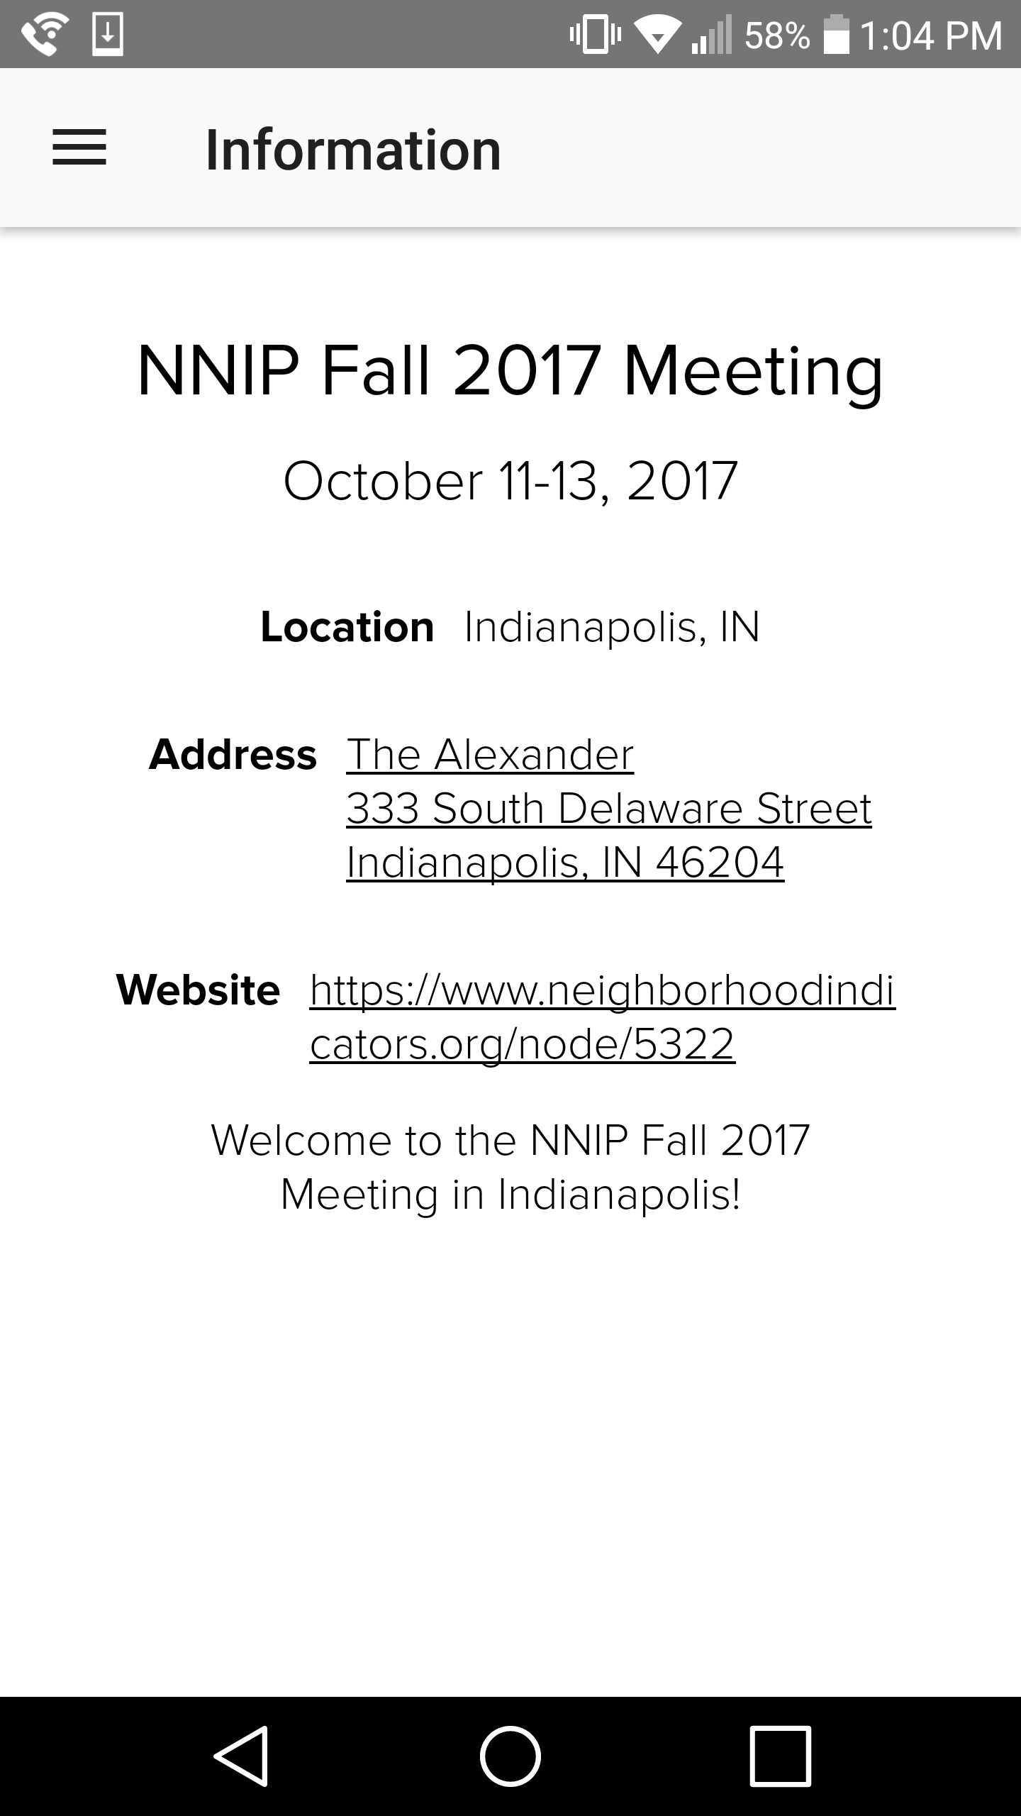
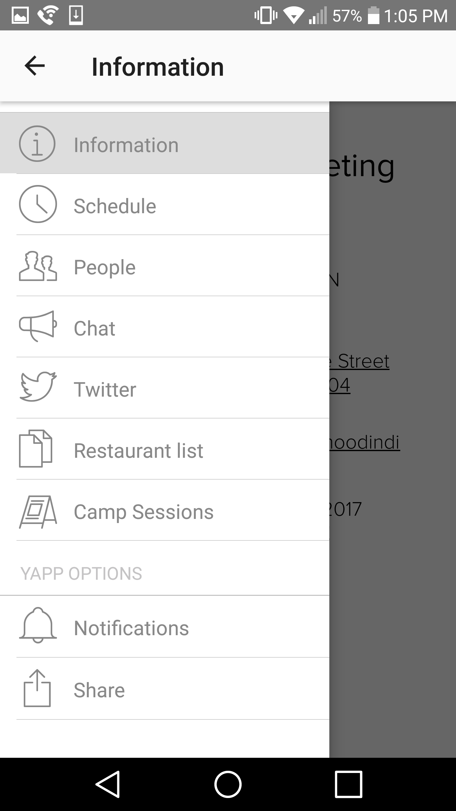
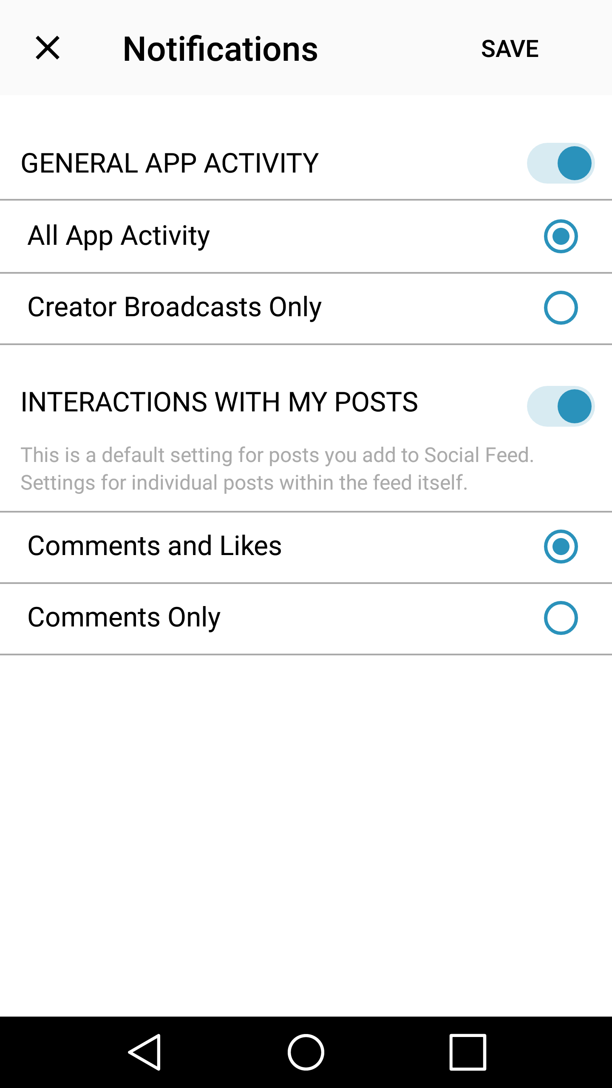
NNIP Meeting App
Step 1
Step 2
Step 3
Notes:
If you don’t want push notifications, here’s how you disable them.
I strongly suggest keeping at least “Creator Broadcasts Only” so that you can still receive alerts from NNIP HQ.
If you have trouble with this, please ask Olivia or me and we will help you.

Slide 15


Reception and Tour
Note: Reception is business-casual
Depart from lobby at 4:15
Return to hotel at 6:15
Time to change
Walk hotel → reception
Depart from lobby at 4:30
Arrive at reception at 6:30
Notes:
Tours – FIND OUT mobility requirements

Slide 16

Breakfast
Breakfast in Market Table Thursday & Friday
Hours: 6:30 – 9:00am
Use the vouchers you received at check-in
You MAY bring your plate to the ballroom
Notes:
You may bring your plate to the ballroom if you don’t finish your breakfast by 9am, but please be on time for the 9am session so we don’t fall behind
Don’t Take Food From the “Nourishment Hub” - We didn’t purchase this and the hotel has asked that we don’t take food from it.
NNIPHQ staff - please stand up – we’re here to make your next 3 days go smoothly , so just let us know if you need anything.

Slide 17
NNIPCamp Indianapolis
Olivia Arena

Slide 18
What is an unconference?
Informal gathering of collaborators
Participants set the agenda
Focused on discussion
Notes:
Go over schedule/timing
Rules are posted on cards?
UNCONFERENCE 101 – Sunlight Foundation
https://www.youtube.com/watch?v=iUEt0xOysr4

Slide 19
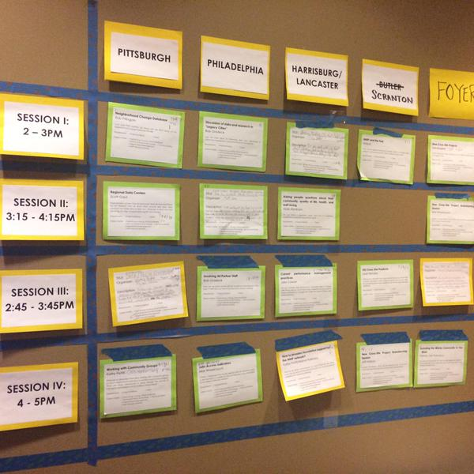
Together we build the agenda
Submit an idea
Vote on your favorites
Volunteer to lead if necessary
On Wednesday and Thursday we build our agenda
Check the app and #nnip for the schedule

Slide 20
Voting?
Virtual v. Physical agenda – how does voting work?
Votes from home helped us prime the pump and identify early topics of interest
Votes on-site are critical so we can make final choices
Make sure to visit the boards today and tomorrow and vote to help finalize camp sessions

Slide 21
NNIPCamp Rules
Set your own agenda.
Introduce yourself.
Assign a note-taker.
Avoid planned speeches & PPTs.
Contribute & allow other to contribute.
Tweet! (if everyone agrees)
COME AND GO AS YOU PLEASE.
Notes:
Go over schedule/timing
Rules are posted everywhere…
UNCONFERENCE 101 – Sunlight Foundation
https://www.youtube.com/watch?v=iUEt0xOysr4
Determine the twitter rules for the session with the group

Slide 22
Most Importantly
Be creative
Hallway conversations count
Have fun!

Slide 23
Welcome to the
#NNIP Indianapolis Meeting!
October 11, 2017

