Slide 1
Welcome to the
#NNIP Baltimore Meeting!
May 17, 2017
Notes:
Welcome – introduce myself.
Start with logistics
Welcome live-stream audiences, cameras are rolling and will be posted afterwards. We’ll be tweeting using hashtag NNIP.
Few opening remarks before introductions

Slide 2
Defining Functions of NNIP Partners
Build and operate information systems with recurrently updated data on neighborhood conditions across topics
Facilitate the practical use of indicators for community building and local policy making
Emphasize the use of information to build the capacities of low-income neighborhoods
Notes:
Many attended the intro session, but we always start out by reminding ourselves of what we have in common.
- assemble and collect ngh data
- work with local groups to USE the data
- make sure everyone has access – esp communities under stress that have traditionally not had access to data.
This is the largest meeting ever with 151 people registered – the room will be quite full at times, so please fill in and get to know your new NNIP friends.
First, thanks to all the partners attending – more than 62 staff from 30 cities and about 1/3 of them here for the first time (22).
Special welcome to our new partners: Houston, LA, and Philadelphia – you’ll be hearing more about them in the Ignite session today.
And 5 alumni
Jake Cowan
Charlotte-Anne Lucas
Randy Rosso
Joe Baldwin
Denice Ross

Slide 3



NNIP Network Supporters:
Funders and Colleagues
Notes:
None of this would be possible without dedicated funders
Cindy Guy– really partners in thinking about directions (Kim Spring, Ji Won, Scot Spencer, Patrick greeting us later today)
Craig Howard - program officer for NNIP and CTDC (can’t be here this time)
Kresge – funder of Turning the Corner project
Microsoft - Elizabeth (who will join tomorrow)
Office of Minority Health
*MW: Send note to Cindy about attendance? Should I do this?

Slide 4
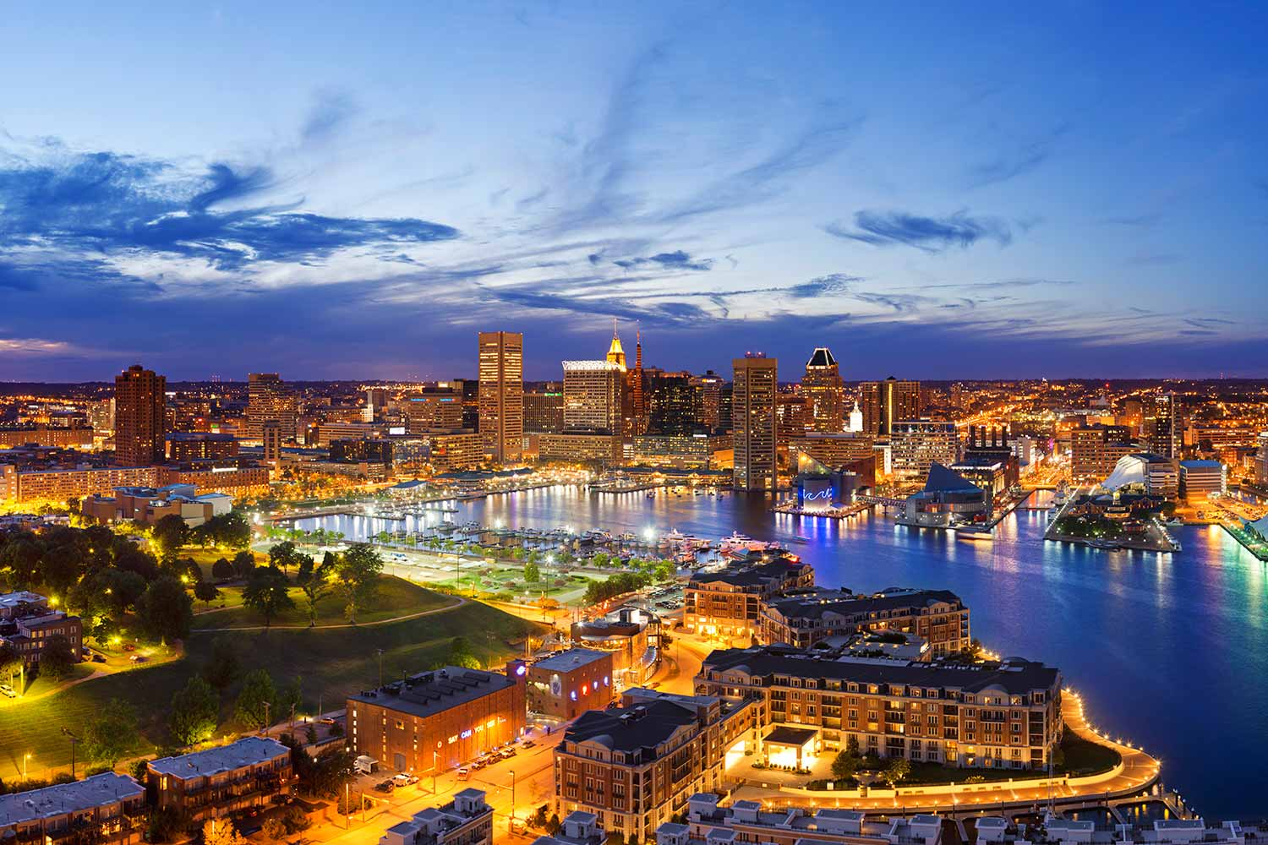
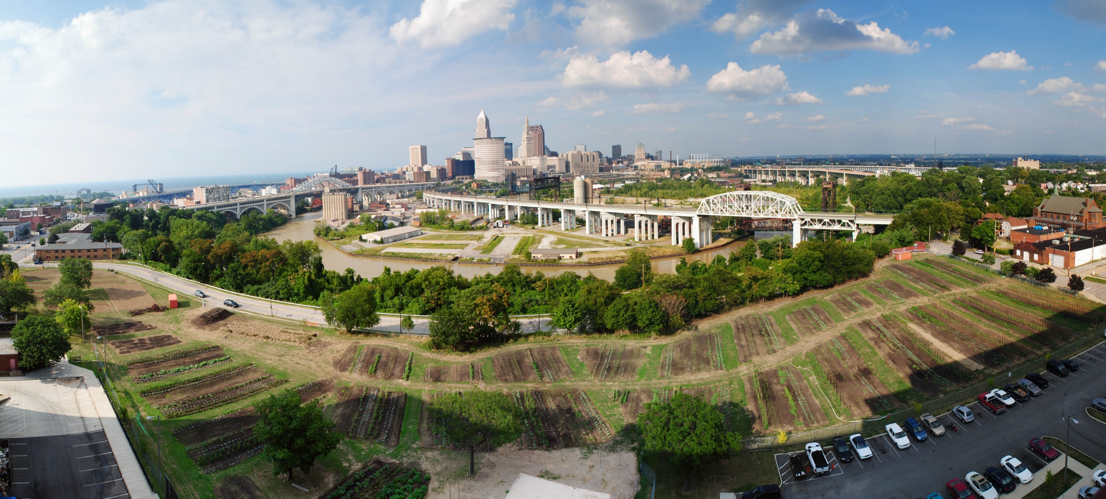
Thanks to
Baltimore Neighborhood Indicators Alliance!
Photo Credit: Tim Thompson
Notes:
Also want to recognize our local partners at the Baltimore Neighborhood Indicators Alliance., Seema, Nancy, especially Cheryl who drove around town to make sure everyone has a great week.
*MW: Who are the additional people to add aside from those three?

Slide 5

Thank you to our local sponsors!
Notes:
NNIP and BNIA-JFI would like to thank everyone who made it possible to hold the Spring 2017 NNIP Partners’ meeting in Baltimore!
In addition to their network support, the Annie E. Casey Foundation provided funding for the tours and reception and the Baltimore Office of Promotion and the Arts granted the use of the Top of the World Observation floor.

Slide 6
NNIP Leadership: Guiding the Agenda
Executive Committee 2017
Mark Abraham, New Haven
Bob Gradeck, Pittsburgh
Seema Iyer, Baltimore
Laura McKieran, San Antonio
April Urban, Cleveland
Noah Urban, Detroit
Recent Members, 2013-16
Eleanor Tutt, St. Louis
Max Weselcouch, NYC
Jeff Matson, Twin Cities
Sheila Martin, Portland
Notes:
[Don’t read all the names] Would the Exec Comm please stand…. These are your representatives – they meet with us monthly and helped a lot with putting the program together.
Tom Kingsley, Leah and I are also part of the Executive Committee.
PLUG for running

Slide 7
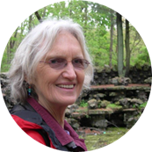


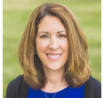
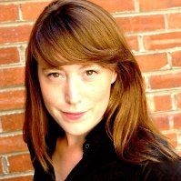
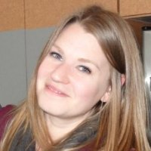
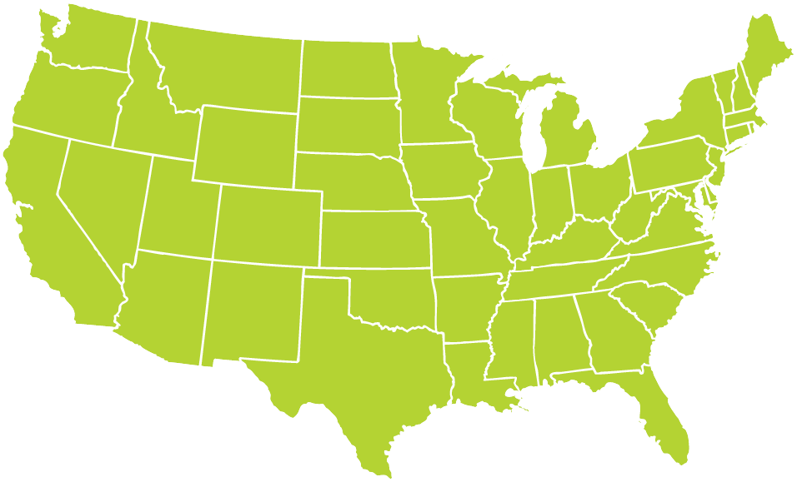
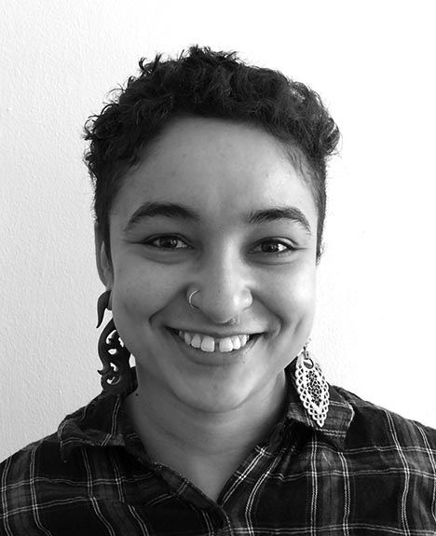

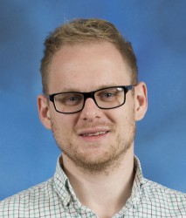
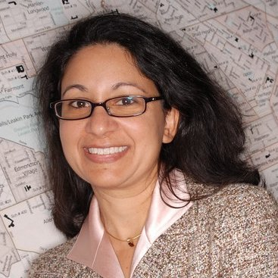
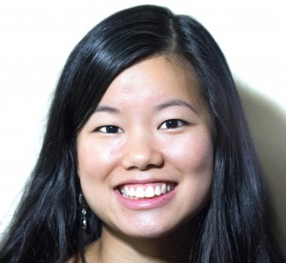
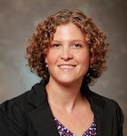
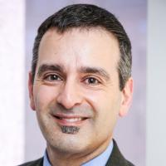
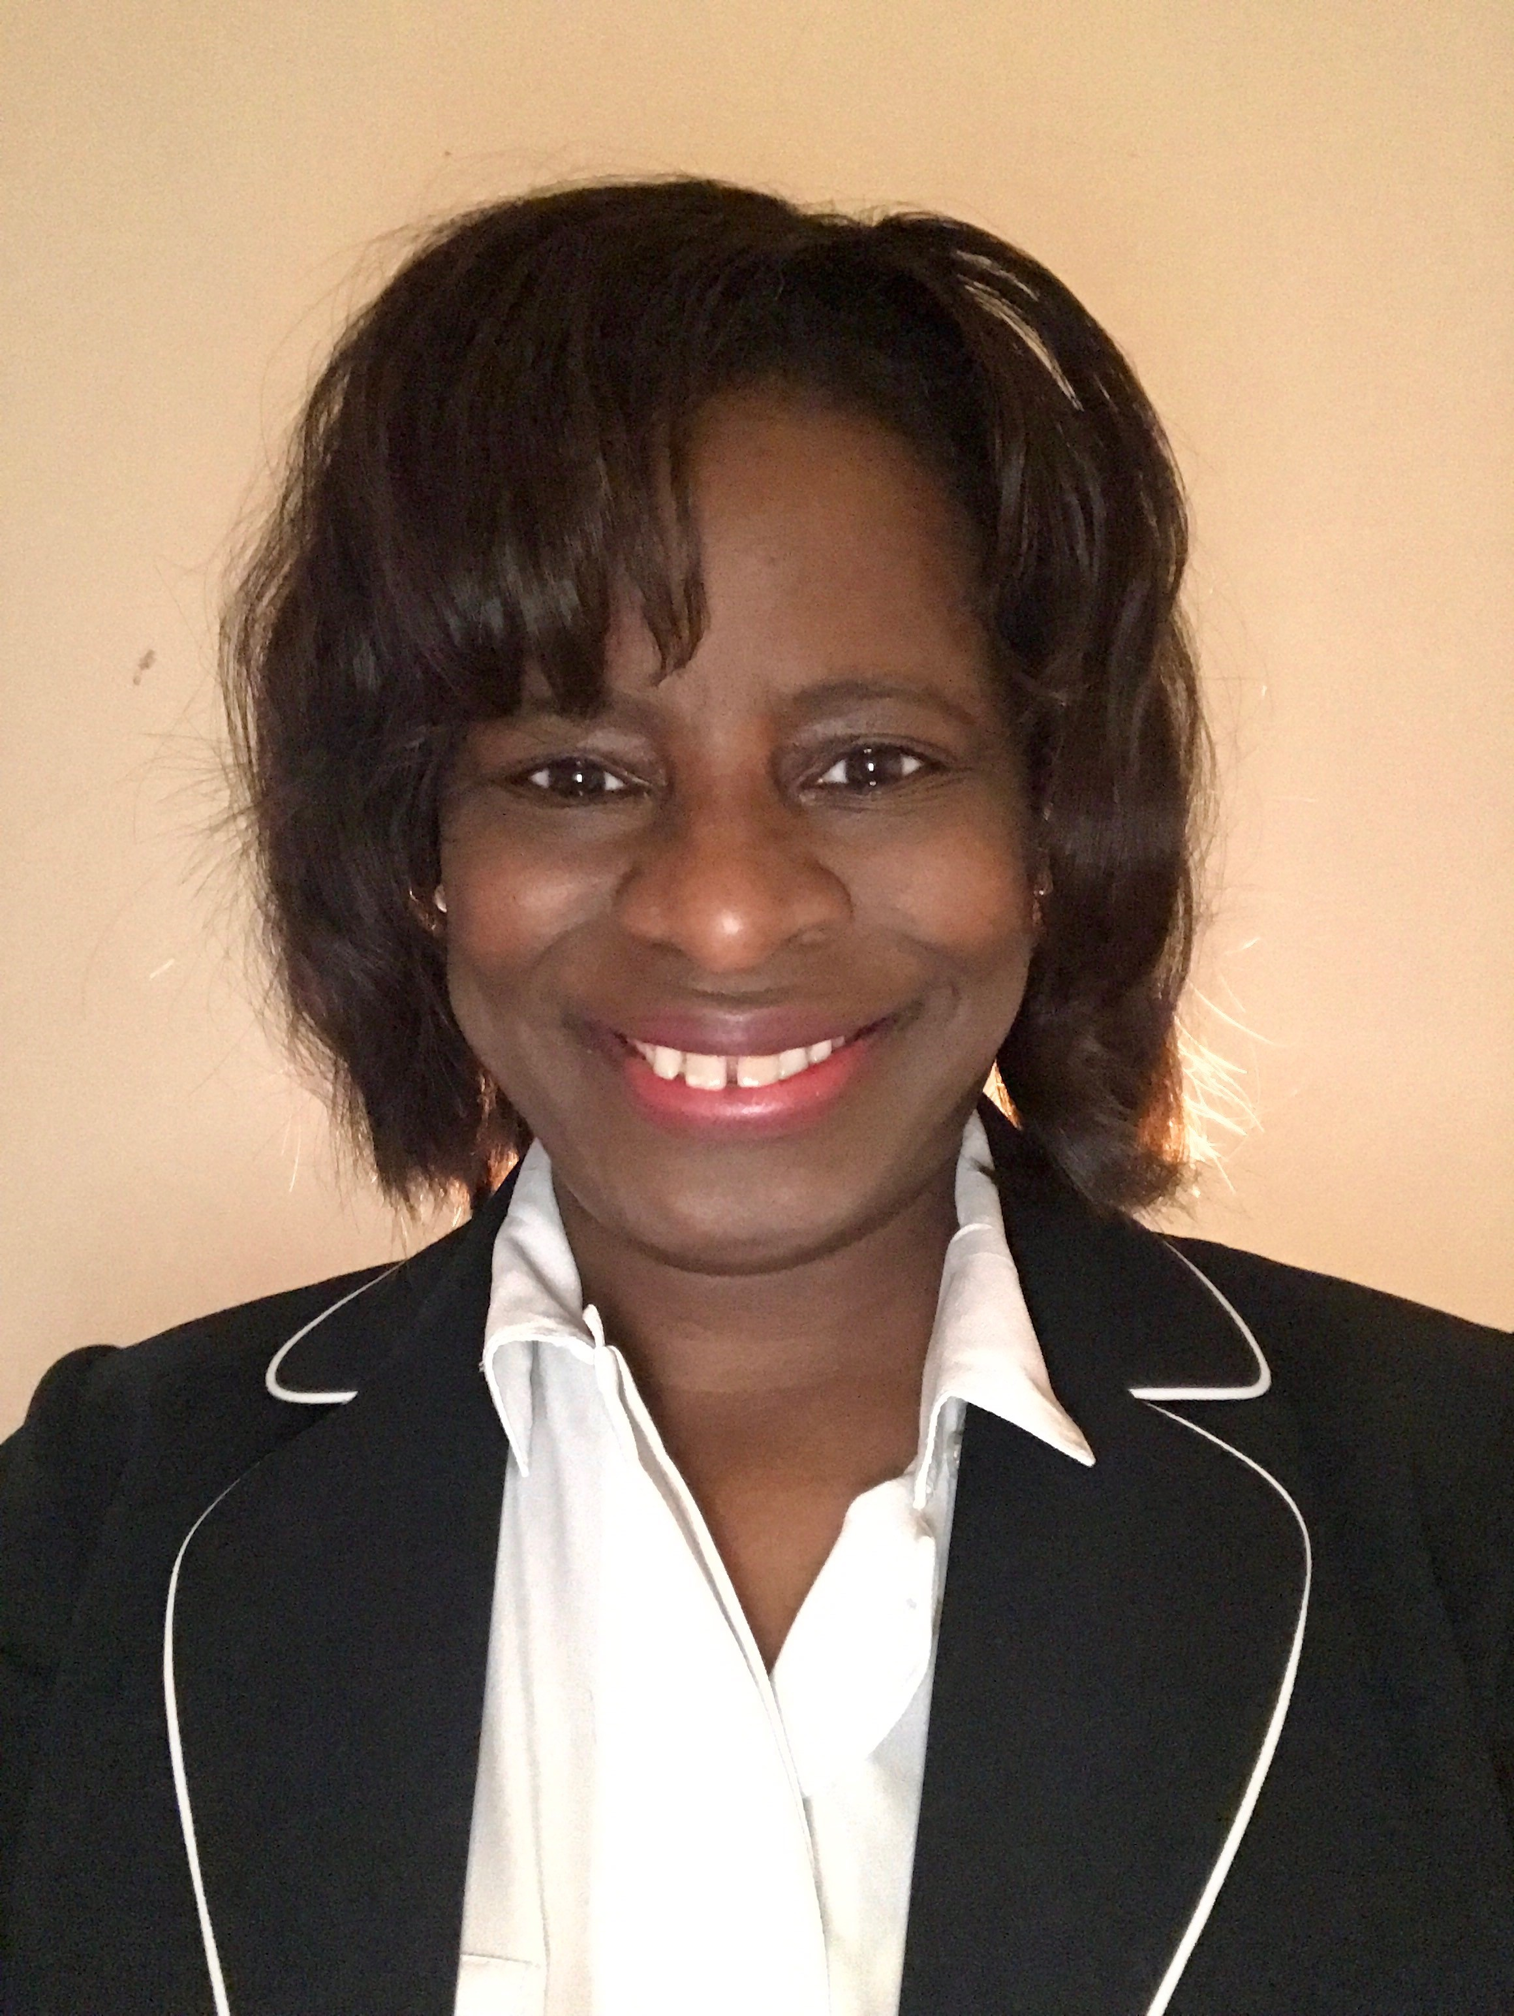
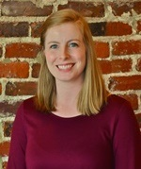
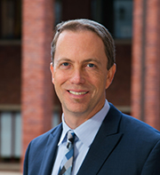
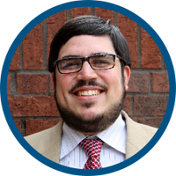
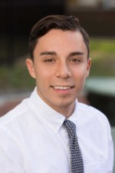

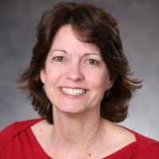
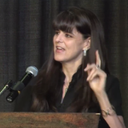
Thanks to Partner Speakers
Notes:
Our lives are made easier and the wealth of expertise in the network and generosity of sharing. Here’s the partners that you’ll hear from over the next 3 days.
Encourage you to thank them in person while we’re together
Particularly Carrie from Milwaukee, Camille from New Haven, Bernardo from New Orleans, Steve from Pittsburgh – presenting on their first time to the meeting.

Slide 8
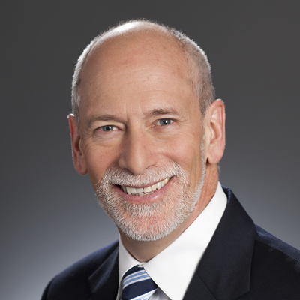
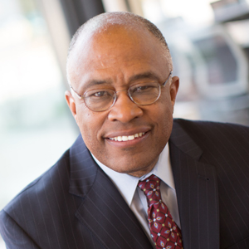
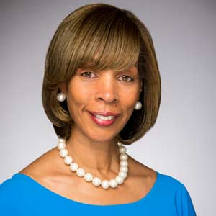
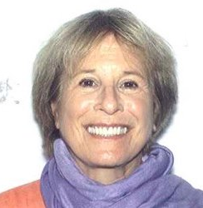
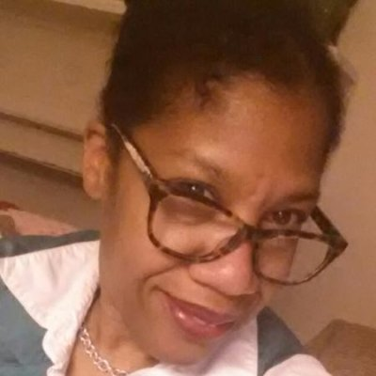
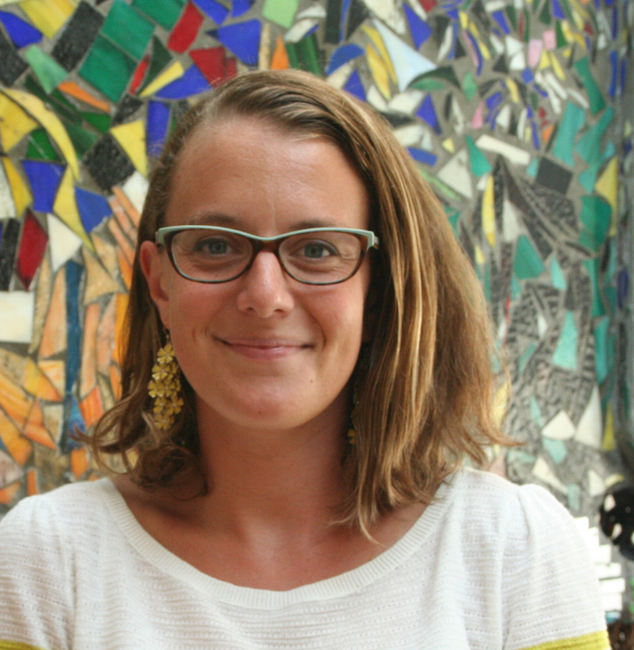
Thanks to Baltimore Speakers
Patrick McCarthy,
Annie E. Casey Foundation
Kurt Schmoke, University of Baltimore
Mayor Catherine Pugh,
City of Baltimore
Jane Brown,
Robert W. Deutsch Foundation
Krista Green,
Baltimore Office of Promotion & The Arts
Julia Di Bussolo,
Arts Every Day
Notes:
This afternoon – lucky to hear about the great work in Baltimore – all listed in your agenda
And be sure to thank your tour guides for tonight.

Slide 9
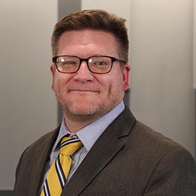
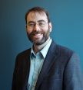
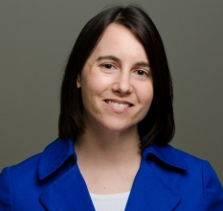
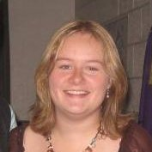
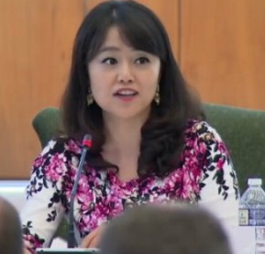
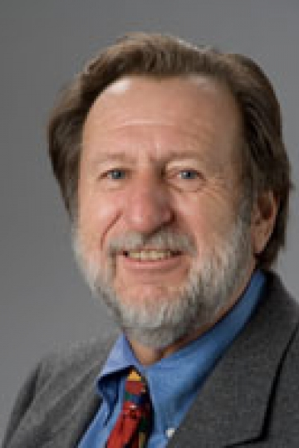
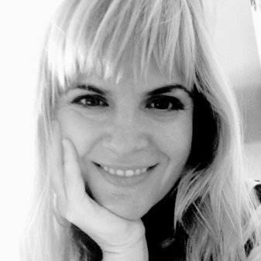
Thanks to Guest Speakers
Michael Wallace,
National League of Cities
Benjamin Orr, Maryland Center on Economic Policy
Hilary Heishman,
Robert Wood Johnson Foundation
Sarah Morgan, Allegheny County
Jennifer Kim,
U.S. Census Bureau
Bill O’Hare,
O’Hare Data and Demographic Services
Kyla Fullenwider
U.S. Census Bureau
Notes:
Another part of NNIP’s value is bringing outside expertise to the network.
Other guests
AcademyHealth
Ash Center at Harvard Kennedy School
Code for America
Federal Reserve Banks of Minneapolis, Richmond and San Francisco
Ford Foundation
Forum for Youth Investment
Living Cities
MetroLab Network
Illinois Public Health Institute
Robert Wood Johnson Foundation
Sunlight Foundation
Virginia Tech

Slide 10
Welcome Guest Cities!
Potential Partners
Chicago, IL
Durham, NC
Memphis, TN
Richmond, VA
Turning the Corner Cities
Buffalo, NY
Phoenix, AZ
Notes:
Part of the network’s mission is to foster NNIP capacities in new cities – welcome them – answer questions - ask about their work….
Phoenix and Buffalo guests are here as part of the Turning the Corner initiative

Slide 11
Integrated Data Systems Pre-session
Governance:
  Engaging and mapping stakeholders
  Developing advisory boards
  IDS policies and procedures
Data Security:
  Data security plans
  Secure data transfer and access
  Compliance audits (FERPA/HIPAA)
  Improving data protections used by data providers
Notes:
Leah and Amanda
Note working on IDS for a while
ADD CASEY LOGO
X people from X cities

Slide 12


Welcome Civic Tech and Data Collaborative and Code for America!
CTDC cities
Boston
St. Louis
Washington, DC
Cleveland
Pittsburgh
San Antonio
Seattle
CfA National Advisory Members
Code for Atlanta
Code for Charlotte
Hack LA
CfA Local
Code for Baltimore
Notes:
Finally, welcome to friends from national organizations – LC/Cfa - some are partners on our cross-site projects
Funded by MacArthur
CTDC guests: DC Housing Insights, Open Cleveland, Jef from San Antonio
NAC guests
Several chances to exchange ideas with them through panels and Camp sessions. Please welcome them at meals and reception.

Slide 13

Expanding Community Data and Technology Training
Brief to advocate for the need for training
Guide to encourage more organizations to conduct training
Factsheet with Summer 2016 survey results
Catalog with descriptions and materials for 20 trainings collected from NNIP and friends
Notes:
Mention Maia and Olivia – Elizabeth Grossman
Partners contributed by the survey, in the presession, as reviewers for the product, trainers,
Expect to go live June 1 and we’ll be reaching out to you to help promote it.

Slide 14
Introductions
Rob Pitingolo

Slide 15
Agenda Review
Leah Hendey
Notes:
Note availability of app with the overall schedule
Stay up to date on new NNIPCamp unconference sessions
Post announcements to all meeting attendees
Post crowd pictures during (and after) each day’s events
Answer daily polls
Walk through what is in the packet – Note code of conduct, framing pages and participant list
Break out rooms logistics
Tours – FIND OUT mobility requirements
Reception: If you are arriving late Wednesday afternoon, we will be departing for the neighborhood bus tour at 4:15 pm from the lobby, which will run until 6:15.
Light reception – expect people to go out afterwards [Is this true?] Point to restaurant list.
How to get back – about a 15 minute walk back or Uber/taxi if you want.
NNIPHQ staff - please stand up – we’re here to make your next 3 days go smoothly , so just let us know if you need anything.

Slide 16
NNIPCamp Baltimore
Maia Woluchem

Slide 17
What is an unconference?
Informal gathering of collaborators
Participants set the agenda
Focused on discussion
Notes:
Go over schedule/timing
Rules are posted everywhere…
UNCONFERENCE 101 – Sunlight Foundation
https://www.youtube.com/watch?v=iUEt0xOysr4

Slide 18
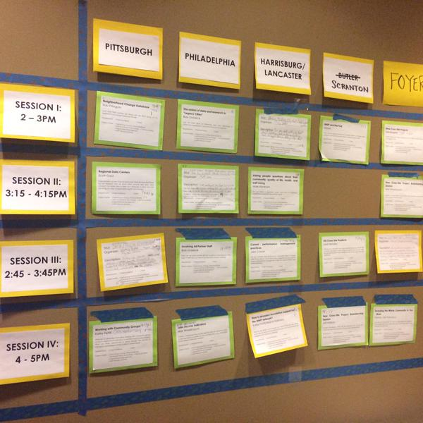
Together we build the agenda
Submit an idea
Vote on your favorites
Volunteer to lead if necessary
On Wednesday and Thursday we build our agenda
Check the app and #nnip for the schedule

Slide 19
Voting?
Virtual v. Physical agenda – how does voting work?
Votes from home helped us prime the pump and identify early topics of interest
Votes on-site are critical so we can make final choices
Make sure to visit the boards today and tomorrow and vote to help finalize camp sessions

Slide 20
NNIPCamp Rules
Set your own agenda.
Introduce yourself.
Assign a note-taker.
Avoid planned speeches & PPTs.
Contribute & allow other to contribute.
Tweet! (if everyone agrees)
COME AND GO AS YOU PLEASE.
Notes:
Go over schedule/timing
Rules are posted everywhere…
UNCONFERENCE 101 – Sunlight Foundation
https://www.youtube.com/watch?v=iUEt0xOysr4
Determine the twitter rules for the session with the group

Slide 21
Most Importantly
Be creative
Hallway conversations count
Have fun!

Slide 22
Welcome to the
#NNIP Baltimore Meeting!
May 17, 2017

