Slide 1
Welcome to the
#NNIP Cleveland Meeting!
September 14, 2016
Notes:
Welcome – introduce myself.
Start with logistics
Welcome live-stream audiences, cameras are rolling and will be posted afterwards. We’ll be tweeting using hashtag NNIP.
Few opening remarks before introductions (heads up on icebreaker question).

Slide 2
Defining Functions of NNIP Partners
Build and operate information systems with recurrently updated data on neighborhood conditions
Facilitate the direct use of indicators for community building and local policy making
Emphasize the use of information to build the capacities of low-income neighborhoods
Notes:
Many attended the intro session, but we always start out by reminding ourselves of what we have in common.
- assemble and collect ngh data
- work with local groups to USE the data
- make sure everyone has access – esp communities of color and distress that have traditionally not had access to data.
This is the largest meeting ever with 125 people registered – the room will be quite full at times, so please fill in and get to know your new NNIP friends.
First, thanks to all the partners attending – more than 53 staff from 25 cities and about 1/3 of them here for the first time (19).
And 9 alumni
Joy Bonoguro
Jake Cowan
Devin Keithley
Charlotte-Anne Lucas
Greg Sanders
Lisa Nelson
Randy Rosso
Eleanor Tutt
Jacob Wascalus

Slide 3


NNIP Network Supporters:
Funders and Colleagues
Notes:
None of this would be possible without dedicated funders
Cindy Guy– really partners in thinking about directions (Ji Won Shon & Jeffrey Poirier)
Craig Howard - program officer for NNIP and CTDC (can’t be here this time)
Kresge – funder of Turning the Corner project
Microsoft – great session yesterday note Adam and Elizabeth (who will join tomorrow)

Slide 4
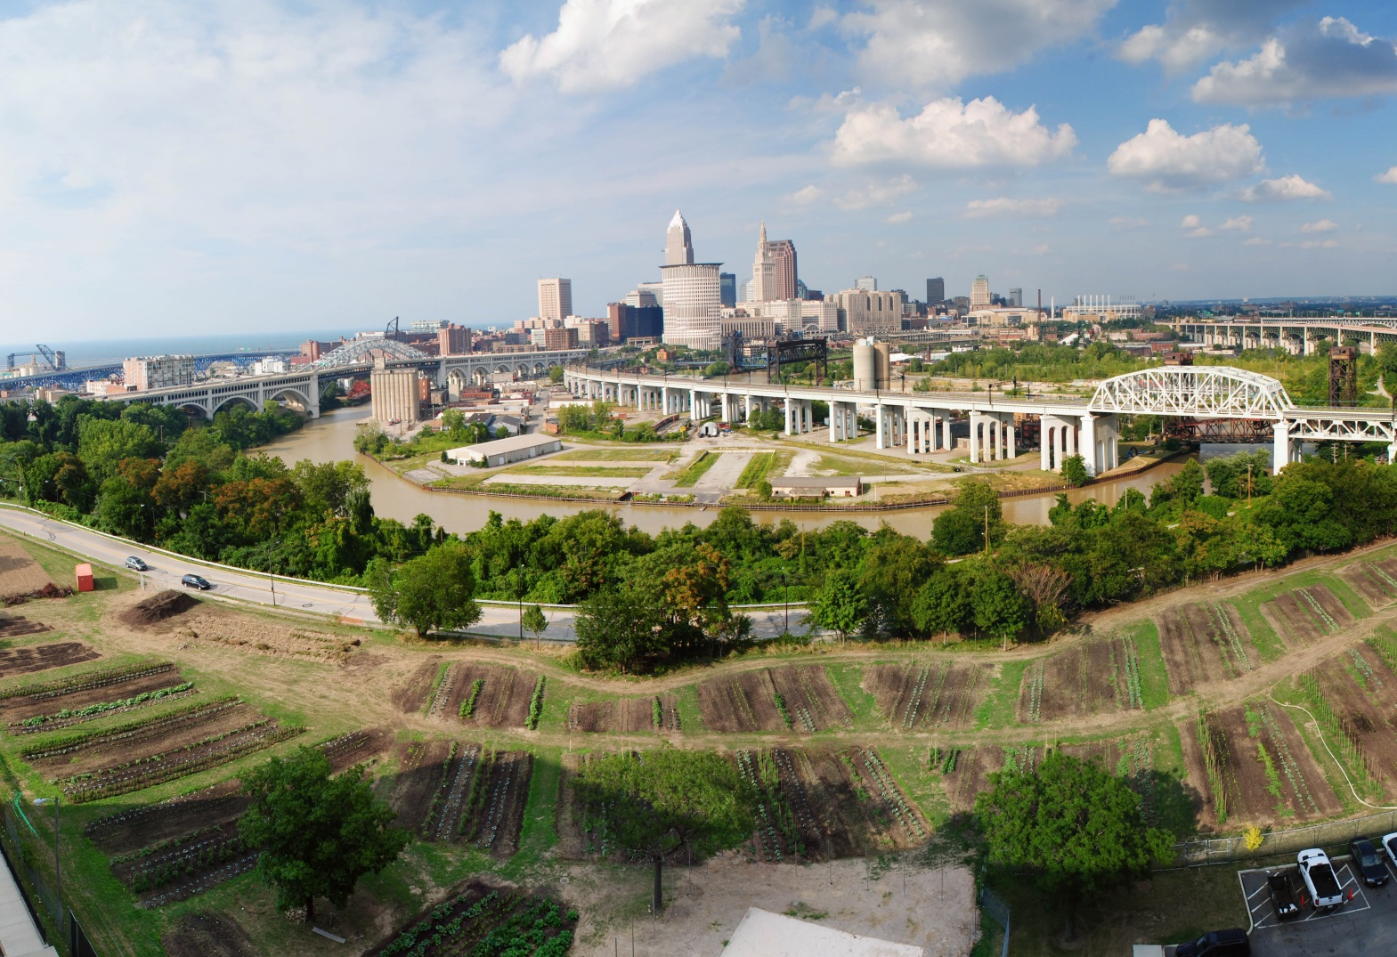
Thanks to Case Western Reserve!
Photo Credit: Tim Thompson
Notes:
Also want to recognize our local partners at the Poverty Center., April, Claudia, Mike and Melissa Van

Slide 5

Thank you to our local sponsors!
Notes:
A special thanks to Leon Wilson and the Cleveland Foundation who made the tours possible and sponsored speaker travel and attendance of local guests.
Also thanks goes to Lisa Nelson and NNIP Alumni and the Federal Reserve Bank of Cleveland for hosting tonight's reception.

Slide 6
NNIP Leadership:
Guiding the Agenda
Executive Committee 2016
Mark Abraham, New Haven
Bob Gradeck, Pittsburgh
Sheila Martin, Portland
Jeff Matson, Minneapolis
Laura McKieran, San Antonio
April Urban, Cleveland
Recent Members, 2012-15
Eleanor Tutt, St. Louis
Max Weselcouch, NYC
Todd Clausen, Milwaukee
Kurt Metzger, Detroit
Notes:
[Don’t read all the names] Would the Exec Comm please stand…. These are your representatives – they meet with us monthly and helped a lot with putting the program together.
Tom Kingsley, Leah and I are also part of the Executive Committee.
PLUG for running

Slide 7
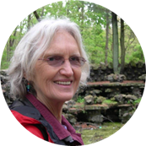

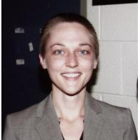
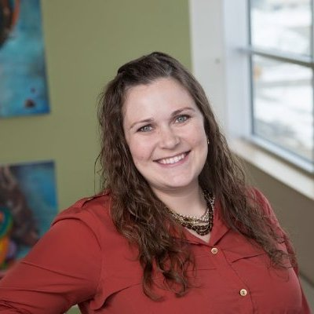

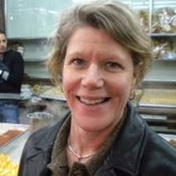
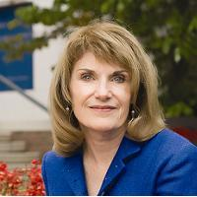
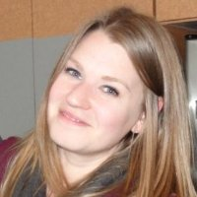
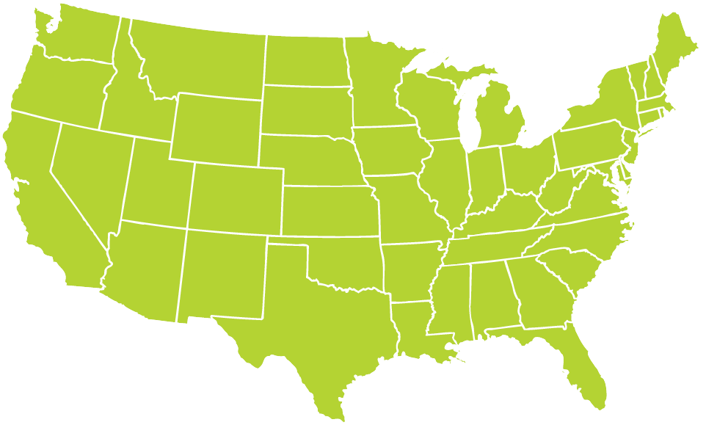
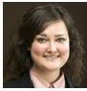

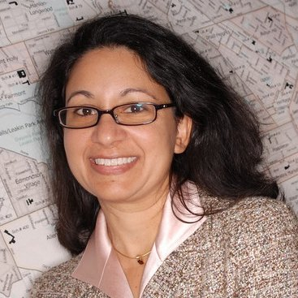
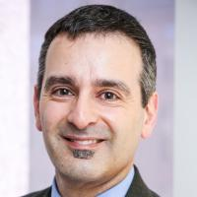

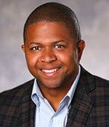
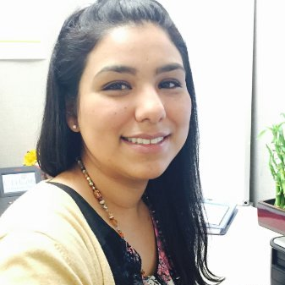
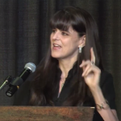
Thanks to Partner Speakers
Notes:
Missing Davin Reed
Our lives are made easier and the wealth of expertise in the network and generosity of sharing. Here’s the partners that you’ll hear from over the next 3 days.
Encourage you to thank them in person while we’re together
Particularly Jason from Portland, John from StL, Davin from NYU, Nina from Cleveland – presenting on their first time to the meeting.

Slide 8
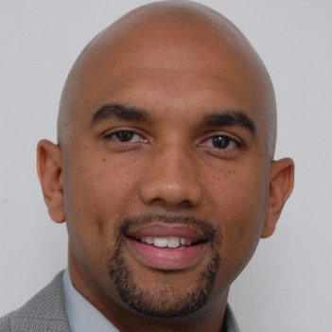
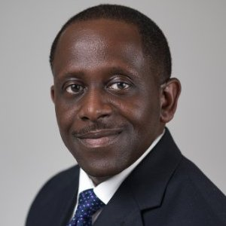
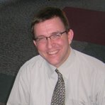
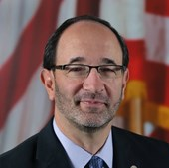
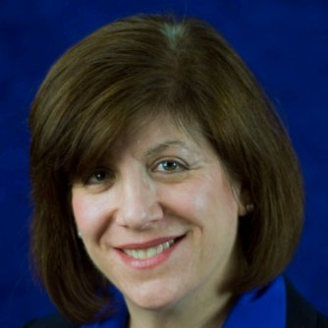
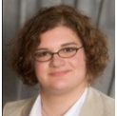
Thanks to Cleveland Speakers
Mark Joseph,
Case Western Reserve University
Leon Wilson, Cleveland Foundation
Rob Fischer,
Case Western Reserve University
Tony Brancatelli, Cleveland City Council
Rebekah Dorman, Cuyahoga County, Office of Early Childhood
Merissa Piazza,
Cleveland State University
Notes:
Another part of NNIP’s value is bringing outside expertise to the network.
This afternoon – lucky to hear about the great work in San Antonio– all listed in your agenda
Our Urban Institute colleague Kilolo Kijakazi and MaTEEas Valenzuela will be here later from King County to help us on the equity panel
Charlie and Spencer will be doing Ignites
And be sure to thank your tour guides for tonight.

Slide 9
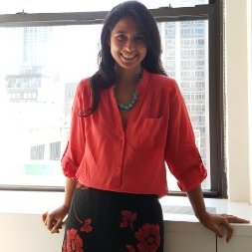
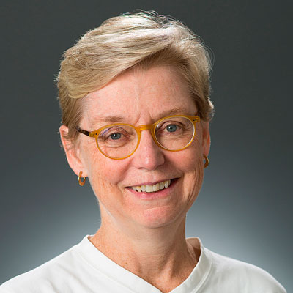

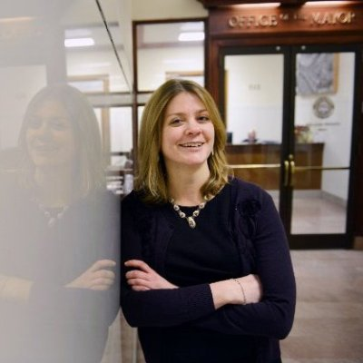
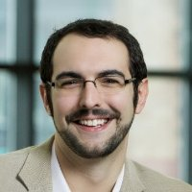

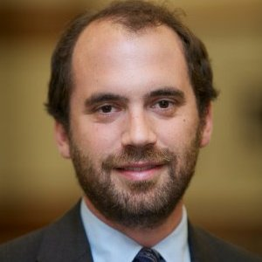

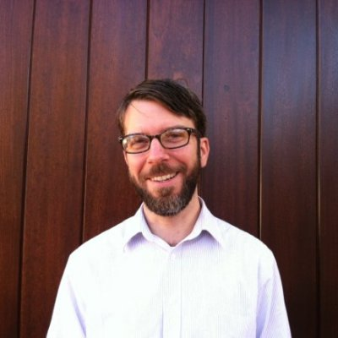
Thanks to Guest Speakers
Elizabeth Reynoso, Living Cities Foundation
Cindy Guy,
Annie E. Casey Foundation
Nate Ron-Ferguson, University of Memphis
Laura Meixell,
City of Pittsburgh
Matt Richardson, Data You Can Use
Joy Bonaguro, City and County of San Francisco
Geoff Smith,
DePaul University
Jacob Wascalus
Federal Reserve Bank
of Minneapolis
John Killeen,
City of Durham
Notes:
Another part of NNIP’s value is bringing outside expertise to the network.
This afternoon – lucky to hear about the great work in San Antonio– all listed in your agenda
Our Urban Institute colleague Kilolo Kijakazi and MaTEEas Valenzuela will be here later from King County to help us on the equity panel
Charlie and Spencer will be doing Ignites
And be sure to thank your tour guides for tonight.

Slide 10
Welcome Guest Cities!
Chicago, IL
Durham, NC
Houston, TX
Newark, NJ
Los Angeles, CA
Memphis, TN
Philadelphia, PA
South Bend, IN
Notes:
Part of the network’s mission is to foster NNIP capacities in new cities – welcome them – answer questions - ask about their work….

Slide 11
Welcome National Organizations!
AcademyHealth
Ash Center at Harvard Kennedy School
Code for America
Federal Reserve Banks of Cleveland, Minneapolis, and Richmond
Ford Foundation
Forum for Youth Investment
Living Cities
MetroLab Network
Illinois Public Health Institute
Sunlight Foundation
Notes:
Finally, welcome to friends from national organizations – LC/Cfa - some are partners on our cross-site projects
Several chances to exchange ideas with them through panels and Camp sessions. Please welcome them at meals and reception.

Slide 12
Introductions
Notes:
Move to introductions – large group so keep it short
Name, org, and favorite indicator or data set

Slide 13
Agenda Review
Leah Hendey
Notes:
Mention code of conduct somewhere? LEAH TO UPDATE
Note availability of app with the overall schedule
Stay up to date on new NNIPCamp unconference sessions
Post announcements to all meeting attendees
Post crowd pictures during (and after) each day’s events
Answer daily polls
Walk through what is in the packet - Note framing pages and participant list
Break out rooms logistics
Tours – FIND OUT mobility requirements
Reception: If you are arriving late Wednesday afternoon, we will be departing for the neighborhood bus tour at 4:15 pm from the lobby, which will run until 6:00. The evening reception will be held from 6:00 – 8:00 p.m. at xxx. If you want to meet us there, you should take a short taxi or Uber from the hotel (there’s not a traffic-safe walking route).
KP add: We’ve left a list at the Fed Res of all registered participants. If you have a spouse or other guest with you that you’d like to bring, please let us know right away.
Light reception – expect people to go out afterwards [Is this true?] Point to restaurant list.
How to get back – Taxi/Uber? OR do we have buses?
NNIPHQ staff - please stand up – we’re here to make your next 3 days go smoothly , so just let us know if you need anything.

Slide 14
NNIPCamp San Antonio
Maia Woluchem

Slide 15
What is an unconference?
Informal gathering of collaborators
Participants set the agenda
Focused on discussion
Notes:
Go over schedule/timing
Rules are posted everywhere…
UNCONFERENCE 101 – Sunlight Foundation
https://www.youtube.com/watch?v=iUEt0xOysr4

Slide 16
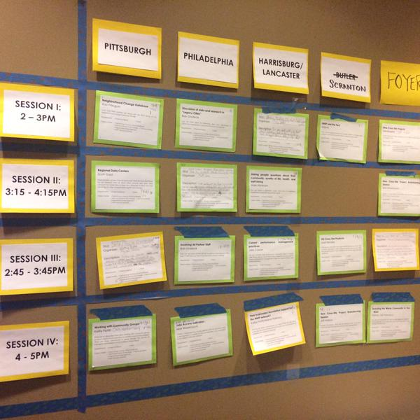
Together we build the wall
Submit an idea
Vote on your favorites
Volunteer to lead if necessary
On Wednesday and Thursday we build our wall
Check the app and #nnip for the schedule

Slide 17
Voting?
Virtual wall v. Physical wall – how does voting work?
Votes from home helped us prime the pump and identify early topics of interest
Votes on-site are critical so we can make final choices
Make sure to visit the wall today and tomorrow and vote to help finalize camp sessions

Slide 18
NNIPCamp Rules
Set your own agenda.
Introduce yourself.
Assign a note-taker.
Avoid planned speeches & PPTs.
Contribute & allow other to contribute.
Tweet!
COME AND GO AS YOU PLEASE.
Notes:
Go over schedule/timing
Rules are posted everywhere…
UNCONFERENCE 101 – Sunlight Foundation
https://www.youtube.com/watch?v=iUEt0xOysr4

Slide 19
Most Importantly
Be creative
Hallway conversations count
Have fun!

Slide 20
Welcome to the
#NNIP Cleveland Meeting!
September 14, 2016

