Slide 1
Fare Choices Ride hailing trends in Metro Boston
NNIP Los Angeles, October 17, 2018
Jessie Partridge Guerrero
Research Manager
Metropolitan Area Planning Council

Slide 2
Challenge
How can we measure the impact of ride- hailing in Metro Boston without any publicly available data?

Slide 3
Goals of our research
Understand impact of ride-hailing on residents, commuters, and transportation systems
Inform regional travel demand modeling and forecasting methods
Improve traffic management and operations
Develop policy responses
Notes:
Summer 2016 – national attention to the impacts of ride hailing
Inform regional travel demand modeling and forecasting methods
Who uses ride-hailing services and what are the main reasons for adoption?
Can we predict the growth in this adoption of on-demand mobility options?
Understand impacts to the transportation system
What are the impacts of ride-hailing services on traffic congestion and transit ridership?
How are ride-hailing services contributing to auto ownership, vehicle miles traveled, and parking demand?
Improve traffic management and operations
Where should public agencies be designating ride-hailing pick-up and drop-off locations?
Can ride-hailing data help inform traffic signal timing, lane management, or congestion pricing?

Slide 4
Efforts to procure data
x
Strategy 1: Inquire ride-hailing companies directly ……………………….................
Strategy 2: Inquire ride-hailing drivers directly ……………………………...................
Strategy 3: Acquire trip-level data from a driver reporting app …………...............
Strategy 4: Acquire ‘big data’ source from Northeastern University ……………….
Strategy 5: Collect ride-hailing passenger survey …………………………….............
Strategy 6: Utilize legislatively-mandated data reporting …………………..............
x
?
?


Notes:
Alejandro Henao PhD student at University of Denver, Jan 2017

Slide 5
Fare Choices
Fare Choices Report
www.mapc.org/farechoices
Authors
Steven R. Gehrke
Alison Felix
Timothy Reardon
Additional Contributors
Jessie Partridge Guerrero
Eric Bourassa

Slide 6
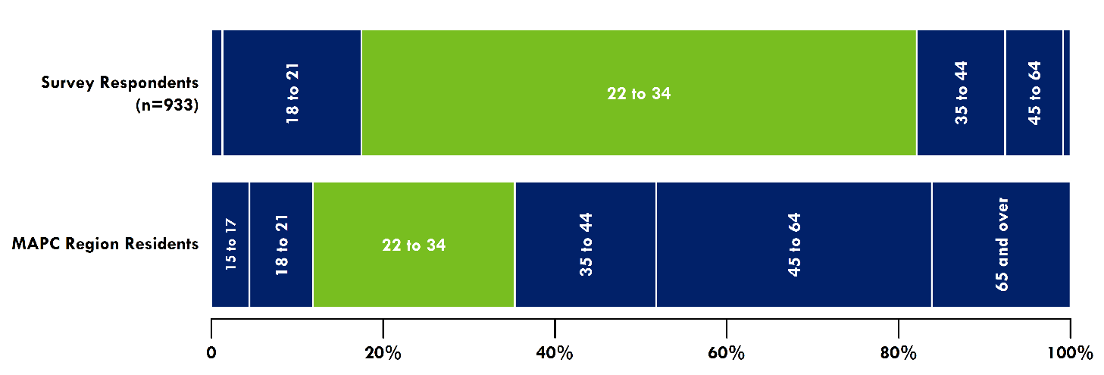
Fare Choices Key Findings
82% of ride-hailing passengers were born after 1983.

Slide 7
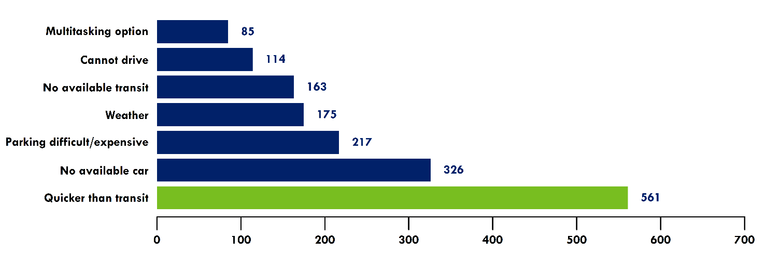
Fare Choices Key Findings
73% of passengers who substituted transit use for ride-hailing stated “quicker than transit” as a main reason.

Slide 8
Fare Choices Conclusions
Main findings
Demographics suggest quick adoption and raise concerns of habit development.
Substitution of more sustainable modes is worsening regional roadway congestion.
Individuals in lower-income households see ride-hailing as a viable alternative to transit.
Individuals without nearby rapid transit service are adopting these services for travel to/from home.
Policy implications
Adjustments to increase the legislatively-mandated $0.20 ride assessment are needed.
$0.20 per ride surcharge through 2027, with $0.10 provided to muni where trip originates.
Our report estimated a revenue loss of $0.35 per ride-hailing trip for MBTA.
Improved provisions and protocols for data sharing agreements with public agencies are needed.

Slide 9
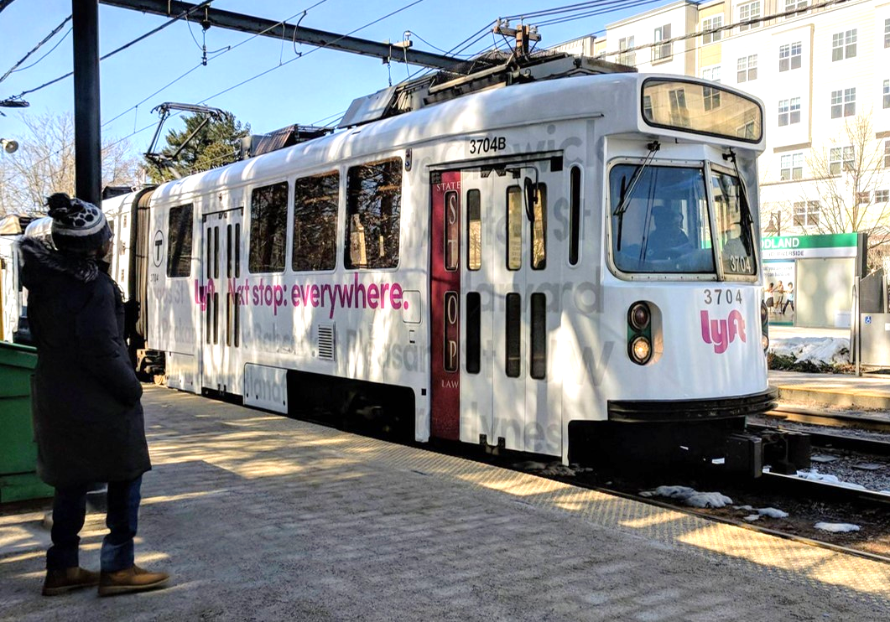
Share of Choices
Fare Choices Report
www.mapc.org/farechoices
Authors
Steven R. Gehrke
Timothy Reardon
Additional Contributors
Alison Felix
Elizabeth Weyant
Elise Harmon
Amanda Linehan

Slide 10
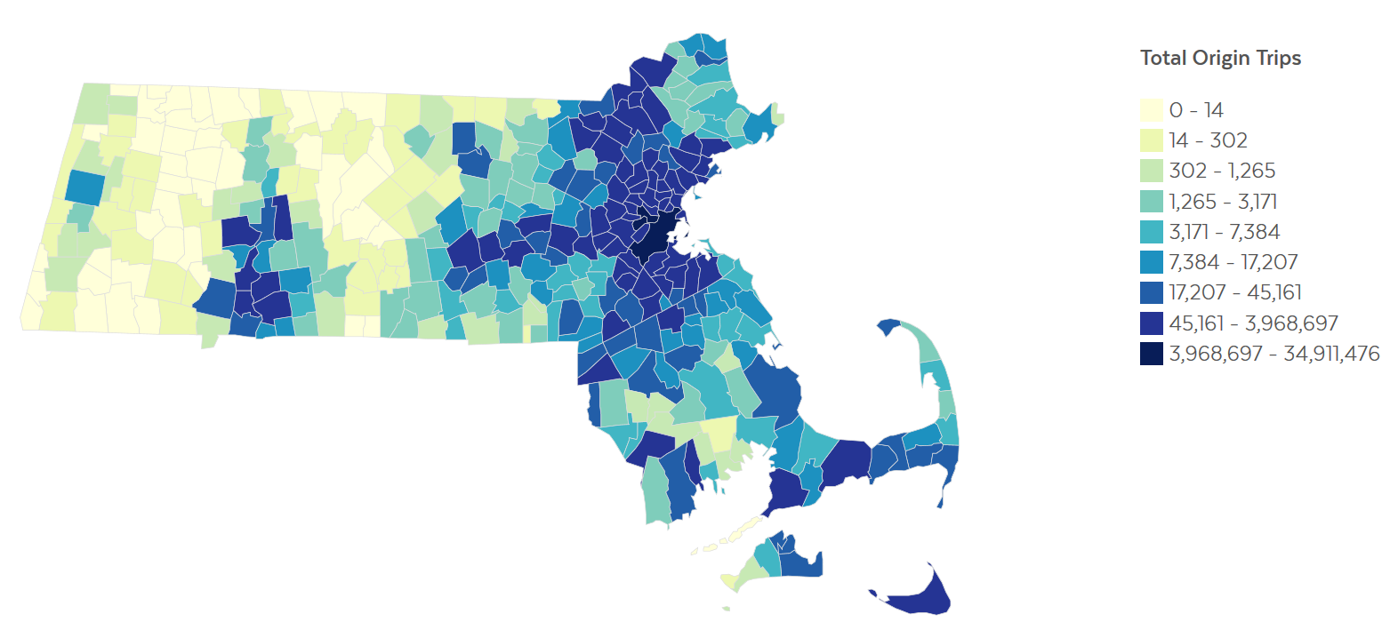
Share of Choices Key Findings
Notes:
In August 2016, Governor Baker signed legislation related to ride-hailing companies
Companies must report to Dept. of Public Utilities (DPU) in regard to certification and driver oversight.
Part of legislation allowed state to begin collecting ride-hailing data on January 1, 2017.
Annual data on municipal-level trip counts, aggregated trip route/length, and crash sites.
Data were publicly released on May 1, 2018 ª
In 2017, there were approximately 64.8 million ride-hailing trips that started in Massachusetts.
For context, more than 408 million public transit trips were taken in the Commonwealth last year.
Over 34.9 million ride-hailing trips began in Boston, with another 6.7 million starting in Cambridge.
Average ride-hailing ride in Massachusetts lasted 15.4 minutes and traveled 4.5 miles at 17.7 mph.

Slide 11
Share of Choices Conclusions
Main Findings
In Boston, we estimate that nearly one in every 25 trips is performed using ride-hailing services.
In region’s Inner Core, at least one ride-hailing trip is conducted for every five public transit trips.
Impact on Revenue and Funds
In 2017, we estimate the net revenue impact of ride-hailing to MBTA as a loss of about $16.5 million.
The 20 Inner Core municipalities will receive about $5.5 million from $0.10 ride assessment.
In 2019, communities will receive $34.8 million for roadway capital improvement projects.
Per-ride surcharge provides welcome new revenue, but remains a relatively small amount.
Impact on VMT
In Massachusetts, ride-hailing accounted for 291 million miles of passenger travel in 2017.
Statewide, ride-hailing travel accounted for just over half a percent of all passenger VMT.
Notes:
In August 2016, Governor Baker signed legislation related to ride-hailing companies
Companies must report to Dept. of Public Utilities (DPU) in regard to certification and driver oversight.
Part of legislation allowed state to begin collecting ride-hailing data on January 1, 2017.
Annual data on municipal-level trip counts, aggregated trip route/length, and crash sites.
Data were publicly released on May 1, 2018 ª
In 2017, there were approximately 64.8 million ride-hailing trips that started in Massachusetts.
For context, more than 408 million public transit trips were taken in the Commonwealth last year.
Over 34.9 million ride-hailing trips began in Boston, with another 6.7 million starting in Cambridge.
Average ride-hailing ride in Massachusetts lasted 15.4 minutes and traveled 4.5 miles at 17.7 mph.

Slide 12
Implications on Transportation System Now and into the Future
Ride-hailing has become a viable travel option as well as competing alternative to public transit.
42-percent of surveyed passengers substituted public transit use with ride-hailing services.
Ratio of ride-hailing-to-public transit mode shares highest in areas without rapid transit service.
Ride-hailing adoption and utilization is largely led by millennials and urban residents.
80-percent of surveyed passengers were under 35 years of age.
84-percent of ride-hailing trips in Massachusetts took place in 20 Inner Core communities.

Slide 13
Next Steps
Greater insight needed into ride-hailing trip distribution, travel patterns, and routes.
Available data sets do not track trips from origin to destination.
Data valuable for understanding impact on transportation system and traffic operations.
Build evidence base on ride-hailing adoption to plan for automated vehicle fleet introduction.

Slide 14
Thanks!
Jessie Partridge Guerrero, Research Manager
Metropolitan Area Planning Council
jpartridge@mapc.org

