Slide 1
Denver regional equity atlas impacts on access to transportation
NNIP Fall Meeting 2018
Los Angeles, CA

Slide 2


Outline
1.
Quick REA History
2.
Case Study on Westwood Neighborhood
3.
Ripple to New Affordable Housing

Slide 3
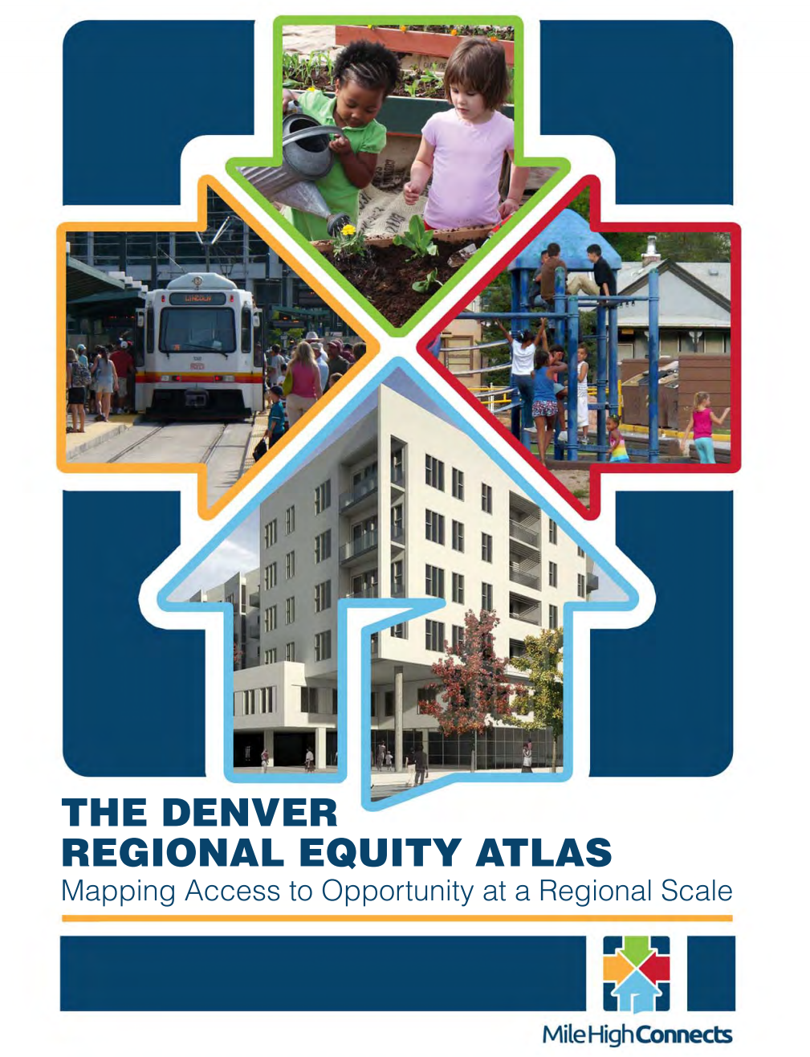
Denver Regional Equity Atlas 1.0
The static version
Released April 2012
Showcase geographic interrelationship between:
Transportation
Housing
Jobs
Education
Health
Highlight social equity disparities
Tell the story – but static

Slide 4
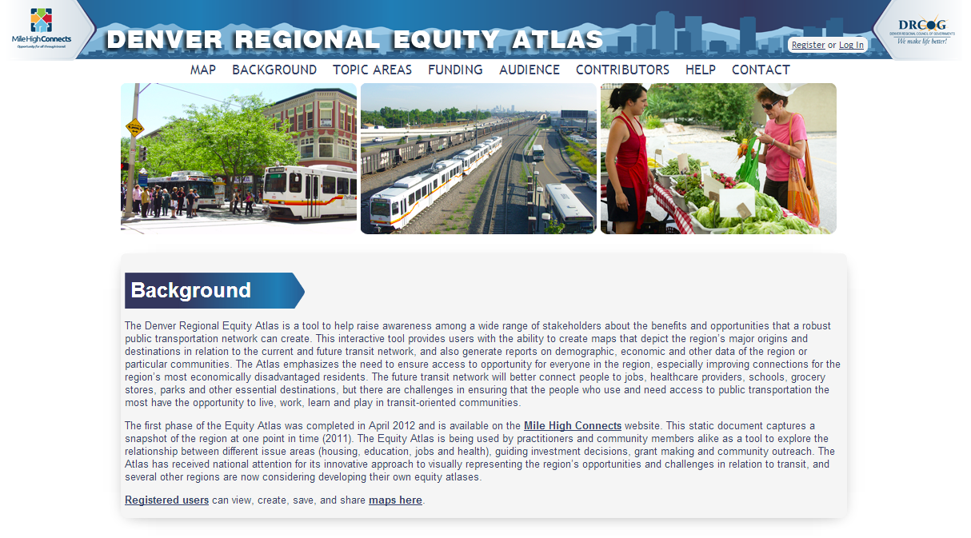
Denver Regional Equity Atlas 2.0
The interactive version

Slide 5
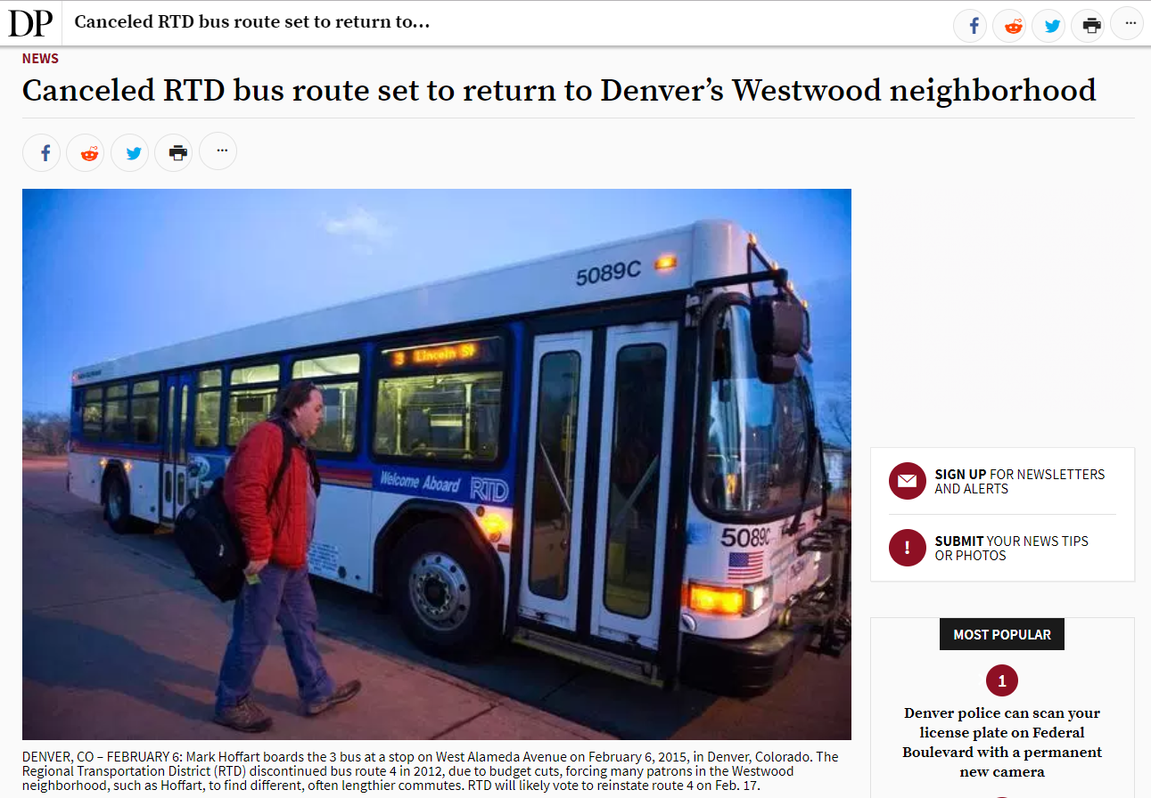
Westwood Neighborhood Impact
Critical transportation service provides access to opportunity

Slide 6
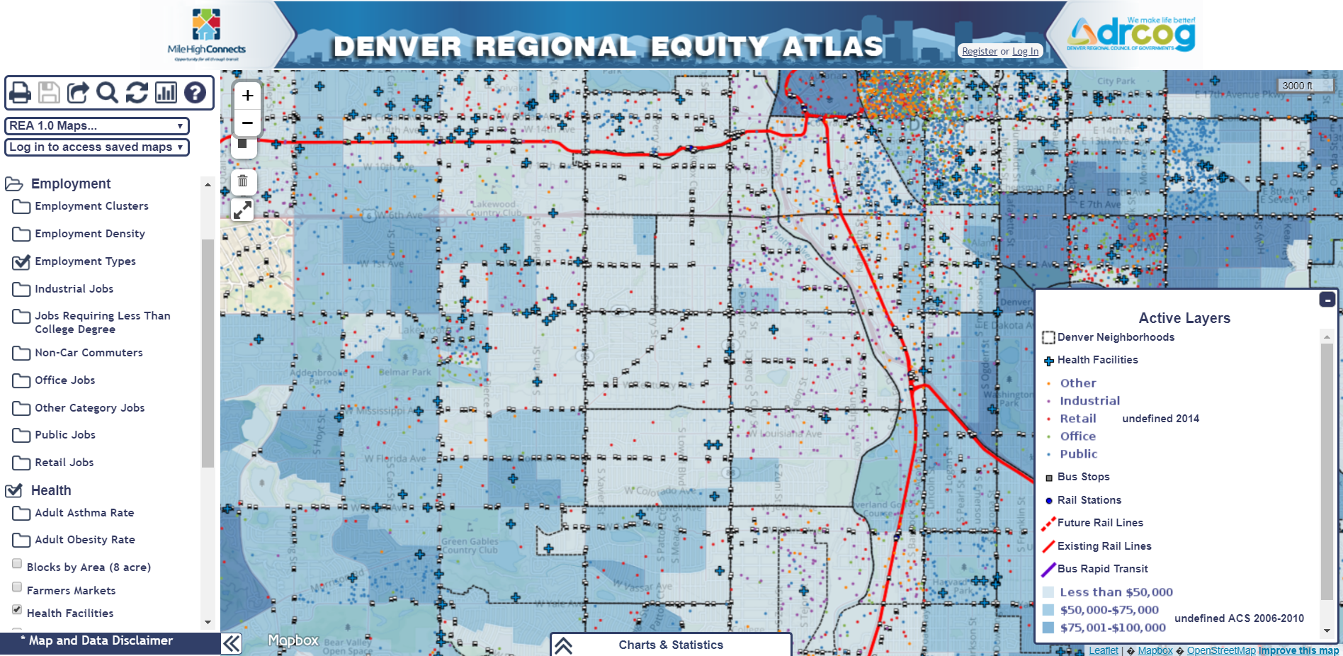
How Did Westwood Get Their Bus Service Back?
Data and Storytelling
17,000 Residents
81% Hispanic
Majority <60%AMI
Stories highlighted
need to access:
Jobs
Health Facilities

Slide 7
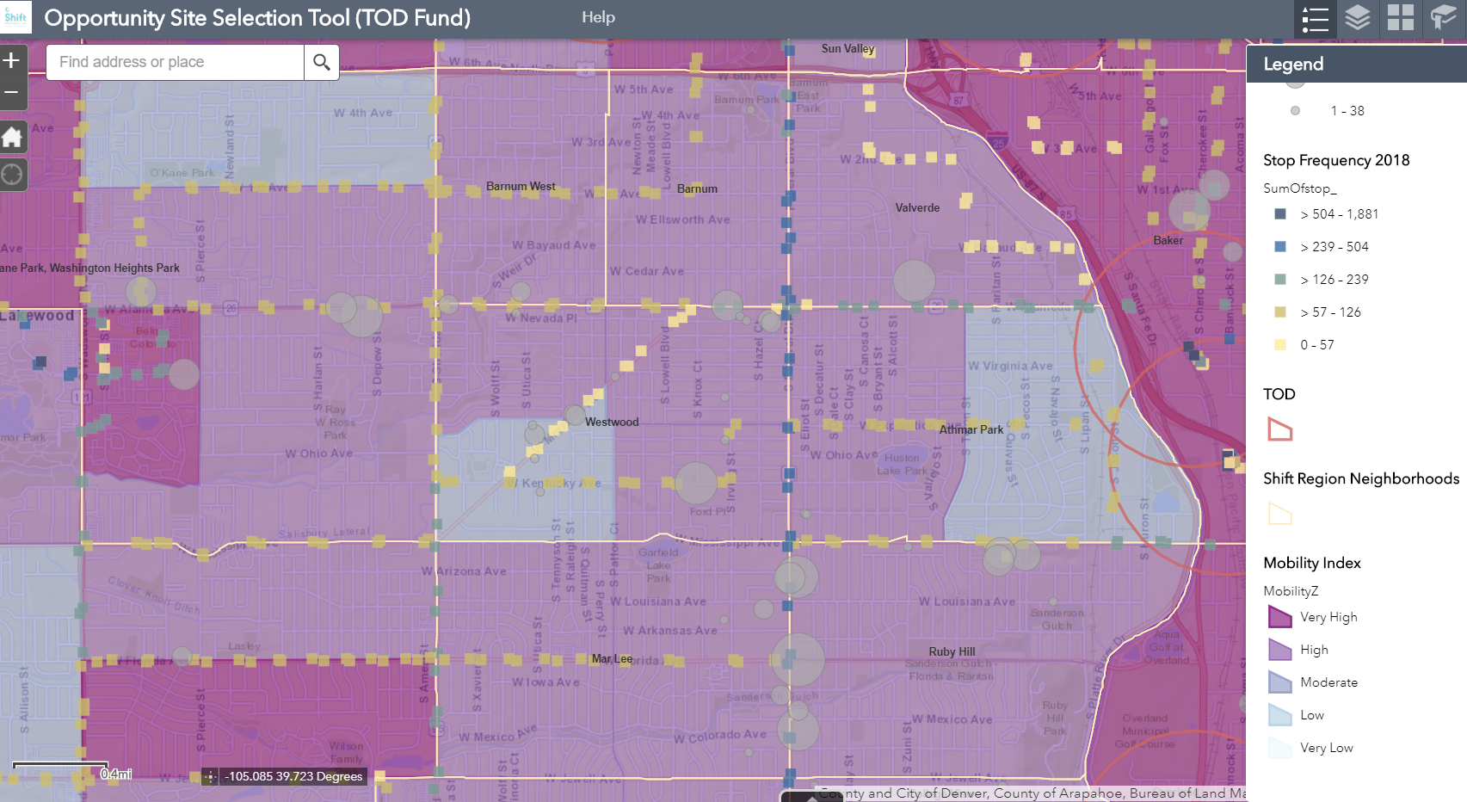
Interrelationship of H+T
Influence on new affordable development
Reinstating route:
Kept fragile mobility index

Slide 8
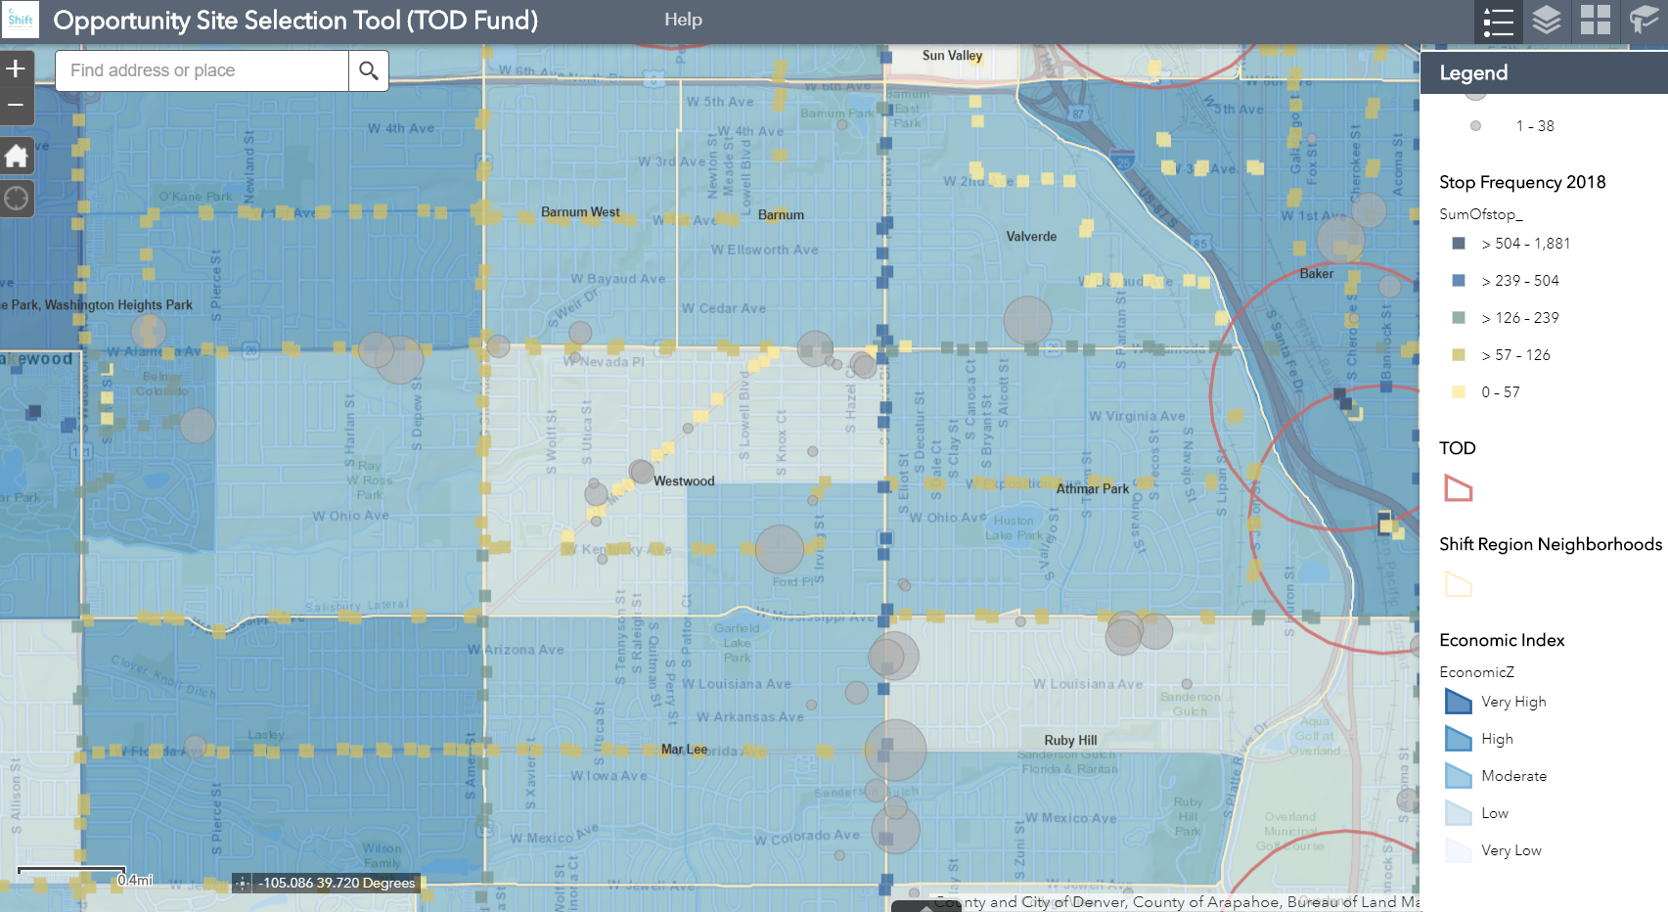
Interrelationship of H+T
Influence on new affordable development
Reinstating route:
Kept fragile mobility index
Lured TOD Fund award
42 units 30-60% AMI

Slide 9
Upcoming Work
Rea 3.0
A Health Equity SDOH Platform
      Will support the rebuilding of the Denver Regional Equity Atlas
      Timeline: 2019 discovery and development – 2020 launch
Key Differences?
Integrating stories and narrative back that were lost from the 1.0 version
Activating a broader base (beyond MHC) to hopefully understand other facets of impact in communities

Slide 10






contact
Jennifer Newcomer
jnewcomer@garycommunity.org
303-454-3776
join our mailing list
Stay up to date on the latest from Shift Research Lab
follow us
for more information visit
SHIFTRESEARCHLAB.ORG

