Slide 1
Opioid Addiction Is a National Crisis… and the Crisis Is Twice as Bad in Massachusetts
NNIP Showcase Presentation
Luc Schuster, Director, Boston Indicators
May 9, 2018

Slide 3
Putting the scale of the opioid crisis in context:
Roughly the same number of opioid-related deaths in 2016 as HIV/AIDS deaths in 1995, the height of the epidemic.
More opioid-related deaths in 2016 than deaths from car crashes.
Driven by the opioid epidemic, Americans deaths from drug overdoses in 2016 were greater than American deaths fighting the entire Vietnam war.
The opioid crisis is one key reason that US life expectancy has fallen for the second year in a row. That last time life expectancy fell in back-to-back years was in 1962 and 1963, when influenza caused an unusual number of deaths.

Slide 6
Why has the problem been worsening in Massachusetts?
Unlikely suspects:
Economic conditions are related to opioid use, but likely aren’t driving the recent increase.
Doctor-prescribed opioids play a key role, but don’t explain why Massachusetts has an opioid-related death rate twice the national average.
Heroin also plays a key role, but not to a degree that is significantly different from other states.
Likely suspects:
Fentanyl is increasingly common, especially illicit fentanyl
There is likely a regional effect at play, with most New England states all having high opioid-related death rates.
Key Northeast drug trafficking routes run through Massachusetts.

Slide 7
Economic conditions are related to opioid use…
…but they likely aren’t driving the recent increase.
 | Opioid-Related Death Rate per 100,000 People from 2011-2015 | Unemployment rate, 2014
Fall River | 34.9 | 12.3%
Carver | 34.8 | 6.4%
Quincy | 32.7 | 6.8%
Everett | 32.6 | 7.2%
New Bedford | 32.2 | 10.3%
Boston | 15.2 | 8.0%
Leominster | 15.2 | 6.7%
Norwell | 15.2 | 5.7%
Wilmington | 15.2 | 6.9%
Easthampton | 15 | 7.3%
Westford | 1.8 | 4.0%
Needham | 1.4 | 5.1%
Wellesley | 1.4 | 5.4%
Concord | 1.1 | 3.2%
Sudbury | 1.1 | 4.1%
 | Difference in unemployment rate from 2009 to 2014
Fall river | -1.7%
Carver | -3.0%
Quincy | -2.1%
Everett | -3.2%
New Bedford | -0.7%
Boston | -2.2%
Leominster | -3.2%
Norwell | 0.0%
Wilmington | 1.1%
Easthampton | 0.8%
Westford | -2.1%
Needham | -0.2%
Wellesley | -1.0%
Concord | -1.1%
Sudbury | -1.5%

Slide 12
There’s likely a regional effect at play, with New England states having high opioid-related death rates.
Rank | State | Fentanyl-related death rate per 100,000 (age-adjusted)
1 | New Hampshire | 30.3
2 | West Virginia | 26.3
3 | Massachusetts | 23.5
4 | Ohio | 21.1
5 | District of Columbia | 19.2
6 | Maryland | 17.8
7 | Rhode Island | 17.8
8 | Maine | 17.3
9 | Connecticut | 14.8
10 | Kentucky | 11.5
11 | Pennsylvania | 10.9
12 | Vermont | 10.1
13 | Michigan | 9.8
14 | Delaware | 8.7
15 | Florida | 8.3

Slide 13
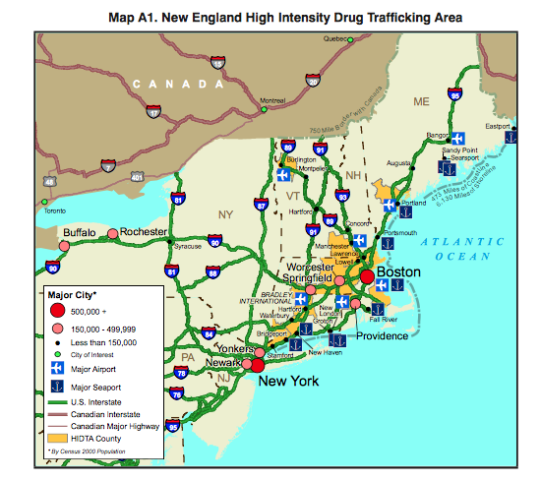
Key Northeast drug trafficking routes run through Massachusetts.

Slide 14
www.bostonindicators.org

