Slide 1

National Neighborhood Indicators Partnership:
An Update from Milwaukee
Data You Can Use
From People You Can Trust

Slide 2

NATIONAL NEIGHBORHOOD
INDICATORS PARTNERSHIP
DATA YOU CAN USE
YOU CAN TRUST
Notes:
Pleased to be here as a member
We are always happy to preserve a blue dot on the map
We are the newest member of NNIP
Milwaukee– Swallow the l
we are on the fresh coast
Sometimes people on the other coasts confuse us with other places that start with an M- not Minneapolis, Minnesota, Michigan
GRATEFUL for the pioneering work of Todd Clausen and Michael Barndt
And the work they did as the Data Center

Slide 3
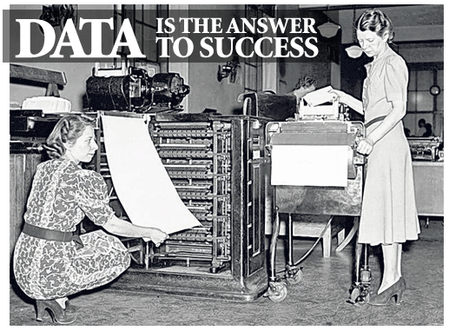
Notes:
50 year old organization with roots in the Planning Council movement. We have always believed that data is the answer to success, but we have some hard felt principles that temper that belief.

Slide 4
Connecting people who need data and people who have data
Government
Neighborhood organizations
Funders
Residents
Academics
Nonprofit
organizations
Dataphyles Unite!
Better Data.
Better Decisions.
Better Communities.

Slide 5












Human Assets
Core Team
Network

Slide 6









Partners
Notes:
Small but mighty staff – lifted by our affiliation with multiple partners
United Way, local foundations, school of public health, medical college of wisconsin–
Add milwaukee succeeds

Slide 7


Health data Users Group (HUG)
Designed by the group
Meets quarterly
Health and….
  Neighborhood Base
  Environment
  Public safety
  Lunch Sponsors
  DASH

Slide 8
Health data Users Group (HUG)
Designed by the group
Meets quarterly
Health and….
  Neighborhood Base
  Environment
  Public safety
  Lunch Sponsors
  DASH

Slide 9
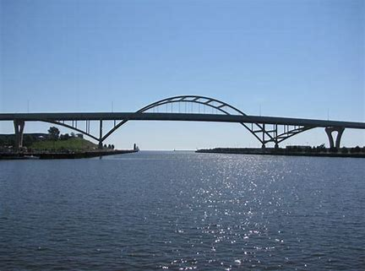
Beyond Market Value
NNIP Partners
AmericanPlanning Association
Change Lab
Federal Reserve Bank PCIT
RWJ 500 Cities
AARP Livability Index
Sales Price
Foreclosure
Single/Duplex Sales
Vacancy
New Construction
Owner Occupancy
Subsidized housing
Nonresidential land

Slide 10
Beyond Market Value
NNIP Partners
AmericanPlanning Association
Change Lab
Federal Reserve Bank PCIT
RWJ 500 Cities
AARP Livability Index
Sales Price
Foreclosure
Single/Duplex Sales
Vacancy
New Construction
Owner Occupancy
Subsidized housing
Nonresidential land

Slide 11
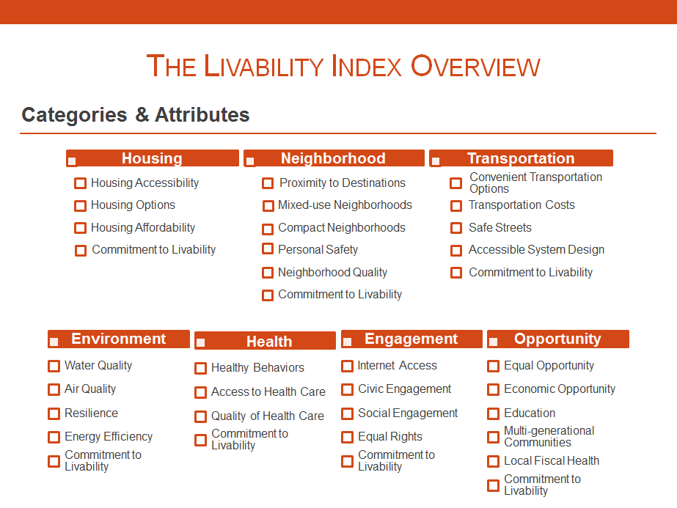


Slide 12
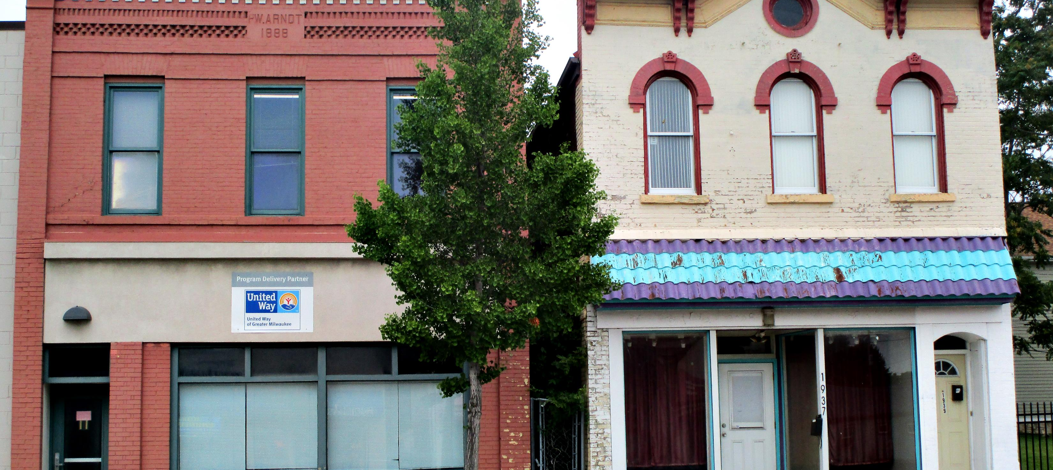
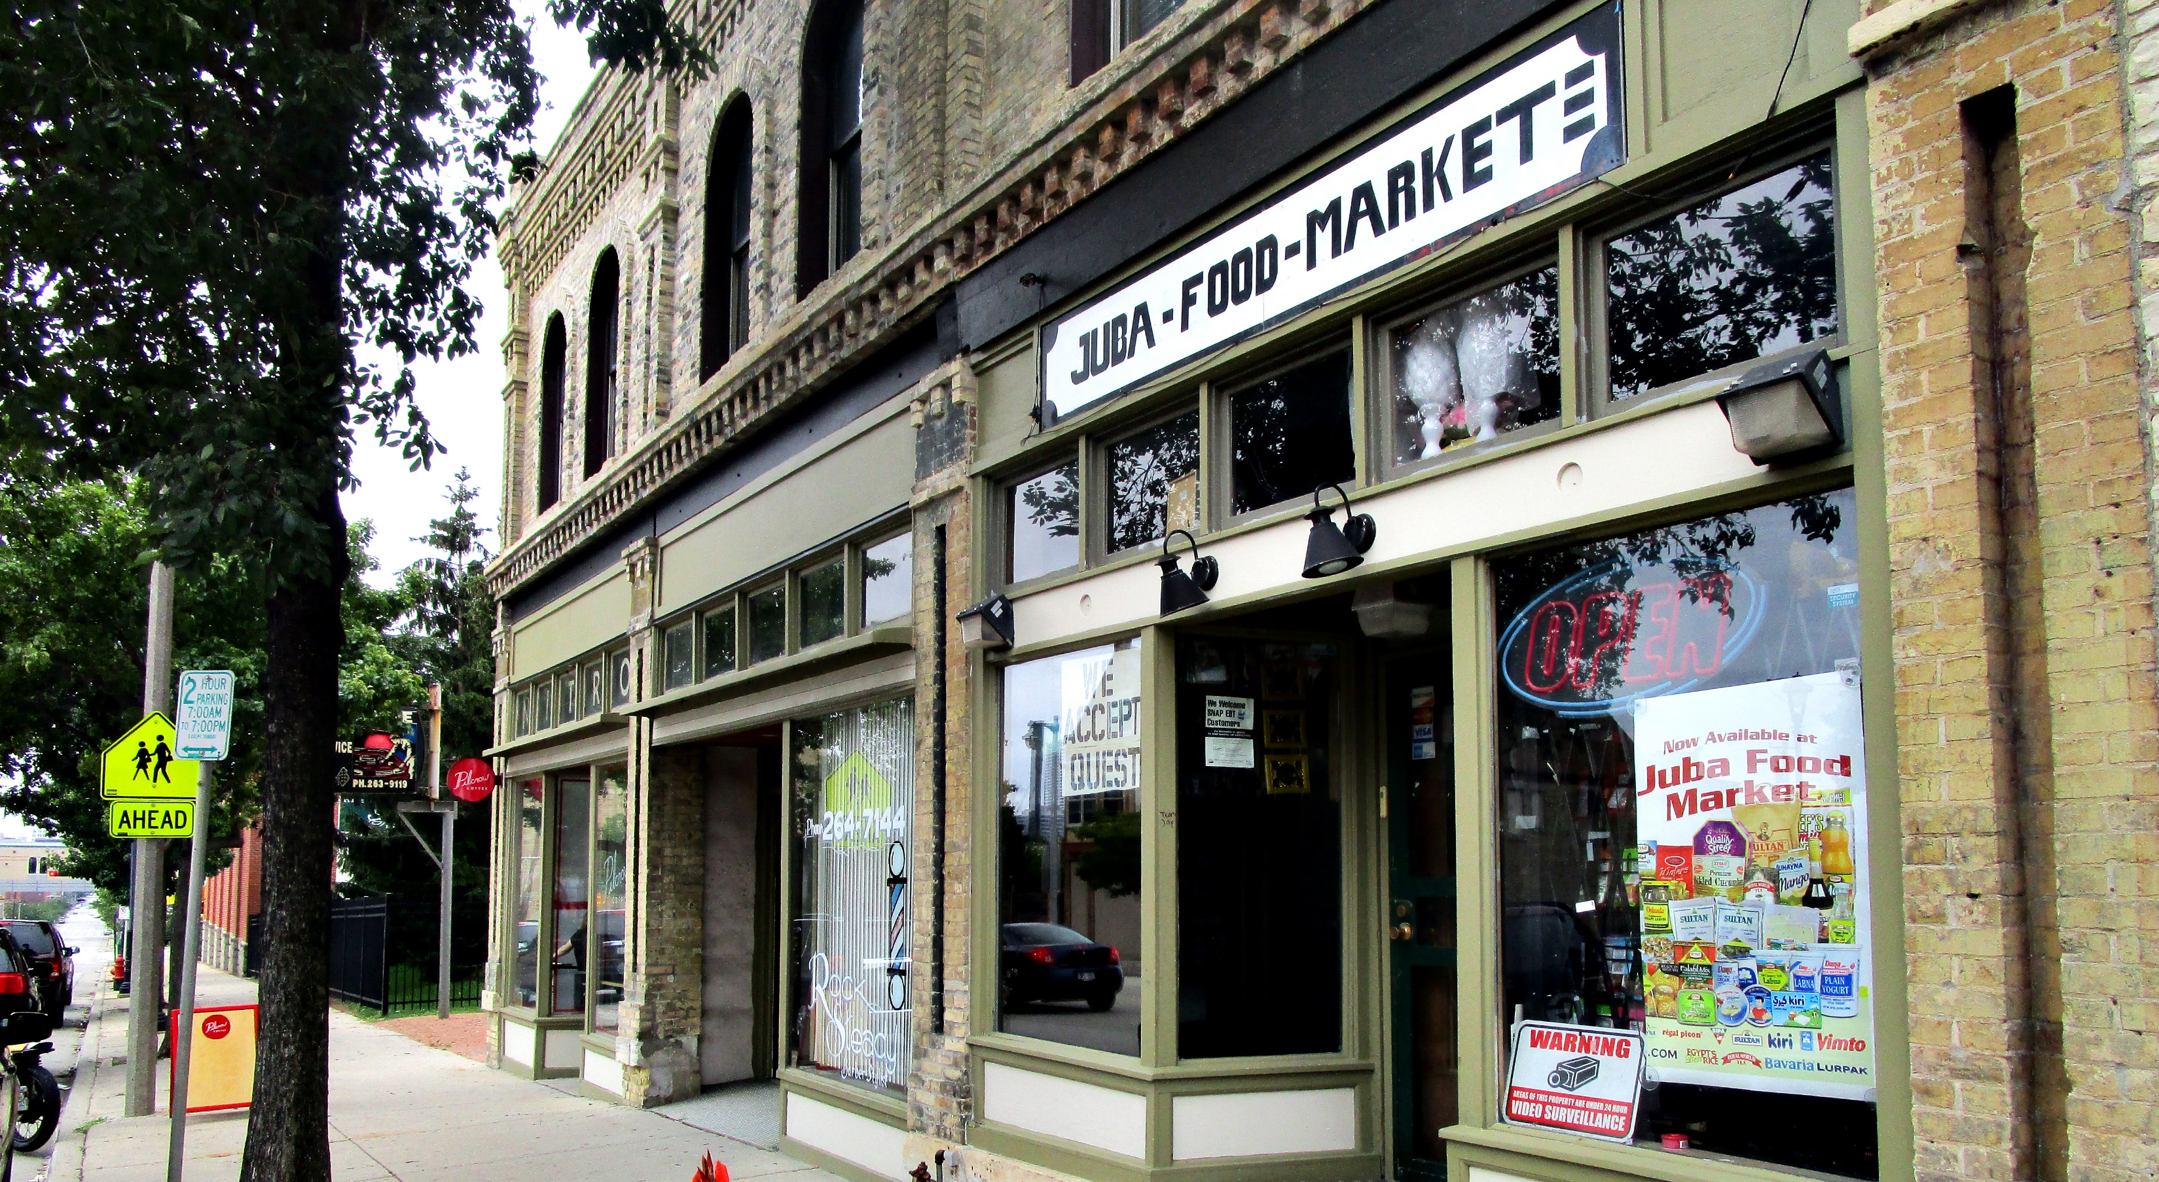
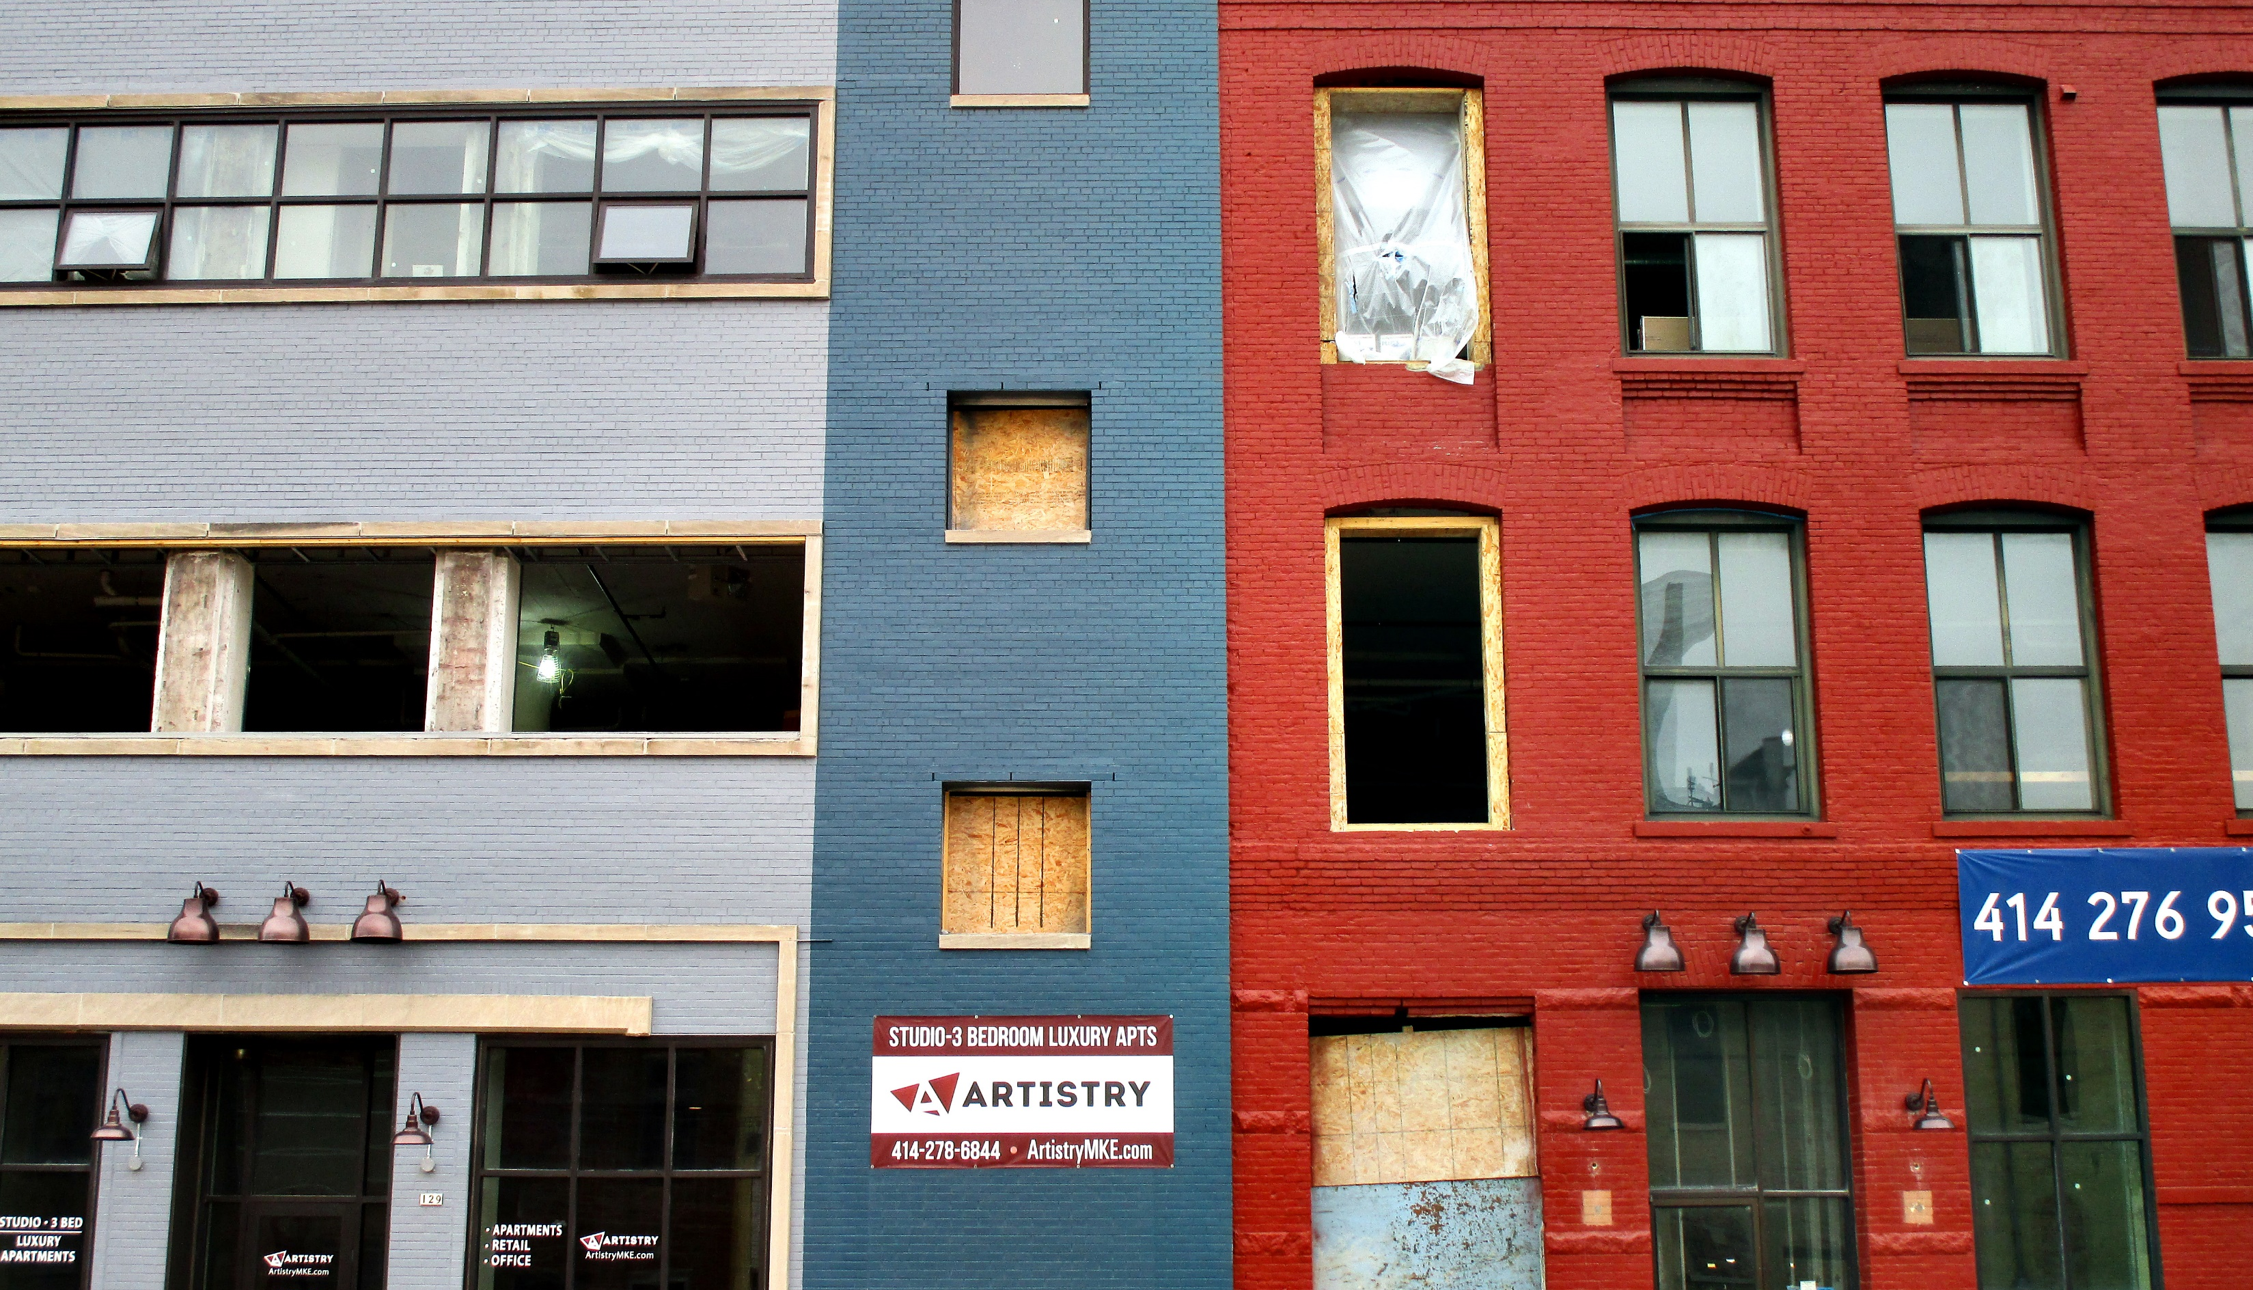
Turning the Corner
City TOD study
Downtown Development
Equitable growth
Anti Displacement Policy

Slide 13
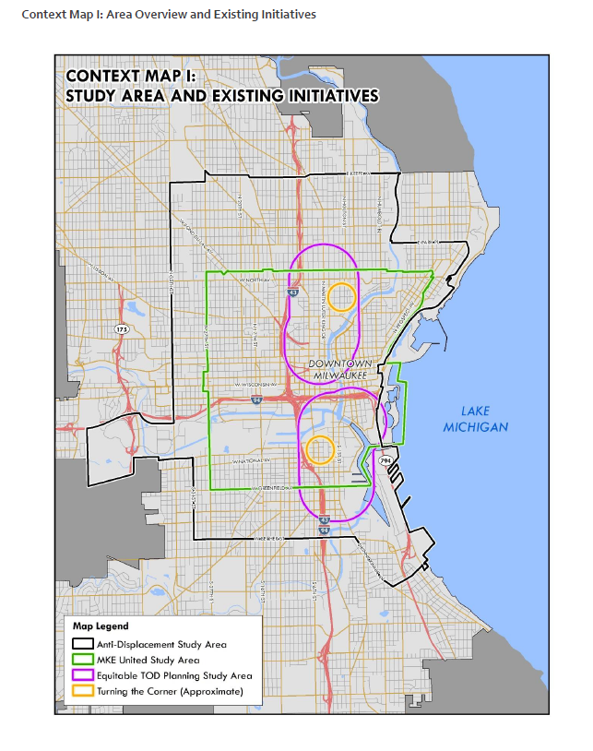
An Anti-Displacement Plan for Neighborhoods Surrounding Downtown Milwaukee, City of Milwaukee Department of City Development, February 2018
Opportunity/ Challenge of Partnership
Community Development Alliance
Opportunity/ Challenge of Partnership
Community Development Alliance

Slide 14


Slide 15

Hot Topics
Byrne (Community Based Crime Reduction)– resident lead surveys
Housing surveys across neighborhoods
Liquor License renewal maps
Sex Trafficking- measuring partnerships
Black lead organizations map
African American Fathers’ Health Literacy
Collective Impact
Theory of Change

Slide 16
Hot Topics
Byrne (Community Based Crime Reduction)– resident lead surveys
Housing surveys across neighborhoods
Liquor License renewal maps
Sex Trafficking- measuring partnerships
Black lead organizations map
African American Fathers’ Health Literacy
Collective Impact
Theory of Change

Slide 17
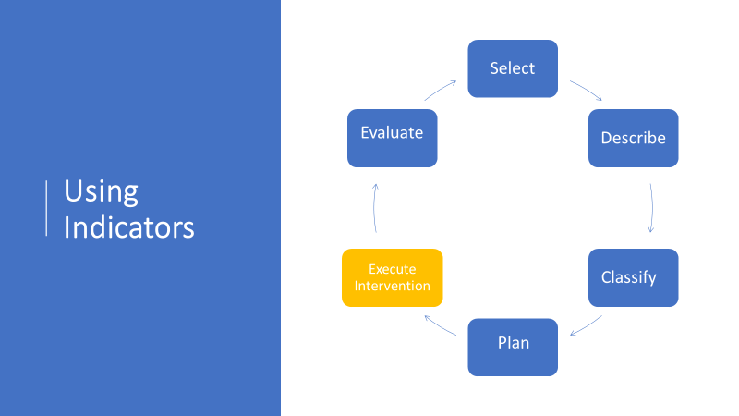




Using
Indicators

Slide 18

Data Day 2018
Theme Bright Spots
Ignites
Skill-Builder on City Portal
Panel on the Data Neighborhoods Want
Keynote on Data as Leadership Opportunity
Data Dream Contest

Slide 19
Data Day 2018
Theme Bright Spots
Ignites
Skill-Builder on City Portal
Panel on the Data Neighborhoods Want
Keynote on Data as Leadership Opportunity
Data Dream Contest

Slide 20


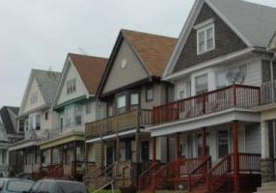

NNIP in MKE 2019
Notes:
From our lakefront to our Riverwalk to our neighborhoods to our nightlife, we are looking forward to hosting the June 2019 NNIP Meeting in Milwaukee.

