Slide 1

Durham, NC
NNIP Showcase, Atlanta May 2018 john Killeen and tim stallmann
Notes:
You've attended NNIP meetings before, so you know about Ignites, but as background, your presentation should be a rapid fire 5 minute presentation, with 15slides automatically advancing every 20 seconds. As an introduction tothe group, we would ask for:
1- 2 slides on who you are (and if desired anything that might stand out as more unique among NNIP partners)
Slides on 1 -2 interesting projects you want to share with the group
1 slide on future ideas/plans

Slide 2
DataWorks’ mission
is to democratize data to facilitate an empowered, productive, and equitable community.
We provide
quantitative indicators with qualitative values.
Our core partners
City of Durham
Durham County
Social Science Research Institute @ Duke University

Slide 3
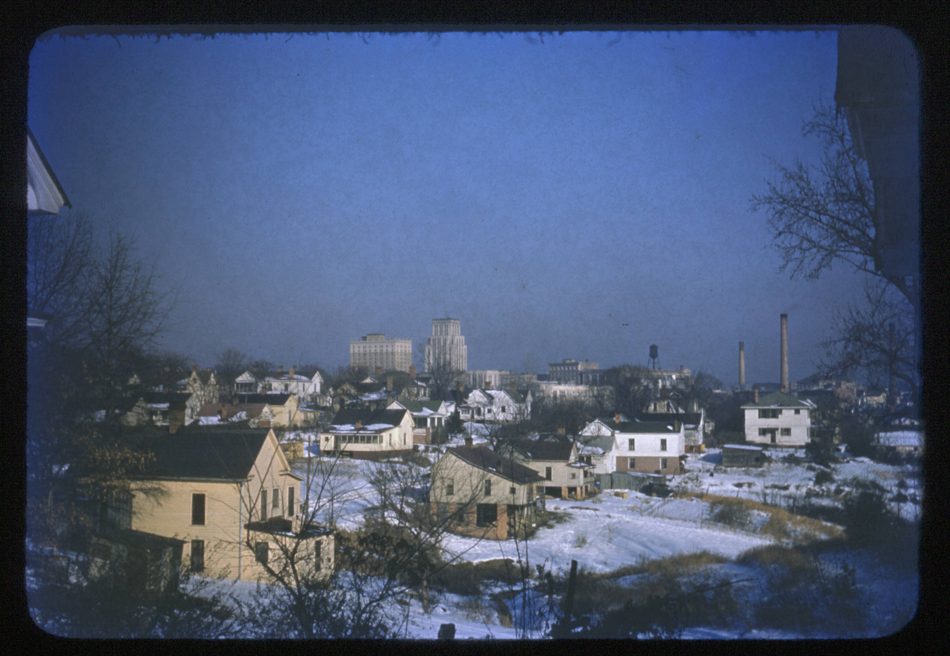
Some of the folks we work with…
Community Empowerment Fund
Birchwood Heights
Community Association
InterNeighborhood Council
DurhamCAN (Congregations, Associations, and Neighborhoods)
Triangle J Council of Governments
Partnership Effort for the Advancement of Children’s Health (PEACH)
Durham Human Relations Commission
Durham County Public Health
Image source: Durham County Library
Notes:
Community organizations/historical institutions/community development/universities

Slide 4
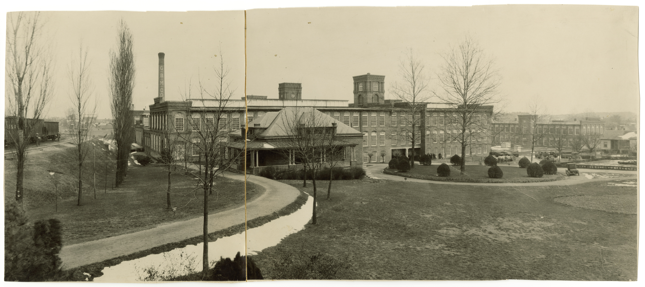
mill villages and industry
Image source: Digital Durham
Notes:
Cotton, textiles, tobacco - example Golden Belt, which linked these in producing cloth bags for Bull Durham tobacco.

Slide 5

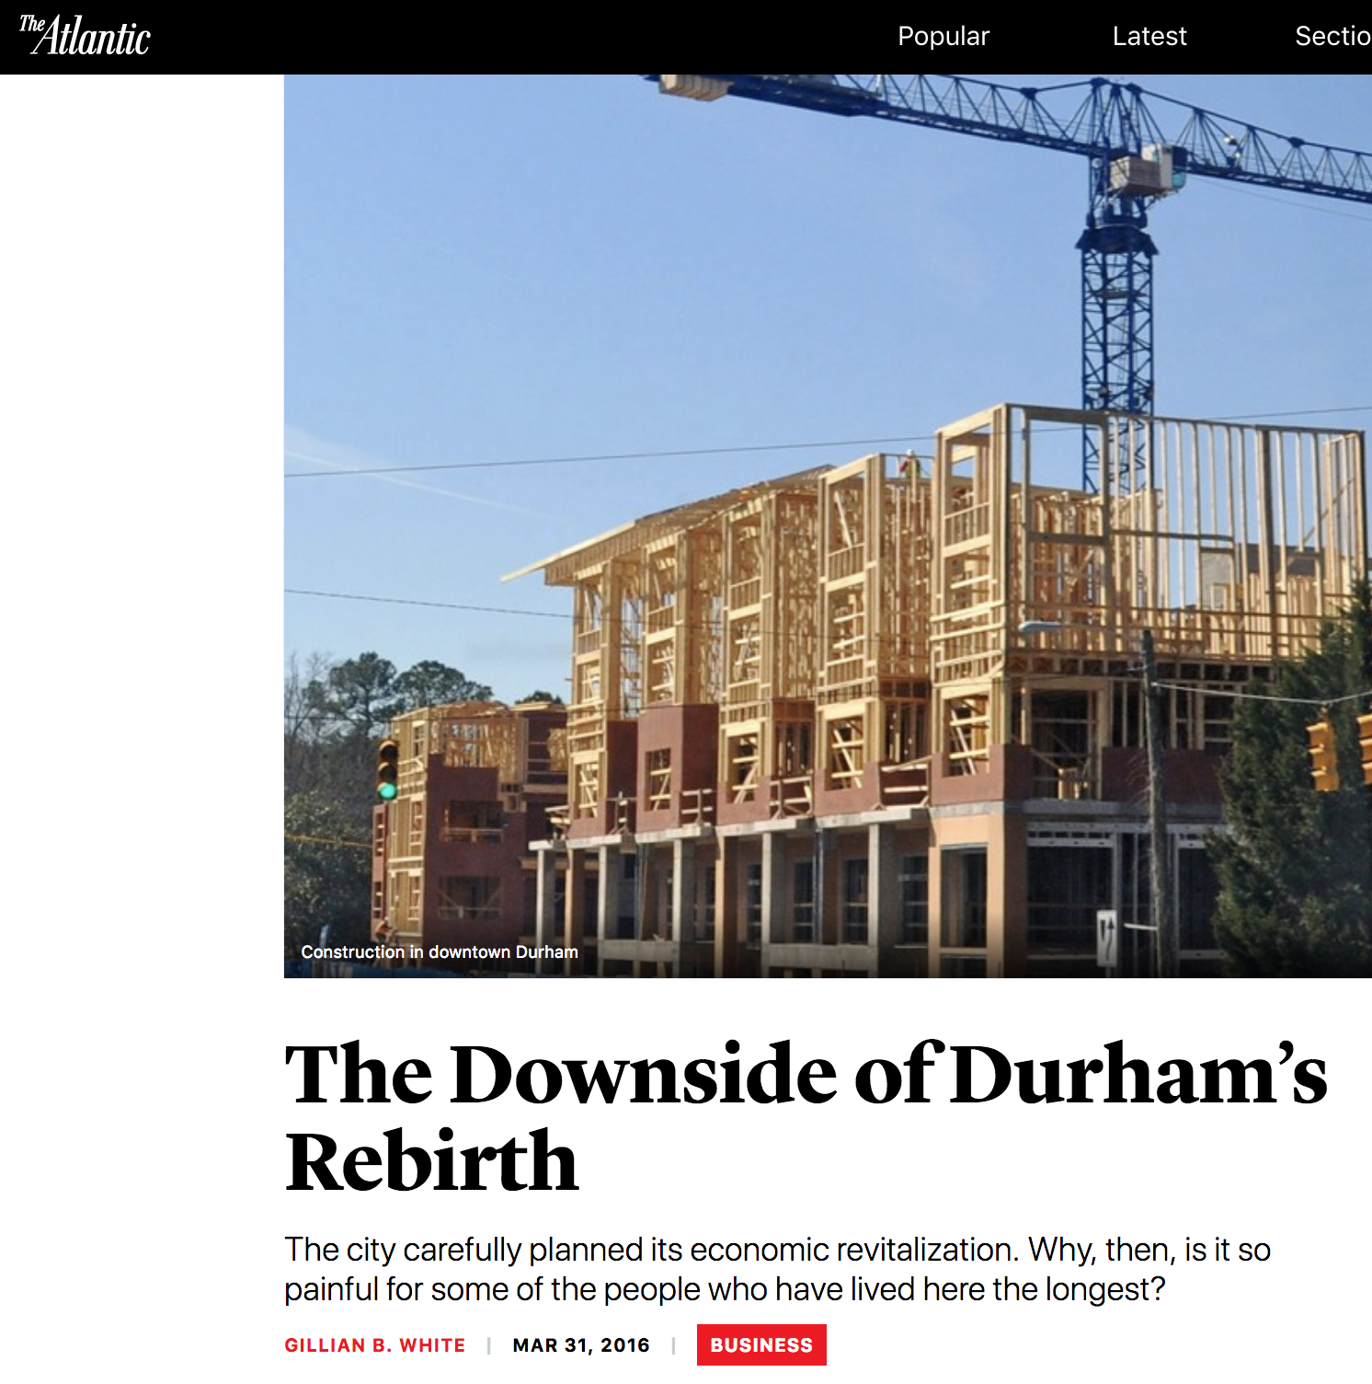
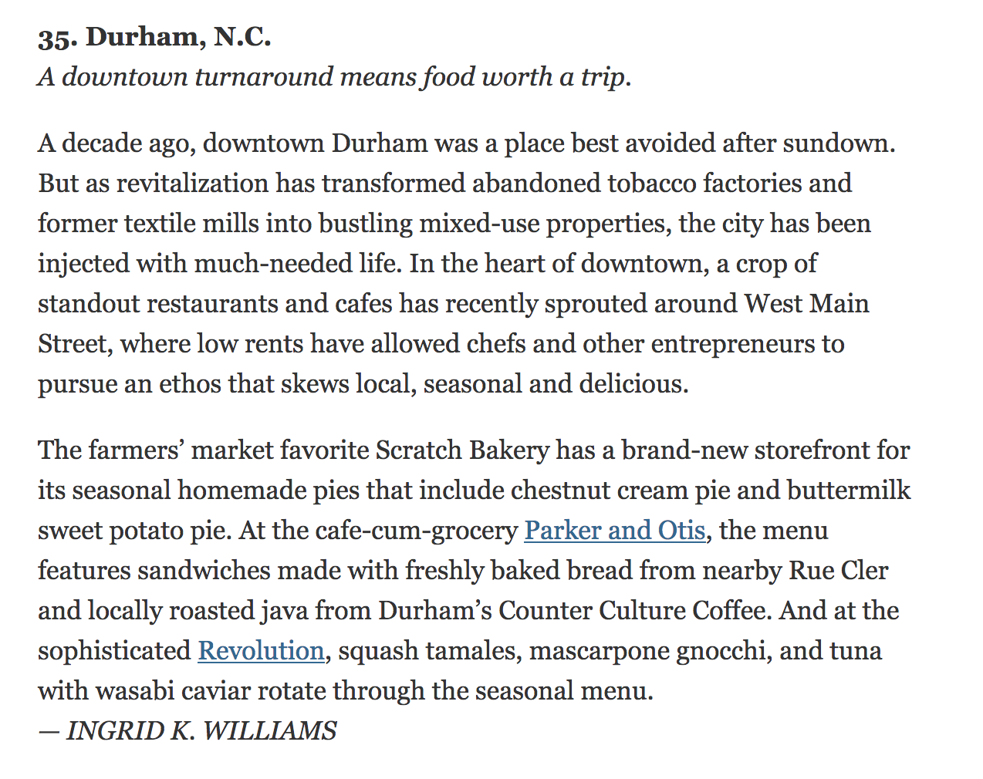
what’s happening in Durham today?
Notes:
https://www.nytimes.com/2011/01/09/travel/09where-to-go.html

Slide 6
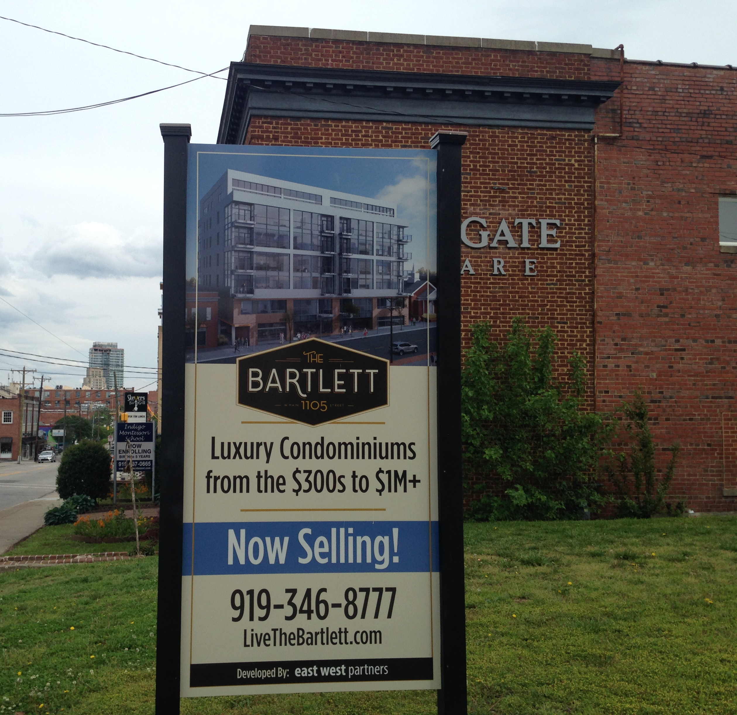
Importance of historical context in times of rapid population change

Slide 7
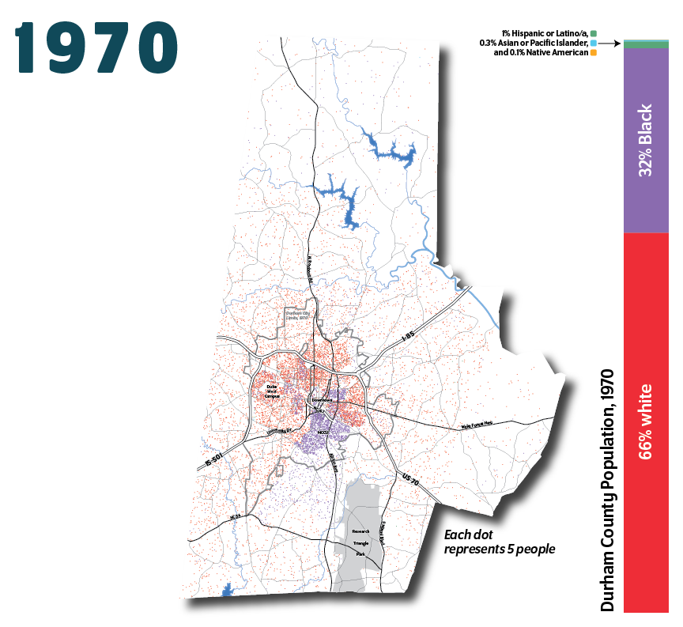
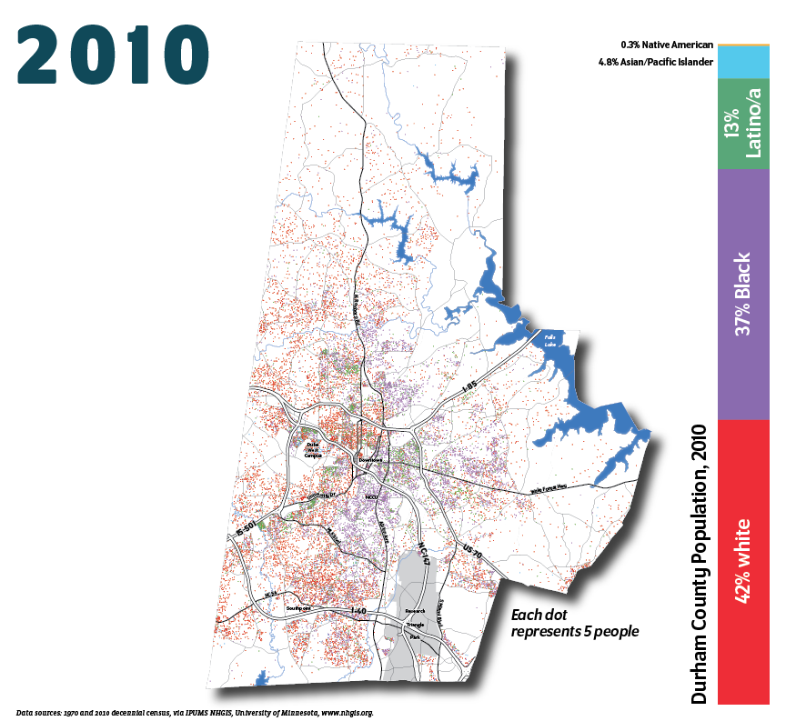
demographics & population
Source: Bull City 150

Slide 8
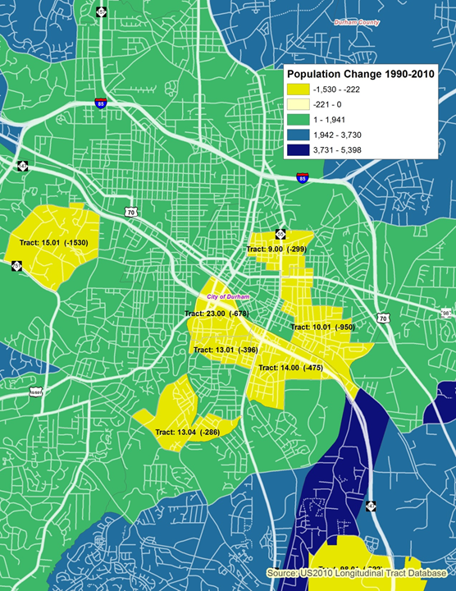
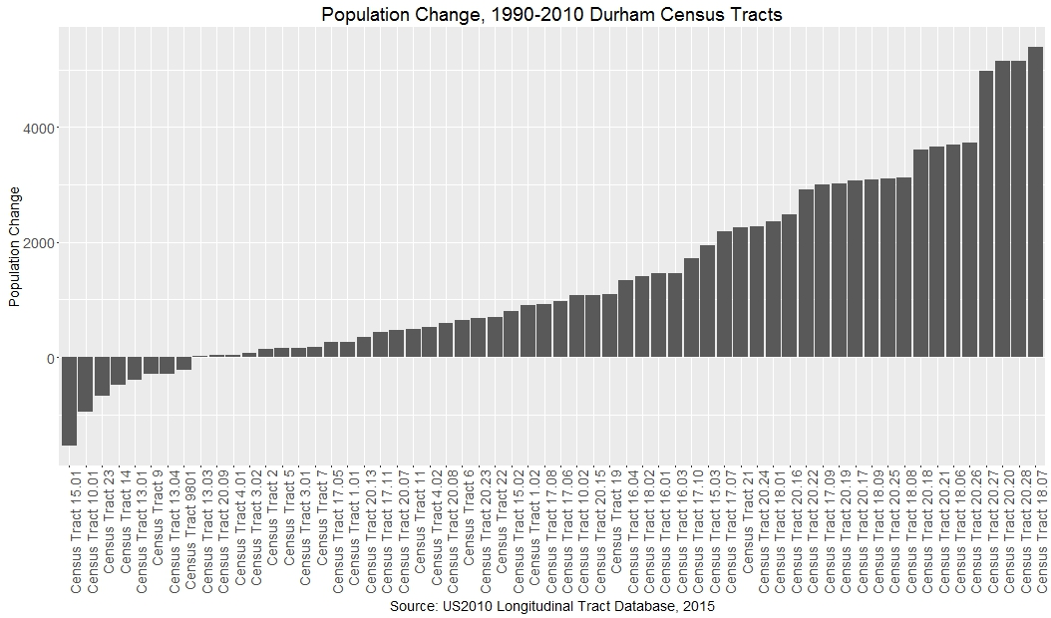
demographics & population

Slide 9
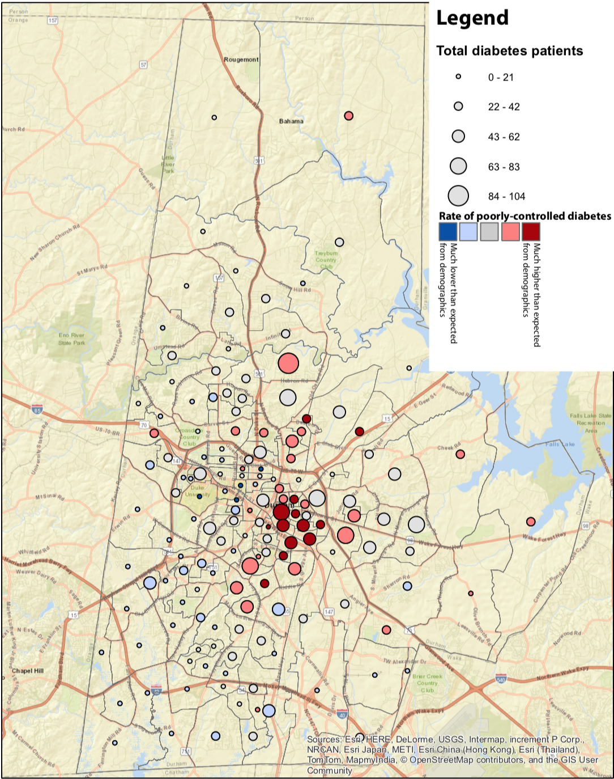
health indicators: aggregated local data
Mapping conditions
Diabetes
Kidney disease
Stroke
Myocardial infarction
Hypertension
COPD
Asthma
Cancers
Community Engagement
Neighborhood groups
Community organizers
Service providers
Health educators
Care managers
Notes:
Intro project:
First access to diabetes data from Duke, pilot of getting more regular nbhd level chronic disease data from Duke via County Health Department
Frame: This is fundamentally resident’s data – comes from our own patient records. Want to make data outputs useful to & accountable to nbhds most impacted by chronic disease
Big differences bxt raw data & BRFSS rates

Slide 10
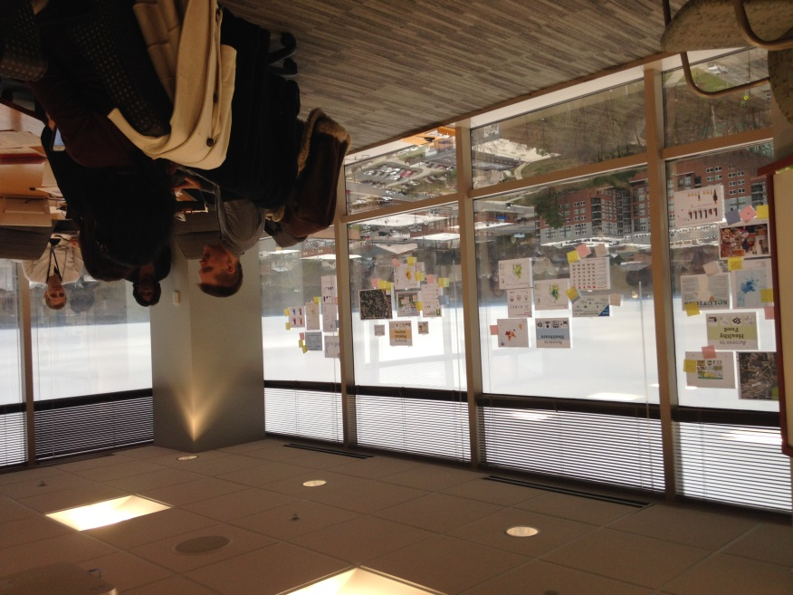
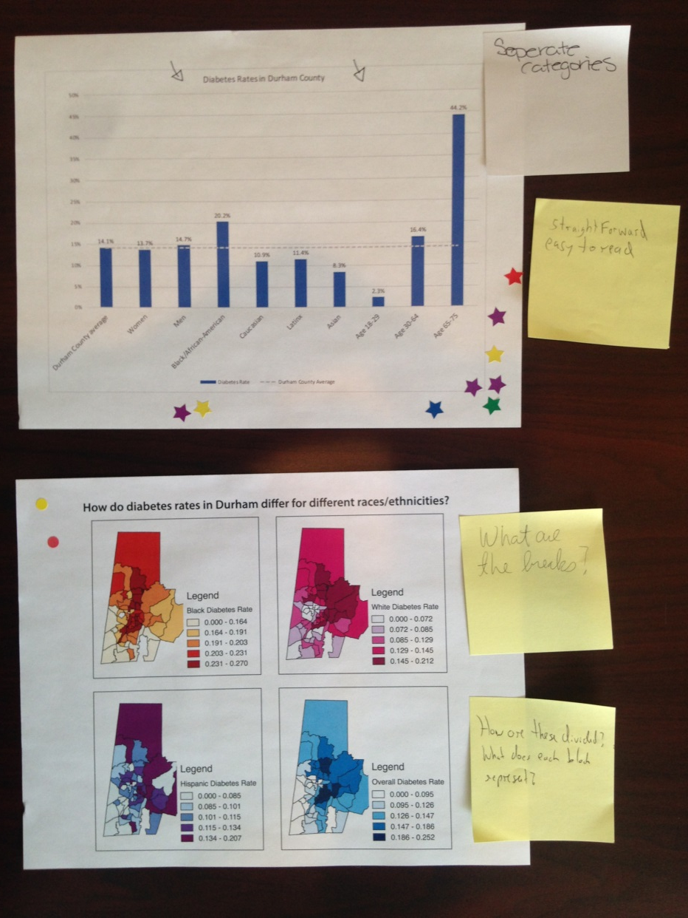

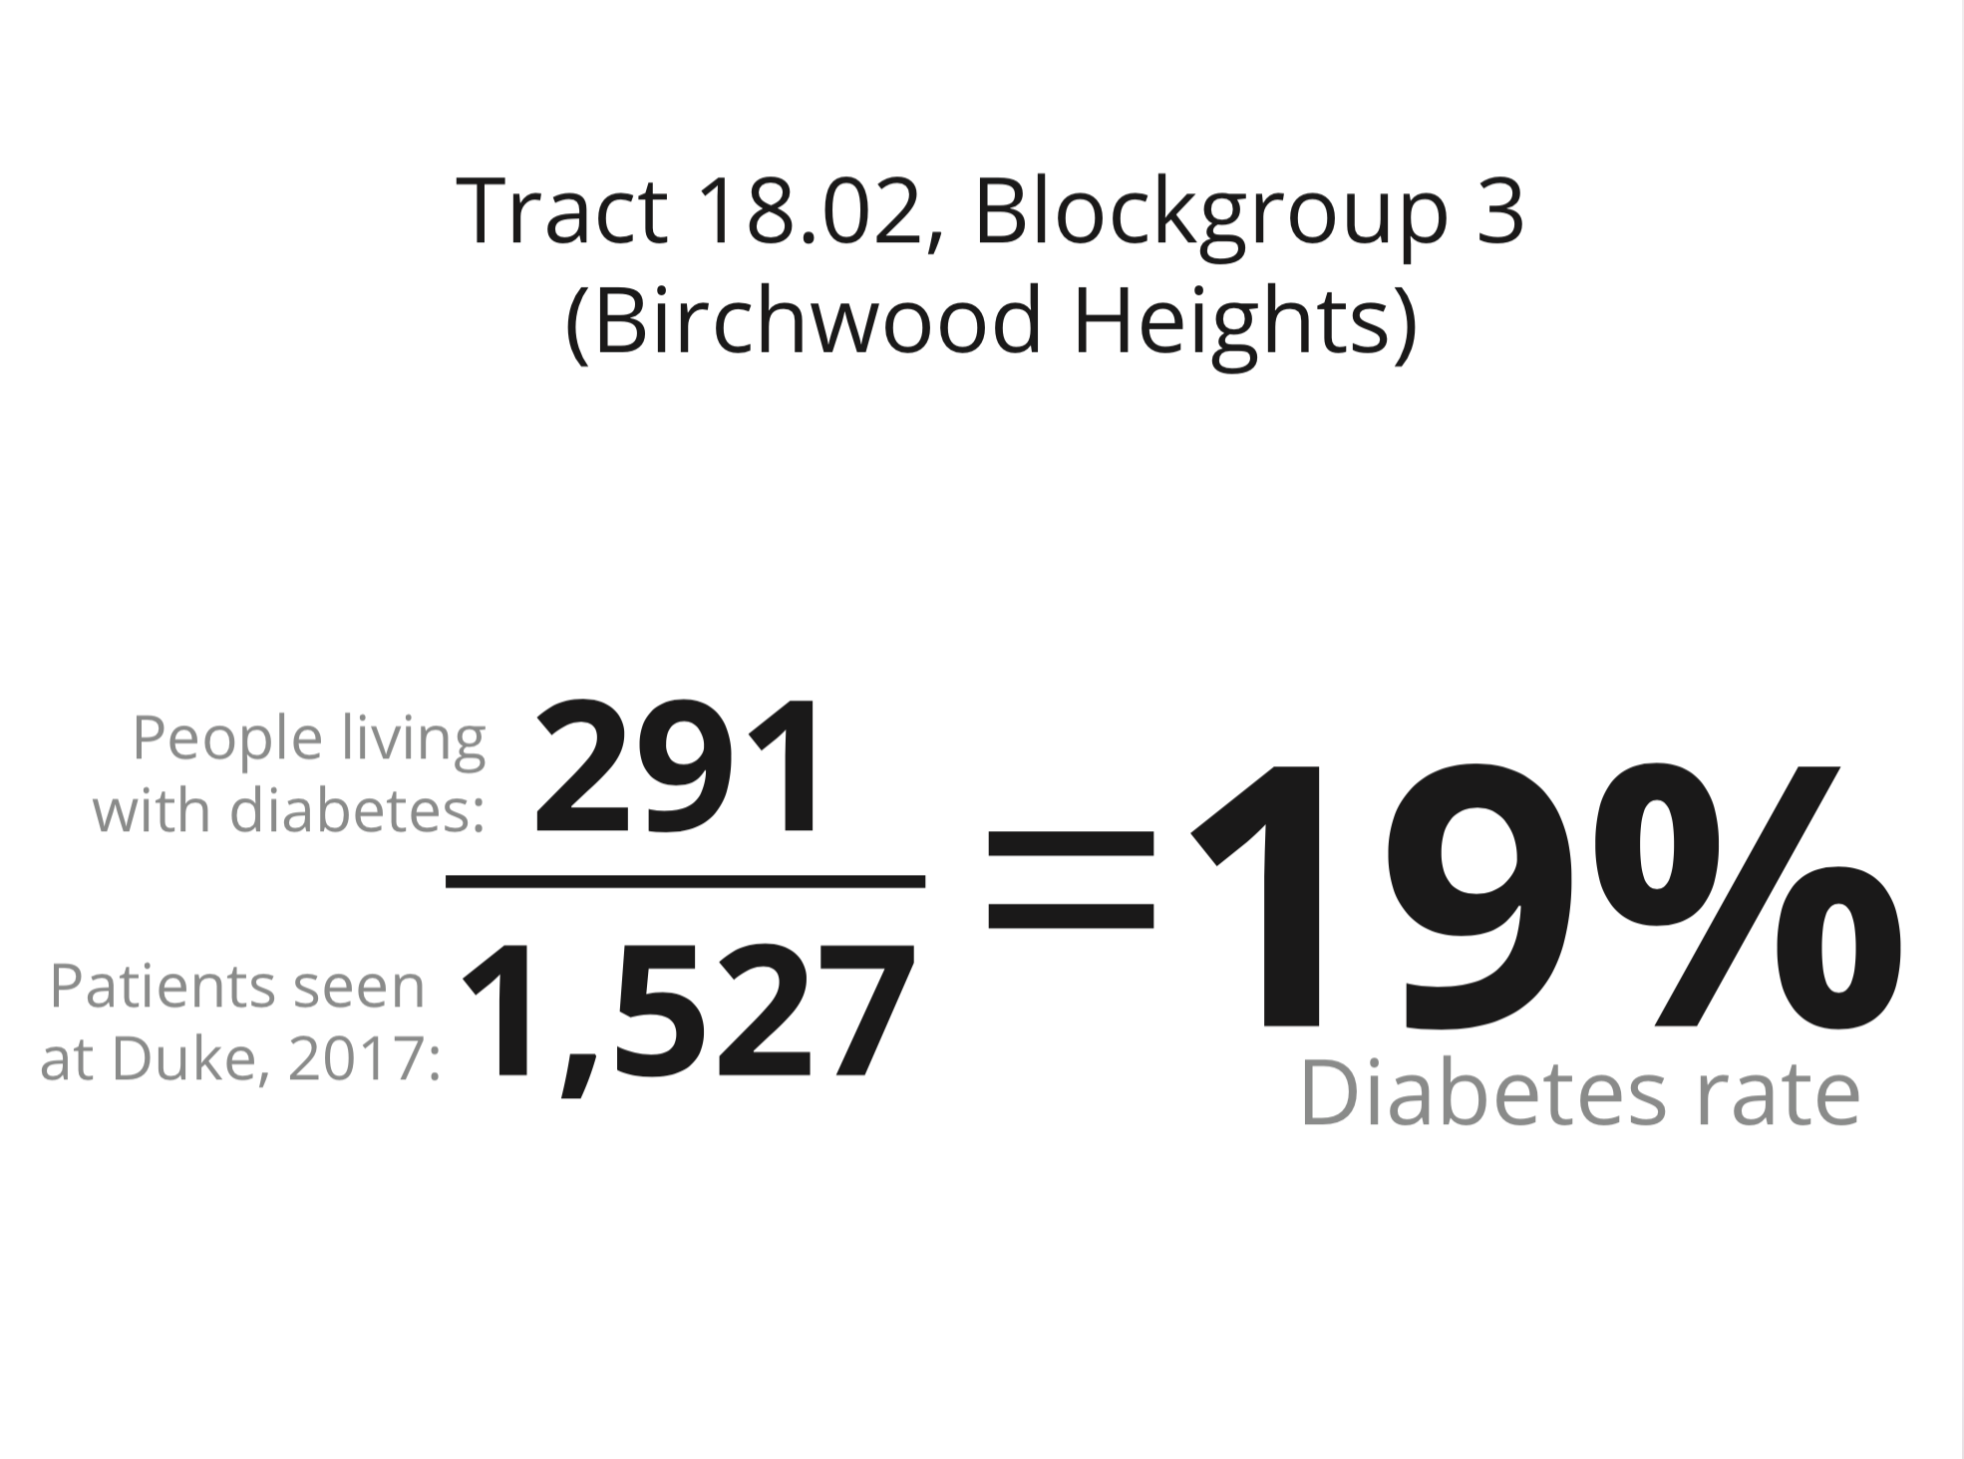
health indicators: workshop curriculum
John – do we have workshop photos to drop in here?
Tim, not a lot of people shots, actually – check this one, which at least shows people/facilitation/gallery. And the photo of the markup on images
Notes:
Talk about workshop curriculum – dual goals of co-design & re-usable material to engage residents in discussions around spatial determinants of health.
1 workshop down so far, several more to go before this year of project is over
Investigating curriculum in Spanish
Outcomes

Slide 11
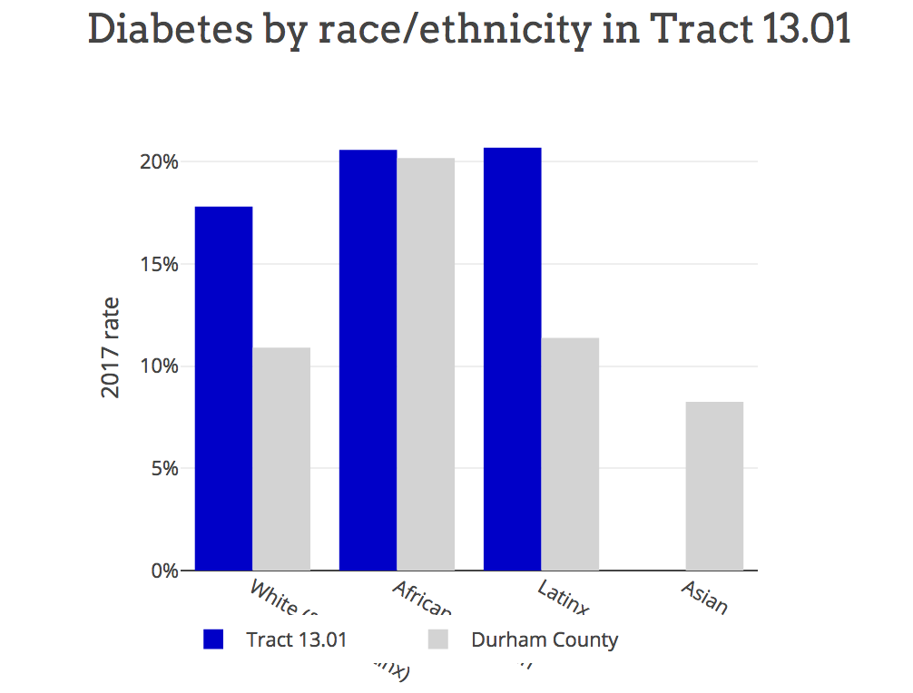
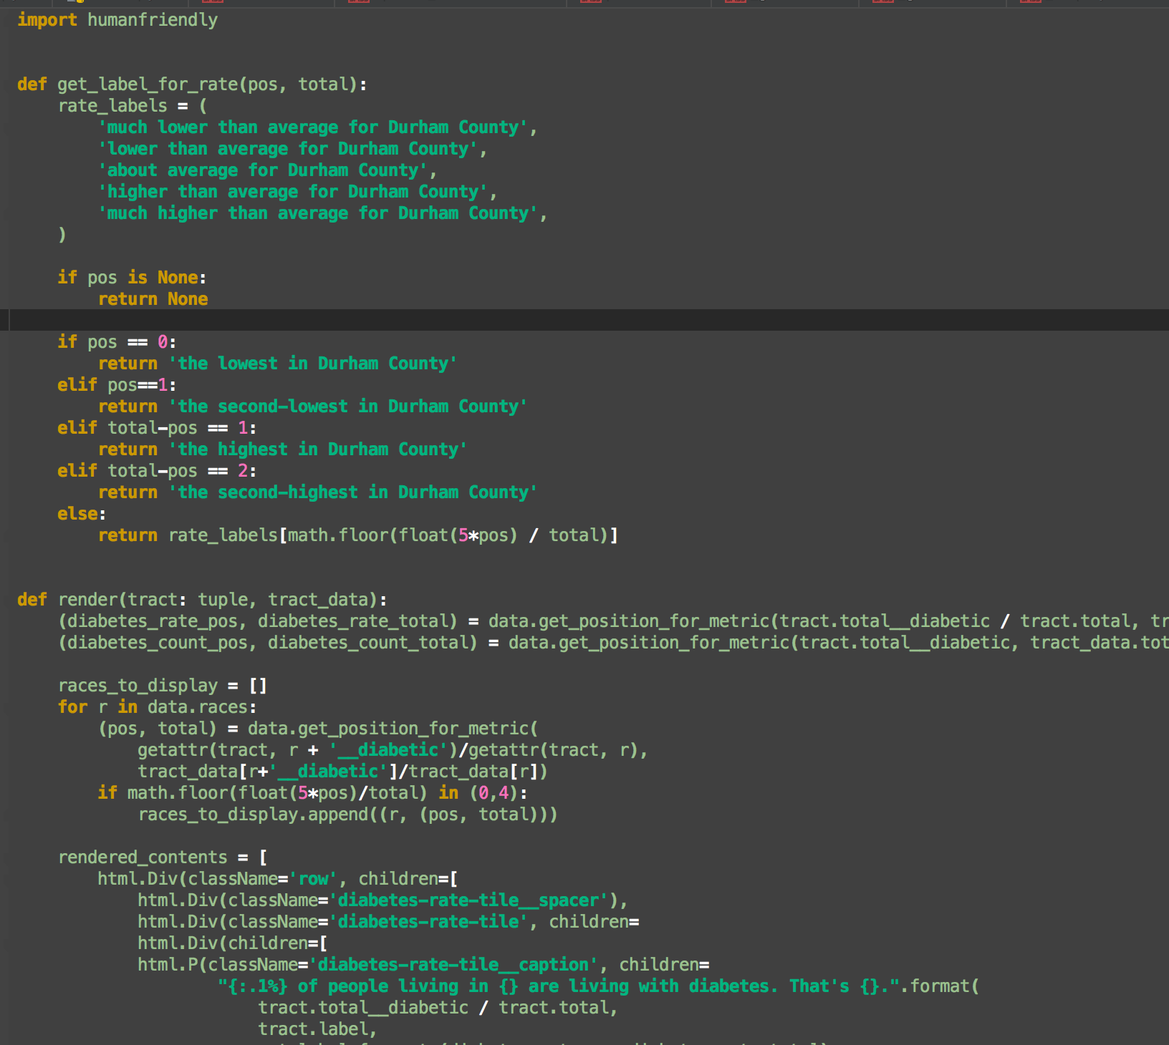
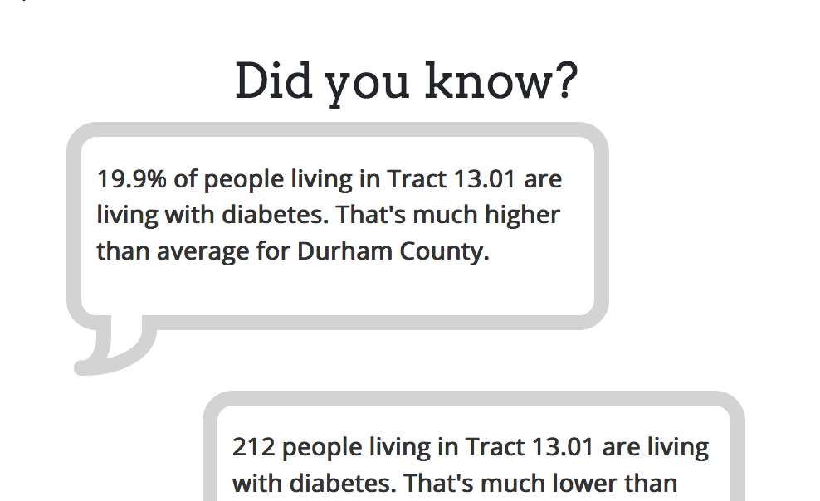
health indicators: infosheet app
County health
data
PostGIS
Server
Census info on
nbhd correlates
Municipal datasets
(policing, evictions, …)
Scraped data
Plotly Dash
Notes:
Overview tech framework – PostGIS -> Plotly Dash, print & web layouts for infosheet
Final goal: App/website with modular graphics which can be used both in printed infosheets, workshop curriculum, & online
Next steps:
Choose 10-20 correlates in conjunction with nbhd workshops (use nbhd priorities to inform list of correlates)
Partner with illustrator to develop graphics corresponding to each correlate & broad categories which can be dynamically changed based on data values
Infosheet gives overview picture of nbhd across broad categories + drill-down
Develop stories around how nbhds have intervened in changing spatial determinants of health – “What can I do?”
Figure out how to include voiceScreen Shot 2018-04-29 at 9.22.19 AM.png
Timeline for development

Slide 12
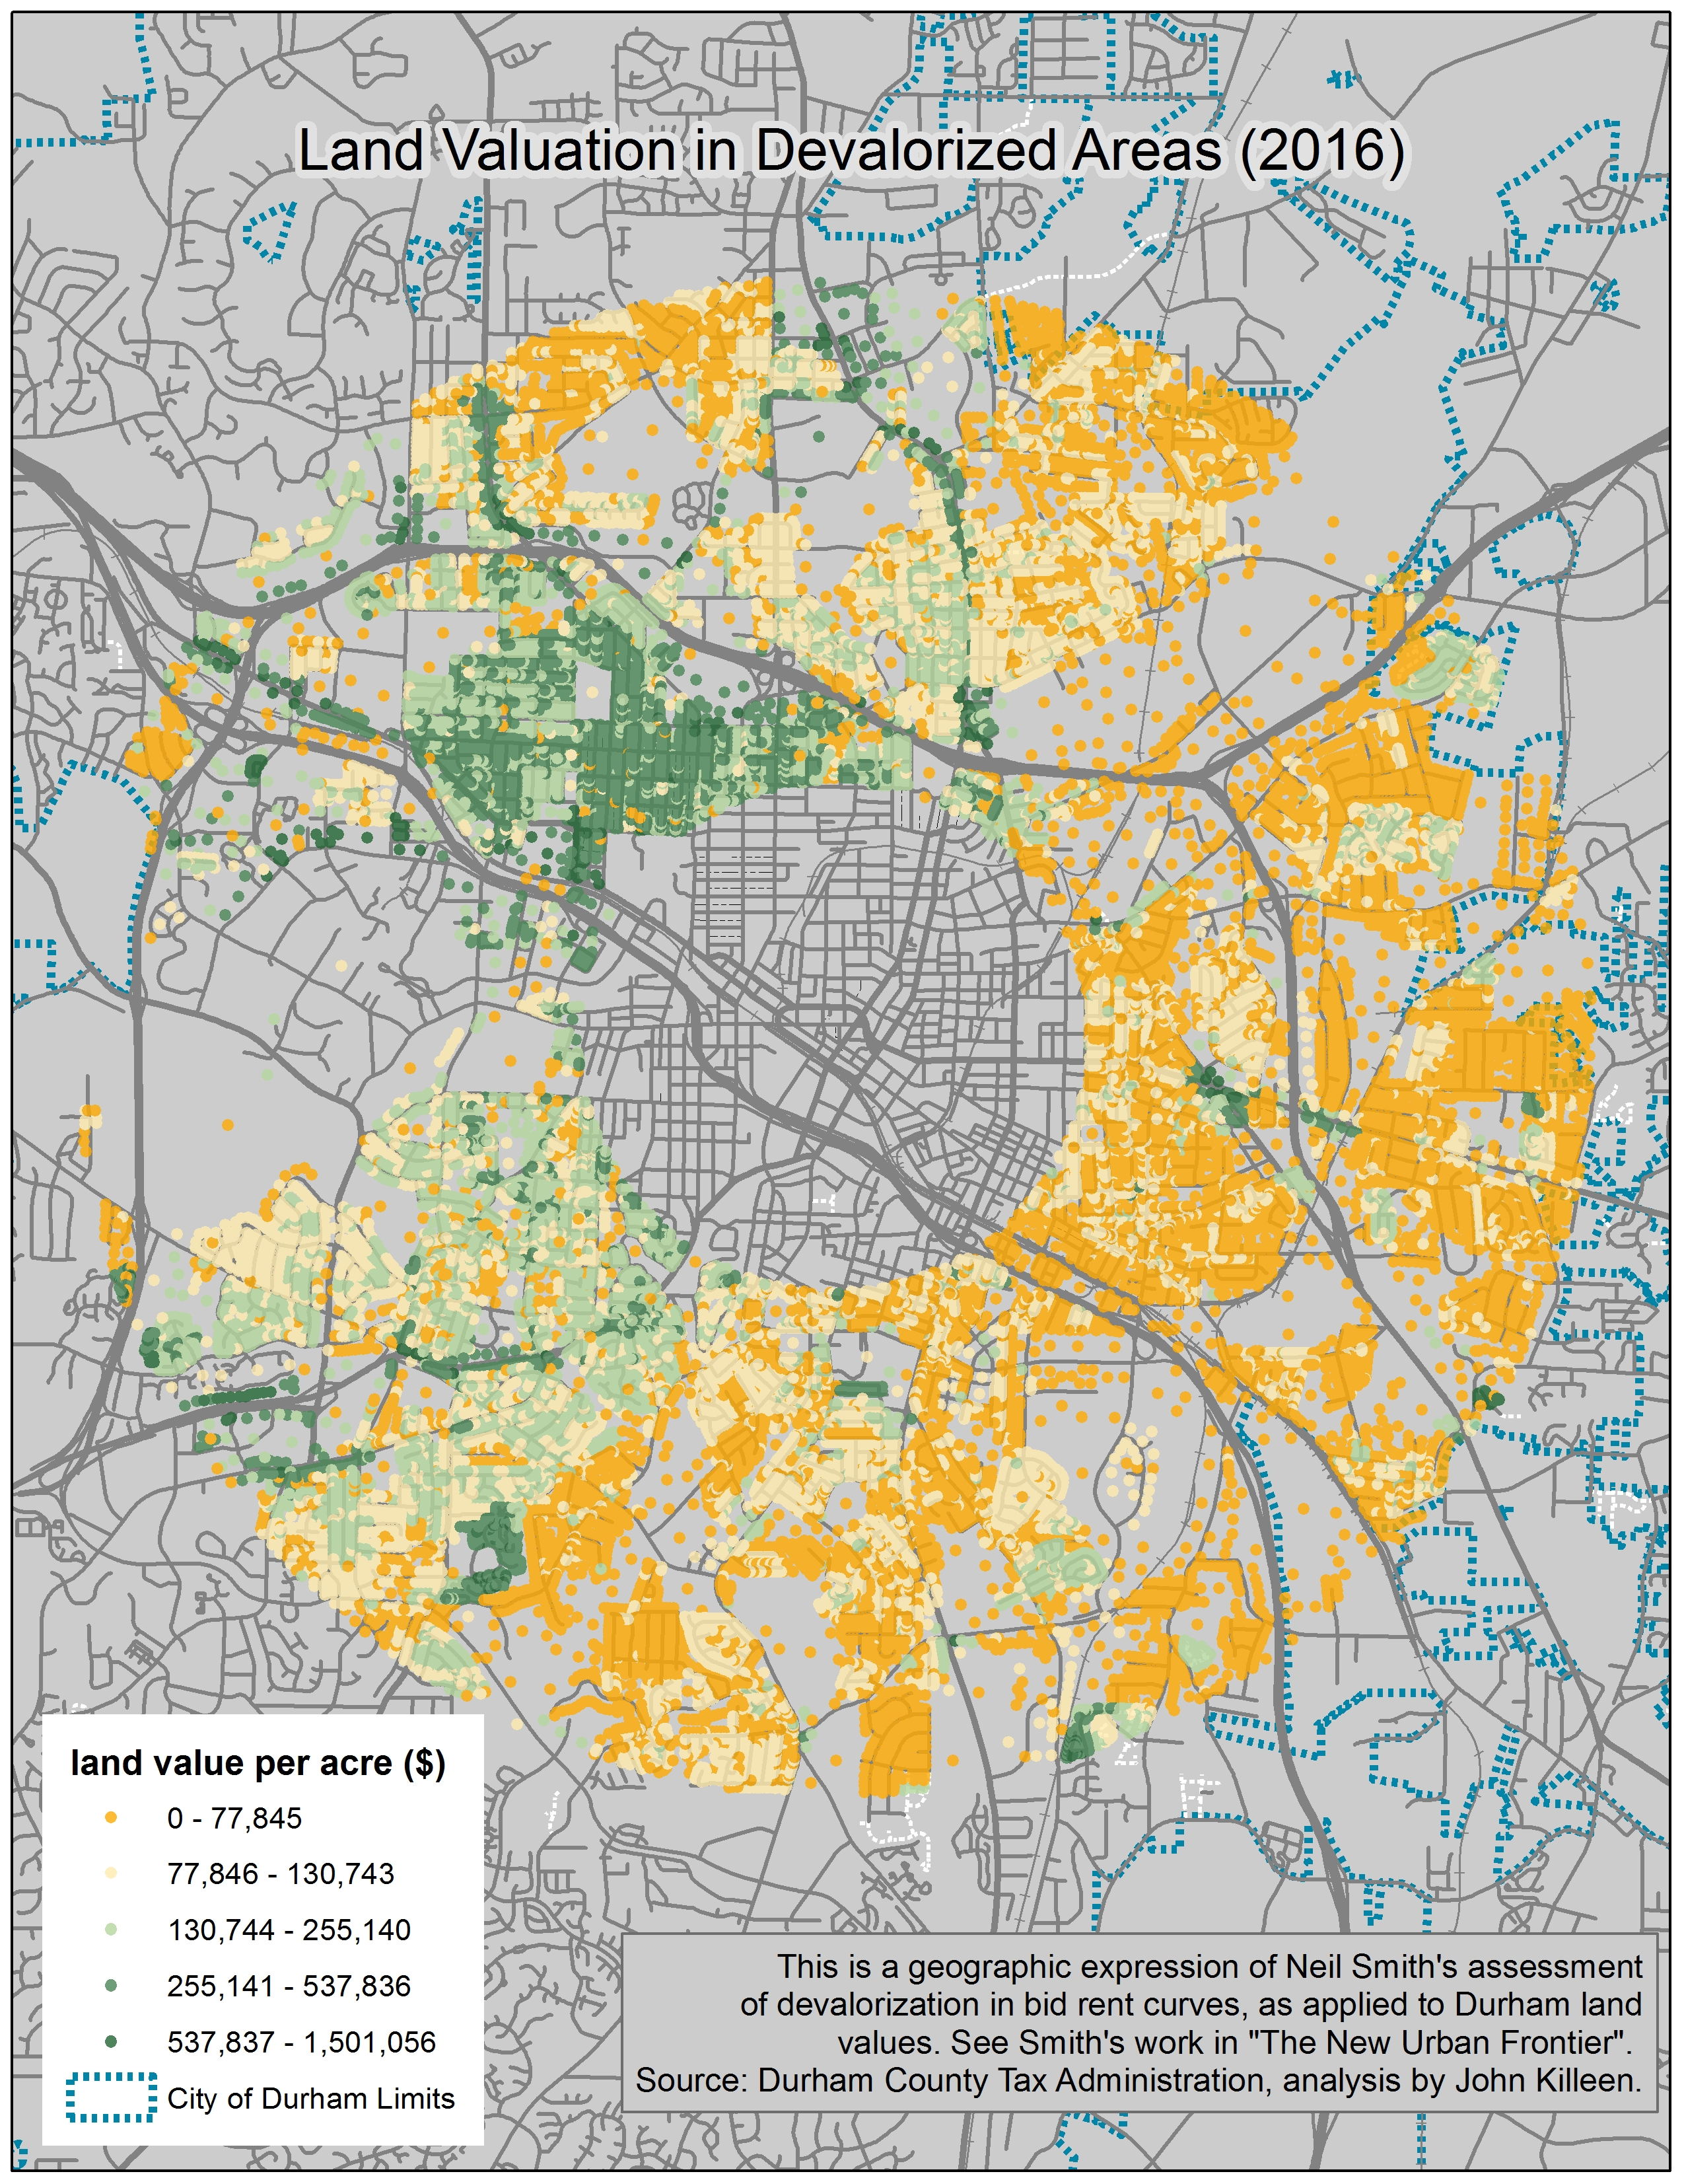
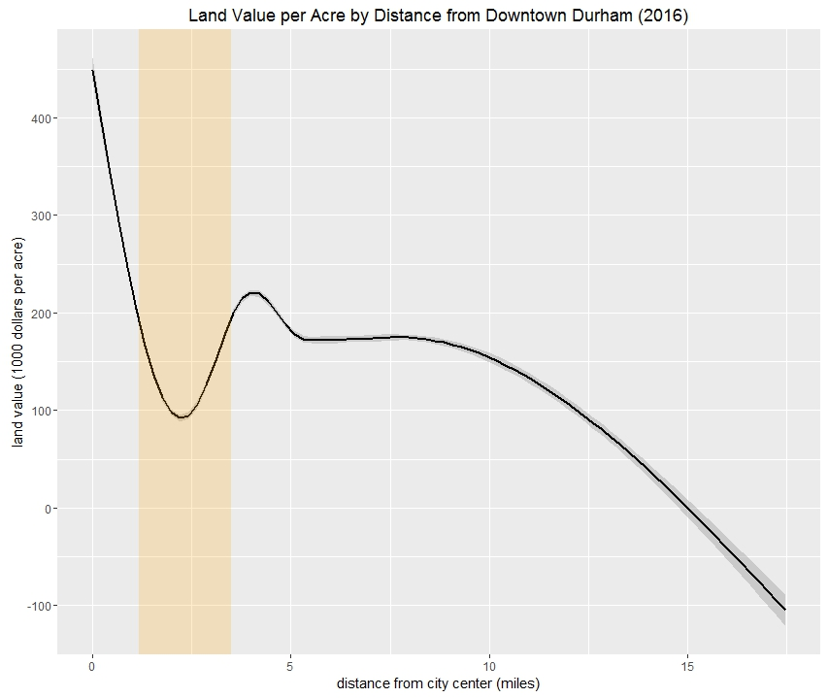
evictions and displacement
Notes:
Following a request from Durham City Council in 2016 to assess where gentrification was happening in Durham, we pursued the need to identify vulnerability of neighborhoods and where displacement is occurring. Assessing devalorization with land rents…

Slide 13
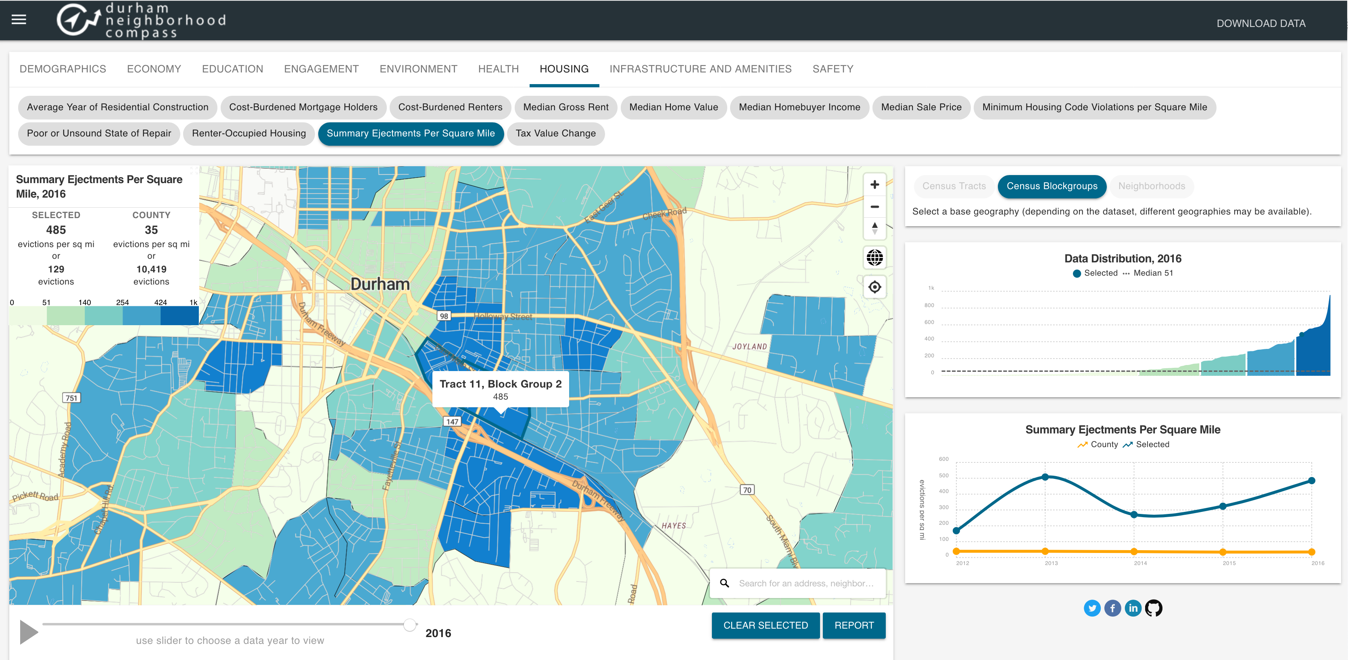
evictions and displacement
Notes:
This led to the acquisition of 5 years of summary ejectment and writs of possession records (66,310) from the Sheriff’s department and geocoding them which revealed concentrations in areas of commercial complexes and DHA properties (large numbers of renters), as well as a prevalence in parts of east Durham neighborhoods with high renter-occupancy and old housing stock.

Slide 14
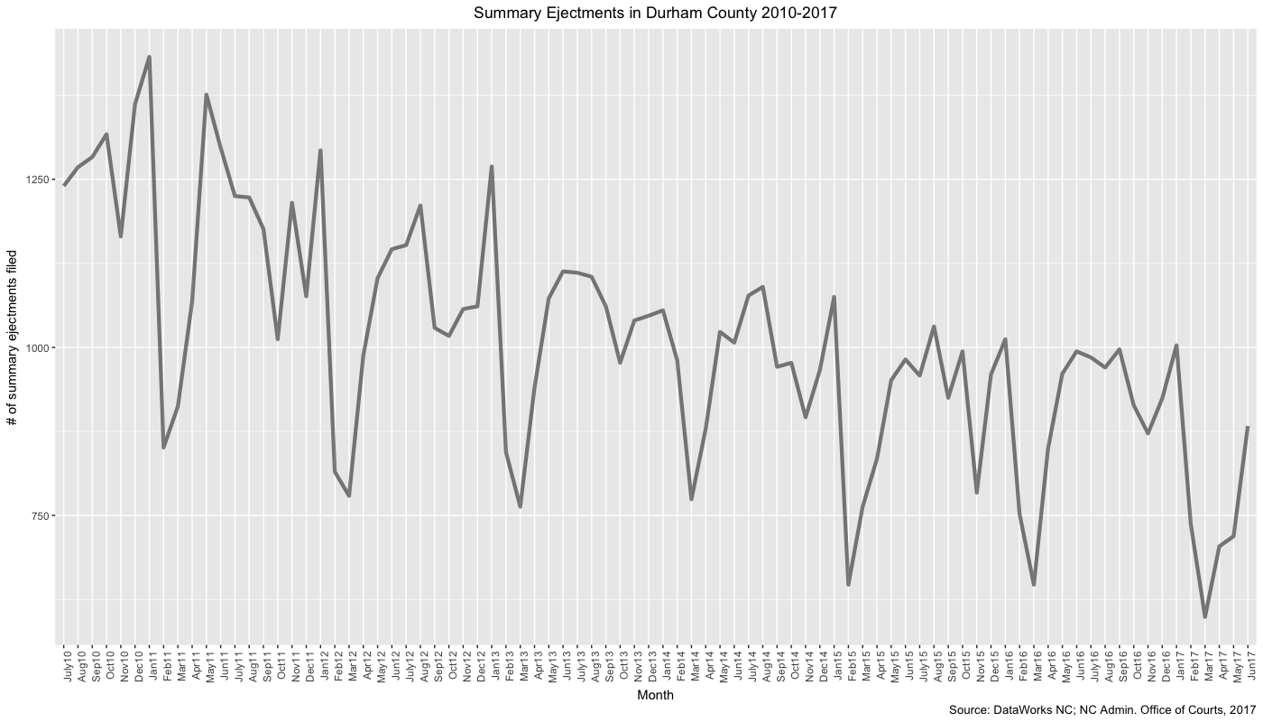
evictions and displacement
Notes:
Collection of all annual/monthly civil case summaries by county, revealing the seasonal cycles of displacement, but also the overall decline in court-processed evictions since 2010.
HRC work on this and ongoing need to merge the stories with the data in what we do, since informal evictions are not an existing dataset – what is the story underlying (or beyond) the decreasing number of court evictions?
CEF, Armin Ameri, interviews with folks who have experienced displacement not just in courts.

Slide 15
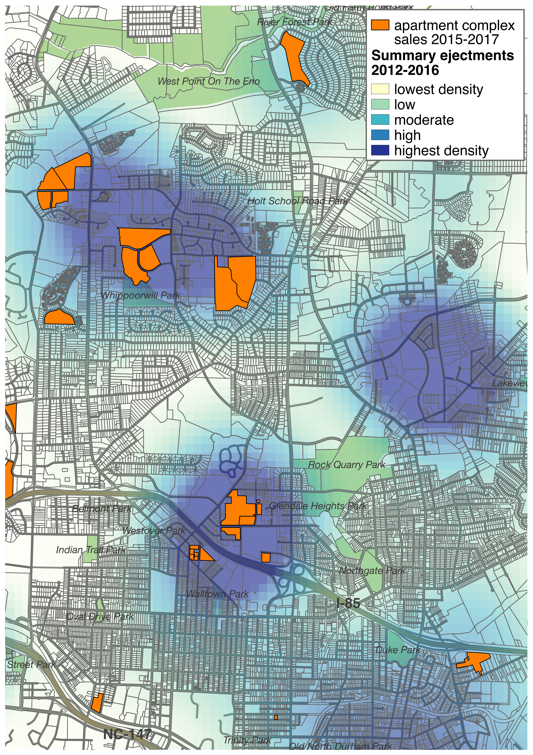
evictions and displacement
“ ...focused on identifying assets which generate healthy in-place cash flow and strong returns through value-add enhancements characterized by cosmetic upgrades, increased property management oversight, accretive financing, capital improvements, and property repositioning/rebranding.”
“…specializes in the acquisition, revitalization and management of undervalued and distressed real estate.”
“By using ----, all you need is a list of delinquent tenants, supporting documents, and a computer, and you can have your evictions underway in minutes.”
“We specialize in minimizing real estate and personal property taxes by analyzing and negotiating assessed values with tax assessors and local and state appeals boards throughout the Southeast.”
“Inflation-protection through rent appreciation”
Notes:
Next: how can we map this system, not just the people who are impacted by it? The major property owners, acquisition of commercial apartment buildings by investment firms, the businesses that profit off of evictions?
Where do global investment strategies impact neighborhoods? “Inflation-protection through rent appreciation” etc.
“By using TheEvictionTeam.com, all you need is a list of delinquent tenants, supporting documents, and a computer, and you can have your evictions underway in minutes.”
Criteria, from http://www.benensoncapital.com/

Slide 16

The Durham Lab
* direct access to data and tools (Neighborhood Compass workshops)
* neighborhood workshops for sharing and interpreting data
* best practices for sharing user-contributed stories/photos, oral history & interviews alongside metrics
* convened panels of neighbors, public administrators, journalists and research folks for discussion and public dialog
Notes:
The Durham Lab is a DataWorks NC program that brings together community members to engage with and share information related to neighborhoods, public policy and research. It operates as concurrent project efforts related to: community access to data (Neighborhood Compass workshops); visualization and storytelling with data (neighborhood workshops for sharing and interpreting data related to specific topics or specific neighborhoods); and public forums for Durham-related stories and research (convened panels of neighbors, public administrators, journalists and research folks for discussion and public dialog).

Slide 17
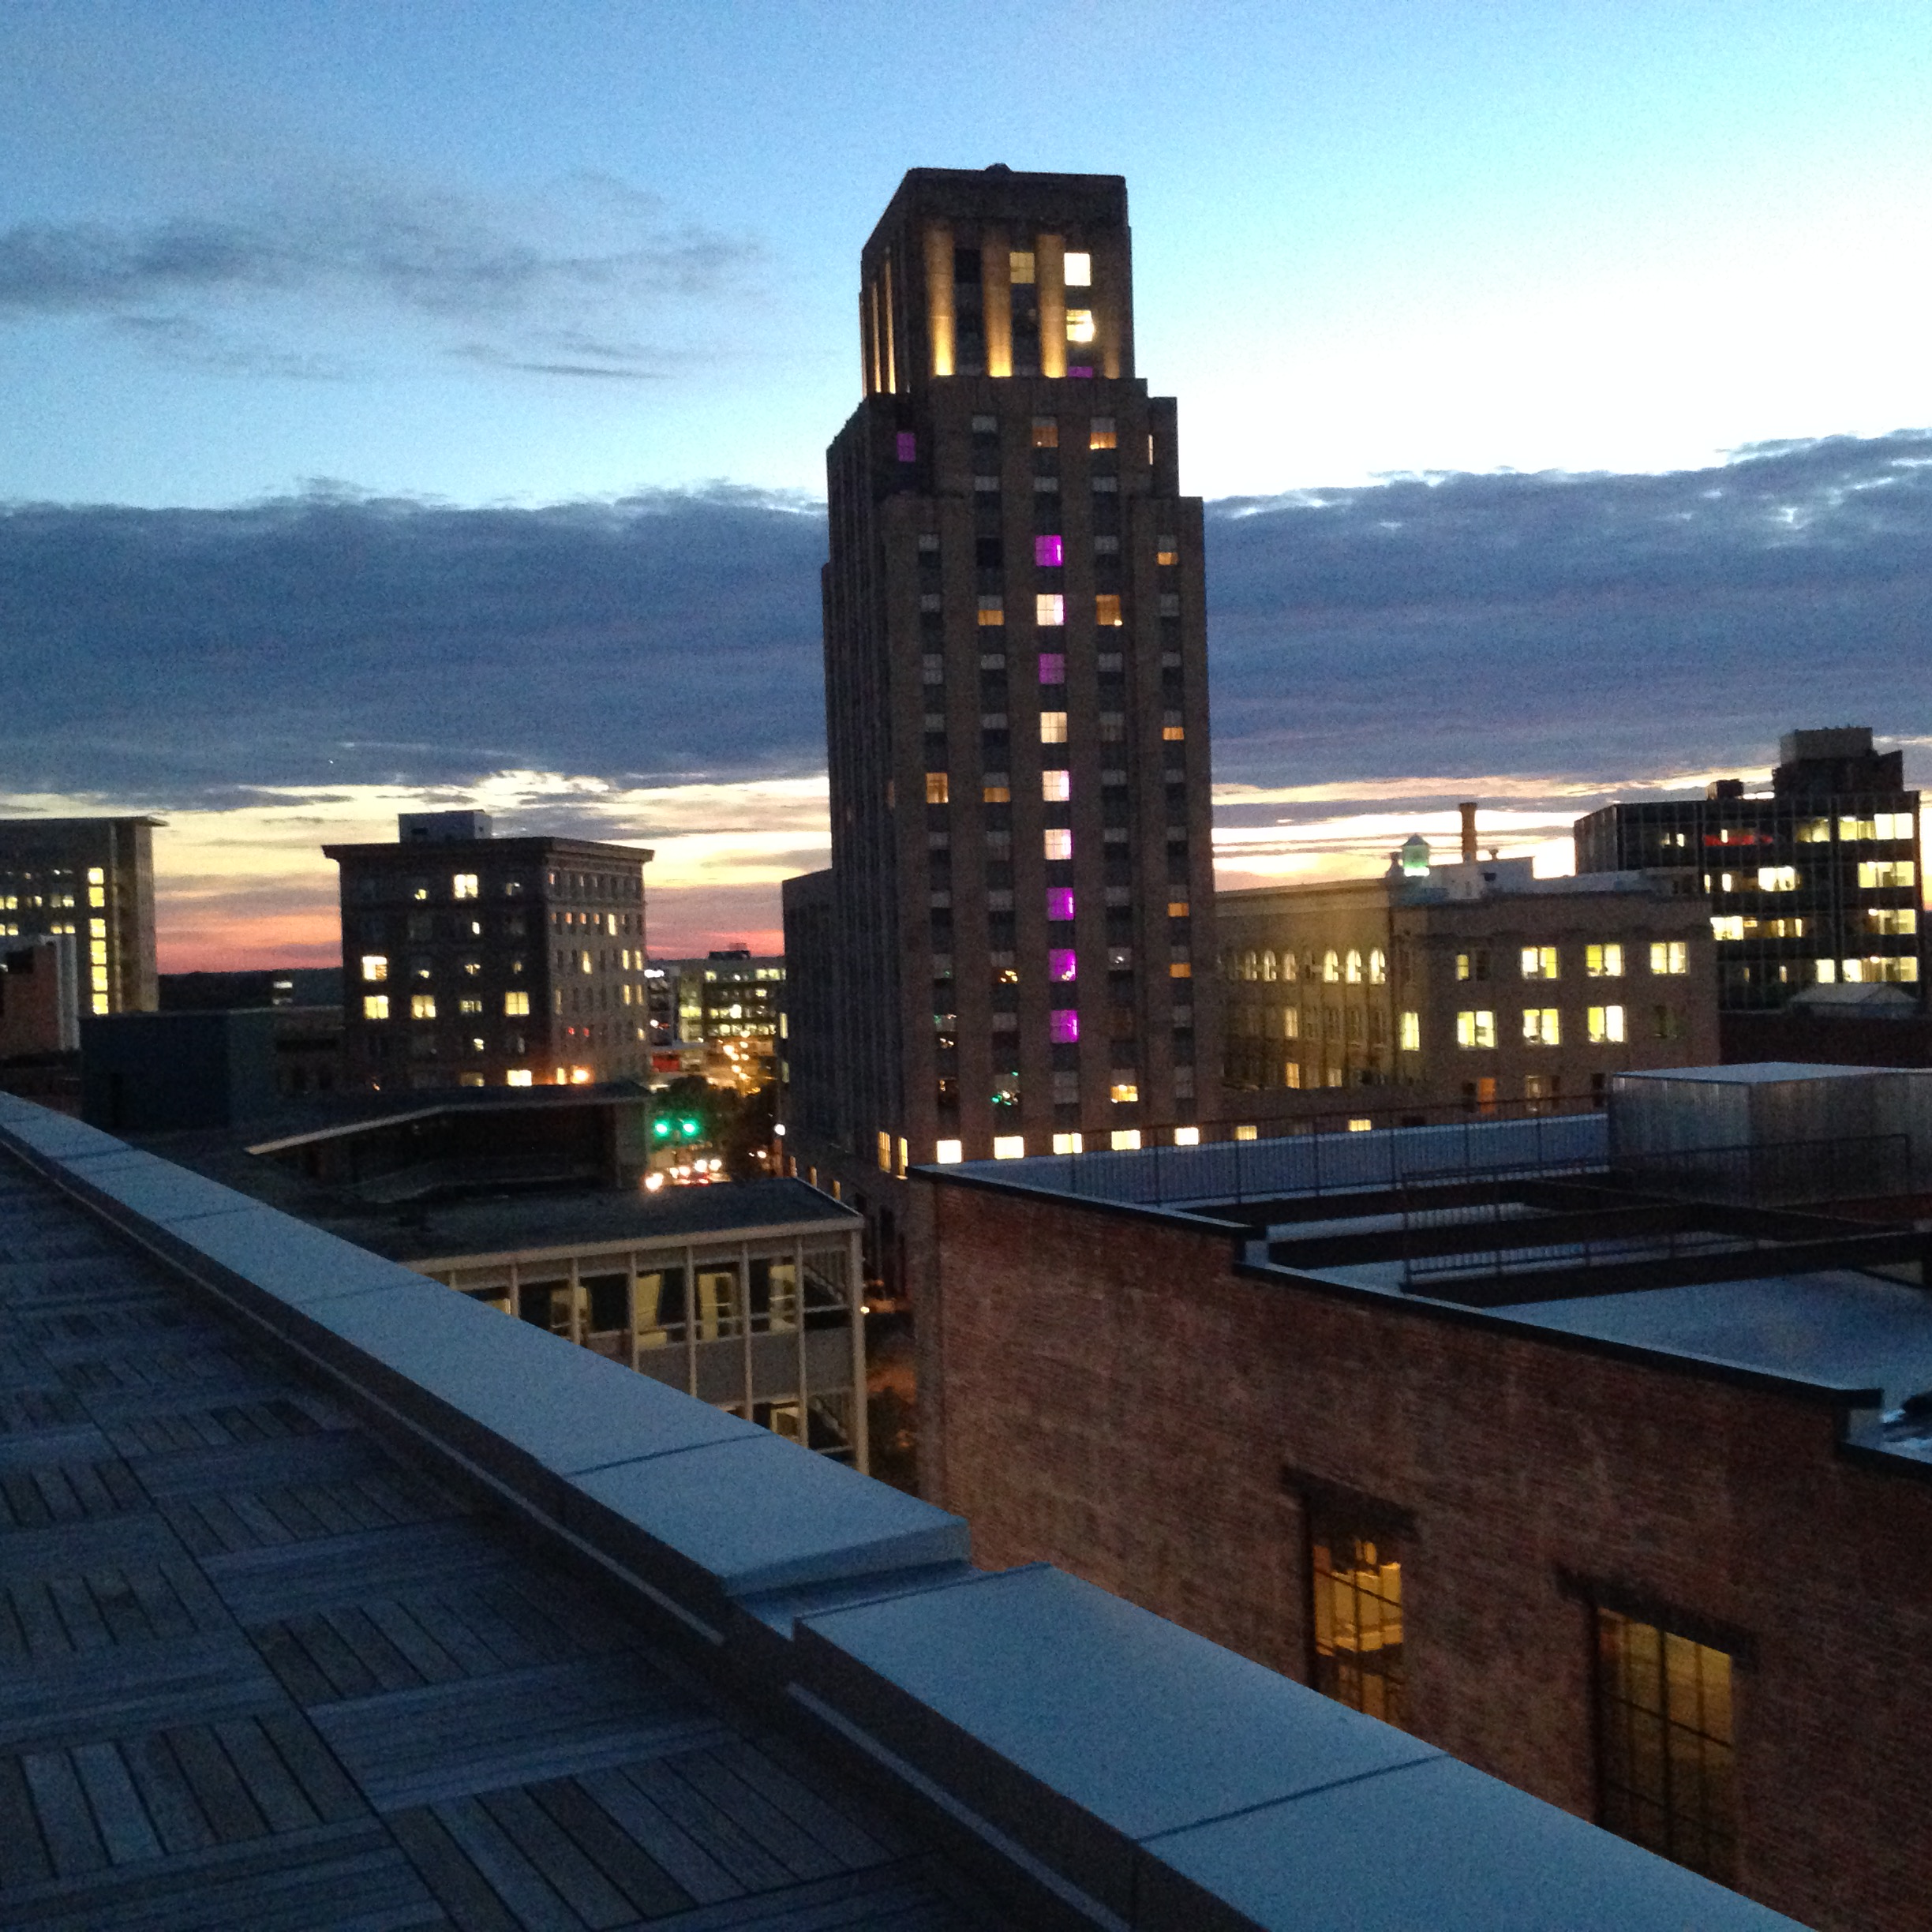
contact us
919.681.2063 johnkilleen@dataworks-nc.org tweets @DataWorks_NC

