Slide 1
A Guide to Shift’s Open Data ecosystem & Data workflow
NNIP Idea Showcase - October 17, 2018
Notes:
--0:10--
My showcase topic is …

Slide 2
FRAMING
1.
Data Challenges
2.
Open Data Ecosystem
3.
Data Workflow
Notes:
--0:22--
I will…
Start from the challenges we face
Open Data Ecosystem as the Solution
Last specifically the Data Workflow for ETL process

Slide 3
Core Data Challenges
Data Share and Collaboration
exchanging data of flat file is not efficient or trackable
shapefile is more than 1 file
support the backend of a public facing application
Secure Data Storage
data providers have specific usage restrictions
exposing sensitive data accidentally
ETL Process
cleaning data from American Fact Finder
repetitive wrangling process for data from same source
Notes:
--1:22--

Slide 4







open data ecosystem
shift research lab
DATA STORAGE
DATABASE FOR SHIFT’S
OPEN DATA TOOLS
PARTNER PORTAL
Notes:
--1:47--
In order to address those challenges, Shift Research Lab built a robust Could Infrastructure hosted by Amazon Web Services.
The Open Data Ecosystem serves three main functions:
secure storage for our data holdings;
a centralized database holding curated data to feed our open data tools;
Provide portal for partners to access our data resources

Slide 5

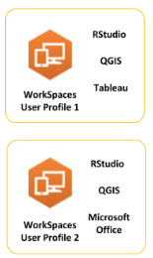
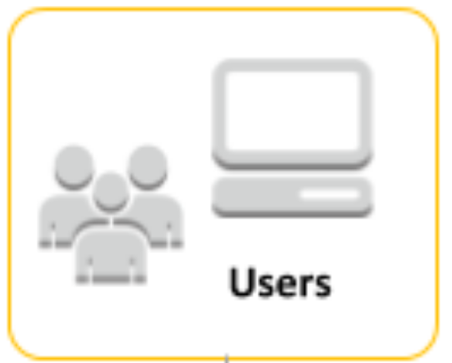





Open Data Ecosystem: Partner Portal
Data Workflow
Authentication
Gateway
Notes:
--2:47--
This page shows finished architecture of the Open Data Ecosystem.
To optimize the way we share data, we built partner portals (shown as blue arrow) that allows users to access or collaborate.
1. For closely collaborative research partners, we provide Authentication Gateway for users to connect to a Virtual Desktop
Within the WorkSpace, users can create customizable personal workspaces, where they can use software products––like Tableau, QGIS and RStudio––to analyze and visualize our data.
2. Data Workflow, allows user to contribute to the inventory
Currently the Workflow sits in the Private Cloud Environment, but not flexible on accessibility for external users
We are building an enhanced Data Workflow User Interface to enable multi-user use case
3. Also we are building Restful API service, for technical users, they can send a request to backend, then the system returns structured data, this process can be streamlined for supporting third party Applications or data visualization dashboard

Slide 6
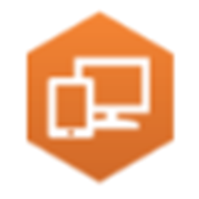

Open Data Ecosystem: Storage
Shift curates and integrates extensive data from national as well as locally-sourced data, potentially containing sensitive information.
Infrastructure:
Virtual Private Cloud
3 data related utilities:
Simple Storage Service: support data workflow
Relational Database Service: centralized database
WorkSpaces: Virtual Desktop providing research environment
S3
Notes:
--3:07--
Since ………
We deployed a set of infrastructure including:
A virtual private cloud encompasses all data holdings,
Inside, there are 3 data related resources deployed:

Slide 7
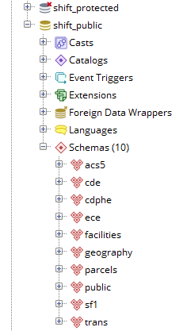
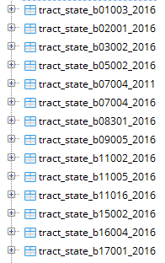
Open Data Ecosystem: Database
PostgreSQL Database
    Open Source
    GIS Analysis
Access Control by:
database: connect, create
schema: use, create
table: select, update, insert, delete…
Notes:
--3:37--
PostgreSQL is a popular open source database engine type, support GIS analysis,
We use this database for research internally, also it’s used to feed public facing applications
We set up nested database structure to categorize dataset based on our organizational needs
Each object database, schema, table
Can be assigned privileges for certain roles individually

Slide 8

Extract Data From…
census API
.csv format for tabular data
.geojson format for geometry data
Data Workflow: Extract Transform Load
Transform
capture machine metadata: timestamps
Enforce field type, field name as specified in config file
HOW TO ACCESS
THIS TOOLS?
Command Line Utility
Partners Granted Access through Keys
Load into Database
database and schema as specified in config file
8￼
Notes:
--4:07--
For populating the database, we built a Data Workflow to streamline the ETL process
…

Slide 9
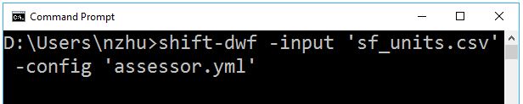


Command Line Interface:
Data Workflow: Tech Approach
S3
HOW TO ACCESS
THIS TOOLS?
Command Line Utility
Partners Granted Access through Keys
Serverless stack
9￼
Notes:
--4:55--
Currently this Workflow is triggered from Github for Census Dataset, and drag and drop to S3 bucket for .csv + geometry,
,which is not flexible
We are trying to build a User Interface as an Entry Point, the initial approach is Command Line Interface
We vison our data partners using it to pump in a raw file, with the choice of selecting a transforming prototype and destination database
as you can see…
Module in the middle performs ETL process, S3 and Lambda is a popular stack for building serverless micro service

Slide 10





stay in touch
Nikki Zhu
nzhu@garycommunity.org
303-454-3755
Jennifer Newomer
jnewcomer@garycommunity.org
303-454-3776
follow us
for more information visit
SHIFTRESEARCHLAB.ORG

