Slide 1
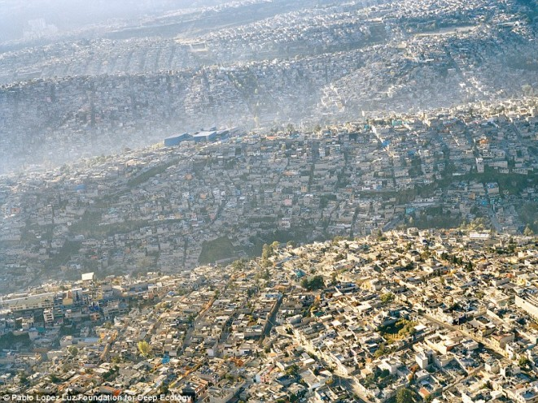
Data from Latin American Cities
Presented by Claire Slesinski, MSPH
Drexel Urban Health Collaborative
at the NNIP Partnership Meeting
October 17-19, 2018 | Los Angeles, California

Slide 2
What is SALURBAL?
“Salud Urbana en America Latina” Urban Health in Latin America
Multi-country research project funded by the Wellcome Trust which aims to:
1
2
3
4
Understand the drivers of health, equity, and sustainability in cities
Evaluate urban policies to understand their impact
Use systems thinking to understand direct and indirect effects of policies
Disseminate results for policy action
Who is implementing SALURBAL?
Pontifical Catholic University of Chile, Santiago, Chile
United Nations University International Institute for Global Health (UNU-IIGH)
Universidad Peruana Cayetano Heredia, Lima, Peru
University of the Andes, Bogotá, Colombia
University of California at Berkeley, USA
University of Chile, Santiago, Chile
University of Sao Paulo, Sao Paulo, Brazil
Washington University in St Louis, Missouri, USA
Economic Commission for Latin America and the Caribbean (ECLAC)
Federal University of Minas Gerais, Belo Horizonte, Brazil
Institute of Nutrition of Central America and Panama (INCAP), Guatemala City, Guatemala
National Institute of Public Health, Mexico City, Mexico
National University of Lanus, Buenos Aires, Argentina
Oswaldo Cruz Foundation, Rio de Janeiro, Brazil
Oswaldo Cruz Foundation, Salvador Bahia, Brazil

Slide 3
City Universe
We aim to include all cities with 100,000 or more inhabitants in Latin America. Our city universe so far includes 371 cities:
Mexico
Guatemala
El Salvador
Nicaragua
Costa Rica
Panama
Colombia
Peru
Brazil
Chile
Argentina

Slide 4
Geographic levels of data linkages and analysis
Level 1_AD: Composed of administrative units (Level 2) encompassing the built-up area of the city visible in satellite imagery
Level 1_UX: Urban extent of the built-up area of a city quantitatively determined from satellite imagery
Level 1_MA: Follows exact country-specific definitions of urban areas, a combination of Level 2 units or Level 3 units
Level 2: Individual administrative “subcity” units nested in Level 1_AD (e.g., municipios or comunas, US counties).
Level 3: “Neighborhoods” that are small census units (e.g., setor censitario, US census tracts) that are nested within Level 2. May approximately be linked with Level 1_UX.

Slide 5
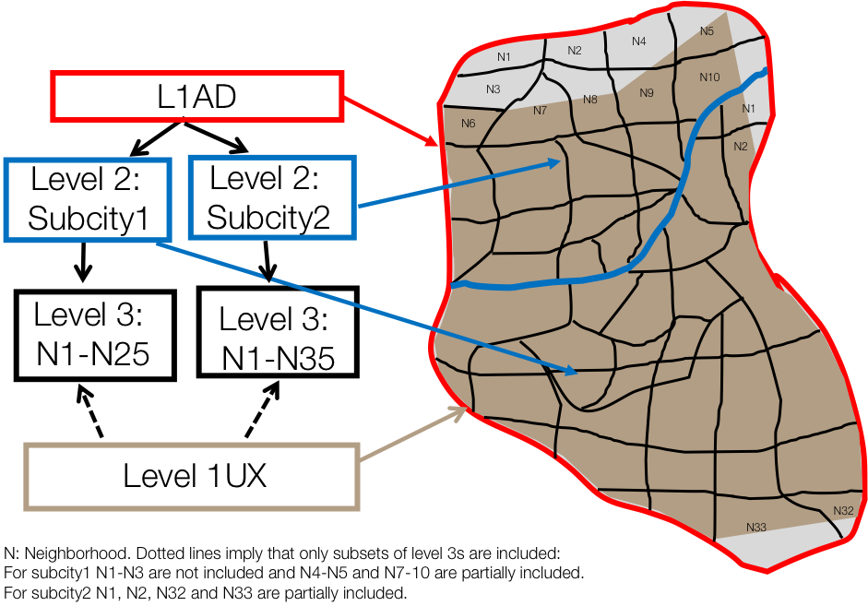
Geographic levels of data linkages and analysis

Slide 6
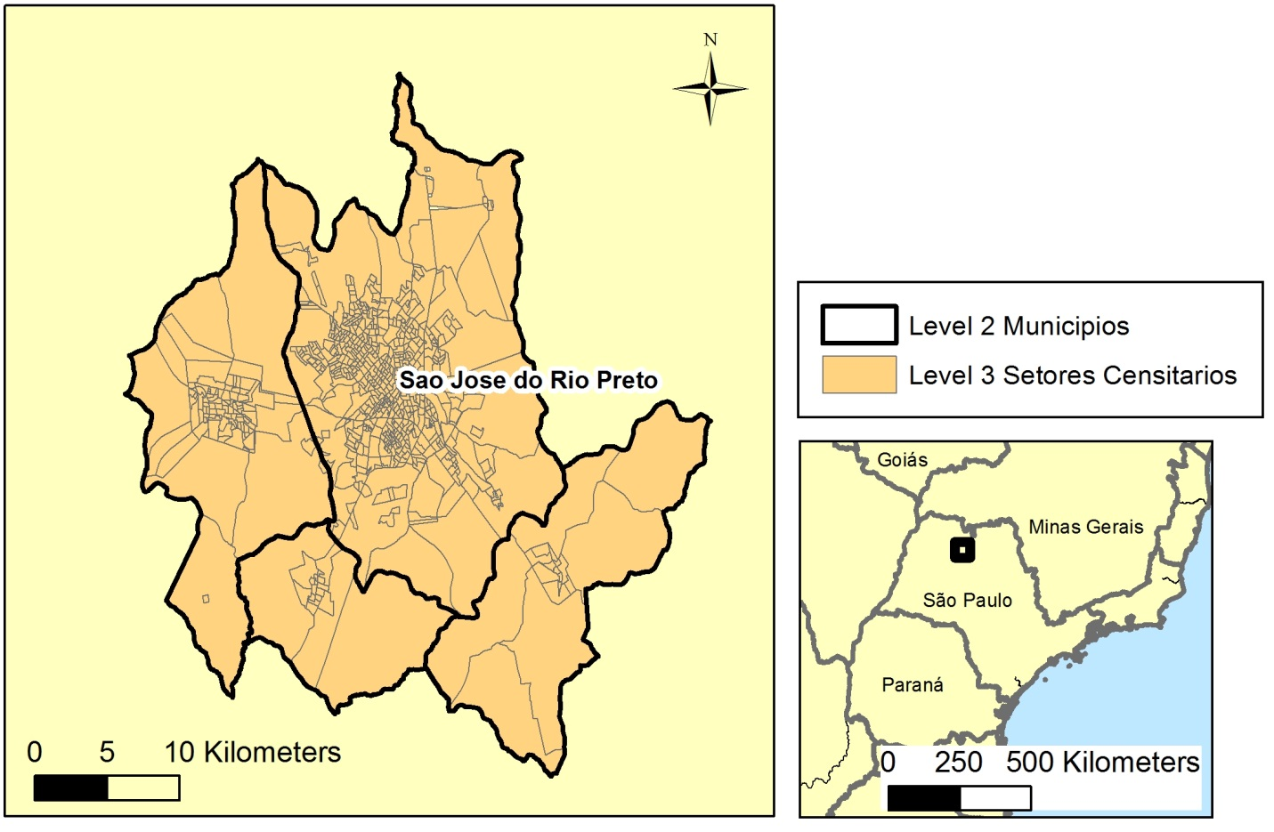

Slide 7
Where did the data come from?
Census and Household Surveys
Open Source Databases
National and State Governments, including vital statistics
Street Maps and Satellite Imagery
International and Policy Organizations
How did we harmonize it?
Applying standard definitions, protocols, and international codes from agencies such as the World Health Organization

Slide 8
What types of data do we have (or will we hopefully soon have)?
Births
Mortality
Behavioral
Health Status
Social Inequality
City Physical Environment
City Built Environment
City Social Environment

Slide 9
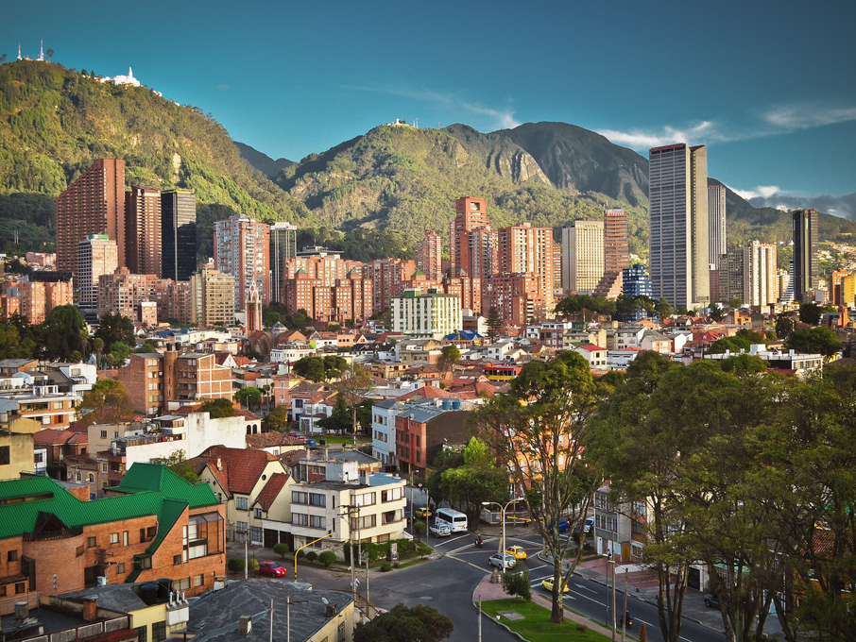
Mortality
Cause-specific mortality by age and sex.

Slide 10
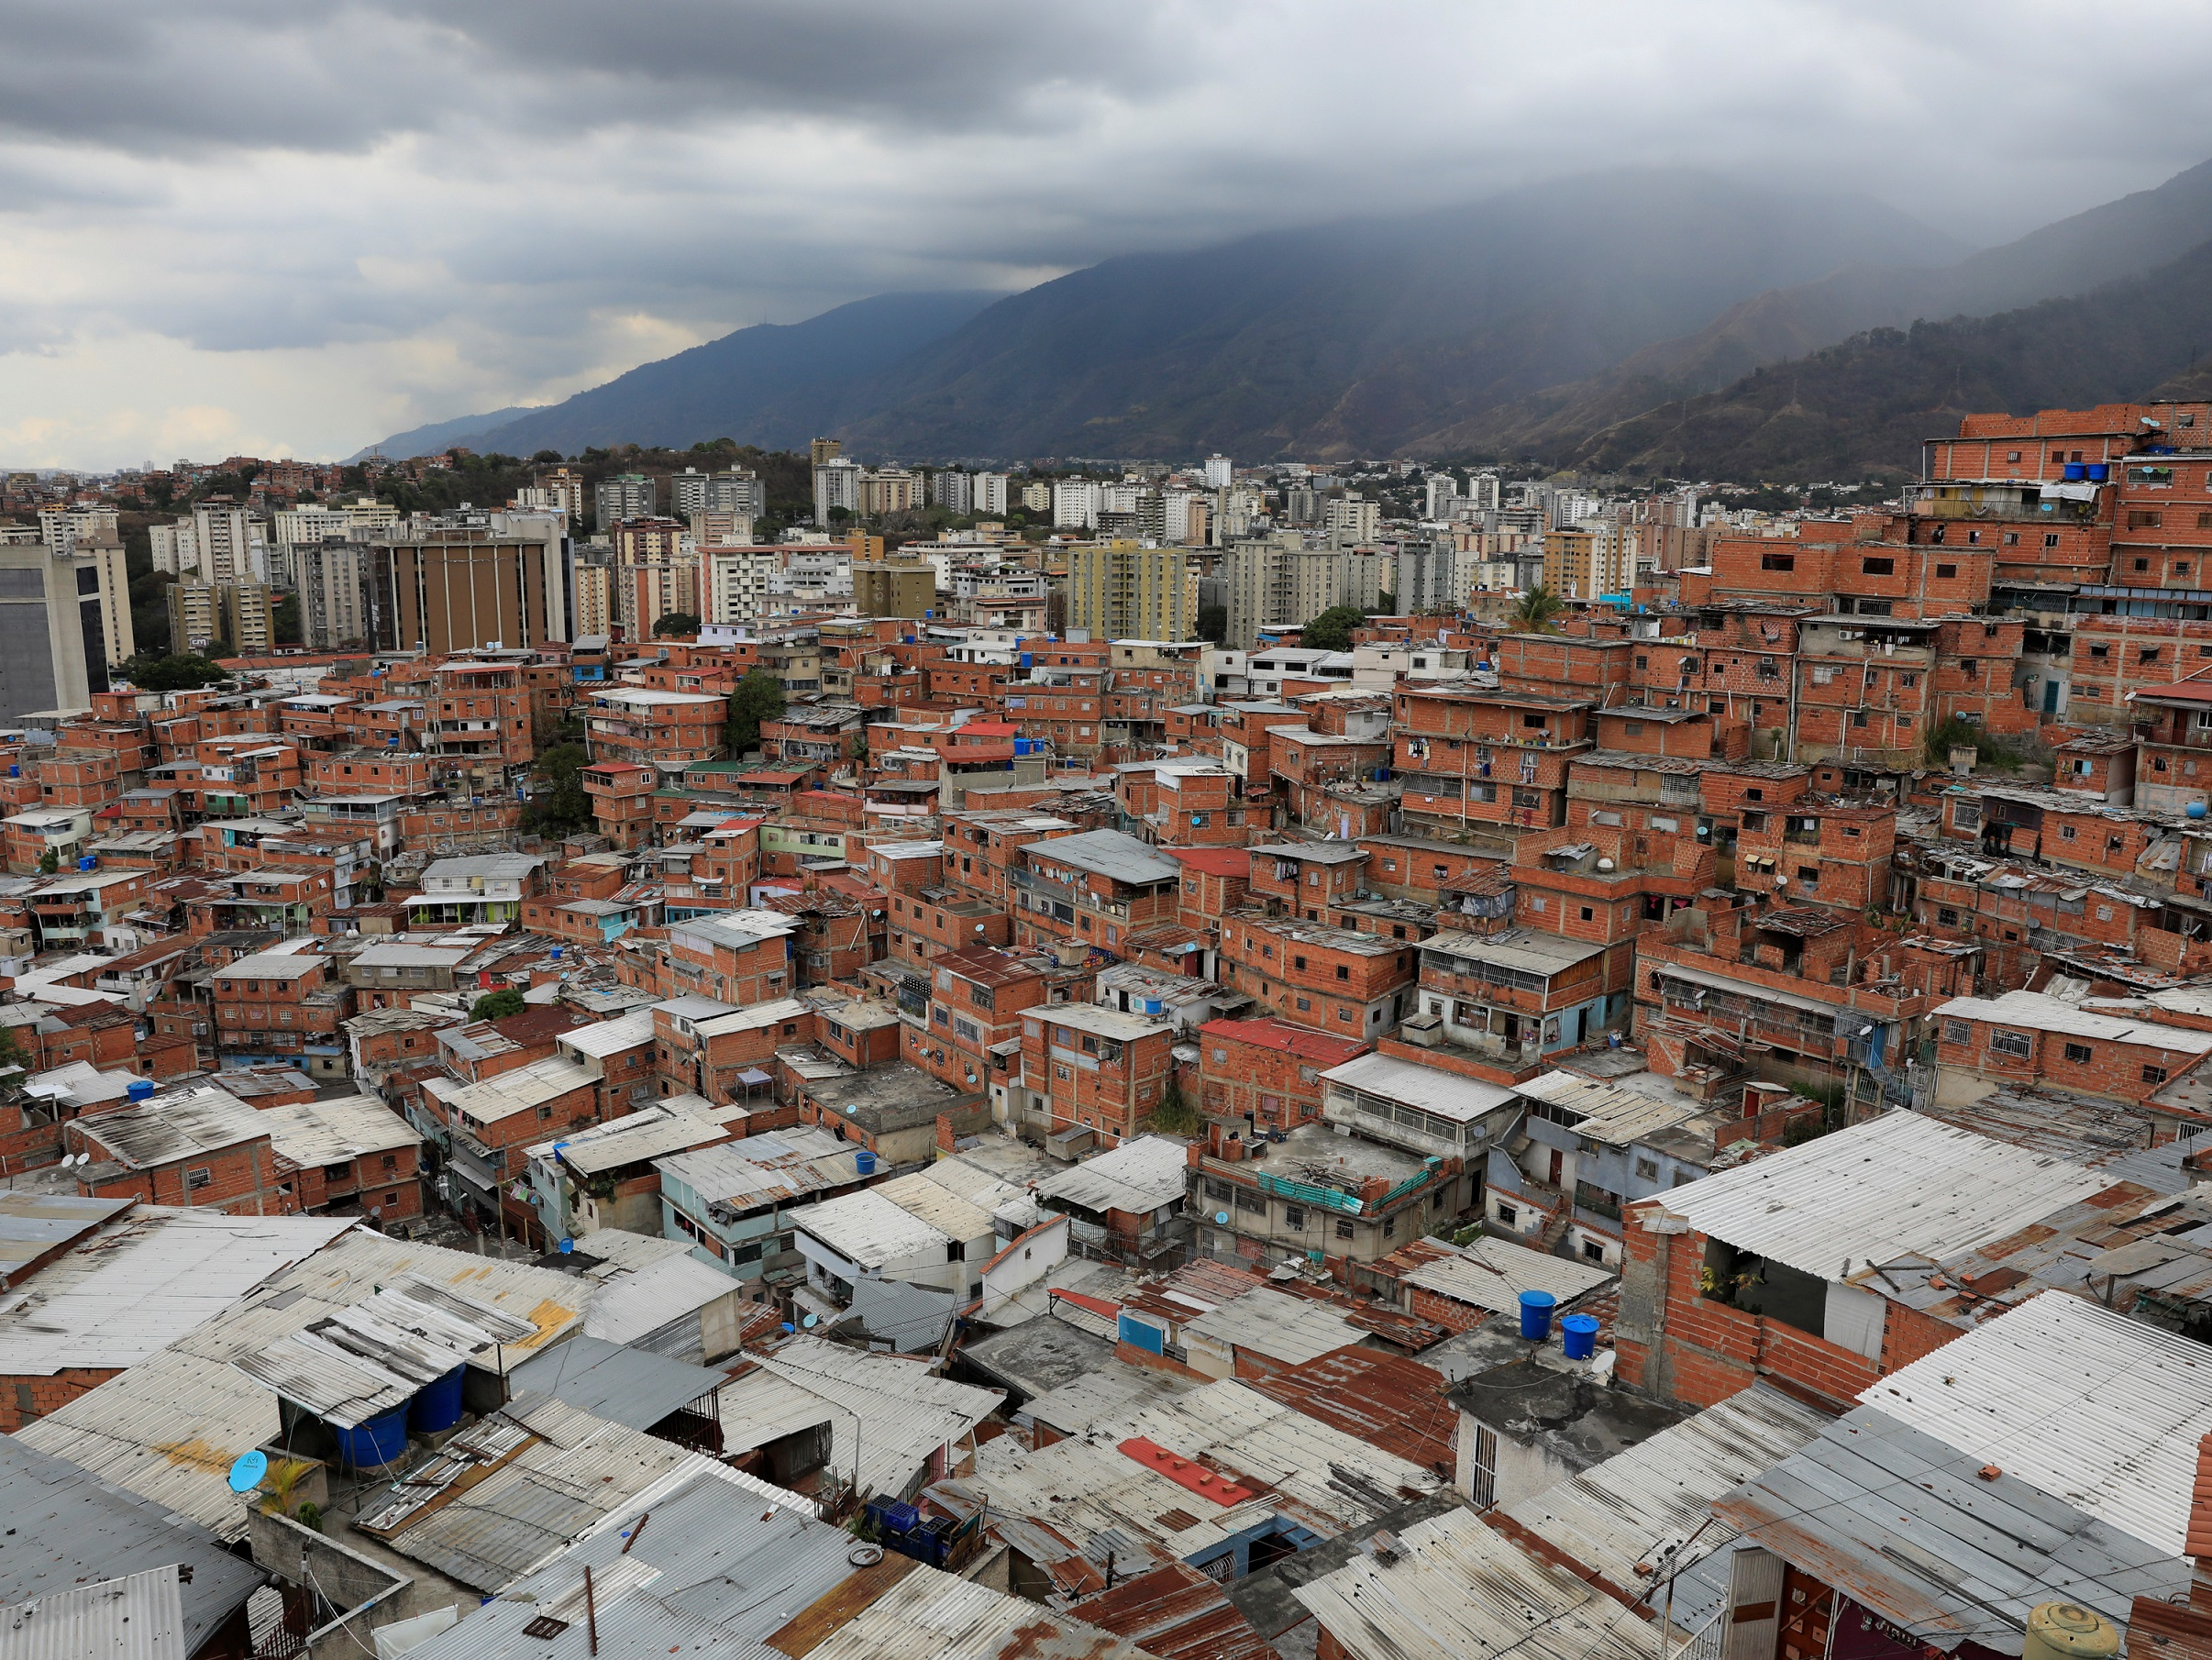
Behavior and Health Status
Binge drinking
Current drinking
Current smoking
Smoking history
Hypertension diagnosis
Treatment
Blood pressure
Age
Sex
Education
Marital Status
Depressive symptoms
Diagnosis of mental health disorder
BMI
Height
Weight
Diabetes diagnosis
and treatment
Substance Use
Total minutes of activity
Transport mode choice
Leisure time physical activity
Walking
Self-rated health status
Diabetes
Hyper- tension
Body measures
Physical Activity
Demo- graphics
General Health
Mental Health

Slide 11
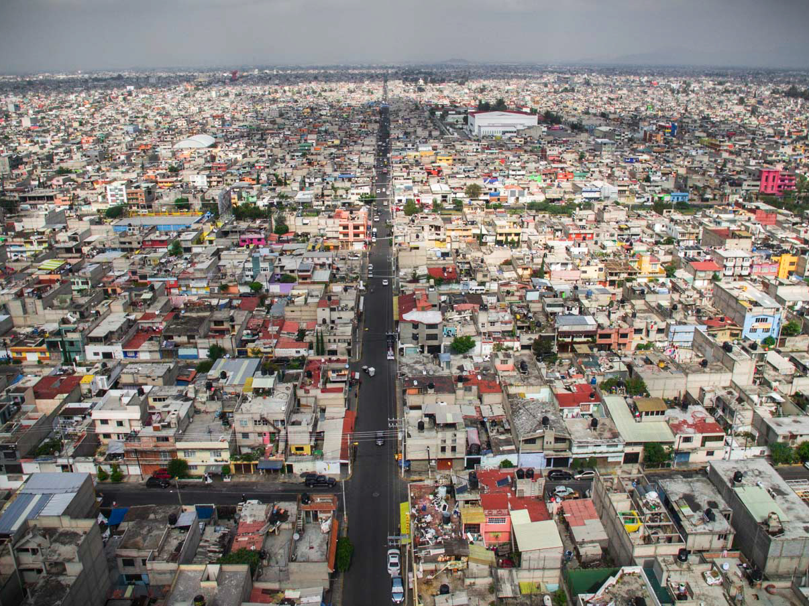
Built and Physical Environments of Cities
Street Design and Connectivity
Street density
Intersection density
Street network
Street length
Air Pollution and Green Space
Parks
Green Space
PM10 / NOx / SO4 / O3
PM2.5
Total population
Neighborhood centrality
Urban landscape
Area
Shape
Fragmentation
Isolation
Edge
Aggregation
Transportation
Bus rapid transit
Metro, light rail, elevated train
Aerial tram
Bicycle facilities
Urban travel delay index
Gasoline price
Food Environment
Density of chain supermarkets
Density of chain convenience stores

Slide 12
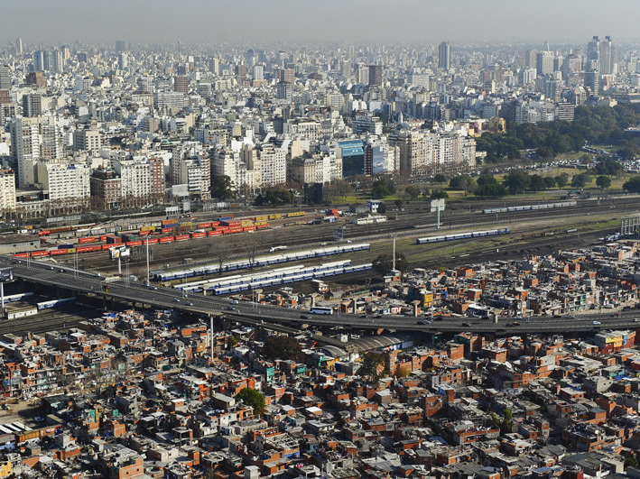
Social Environment
Education
15-17 yrs old in school
Adults with secondary education
Education-based GINI index
Gender
Female labor force participation
Female government participation
Employment
Unemployment
Labor force participation
Informal Settlements
Water connection
Sewage connection
Overcrowding
Housing materials
Poverty
Income
Income-based GINI index

Slide 13
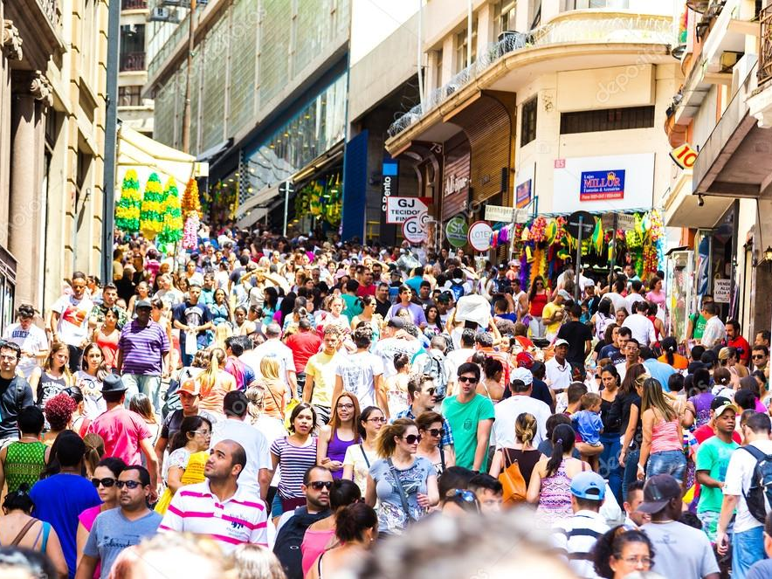
Social Environment
Violence & Disorder
Violent deaths
Crime and safety
Social disorder
Social Cohesion & Social Capital
Community organization membership
Neighborhood connectedness
Government
Governance
Social services
Healthcare

Slide 14
What can we do with this data?

Slide 15
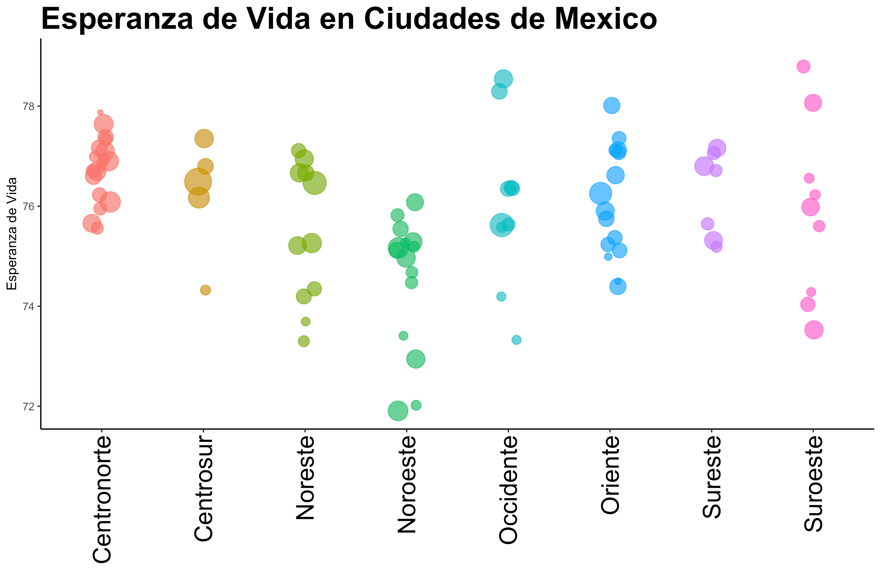

Slide 16
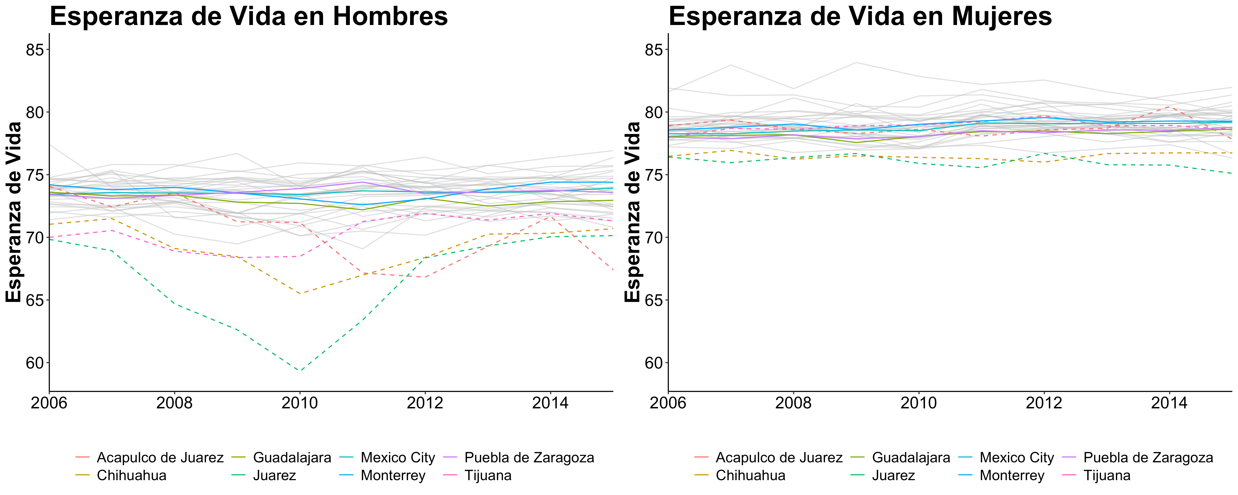

Slide 17
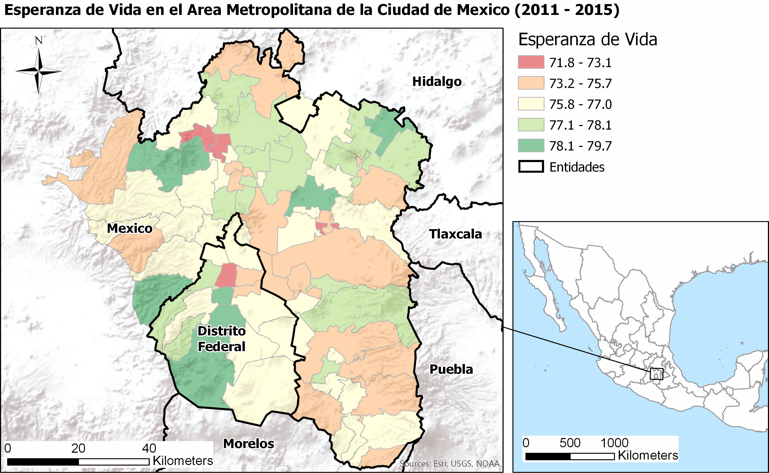

Slide 18
Some questions we want to answer
Are levels of air pollution in LAC cities associated with cardiovascular and respiratory mortality?
How does road traffic mortality (overall and by road user type) vary by age, sex and education in SALURBAL cities?
Is there any association between landscape and road network metrics and age-adjusted overall road traffic mortality?
What city level factors are associated with differences in infant mortality across cities?
How do educational inequalities in hypertension and diabetes (and key risk factors incl. dietary habits, physical activity & substance use) vary across cities?
Is living in slums associated with self-reported health and life satisfaction, and does this association differ across cities?
Is commute mode associated with life satisfaction and mental health?
Are the changes in the distribution of the retail food environment associated with diabetes and obesity prevalence in Mexican cities?

Slide 19
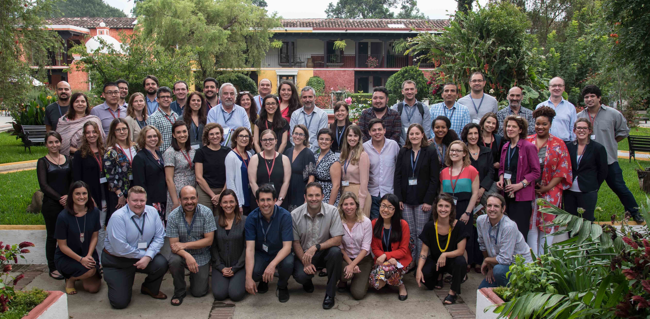
Thank you!
Gracias
Obrigada!
This PPT represents countless hours of work by the Drexel University Data and Communications Teams:
Ana Diez Roux, Alex Quistberg, Ana Ortigoza, Lance Ballester, Usama Bilal, Kari Moore, Steve Melly, Adriana Lein, and Felipe Garcia España,
as well as the entire international SALURBAL team.

