Slide 1
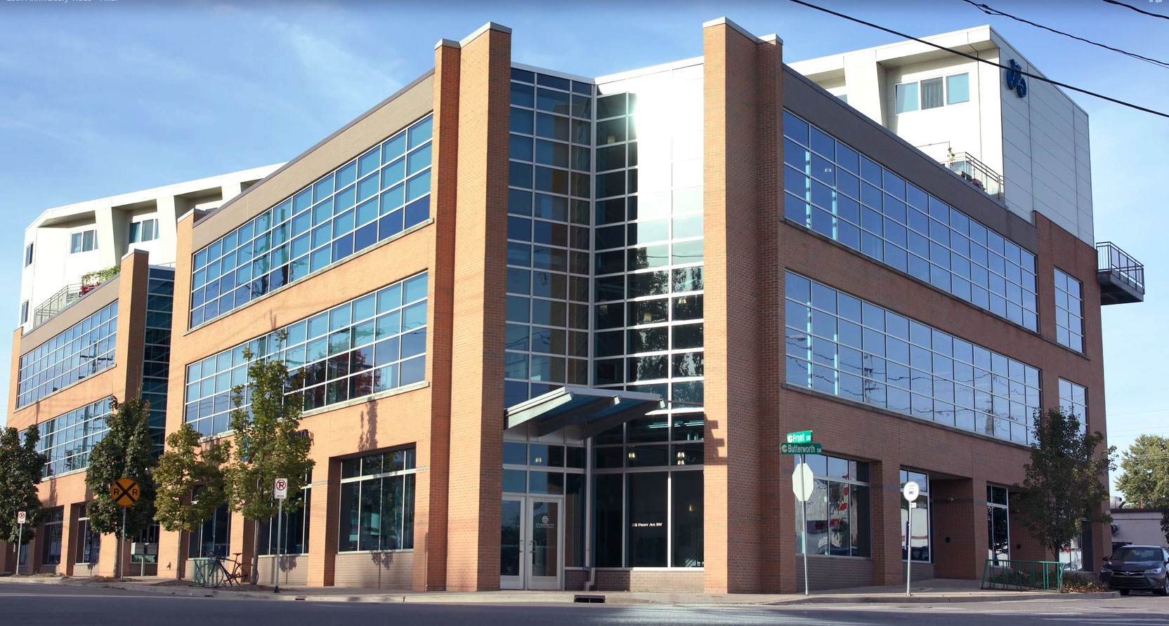
Dorothy A. Johnson Center for Philanthropy
AT GRAND VALLEY STATE UNIVERSITY
HISTORY
Established in 1992 as an academic center for advancing philanthropy and nonprofit leadership. Housed in GVSU’s CCPS, in Grand Rapids Mich.
MISSION
The Dorothy A. Johnson Center for Philanthropy aims to be a global leader in helping individuals and organizations understand, strengthen, and advance philanthropy.

Slide 2
Community Research Institute
Guides nonprofits, foundations, institutions, and neighborhood groups in using data to do good
We help our partners to share original research to use in:
Awareness building
Local and regional decision making
Program evaluation
Customized tools
Research Service
We work with data to:
Improve access
Monitor change
Aggregate/ Disseminate
Analyze community need

Slide 3
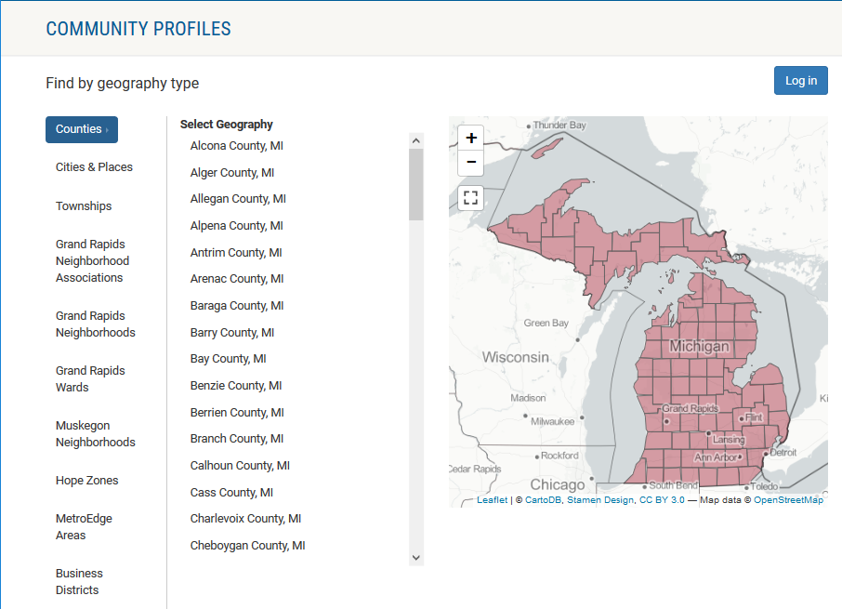
Community Profiles
Notes:
A look into Michigan counties, cities and neighborhoods to show key demographic, housing, economic and other important data.

Slide 4
Community Profiles 2.0
Notes:
A deeper dive into key demographic, housing, economic and other important data through interactive mapping, customized charts, and access to data for any customized user-defined neighborhood.

Slide 5
Community Profiles - Data Portal
Notes:
A place to access all data available through CRI tools

Slide 6
Community Profiles - Data Portal
Notes:
Select an indicator, geography type and year/source from the menu to build your download

Slide 7
Community Profiles - Data Portal
Notes:
Tools available to viewing selection and downloading data

Slide 8
Community Profiles - Data Portal
Notes:
Data selected lets the user review their current data selection before downloading

Slide 9
Community Profiles - Data Portal
Notes:
Download as CSV to get data selected by the user

Slide 10
Community Profiles - Data Portal
Notes:
Data output in CSV format

Slide 11
Existing Version
Only available on Google Play (Android)
Obsolete
OS version
Content
Community Profiles - Mobile

Slide 12
Upcoming Version
Non-native
Google Play (Android)
App Store (iPhone)
Updated content
Partnership with GVSU’s Applied Computing Institute
Developed by students
Community Profiles - Mobile

Slide 13
Not a simplified version of the web tools but a concept fully designed for a mobile application:
Reduced number of geographies
State
County (WM)
City (WM)
Neighborhood (GR)
Curated set of of indicators
Based on traffic/interest on the web tools
Limited entry options with similar navigation paths
Identical summary results per path
Community Profiles - Mobile

Slide 14
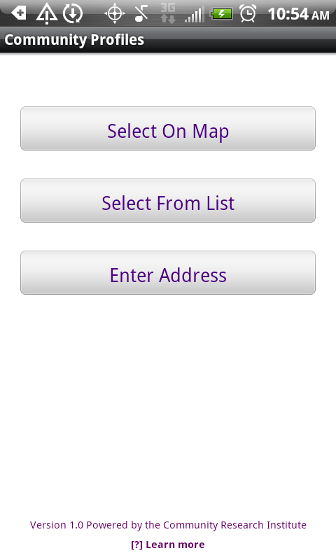
Indicators Available:
Total Housing Units
Average Household Size
% Owner Occupied Housing Units
% Renter Occupied Units
% Vacant Housing Units
Total Population
% Female-headed family
% Population under 18 years old
% White
% Non-White
% Black or African American
% Hispanic or Latino
Entry Options:
Community Profiles - Mobile

Slide 15
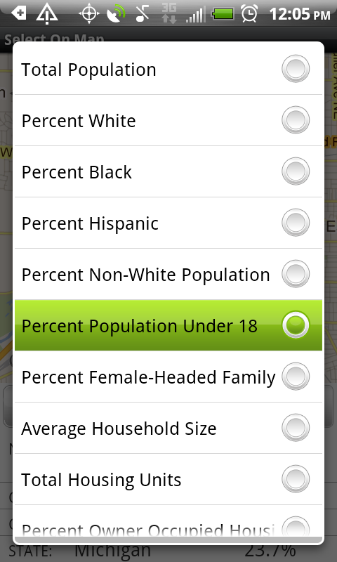
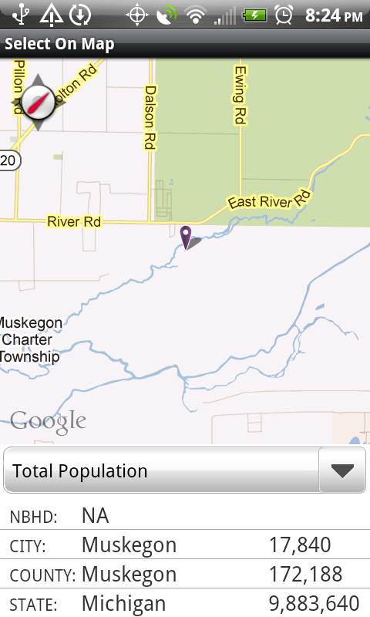
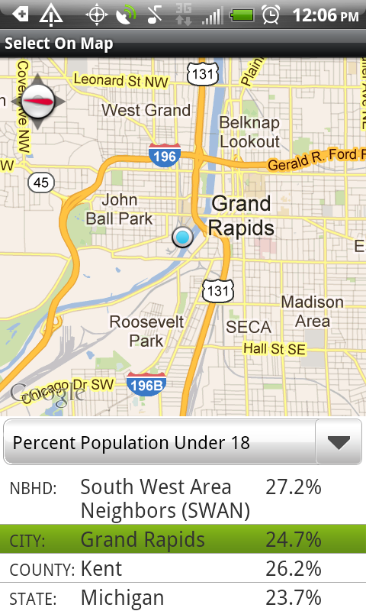
Default:
center on
current
location
Select an indicator
(Default: Total Population)
The corresponding values per geography will show here
Community Profiles - Mobile

Slide 16
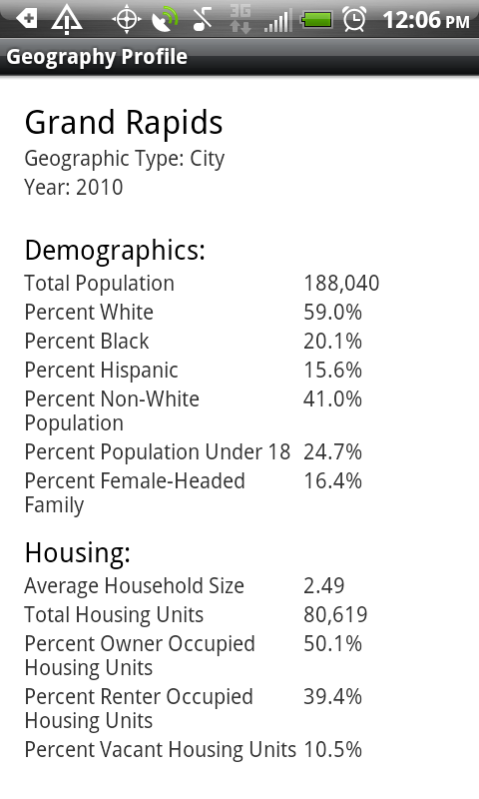
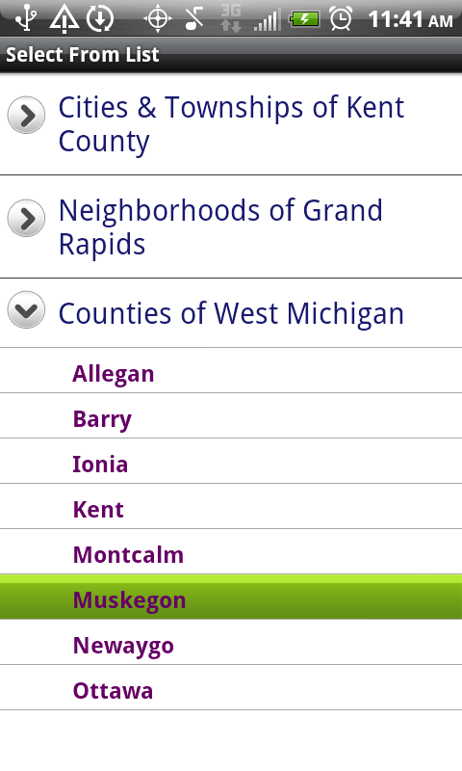
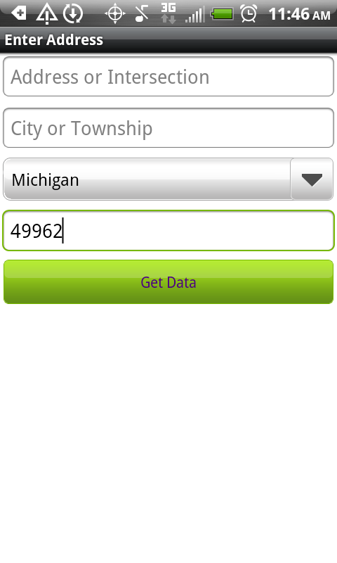
Alternate Paths
Select From List
Enter Address
Community Profiles - Mobile

Slide 17
Rebrand and Relaunch
Create as a suite of tools
Reports
Data Visualization
Data Portal
Mobile
Rebrand to a single name for the suite

Slide 18
Rebrand and Relaunch
Rebrand to a single name for the suite
Reach for a broader audience
Collect user testimonials

Slide 20
Community Activation: Tools to Inform and Engage
Adriana Paz, M.S. C.I.S. Senior Database Administrator
pazsanad@gvsu.edu
NNIP, October 17, 2018

