Slide 1
Predicting homelessness with integrated data and machine learning
Davin Reed, NYU Wagner and Furman Center for Real Estate and Urban Policy
Collaboration with the New York City Center for Innovation through Data Intelligence
NNIP Partnership Meeting, April 6, 2016

Slide 2
Overview
Background
Research questions
Integrating data
Machine learning
Challenges and opportunities of integrated data and machine learning

Slide 3
Background
Increase in shelter use and specifically family shelter use over time
Effective prevention services exist but are currently mostly limited to families seeking help

Slide 4
Research questions
Is it possible to leverage existing administrative data to predict shelter risk for families not actively seeking help?
Can building and neighborhood characteristics improve prediction?
How well can a best possible model do?
Can we identify a handful of “red flag” predictors, and how well do they do?

Slide 5
Integrating data
Individual
Department of Homeless Services: Family shelter applications, stays, and eligible stays
Building
Department of Finance
Housing Preservation and Development
New York State (foreclosures, housing court)
Rent Guidelines Board
NYCHA
Neighborhood

Slide 6
Machine learning
Algorithmic, not statistical, approach to prediction
Very flexible, very robust
Focus on prediction out of sample
Avoids overfitting

Slide 7
Machine learning
Four main types of models
Complex (best possible) models
Building level
Individual level
Red flag models
Building level
Individual level
Results here are only for building-level models

Slide 8
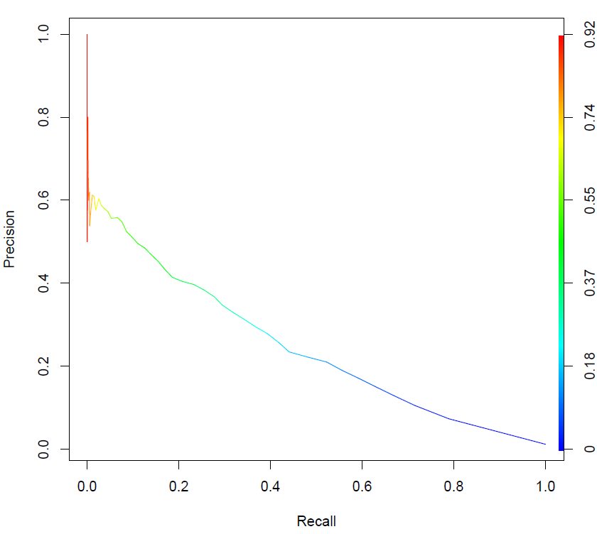
Machine learning
Complex model: random forests

Slide 9
Machine learning
Recall | Precision | Outreach
10% | 50.5% | 2,586 buildings
25% | 38.8% | 8,435 buildings
50% | 21.6% | 30,345 buildings
If we reach out to the 2,586 highest-risk buildings, half will actually send a family to shelter.
And those 1,296 buildings that actually send a family to shelter will be 10% of all that do so.

Slide 10
Machine learning
Red flag models
Identify a handful of best predictors
Shelter application variables are best predictors
Previous application from building
Applications from other buildings on block

Slide 11
Machine learning
Block-level variables are next best
Created by aggregating building-level characteristics to block level
Tax delinquency
Sale
Rental status
Hazard

Slide 12
Challenges
Integrated data
Protecting individuals’ private information
Legal hurdles to accessing and integrating different data sets
Restrictions on how and where can use integrated data
Technical and computational
Data sets can get enormous: tens of millions of observations, hundreds of variables
Time costs of assembling and cleaning data

Slide 13
Opportunities
Integrated data
More variables
Model greater complexity, uncover new relationships
More observations
More power
Machine learning
Greater predictive accuracy
Greater flexibility
The future of prediction, increasing role in policy

Slide 14
Conclusions
Integrated data and machine learning greatly improved our project’s ability to predict homelessness
Individual, building and neighborhood characteristics all matter
Building-level models using integrated, publicly available data do quite well

