Slide 1
Leveraging Integrated Data Systems to Examine the Effect of Housing and Neighborhood Conditions on Kindergarten Readiness
Claudia J. Coulton, Ph.D., Professor
Francisca G.-C. Richter, Ph.D., Research Assistant Professor
Seok-Joo Kim, Ph.D., Senior Research Associate
Robert Fischer, Ph.D. Research professor
Youngmin Cho, M.A., Graduate Assistant
Center on Urban Poverty and Community Development
Funding for this study was provided by the John D. and Catherine T. MacArthur Foundation as part of the How Housing Matters program.

Slide 2
Purpose of the study
To examine the influence of early childhood housing conditions on lead exposure and school readiness for all children entering kindergarten over a four year period in a big city school system.
To demonstrate the cost-effectiveness of using Integrated Data Systems (IDSs) that link administrative data on both individual children and residential properties to investigate housing and early childhood policy concerns.

Slide 3
Conceptual model: Hypothesized relationships between housing, mediators and kindergarten readiness scores
Family characteristics
Child characteristics
Housing characteristics
Housing market
distress event
Neighborhood quality
Child maltreatment
Kindergarten Readiness Assessment- Literacy
(KRA-L)
Elevated
blood lead concentrations
Residential moves
Family, child
background
Early childhood experiences
(Ages 0 – 5)
Readiness at K entry
(Ages 5 – 6)

Slide 4
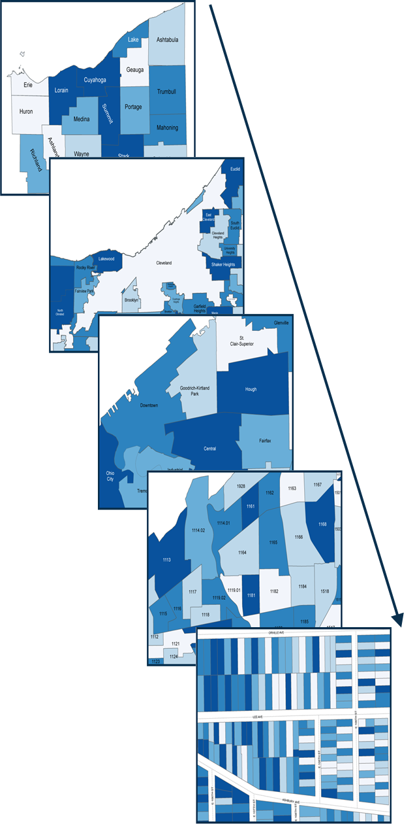
Data systems: ChidHood Integrated Longitudianal Data (CHILD) system and Neighborhood Stabilization Team (NST) web application
CHILD system
NST web application
Teen births
Mother’s demographic
Birth weight
Prenatal care
Birth
Certificates
Child
Medical
Data
Infant mortality
Elevated Blood
Lead
Region
ID₂
ID₁
City
Medicaid
SNAP
TANF
Public
Assistance
Housing
Housing condition
Tax
delinquency
Foreclosure
ID₃
ChildHood
Integrated
Longitudinal
Data(CHILD)
System
Address
Neighborhood
Abuse/
neglect
Foster care
Juvenile
court
Homeless
Child
Welfare
ID₄
GeoID
Neighbor-
hood
Poverty
Age
Unemployment
Race/Ethnicity
Immigrants
Census Tract
ID₅
ID₆
Home visiting
Child care
UPK
Special needs child care
Early childhood mental health
Services
Public
School
Attendance
KRA-L
Proficiency test
Disability
Graduation test
Parcel

Slide 5
Sampling and study design
Sampling criteria
Children who entered kindergarten for the first time in the Cleveland Metropolitan School District (CMSD) during the 2007-2010 academic years
Sample size
13,762 children
Study design
Longitudinal, population-based study that draws on IDSs covering children and properties
Study population was followed from birth through kindergarten entry using monthly address histories from a combination of administrative records.

Slide 6
Accuracy of monthly address history
Accuracy | Tool | Description | N | (%)
High I | ArcGIS | >80% (Highest accuracy) | 42,619 | (93.4)
High II | Mapmarker | Street & Zip code (Highest accuracy) | 1,253 | (2.8)
Moderate I | ArcGIS | 60-80% (Moderate) | 221 | (0.5)
Moderate II | Batchgeo & Google | Exact position (Street & Zip code) | 81 | (0.2)
Low I | Batchgeo & Google | Street center within zip code | 606 | (1.3)
Low II | Census 2000 | Center of Zip code | 109 | (0.2)
Unknown |  | Unknown (Out of OH, etc.) | 1 | (0.0)
Total |  |  | 44,890 | (100.0)

Slide 7
Linking address history to County parcel data: Accuracy of matching
Parcel accuracy | Description of matching | N | (%)
High I | Matched by address and zip code | 38,693 | (86.9)
High II | Matched by address | 1,715 | (3.9)
Moderate | Manually matched ^{a)} | 4,092 | (9.1)
Low I | No street number | 10 | (0.0)
Low II | Strange or blank addresses | 33 | (0.1)
Total |  | 44,543 | (100.0)
Note. ^{a)} Manual matching was conducted via the following County website: Http://recorder.cuyahogacounty.us/searchs/parcelsearchs.aspx

Slide 8
Descriptive statistics
Variable |  | M or %
Race/ethnicity | Reference=African American | 69.0%
 | Non-Hispanic White | 18.2%
 | Hispanic | 11.7%
 | Other | 1.1%
Family characteristics | Poverty (Share of time below poverty line) | 0.75
Neighborhood qualityª | Concentrated disadvantage score above 70p | 0.66
Housing characteristicsª | Poor condition housing | 0.18
 | Low value housing (<$30,000 inflation adjusted) | 0.31
 | Public housing or project based Section 8 | 0.10
Housing mkt distressª | Parcel with tax delinquency | 0.15
 | Parcel in foreclosure | 0.07
 | Parcel owned by speculator | 0.05
Buffer 500ft | With tax delinquency | 9.95
(Avg. number of parcels) | In foreclosure | 3.51
 | Owned by speculator | 2.46
Mediators | Child neglect/abuse investigation (% ever) | 40.3%
 | Residential moves (Average per year) | 0.46
 | Lead level in blood >5 μg/dL (% positive) | 38.6%
Note. ªShare of years exposed to each condition

Slide 9
Marginal Structural Models (MSM) for the relationship between housing conditions and KRA-L
Variable |  | I |  |  | II |  |  | III
 | b | se |  | b | se |  | b | se
Neighborhood qualityª
Concentrated disadvantage^{b} | -0.71 | 0.20 | *** | -0.77 | 0.22 | *** | -0.74 | 0.22 | ***
Housing characteristicsª
Poor condition housing | -0.43 | 0.23 | † | -0.34 | 0.24 |  | -0.13 | 0.24
Low value housing^{c} | -0.13 | 0.20 |  | -0.33 | 0.20 |  | -0.25 | 0.20
Public housing or project based Section 8 |  |  |  | -0.17 | 0.29 |  | -0.15 | 0.29
Housing mkt distressª
Parcel with tax delinquency |  |  |  | -0.78 | 0.28 | ** | -0.52 | 0.29 | †
Parcel in foreclosure |  |  |  | -1.39 | 0.44 | ** | -1.01 | 0.44 | *
Parcel owned by speculator |  |  |  | -1.54 | 0.39 | *** | -1.25 | 0.39 | **
Buffer 500ft- Avg. number of parcels
With tax delinquency |  |  |  | 0.05 | 0.02 | ** | 0.05 | 0.02 | *
In foreclosure |  |  |  | -0.11 | 0.05 | * | -0.11 | 0.05 | *
Owned by speculator |  |  |  | 0.02 | 0.05 |  | 0.03 | 0.05
Mediators
Child neglect/abuse investigationª |  |  |  |  |  |  | -2.21 | 0.34 | ***
Residential moves (average per year) |  |  |  |  |  |  | -0.45 | 0.17 | *
Lead level in blood>5μg/dL (Ref:Negative)
(Positive) |  |  |  |  |  |  | -0.84 | 0.14 | ***
Note. †p<.10, *p<.05, **p<.01, ***p<.001. N=13,689 (Multiple imputation, m=30). All models included a dummy variable for the year of entry into kindergarten. ª Share of years up to k entry exposed to each condition. ^{b} Score>70th percentile. ^{c} <$30,000 inflation adjusted. MSM=weighted by the Inverse Probability of Treatment.

Slide 10
Marginal Structural Models (MSM) for the relationship between housing conditions and lead poisoning
Variable | dy/dx | se
Neighborhood qualityª
Concentrated disadvantage^{b} | 0.086 | 0.013 | ***
Housing characteristicsª
Poor condition housing | 0.038 | 0.012 | **
Low value housing^{c} | 0.054 | 0.011 | ***
Public housing or project based Section 8 | -0.008 | 0.017
Housing mkt distressª
Parcel with tax delinquency | 0.057 | 0.014 | ***
Parcel in foreclosure | 0.051 | 0.024 | *
Parcel owned by speculator | 0.046 | 0.027 | †
Buffer 500ft- Avg. number of parcels
With tax delinquency | 0.003 | 0.001 | ***
In foreclosure | 0.010 | 0.003 | **
Owned by speculator | 0.000 | 0.004
Note. †p<.10, *p<.05, **p< .01, ***p<.001. N=13,681 children (Multiple imputation, m=30). Model controls for year of birth. Dependent variable values=Positive, Negative, Not Tested. ª Share of years up to age 3 exposed to each condition. ^{b} Score>70th percentile. ^{c} <$30,000 inflation adjusted. dy/dx = Margins for probability of testing positive. MSM=weighted by the Inverse Probability of Treatment.

Slide 11
Average predicted test scores for levels of housing and neighborhood distress
*
*
Negative lead test
Positive lead test

Slide 12
Conclusions
Housing quality and market distress can be important factors in understanding the ecological context for early educational success.
The state of repair of families’ housing units within neighborhoods are a proximal influence that further contributes to kindergarten readiness.
Housing market forces play a role in exacerbating housing problems and their effects on children.
There are spillover effects of housing disinvestment in the immediate area to children in nearby properties.
IDSs that incorporate detailed information on children and on the conditions of the properties that they live in can be useful for research and policy planning at a population scale.

Slide 13
Thank you!
Q / A
Contact Information
Claudia J. Coulton, Ph.D. (claudia.coulton@case.edu)
Resources
Center on Urban Poverty & Community Development: http://povertycenter.case.edu/
NEO CANDO: http://neocando.case.edu/

