Slide 1
Developing Public and Academic Libraries as Key Participants in Civic Open Data Ecosystem
Funded by Institute of Museum and Library Services (IMLS) –
A partnership of the University Library System at the University of Pittsburgh, Carnegie Library Pittsburgh, Western Pennsylvania Regional Data Center, and NNIP.

Slide 2

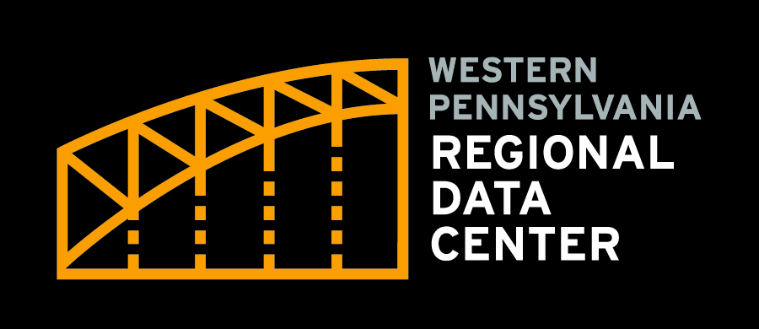



Slide 3
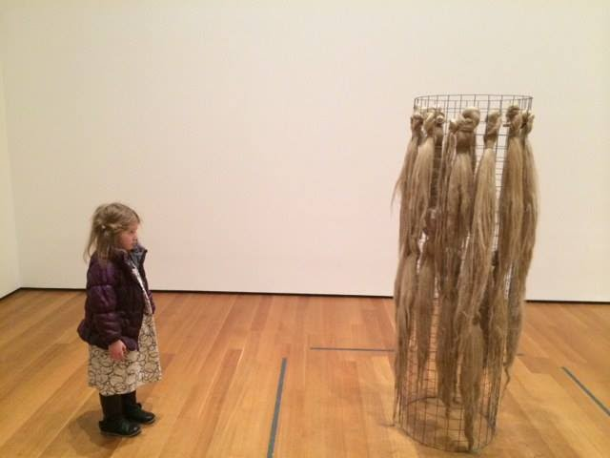
The Institute of Museum and Library Services (IMLS)
Mission: to inspire libraries and museums to advance innovation, lifelong learning, and cultural and civic engagement.
Notes:
is the primary source of federal support for the nation's 120,000 libraries and 35,000 museums…

Slide 4
2 year project working to develop the capacity of public and academic libraries to serve as key partners in local open civic data ecosystems
Notes:
consider roles, opportunities, practices, and governance in the civic data ecosystem;
anticipate and address common challenges;
measure local civic open data health and capacity;
and learn from examples of successful civic data partnerships.

Slide 5
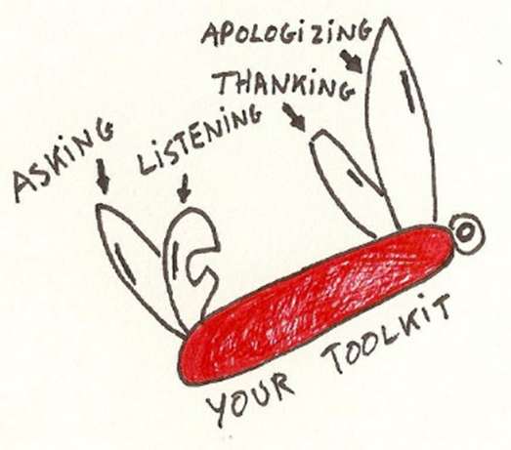
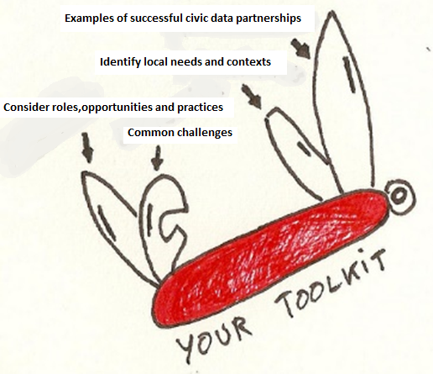
OUTPUT
Guide and toolkit to build intermediary capacity
Notes:
identify local needs and contexts around open civic data; consider roles, opportunities, practices, and governance in the civic data ecosystem; anticipate and address common challenges; measure local civic open data health and capacity; and learn from examples of successful civic data partnerships.

Slide 6




YEAR 1: Cross pollination Opportunity
Fall 2018 Digital Library Federation (DLF) Conference
Spring 2018 NNIP Pre-Session
Notes:
To build relationships between libraries and other non-library data intermediaries, and to gather additional information for the guide, the project will conduct two workshops that bring together regional teams consisting of at least one library partner and one NNIP or comparable civic data partner. One workshop will take place at a national NNIP meeting in spring 2018 and another at the Digital Library Federation (DLF) Forum in fall 2018. At NNIP and DLF, the project will provide stipend awards to subsidize the workshop participation of regional teams (consisting of at least one library partner and civic data partner). We will make awards to support the attendance of up to ten pairs representing different cities or regions. In addition to the workshop stipends, the project will encourage cross-pollination of library and non-library data intermediaries through Cross-Pollinator Registration Awards. Through a mix of cost shared contributions and requested funds, up to five of the workshop participants will receive complimentary registration to stay on to attend the conference of their non-affiliated community (either NNIP or DLF), further strengthening partnerships and cross-pollinating the communities.

Slide 7

YEAR 2: Testing Opportunity
$ for 5 Communities to participate in field testing
Notes:
5 libraries with existing or strong potential roles in their civic data ecosystem.
The project will support libraries with ideas for testing and further developing aspects of work represented in the guide.
Each awardee will agree to contribute a case study, documenting their local experience, as well as participate in regular communications of this cohort, described below. The case studies will be featured in the guide to illustrate the variety of library roles in civic data partnerships. The project team will work with applicants to ensure that proposed activities align with the guiding principles.

Slide 8

Follow up with us at a Camp Session
Or get in touch…
Liz Monk
monk.e@pitt.edu
Eleanor Tutt
tutte@carnegielibrary.org
Bob Gradeck
rmg44@pitt.edu

Slide 9
Thank you!

