Slide 1
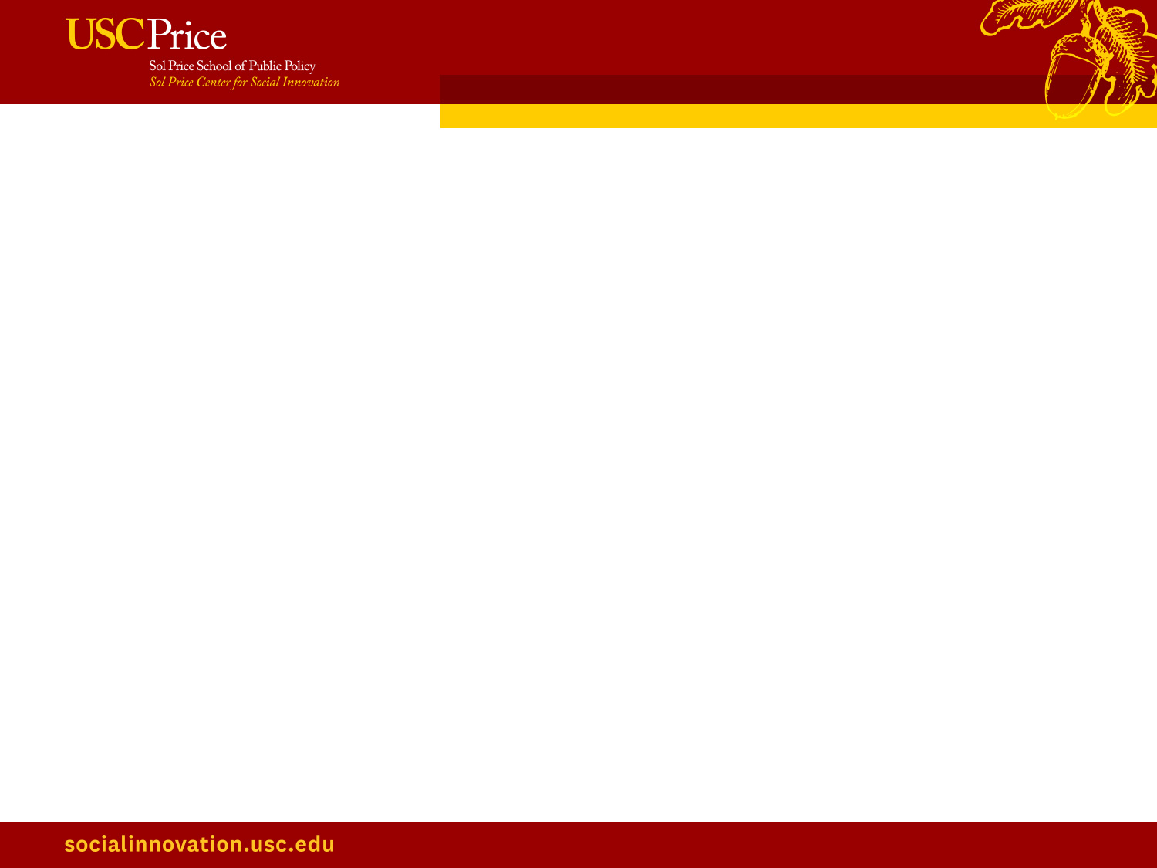
Storytelling Through Neighborhood Data
Neighborhood Data for Social Change
A Project of the USC Price Center for Social Innovation
@USCPriceCSI
https://socialinnovation.usc.edu/

Slide 2
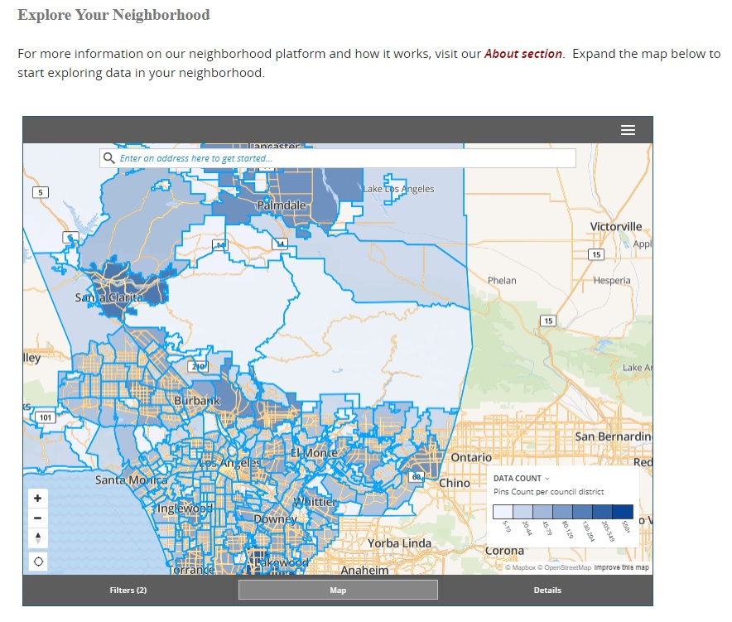

Neighborhood Data for Social Change
  The Price Center’s new NDSC platform compiles and organizes neighborhood (census tract) level data from a variety of sources in order to analyze and disseminate findings to decision makers in Los Angeles County
  The NDSC data platform is not only about producing data.
  The Price Center collaborates with community partners to craft and disseminate data stories that highlight trends, challenges, and opportunities in local communities.
@USCPriceCSI
https://socialinnovation.usc.edu/

Slide 3
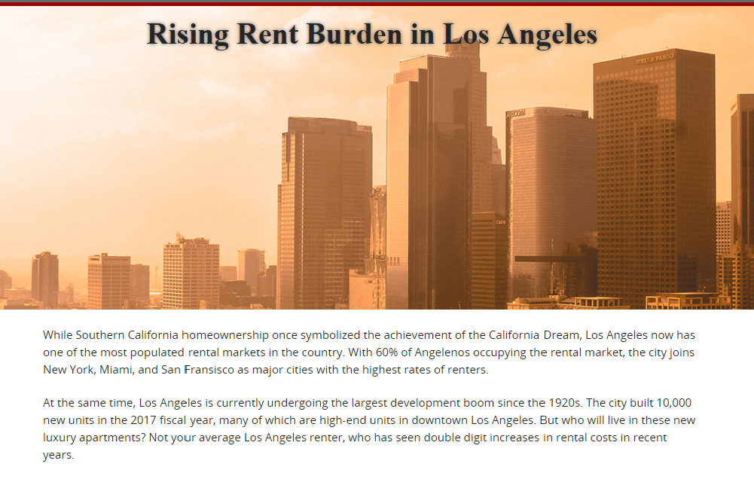

@USCPriceCSI
https://socialinnovation.usc.edu/

Slide 4
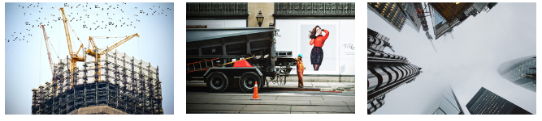
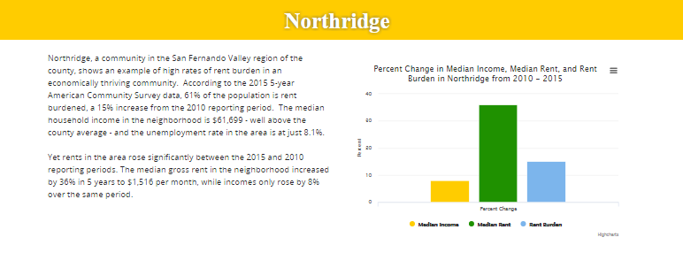

@USCPriceCSI
https://socialinnovation.usc.edu/

Slide 5
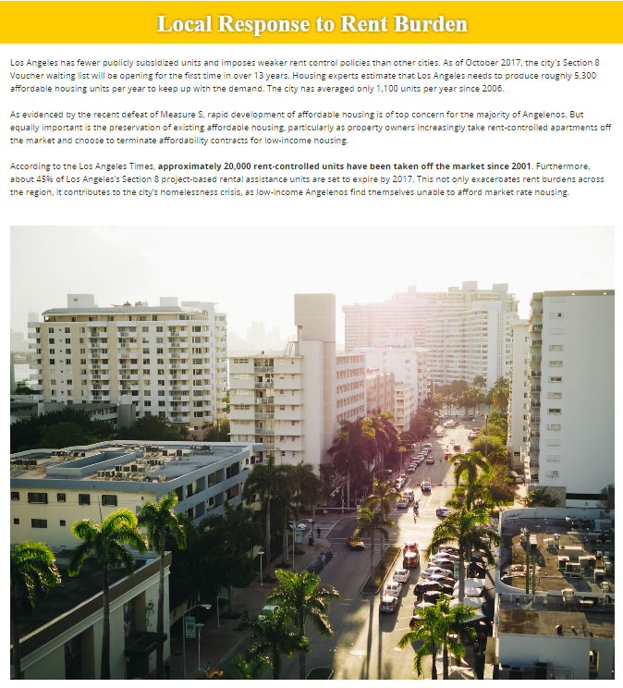

Production of Data Stories:
Identify interesting trends from data in specific policy areas (health, housing, environment, etc.)
Review source material to provide context and history
Locate open source photos (or take original photography!)
Create interactive maps and visualizations
Draft narrative (800 words)
Fact check!!!
Partner Collaboration
@USCPriceCSI
https://socialinnovation.usc.edu/

Slide 6
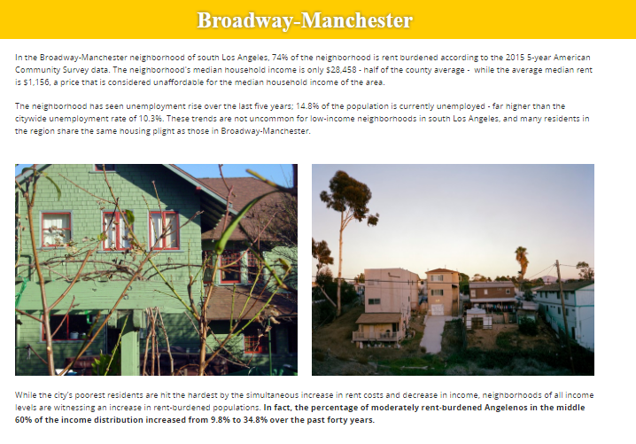

Key Elements of Data Stories:
Rich journalistic-style narrative that describe interesting data findings
Background source material to round out the story
Interactive maps, charts, and other data visualizations
Engaging photos and video
First person quotes (if possible!)
@USCPriceCSI
https://socialinnovation.usc.edu/

