Slide 1
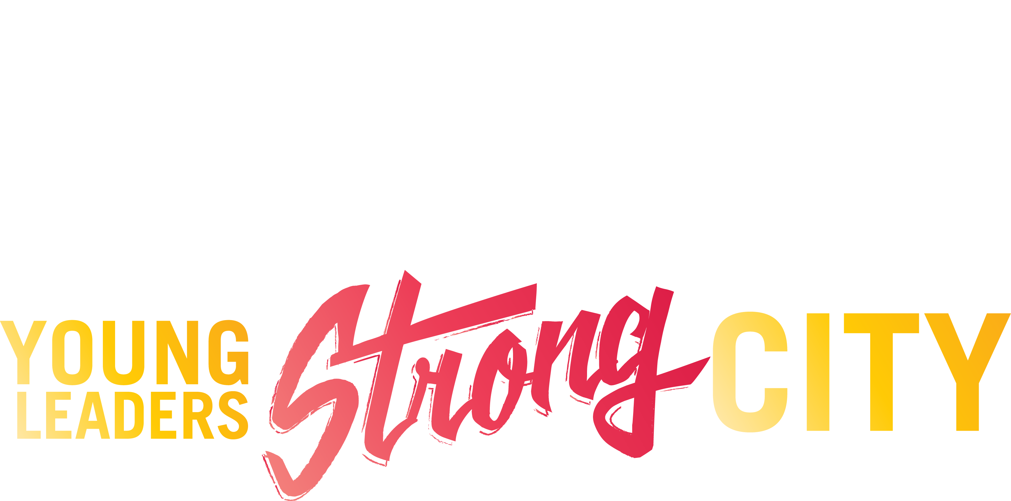

Slide 2
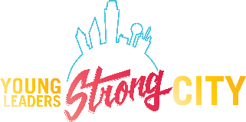
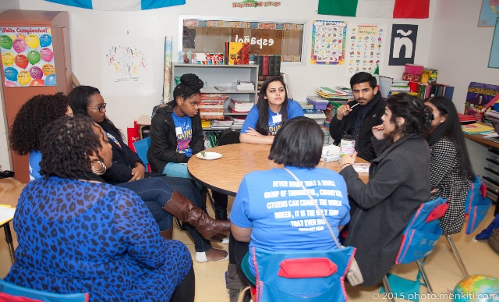
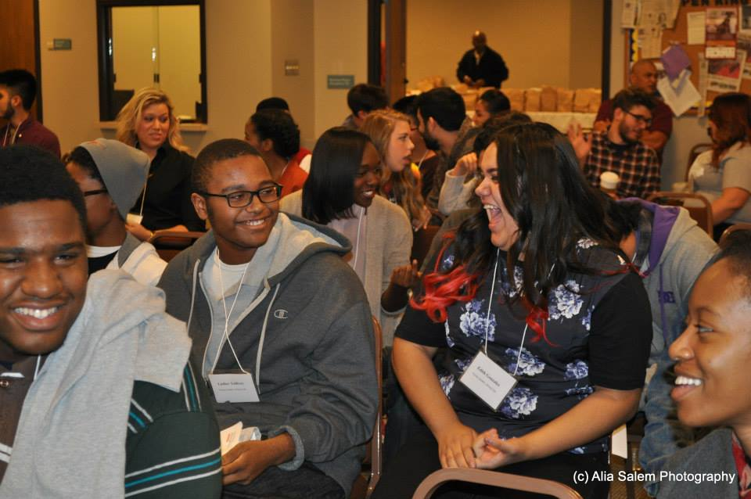
Dallas’ Only Social Justice and Equity Summit for Teens
Young Leaders, Strong City (YLSC) started in 2014
Space for Dallas metro high school students to learn about social justice and equity issues
Consists of an annual summit where students explore systemic inequities through different workshops
Programming is changed each year for relevancy

Slide 3
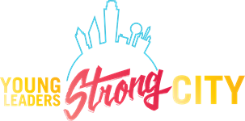
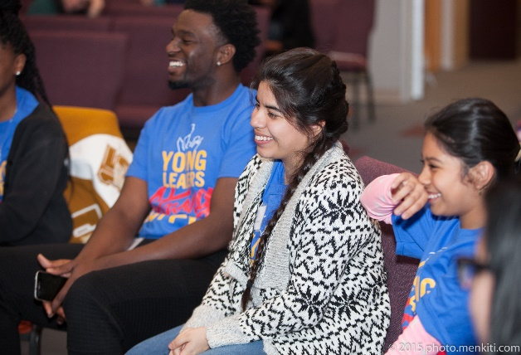
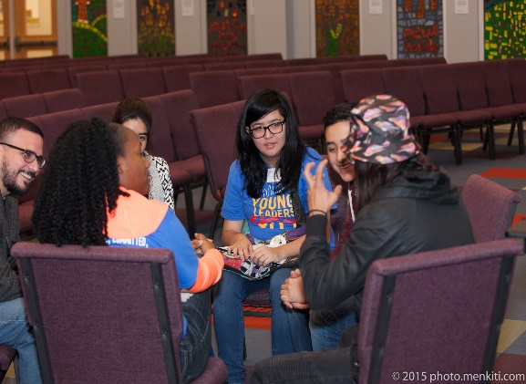
A Brief History
In 2014 Dallas hosted Facing Race, the country’s largest conference on racial justice
Sara Mokuria, Associate Director of Leadership Initiatives at IUPR, organized a conference host committee
Recognition of a gap in youth programming in conference
IUPR and several collaborators started YLSC
Well received, so it was made into an annual summit.
We recruit Dallas-area students from public, private, charter and magnet high schools
Facilitated by local leaders in different areas of the community
In 2014, 71 high school students attended, 29 students attended in 2015, and 38 students attended in 2016

Slide 4
A Brief History
In 2014 Dallas hosted Facing Race, the country’s largest conference on racial justice
Sara Mokuria, Associate Director of Leadership Initiatives at IUPR, organized a conference host committee
Recognition of a gap in youth programming in conference
IUPR and several collaborators started YLSC
Well received, so it was made into an annual summit.
We recruit Dallas-area students from public, private, charter and magnet high schools
Facilitated by local leaders in different areas of the community
In 2014, 71 high school students attended, 29 students attended in 2015, and 38 students attended in 2016

Slide 5
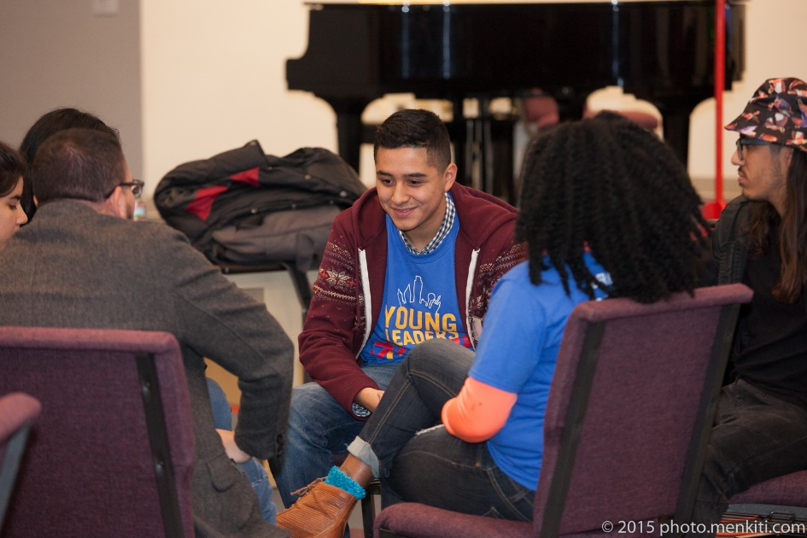
Guiding Principles
Diversity
We value the insights, relationships and understandings that are developed when divergent paths cross
We seek to create an environment that cultivates diversity across multiple dimensions of identity
We acknowledge, respect and celebrate our difference(s) and commonalities.
Learning with Intent
We are committed to practicing justice, liberation, and peace in our engagements
We are committed to share what we learn with our families, communities, and the world.
Collective Value
Everyone has intrinsic value, and power
Everyone has the ability to learn, teach, and lead
We encourage people to engage with their whole selves
In the words of Ella Baker we believe, “Give light, and people will find the way.”
Restorative Justice
We spend more time building than attacking
By creating a nurturing environment that we promote restoration, not depletion
Going to the hard place
We recognize the importance of struggle in promoting transformation
Instead of avoiding difficult conversations, we face them head on with love and care
We provide space to address the issues young people are witnessing and experiencing

Slide 6
Guiding Principles
Diversity
We value the insights, relationships and understandings that are developed when divergent paths cross
We seek to create an environment that cultivates diversity across multiple dimensions of identity
We acknowledge, respect and celebrate our difference(s) and commonalities
Learning with Intent
We are committed to practicing justice, liberation, and peace in our engagements
We are committed to share what we learn with our families, communities, and the world
Collective Value
Everyone has intrinsic value, and power
Everyone has the ability to learn, teach, and lead
We encourage people to engage with their whole selves
In the words of Ella Baker we believe, “Give light, and people will find the way.”
Restorative Justice
We spend more time building than attacking
By creating a nurturing environment that we promote restoration, not depletion
Going to the hard place
We recognize the importance of struggle in promoting transformation
Instead of avoiding difficult conversations, we face them head on with love and care
We provide space to address the issues young people are witnessing and experiencing

Slide 7
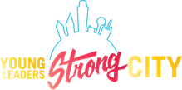
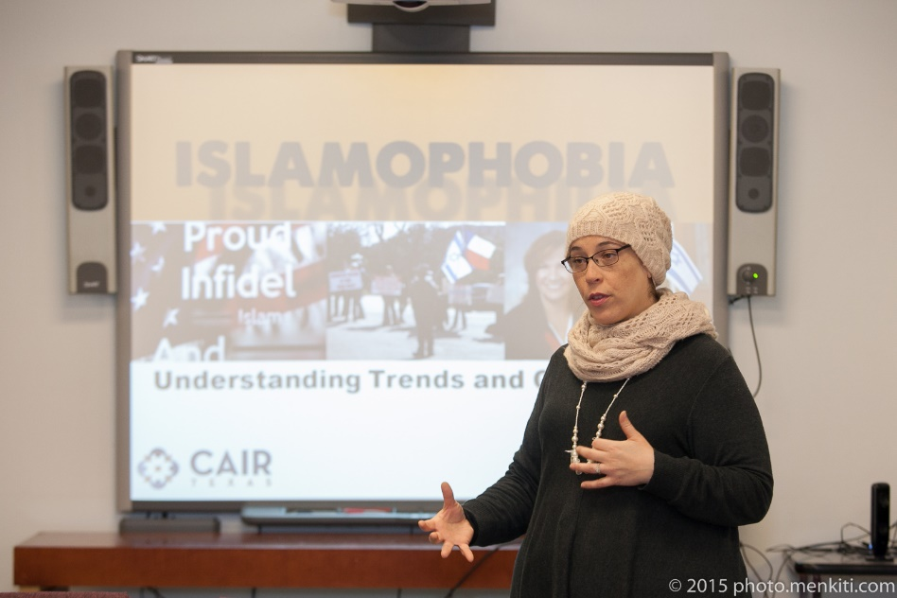
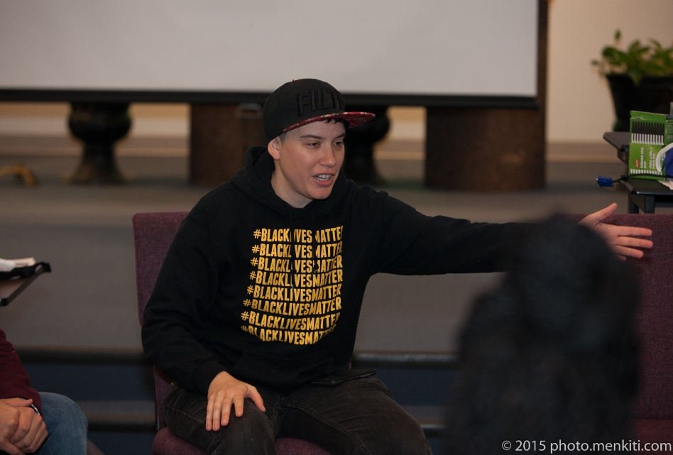
What We Are Building
Goal
Our goal is to supports advocacy and action on complex social justice issues by building a network of young people who are equipped with skills to understand and dismantle systemic inequities in their schools and communities
Objectives
Provide access to engaging workshops, panels, and plenaries
Create space for collaboration and sharing knowledge, building pride, and develop deeper awareness of local history
Skill building and leadership development
Engage in constructive conversations that are grounded in strategies to build a better future

Slide 8
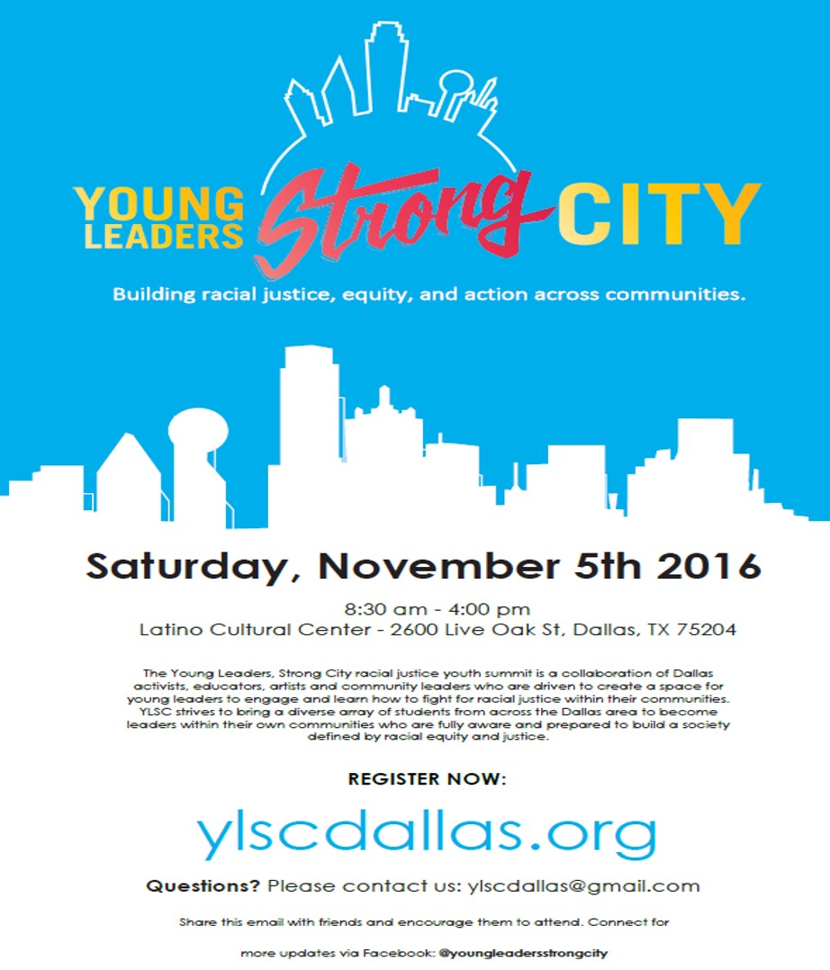
Recruitment
Contact guidance counselors in public private and charter high schools in Dallas
Collaborators reach out to educators and others within network
Distribute promotional materials within schools
Boost posts on Facebook
No fee to register or attend
Stakeholders may also register to volunteer

Slide 9
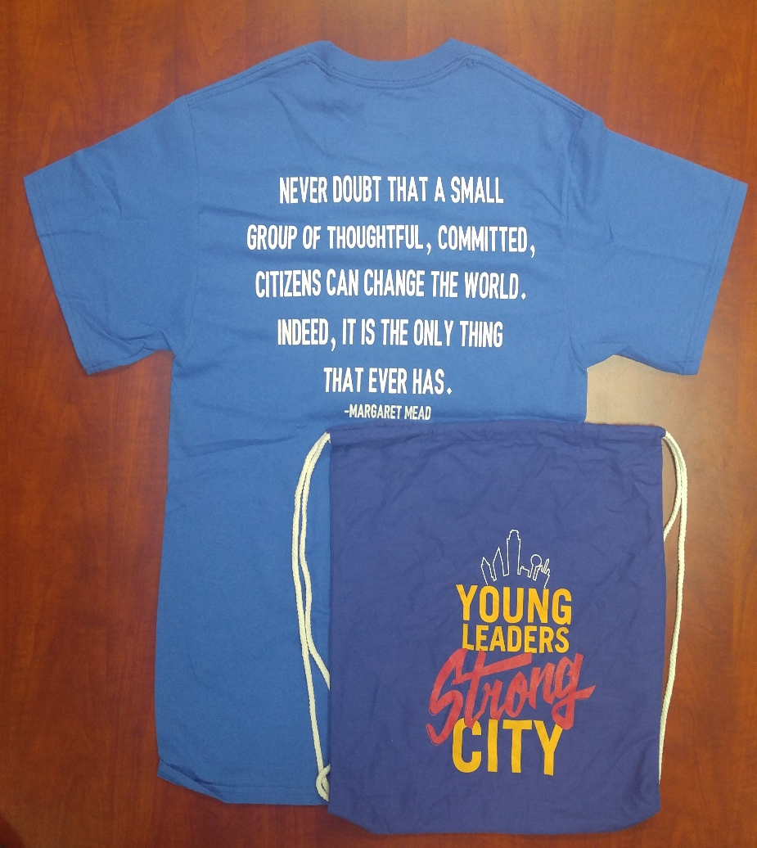
Swag
2014-2015
2016

Slide 10
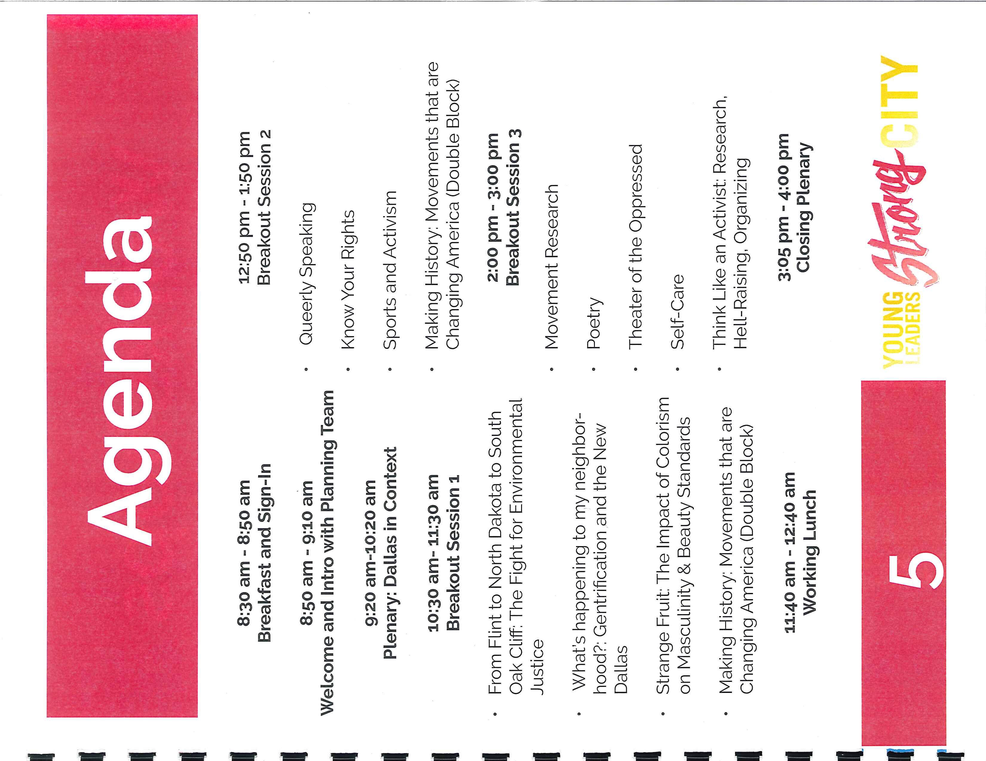
A Day of YLSC

Slide 11
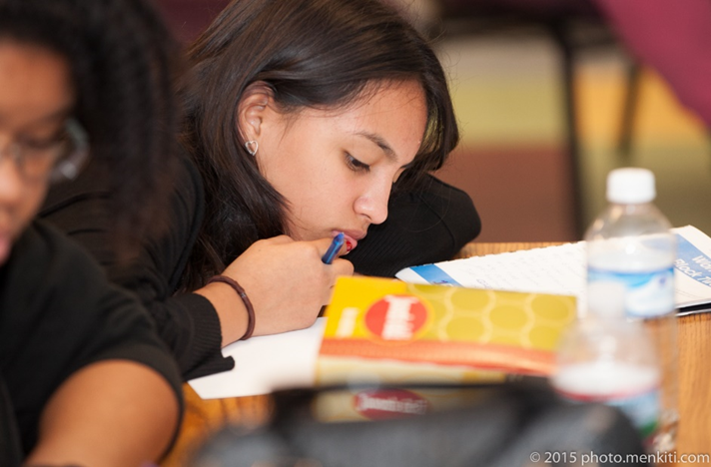
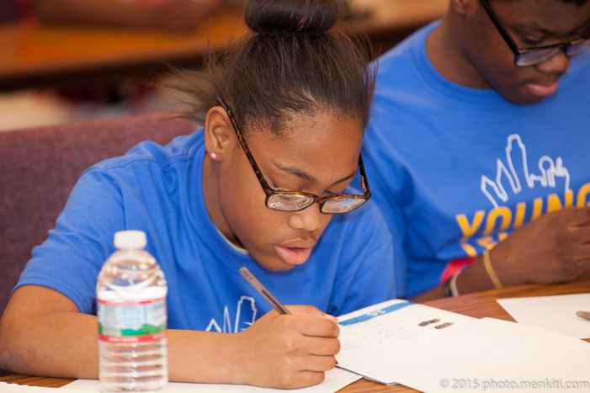
Lessons and Challenges
Steep attendance drop: 71 in 2014 to 38 in 2016
Scheduled during and SAT Saturday two years in a row
Large gap between the number of students who registered and the number of students who attend
Certain workshops are poorly attended
Staff turnover among collaborating agencies slows down momentum
Striking a balance between centralized delegation from IUPR and allowing collaborating agencies certain control
Continuity and communication with previous attendees inconsistent
Funding!!!

Slide 12
Lessons and Challenges
Steep attendance drop: 71 in 2014, 29 in 2015, 38 in 2016
Scheduled during and SAT Saturday two years in a row
Large gap between the number of students who register and the number of students who attend
Certain workshops are poorly attended
Staff turnover among collaborating agencies slows down momentum
Striking a balance between centralized delegation from IUPR and allowing collaborating agencies certain control
Continuity and communication with previous attendees inconsistent
Funding!!!

Slide 13
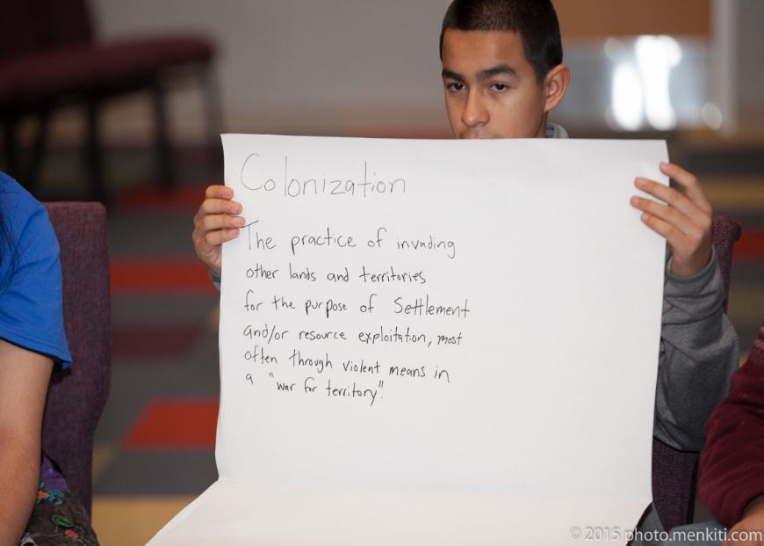
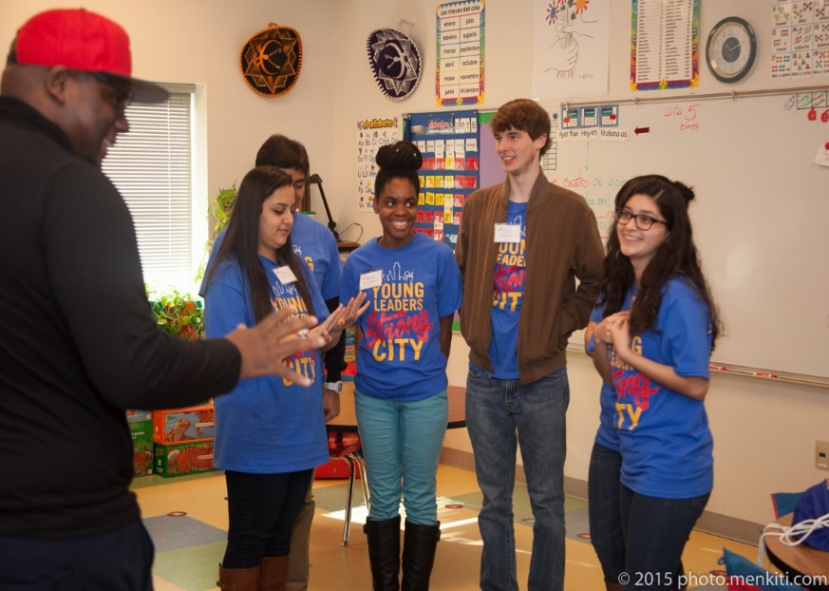
The 2017 Summit
Four tracks
Art, Media & Culture
A Better World is Possible: Organizing, Activism & Resistance
Think Globally, Act Locally
Each One, Teach One: Skill Sharing
Each YLSC experience is unique
Students curate their own experience by choosing workshops that align with their interests
Range of topics: the school to prison pipeline, indigenous images in sports, gentrification. mainstream beauty images, etc
The facilitators are professionals who employ a variety of methods to engage students in the content

Slide 14
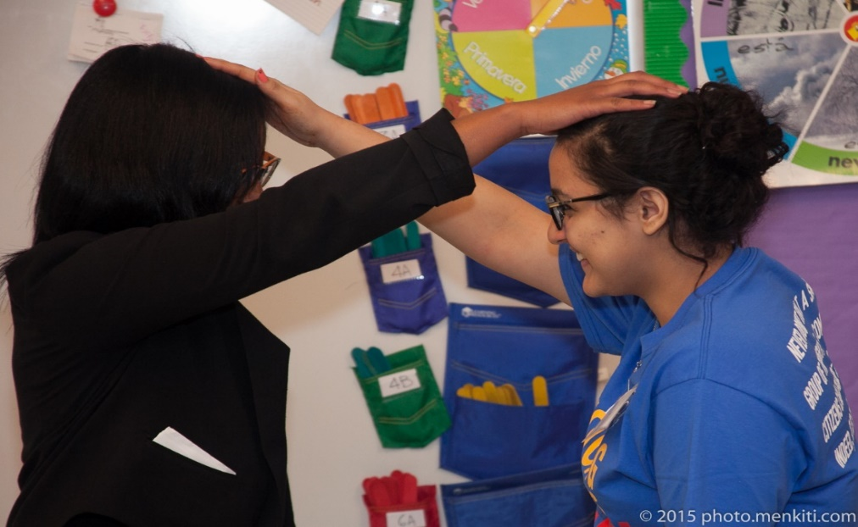
Looking to the Future
Long-term goals are to expand programming to include monthly meet-ups for students
The Summer of 2018 YLSC will also be offering a book club to former participants because they have expressed a desire to stay continuously engaged

Slide 15
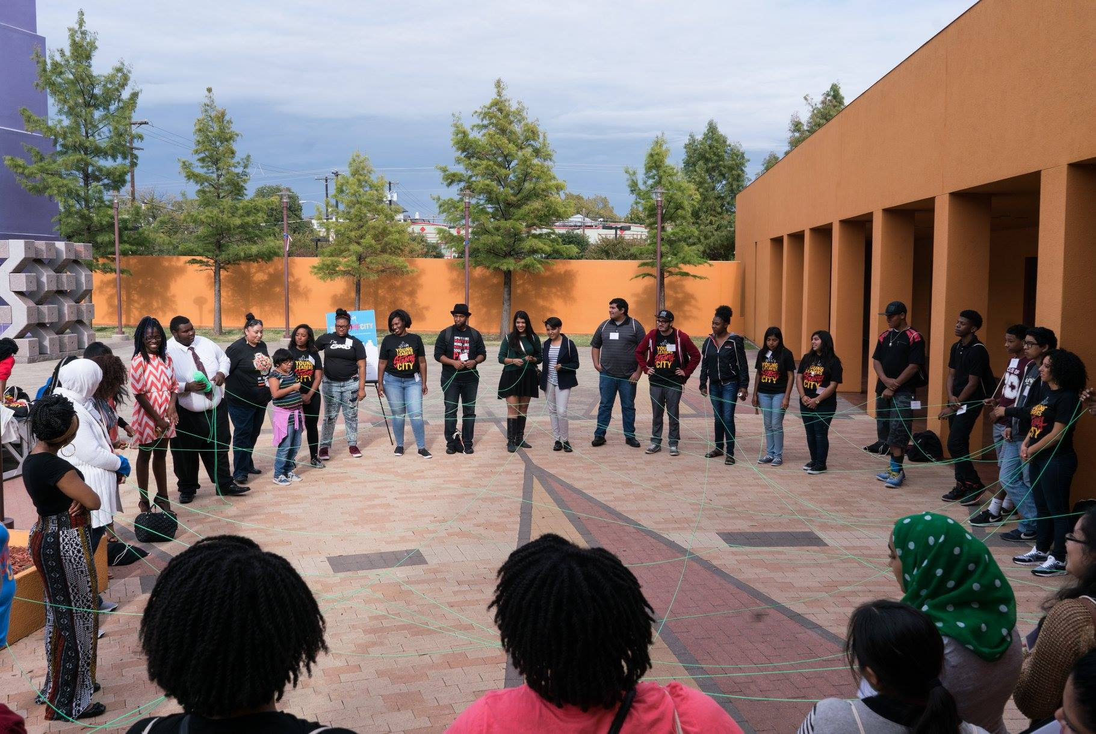
Thank You for Listening

