Slide 1
A city on the rise… but whose?
Norma I. Garza, MPH

Slide 2
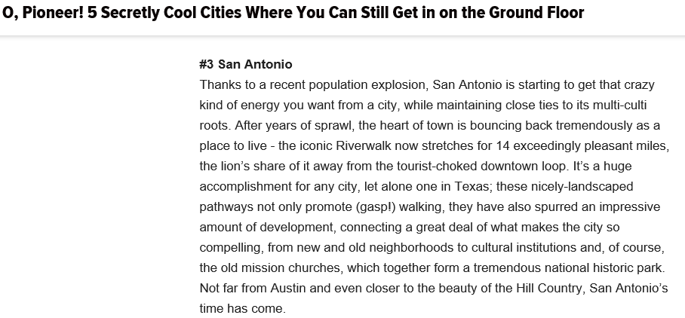
San Antonio

Slide 3
Contrast

Slide 4
Inequality
Source: Economic Innovation Group

Slide 5
Hispanic or Latino Population
9% - 32%
32% - 48%
48% - 66%
69% - 84%
85% - 100%
Percent of Hispanic of Latino population by census tract
Source: U.S. Census Bureau, 2010-2014 American Community Survey 5-Years Estimates

Slide 6
Population Projections
Source: Office of State Demographer Texas State Data Center.
Migration rate of 0.5 2000-2010

Slide 7
Brain Gain
Source: Russell, J and Richey Piiparinen. San Antonio Talent Economy: Bubble and Barriers. (2012). http://www.sa2020.org/wp-content/uploads/2013/03/San-Antonio-Talent-Economy-Bubble-and-Barriers.pdf
Educational Attainment by Previous Residence. U.S. Census Bureau, 2014 American Community Survey 5-Year Estimates
Notes:
“Brain Gain” (Return Migration)

Slide 8
Dropout Rate
1 | Alamo Heights ISD | 7 | Somerset ISD | 13 | Northside ISD
2 | Harlandale ISD | 8 | North East ISD | 14 | Judson ISD
3 | Edgewood ISD | 9 | East Central ISD | 15 | Southside ISD
4 | Randolph Field ISD | 10 | Southwest ISD
5 | San Antonio ISD | 11 | Lackland ISD
6 | South San Antonio ISD | 12 | Ft Sam Houston ISD

Slide 9
Housing
Source: U.S. Census Bureau, 2014 American Community Survey 1-Year Estimates

Slide 10
Housing-Cost Burden
8% - 22%
22% - 34%
34% - 45%
45% - 58%
59% - 94%
Percent of occupied units spending 35% or more of their household income on rent
Source: U.S. Census Bureau, 2010-2014 American Community Survey 5-Years Estimates
Notes:
For map is 5yrs

Slide 11
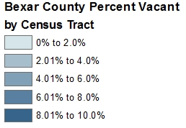
Vacancies
Bexar County Percent of Residential Addresses by Census Tract
0.0% - 0.6%
0.7% - 1.5%
1.6% - 2.5%
2.6% - 4.5%
4.6% - 14.%
Source: HUD USPS DATA 2015 Q4

Slide 12
Poverty
0% - 9%
10% - 18.%
19% - 28%
29% - 41%
42% - 72%
Percent of all people whose income is below the poverty level
Source: U.S. Census Bureau, 2010-2014 American Community Survey 5-Years Estimates

Slide 13
Income
$ 10,365 - $ 35,873
$ 36,149 - $ 51,813
$ 53,854 - $ 73,456
$ 74,955 - $101,579
$105,208 - $172,679
Median household income
Source: U.S. Census Bureau, 2010-2014 American Community Survey 5-Years Estimates
Notes:
Change to blue color ramp

Slide 14
Obesity
43% (31% - 55%) Near Eastside
42% (27% - 59%) Southeast
37% (30% - 46%) Near Westside
35% (25% - 46%) Southwest
34% (24% - 46%) Northeast
29% (21% - 38%) Near Northside
24% (17% - 31%) Far Northside
22% (16% - 29%) Far Northwest
Source: 2014 BRFSS

Slide 15
Diabetes
23% (15% - 34%) Near Eastside
20% (15% - 27%) Near Westside
15% ( 8% - 28%) Southeast
14% ( 9% - 20%) Southwest
13% ( 8% - 20%) Northeast
11% ( 7% - 16%) Far Northwest
11% ( 7% - 16%) Far Northside
10% ( 6% - 15%) Near Northside
Source: 2014 BRFSS

Slide 16
Moving forward
Using local information for better planning
Data integration for decision making
Data-driven community change

