Slide 1
Poverty, Race, Place, and Young Children
Building Social Capital and Strengthening Families
Charles Bruner, NNIP Conference

Slide 2
Poverty, Race, and Young Children: Intertwined and Profound
Poverty affects material well-being but also affects relative status and opportunity for growth and development in society. Poverty is greatest among young children and has more implications than material well-being alone.
Young children of color are more likely than white children to experience poverty. They and their families also are more likely to experience social and structural discrimination, exclusion, and marginalization that are hazardous to future development.

Slide 3
Young Children Age Group Most Likely to Live in Poverty
Source: U.S. Census Bureau, Public Use Microdata Sample, 2011-2013

Slide 4
Young Children of Color by Far the Most Economically Disadvantaged
Source: United States Census, Public Use Microdata Sample 2012

Slide 5
Place, Poverty, Race, and Young Children: Location Matters
Young children disproportionately live in places with high overall child poverty rates.
Place is particularly important to young children – where young children live affects the social, educational, health, and safety supports they need for their growth and development. Young children of color disproportionately live in high poverty neighborhoods.

Slide 6
Poorest Neighborhoods: Wealthy in Young Children
Very Young Children (0-4) as Percentage of Population
By Census Tract Child Poverty level
Implication: Poorest neighborhoods need half again as many child and family-friendly gathering points, activities, and supports.
Source: United States Census Bureau, Population Division 2013

Slide 7
Poorest Neighborhoods: Highly Segregated
Note: While 8.4 percent of White, non-Hispanic children live in census tracts where the poverty rate is above 40 percent, 38.2 percent of African Americans, 31.9 percent of Native Americans, and 28.9 percent of Hispanics do.

Slide 8
Poverty, Place and Young Children: A Deeper Dive
These high poverty census tracts require community-building approaches – including strengthening social, educational, physical, and health capital for young children and their families.

Slide 9
Census Tract Comparisons from Census Data
Poorest tracts (50%+ child poverty) compared to least poor tracts (10%- child poverty):
Poorest Least Poor
Single parent families 60.1% 24.6%
Disconnected Youth (16-19) 16.4% 5.4%
Adults without high school degree 28.8% 7.3%
Adults with college degree 12.7% 41.1%
Households with wage income 66.4% 78.3%
Households with savings/wealth 8.2% 30.1%
Owner-occupied housing 41.1% 75.2%
Preschool participation 3-5 year-olds 37.3% 49.4%
Young children of color 81.3% 33.5%

Slide 10
Left and Right Scholarship Agreements
Robert Putnam. Our Kids: The American Dream in Crisis.
Charles Murray. Coming Apart: The State of White America, 1960-2010.
Changes to American families and society threaten the future as we have valued it.
Increased segregation (by place and associations) of upper- and low-class/income families and their children.
Differences as result of this segregation: Idle and disconnected young men, single parenting by less-educated women, higher crime and lack of security in life – producing educational, health, and social disparities.
Implications of these differences: two Americas and the “crisis” of “coming apart” – particularly for the next generation growing up.
PLACE and SOCIAL CAPITAL matter.

Slide 11
Beyond Census Data: Comparing Neighborhoods of Affluence and Poverty
A Tale of Two DCs
Ward 3 Ward 7
Parent(s) of 0-3 with BA * 97 % 20 %
Two-Parent Households 0-3) * 93 % 15 %
Births to Unmarried Women 7 % 85 %
Percent teens giving birth ** 0.2 % 7.8 %
Low birthweight 7 % 15 %
Late or no prenatal care 3.8 % 9.1 %
Infant deaths (0-1) 0.1 % 2.5 %
Substantiated abuse (0-3) .03 % 3.5 %
EI screenings 0-3 yr. olds 2.7 % 2.4 %
Gold Star Ratings of child care *** 100 % 22 %
Family income under 200% pov. * 97.1 % 28.1 %
Source: Child Trends/Bainum Family Foundation (2015). Infants and Toddlers in the District of Columbia.
* PUMA data in which Ward 3 and 7 located. ** Ward 2/3 and 7/8 combined. *** Ward 2, Ward 3 has no participating child care centers in QRIS.

Slide 12
Beyond Census Data: Mapping Neighborhood Child Social Capital
Neighborhood Mapping Opportunities for NNIP
Child recreational spaces (parks, playgrounds, jungle gyms, baseball diamonds, basketball courts, soccer fields, tennis courts, swimming pools, bike trails)
Organized activities for children (cub scout dens, soccer leagues, martial arts classes, tumbling tots, library reading programs, child art programs)
Elementary school resources (physical space, learning center resources, family programs, extra-school activities on site, per pupil funding)
Other child-and- family-friendly gathering spots (libraries, community centers, faith institutions – and their offerings for young children/families)
Child care and preschool (registered/licensed centers and homes, quality ratings, private kindergarten preparatory schools)
Language and culture-specific resources (books, classes, activities that are culturally and linguistically consonant with the population)

Slide 13
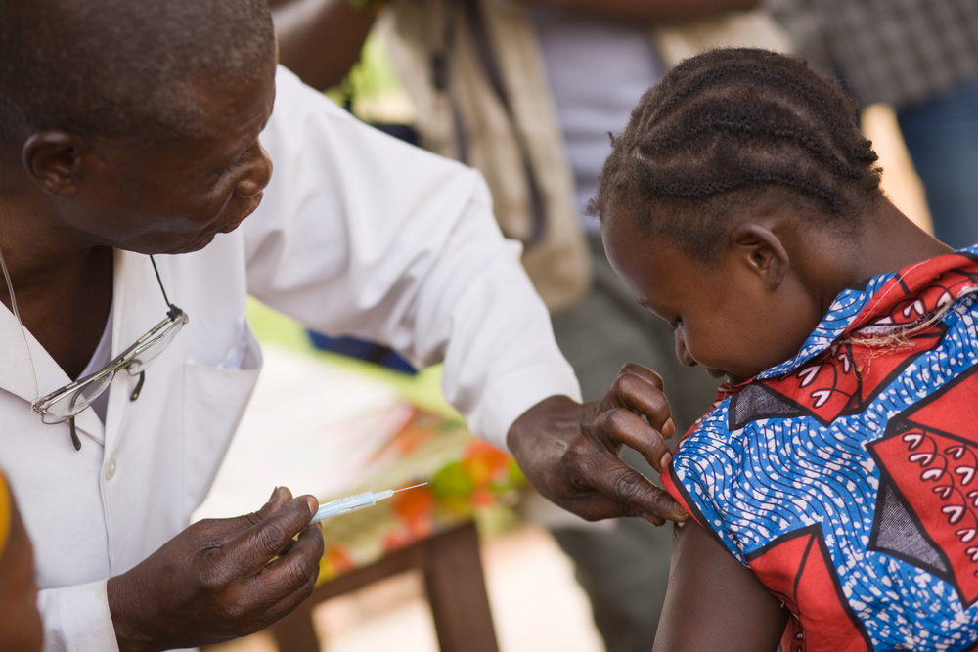
Emerging Consensus on New Directions in Ending Poverty and Inequality
AEI/Brookings Working Group on Poverty and Opportunity Recommendations:
“Strengthen families in ways that will prepare children for success.”
Community Health Council of American Academy of Pediatricians Report on Poverty and Child Health in the United States
“Support integrated models of care in the medical home that promote effective parenting and school readiness.”

Slide 14
Toward Purple Solutions to Young Child Poverty
BLUE Proposals: Minimum wage increase, paid family leave, affordable higher education, universal preschool
RED Proposals: Devolution for community ownership and solutions, faith-based/fatherhood/personal responsibility initiatives
PURPLE Proposals: TBD (government, community, early childhood, and health role in strengthening families)

Slide 15
NNIP Opportunities to Promote Purple Solutions
LOCATION, LOCATION, LOCATION … SHOWING THE NEED AND OPPORTUNITY TO FOCUS ON PLACE TO ADDRESS ELIMINATING POVERTY OVER A GENERATION
A FOCUS ON CHILD SOCIAL CAPITAL …
SHOWING THE NEED FOR COMMUNITY-BUILDING INVESTMENTS IN POOR NEIGHBORHOODS THAT PROVIDE OPPORTUNITIES FOR YOUNG CHILDREN AND THEIR FAMILIES

Slide 16
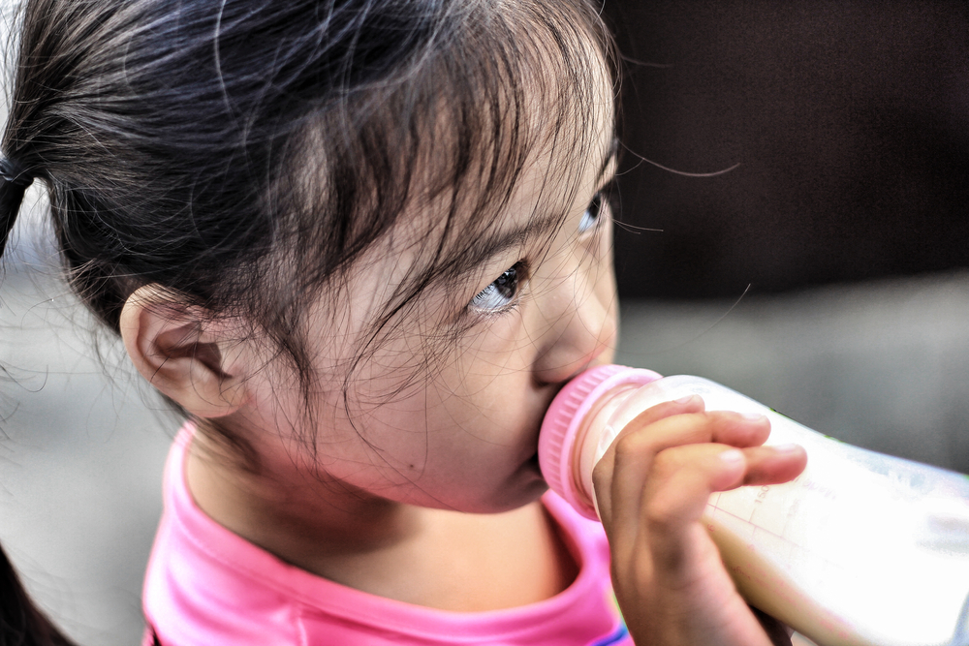
Additional Resources
Fifty State Chart Book: Dimensions of Diversity and the Young Child Population
Where Place Matters Most: Young Children and Their Future
Village Building and School Readiness: Closing Opportunity Gaps in a Diverse Society)
Top 10 Things We Need to Know About Young Children and Health Equity
http://www.cfpciowa.org/en/issues/health_equity/

