Slide 1


Informing the Conversation on
Economic Mobility in Charlotte
Laura Simmons April 2016

Slide 2

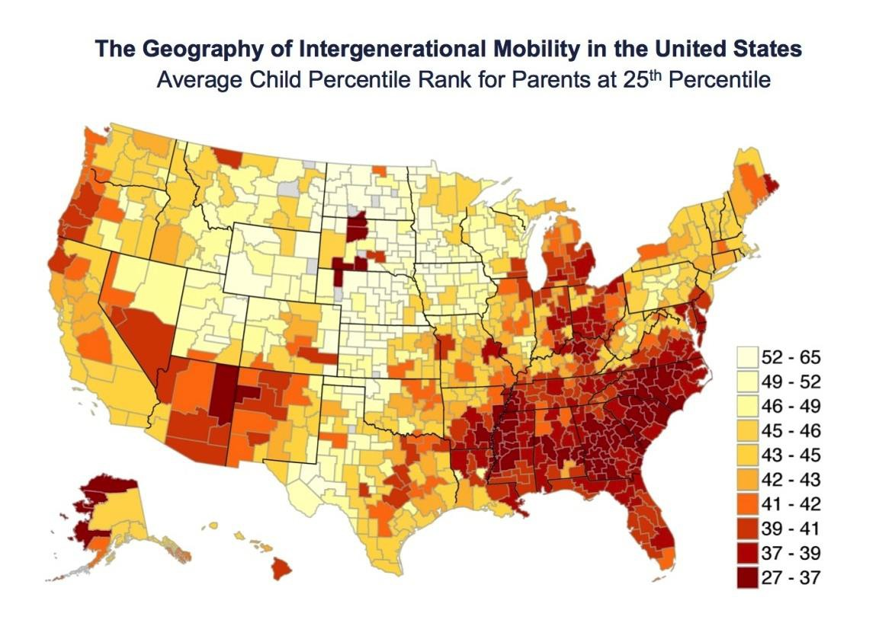
Where is the Land of Opportunity?
Not Charlotte…
50 Biggest Cities
Salt Lake City
Pittsburgh
San Jose
Boston
San Francisco
……
Detroit
Indianapolis
Raleigh
Atlanta
Charlotte

Slide 3




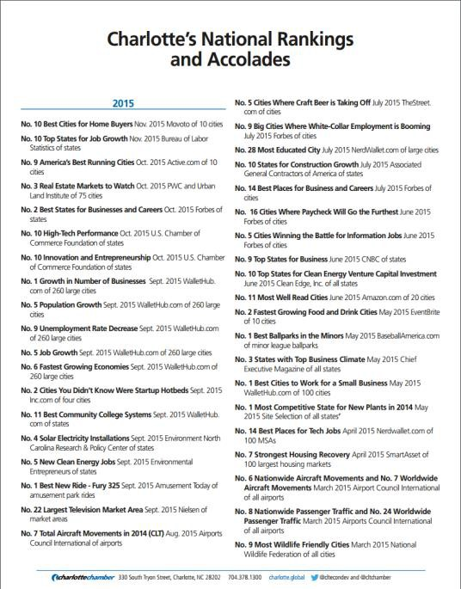


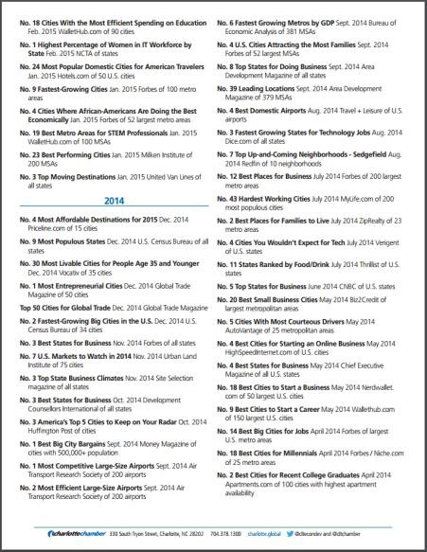
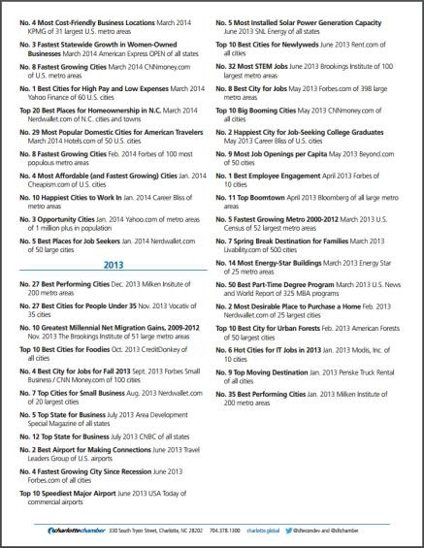




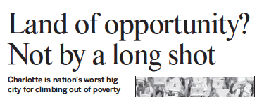

But everyone says Charlotte is great. What happened?

Slide 4

























Enter the Charlotte-Mecklenburg Opportunity Task Force
Learn about the issues
Develop strategies
Public release
2017
2015
2016

Slide 5

The Institute is supplying the OTF with data and research

Slide 6

We are experimenting with a new structure: research and data
on-demand

Slide 7

Several partners are contributing
D TA

Slide 8
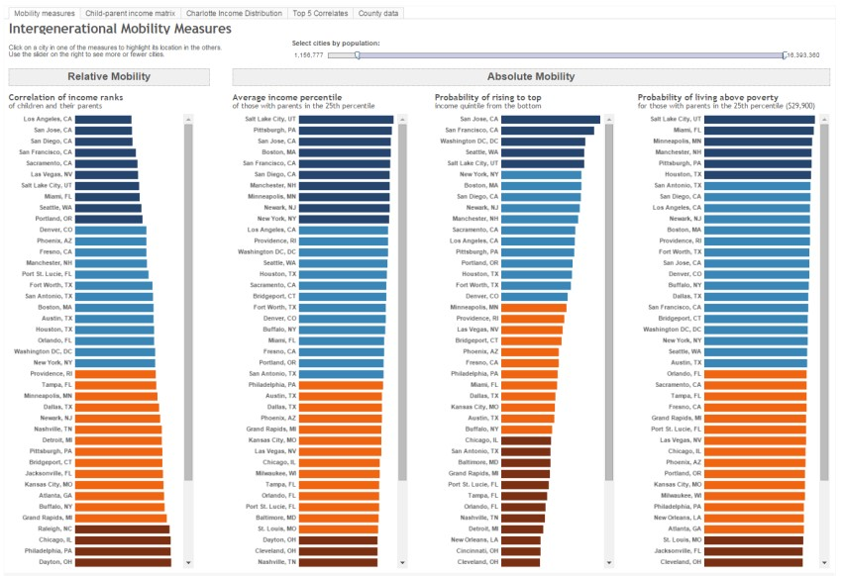
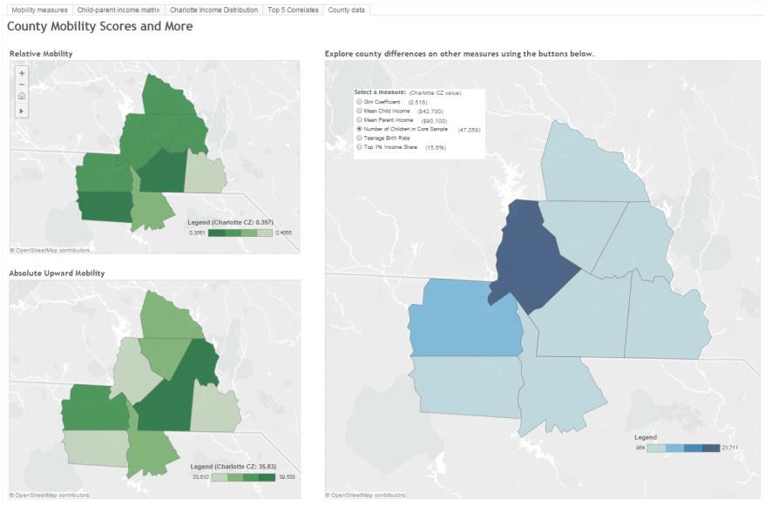
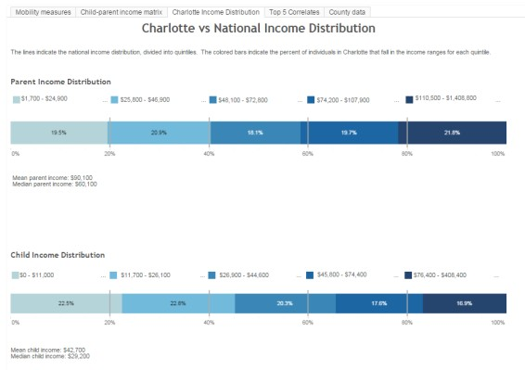
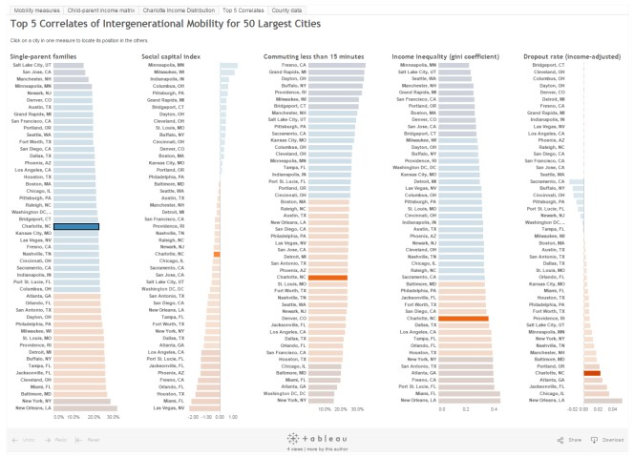
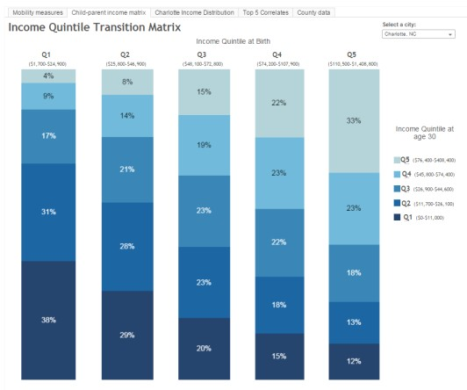
Getting to know the Chetty data
https://public.tableau.com/profile/ui.uncc#!/vizhome/Chetty/Mobilitymeasures

Slide 9

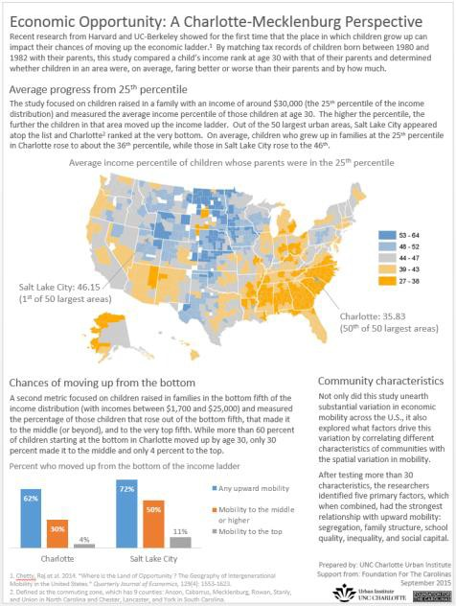
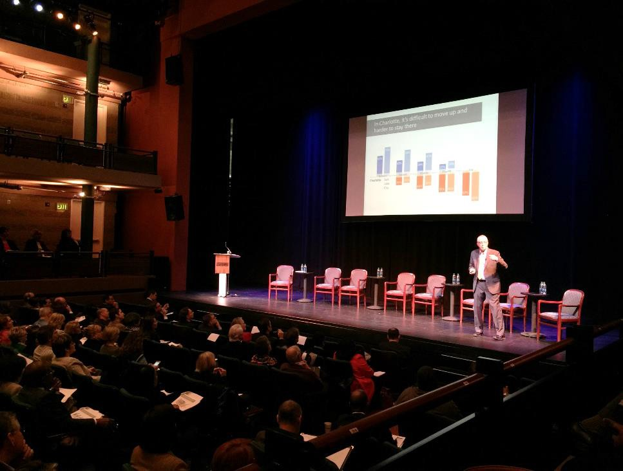

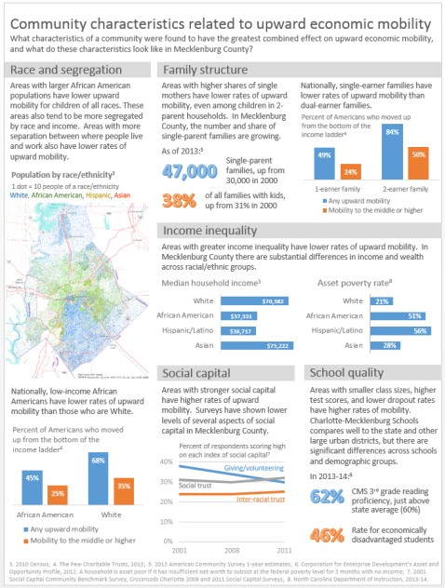
Translating the Chetty study and
adding context with local data

Slide 10





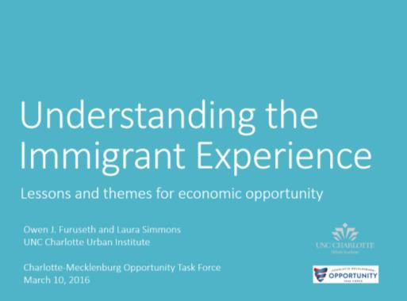



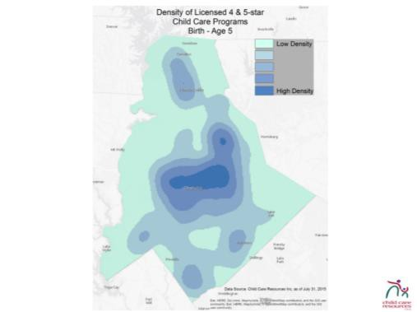
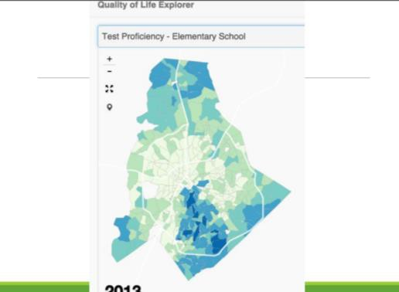
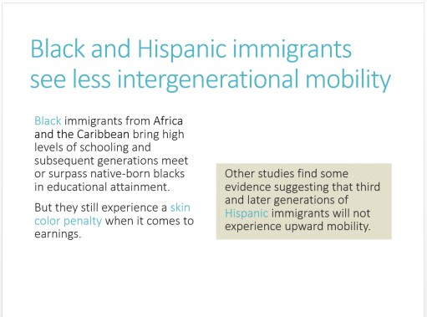
Highlighting other research
related to economic mobility

Slide 11

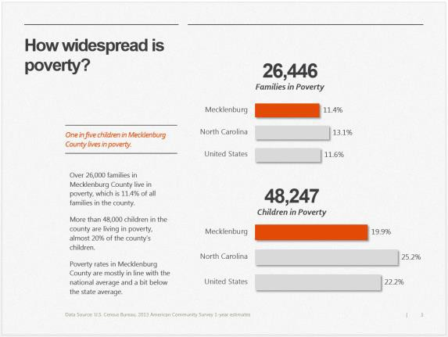
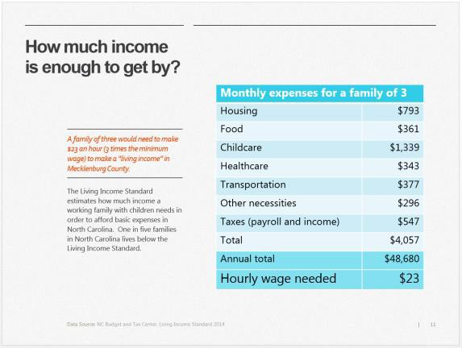

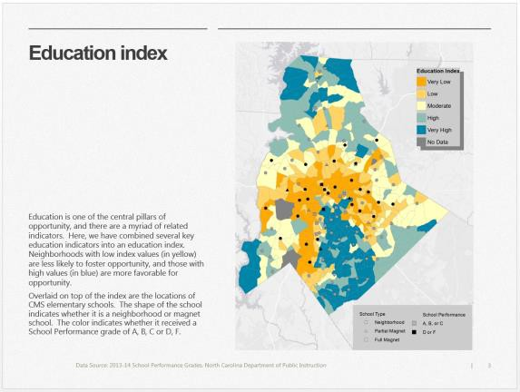
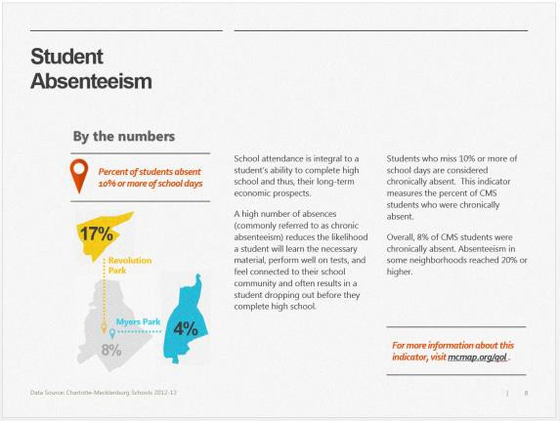
Providing local and neighborhood
data related to economic mobility

Slide 12
Lessons Learned
Clients like the
flexibility of the
on-demand format,
but it can be tricky to plan for and manage.

Slide 13
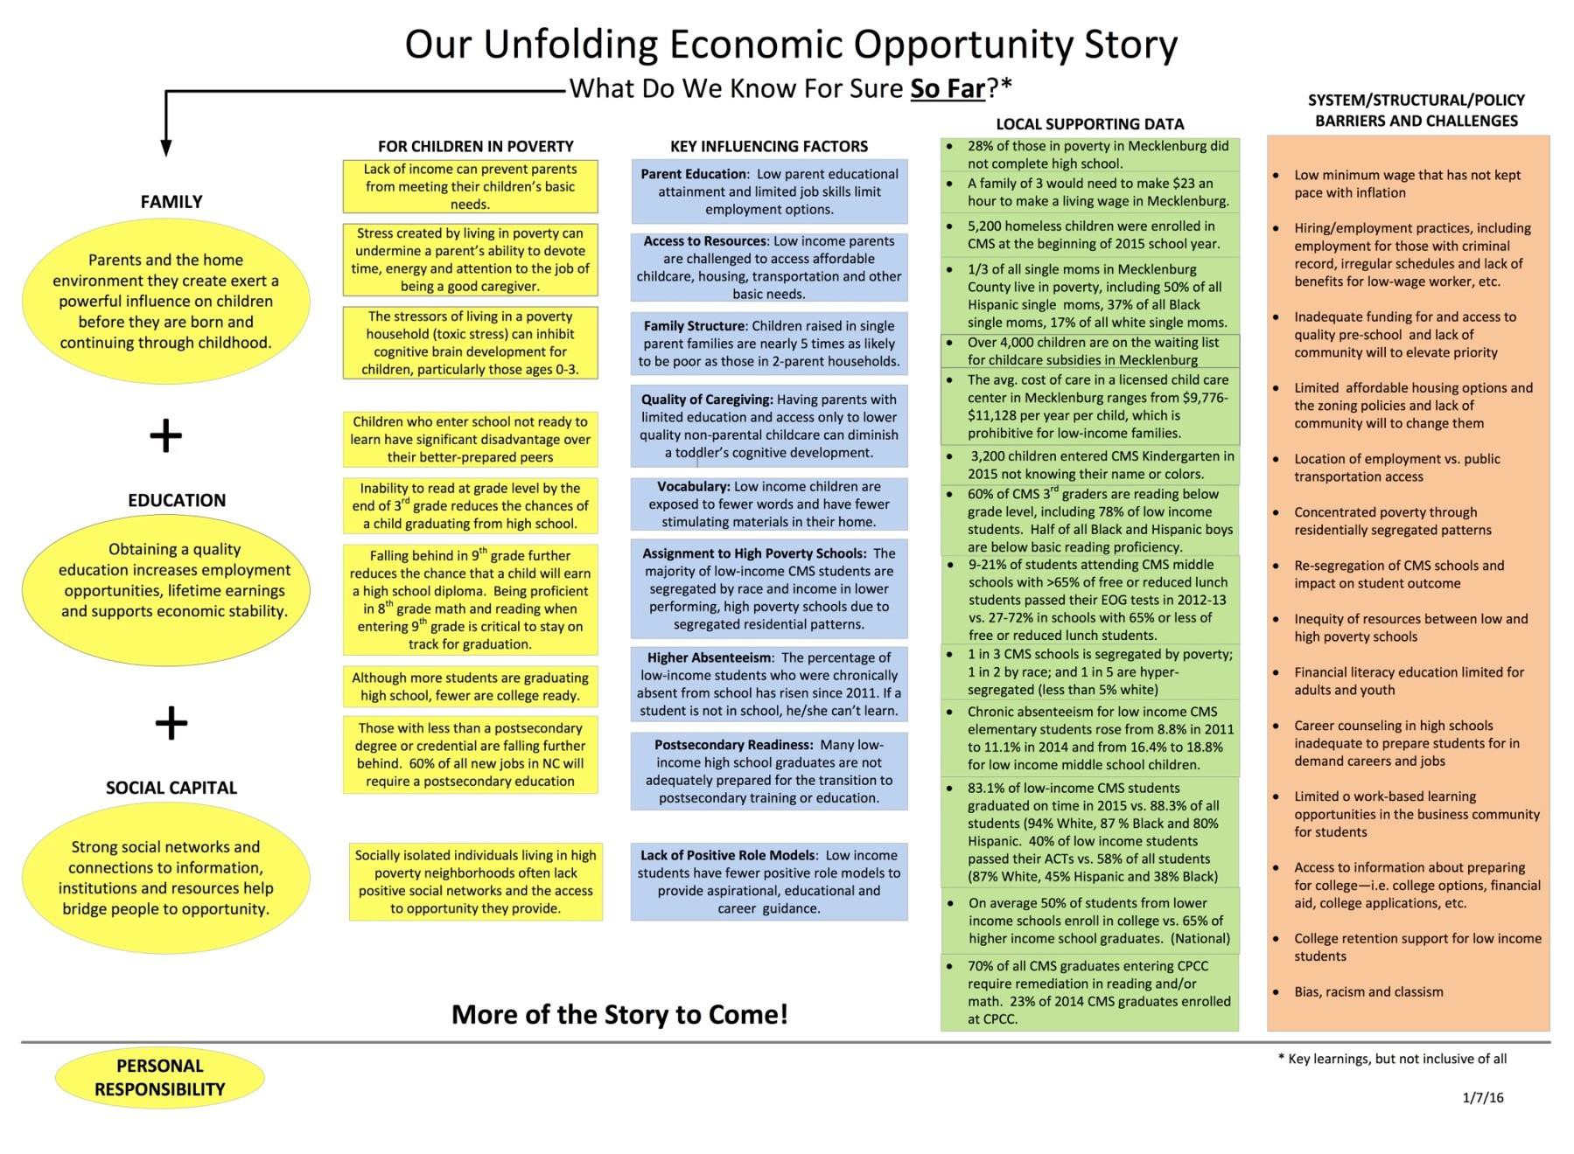
Lessons Learned
Economic mobility is a complex issue

Slide 14
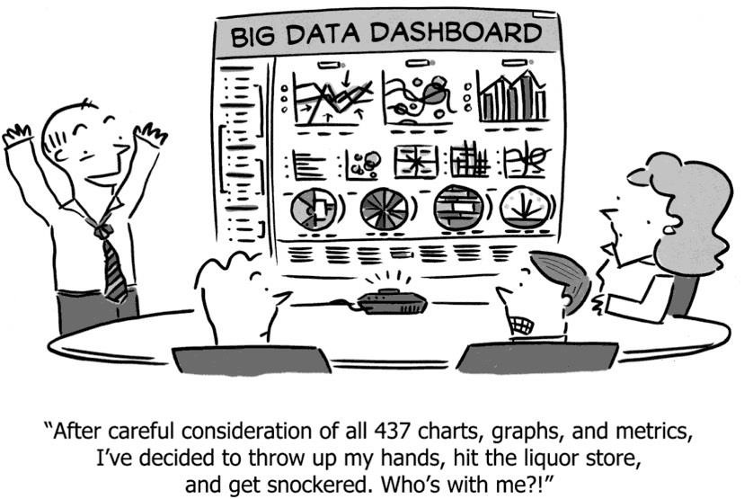
Lessons Learned
It can be overwhelming

Slide 15
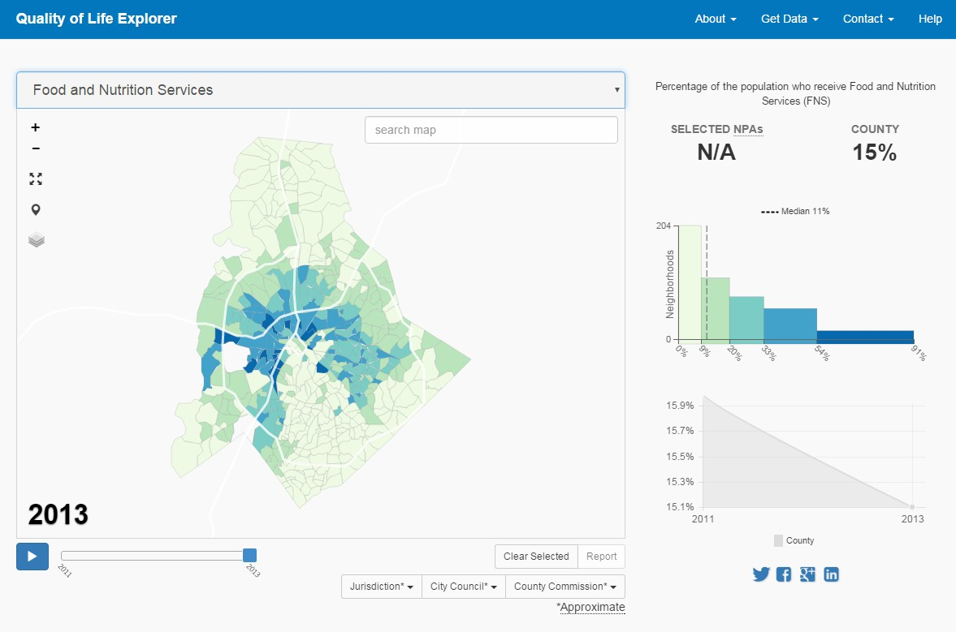
Lessons Learned
Neighborhoods matter!

