Slide 1


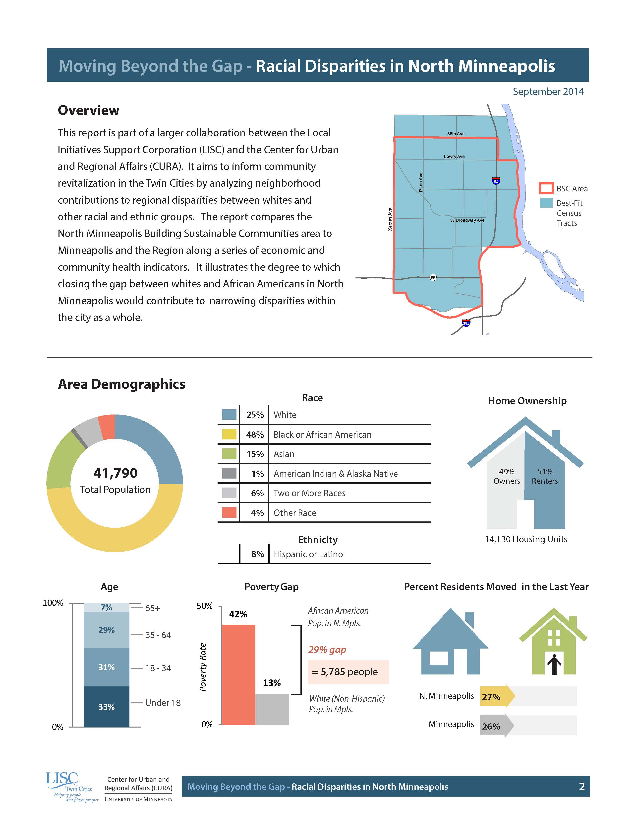
Interactive Disparity Calculator
Jeff Matson
NNIP Cleveland
9/14/16
Notes:
This project grew out of a partnership (contract really) with our local LISC office and the national research office in D.C. In 2014 we produced a series of reports for the BSC neighborhoods in our region that tried to get at the racial disparity gaps across a number of indicators and what it would take to close them.

Slide 2
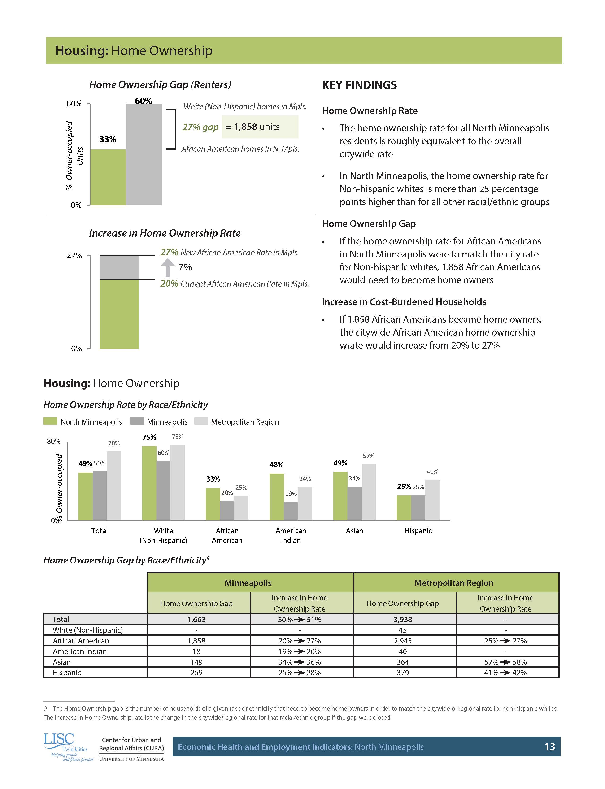
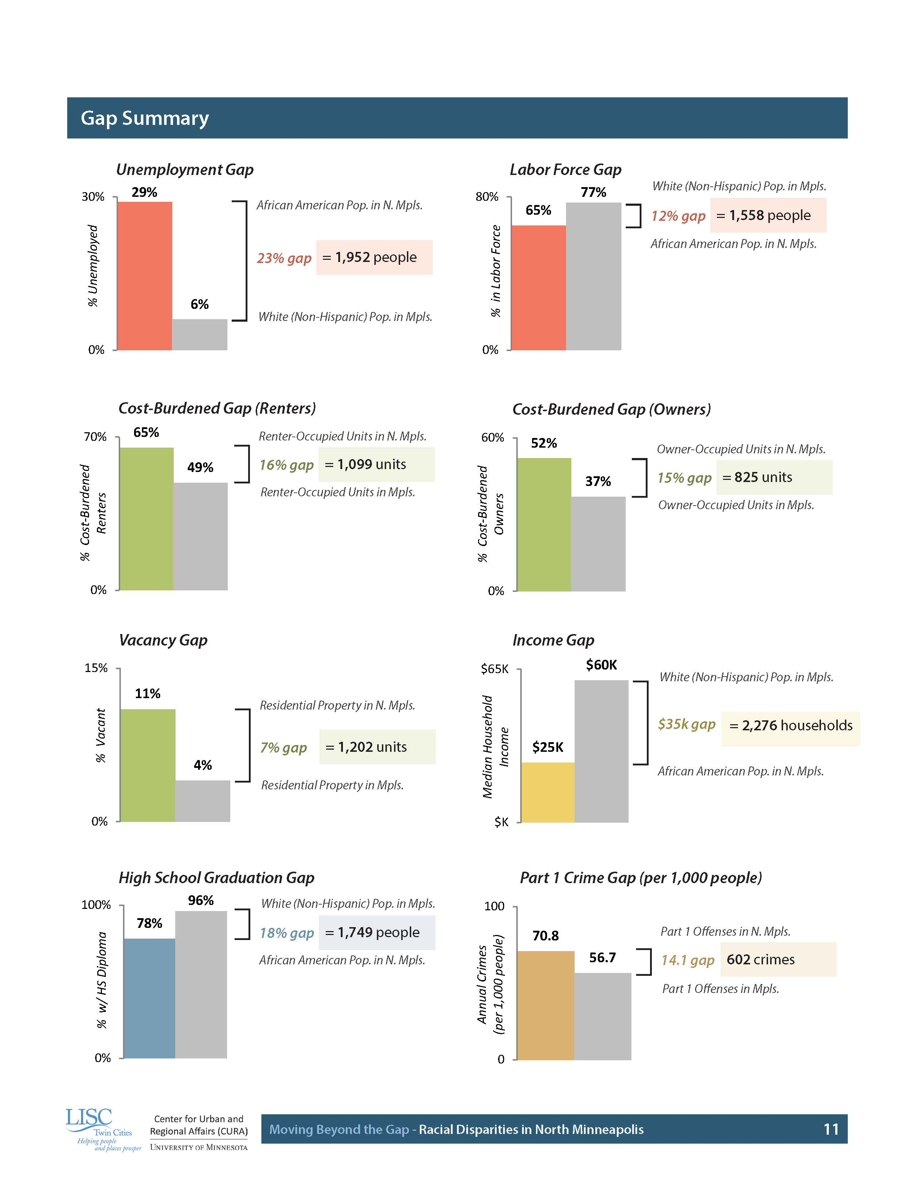
Notes:
This example shows the gap in home ownership between African-Americans and Non-Hispanic White households and the number of new ownership opportunities that would need to be created to close that gap. Also the effect this would have on the regional metric for African American home ownership if you closed the gap just in this one neighborhood. We did this for eight indicators in four neighborhoods.
Naturally this got us thinking what if we did this across all LISC BSC cities, made it interactive and let you customize the comparison geographies.

Slide 3
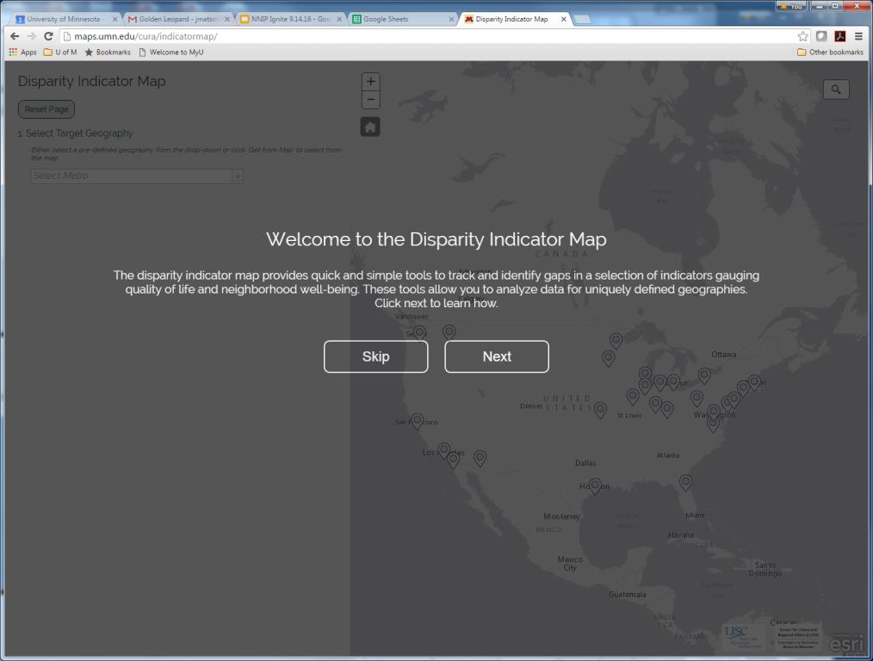
Notes:
So we built the Disparity Indicator Map (DIM?) Needs a better name, I know.
When you go to the website you’ll see the opening splash screen. Click ‘Skip’ to jump right in or ‘Next’ to move through a short tutorial on using the site

Slide 4
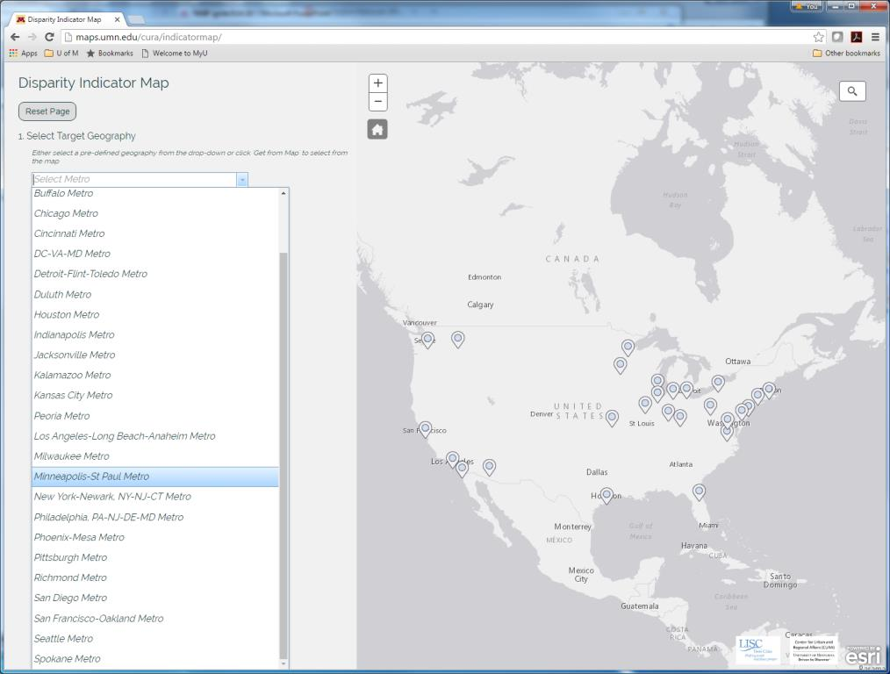
Notes:
Past that, the opening page shows both a drop down list of Metro Areas and a clickable map. Either work to get you started.
Here I’m selecting the Minneapolis-St. Paul Metro

Slide 5
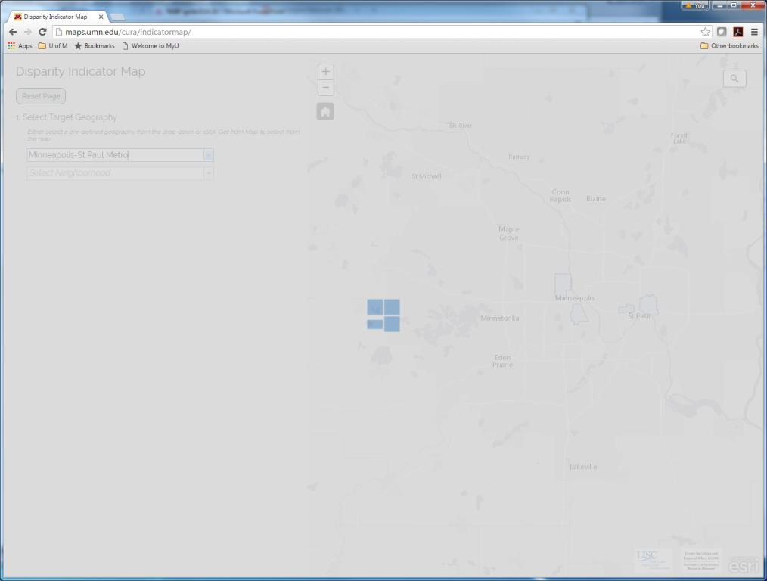
Notes:
Some processing occurs as it loads the study area Census tracts to the web browser

Slide 6
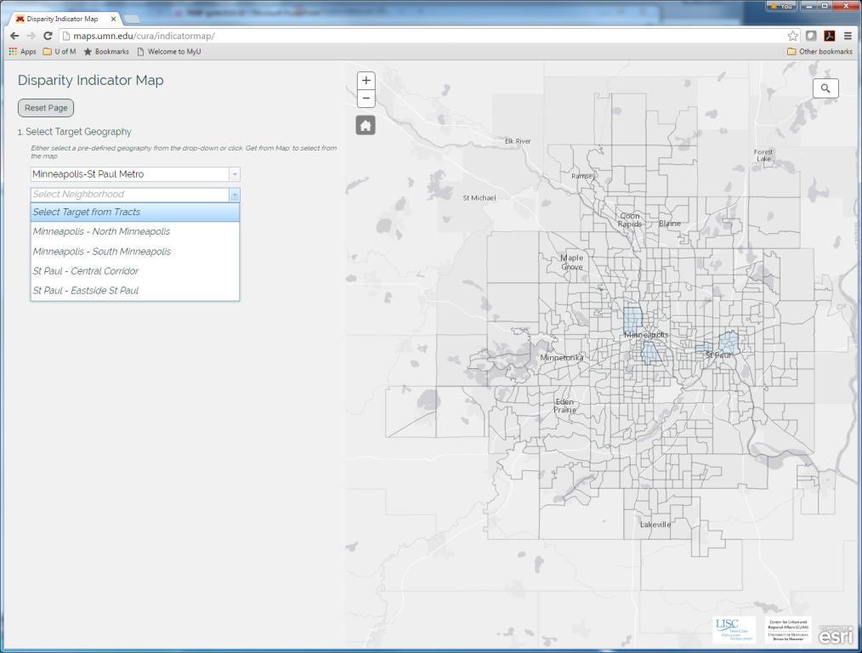
Notes:
The next step is selecting the target neighborhood from within the metro area you selected in the previous step.
You can also create a custom area by selecting from tracts. Click on one or more tracts to create a custom area

Slide 7
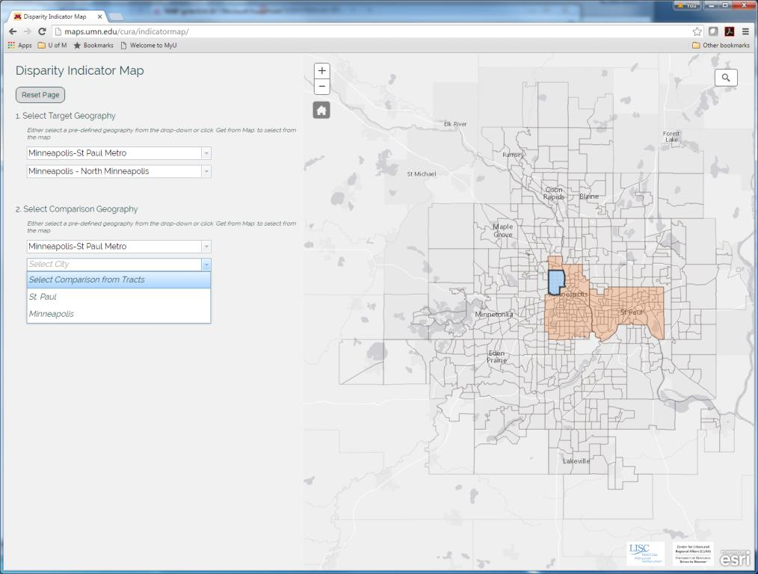
Notes:
I’ve selected a neighborhood (LISC BSCs) and now need to choose a comparison city. By default it’s the city or cities that contain the neighborhoods in your target study area. But, you’re not required to compare with the same metro as we’ll see later.

Slide 8
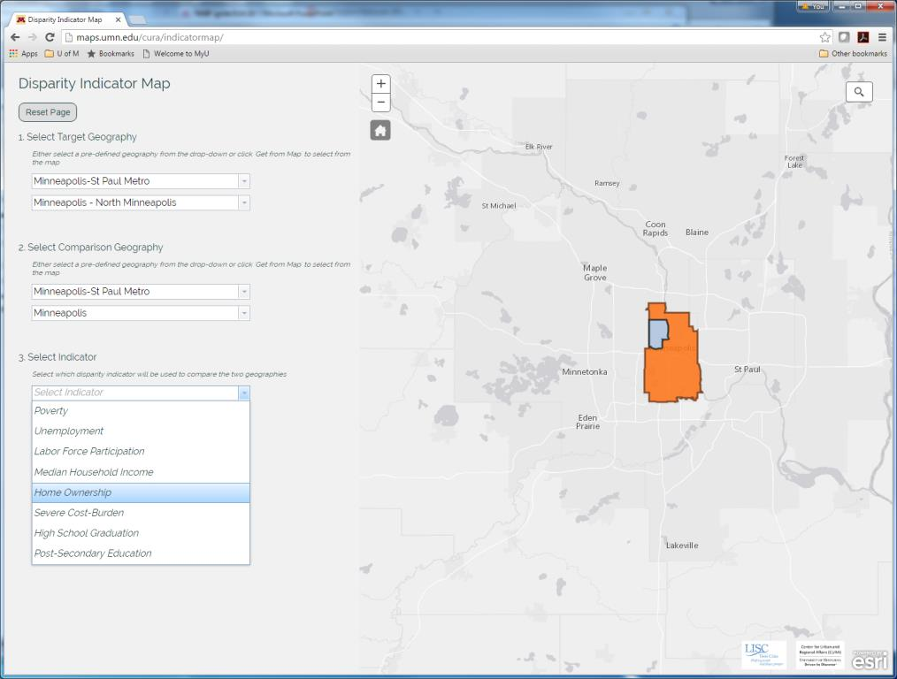
Notes:
Finally you need to pick one of these eight indicators

Slide 9
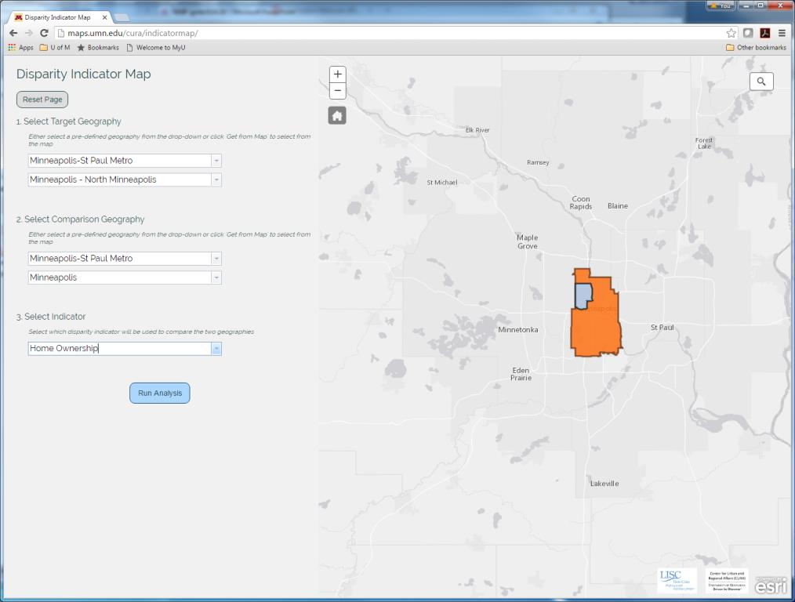
Notes:
And hit Run Analysis

Slide 10
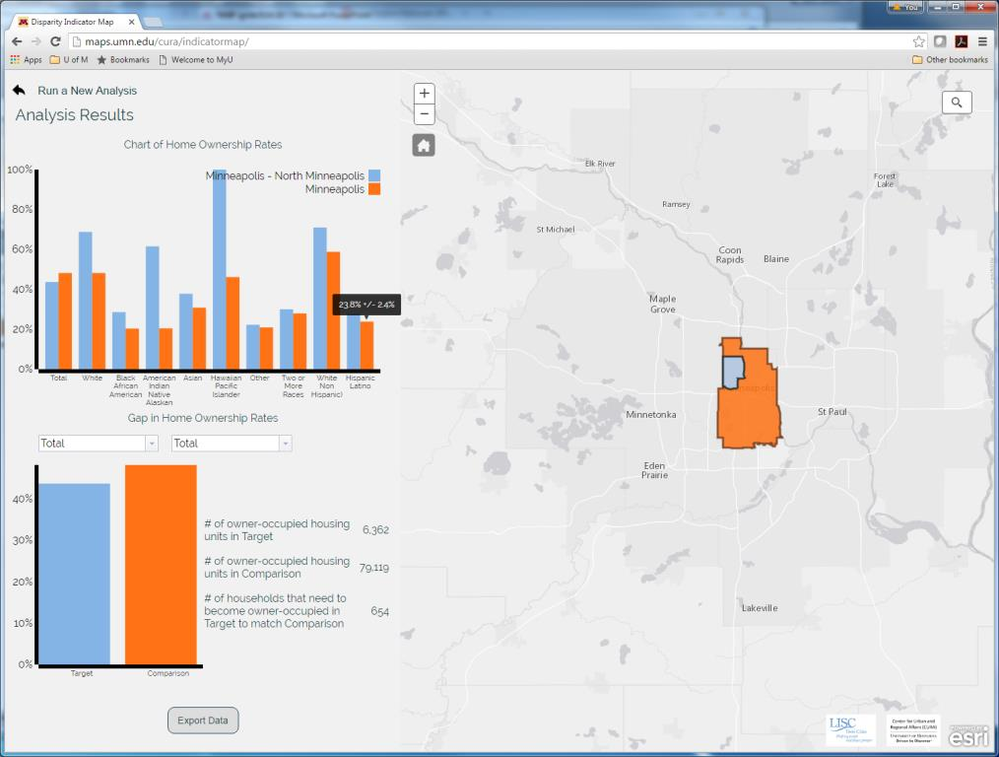
Notes:
The results are two bar graphs. The first show the difference in values for the chosen indicator across all races/ethnicities.
As you can see on the far right of this graph, hover over any of the bars to see the value and margin of error

Slide 11
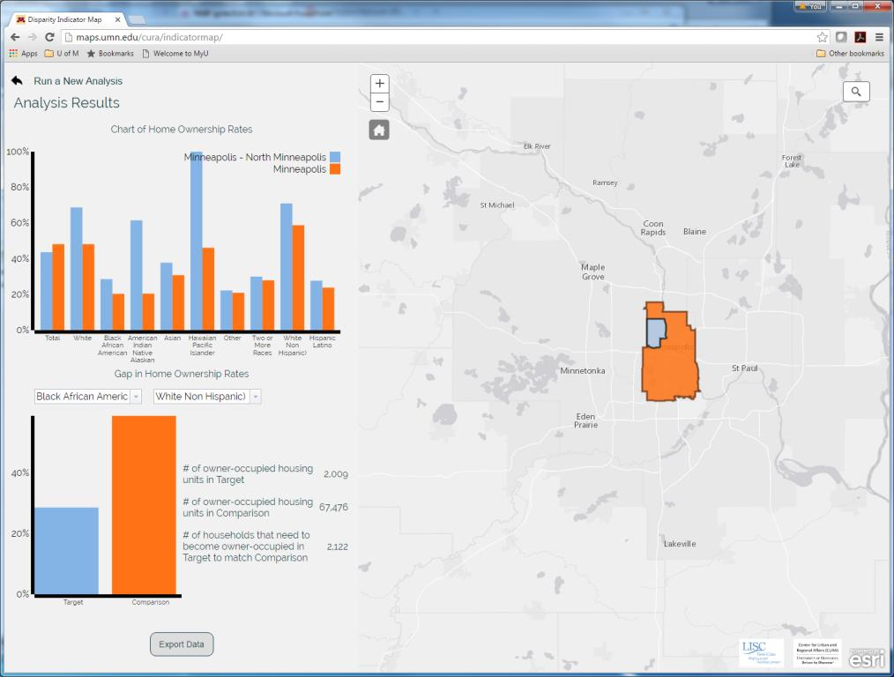
Notes:
The second shows a comparison of a single race in the target and comparison geographies and calculates the number needed to close the gap
Here we see African Americans in the target neighborhood v. non-Hispanic whites in the City.
Roughly 2,000 African American households in North Minneapolis would need to move into home ownership to close that disparity in

Slide 12
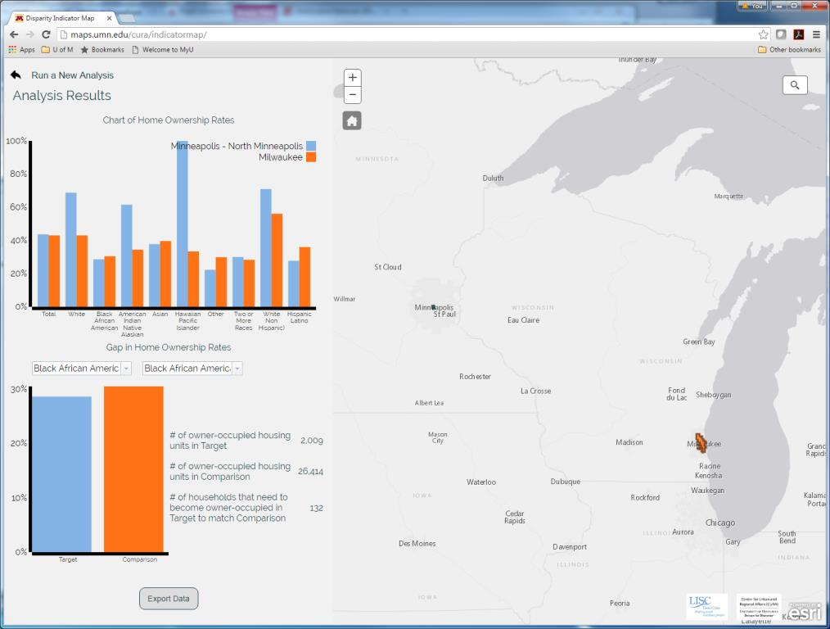
Notes:
As mentioned previously you can compare your neighborhood with a city in another metro

Slide 13
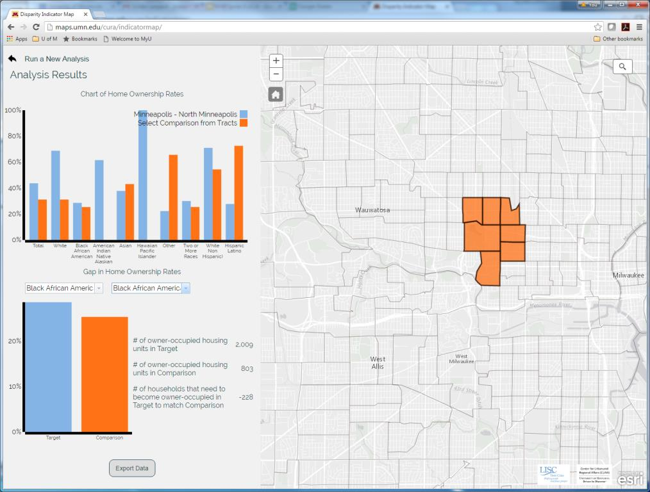
Notes:
Or with a neighborhood in another metro by using the ‘Select Comparison from Tracts’ drop down.
Here is North Minneapolis home ownership compared to Washington Park in Milwaukee

Slide 14
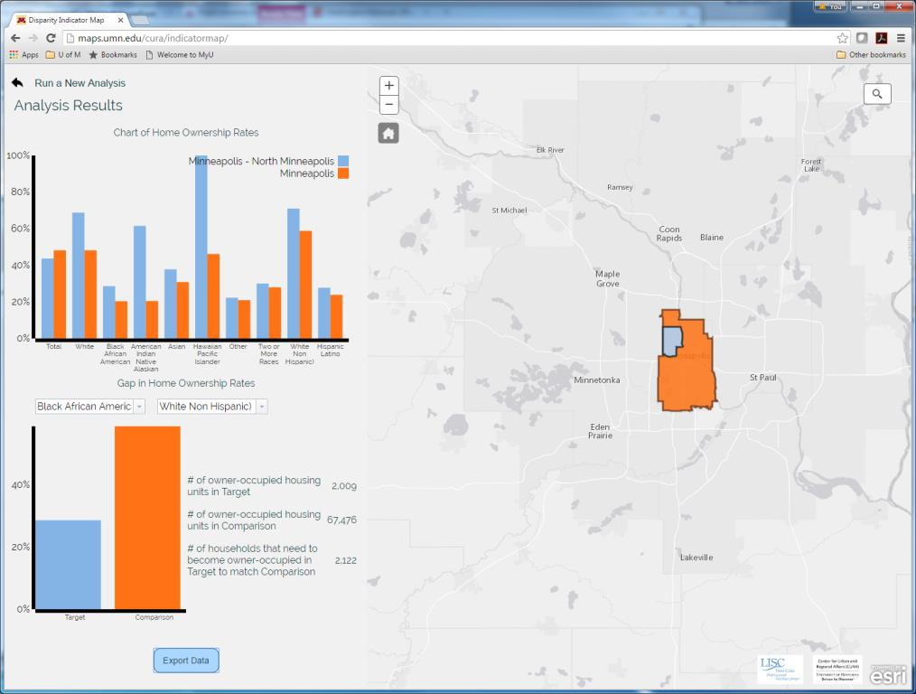
Notes:
You can export the raw data behind your analysis using the ‘Export Data’ button
Run a New Analysis, in the top left, brings you back to select new neighborhoods or indicators
And there’s a Reset Page button on the previous screen that takes you back to the U.S. map and list of metro areas.

Slide 15





Thank you!
Jeff Matson
jmatson@umn.edu
Notes:
Here are a bunch of words I don’t understand but I’m told this is what you need to build this.
Finally, we’re also talking with PolicyLink about potentially integrating this into their National Equity Atlas.

