Slide 1

Measuring
Community Impact of & Community Need for
Social Enterprise
September 14, 2016

Slide 2




Community Research Partners
Who we are:
501(c)(3) founded in 2000
Our Mission: Strengthen communities through data, information, and knowledge
Our Founding Partners:

Slide 3
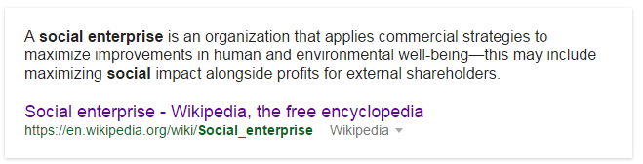

Social Enterprise

Slide 4



Project Partner:
Center for Social Enterprise Development
Notes:
Social enterprise is the new fad (I’m not as cynical as I sound!) in central Ohio.

Slide 5

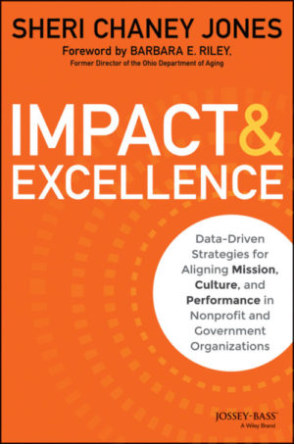
Project Partner:
Measurement Resources
Notes:
A collaborator and a competitor (in a good way)

Slide 6
The Idea

Slide 7


Pros:
  Great idea – one stop shopping
  Gets people talking about what “success” looks like
  Engagement across sectors (public, private)
Cons:
  Anybody ever heard of a data management system that never really got used because you can’t get good data OUT?
  Cost
  Link between social enterprise success and community change?!?!

Slide 8

Questions we could answer
Who’s doing what to address specific needs (e.g., employment for restored citizens)?
Are some social impacts more “successful” than others?
How do we connect local social enterprise efforts to community level change? Or nonprofits to entrepreneurs?
And more
Notes:
Predictive analytics

Slide 9



Interesting support so far

Slide 10
Contact information
Lynnette Cook, PhD
Executive Director
P: 614-737-2932
lcook@researchpartners.org
Community Research Partners
399 East Main Street, Suite 100
Columbus, Ohio 43215
www.researchpartners.org
@CRPColumbus

