Slide 1
A Framework for Understanding Civic Tech and Data Ecosystems
Katya Abazajian
NNIP Cleveland
September 14, 2016
Notes:
Hi, my name is Katya Abazajian – today I’ll be presenting a framework for understanding civic tech and data ecosystems.
This framework has come out of the Civic Tech and Data Collaborative cross-site project. The project seeks to improve ecosystems by convening collaboratives in selected cities.
We hope that the framework we’ve developed will illuminate what it means to have a strong civic tech and data ecosystem.

Slide 2
Civic Tech and Data Collaborative
Demonstration Sites
Boston
Youth employment
St. Louis
Criminal justice reform
Washington, D.C
Affordable housing
Learning Partners
Cleveland
Pittsburgh
San Antonio
Seattle
Notes:
The national partners of the Civic Tech and Data Collaborative (shown here) chose 3 demonstration sites and 4 learning partners to participate.
Local teams include NNIP partners, local government agencies, CfA brigades, and a mix of local funders, nonprofits, and universities.
Demonstration sites are in cities with collaboratives that have chosen to address locally important issues that would benefit from cross-sector collaboration.
Learning partners are cin ities where ecosystems have resources and/or partners in place, but instead of issue-oriented work, are focusing on relationship-building and infrastructural questions to get started.

Slide 3
Central Question
How can we harness
the power of data and technology
to increase efficiency, equity, and effectiveness in ways that will benefit the most vulnerable residents in our urban communities?
Notes:
The framework emerged out of a single question: How can we harness the power of data and technology to increase efficiency, equity, and effectiveness in ways that will benefit the most vulnerable residents in our urban communities?
All of our national organizations sought to stay rooted in making a positive impact in communities instead of letting data and tech be the focus of our work.
We believe that cities can use data and tech to their full potential by being intentional in using them to address pressing local issues. We hope this project builds capacity in each of the participating cities so they can take collaborative action using tech and data beyond this initiative.

Slide 4
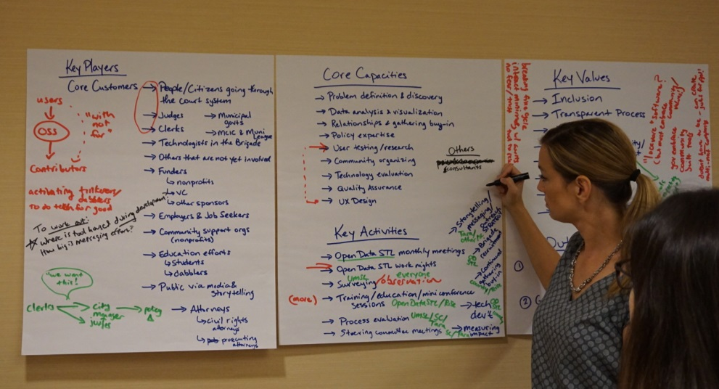
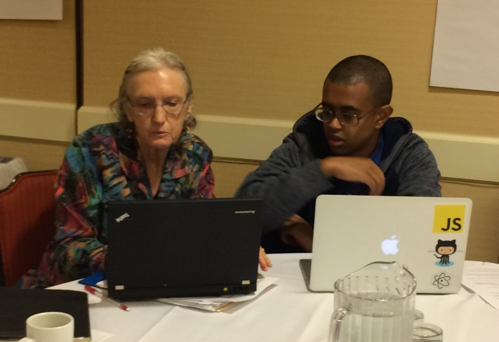
CTDC Draft Framework
Competencies
Collective action
Resources
Notes:
BREATHE
But what does it take to put practices into effect that leverage modern data and tech and address communities’ needs better than existing systems?
To start developing our framework, we drew from the work of local partners at the first convening in Oakland, and from the last year of working together. Here you can see pictures of local partners hard at work mapping key players, capacities, and values. The framework also includes knowledge from our three national networks.
Unfortunately, we don’t have time to go over the framework in detail, but we’ll be sharing our draft documents with the network.

Slide 5
Competencies
Cross-organizational management
Problem articulation
Community organizing
Issue knowledge
Technology design
Data management
Storytelling
FINDING THE RIGHT PEOPLE
Notes:
An initial question for many is who do we need? In our Oakland meeting, participants ran through lists of institutions that would make sense to involve, listing out partners and friends from previous work. But how do you zoom out and make that process applicable to any city?
With this framework, we wanted to shift the perspective from identifying specific organizations to focusing on competencies, which are listed here and explained in more detail in the framework document.
We found that there are no rigid rules about what type of organization fills which roles. Needed this flexibility to address the potential in cities without NNIP partners or brigades.
Cross-organizational management of individuals from multiple sectors; specifically the fields of technology, government, and the subject areas in which we work.
Problem articulation of the most pressing civic issues that negatively impact a community;
Community organizing and engagement of the people affected by the problem identified
Knowledge about particular issues based on formal training, professional practice, or life experience
Designing policy and programs that take advantage of innovations in technology to augment the implementation of policy goals. Policy-making and program implementation (or action steps)
Design and building of technology solutions
Data management and application from collection, dissemination , and analysis of data
Storytelling that documents and translates the experience of communities collaborating on civic issues --from the identification

Slide 6
Collective Action
Identify a shared result
Decide on roles
Define measurements for progress
Agree on shared decision-making
Allocate resources
Engage continuously
Change institutional barriers
FINDING THE RIGHT PEOPLE
UNITING AROUND A GOAL
Notes:
BREATHE
The next question –How can we get on the same page and get things done?
We believe that an effective collaborative is one that can accomplish a project goal to benefit communities in need while leveraging the competencies of its partners. To do this requires a collective action mindset.
Whether it’s for a short-term project or a long-term initiative, Collective action requires commitment and communication between organizations, especially across sectors.
Our steps for developing collective action in an ecosystem are listed here. By taking these steps together, you work toward making sure the shared value of the work lasts over time.

Slide 7
Resources
Financial and in-kind resources to support:
Staff and volunteers
Designing/implementing
Cultivating capacities
Organizational infrastructure
Contributed Technology
Contributed Data
Physical spaces
FINDING THE RIGHT PEOPLE
UNITING AROUND A GOAL
IDENTIFYING RESOURCES
Notes:
An obvious challenge for most cities that needs to be addressed collaboratively is how to get resources, which come in many forms.
Financial support is necessary to assemble staff and volunteers, design projects, and cultivate new long-term capacities.
Teams often need technology upgrades like data visualization applications or specific government data to accomplish project goals.
Teams also need meeting spaces to bring conversations to life and foster better relationships.
Working together to identify and allocate these resources ensures that the project has energy beyond just one organization driving the operation.

Slide 8
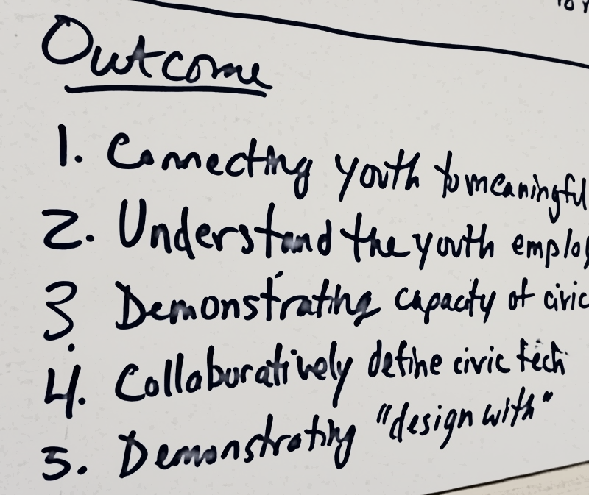
National Goals
Documentation
Infrastructural lessons are key
Celebration
Scaling and replication
Learning from partner cities and refining the framework
Assembling materials to help all cities leverage civic data and tech
Notes:
FAST
For the national team, this project is an iterative process. Our goal is to enable cities to get a head start in developing their local civic tech and data ecosystems.
DOCUMENT
We seek to document how cities are carrying out their collaborative work. We believe the lessons we have learned so far will be central to future efforts to better understand civic tech and data ecosystems.
CELEBRATE
We also want to celebrate the wonderful work being done in our demonstration and learning partner cities. Each of these cities is taking bold steps with the goal of making meaningful progress in their communities.
SCALE
Finally, we want to scale and replicate. By supporting amazing projects happening in our partner cities, we’re able to draw out lessons that apply across the country.

Slide 9
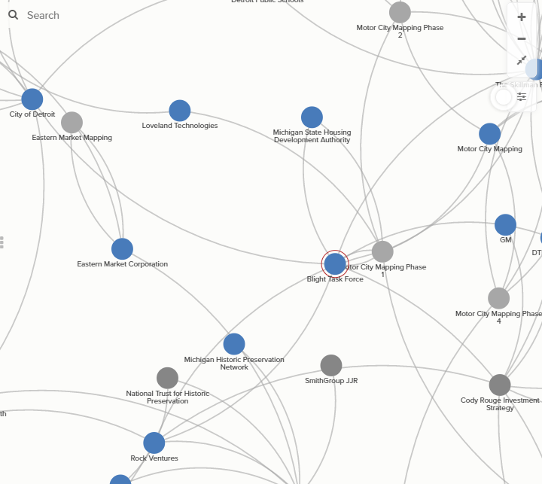
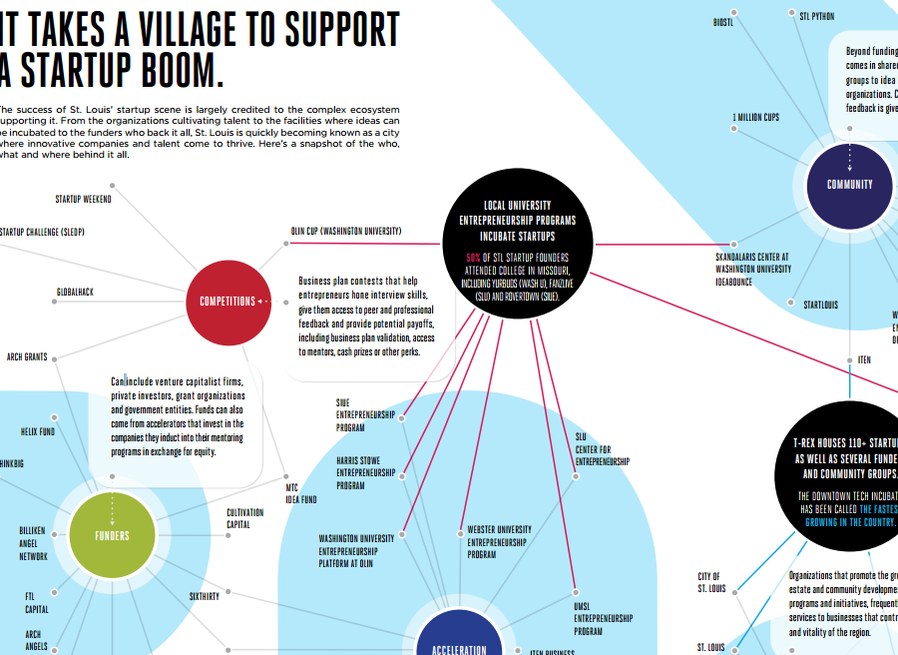
What Can You Do? Understand Your Ecosystem
Notes:
Just thinking about the players in your community and whether they’re engaging in collaborative work may be a good starting step.
By identifying the landscape you can start to see where there are gaps in the network. Do you struggle to have city agencies partner with external groups? Does your city have a self-sustaining tech presence? Are there nonprofits interested in cross-sector collaboration?
Some cities, like Cleveland, have started to document the players by conducting interviews across sectors, and other cities have used network visualization. Tools like Civic Graph or Kumu are great visualization tools that we’re exploring.

Slide 10
Please provide feedback!
Additional Resources
National Partner Resources
NNIP CTDC Cross-Site Project page
Living Cities CTDC Project Page
CTDC Oakland Meeting Materials
Other Resources
Microsoft Civic Graph Network Mapping Tool
Network Impact Civic Tech Assessment
Notes:
Another thing you can do is provide feedback on the framework! We’ll be sharing a draft with more detail about the ideas I’ve presented here, and feel free to peruse the additional resources which are posted along with this PowerPoint on the NNIP website.
We’ve also proposed an unconference session if people are interested in talking about the framework or discussing your projects combining civic tech and data.
Thank you!

