Slide 1
Cleveland: People, Place, and Innovation, September 14, 2016

Slide 2
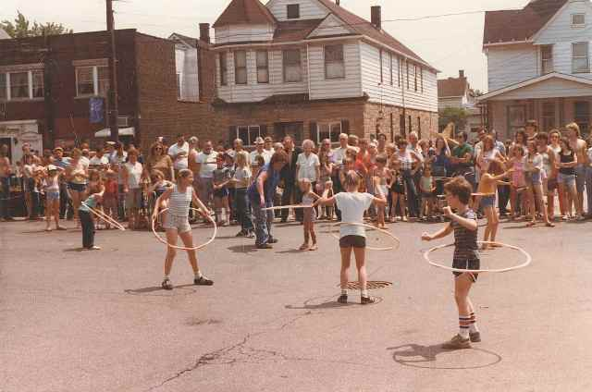
Slavic Village in 1990
28,341 residents
3.5% Black
12% Vacancy
42% renters
$25,000 median HH income

Slide 3
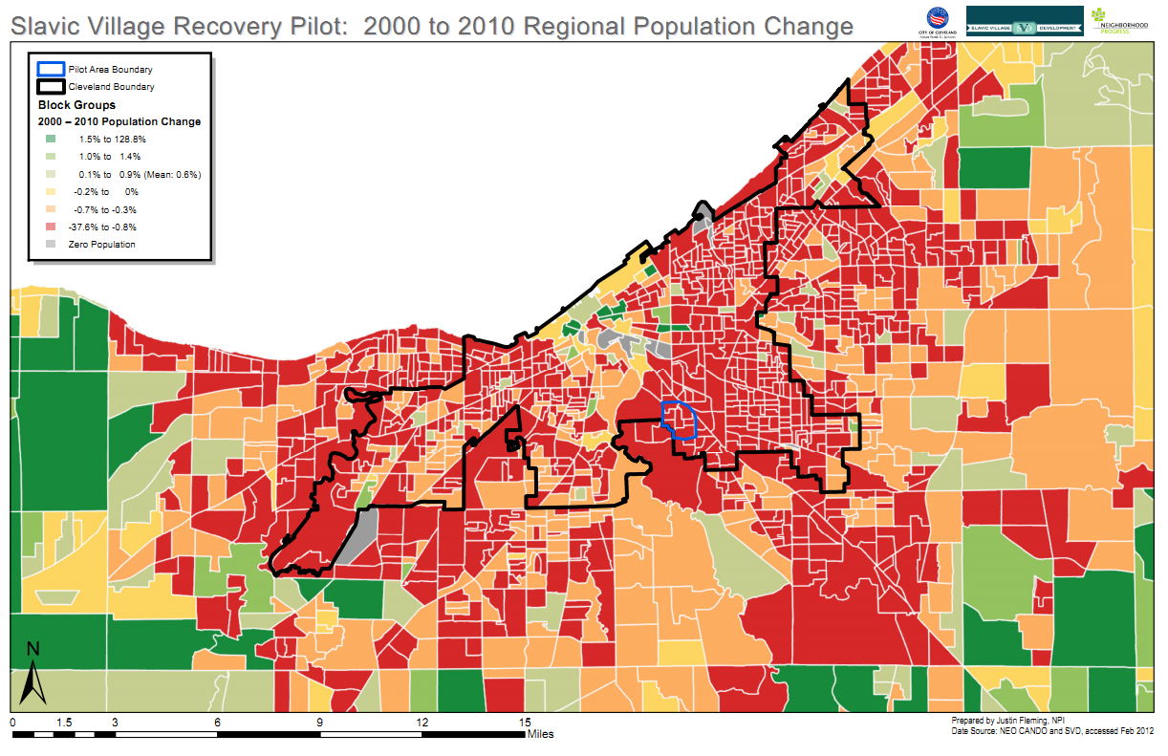
Notes:
This shows the location (outlined in blue), and highlights the issue, large outmigration since 2000

Slide 4
Slavic Village in 2010
22,432 residents
52% Black
28% Vacancy
59% renters
$26,304 median HH income ($15,360 1990)

Slide 5
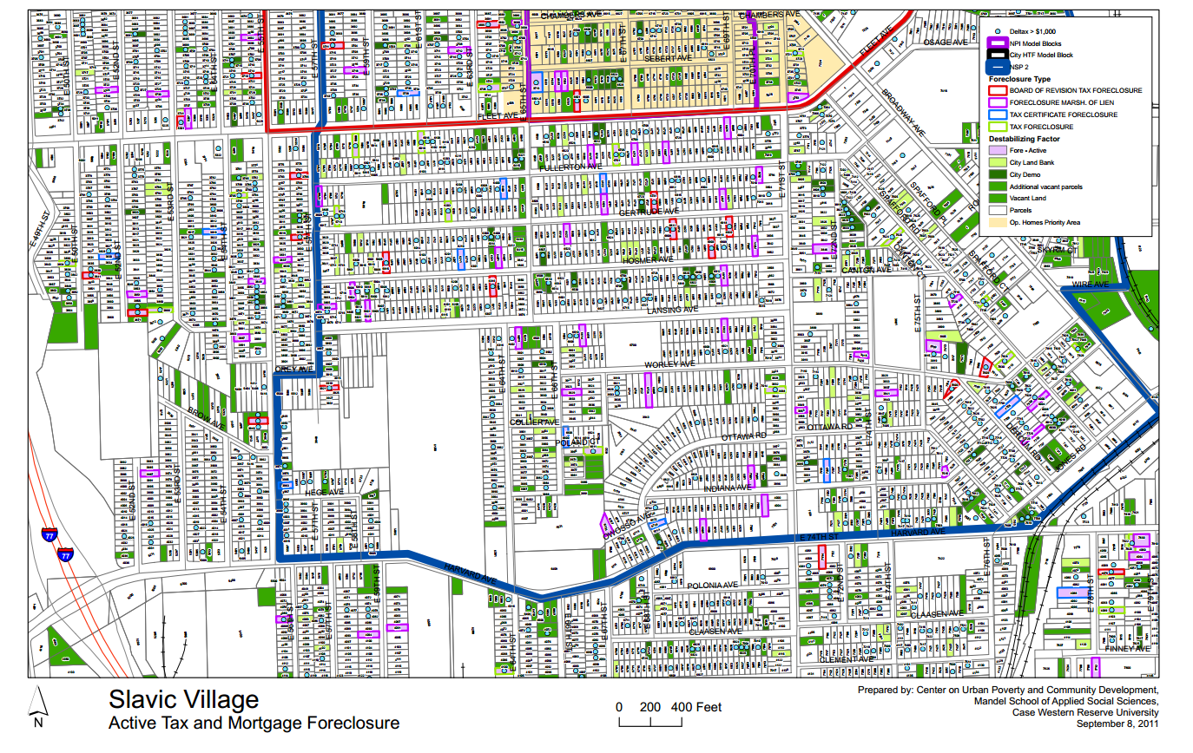

Slide 6
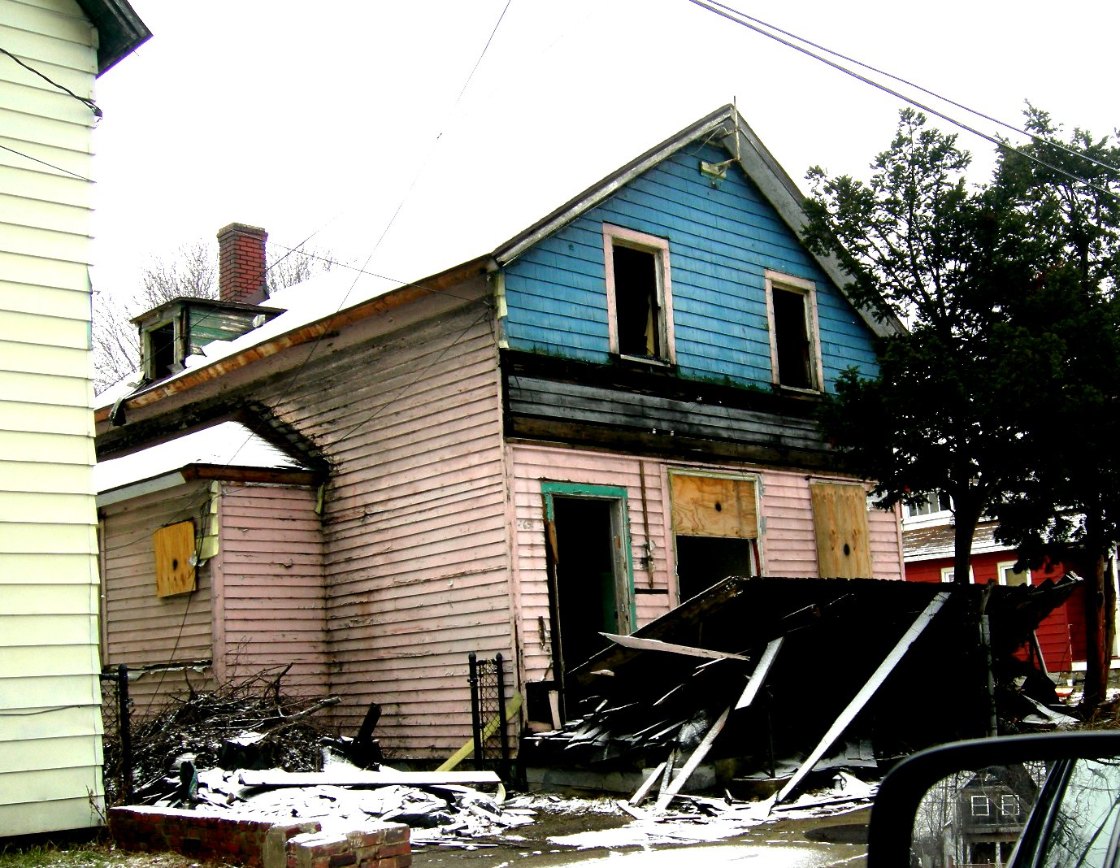

Slide 7
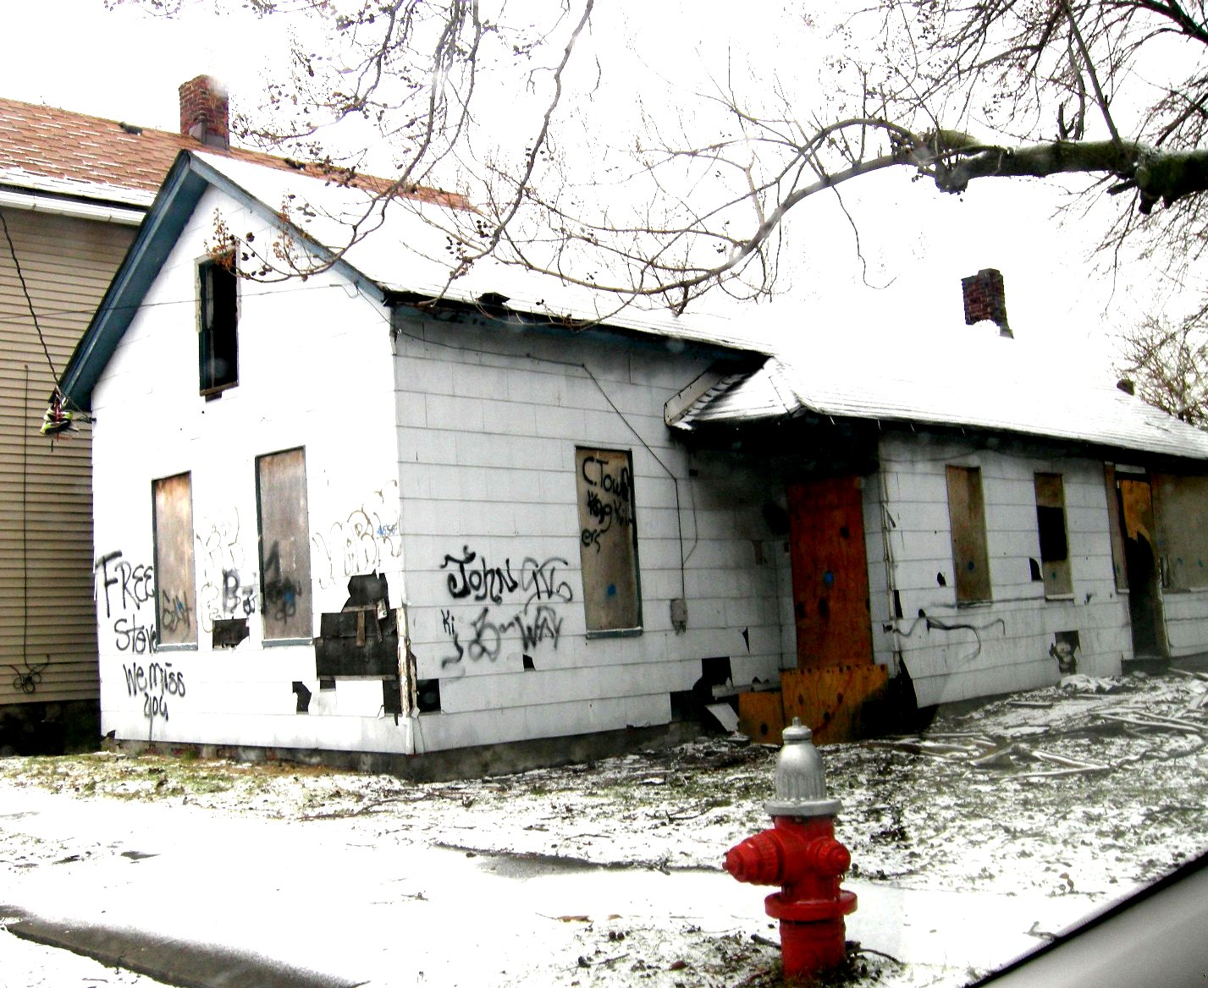

Slide 8
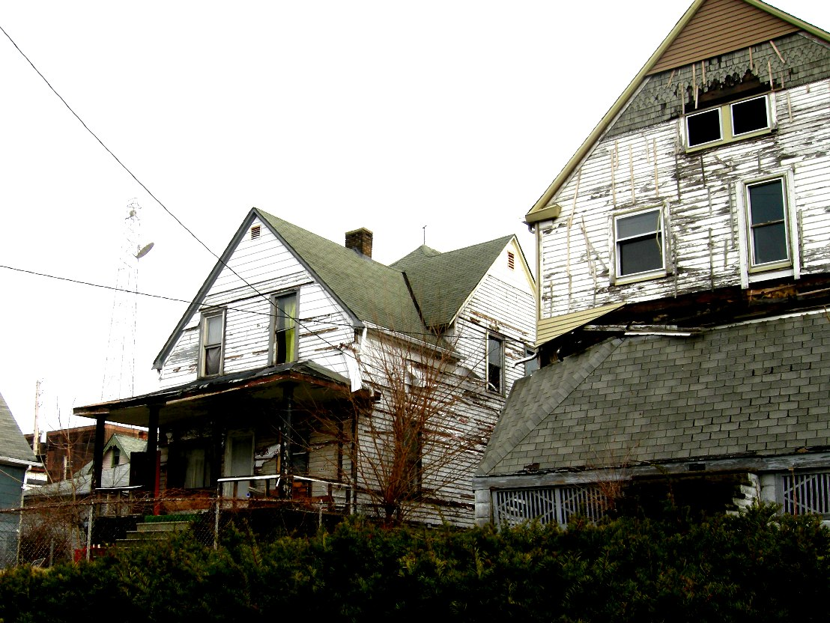

Slide 10
The Scope of the Problem in 2011
5 years- How long the average Cleveland foreclosed home was vacant
954 days- How long the average foreclosed home was on the market
100,000- How many houses in Ohio were vacant and awaiting demolition

Slide 11
What was needed
A Complete Partnership of Community Leaders, City Government, Banks, and Investors
A Strong Private Development Entity with Assets for Rehabilitation and Sale
A Clear Plan, Financing, and Support for Demolition

Slide 12
A Comprehensive Approach
The Goal of Rehabilitation and Sale in a Revitalized Market
Model Block Approach
Targeted Demolition
Code Enforcement and Housing Court
Vacant Property Survey
Acquisition of Delinquent, REO, Foreclosed, and Vacant Property
Credit-Worthy Buyers

Slide 13
Neighborhood Characteristics
A Large Enough Area with Major Assets
A Market That Can Be Rebuilt
A Major Marketing Push
A Committed Set of Partners

Slide 14
Slavic Village Recovery, LLC
Acquire Low-Value Properties from GSEs, Servicers, and CCLRC
Rehabilitate (Moderate Plus) up to 200 Single-Family Homes in a Concentrated Area
Create Affordable Housing
Rebuild the Housing Market
No Subsidy or Gap Financing

Slide 15
SVR Partners
Forest City Enterprises
RIK Enterprises (Community Blight Solutions)
Slavic Village Development (CDC)
Cleveland Neighborhood Progress
First-of-its-Kind Strategic Collaboration between For-Profit and Non-Profit Partners

Slide 16
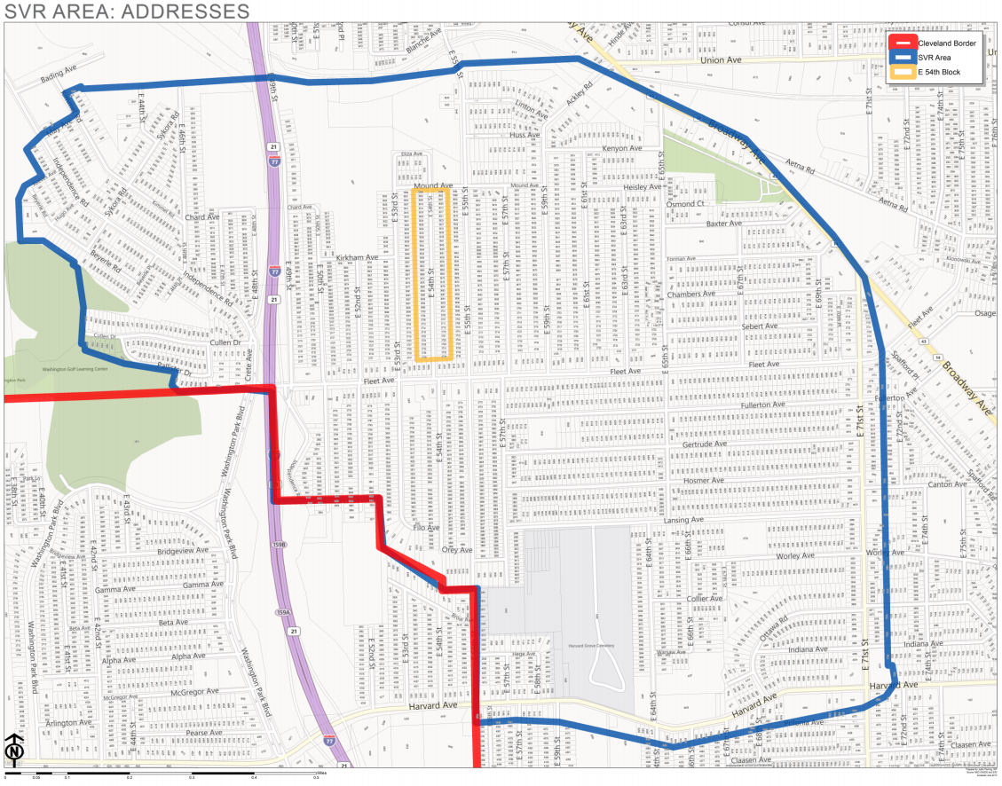

Slide 17
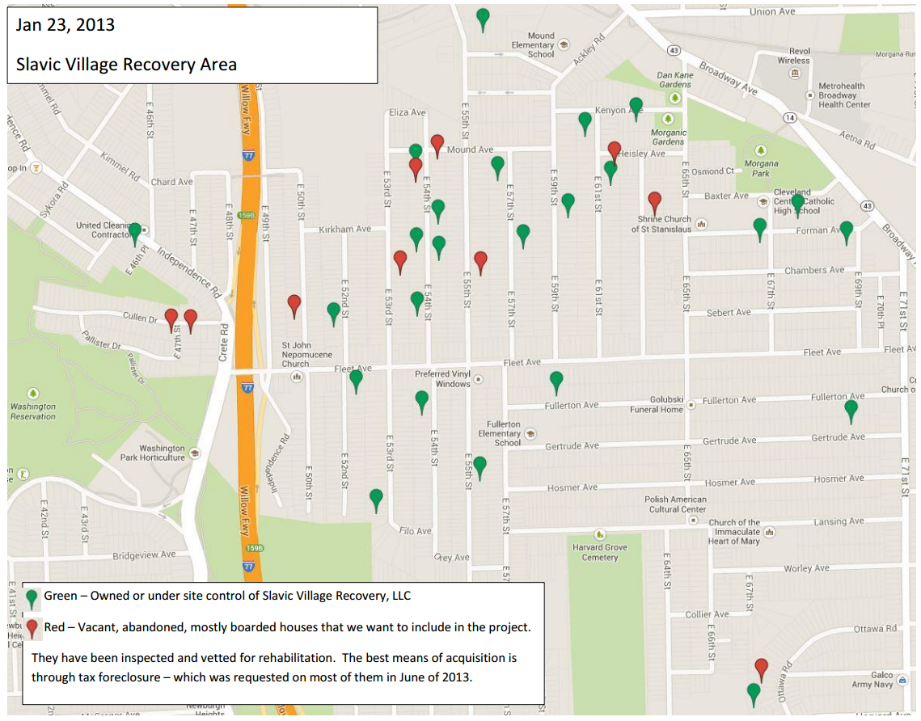

Slide 18
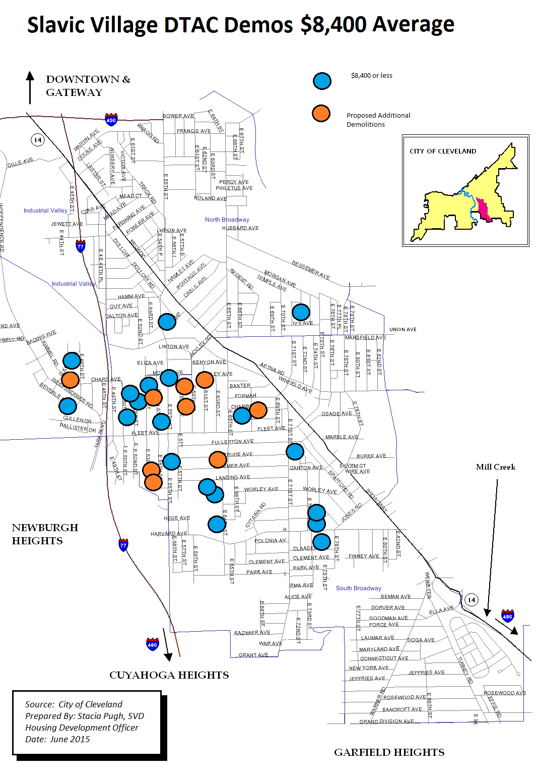
A Little Help From Our Friends
$175,000 Grant from Wells Fargo- Curb Appeal, 50/50 Home Repair
$350,000 Demolition Fund- County Prosecutor
511 Targeted Demolitions in Last 3 Years
Extremely Patient Capital from Forest City and CBS

Slide 19
Who are the buyers? (as of 12/2015)
16 African American, 2 Latino, 7 white
$80,000 to $14,000 Annual Income (Median $65,900)
Purchase price $73,900 to $51,900 (Median $64,900)
773 to 539 Credit Score (Median 658)
68 to 24 yrs old (Median 45)
10 households with children
7 single-person households

Slide 20
Housing Market on the Rise

Slide 21
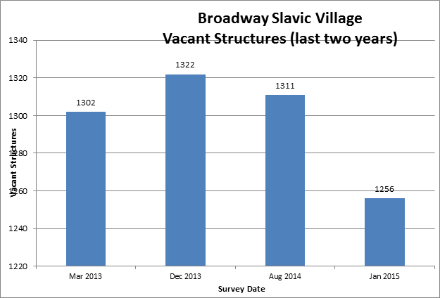
Vacant Property Trend

Slide 22
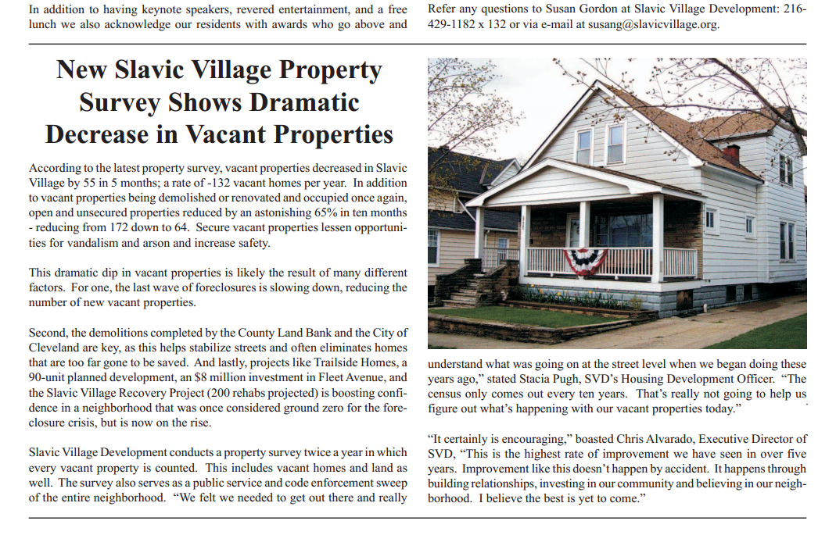
Buying Stabilizing & Renovating

Slide 23
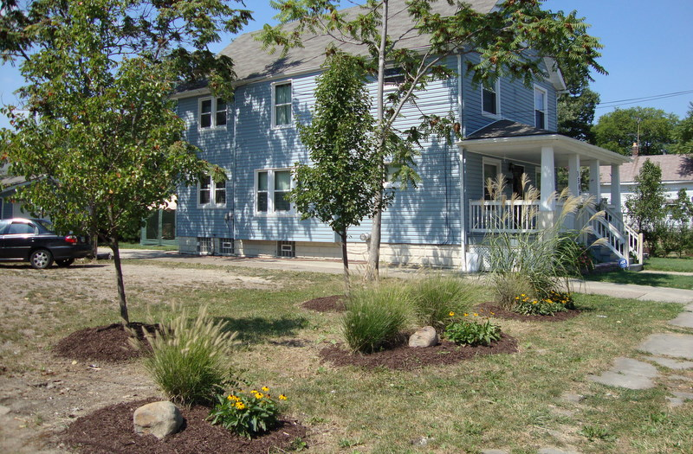

Slide 25
Questions?

