Slide 1
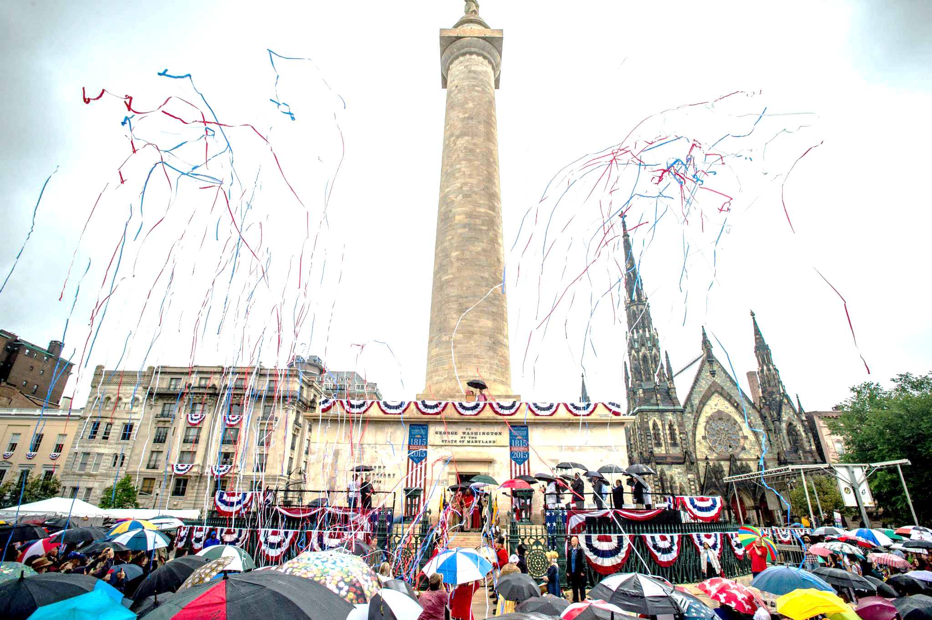
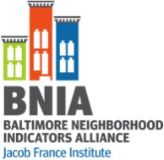
Baltimore: People, Place and Cultural Mapping
Seema D. Iyer, PhD
Associate Director, Jacob France Institute
NNIP Meeting 2017
www.bniajfi.org
@bniajfi
#VitalSigns15

Slide 2
What is Neighborhood?
Baltimore is a City of Neighborhoods
Durable properties of places based on people, history, geography
Robert Sampson, Great American City 2012
Home
Neighbors
Community
Services
Schools
Political Representation
Well Being
Health
Identity
Markets
Housing
Retail

Slide 3
Community Based Indicators
Neighborhood context influences how activities and policies take hold
Bits of information that, when combined, generate a picture of what is happening in a local system
They provide insight into and ongoing monitoring of the overall direction of a community
Rhonda Phillips, Community Indicators 2003
Economic
Social
Environmental
Cultural

Slide 4
Which Indicators

Slide 5
We Heard From Communities
Begin in 2000 through a community-based outreach process
Community Roundtables again in 2011 for the next decade
Community perceptions on quality of life
Racial Diversity Index
Properties under foreclosure
Vacant and abandoned housing
Crime rates
Unemployment rate
High School Drop out rate
Dirty Streets and Alleys
Alternative Transportation Use
Walk Score
Poverty Rate

Slide 6
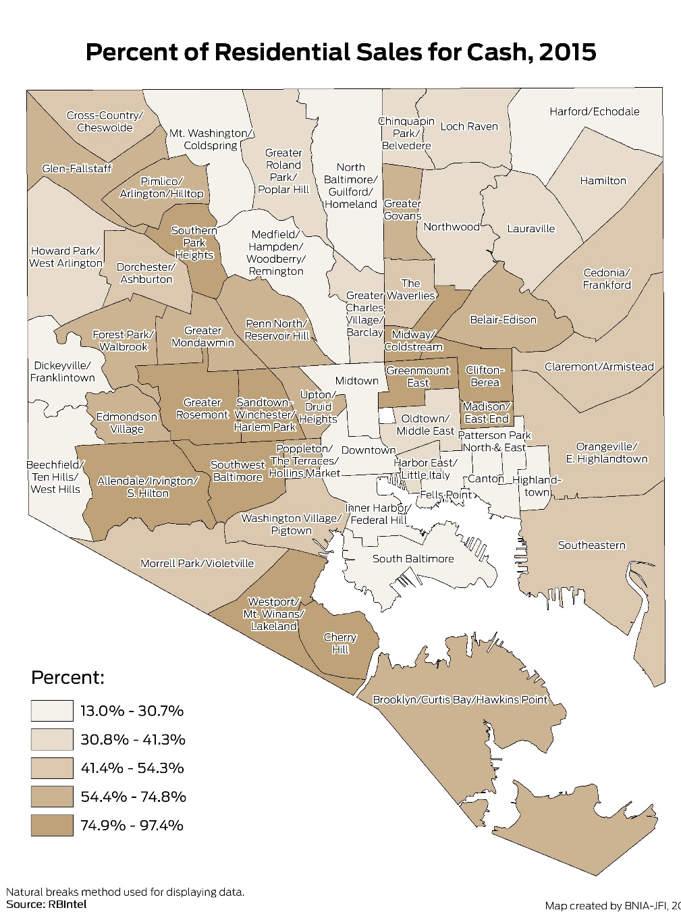
We Learn from NNIP Partners
Cash-Based Sales
Historic Property Tax Credit
Weatherized Homes
Fast Food Density
Mortality Rates
Library Membership Rate

Slide 7
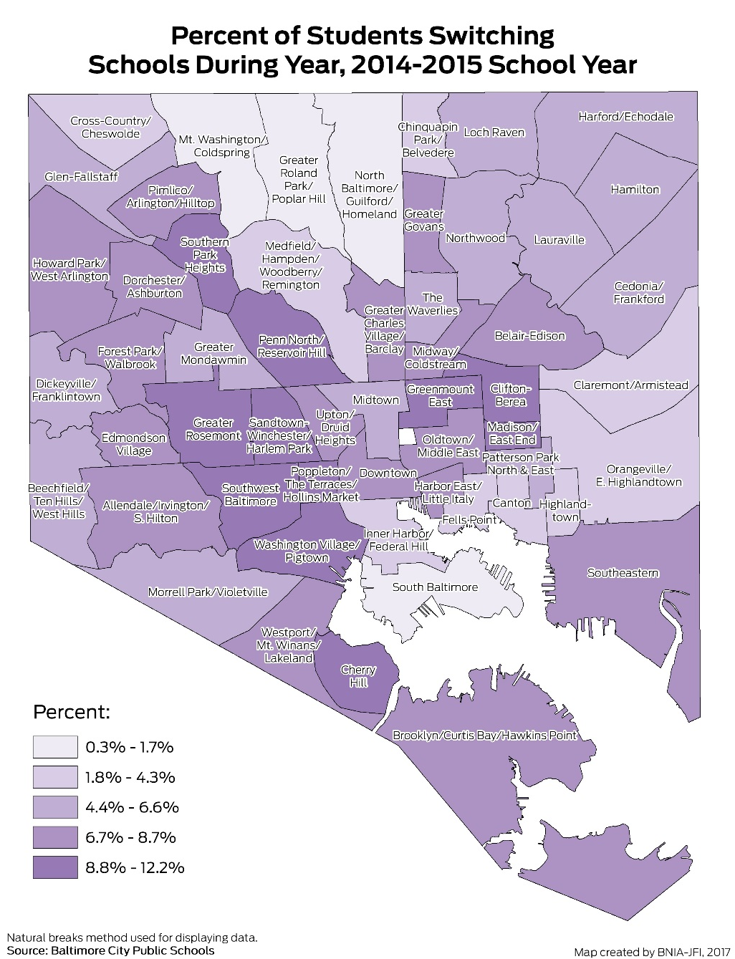
We Heard from Baltimore Organizations
Kindergarten Readiness
% of Students Switching Schools
Life expectancy
Event Permits
No-Vehicle Households
Miles of Bike Lanes
Cultural Arts Opportunities

Slide 8
Synthesis

Slide 9
Increase housing diversity in every neighborhood by providing realistic housing options for a range of household incomes and racial backgrounds.
Reduce or maintain vacant and abandoned housing below 4% in every neighborhood
Reduce the percentage of households traveling more than 45 minutes to get to work
Policies and programs much take in account both people and place
Access to information by itself doesn’t change people’s minds; need to present the data in a compelling way

Slide 10
Arts & Culture Mapping

Slide 11
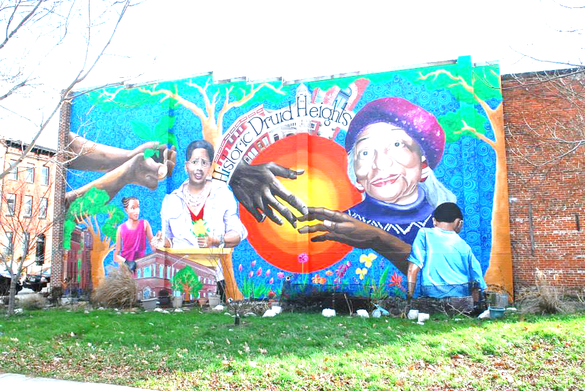
Vitality in Neighborhoods = Umami?
What did we know?
Baltimore is the cultural and historic center of the region
Arts and Entertainment Districts:
Station North (est. 2002), Highlandtown (est. 2003) and Bromo Tower (est. 2012)
Research on Measuring Vitality
Arts opportunities providing spaces and events for social interaction of increasingly diverse residents (Ann Markusen)
Talent, Tolerance, Technology -- Creative Class (Richard Florida)
Presence, Participation, Support -- Urban Institute’s Arts and Culture Indicators Project

Slide 12
Why is measuring arts and culture important?
Tell a more inclusive data story about what’s going on in neighborhoods
Raise awareness about equitable distribution of resources and representation of cultural assets
Heighten awareness of art opportunities among wide audiences, including arts organizations, businesses, developers, and policymakers
Arts/Cultural Opportunities
Community-Buidling/Social Cohesion
Wellbeing

Slide 13
Build from BNIA’s expertise as a data-gatherer
Centralized source for geographically-based arts and culture data for neighborhoods
Interactive, web-based, publicly-accessible
Allow for crowdsourcing of information
Available July 2017
Learn more at geoloom.org/Beta

Slide 14
Assessing Participation

Slide 15
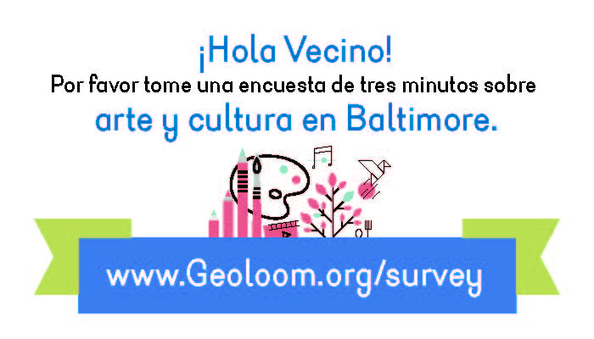
GEOLOOM Participation Survey, February 2017-March 2017
Online survey for residents, workers and anyone else
Aim was to get neighborhood representation
Community-based outreach to ensure participation in all neighborhoods
Over 1,600 responses; just over 1,000 were Baltimore city residents

Slide 16
Participation Categories
Created art outside of your home for your profession or as part of a community activity
Took a class or taught dance, literature, media, music, performance, or visual art
Exhibit, gallery, museum, or other display of arts or culture
Festival, block party, parade, marching band, or similar event
Historical site, monument, cemetery, or historical program or event
Live performance, such as concerts, dance, shows, or stand-up comedy in any location including a bar, club, place of worship, pop-up venue, restaurant, or symphony hall
Literary event, such as a book reading, poetry reading, or spoken word presentation
Sporting event, professional or organized amateur event, including children's leagues, but not regular exercise or fitness
Movie at a theater or other venue
Any activity or event not included above
I haven't done any of these

Slide 17
Baltimore Residents' Participation by Category (N = 1,011)

Slide 18
What Didn’t We Ask?
Curated Event/Talk
Recreation/ Game Night
Civic Engagement/ Protest
Community Meeting/ Clean Up
Outdoor Exhibit/Event
Conference/ Convention/ Fair
Yoga
Dance/Chorus
Book Club
Cooking/ Food/ Farmer’s Market
Faith Based Event
Baltimore Bike Party

Slide 19
Differences in Participation
Type of Event | Age | Education | Gender | Race | Income
Live performance |  | * |  |  | *
Movie at a theater or other venue |  | * |  |  | *
Exhibit, gallery, museum, or other display of arts or culture |  | *
Historical site, monument, cemetery, or historical program or event |  | * | * | White
Festival, block party, parade, marching band | * |  |  | Hispanic
Took or taught a class |  |  | *
Created art outside of your home | *
Literary event (book/poetry reading, or spoken word presentation) |  |  |  | Black/ AA | *
Sporting event |  |  | *
I haven't participated in any of these |  | *

Slide 20
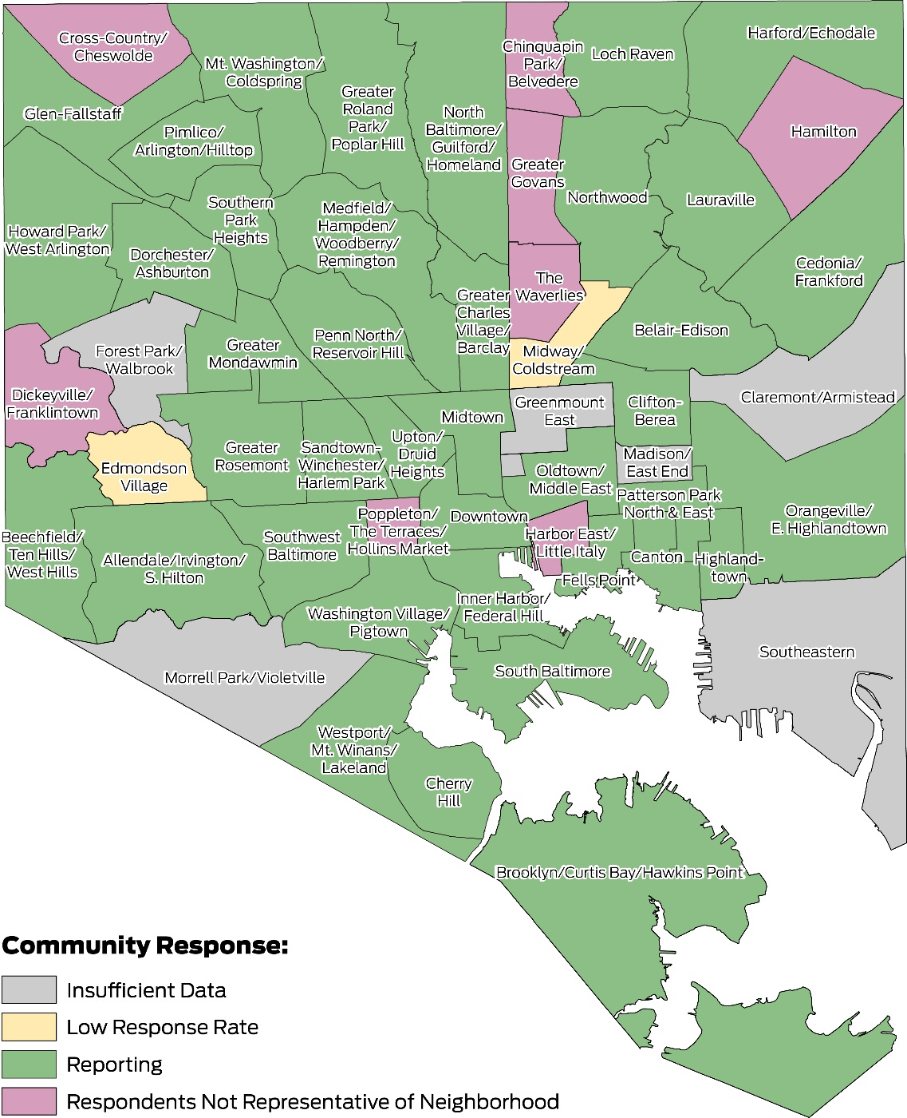
Responses by Neighborhood

Slide 21
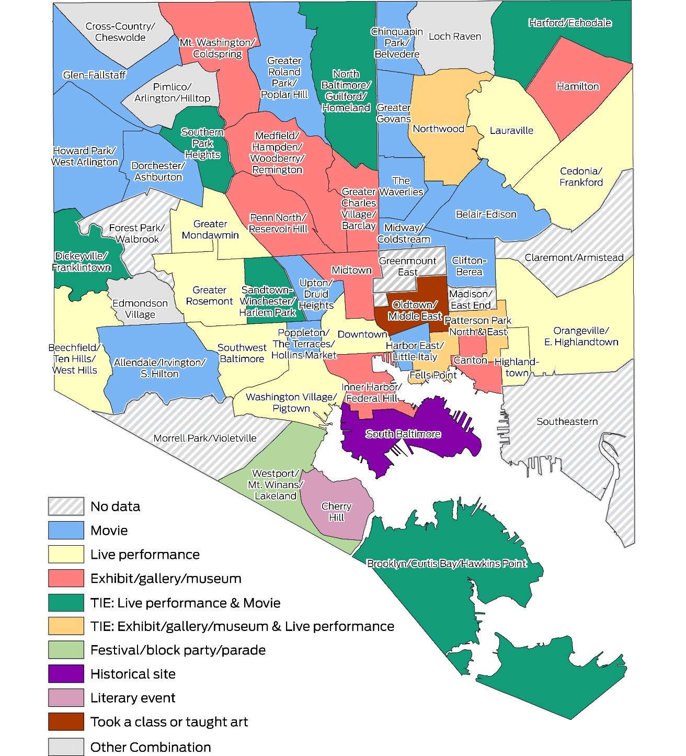
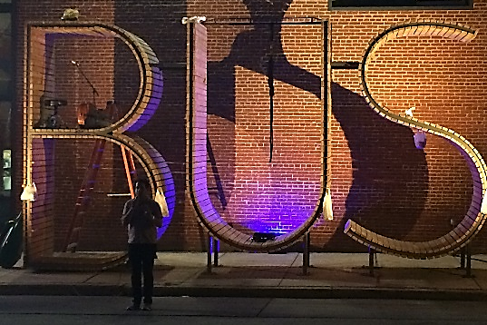
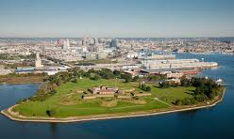
Responses by Neighborhood
Similarities across neighborhoods

Slide 22
Jane Brown, Robert W. Deutsch Foundation
Krista Green, Baltimore Office of Promotion & The Arts
Julia Di Bussolo, Arts Every Day
Christine Hwang, Baltimore Neighborhood Indicators Alliance

