Slide 1
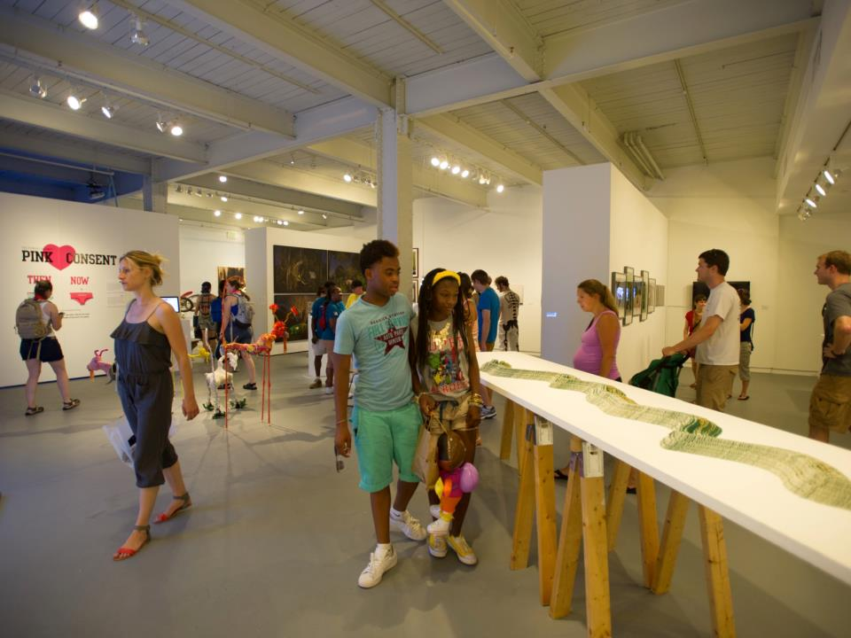
Making Baltimore a more creative and vibrant city.

Slide 2
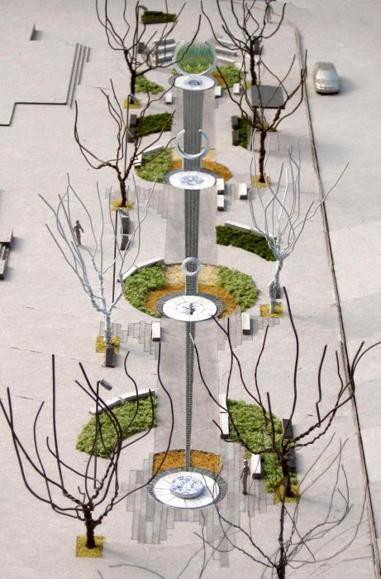
Public Art Commission
Oversees % for Art Ordinance
12 active projects,
Maintains database of over 700 public artworks in Baltimore City
Manages pool of over 400 qualified Public Artists

Slide 3
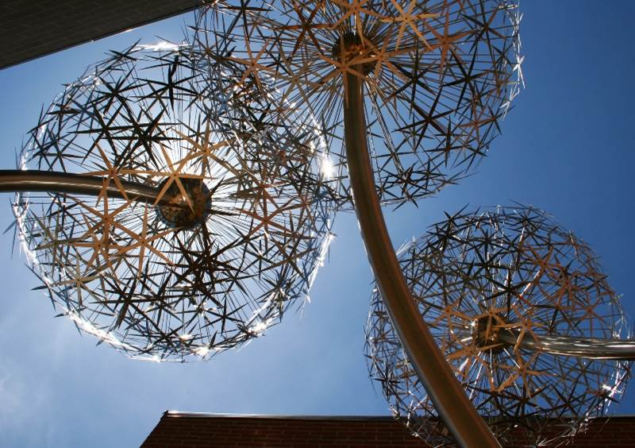

Slide 4
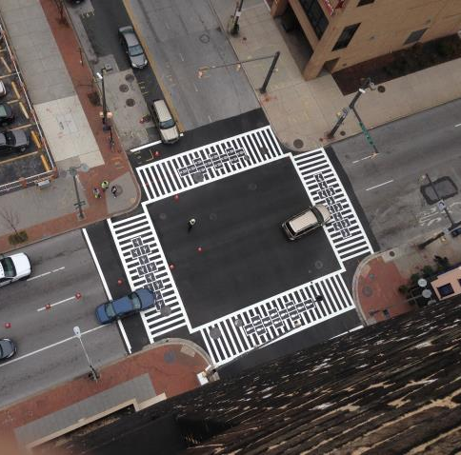
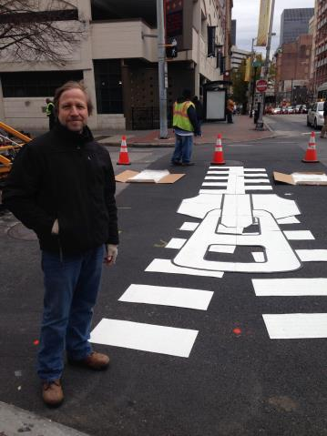
Crosswalk Project

Slide 5

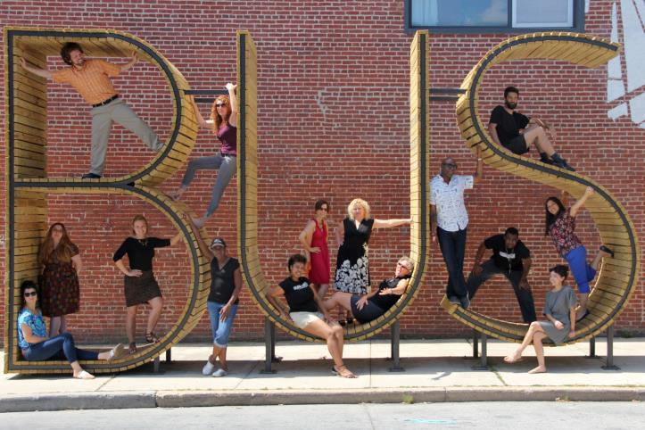
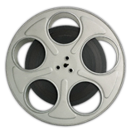
Arts & Entertainment District
Placemaking Project: Transit
Highlandtown

Slide 6
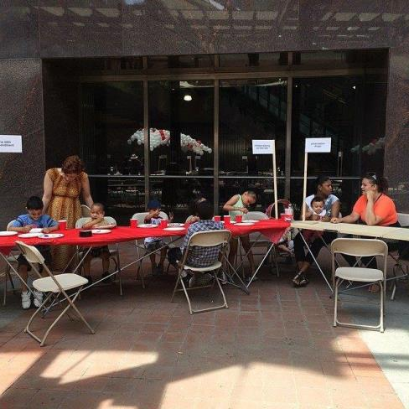
Arts & Entertainment District
Placemaking Project: Transit
Bromo

Slide 7
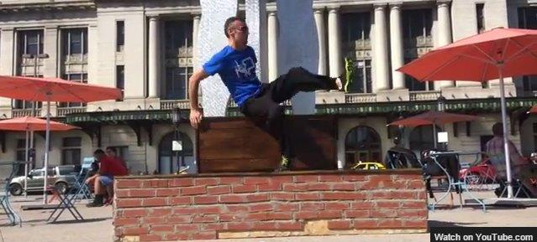
Arts & Entertainment District
Placemaking Project: Transit
Station North

Slide 8
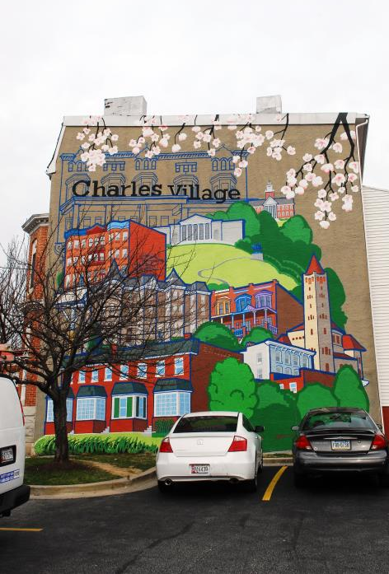
Baltimore Mural Program
More than 200 murals
Sites throughout the city

Slide 9
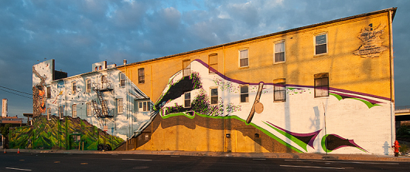
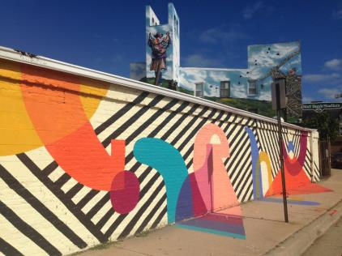
Warner Street Mural
Photo credit: David Muse

Slide 10
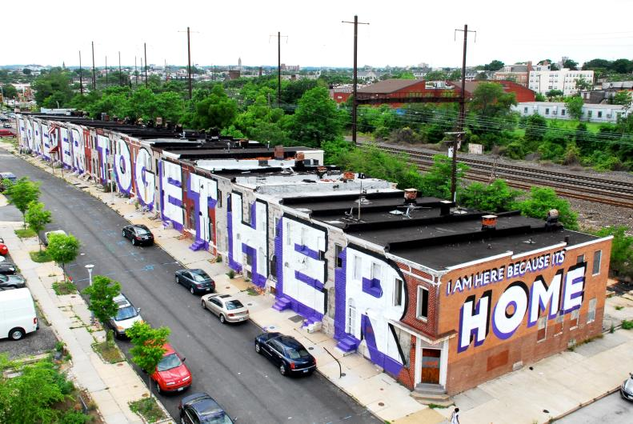
Love Letter to Baltimore
Photo credit: Matthew Kuborn

Slide 11
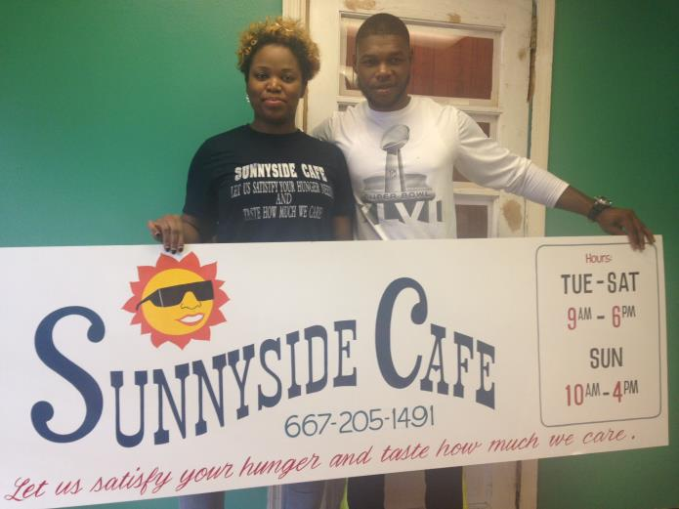
Steve Powers’ Sign Painting Shop

Slide 12
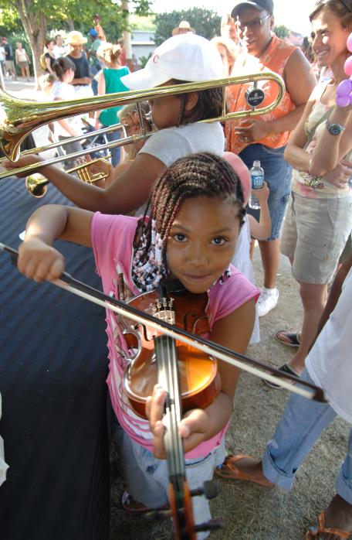

MECU
Neighborhood Events
Small grants to local community organizations for events.
Over 6,000 people across 23 city zip codes participated!

Slide 13
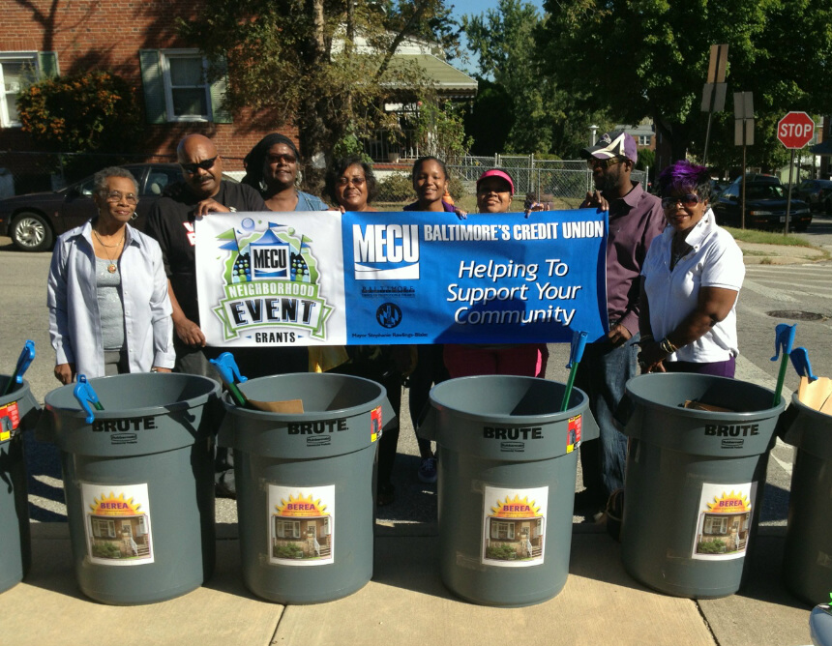

Slide 14
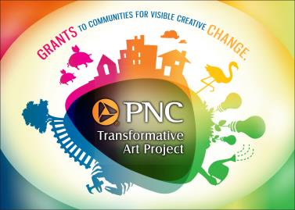
Transformative Art Project
Using art to create neighborhood identity and raise the positive visibility of a community
Permanently reinventing public spaces with non-profit community groups working in partnership with professional artists
Awards of up to $30,000

Slide 15
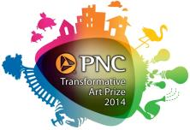
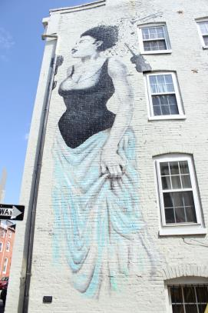
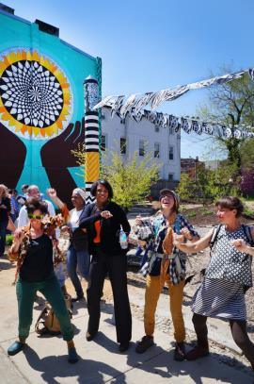
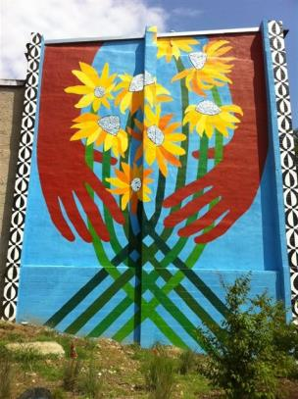
PNC Transformative
Art Prize

Slide 16
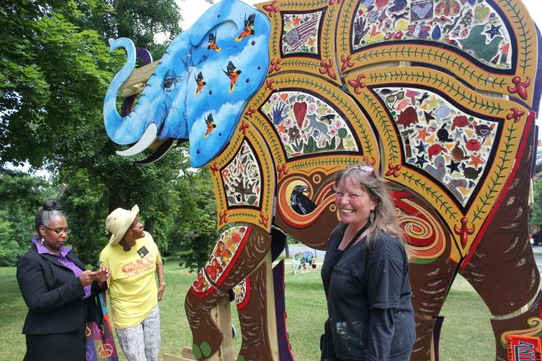
PNC Transformative
Art Prize

Slide 17
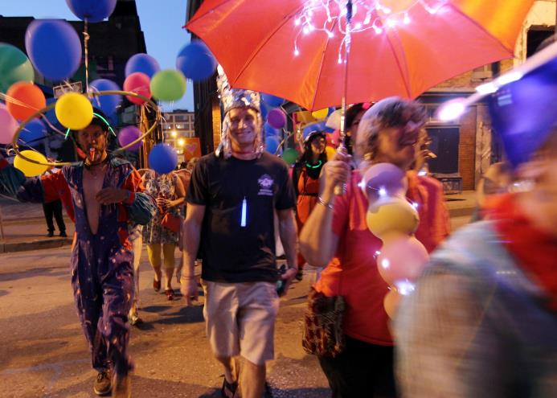
PNC Transformative
Art Prize

Slide 18
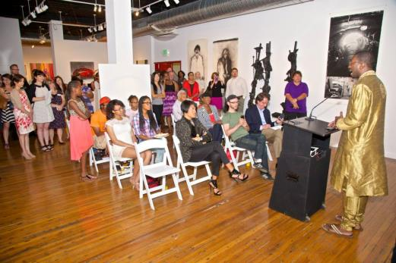
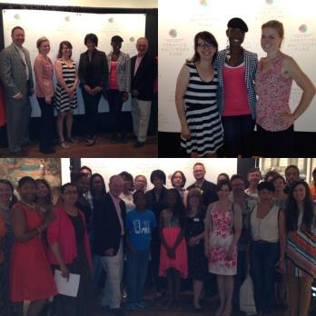
Creative Baltimore Fund/Mayor’s Artists Awards

Slide 19
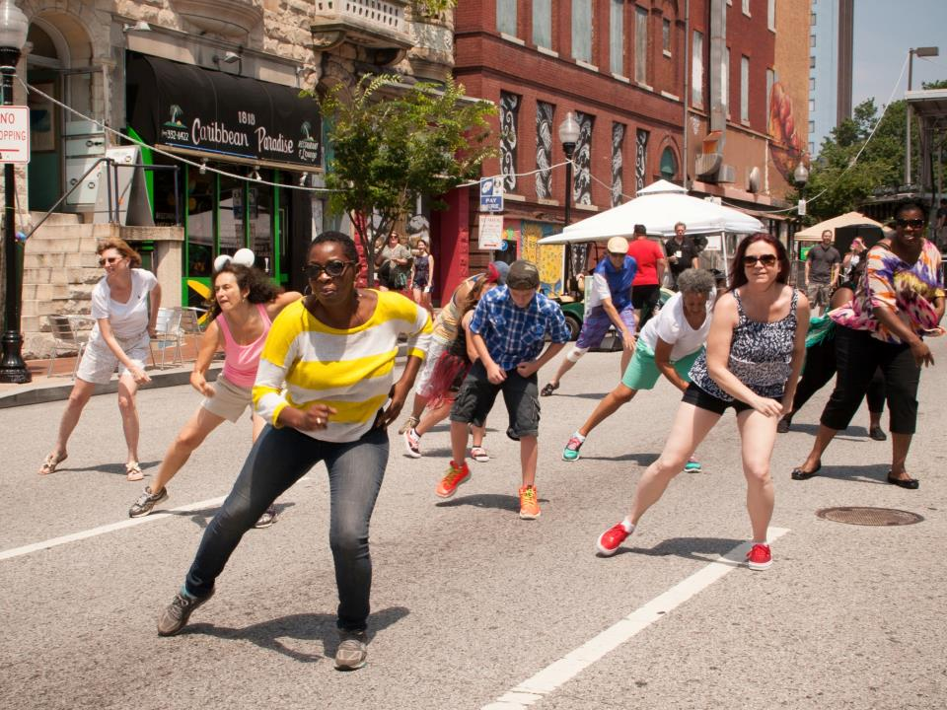

Slide 20
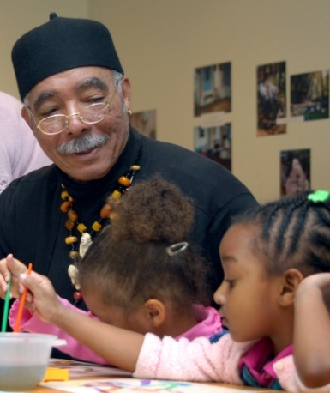
School 33 Art Center
Bright StARTs
Arts education year-round for underserved children in grades K-12 out-of-school
-2,500 students participate annually.

Slide 21
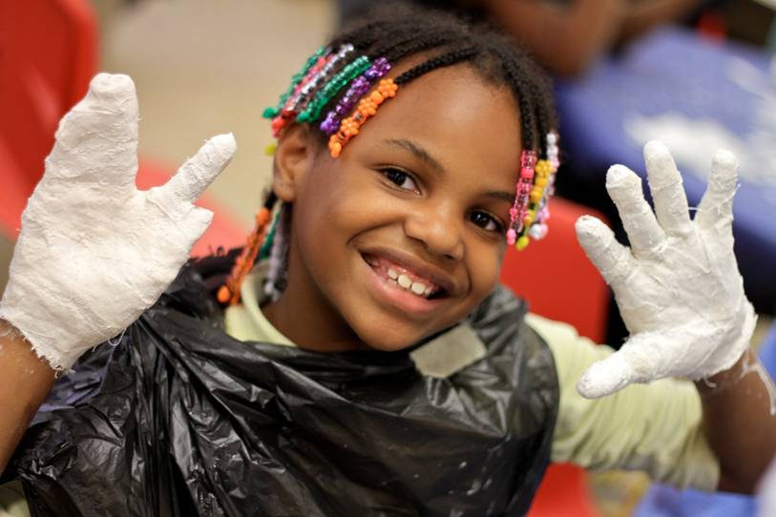
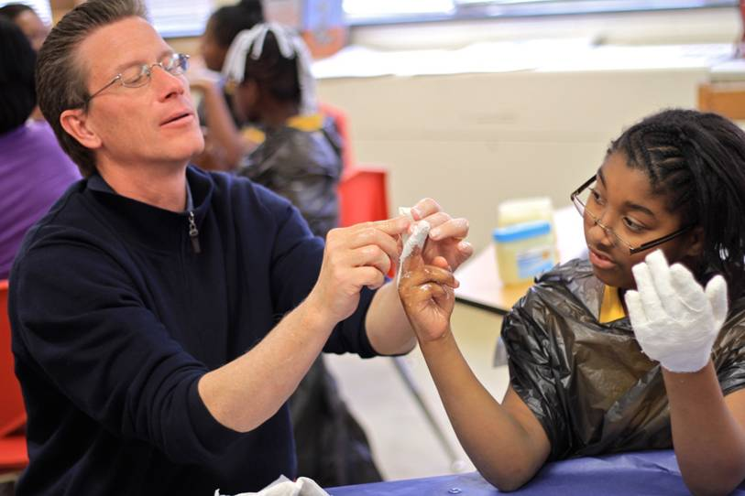
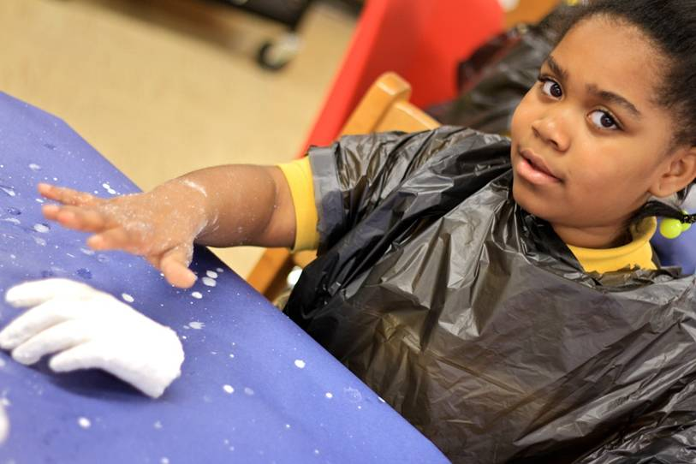
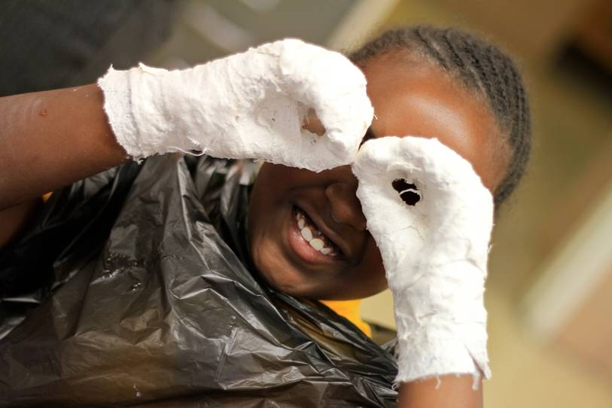
Bright StARTS
Partnerships with Baltimore Family League, City Schools & others

Slide 22
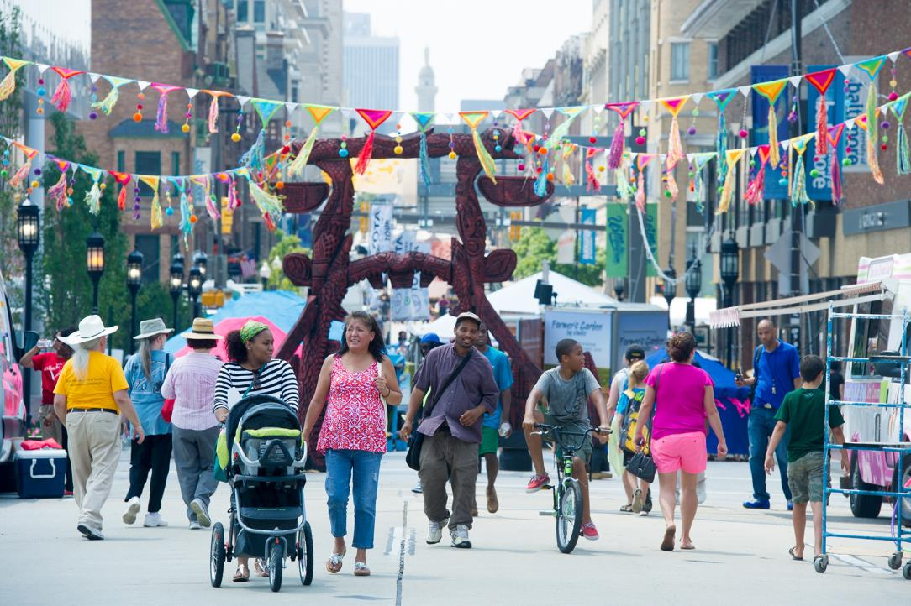
Quality of Life
A Better Baltimore

