Slide 2
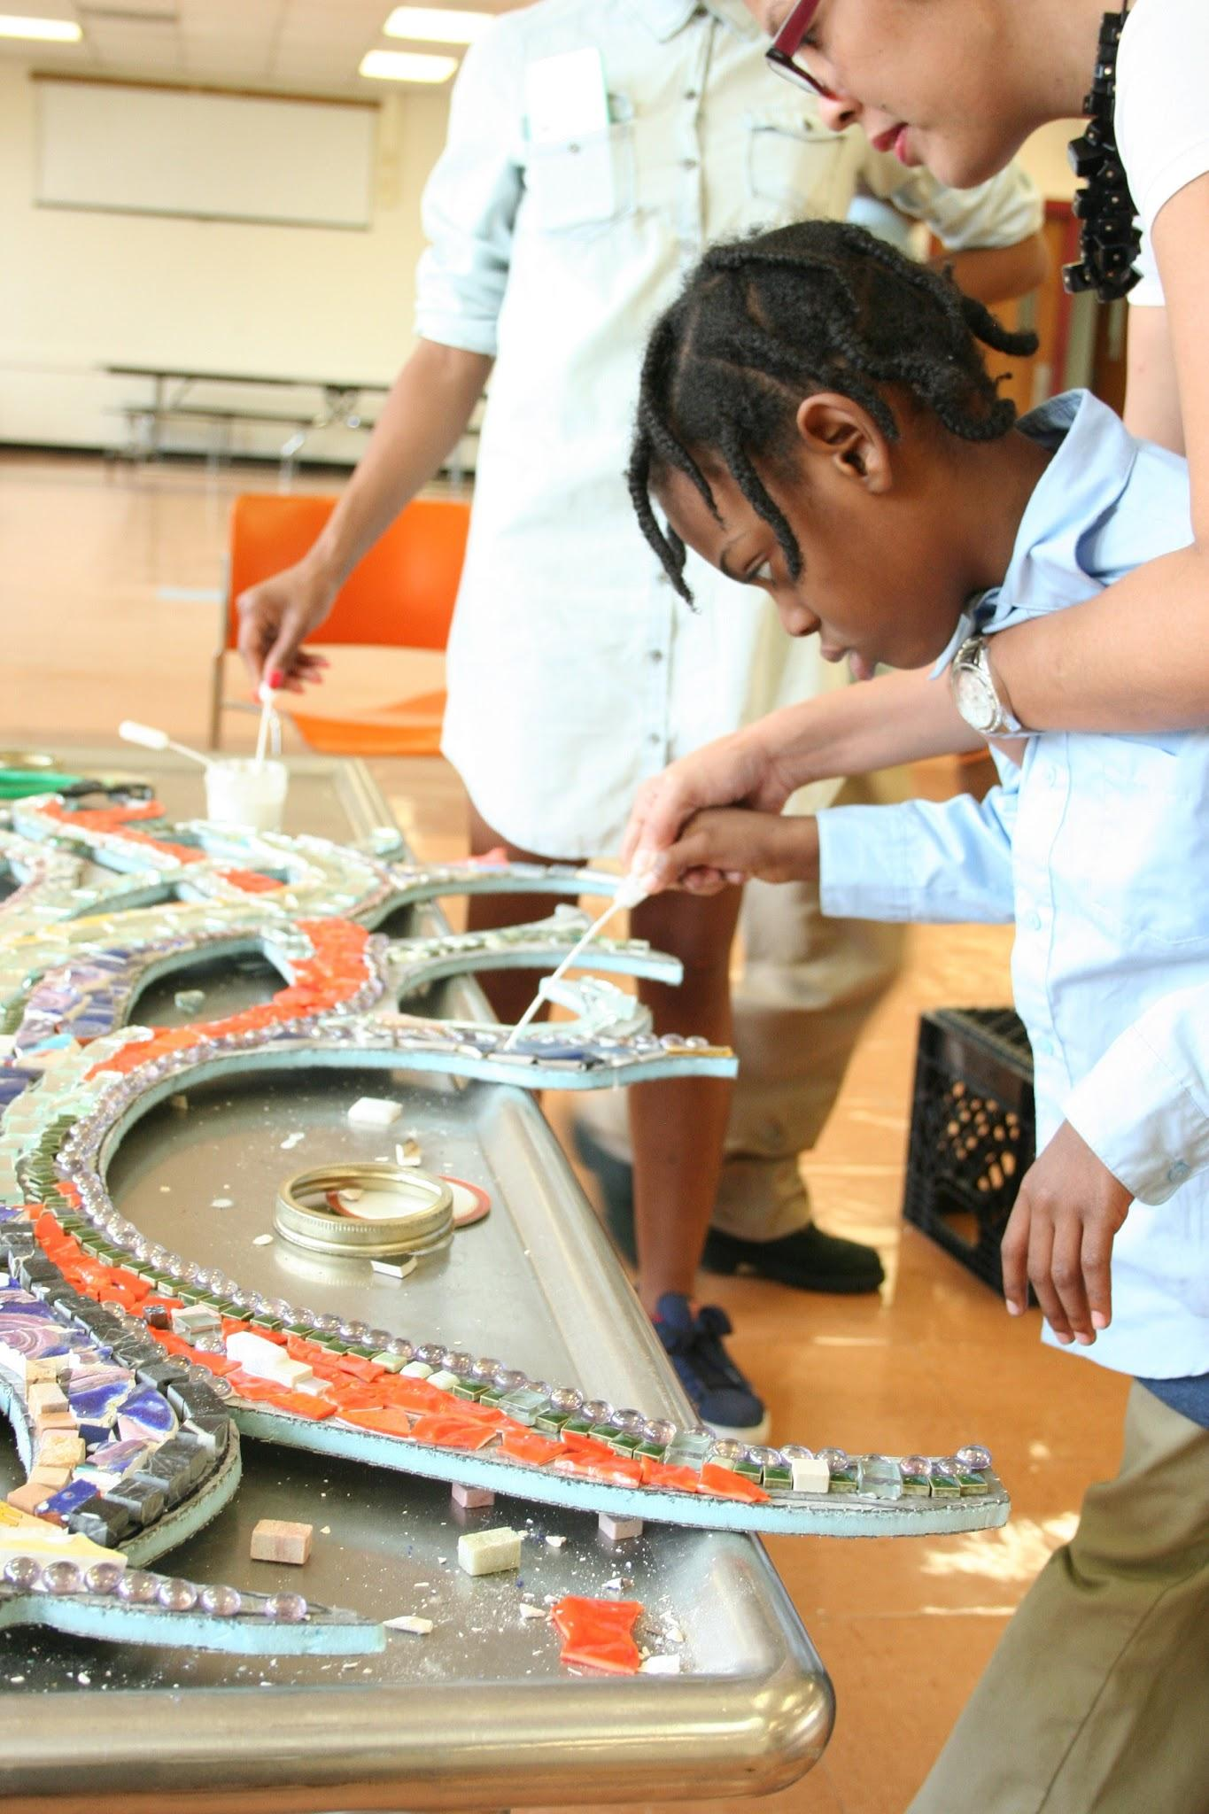
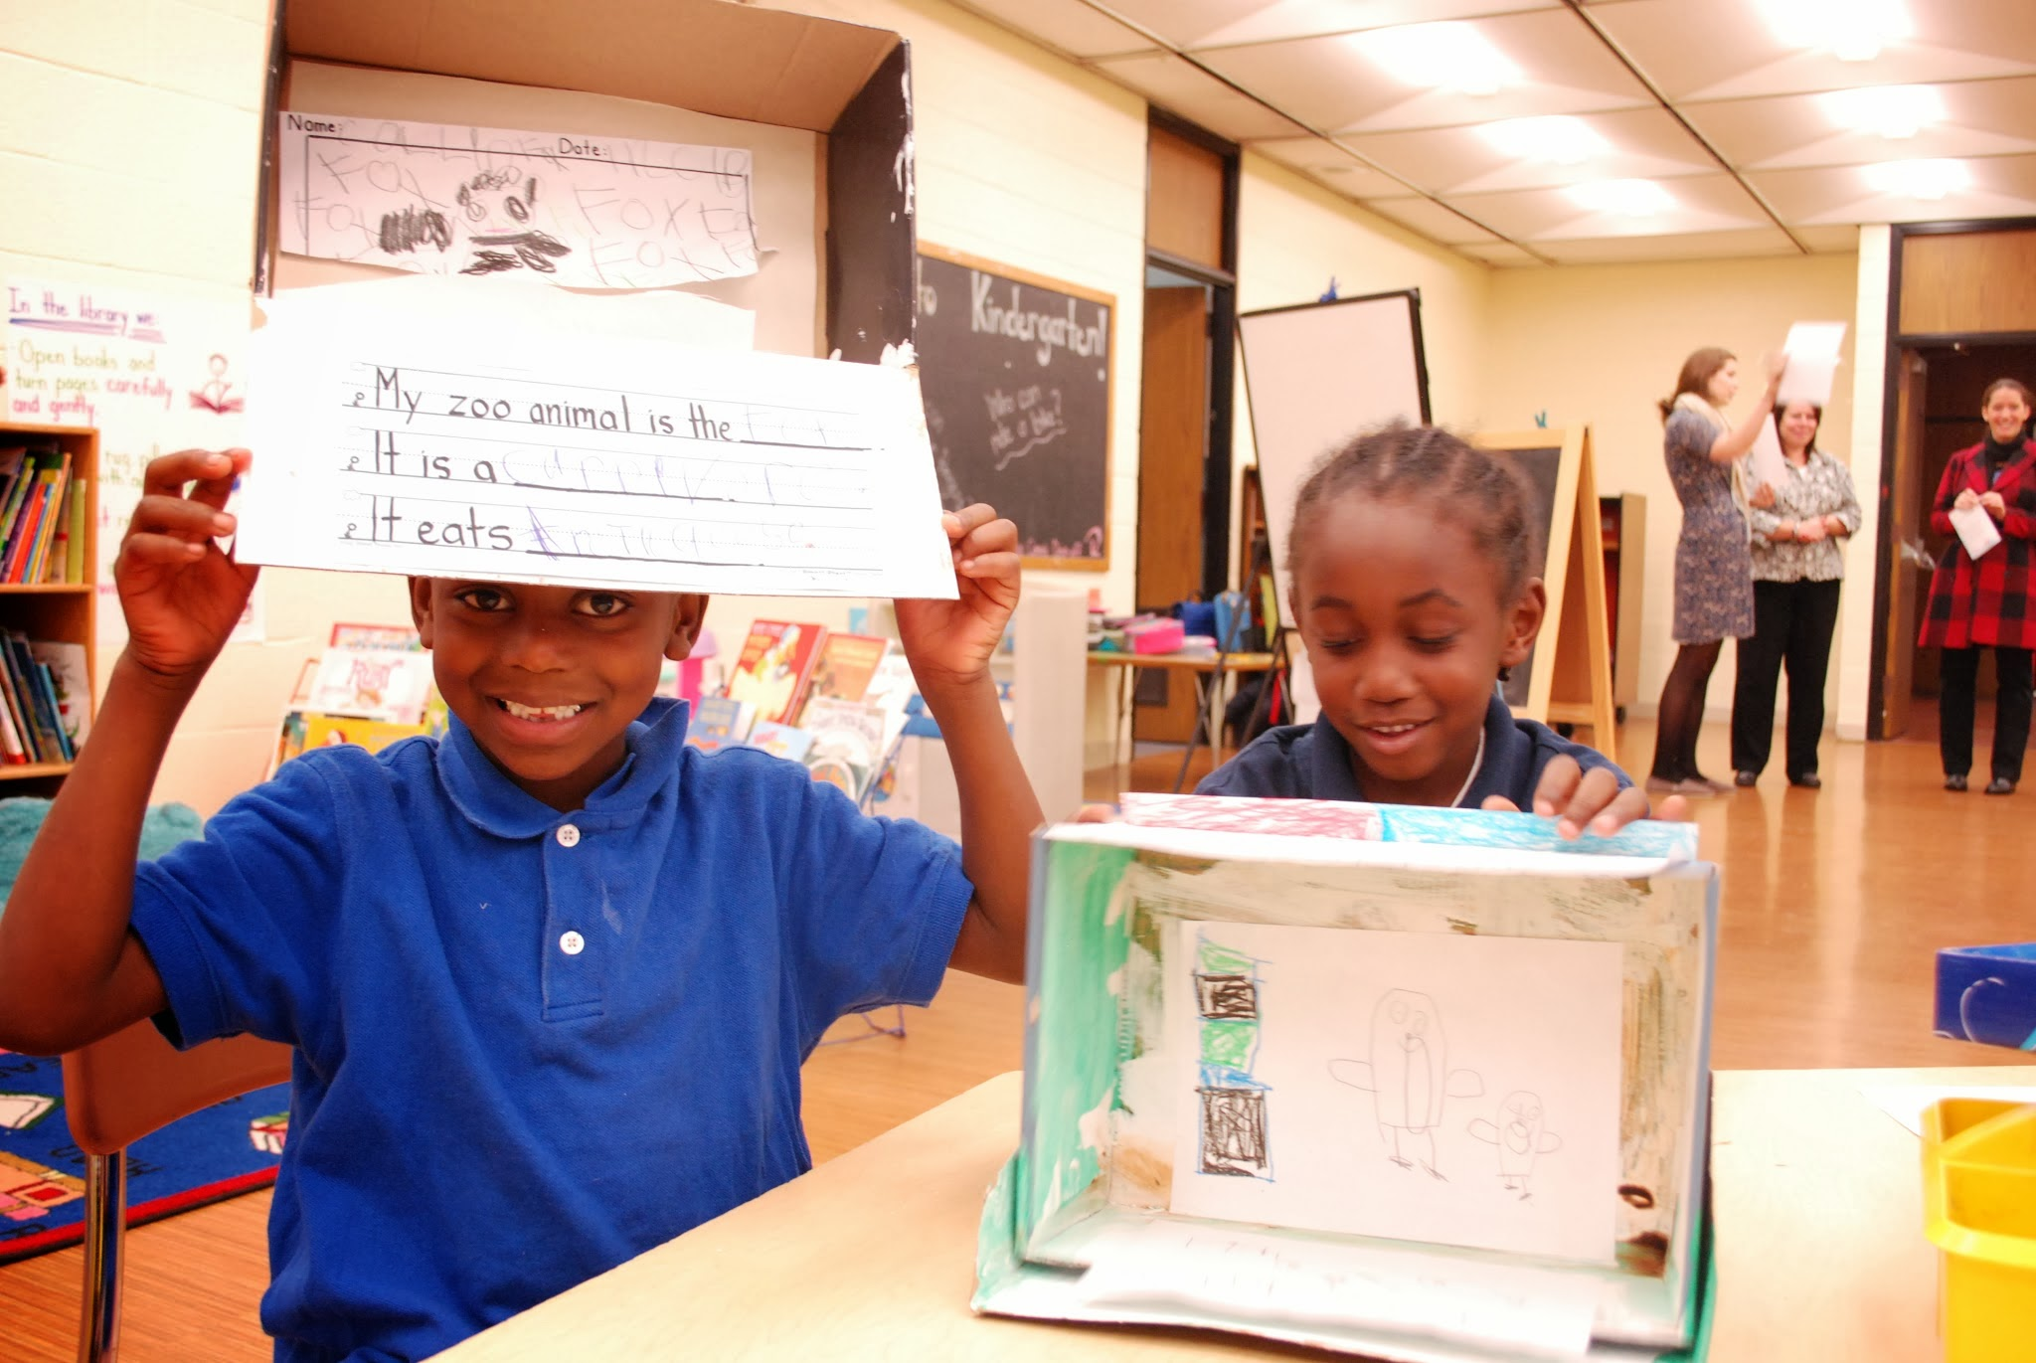
Our mission is to serve as a catalyst for creative learning in Baltimore City Public Schools.

Slide 3
What does Arts Every Day do?
Build and Sustain long-term partnerships with schools
Empower teachers as leaders within their school communities
Connect teachers to artists, makers, and cultural organizations
Provide Framework for building a creative learning culture
Work in Partnership with Statewide organizations on advocacy and policy

Slide 4
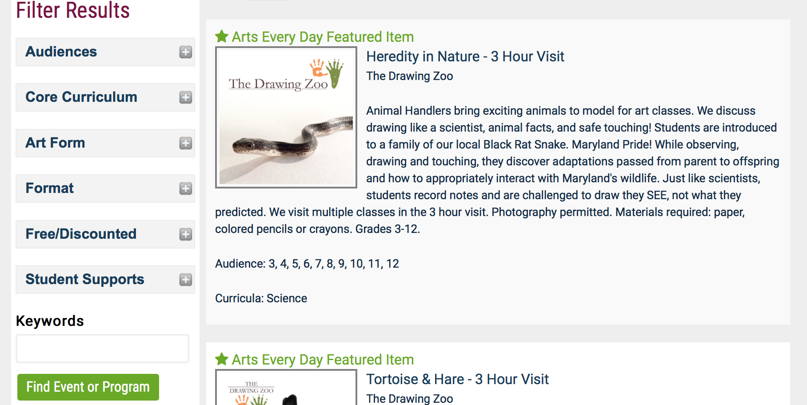

Slide 5
Arts Rich School
Sequential Arts Instruction
Partnerships Baltimore’s Arts and Cultural Community
Arts Integration

Slide 7
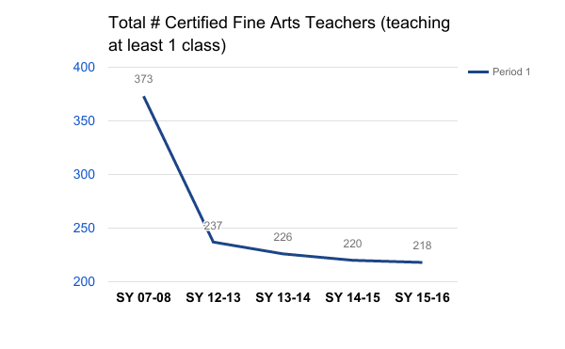
Notes:
Add in 2007 total staffing numbers
58% decline from 2007 to 2016
Need breakdown of instrumental programs
373.9
Data we were given did not differentiate between a staff member serving as .5 at two schools

Slide 8
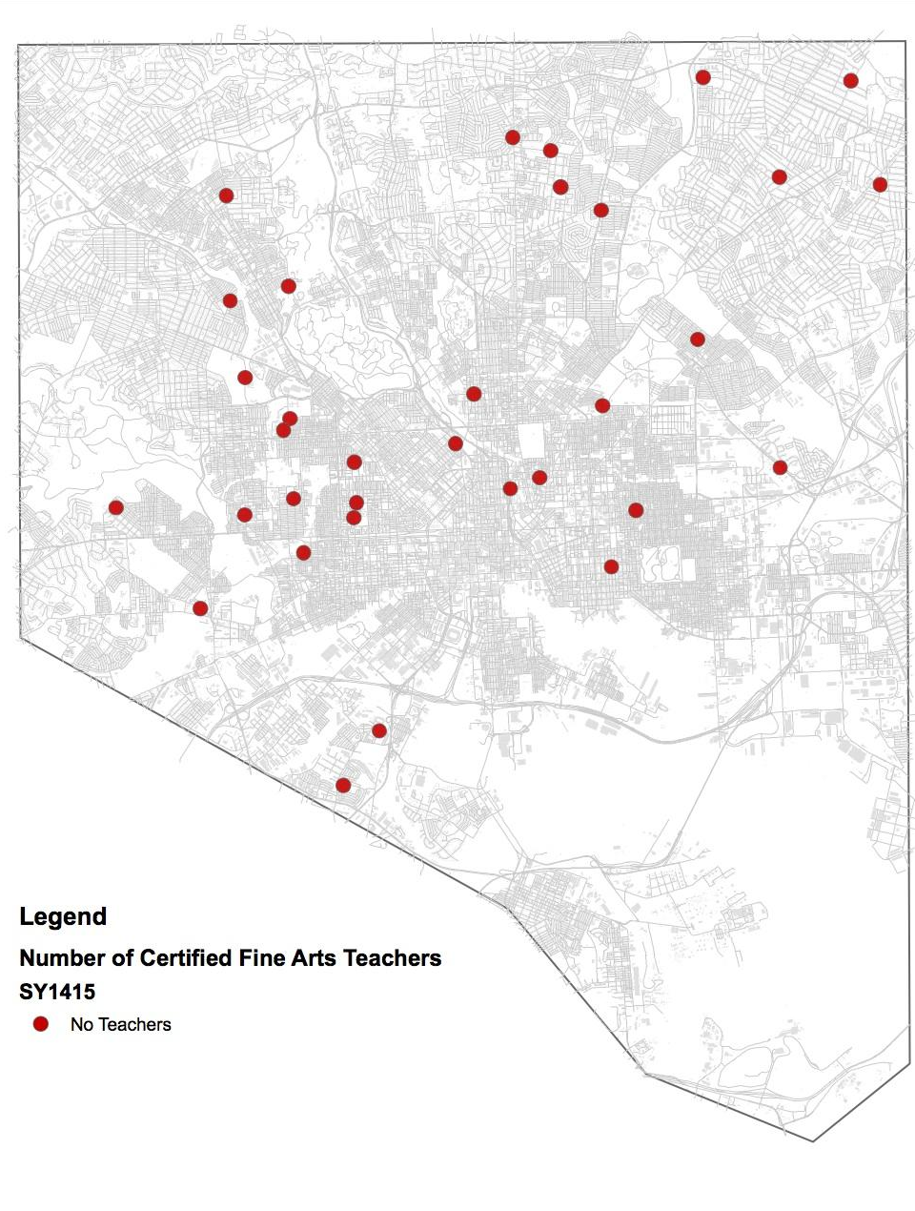

Slide 9
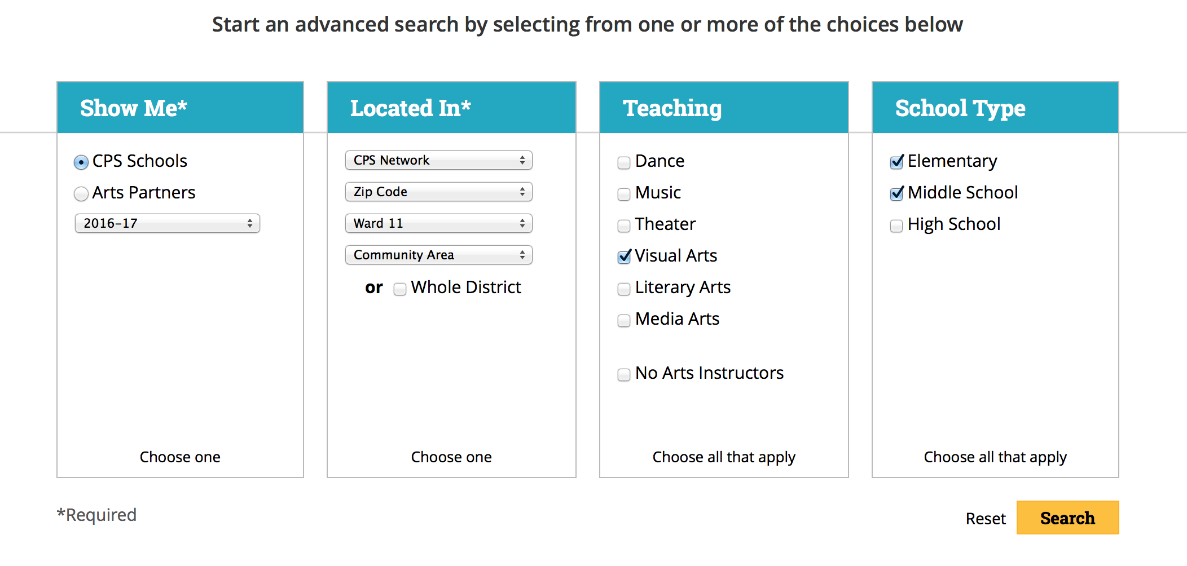

Slide 10
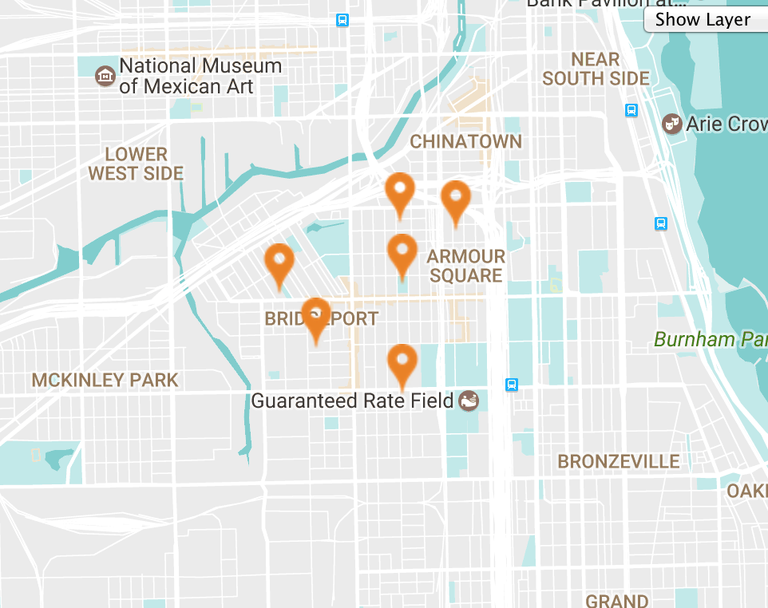
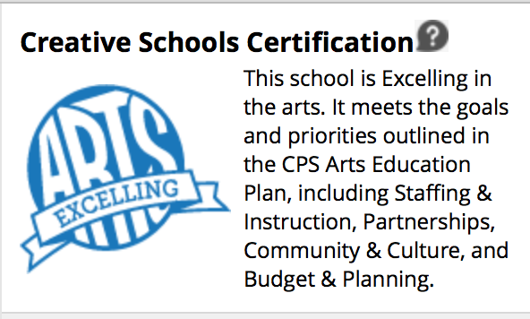

Slide 11
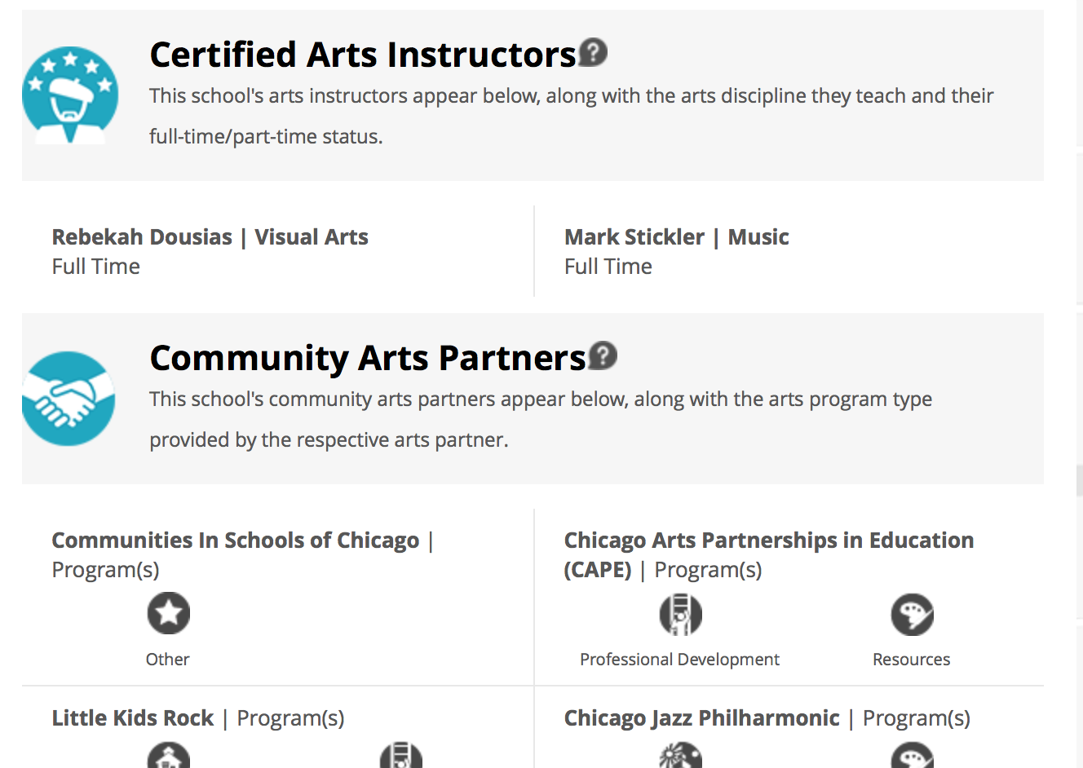

Slide 13
Julia Di Bussolo
Executive Director
Email: Julia@artseveryday.org
410-685-1172
www.artseveryday.org

