Slide 1
Our Theory of Change
Data-Driven Organization
Turning data into information and information into action
Data
Storytelling
Data
Visualization
Data
Development
Increasing value to community problem solvers

Slide 2
How We Approach Our Theory of Change
We have three main approaches to creating an evidence-based, data-driven decision-making culture in the region:
Develop and maintain the most comprehensive collection of neighborhood-level data, enhanced by state-of-the-art visualization tools and sophisticated data journalism. Our vehicle to achieve this is our website: www.neighborhoodnexus.org

Slide 3
http://neighborhoodnexus.org/
Notes:
Role and purpose of ARC and Neighborhood Nexus, relationship to NNIP
ARC Resources to non-profit and government sector
Frame context of who is sharing data and how
Discuss how data is influencing Regional priorities
What are the major challenges?
Regional Data and Tools
History of ARC and Neighborhood Nexus
Found ourselves without a CIS
Weird because TAP
Community Intelligence System
Decision Support tool
Talk through the data-driven decision-making process
Big data and Data Science as “cool”
Then talk about what we do isn’t that cool
Making the leap from data to information is critical
But what we spend most of our time on is helping communities, clients, whatever, turn that information into action by being data curators and data storytellers.
So we take our lessons learned from the science of data, then leave that behind and focus on the art. The art of driving an agenda to make policy decisions.
We essentially make big data small by focusing on the big narrative instead of Big Data - So in that respect, we get a lot of guidance…
Get a lot of support and guidance from NNIP in helping us think through that data-driven process… Biggest challenge is data literacy
The reason I always talk about the data-driven process is that Google has spoiled us. We confuse getting results from searches with getting information we can use to make data-driven decisions.
This data worldview we have helps organize and coalesce different types of organizations around common causes because the difficult challenges we face are systemic (talk about the cycle), and this data-driven framework, with having LOTS and LOTS of data at its core, helps bring these different voices to the table and allows us look to solutions that speak to the system. There are lots of organizations out there that are doing truly amazing things – but to tackle these systemic challenges, YOUR organization alone can’t solve it by yourself. This process I talk about, these types of community intelligence systems, they are central to collective impact – they drive collective impact efforts.
Which gets us back to why a regional planning organization was interested in this in the first place. It helps us take on the role we are best suited for – a community convener, a safe space to talk about these complex, systemic issues.
So – I’m done with my soapbox for now. I do actually have some slides to show you. These help exemplify some of the things I was talking about.

Slide 4
Data As A Public Good
http://neighborhoodnexus.org/

Slide 5
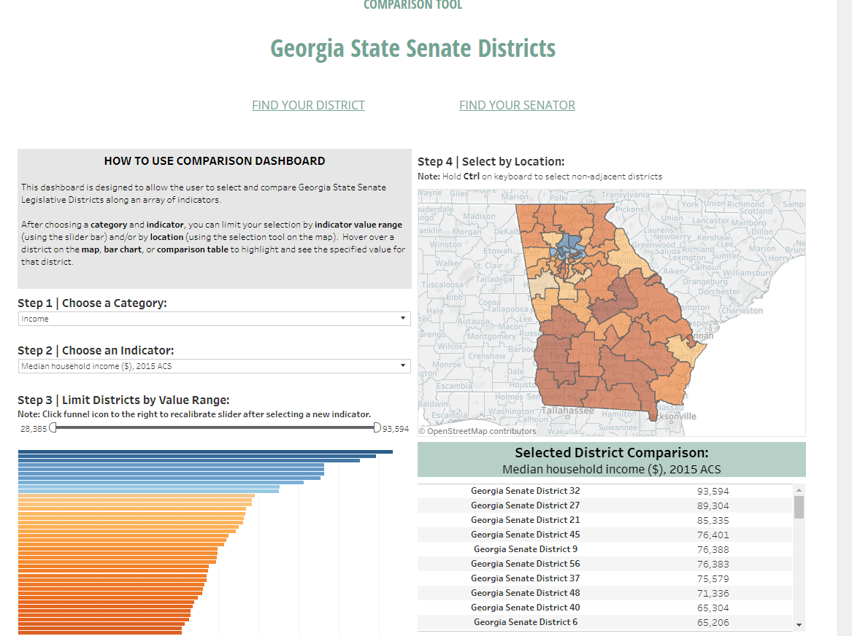
http://neighborhoodnexus.org/case-studies/enterprise/

Slide 6
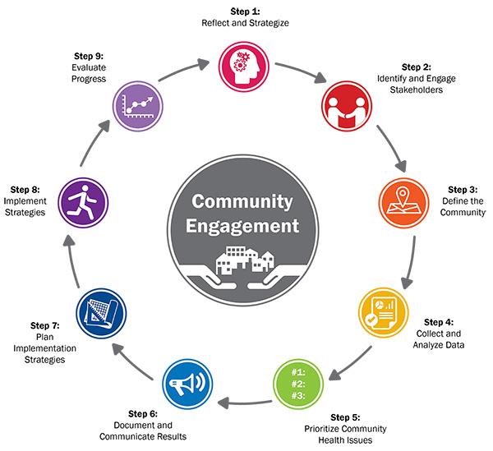
How We Approach Our Theory of Change
2. Engage with community organizations to promote better data literacy and increase capacity through training, data analysis and story-telling.

Slide 7
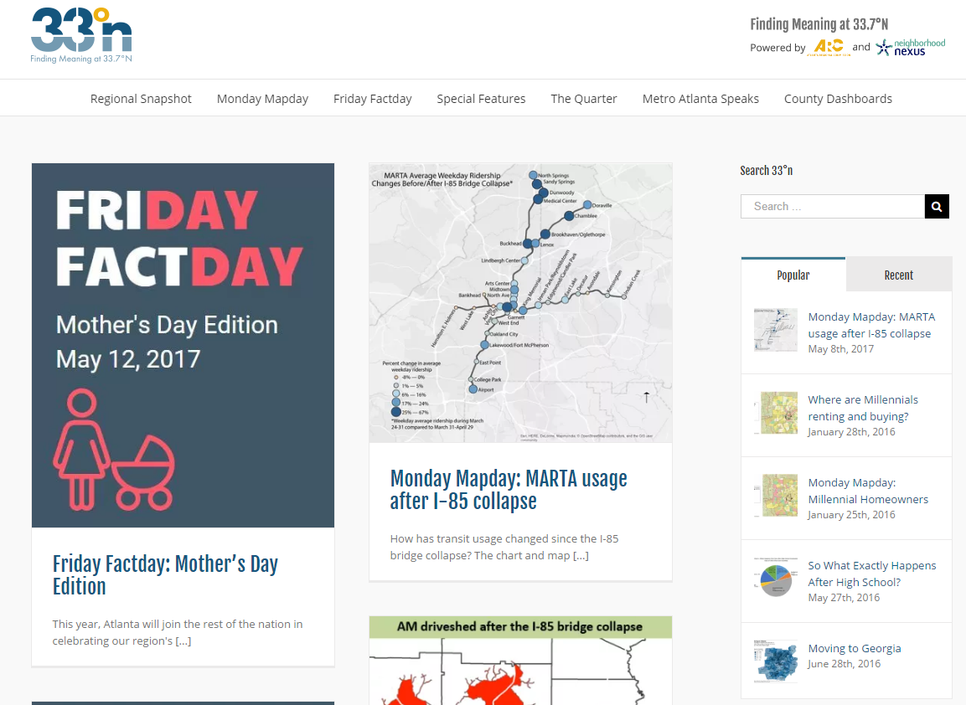
Data Story -Telling
http://33n.atlantaregional.com/

Slide 8
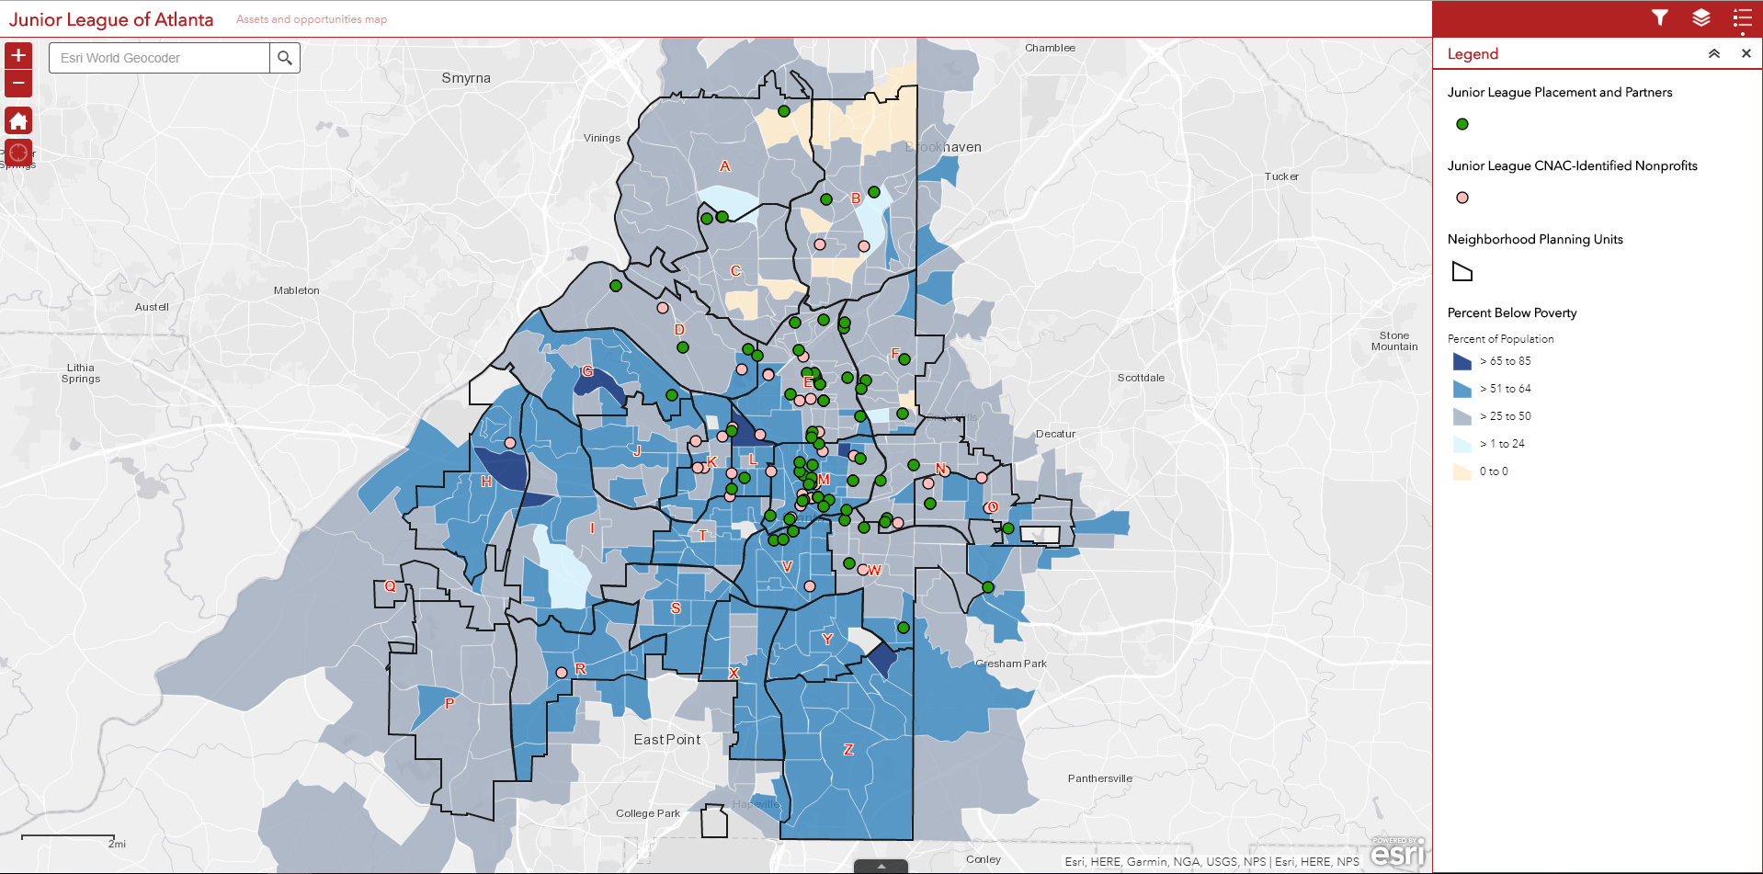
Junior League Annotated Asset Map

Slide 9
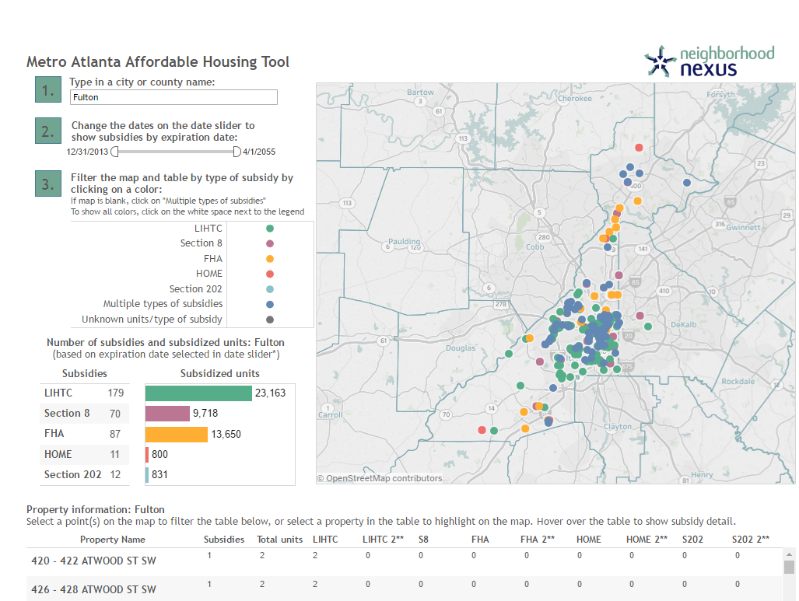
Enterprise Community Partners
http://neighborhoodnexus.org/case-studies/enterprise/

Slide 10
How We Approach Our Theory of Change
3. Perform deep-dive engagements as part of our fee-for-service portfolio to help organizations identify key indicators of progress to measure the impacts of their work and investments.
Health
Get Georgia Reading
ARCHI
Income
Stabilization
Education
Learn4Life
GEEARS
GA Partnership
United Way
Laureus
City of Atlanta

Slide 11
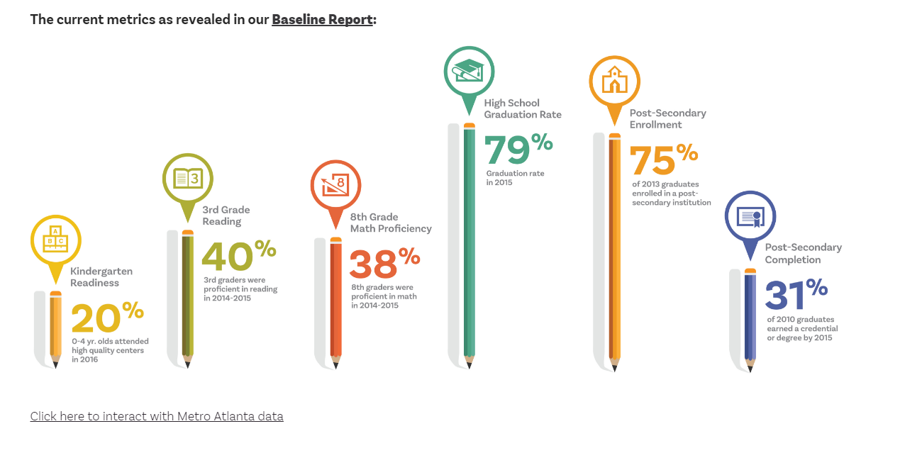
Learn4Life
http://l4lmetroatlanta.org/
Physical Fitness and 3rd Grade Reading Proficiency

Slide 12
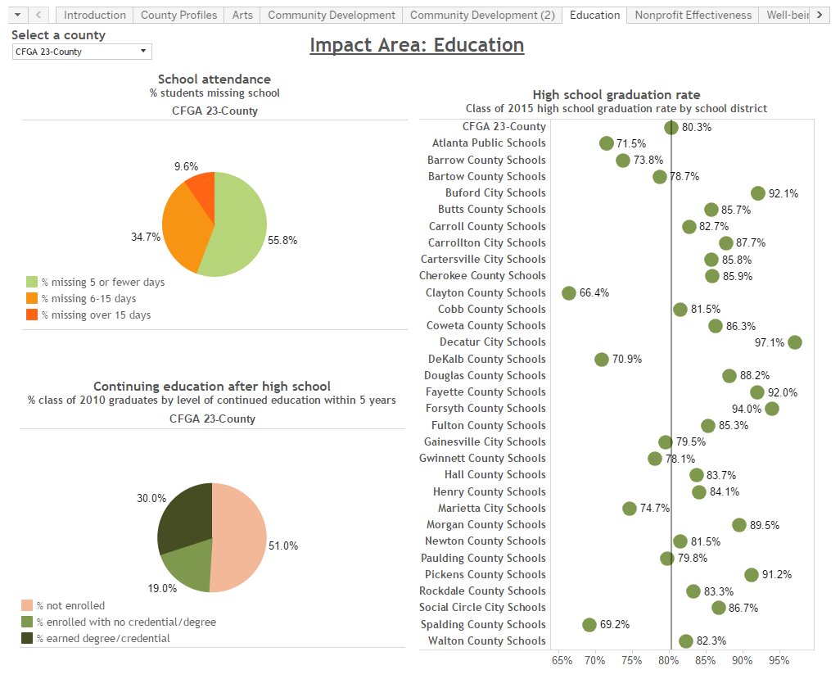
The Community Foundation for Greater Atlanta
http://neighborhoodnexus.org/case-studies/cfga/

Slide 13
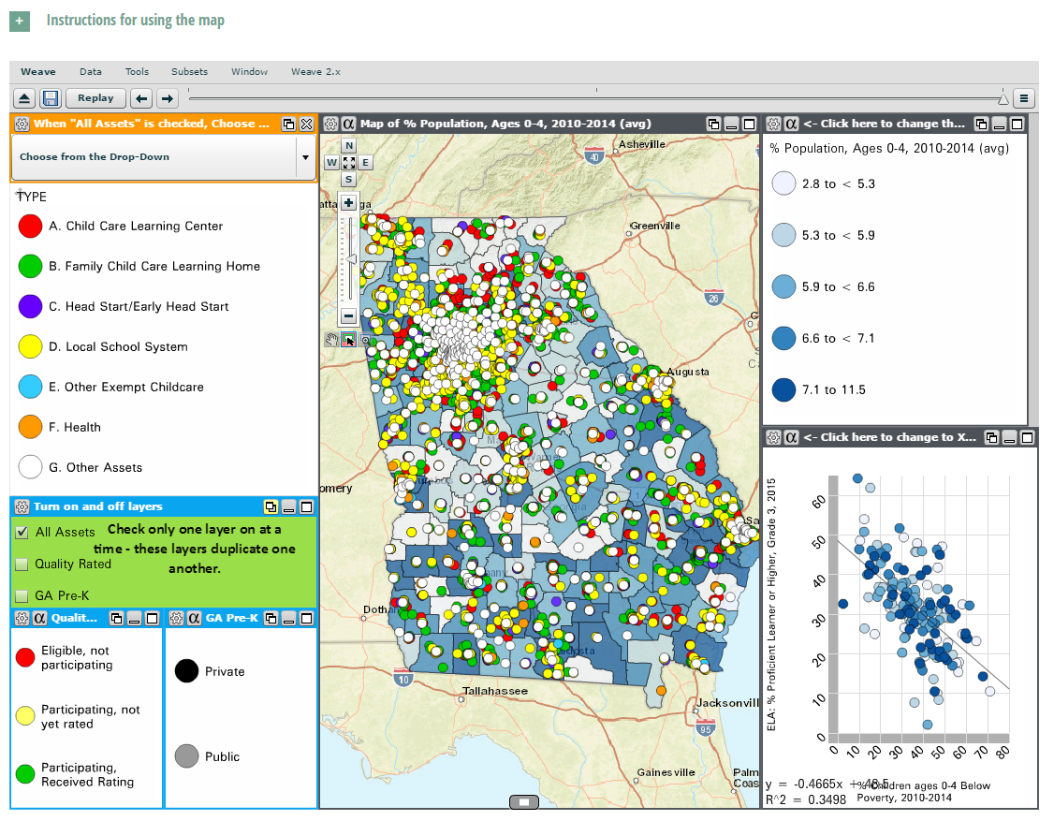
Georgia Early Education Alliance for Ready Students (GEEARS)
http://neighborhoodnexus.org/case-studies/geears/

Slide 14
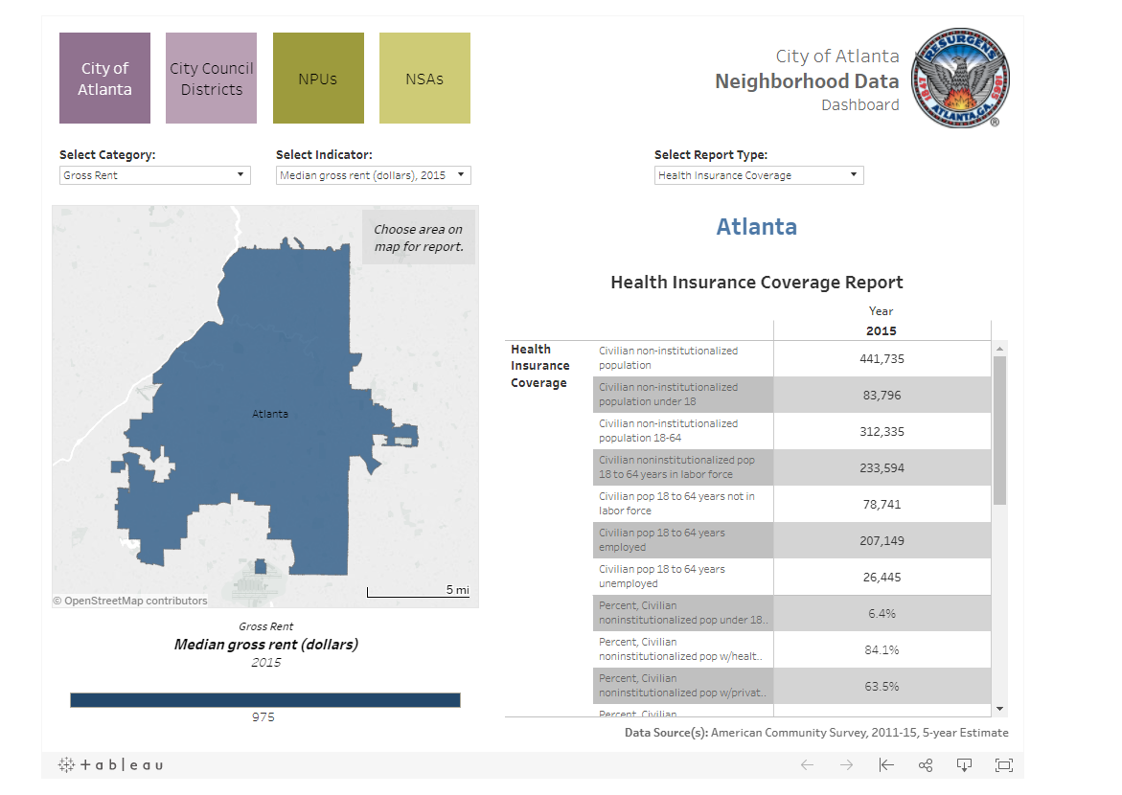
City of Atlanta Dashboard

Slide 15
Atlanta and Beyond:
Exploring Who We Are and Why We Are the Way We Are
Mike Carnathan
Manager, Research & Analytics
Atlanta Regional Commission/Neighborhood Nexus
January 18, 2017

Slide 16
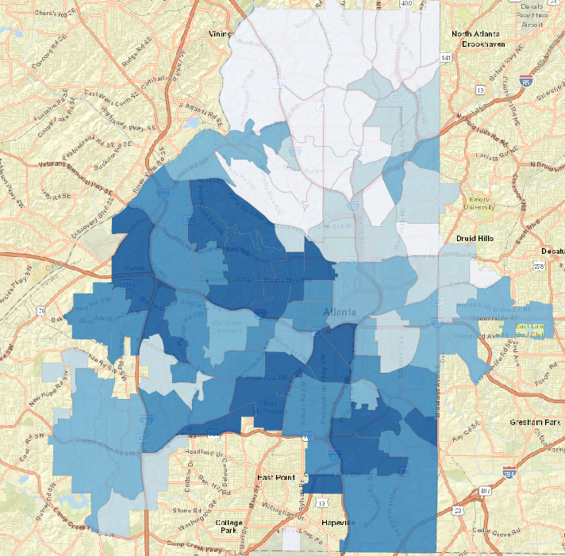
http://www.neighborhoodnexus.org/project_coa

Slide 17
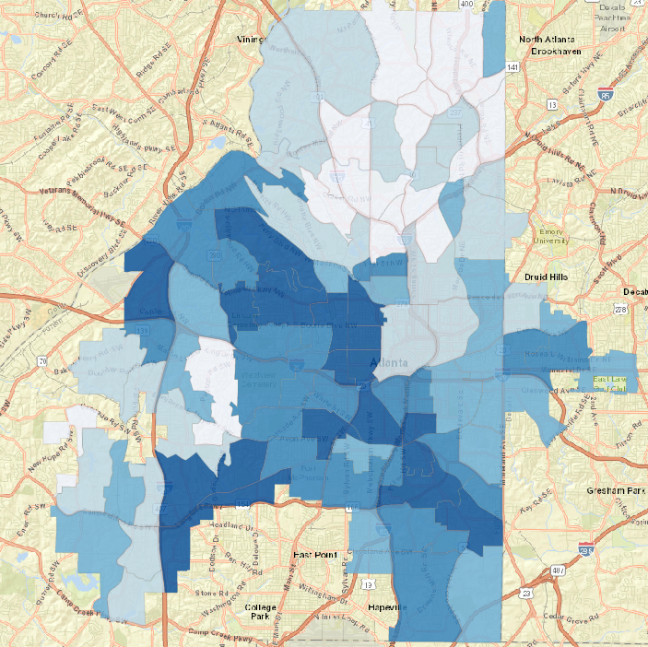
http://www.neighborhoodnexus.org/project_coa

Slide 18
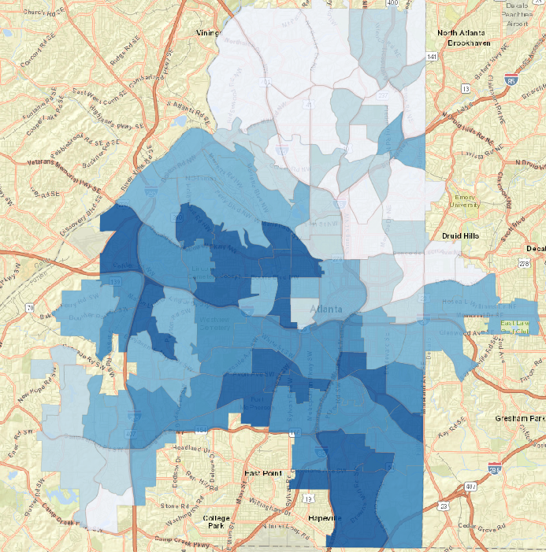
http://www.neighborhoodnexus.org/project_coa

Slide 19
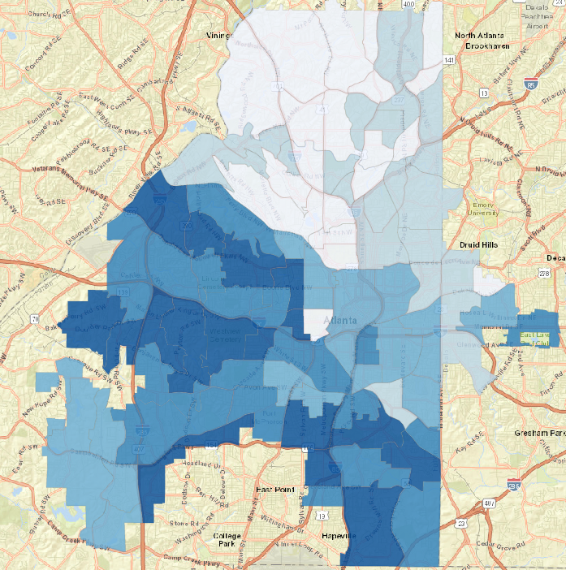
http://www.neighborhoodnexus.org/project_coa

Slide 20
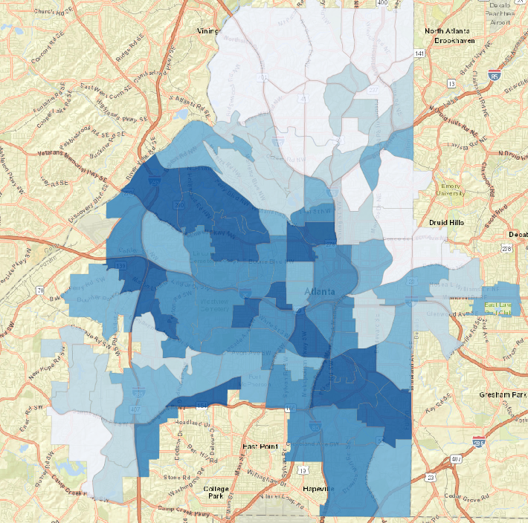
http://www.neighborhoodnexus.org/project_coa

Slide 21
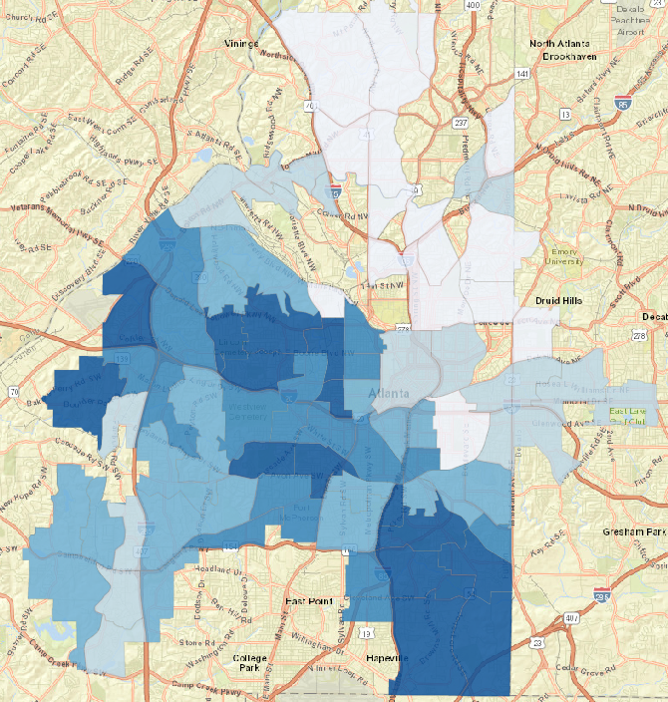
http://www.neighborhoodnexus.org/project_coa

Slide 22
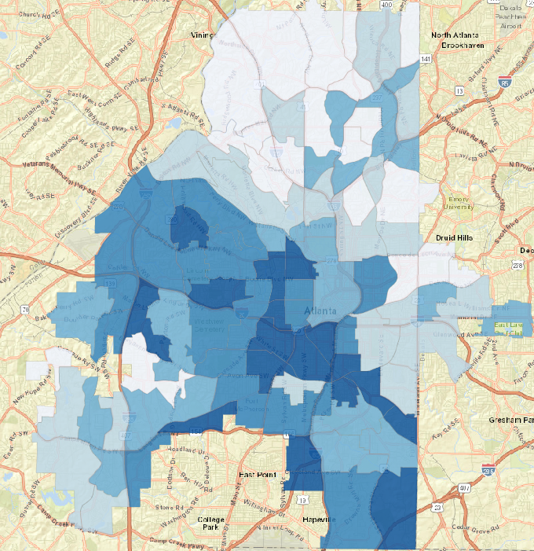
http://www.neighborhoodnexus.org/project_coa

Slide 23
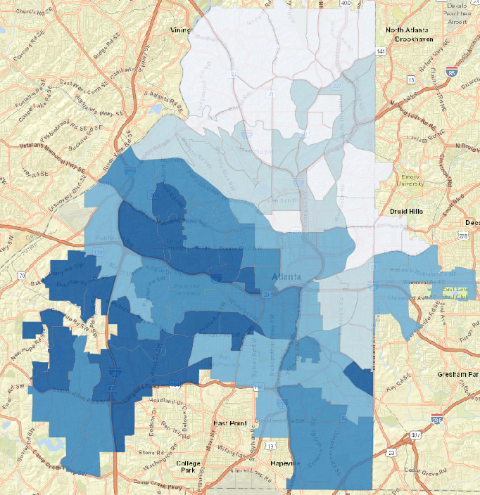
http://www.neighborhoodnexus.org/project_coa

Slide 24
Did you notice any similarities?

Slide 25
% Violent Crimes
http://www.neighborhoodnexus.org/project_coa
Source: Atlanta PD; via Neighborhood Nexus

Slide 26
% Units Surveyed in poor or deteriorated condition
http://www.neighborhoodnexus.org/project_coa
Source: Atlanta Housing Survey (SCI); via Neighborhood Nexus

Slide 27
% of Adult Population with No High School Diploma
http://www.neighborhoodnexus.org/project_coa
Source: American Community Survey; via Neighborhood Nexus

Slide 28
% of 18-64 yr.-olds with a disability
http://www.neighborhoodnexus.org/project_coa
Source: American Community Survey; via Neighborhood Nexus

Slide 29
% in Poverty
http://www.neighborhoodnexus.org/project_coa
Source: American Community Survey; via Neighborhood Nexus

Slide 30
Teen Birth Rate
(per 1,000 births)
Source: GA DPH; via Neighborhood Nexus

Slide 31
% of households with no vehicles available
http://www.neighborhoodnexus.org/project_coa
Source: American Community Survey; via Neighborhood Nexus

Slide 32
% Black
http://www.neighborhoodnexus.org/project_coa
Source: 2010 Census; via Neighborhood Nexus

Slide 33
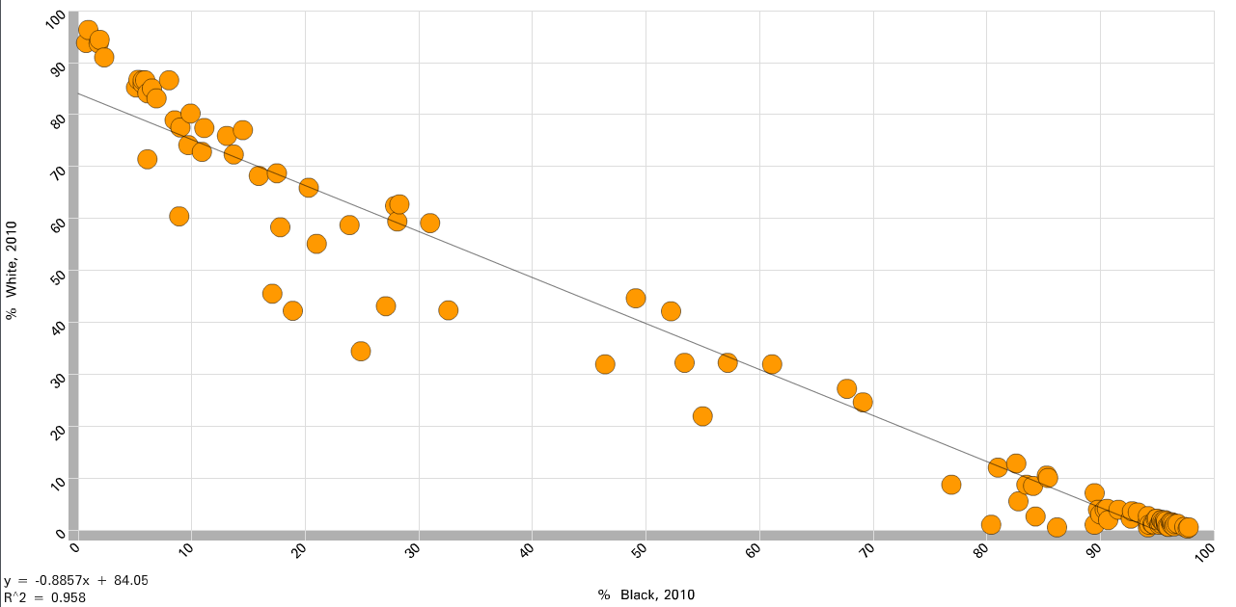
The Big Sort
http://www.neighborhoodnexus.org/project_coa
Source: 2010 Census; via Neighborhood Nexus

Slide 34
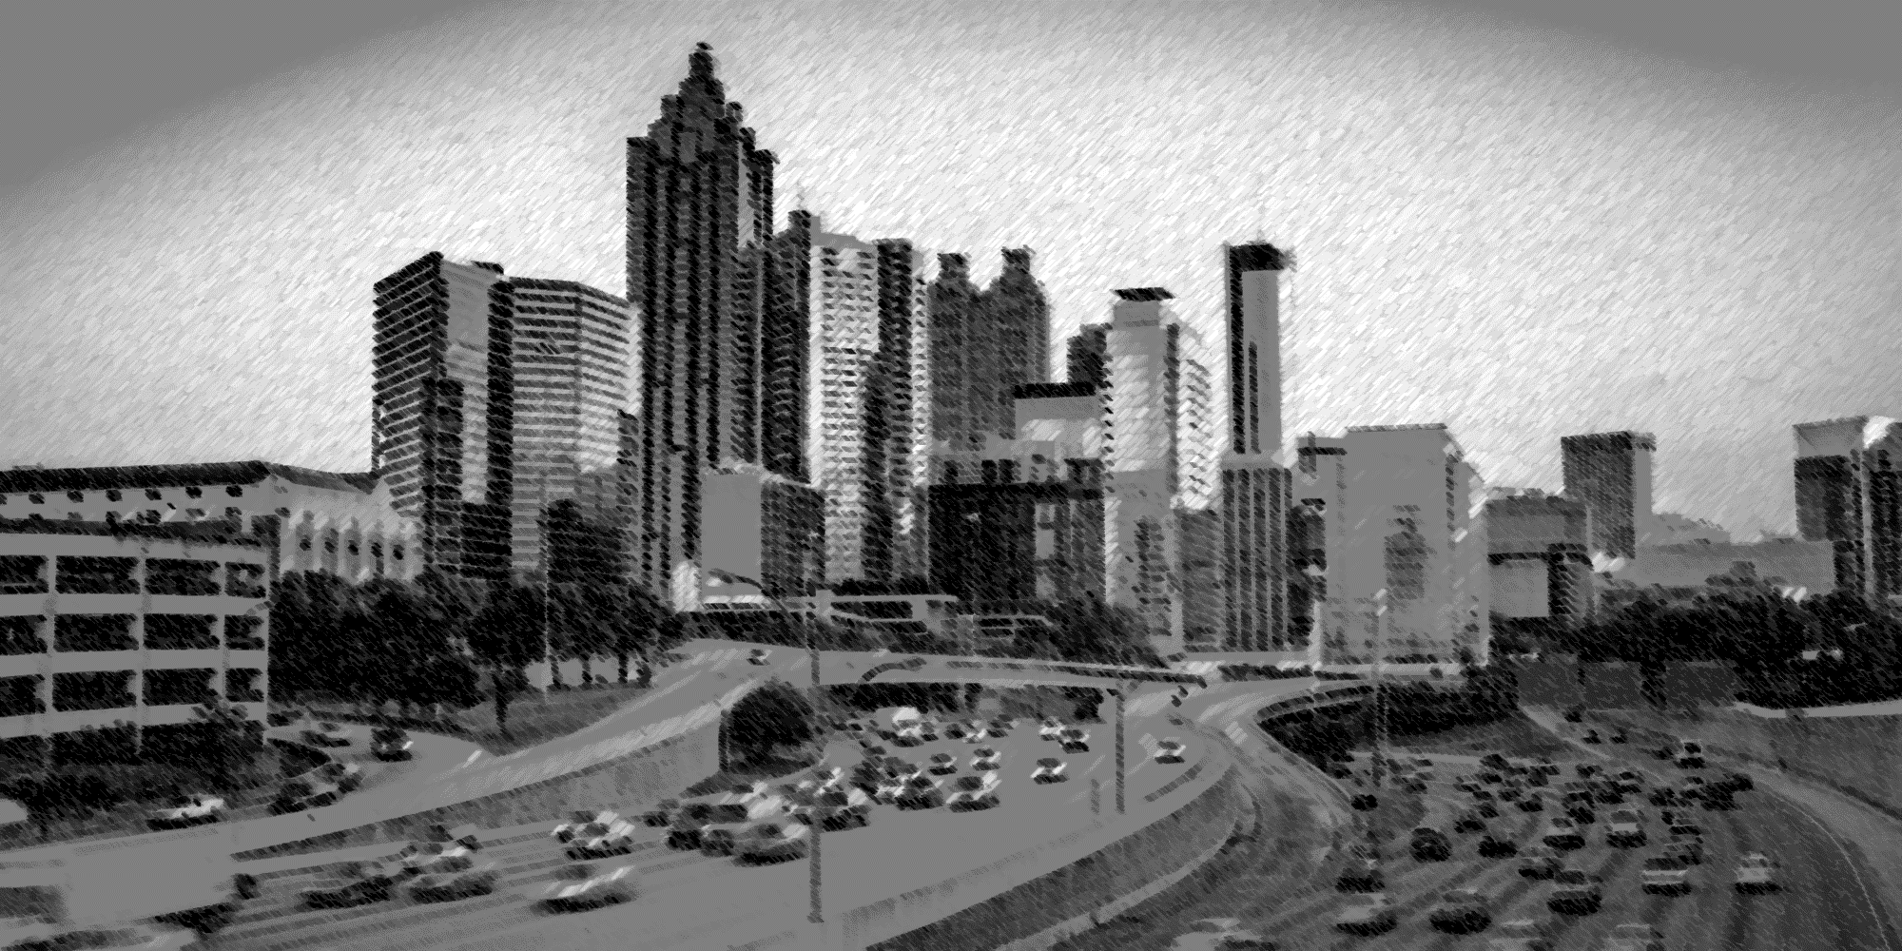
Quick Look Back!

Slide 35
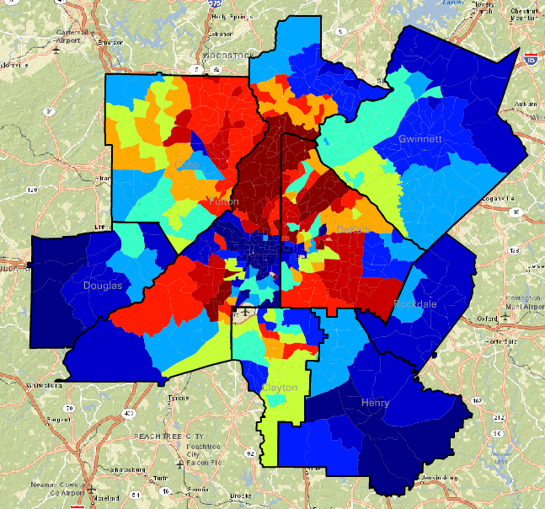
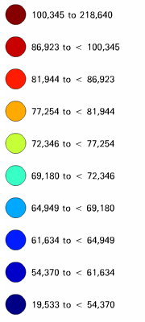
Average Family Income, 1970 ($2013)
Source: Neighborhood Change Database, Geolytics (analysis by ARC Research)

Slide 36
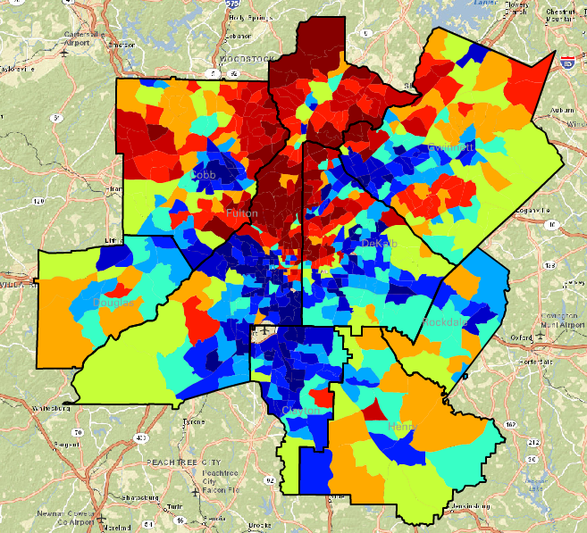
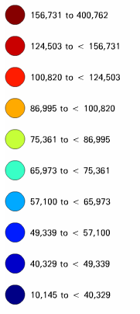
Average Family Income, 2009-2013 ($2013)
Source: Neighborhood Change Database, Geolytics (analysis by ARC Research)

Slide 37
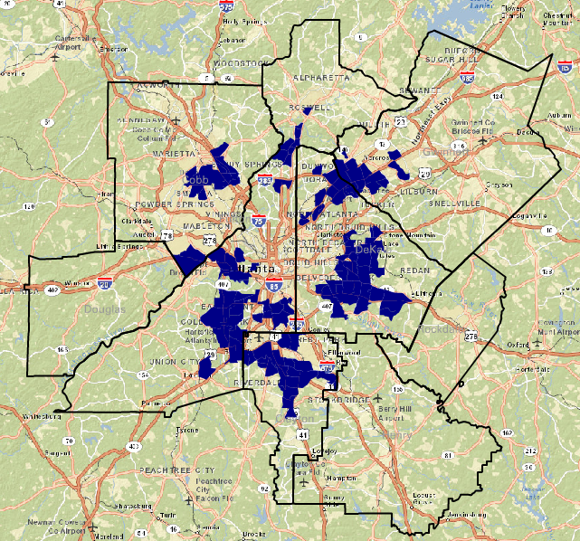
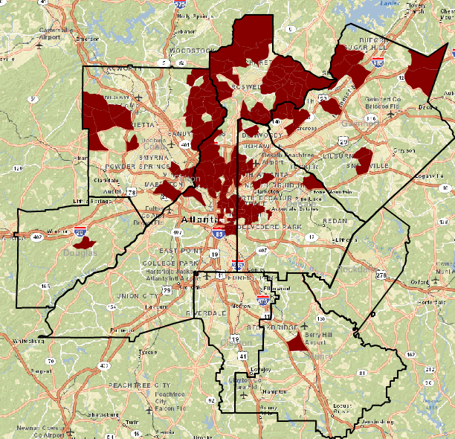
Change in Family Income: 1970 – Current (2009-2013)
Neighborhoods with Largest Declines in Average Family Income
Neighborhoods with Largest Increases in Average Family Income
Source: Neighborhood Change Database, Geolytics (analysis by ARC Research)

Slide 38
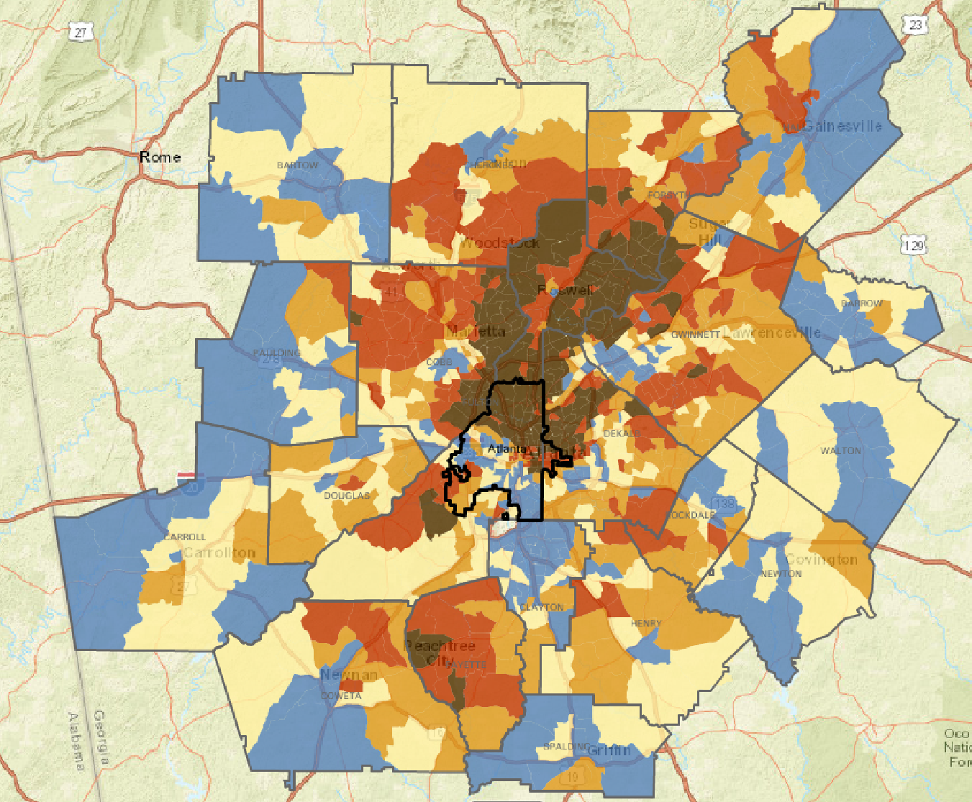
The “Systems” Look At Metro Atlanta
College Educated
Source: 2010 Census

Slide 39
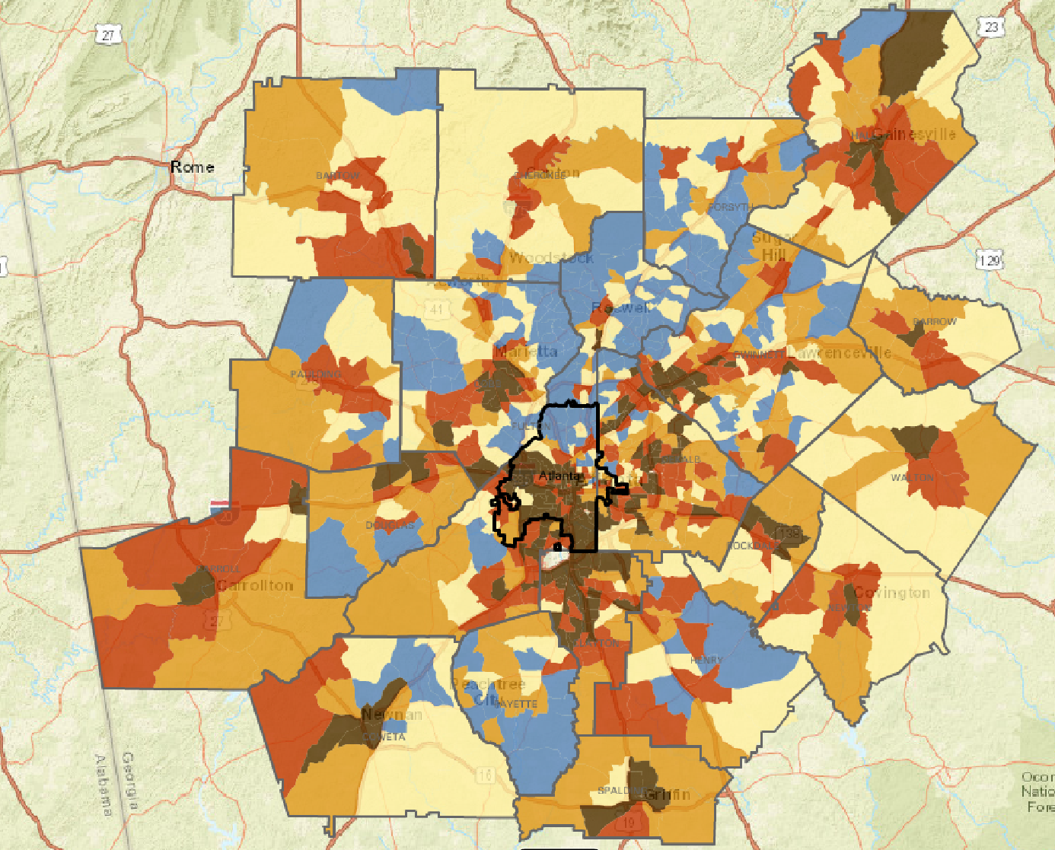
The “Systems” Look At Metro Atlanta
Poverty
Source: 2010 Census

Slide 40
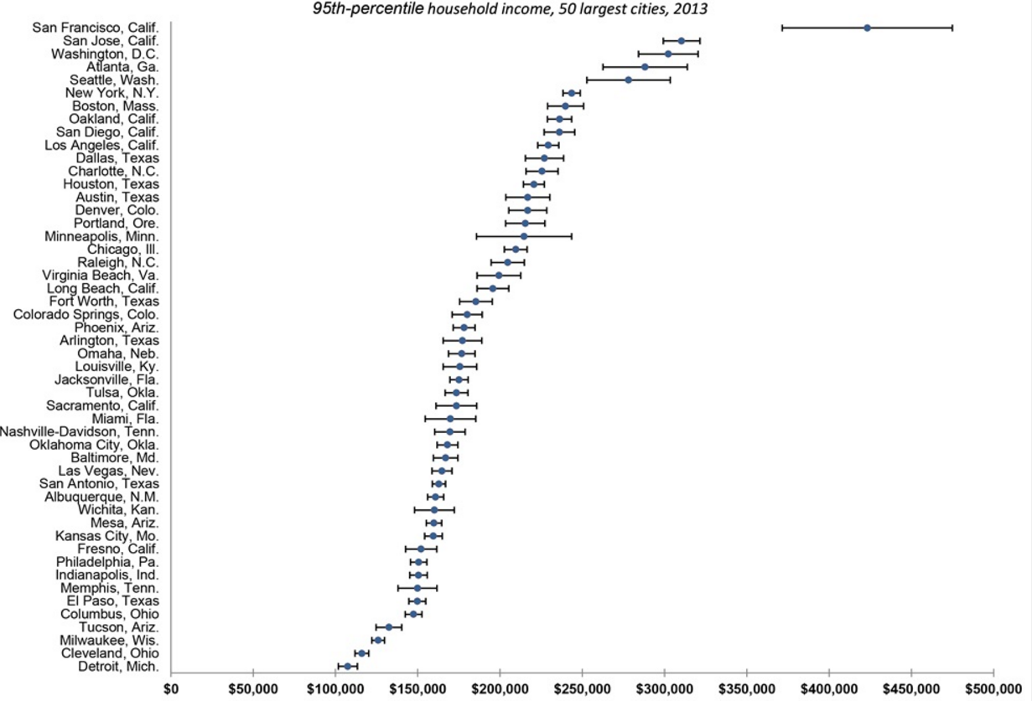
Atlanta’s Wealthy is VERY Wealthy…
Source: US Census
Notes:
And as you can see here, the South Atlantic region – Virginia, the Carolinas, Georgia and Florida – is expected to add more people than any other region in the nation over the next 25 years or so. This should bode well for our economic future. Still, there are plenty of opportunities for us to make sure metro Atlanta not only participates in this growth, but becomes the place to be for the next generation of creative workers.

Slide 41
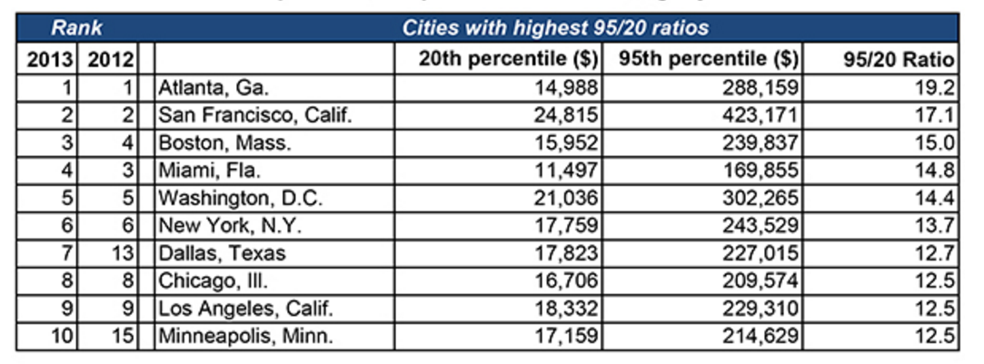
…Which Leads to High Income Inequality
Source: ESRI Demographics

Slide 42
Residents Struggle for Housing Costs in High Poverty Neighborhoods
Source: 2010-2014 American Community Survey, via Neighborhood Nexus

Slide 43
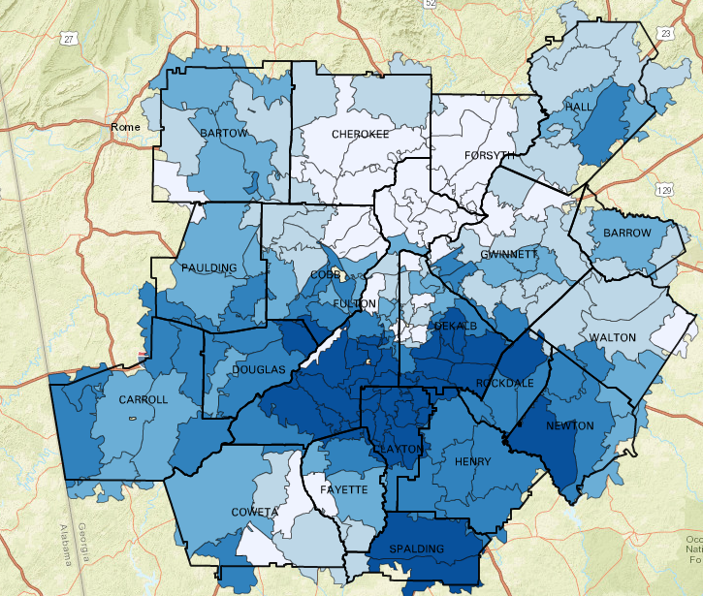
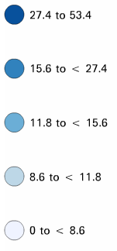
… and struggle in other ways as well…
% of Homes with “Negative Equity”
(Owe more on the house
than what it is worth)
http://www.neighborhoodnexus.org/zip-code-mapping
Source: Zillow, via Neighborhood Nexus

Slide 44
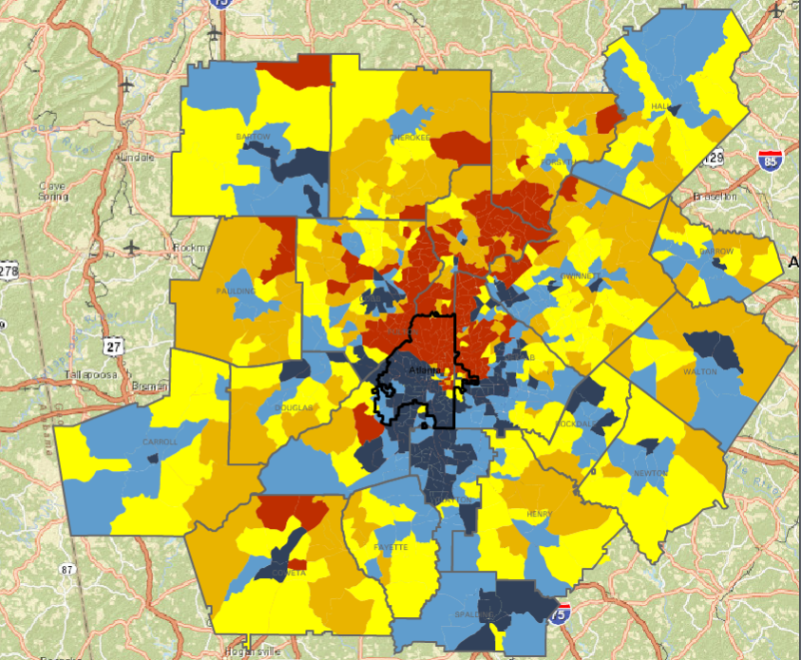
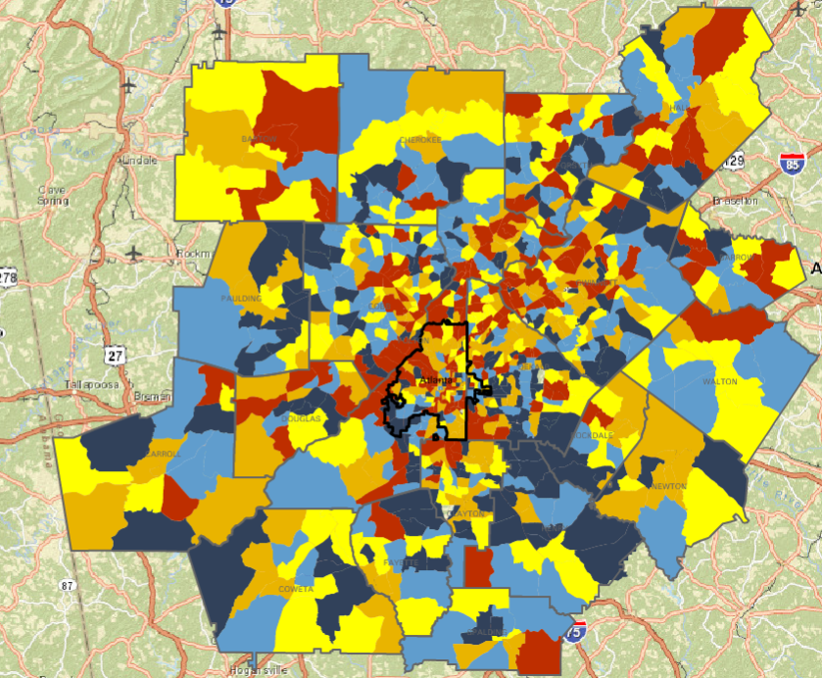
Low-Income Workers & Low-Income Jobs
Where Low-Income Workers Live
Where Low-Income Jobs Are Located
Source: LEHD, Census

Slide 45
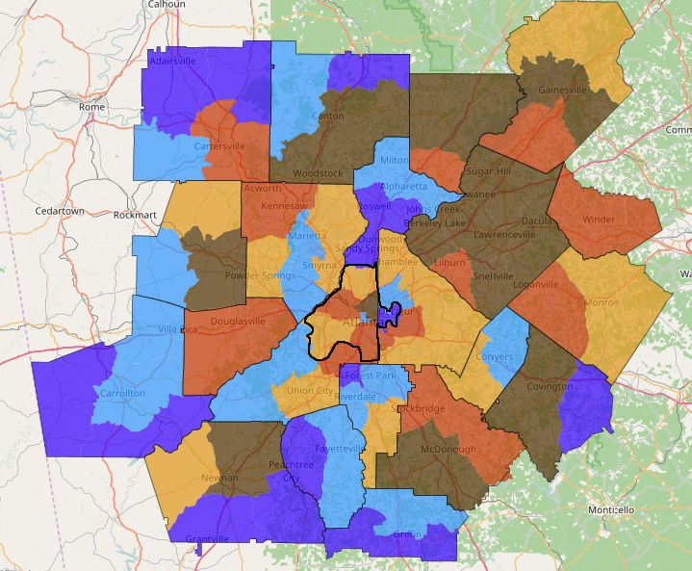
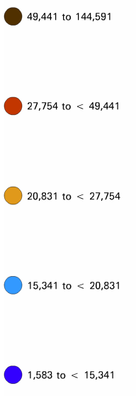
Where to Now?
Forecast Population Change, 2015-2040
http://www.neighborhoodnexus.org/
Source: ARC’s Forecast Series 15

Slide 46
Working with our Partners to define and address Inequalities

Slide 47
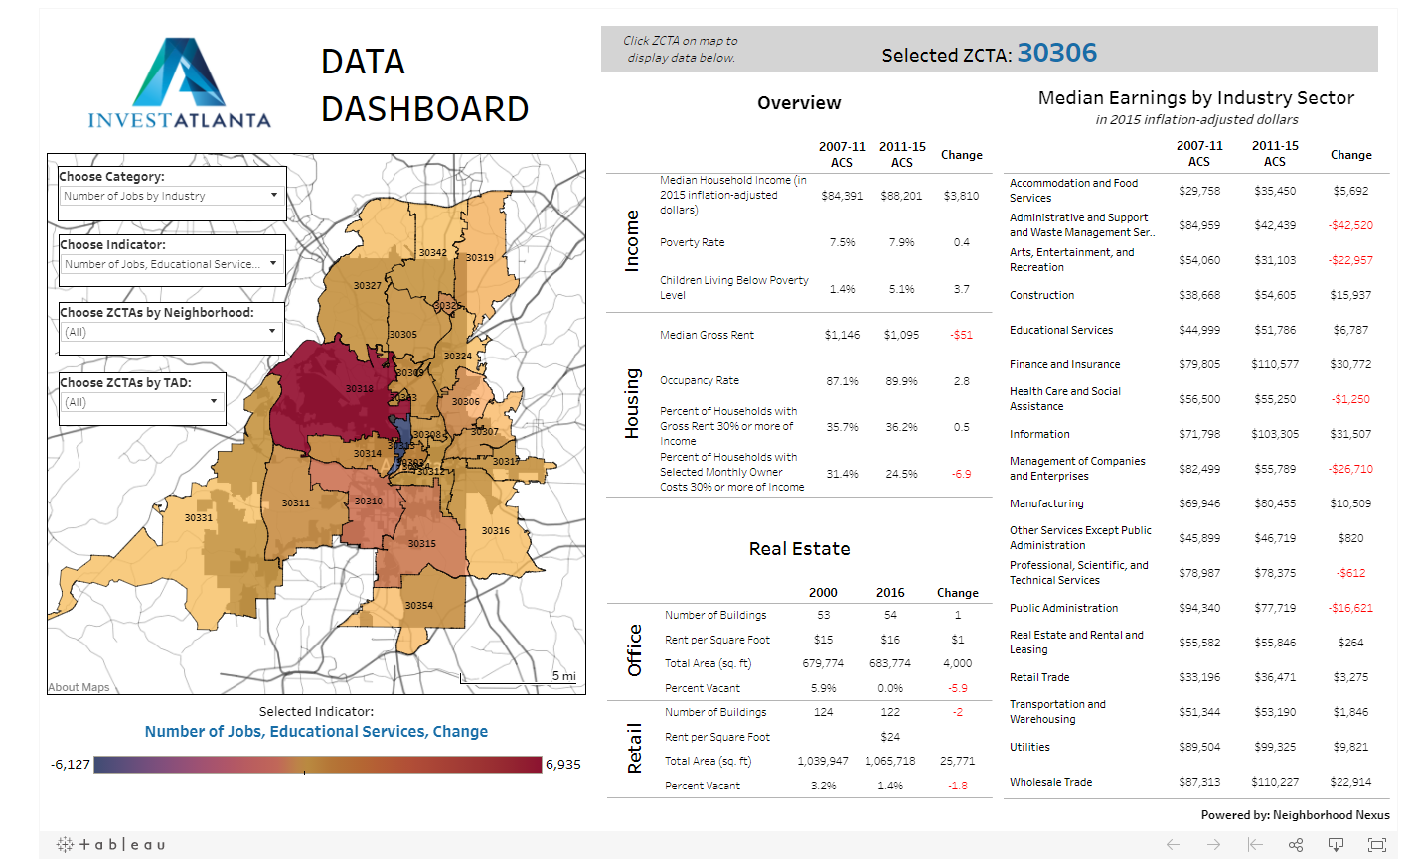
Invest Atlanta

Slide 48
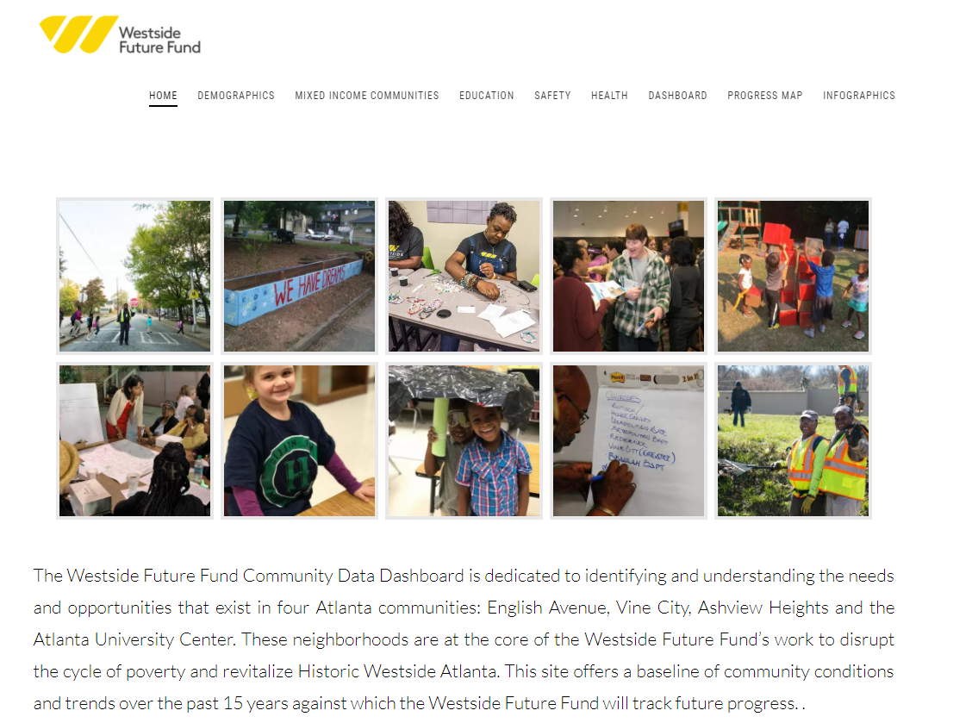
Westside Future Fund Microsite (with Tools)

Slide 49
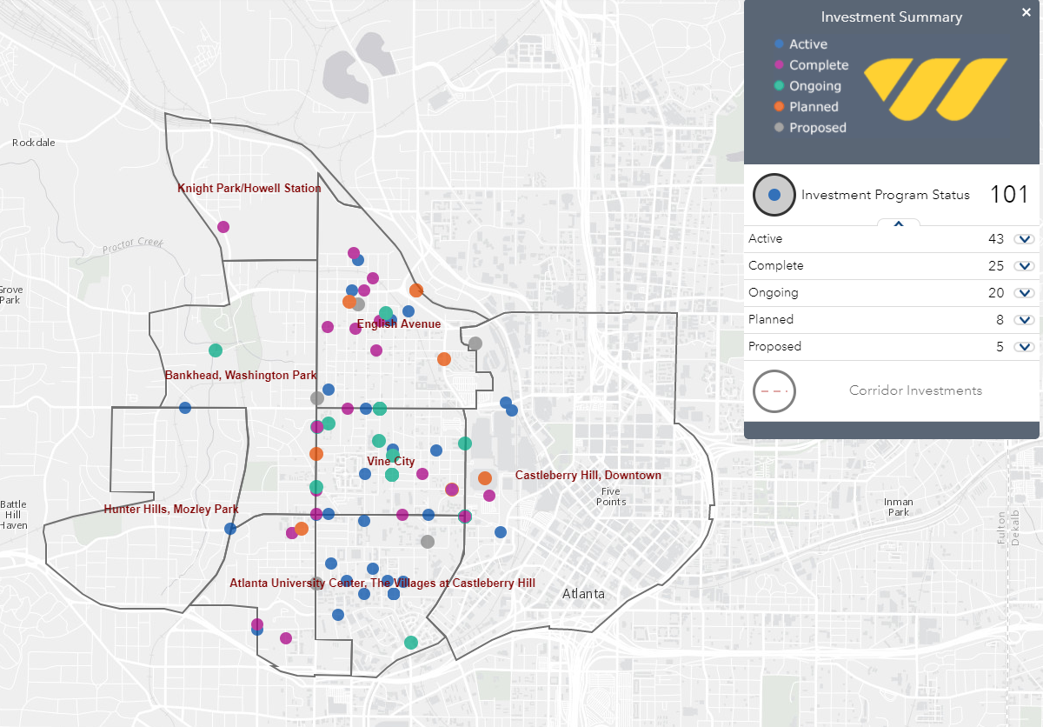
Westside Future Fund Investment Map

Slide 50
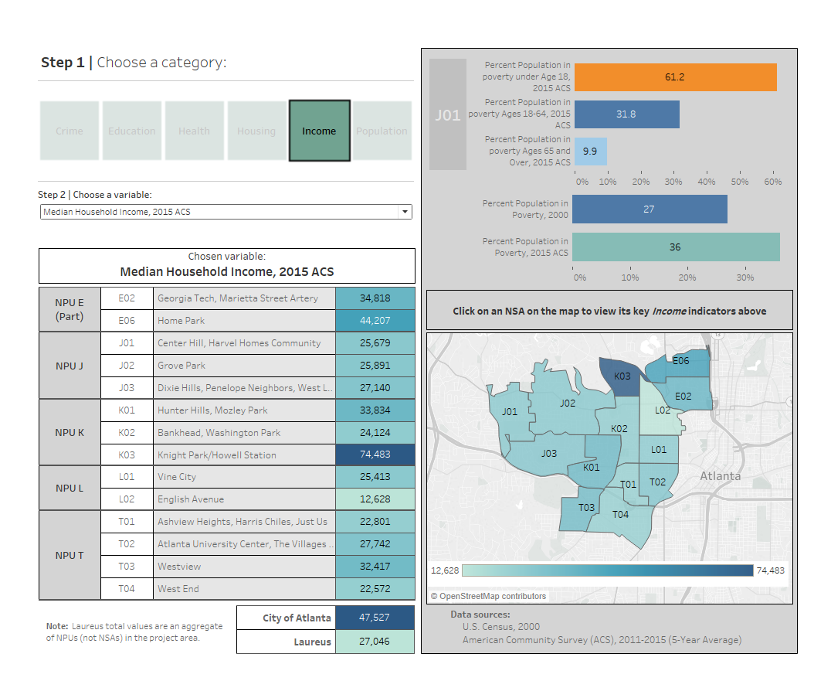
Laureus for Sport Good

Slide 51
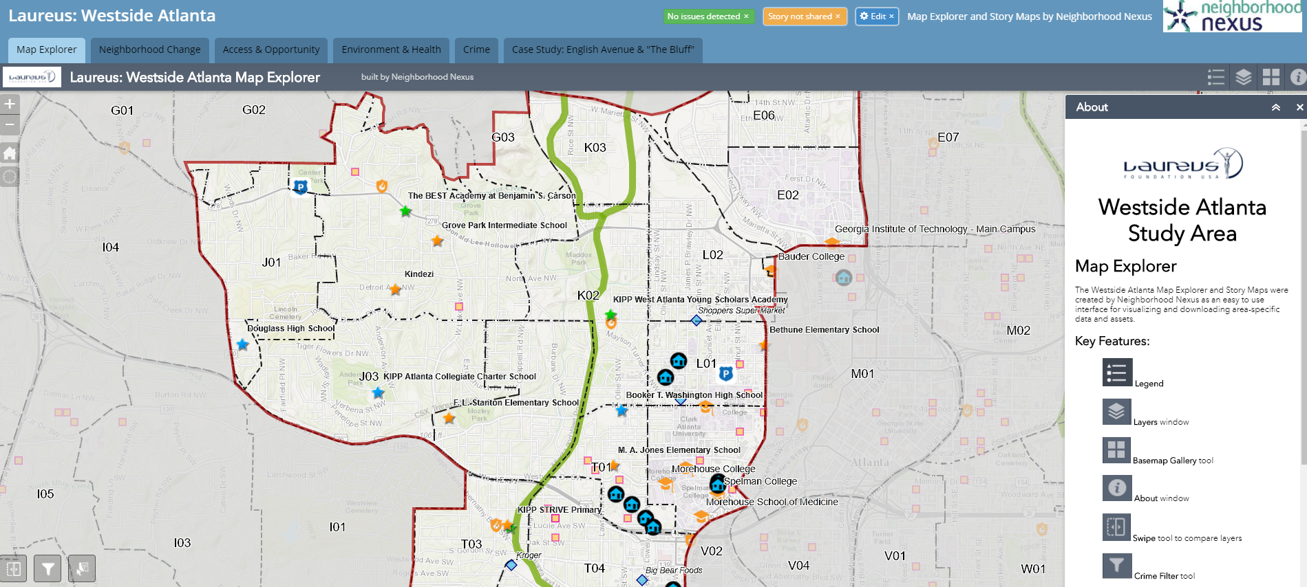
Laureus StoryMap

