Slide 1
A Journey to Better-Understand Occupancy Identifying Rental Properties to track housing Stability in Detroit
Noah Urban, Data Driven Detroit
May 9th, 2018

Slide 2
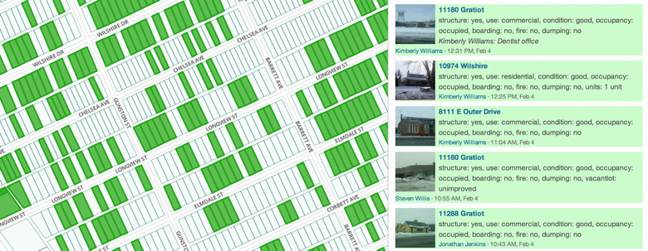
Some context
Notes:
Talk about Motor City Mapping, and how that project developed a wide array of parcel-based datasets. However, it also led to people wanting a lot more detailed property information from us. Sometimes, people wanted things we didn’t have – rental data was one of the most common. We tried to get the information, but ran into challenges.

Slide 3
What do all of these buildings have in common?
Notes:
Answer – none of them are on the City’s registered rental list

Slide 4
The problem:
140,000+: Renter-occupied housing units reported by ACS (including ~60,000 in multi-family structures)
7,750: Registered rental properties in Detroit (City file)
Notes:
Detroit’s information on properties that are registered as rentals is woefully inadequate. With so many conversations around displacement and landlords operating poorly-maintained properties, it can make enacting policy challenging, particularly given rampant speculation in the City. A lot of people wanted us to try to get better data so that they could take action around these issues. Here are a couple examples.

Slide 5
Scenario 1: Multifamily Rental Properties
Where are they located in Greater Downtown Detroit?
Notes:
One of our Partners – Capital Impact Partners – wanted to better understand where multifamily properties were located in Greater Downtown to inform recommendations about strategies to reduce displacement. Want to know what the overall inventory is.

Slide 6
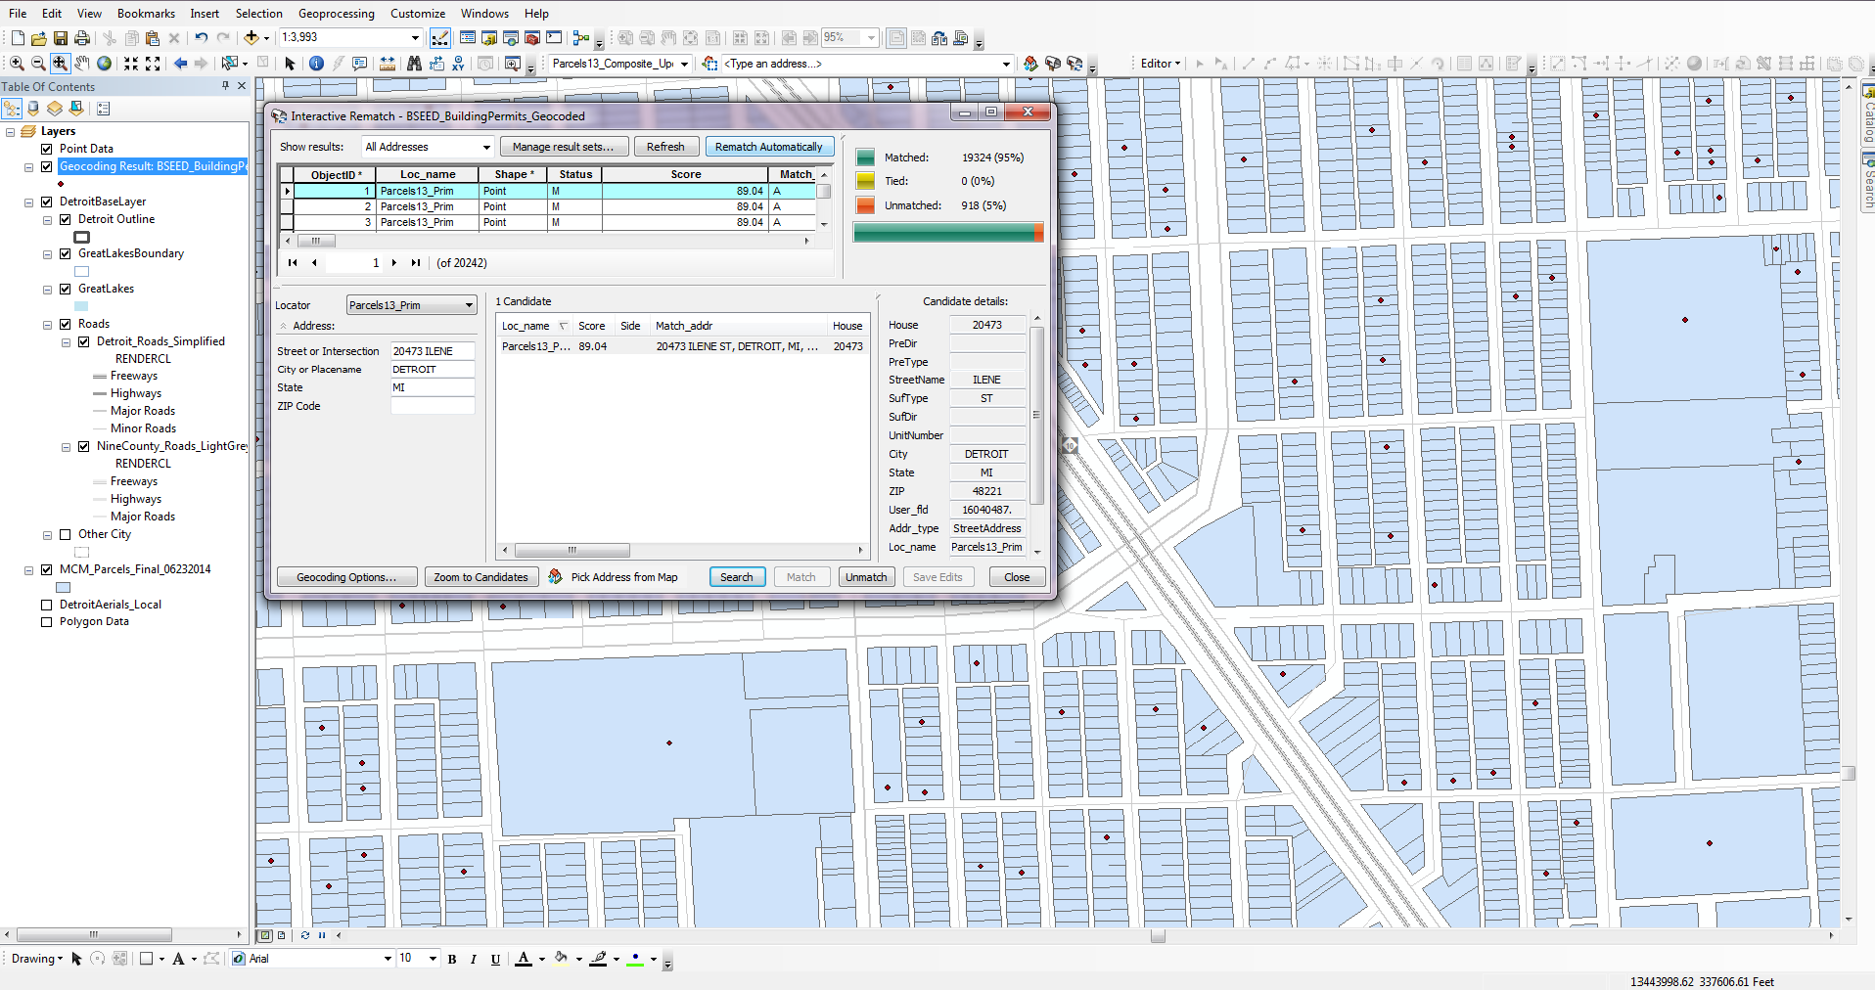
Geocoding…lots of geocoding
Notes:
Detail how we geocoded Valassis addresses to parcel, then aggregated up counts of addresses by parcel to understand where multifamily units are located

Slide 7
How are the data being used?
Notes:
Helps to inform strategic policy guides that are offering tools, practices, and strategies to help reduce displacement and housing instability. We’re not housing redevelopment experts, so we don’t know what strategies are available, but we’re getting the information to people who do know how to make those recommendations. CDFIs are very active in Detroit, and this study helped to influence and centralize policy.

Slide 8
Scenario 2: 1-4 Unit Rental Properties
Where are they, and what condition are they in?
Notes:
Identifying 1-4 unit properties is an entirely different story – Detroit is a 90% residential city, and the vast majority of properties are single-family houses. No easy fix here.

Slide 9
Background
Desire to estimate the overall need for rehabilitation for 1-4 unit rental properties
Need to identify financing gaps and strategies

Slide 10
Initial research
City tax emption data as a potential source?
Only about 53,000 habitable residential buildings in Detroit do not have a homestead exemption
Notes:
Initially thought that the City data could provide this source. We were wrong.

Slide 11
A multiple-source approach
Motor City Mapping
“Habitable Structure”
Valassis
Between 1 and 4 Residential Addresses
City of Detroit
Owner Address <> Property Address
And others!
Notes:
Given this, we explored an alternate approach – trying to use a lot of different datasets and indicators to triangulate a number that was more in line with what the ACS reported
Other Data Sources – more City data – BSEED, Tax Status, Residential Codes for Assessor
Narrowed it down to 116k properties – not perfect, but still better than 7k

Slide 12
How are the data being used? Some quick findings to inform action:
99% built pre-1978
30% received a blight violation since 2005
22% are investor/speculator-owned
14% have no active utility customer service agreement
Notes:
These quick findings were relayed back to Center for Community Progress, as well as a detailed parcel-level dataset. Even now, they’re helping to inform work that Center for Community Progress is doing to help get a better idea of where rental properties are located in the City, and what conditions they exist under

Slide 13
Additional Uses

Slide 14
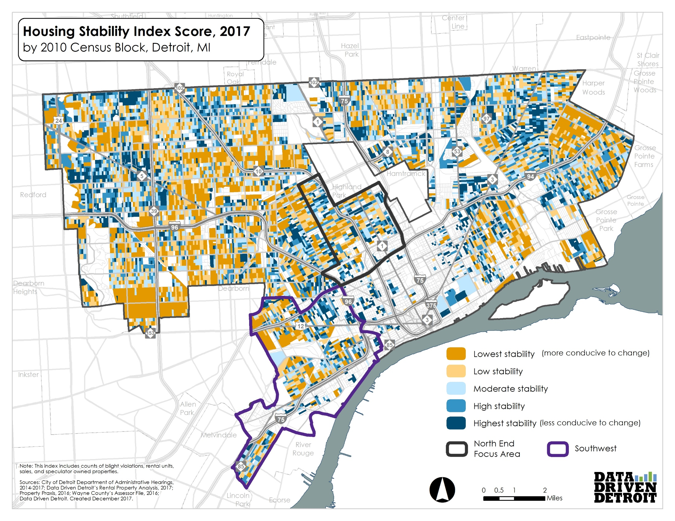
Notes:
Rental played into Housing Stability Index Score for Turning the Corner

Slide 15
www.DataDrivenDetroit.org
Noah Urban
noah@DataDrivenDetroit.org
Looking for data?
AskD3@DataDrivenDetroit.org
@D3detroit

