Slide 1
Mapping Displacement Pressure in Chicago Neighborhoods
May 9, 2018
Presented by the Institute for Housing Studies at the NNIP Atlanta Partners Meeting

Slide 2
Institute for Housing Studies
IHS’s mission is to provide reliable, impartial, and timely data and research to inform housing and community development policy decisions and discussions in the Chicago region and nationally
IHS accomplishes this through an applied research model
Data collection and improvement
Applied research
Technical assistance
Mapping displacement pressure in Chicago neighborhoods
Case study – Impact of The 606 on housing affordability
Developing a methodology for assessing displacement risk citywide
Connecting results of analysis to community development practitioners

Slide 3
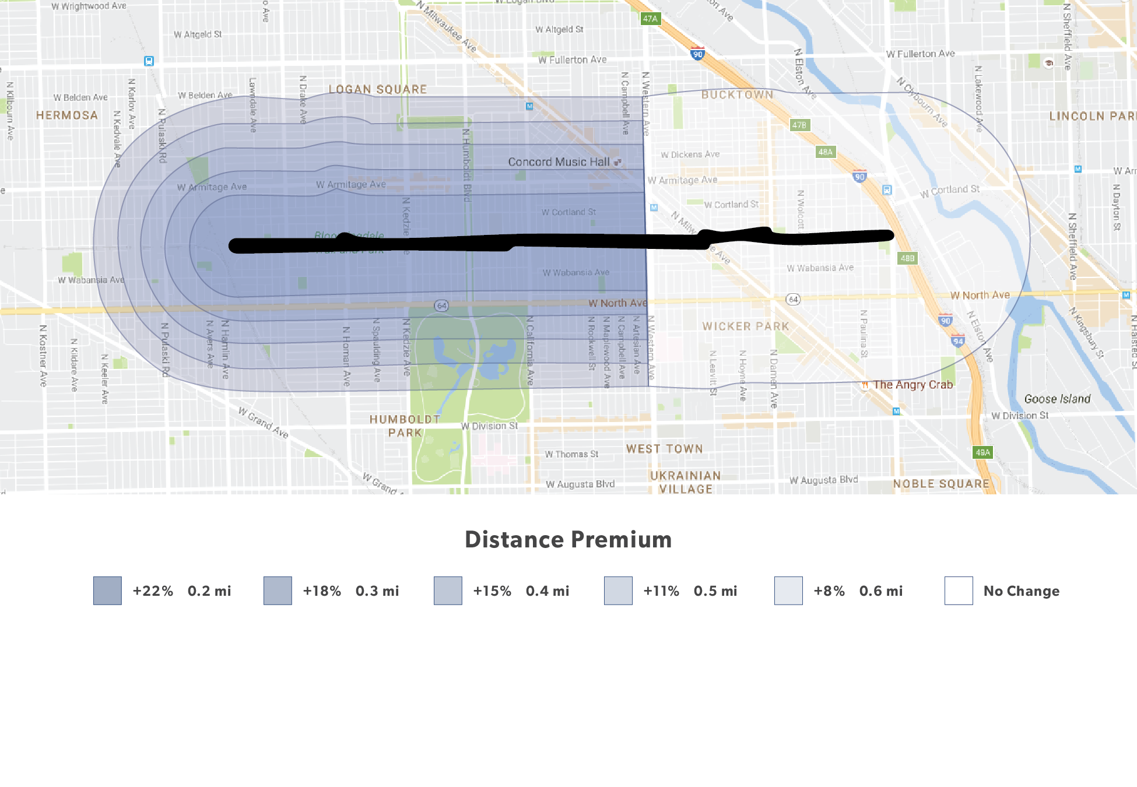
Case study – How did The 606 affect housing demand?
Change in price premium in 606 West by distance (miles) from The 606
Source: IHS calculations of data from IHS Cook county house Price index 2016 2q
Notes:
We know the trail opening had an effect
Effects of the trail decline with distance
After ½ mile it becomes less significant.

Slide 4
Key Findings for Policy and Practice
Neighborhood characteristics matter
A neighborhood’s location, housing characteristics and the underlying vulnerability of the population to displacement can help us anticipate effects.
The timing of interventions are important to their success
The market can change quickly and many of the most robust strategies to preserve affordability are impractical in strong markets.
Proximity matters
The impact varies depending on distance to the project and policies can similarly be geographically targeted.
Policy incentives must be responsive to market changes
Understanding the scale of effects can help inform policy incentives targeted to owners to keep housing affordable.

Slide 5
Understanding displacement pressure citywide
Identifying characteristics of displacement pressure
Identify areas that are potentially vulnerable to displacement
Affordability shifts
Current sales price: Measure of market affordability
Change in sales price: Indicator of shifting demand
Vulnerability
Demographics
Housing stock
Combine layers to highlight areas with different levels of displacement risk
Vulnerable areas with rising demand for housing
High-cost, rising demand
Moderate-cost, rising demand
Low-cost, rising demand

Slide 6
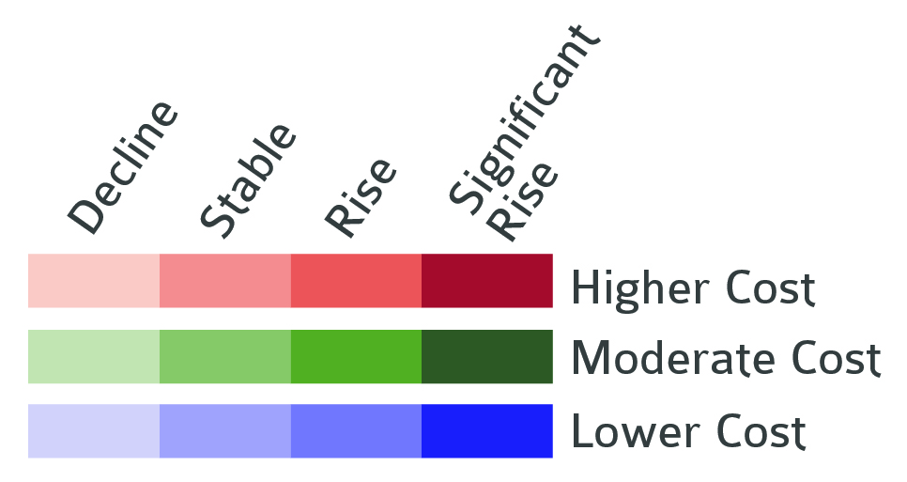
Current and changing levels of housing affordability
Source: IHS calculations of property sales data from Cook County recorder of deeds, 2016 and 2012, Cook county assessor

Slide 7
Identifying areas with vulnerable populations and housing types
Source: IHS calculations of 5-year American community survey data, 2011-15

Slide 8
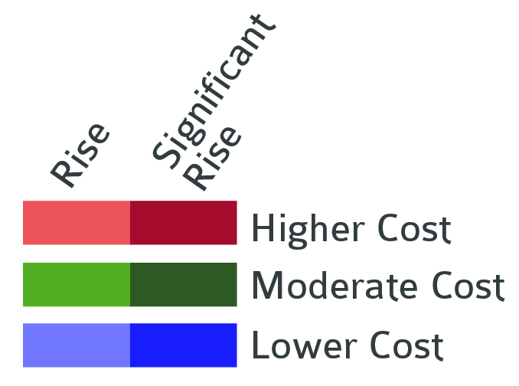
Combining layers to identify areas with displacement pressure
Source: IHS calculations of 5-year American community survey data, 2011-15 and property sales data from Cook County recorder of deeds, 2016 and 2012, cook county assessor

Slide 9
Assessing Displacement Risk in Vulnerable, Rising Markets
High-cost
Likely active displacement
High demand for market-rate housing creates opportunities and challenges for policies leveraging that demand to build and preserve affordable units
Moderate-cost
Potential “tipping-point” neighborhood
The relative affordability of these markets gives practitioners an opportunity for more proactive policies to preserve affordability, but window is closing
Low-cost
Limited current risk from rising prices
Population loss tied to long-term disinvestment might be more critical type of displacement
Abundance of lower-value properties and land may provide the best opportunity for comprehensive, long-term housing strategies for inclusive growth

Slide 10
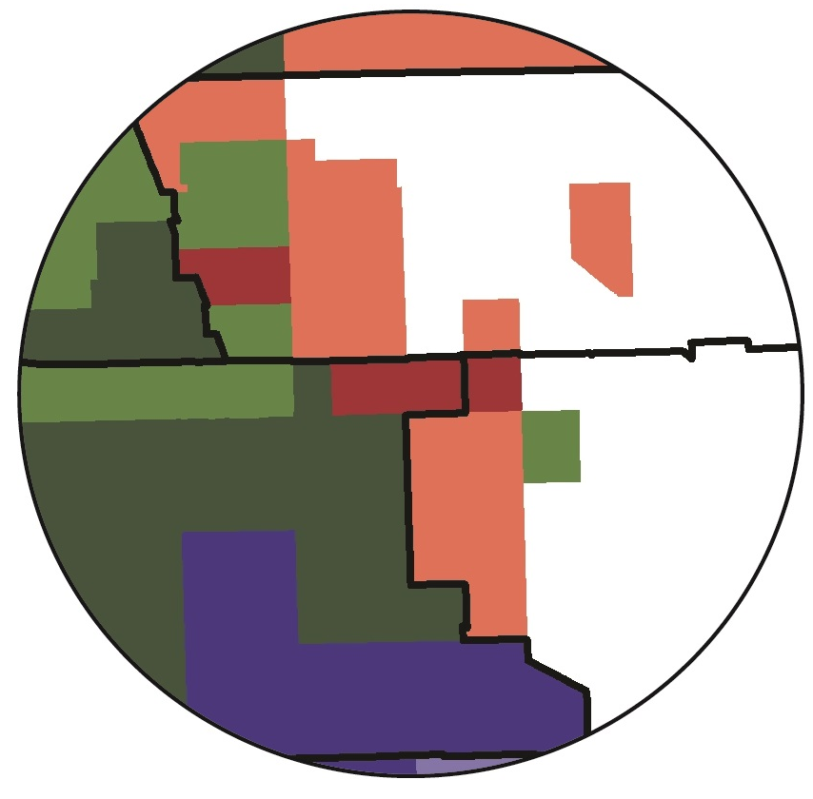
Case study – Neighborhoods around The 606
Source: IHS calculations of 5-year American community survey data, 2011-15 and property sales data from Cook County recorder of deeds, 2016 and 2012

Slide 11
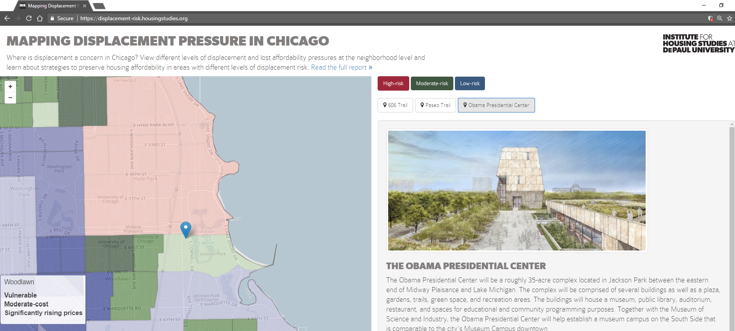

Slide 12
Application to policy issues
Provide framework for discussing affordable housing and displacement challenges
Support implementation of targeted interventions
Example – Targeted strategies to preserve at-risk naturally occurring affordable housing
Inform proactive strategies around public investment projects
Example – Obama Presidential Center
Connect to other place-based community development issues
Examples:
Equitable transit-oriented development – Elevated Chicago
Environmental improvements – Chicago River

Slide 13
Mapping Displacement Pressure in Chicago Neighborhoods
May 9, 2018
Contact: gsmith33@depaul.edu

