Slide 1
Fostering a Data-Driven Community
What we’re trying over in Cleveland

Slide 2
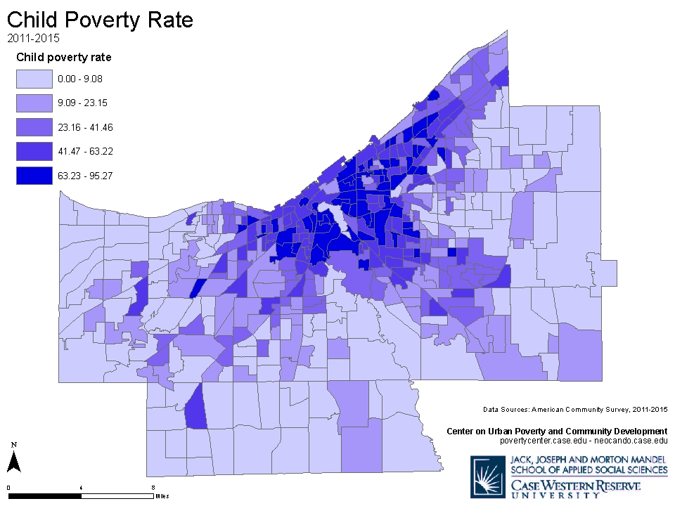
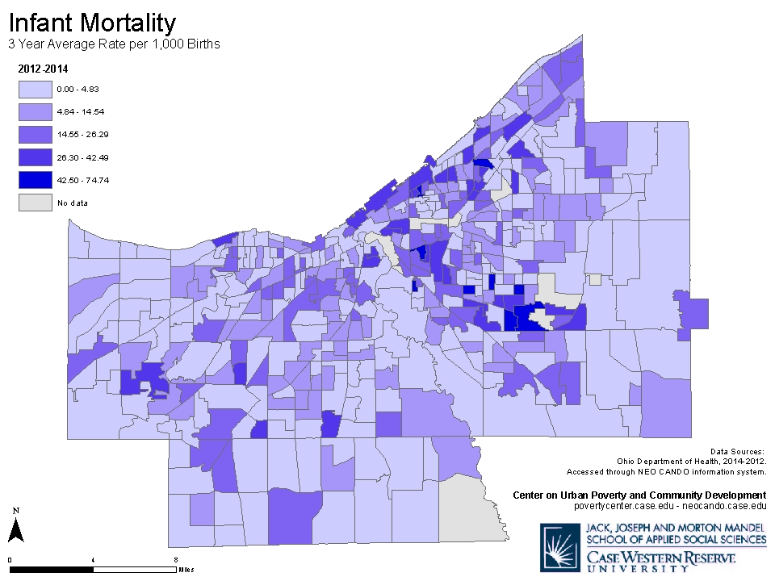
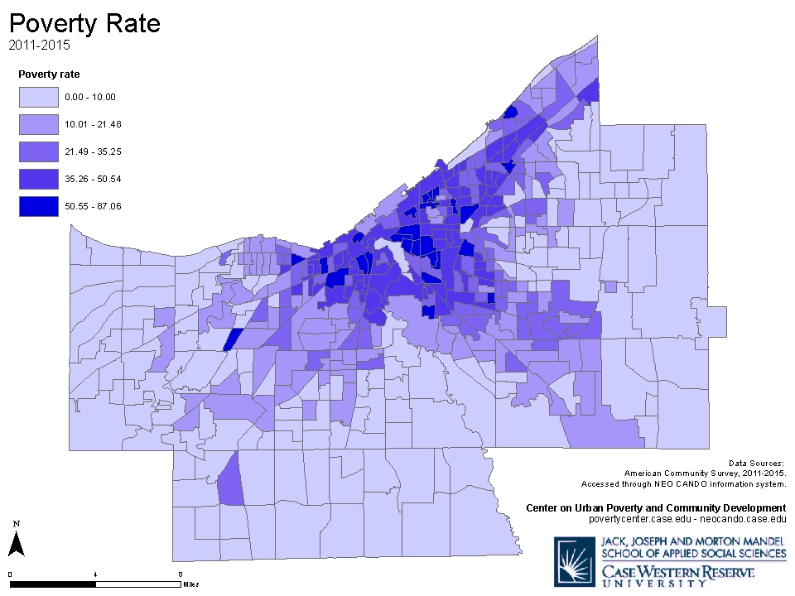
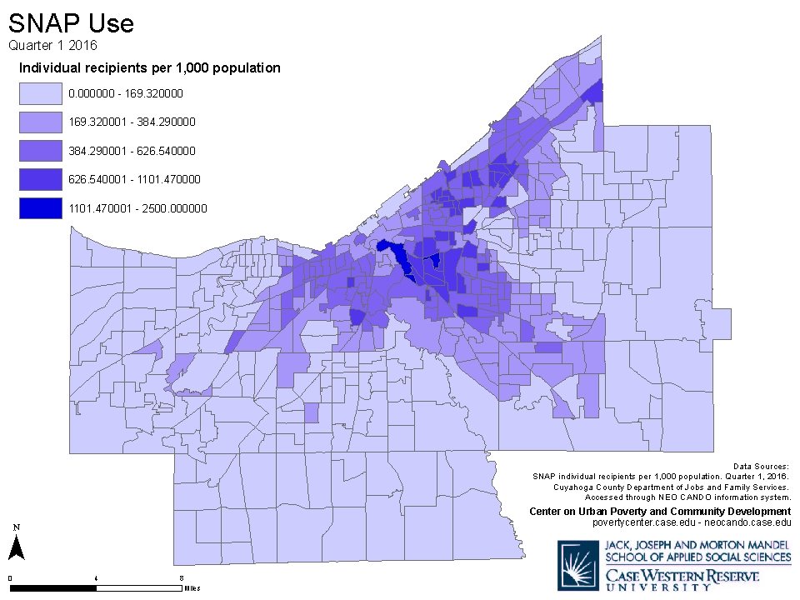
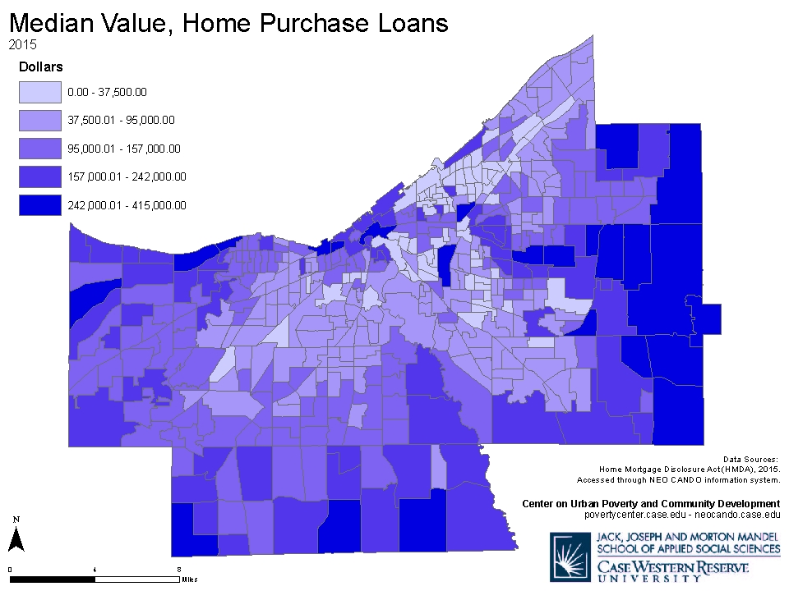
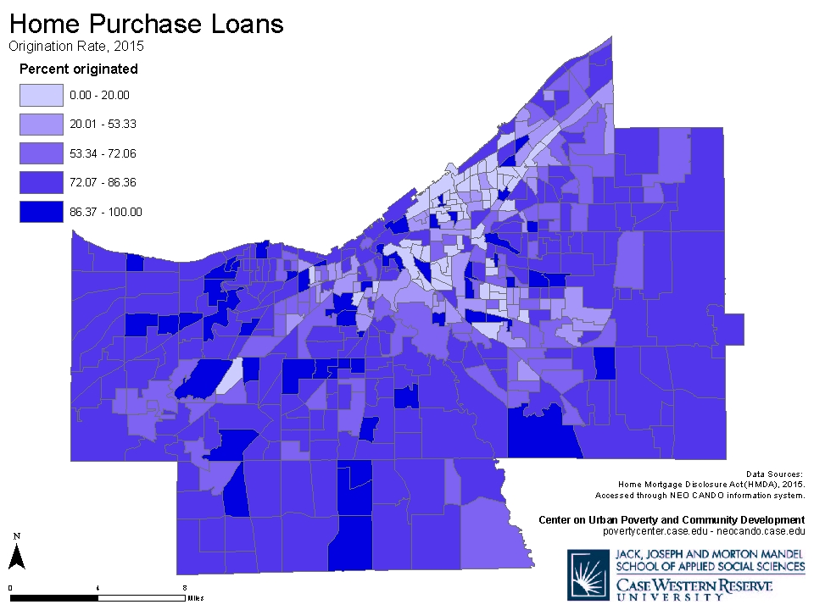
There’s gotta be a better way
Notes:
Lots of map requests and one-of technical assistance requests lead to thinking about how to be more sustainable in answering one-off community questions
PLUS common experience that hand holding is needed to correctly define the question/request for technical assistance—finding the question behind the question
PLUS funder confusion about why some many agencies in town ask for funds for processing ACS data

Slide 3
Better understand needs
What are community data/information needs?
Who’s in the ecosystem?
Notes:
Lead to thinking about how to build community capacity to meet one-of technical assistance request/data needs
How can existing local research/data agencies better collaborate to meet community needs?
NERDS group- informal convening of local researchers to build relationships
NNIP discussion of civic tech got me involved with CFA in Cleveland→
grew relationships into Civic Tech and Data Collaborative→
data days conference and forthcoming ask for funding to attempt regional data alliance, open data advocacy push, grassroots civic tech exploration

Slide 4
Build local capacity to meet needs
Where are there unmet needs?
How can existing local research/data agencies better collaborate to meet community data/information needs?
What else is missing?
Notes:
Lead to thinking about how to build community capacity to meet one-of technical assistance request/data needs
How can existing local research/data agencies better collaborate to meet community needs?
NERDS group- informal convening of local researchers to build relationships
NNIP discussion of civic tech got me involved with CFA in Cleveland→
grew relationships into Civic Tech and Data Collaborative→
data days conference and forthcoming ask for funding to attempt regional data alliance, open data advocacy push, grassroots civic tech exploration

Slide 5
What we are doing
NERDS group- local group of area research entities meet informally to share current work, network
Cleveland Civic Tech and Open Data Collaborative- cross-sector collaborative focusing on civic tech and open data
Notes:
Horizontal- Nerds
Vertical- CT&DC
Get out of it—
Better referrals through better network
Building data sharing connections
Helping to further open data movement in Cleveland
Building partnerships for regional data alliance

Slide 6
Refine your unique value
Poverty Center as an example
Expertise and experience in linking and integrating data
Research, evaluation, consultation and technical assistance
FREE access to data
Notes:
What community needs does Poverty Center currently meet?
Expertise and experience in linking/integrating data
Research, evaluation, consultation/technical assistance
FREE access to data (in a time when more and more are monetizing this activity); public portals into Poverty Center data warehouse
Data from IDSs
Value add to census data: local geographies unified across time
Data linked by geography
“powered by NEO CANDO” specific data applications generated in close partnership with community partners
not wedded to any one technology (because it’s ever-changing)
free training
Overall refined our thinking about our mission, the data and research environment, the public portal environment, and where we fit in. Refined some strategic thinking about how we relate to technology. Refined how we communicate about our organizational focus and value-added

Slide 7
New questions
Does the community value free data?
What is our role in advocating for open data?

Slide 8
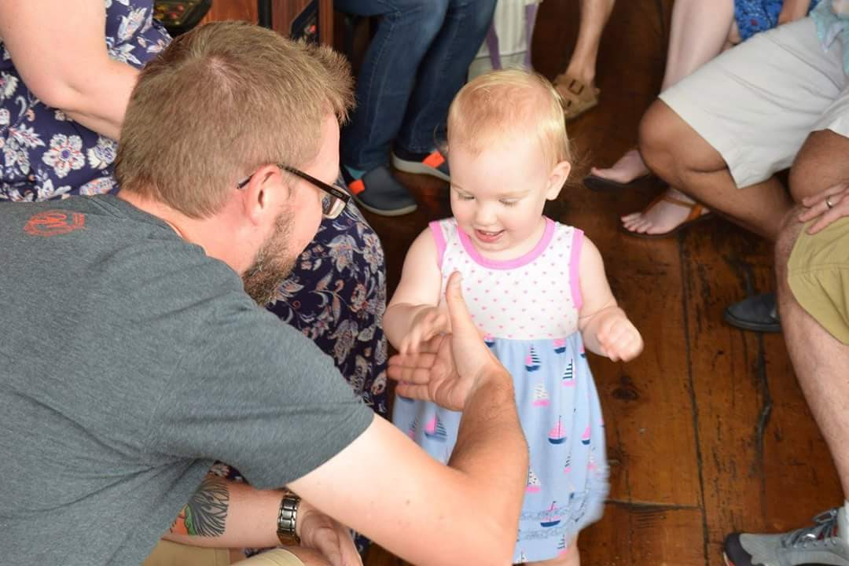

Slide 9
Contact
April Hirsh Urban
Center on Urban Poverty and Community Development
April.urban@case.edu
216-368-3390
@AprilHirsh

