Slide 1

The Work of the Cleveland NNIP Partner
Data
Empowered
Rob Fischer, Ph.D.
Center on Urban Poverty and Community Development
Jack, Joseph and Morton Mandel School of Applied Social Sciences
Case Western Reserve University
Notes:
Welcome, intro, humble acknowledgement/congratulations to other finalists/friends

Slide 2
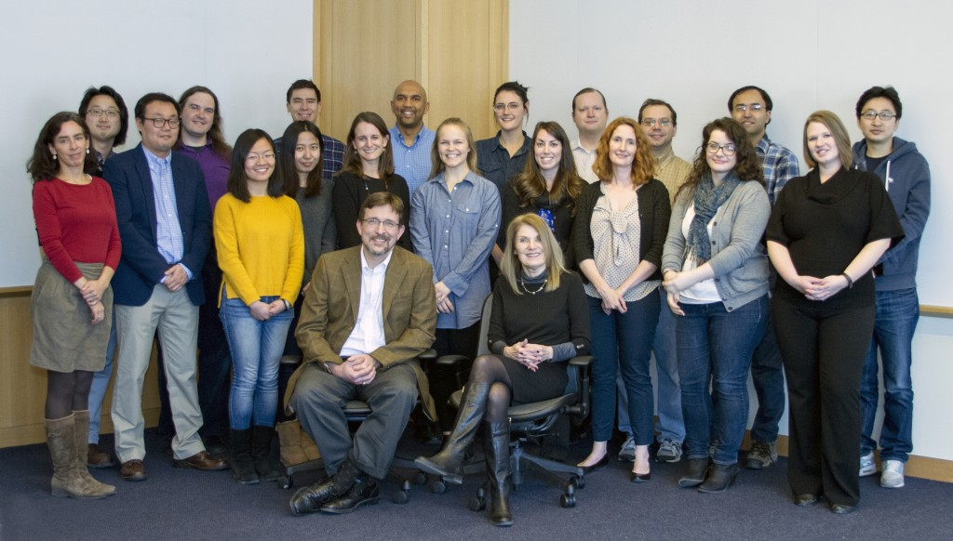

Center on Urban Poverty and Community Development
Our focus:
Neighborhood as a fundamental interface between individuals and systemic forces that drive opportunities.
Specific Goals:
-Through local engagement aim to build knowledge of what works in policy and practice
-Through national partnerships aim to bring community to the forefront of efforts to address social disadvantage
Located with the Mandel School of Applied Social Sciences at CWRU, celebrating 100th year of service
A creative team of faculty, staff, and students with diverse set of skills

Slide 3






























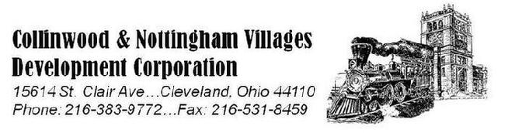





Community Driven Partnerships
Notes:
As the practical need for information grew, three partners helped steward the development of the NST Web App:
The City of Cleveland
Neighborhood Progress, Inc.
and the Cuyahoga Land Bank
Neighborhood Progress Inc. works in depth with over 20 community partners, using the NST Web App and the information it houses as a critical part of its neighborhood-stabilization model.
In addition, we have made the Web App accessible to a number of other community partners at their request.
The input from our community partners drives the development of the NST Web App.

Slide 4
The Center’s areas of work
Indicator data at the neighborhood level – public portal
Integrated data at the individual level (persons and properties)
Research and evaluation projects focused on children, families, and neighborhoods

Slide 5
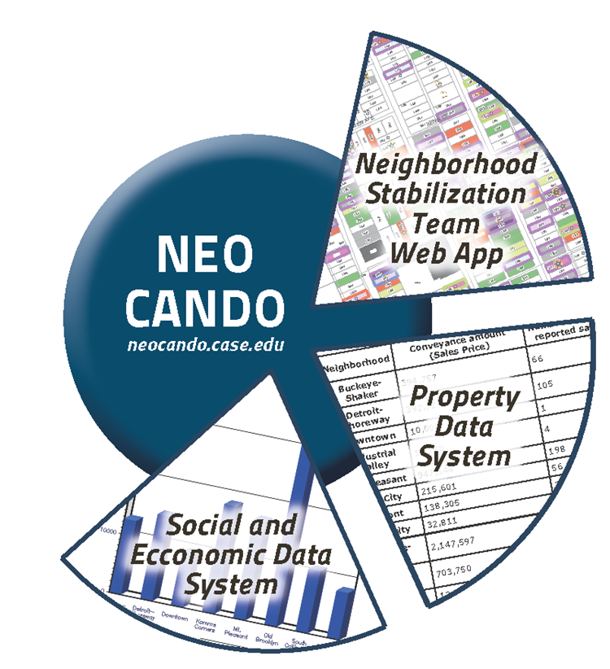
NEO CANDO 2010+
NEO CANDO 2010+ in a nutshell…
Evolving since 1992--provides tabulated data on neighborhoods
An open data portal now covering 4.2 million people in 17 counties in northeast Ohio
Enables rapid exploration of social and economic indicators for thousands of users including policy-makers, community developers, and researchers
Gives individuals and organizations access to high-quality statistics about the areas they serve

Slide 6
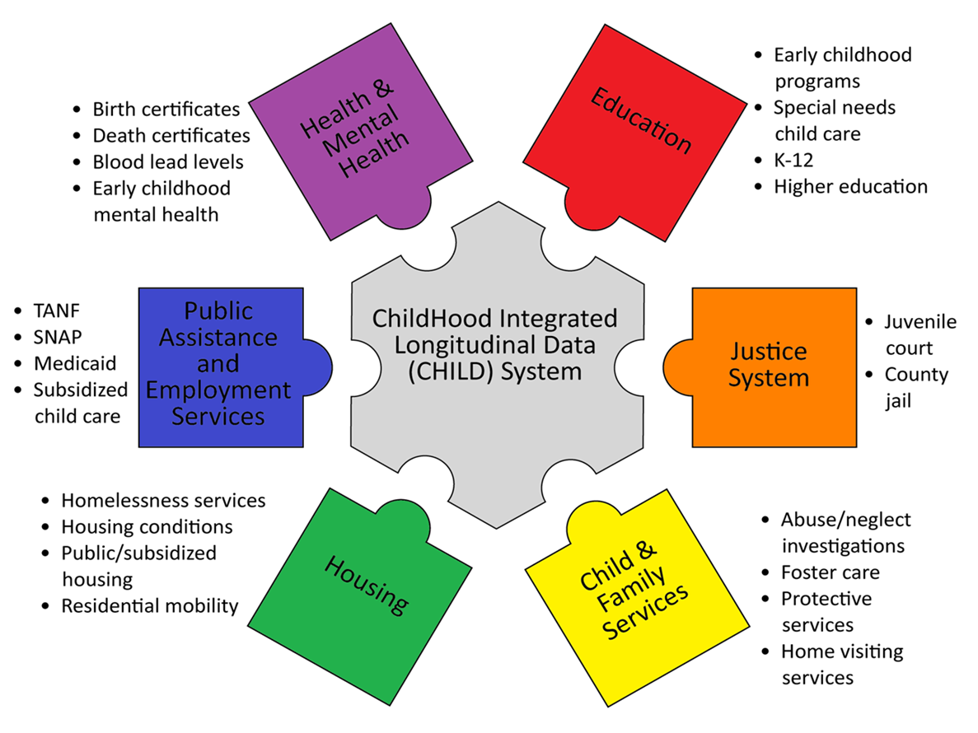
Childhood Integrated Longitudinal Data (CHILD) System
Includes all children born in Cuyahoga County since 1992
Draws on routinely available administrative data to monitor program delivery and outcomes
Brings together data at the individual child level for longitudinal analyses
Started with focus on young children, recently adding older youth, transition to adulthood and linked parent records
500,000 children and counting

Slide 7
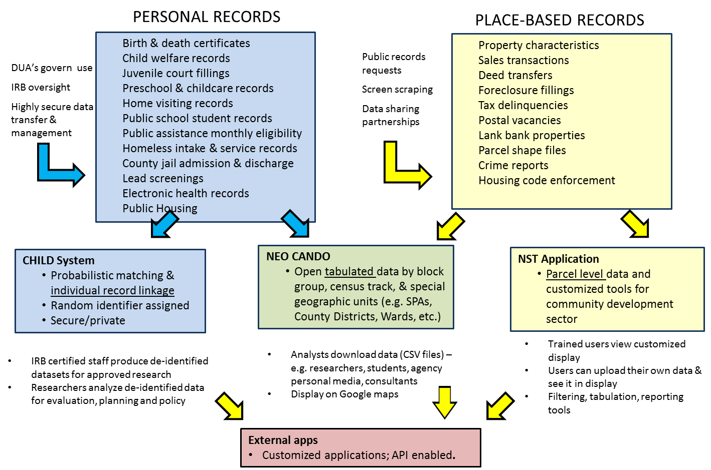
Overview of Center Data

Slide 8
Driving Program Effectiveness
15 years of work evaluating early childhood programming in Cuyahoga County including home visiting, pre-k, early childhood mental health, and child care consultation
Recent study of Cleveland kindergarteners that used CHILD to predict k readiness based on early childhood exposures and housing
Prospective experimental study underway of first county-level Social Impact Bond focused on homeless families with children in foster care

Slide 9
New developments
Launching APPs that work with NEO CANDO
  Neighborhood Progress Drivers Dashboard—built on Prov Plan code
  Health Data Matters Live Stories
Two-generation IDS
  Children in CHILD become adults and have own families
  Parallel system to child links records of other household members

