Slide 1
Presentation to NNIP
September 14, 2016
Rebekah Dorman, PhD

Slide 2
Public/Private Partnership
Philanthropy
A public/private multi-sector
partnership that leads the Early Childhood Agenda in Cuyahoga County.
Business
Nonprofit
Agencies
Government
● Advocates
● Volunteers
● Families

Slide 3
QUICK FACTS
Founded in 1999
A public/private partnership from the beginning
Public Funding: >$240 million
Private Funding: >$40,000,000

Slide 4
Invest in Children funds and administers a comprehensive service system for children and families prenatal-kindergarten
Home visiting
Early Childhood Mental Health
Improving Child Care Quality
Universal Prekindergarten

Slide 5
Evaluation is a cornerstone:
Data informs many types of decisions
Since 1999, Invest in Children has partnered with CWRU on CHILD : Key to our success and continued funding.

Slide 7
Universal Prekindergarten (UPK) Overview
Comprehensive, voluntary, high-quality early care and education for 3 – 5 year-olds that will help them enter school ready to succeed
2,000 seats in 33 sites located throughout Cuyahoga County including public preschools, Head Start, licensed child care centers, and licensed family child care homes
Tuition Assistance to families up to 400% FPL

Slide 8
Impact of Integrated Data: Answering Important Questions
Overall, who attends UPK?
What is impact on the child? Does dosage matter?
Is Kindergarten Readiness evident on state administered assessment?
Does state administered assessment predict 3rd grade reading?

Slide 9
Children Served Since 2007 by UPK
Over 9,000 served, most for two years
48% lived in Cleveland, 52% lived in the suburbs
65% on Medicaid
49% Female, 51% Male
53% African American; 40% White; 7% Other

Slide 10
What is the impact of UPK on
children’s school readiness?
Children in UPK showed statistically significant gains in school readiness on all five subscales of the Bracken School Readiness Assessment.
Children who attended UPK for two years and then entered CMSD had a mean KRA-L score of 18.7 which is three points higher than the average for all CMSD Kindergarteners of 15.7

Slide 11
UPK students Pre/Post Bracken School Readiness Score Change by lead level

Slide 12
“UPK 2.0”
TOP PRIORITY OF COUNTY GOVERNMENT
Transformative $23M Public/Private partnership
Tied to long range goals of workforce development
Doubles the number of children served

Slide 13
Impact of Integrated Data: Answering Important Questions
What is the capacity to expand in high quality programs that serve low income children?
Where are those programs?
How many are Head Start? (funding implications)

Slide 14
Map of potential sites

Slide 15
Other examples….
Understanding the geography of early childhood
County Council Profiles
City/Suburbs
Increasing Collaboration: Whose family is it anyway? From “my” to “our”….
Showing how families interact with multiple systems
Pay For Success: The Intersection of Child Welfare and Homelessness
Are referrals happening? The “hand off” from agency to agency.
Do we really have a system?

Slide 16
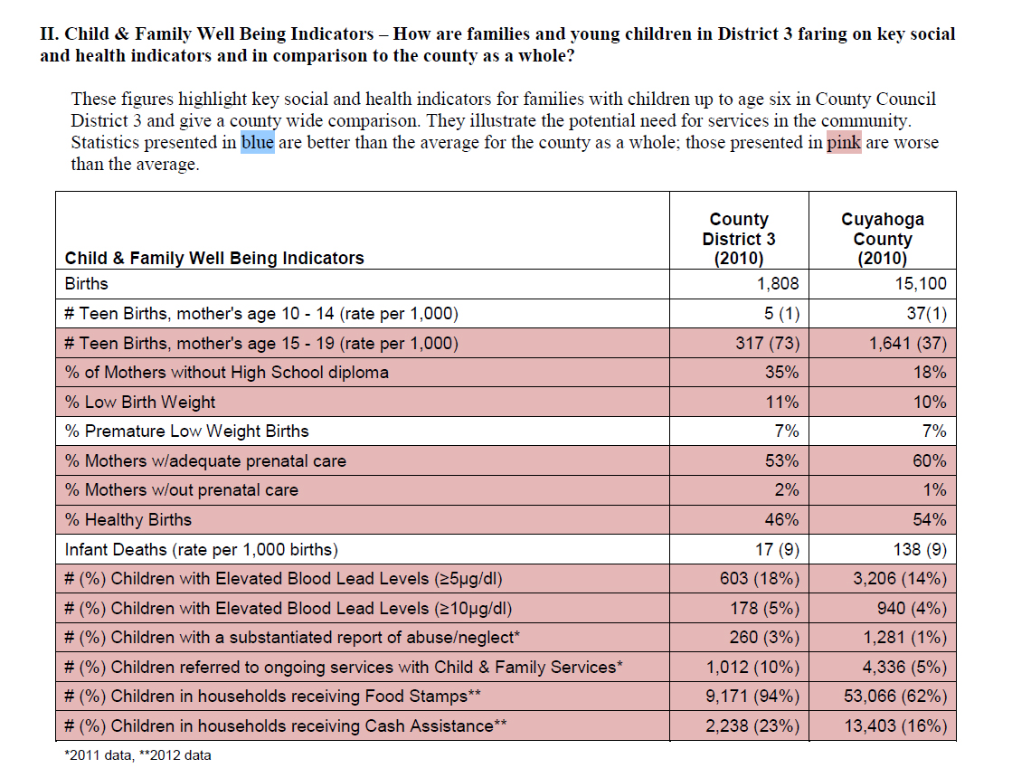
Council District Profile

Slide 17
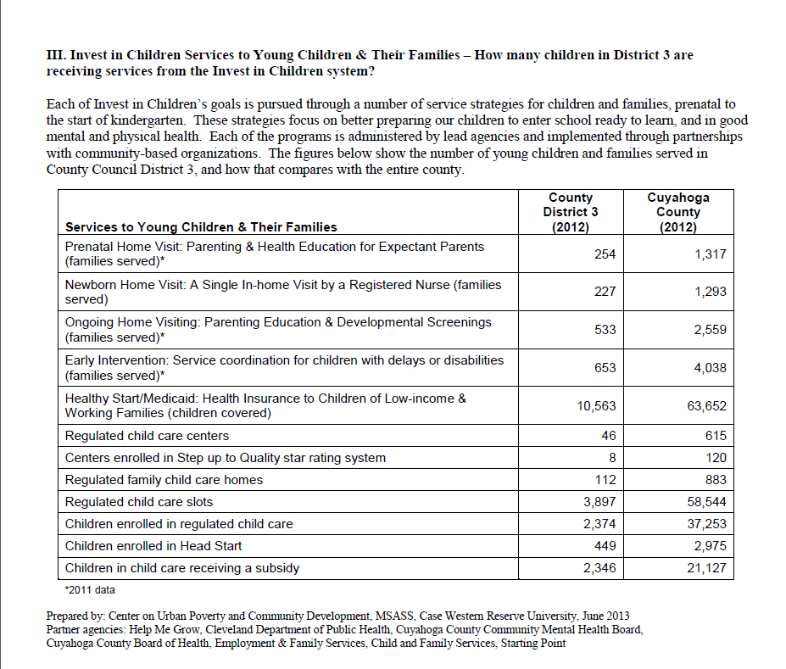
Council District Profile

Slide 18
The Geography of IIC Services 1999 - 2008
Figure 3.7 Percent of Children Served by IIC Programs by Residence (City of Cleveland versus Cuyahoga County outside Cleveland) 1999-2008

Slide 19
Other examples….
Increasing Collaboration: Whose family is it anyway? From “my” to “our”….
Showing how families interact with multiple systems
Pay For Success: The Intersection of Child Welfare and Homelessness
Are referrals happening? The “hand off” from agency to agency.
Do we really have a system?

Slide 20
Questions?
Notes:
Paul’s close

