Slide 1
NNIP’s 20th Anniversary
Celebrating the Past and Charting the Future
September 14, 2016

Slide 2

NNIP Network through the Years
Cindy Guy, Annie E. Casey Foundation
Notes:
What does this look like on the ground? First go through a series of quick examples and then more in-depth into 2 others.

Slide 3
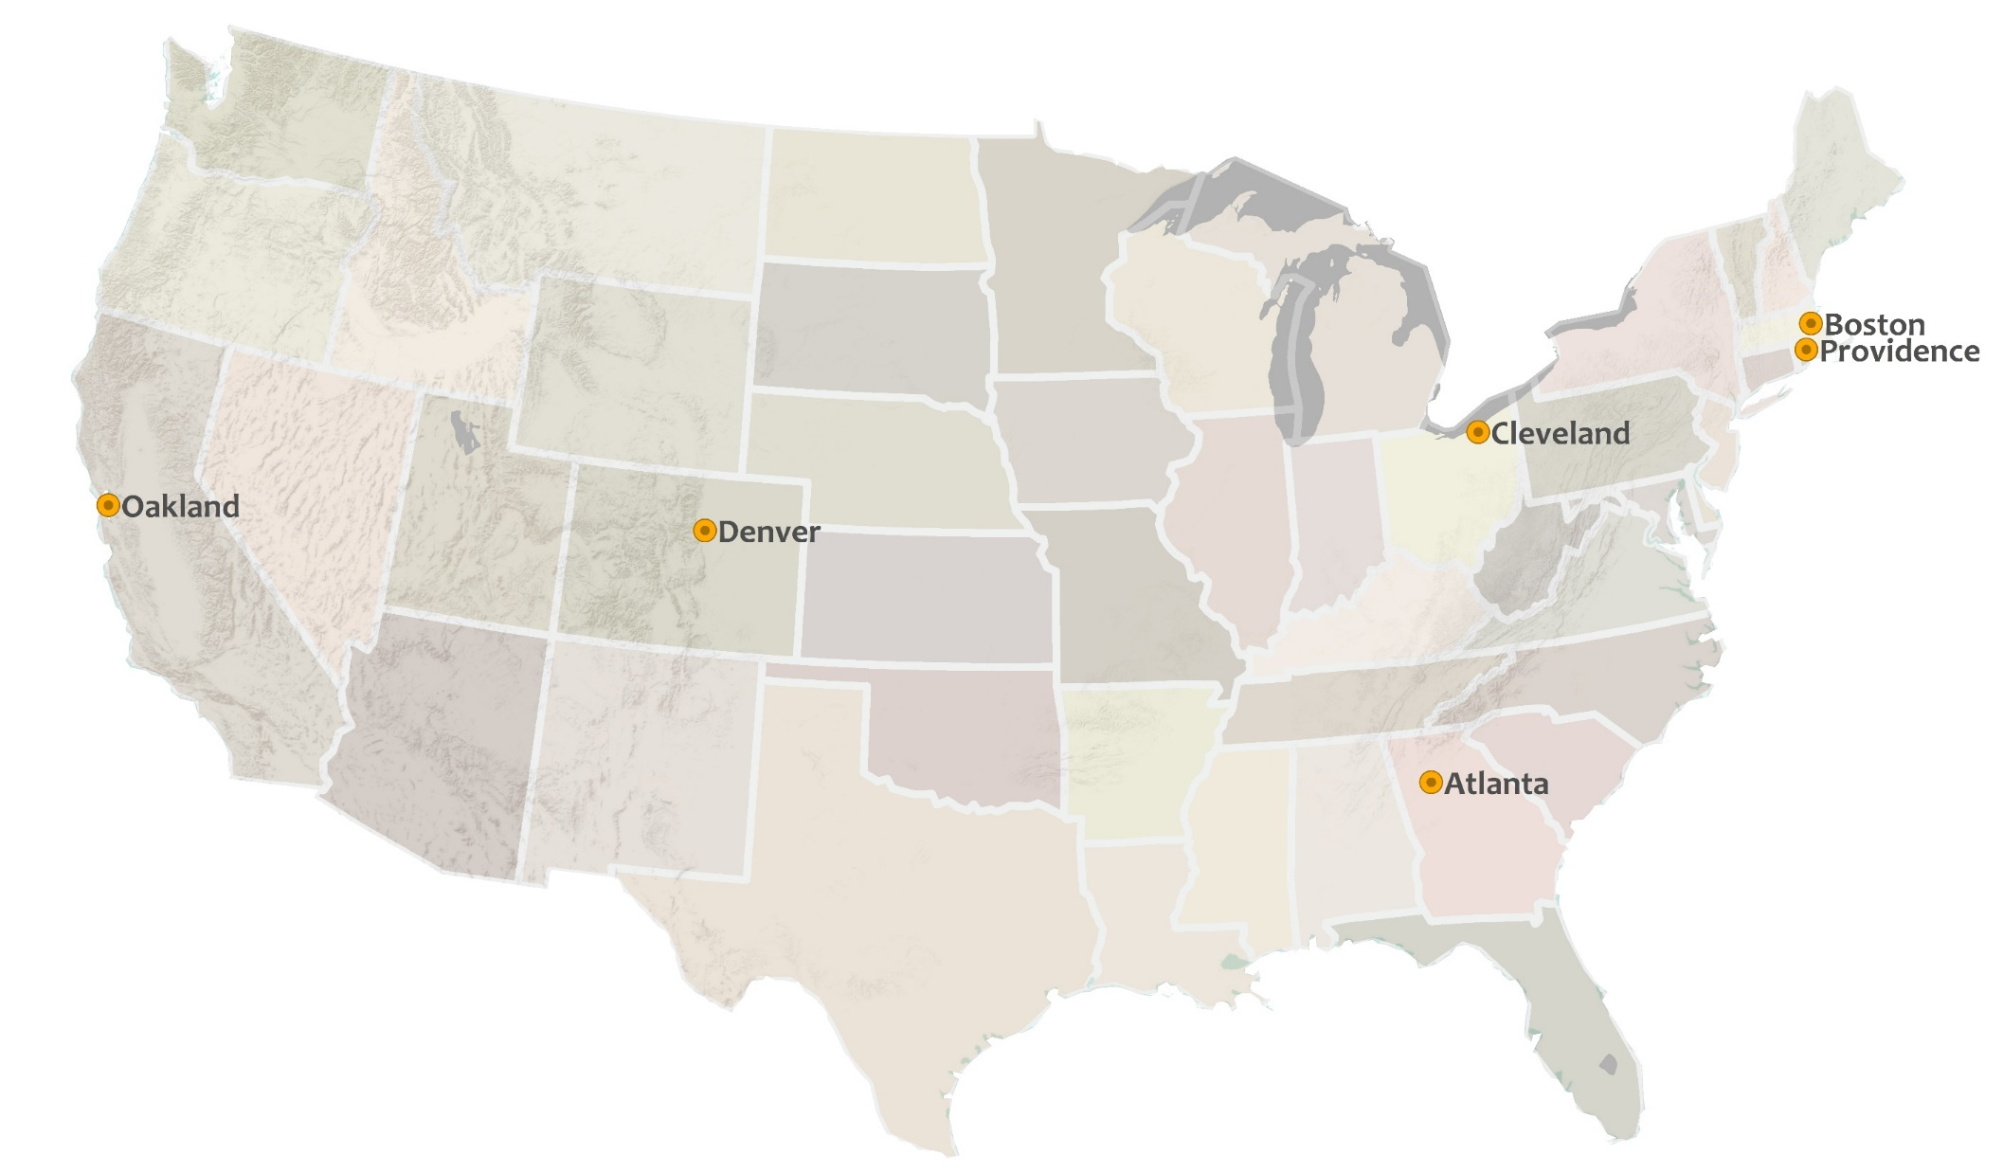


1996

Slide 4
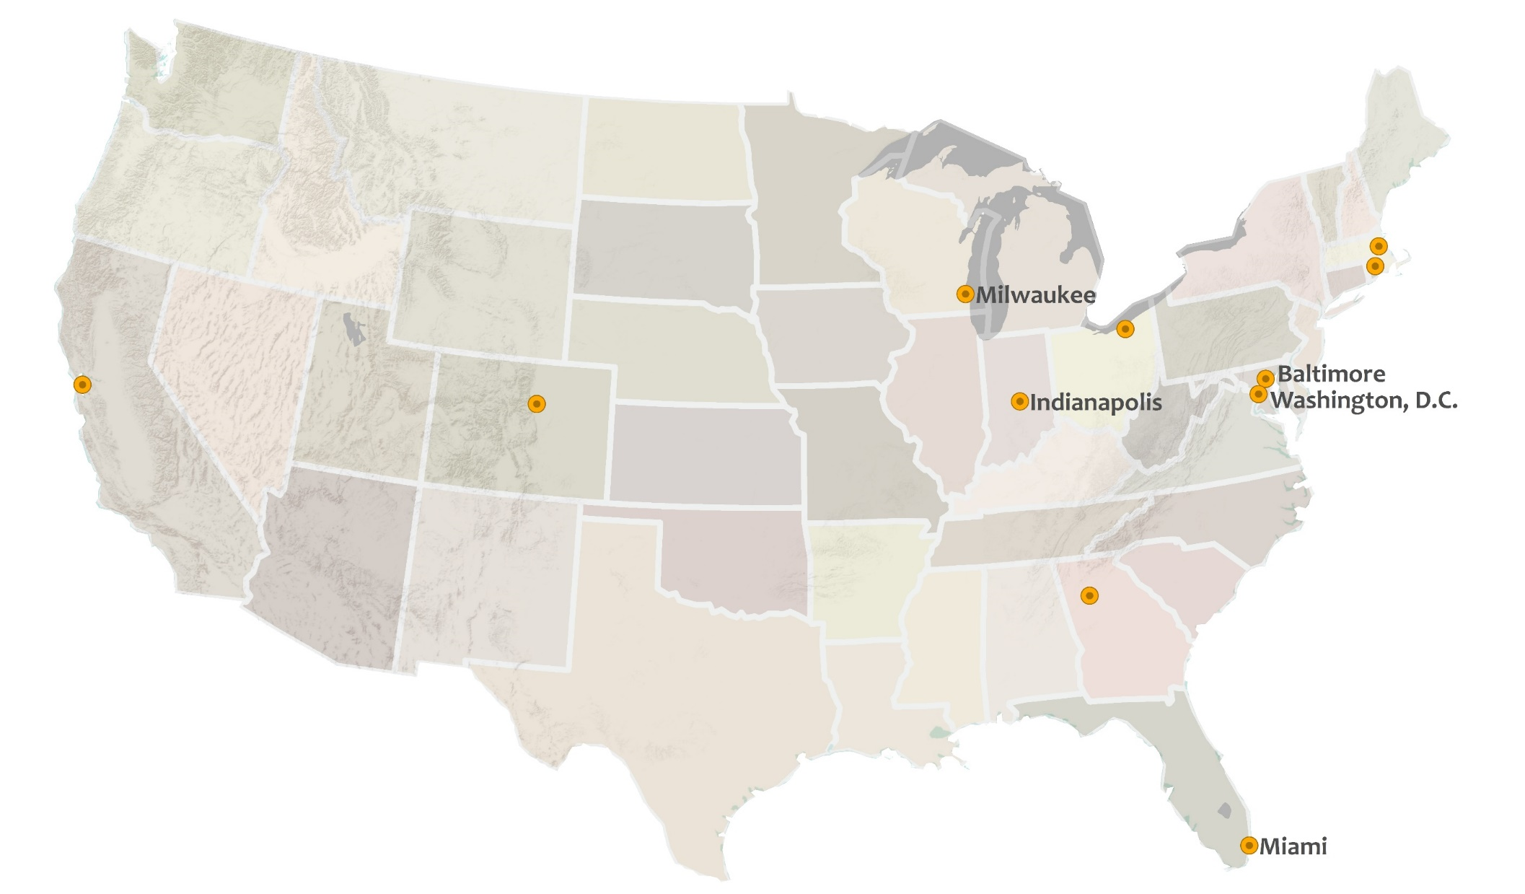
1999

Slide 5
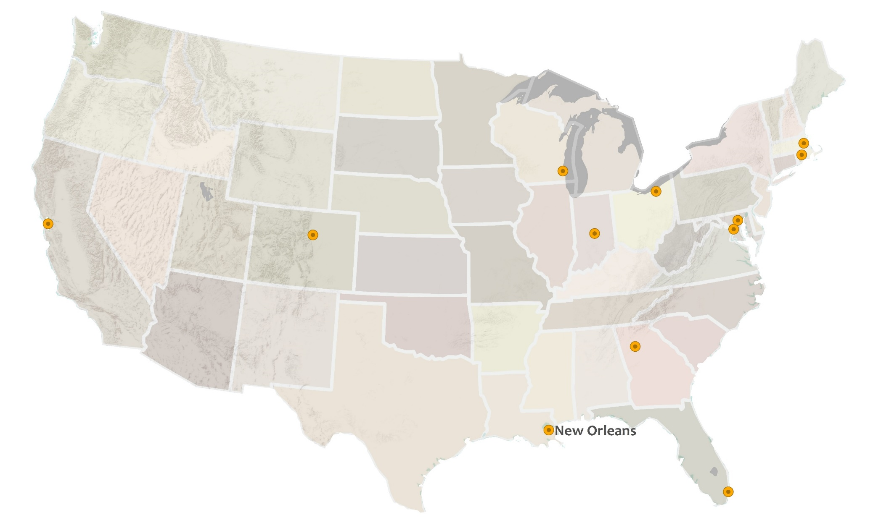
2002

Slide 6
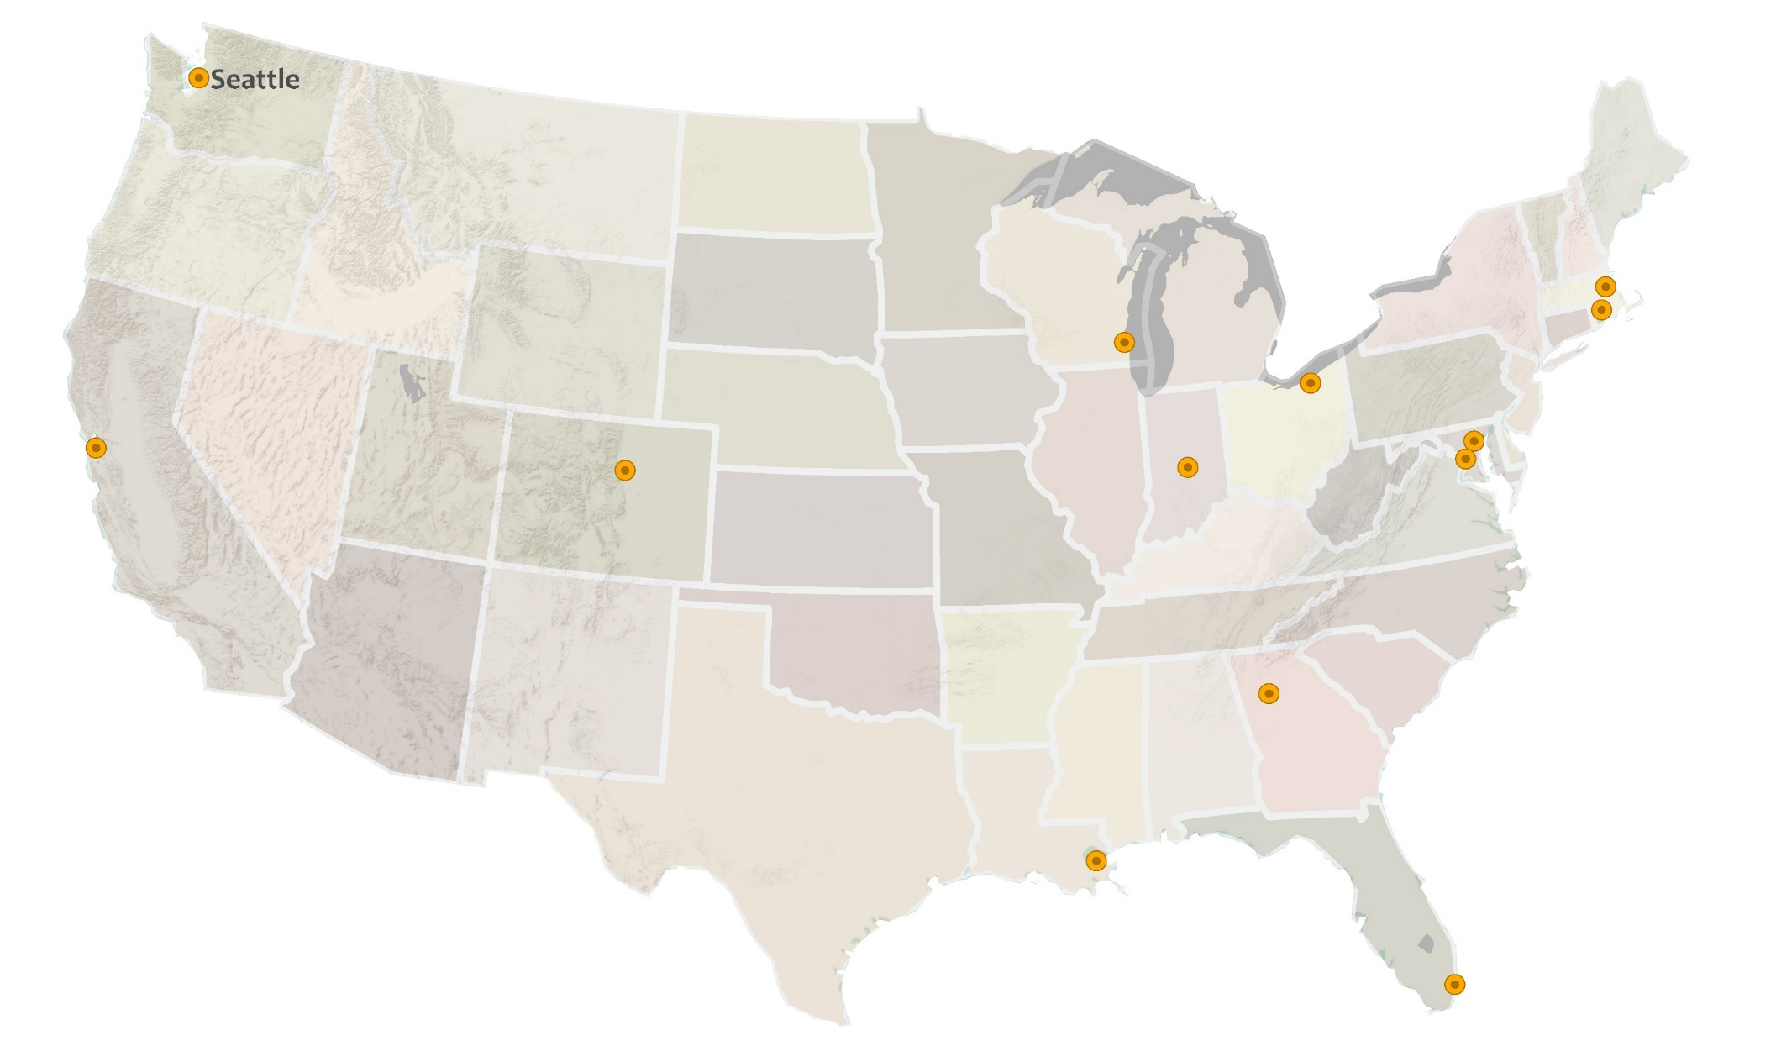

2003

Slide 7
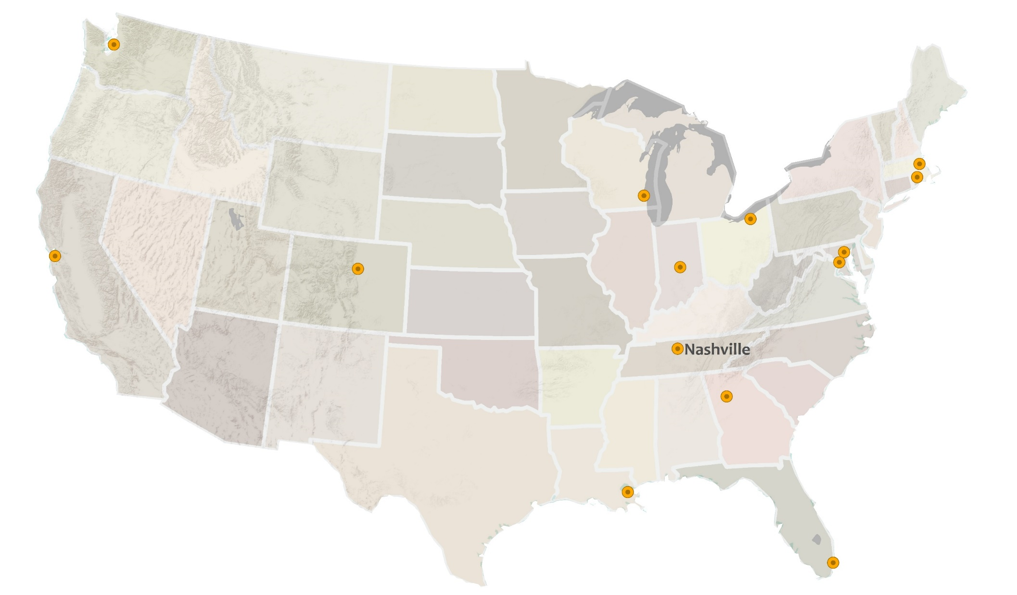
2004

Slide 8
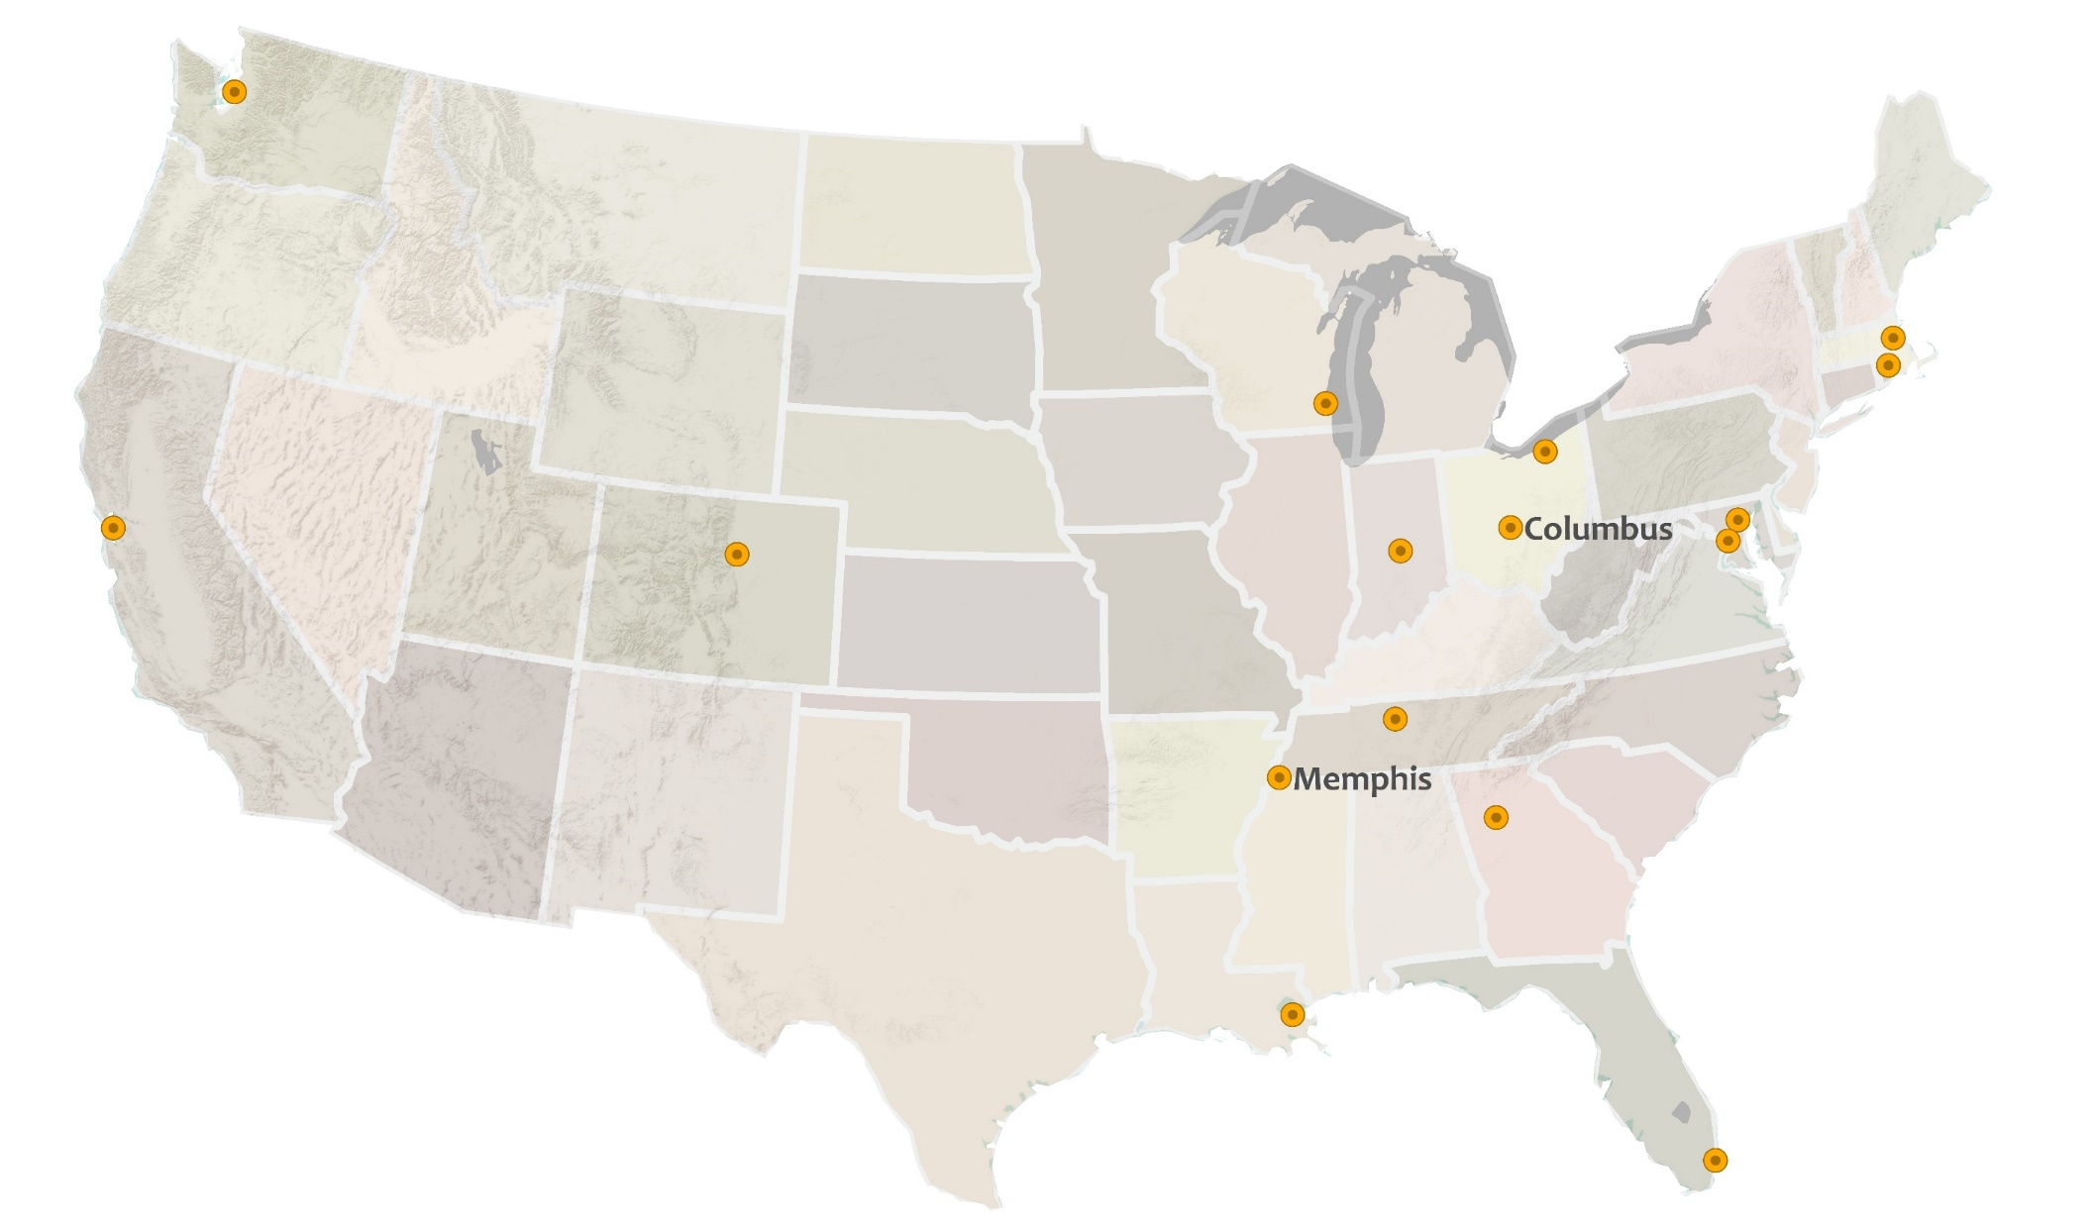
2005

Slide 9
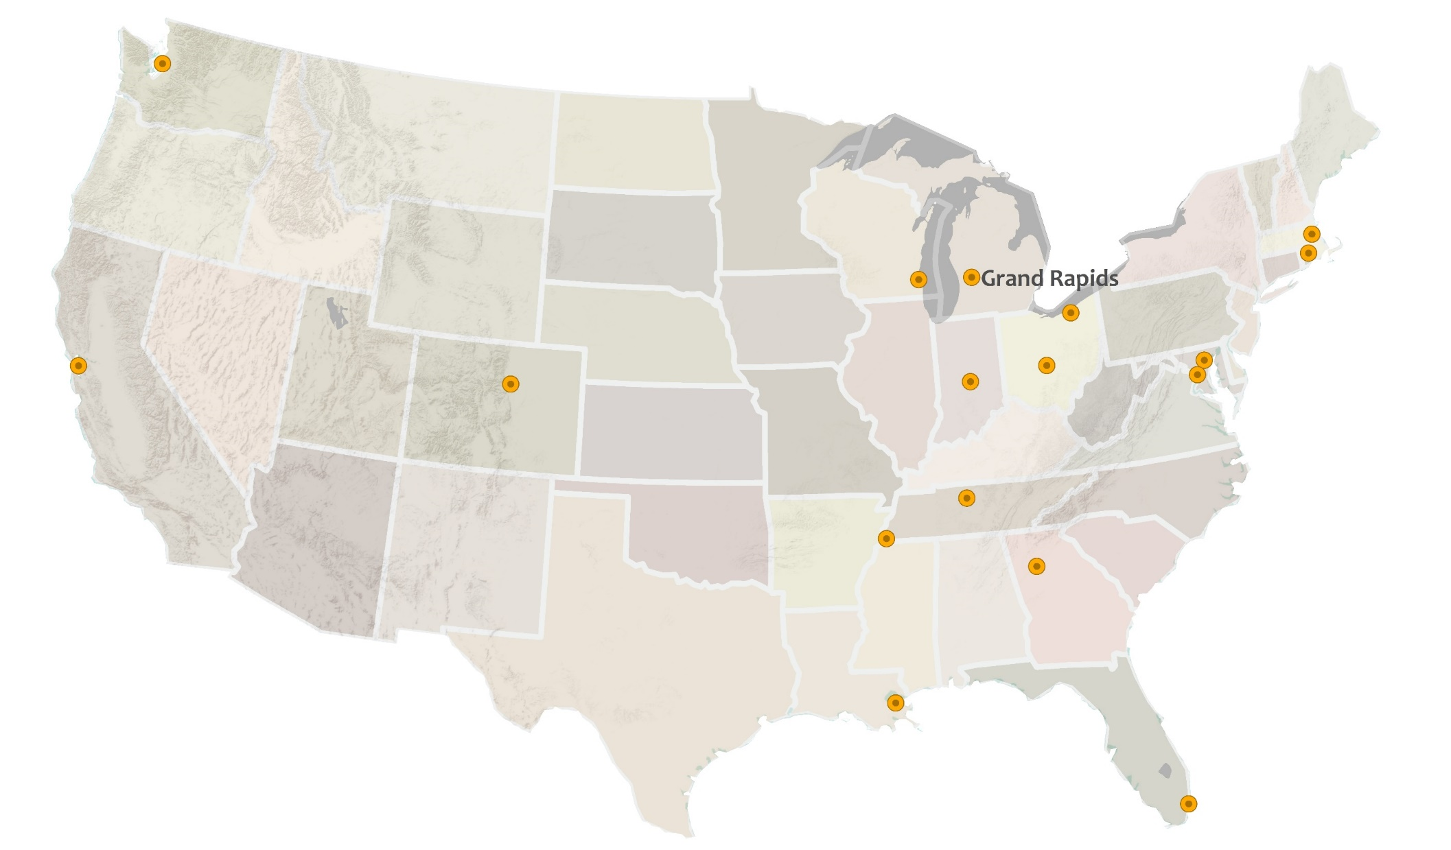
2006

Slide 10
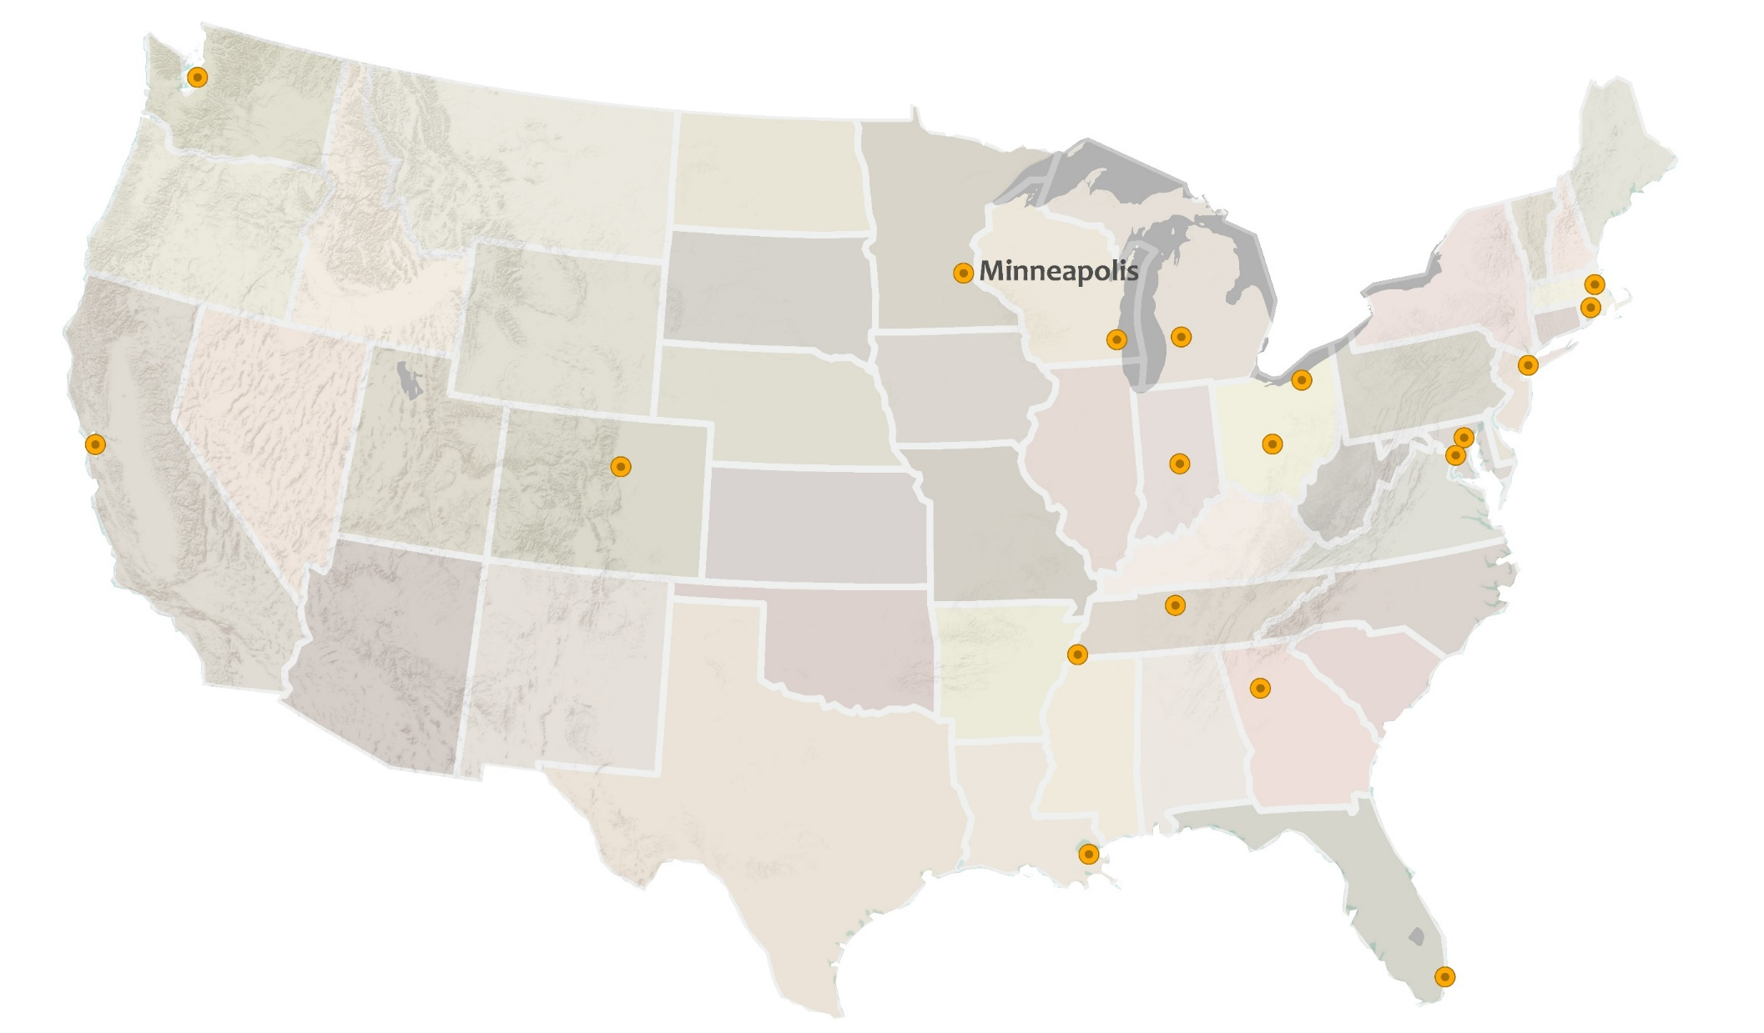
New York
2007

Slide 11
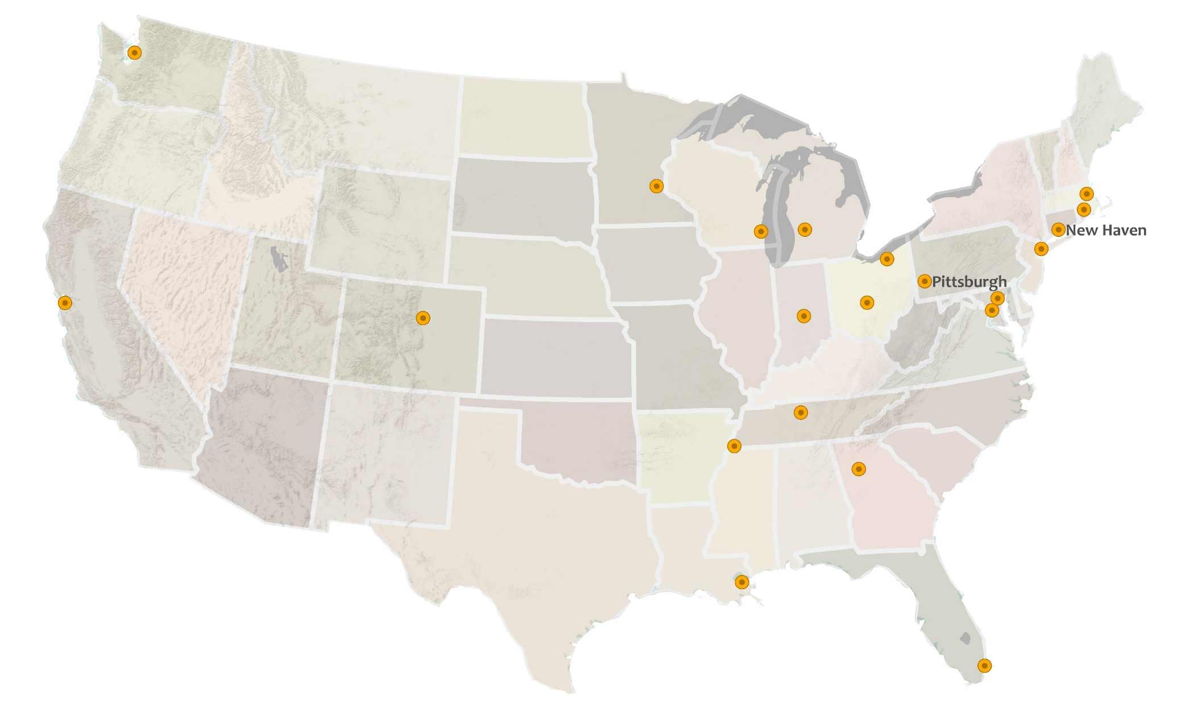
2008

Slide 12
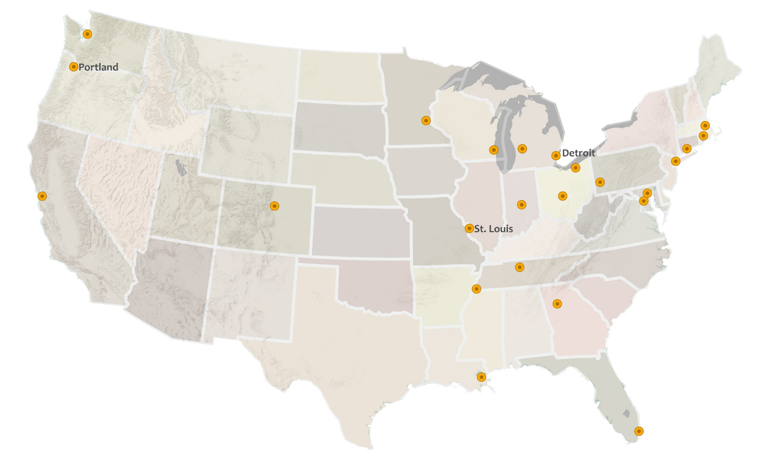
2009

Slide 13
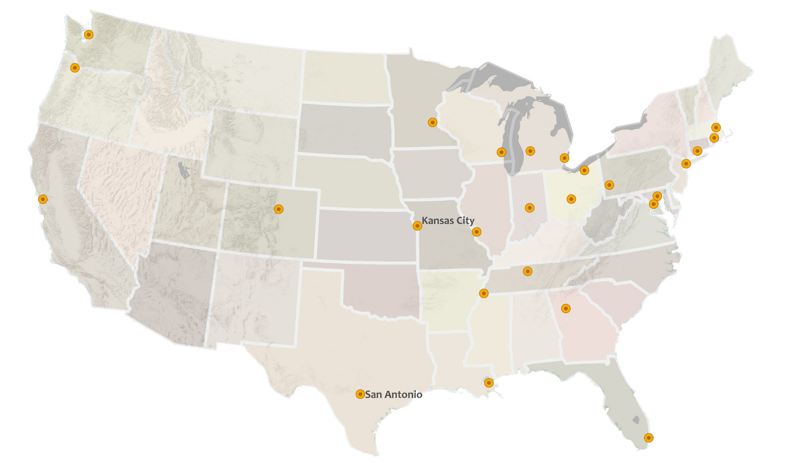
2010

Slide 14

2012

Slide 15
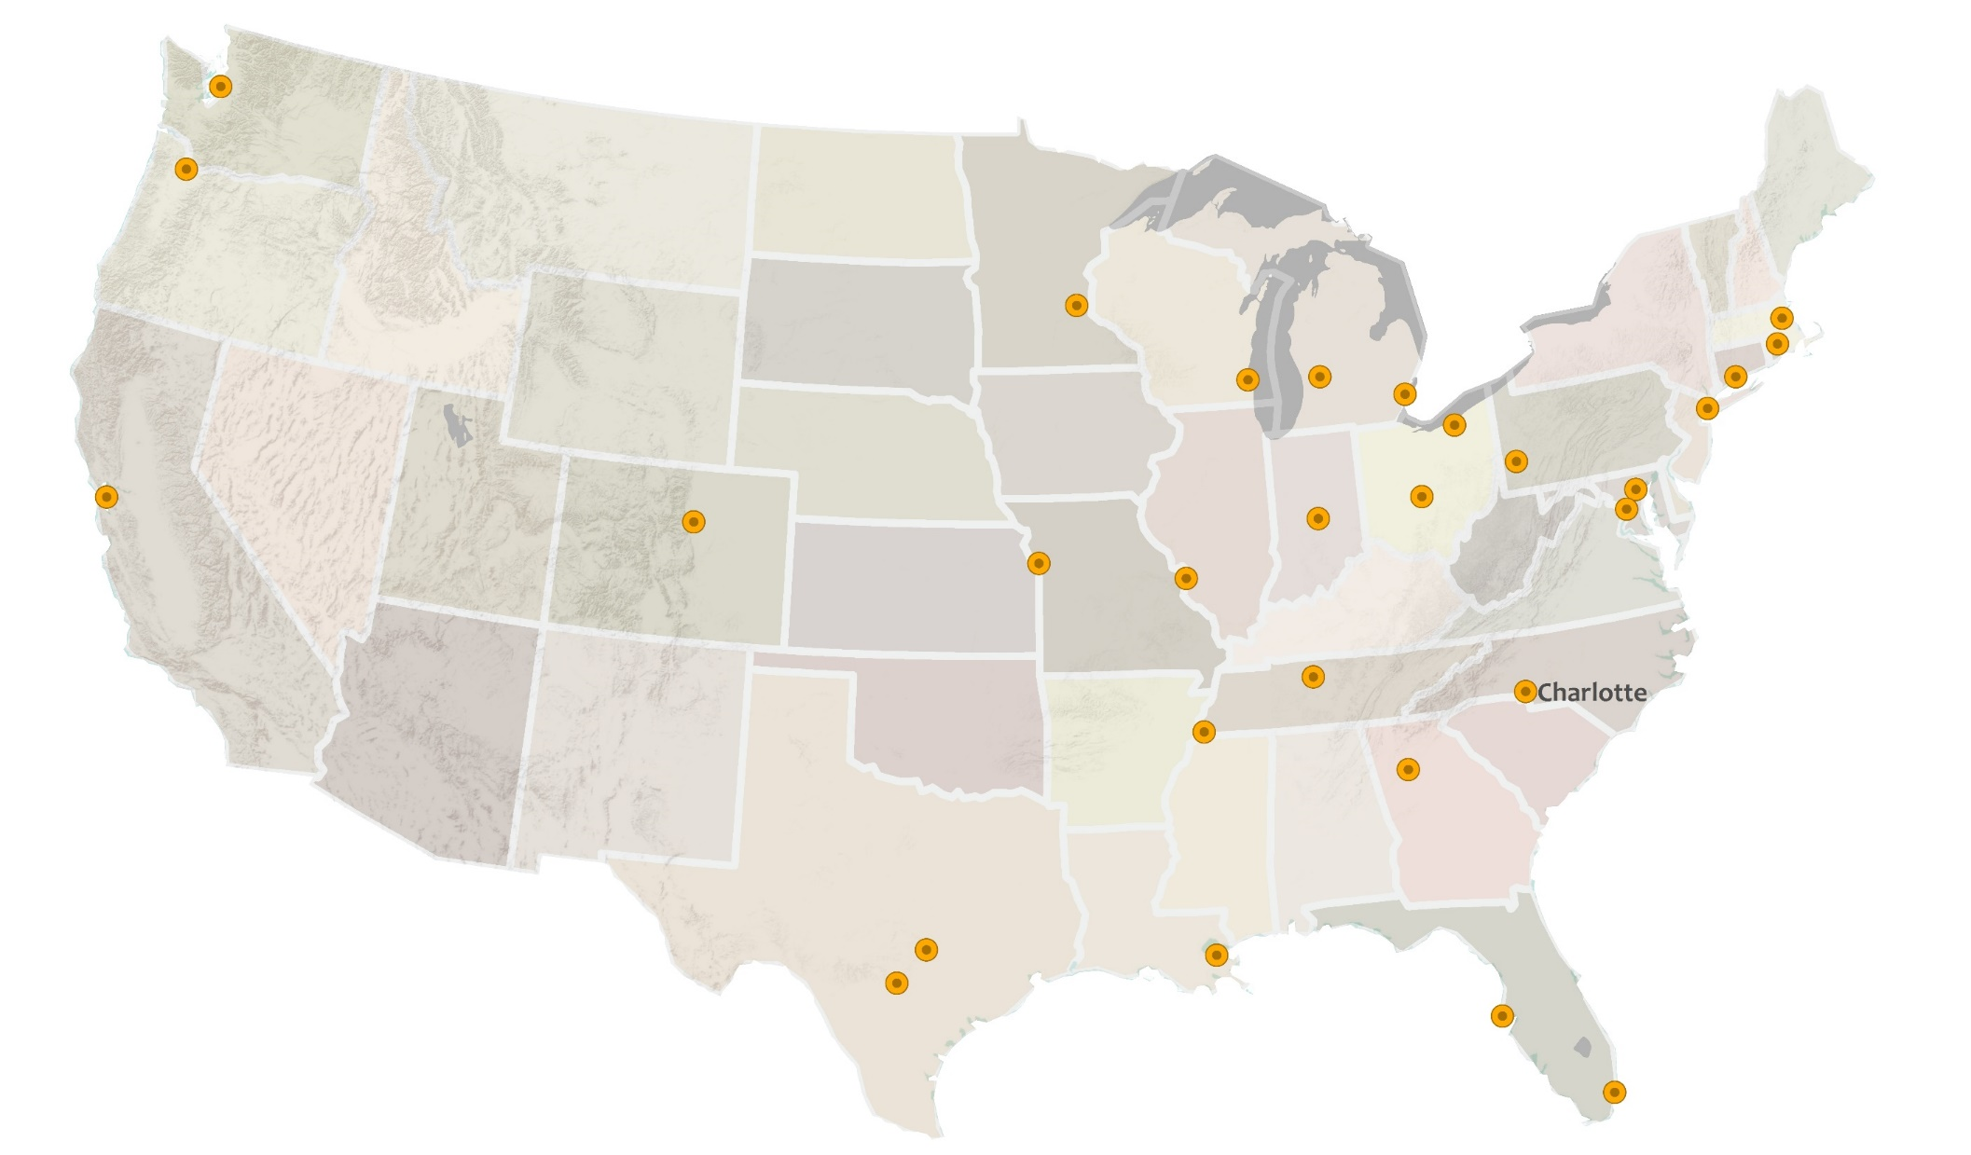
2014

Slide 16

2003
Seattle
2009
Portland
2007
Grand Rapids
Detroit
Cleveland
1996
Minneapolis
2006
2008
Boston
1999
2009
2007
Providence
Milwaukee
1996
New Haven
2008
New York
1996
1996
1999
2005
1999
Oakland
Pittsburgh
Baltimore
Denver
2010
2009
Indianapolis
Columbus
Washington, D.C.
Kansas City
St. Louis
2004
2014
2005
Nashville
Charlotte
Memphis
1996
Atlanta
2012
2002
2010
Austin
New Orleans
NNIP
San Antonio
2012
Date Joined
Pinellas County
1999
Miami
Thanks to Randy Morris in Portland for the maps!

Slide 17


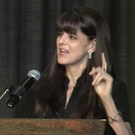
Today’s panelists
Claudia Coulton
Cleveland
Sheila Martin
Portland
Laura McKieran
San Antonio
2003

Slide 18
Commemorating NNIP’s 20 Years
Establishing Awards to Recognize Excellence
Peter Tatian
September 14, 2016

Slide 19
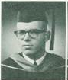

Thank You Tom for 20 Years of Dedication!
University of Southern California
Yearbook Photo
Urban Institute

Slide 20

Defining Functions of NNIP Partners
G. Thomas Kingsley
Impact Award
To annually recognize an NNIP partner organization for their important contributions in using neighborhood data to improve local policy and practice to benefit low-income communities.

Slide 21

Network Steward of the Year Award
To recognize an individual’s outstanding contributions to NNIP’s peer-learning network that helped to
strengthen the connectivity among partners,
increase knowledge and sharing within the network, or
raise the profile of the network.

