Slide 1
Issue Brief: Housing
Tyler Munn, MPH

Slide 2
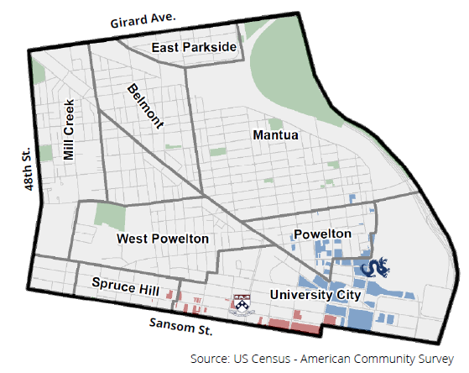
Introduction to WPPN
The West Philly Promise Neighborhood is a 5-year initiative funded by a U.S. Department of Education grant to support cradle to career opportunities for children living or going to school in the Promise Neighborhood footprint.

Slide 3
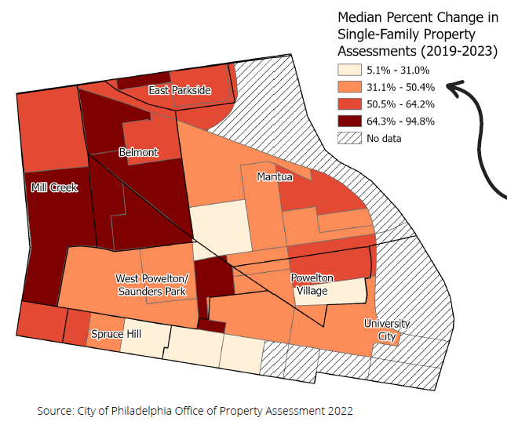
Change in Property Assessment in PN
The median property value in the PN rose 50.4% from 2019 to 2023 compared to 31.0% in Philadelphia.

Slide 4
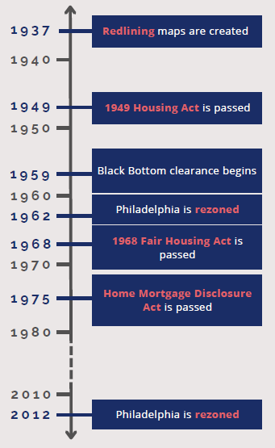
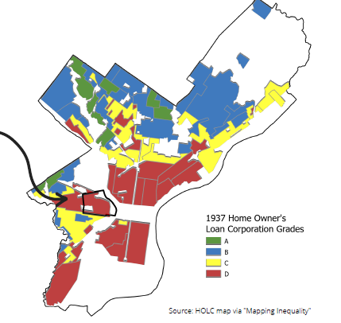
Institutional Housing Decisions

Slide 5
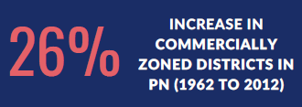
Historical Zoning in PN

Slide 6
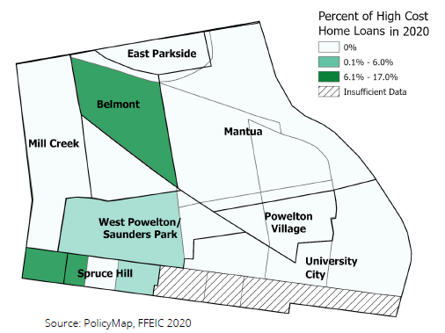
Home Loans

Slide 7
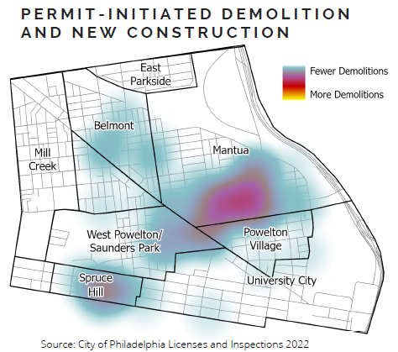
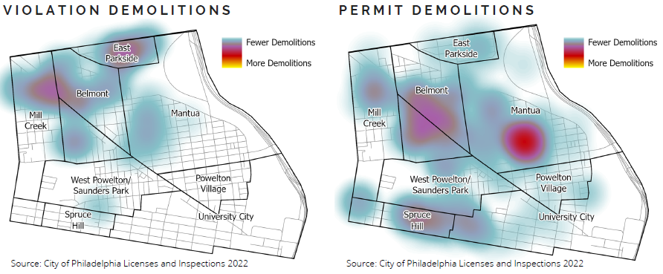
Demolitions and New Construction in PN

Slide 8
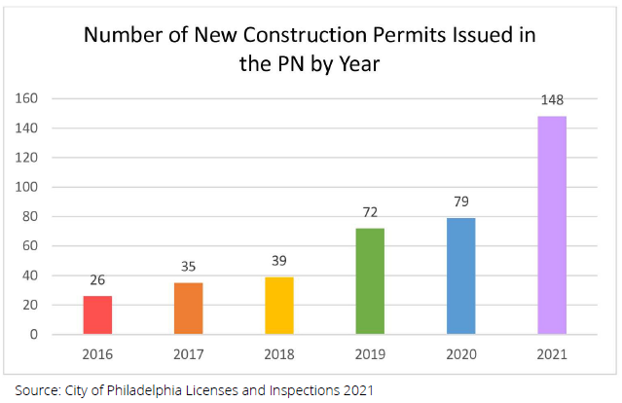
New Construction in PN

Slide 9
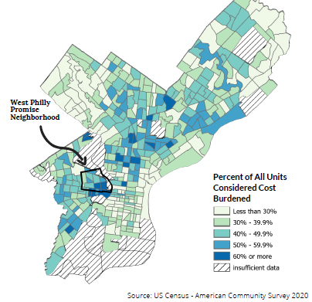
Housing Cost Burden

Slide 10
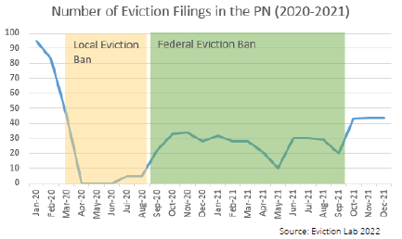
Evictions in PN

Slide 11
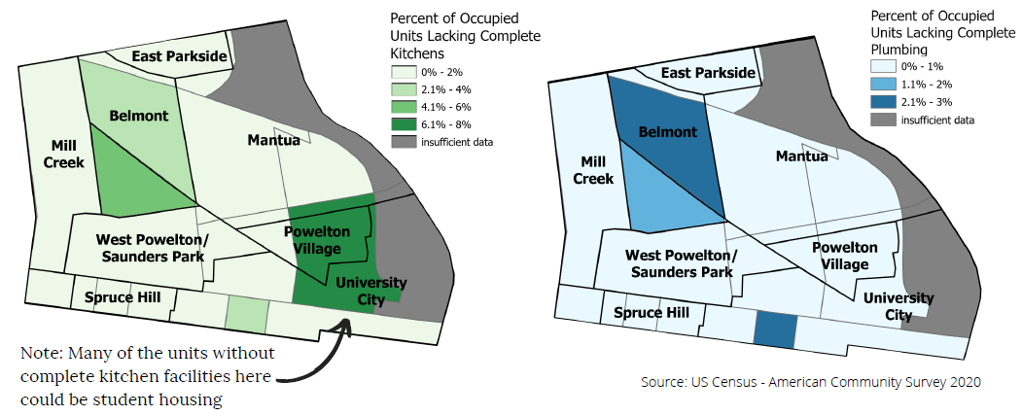
Housing Quality

Slide 12
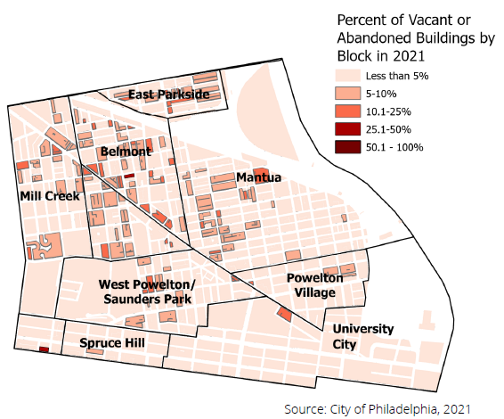
Vacant and Abandoned Buildings

Slide 13
Contact
WestPhillyPN.org
Contact: Tyler Munn; tjm429@drexel.edu
Project Contact: Erikka Gilliam; elg72@drexel.edu

