Slide 1
Using Linked Property Data for
Community Action
Kathy Pettit
Puerto Rico Housing and Data Workshop
November 7, 2018
Notes:
Thank you for inviting me – it’s great you all are pulling together to tackle a common need.

Slide 2

Urban Institute
Urban is dedicated to elevating the debate
on social and economic policy through
rigorous research and engagement.
We believe in the power of evidence to improve lives by
  Reducing hardship amongst the most vulnerable
  Expanding opportunities for all people
  Strengthening the effectiveness of the public sector
Notes:
A little about our perspective. Urban Institute is a nonprofit research organization dedicated to elevating the debate on social and economic policy through
rigorous research and engagement.
Motivations for getting our work into the public debate, particularly around improving conditions low-income households and communities

Slide 3
National Neighborhood
Indicators Partnership
Collaborative effort of Urban Institute and 30+ local data intermediaries since 1995
NNIP partners collect and organize neighborhood data to help local stakeholders improve their communities.
  Trusted and engaged institutions
  Most outside of government, but collaborate closely with city and county agencies
Notes:
Urban coordinates the National Neighborhood Indicators Partnership or NNIP. NNIP is a peer learning network of more than 30 local organizations, INCLUDING ALLISON’S ORGANIZATION IN NOLA WHO YOU’LL HEAR FROM IN A MINUTE.
The institutional model is not the focus of my presentation today, but just want to share the basics.
[walk through text]
Mission:
The point is to get the information used - whether for policymaking, community building, program planning.
Institutions:
The partners are housed in various types of institutions – mainly universities, independent nonprofits.
But whatever the home, they are all respected organizations with a long-term stake in their community. People believe the data and analysis that is published.
Mention govt briefs

Slide 4
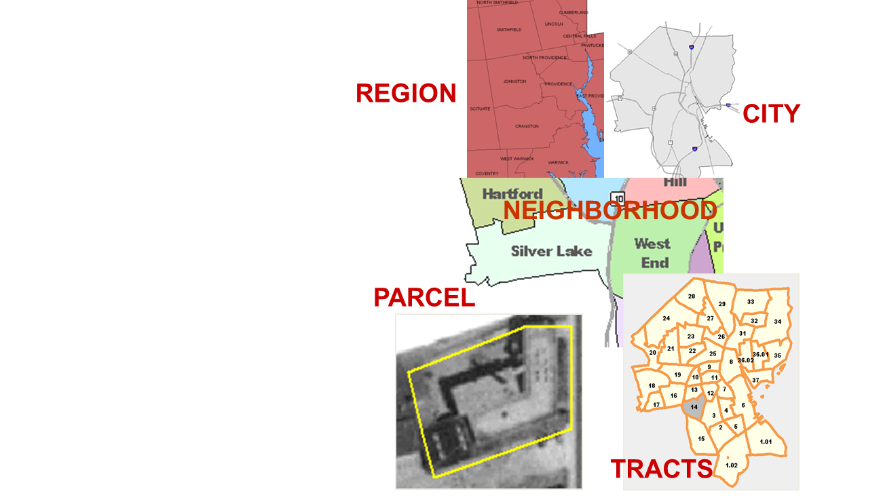
Relevant Data Across Topics and Time
Examples of Data
  Education
  Child care
  Births, deaths
  TANF, Food Stamps
  Health
  Crime
  Property sales, prices
  Foreclosures
Notes:
Data: at the core of the work…
Partners all agree to assemble and organize local government data that is
1) Ngh-level
2) On a range of issues (need to understand ngh issues and interventions holistically)
3) Over time (to understand trends and be responsive when issues arise)
They try to get as much data as possible at the parcel or address level to be able to roll-up the data to the relevant geography for different questions.

Slide 5
From Data to Action
Steps | Examples
1. Collect Data | Administrative Data Household/ Property Surveys
2. Enhance Data | Integrated Data Systems Neighborhood Indicators
3. Interpret Data | Analysis Local Knowledge
4. Share Data | Tools and portals Visualization
5. Build Capacity to Use Data | Training Technical Assistance
6. Engage with Data | Organizing and Advocacy Policy and Planning
7. Measure Impact | Interim Outcomes Community Change
Notes:
Having and publishing data isn’t enough. This tables shows how we think about to move from accessing data to better engagement and decisions.
You don’t need to absorb all of these steps, but we think it is important to unpack the stages.
Within all of our cities, our partner organizations are just one player in the ecosystems that contribute to the process of moving from data to action. Government agencies, funders, nonprofits, advocates, technology, and other research organizations all can play a part.
Thinking through the whole sequence helps jog ideas about what pieces are needed to achieve community goals, what capacities the different actors have, and what gaps need to be filled.

Slide 6
NNIP Principles
Build local, multipurpose institutional capacity for the long-term.
Use short-term projects to advance broader vision and relationships.
Bring talent from across silos to the table to understand and address issues together.
Be a voice for equity – ensure access for residents and groups in low-income areas.
Notes:
Those steps can be done to accomplish any goal, but in NNIP, our value system is the glue that binds us together.
Local capacity is the core of NNIP – investing in the local organizations ability to collect and use data has dividends beyond any one project. We think its key to have trusted and engaged institutions as the messenger and helper.
2. Most of our partners funding (70%) comes from projects, but they weave the work together to fulfill their larger mission.
3. NNIP partners are often working on long-term problems that need all perspectives to figure out solutions. These types of coalitions function differently when they are all working from a common set of information.
4. Finally, we focus on leveling the playing field – making sure that groups that have not traditionally had the data or skills to use it have access and illuminating disparities that exist in ngh conditions within a city.

Slide 7
Examples from the field
Notes:
What does this look like on the ground?
All three of these examples illustrate how a common set of high-quality, linked data about properties help public and private stakeholders make better individual and collective decisions.
I decided to share 3 in less depth so show you some diversity, but am happy to follow up after for more questions.

Slide 8

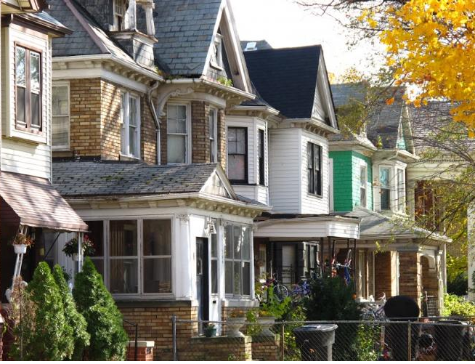
Detroit
Notes:
Acknowledge partner

Slide 9

Detroit Blight Removal Task Force
Goal: to develop a straightforward and detailed implementation plan to remove every 'blighted' residential structure, commercial structure and public building, and clear every blighted vacant lot in the city of Detroit
Notes:
In 2013, the Task Force brought private, philanthropic, nonprofit, federal, and state partners together with the city, to develop a straightforward and detailed set of recommendations.
Ambitious goal to remove every 'blighted' residential structure, commercial structure and public building, and clear every blighted vacant lot in the city of Detroit
Led by Dan Gilbert (private sector), Linda Smith (Non-Profit Housing Corporation), Glenda Price (Detroit Public Schools Foundation)

Slide 10
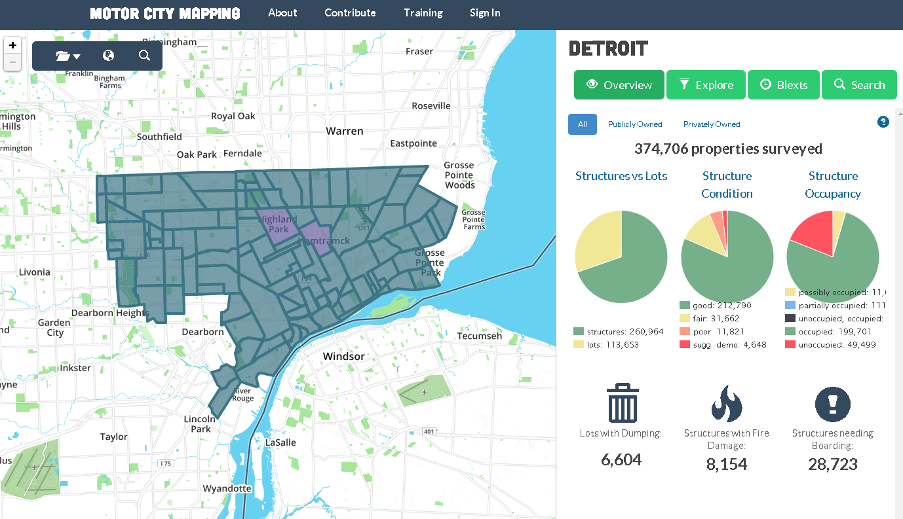
Motor City Mapping
Notes:
The Task Force realized that they did not have the information they needed to come up with a sound plan.
In November 2013, the Blight Removal Task Force, in partnership with Michigan Nonprofit Association, Data Driven Detroit, and Loveland Technologies, began a physical survey to gather property condition data for all 380,000 parcels in the city.
Goal to create a comprehensive database of detailed information including the condition of each and every property in Detroit.
Over 10 weeks, about 150 resident surveyors and volunteer drivers documented residential & commercial property conditions.
photos, checklist on housing/lot conditions (occupancy, lot vacancy, fire damage, dumping and property use etc.
Data was uploaded via a live-stream feed to ‘mission control’, where associates performed a quality control check on all data
Findings: 84,000 + structures and vacant lots in need of intervention:
D3 then linked the primary-collected data with almost 20 other data sets, like Properties with No Gas/Electric Service, fire incidents, crime, land bank inventory
OTHER:
40,000 blighted structures are recommended for immediate removal
38,000 structures have “Blight Indicators” and need further evaluation.
6,000 vacant lots showed evidence of dumping and need immediate attention
Valassis Vacancy Data
Tax Distress, Foreclosures
Property Transactions
Building Permits
Business Licenses
“Improve Detroit” Calls
Assessment Data
Blight Violations
***
Survey Key
Is there a structure on the site?
Is the structure occupied?
What is this site used for?
How many residential units?
What type of residences?
What type of commercial occupant(s)? industrial? Institutional?
What is the condition of the structure?
Is the structure fire damaged?
What is the level of fire damage?
Is the building secure or open to trespass?
What is the site used for?
Is the lot maintained?
Is there dumping on the site?

Slide 11
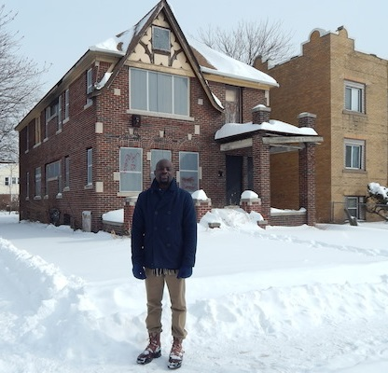
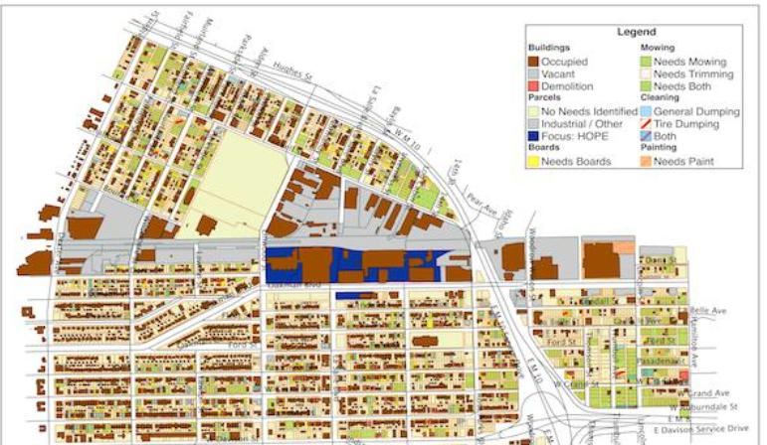
HOPE Village Neighborhood Action
Notes:
MCM was used by the city and other institutional actors to decide on priorities and investments, but because the data portal was public, resident groups could also use it.
The HOPE Village Initiative covered about 100 blocks – they hosted a three-day anti-blight event and used MCM data to plan out where volunteers would board up houses, clean up vacant lots and begin beautification efforts as part of "a transformative plan for the neighborhood”

Slide 12
Today: Metro Detroit Data Alliance
Vision for a central data repository with contributors from public and nonprofit sectors
Leverages lessons from Motor City Mapping
API that would handle aggregation at various levels of geography for advanced users
Mapping and interfaces for non-technical audiences
Notes:
This is also a bit of a cautionary tale. Over time, the context changed as the city built its own data capacity and funder interests shifted, and in the end, MCM was archived in 2017. Some of the original data is being published by D3’s, the city, and private firms, but not all and not linked together.
More recently, Data Driven Detroit has envisioned a Metro Detroit Data Alliance. With a coalition of partners, including Microsoft, the Downtown Detroit Partnership, the University of Michigan, the City of Detroit Department of Innovation and Technology, the Detroit Riverfront Conservancy, and the Detroit Economic Growth Corporation (among others)
They are thinking about how this could be accomplished and sustained using the regular workflow of different contributors.

Slide 13
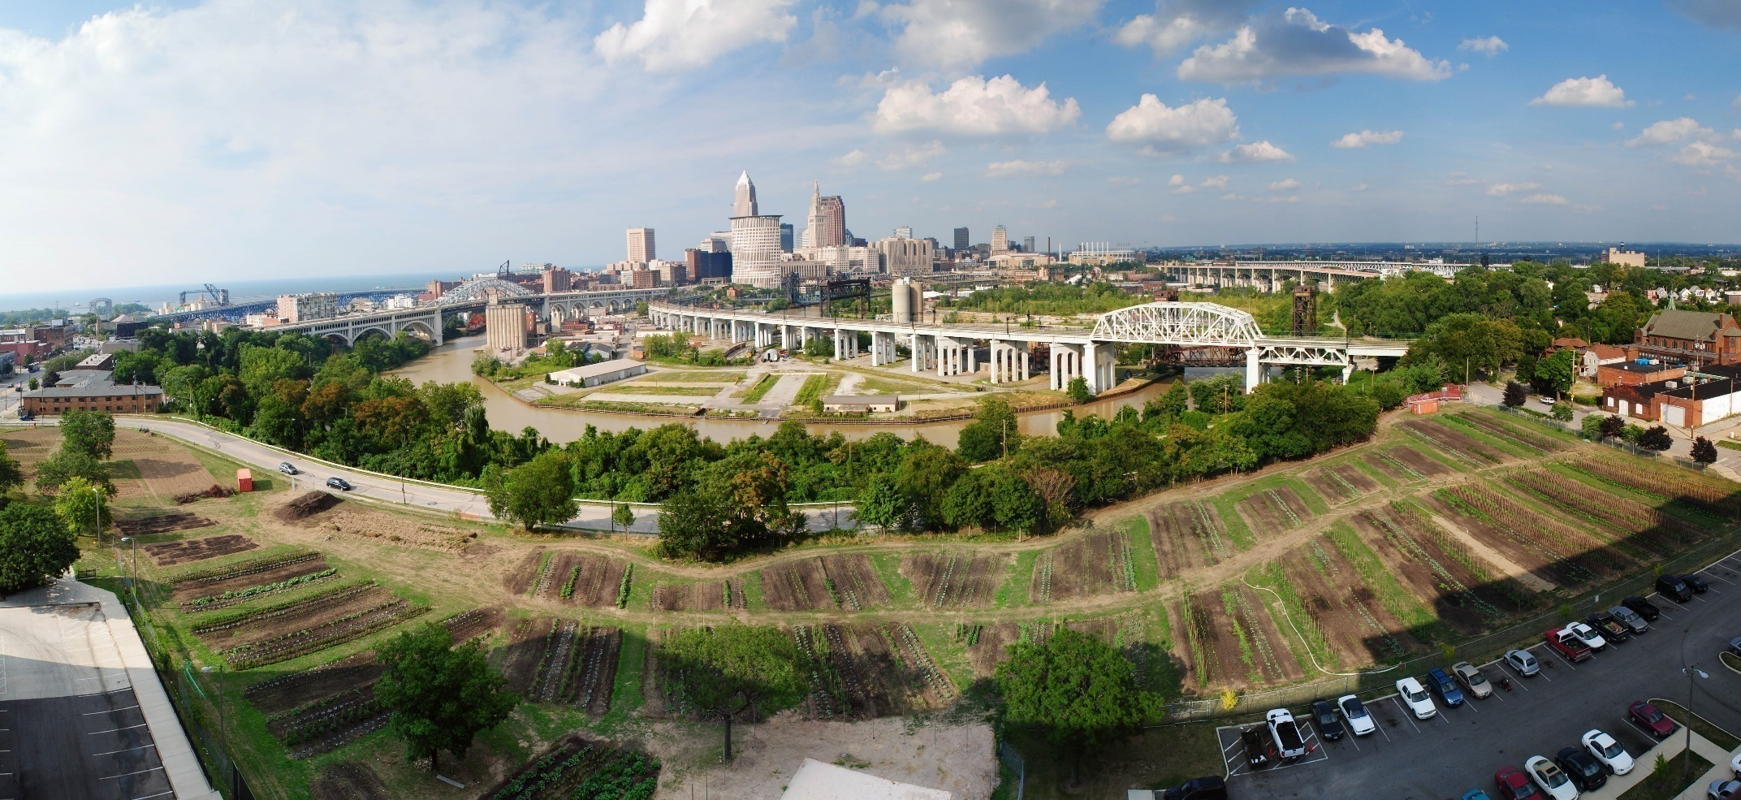
Cleveland
Notes:
acknowledge partner.

Slide 14
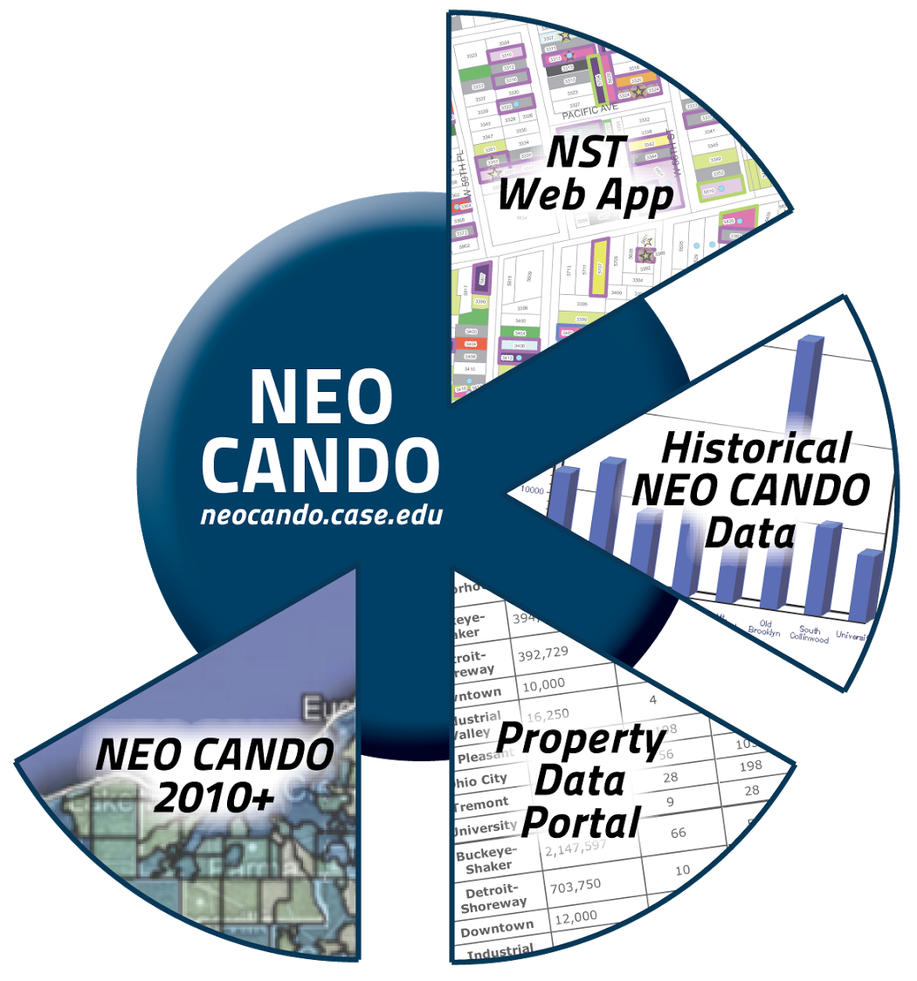
Neighborhood Strategy Technology App
NEO CANDO data system and cross-sector action coalitions in place
Need for neighborhood stabilization efforts
NST Web App launched in 2010
Notes:
Case Western our original partner – they have been collecting and linking data on properties for 20 years. NEOCANDO was their first application – tract-level indicators.
and had solid relationships in place with the city and nonprofits working on ngh development, including through responding to the foreclosure crisis.
As the city came out of the recession, they realized the need for a shared property level system, and the Ngh Strategy Technology portal was launched.
So they have a common data store that feeds different applications for different audiences.

Slide 15
Neighborhood Strategy Technology App
Data system of parcel-level data for all parcels in Cuyahoga County, OH
Users can map, search, filter, sort, and download data.
Users can add their own data
Notes:
The Neighborhood Strategy Technology Web Application (NST) enables a diverse group of government and community agencies to collaborate in improving the communities of Cleveland and Cuyahoga County. Users can access, filter, and map data, as well as save custom queries and download spreadsheets of data.
Operational tool – users can add their own data.

Slide 16
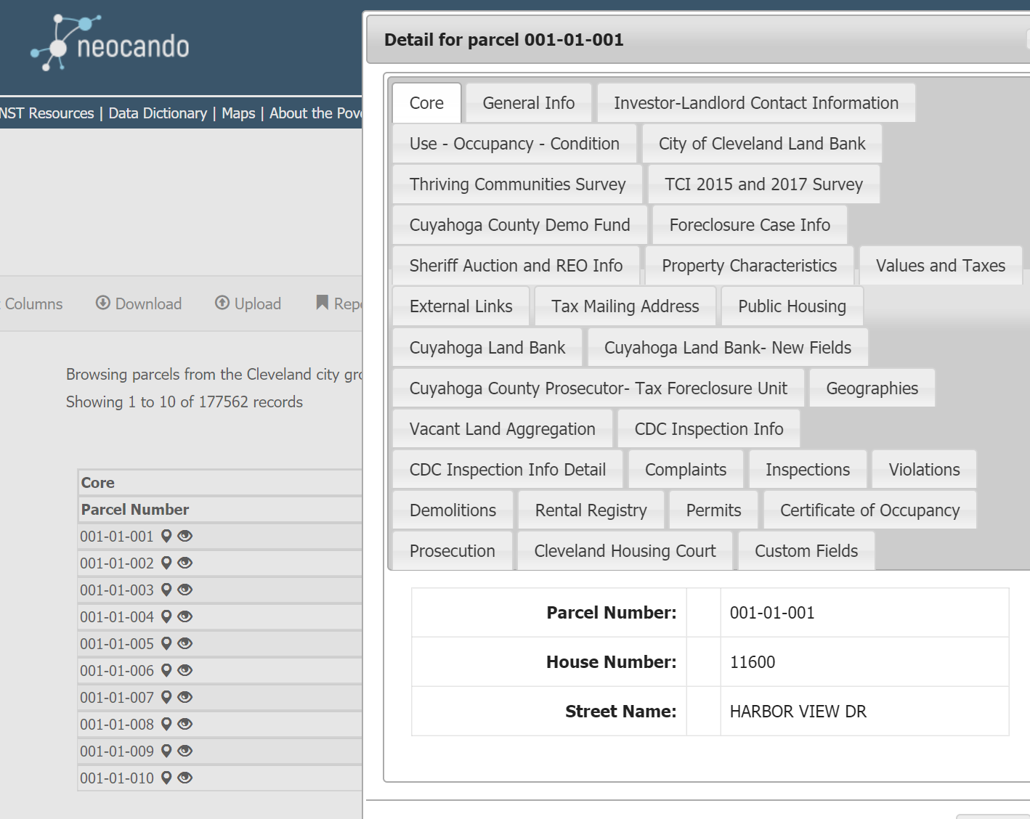
Neighborhood Strategy Technology App
Notes:
Much of the data is updated weekly.
Sources and frequency are driven by the use-cases
CDCs – can pull up properties in their service area, identify the ones held by the land bank, immediately access the property characteristics of these properties, see the status of the other properties on the street, and determine whether a particular property is one their organization wants to invest in. Also upload their own collected data.
Community organizers within the CDC can also generate lists of homeowners having financial difficulty with their mortgage or taxes and reach out to them through a door-knocking effort
The city’s code enforcement agencies and the land bank also use the system, ensuring everyone is working off the same information and avoiding the need to duplicate effort.
OTHER: Quickly access information on property ownership, occupancy and vacancy, foreclosure, sheriff’s sale, and REO history, detailed tax information, code enforcement information, demolition information, property surveys conducted by area agencies, and more. In addition to linking and making data available, NST also serves as a communication platform and place for agencies to house their own data.

Slide 17

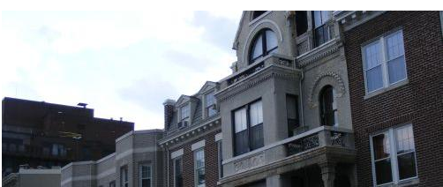
Washington, DC
Notes:
Note we are the partner for the Washington area

Slide 18
DC Preservation Network
Develop responses and strategies to preserve affordable housing for residents with low income
Participants:
  Co-convened by Urban-Greater DC and the Coalition for Nonprofit Housing and Economic Development
  City housing agencies
  U.S. Department of Housing and Urban Development
  Nonprofit and private housing developers
  Tenant organizers and legal services providers
Notes:
The Problem:
Most subsidized housing is privately owned; government provides incentives
Owners can choose to stop receiving incentives (under certain circumstances)
Advocates and government agencies can often intervene – spending time and money to preserve these buildings
There’s not enough resources to save every building, so they need to know how to prioritize preservation efforts.
Preservation network is a Coalition of organizations commitment to action and advocacy to achieve this shared goal
Meets monthly to review those properties up to a year out that may be at risk of losing affordability – review upcoming properties – try to get ahead of the curve

Slide 19
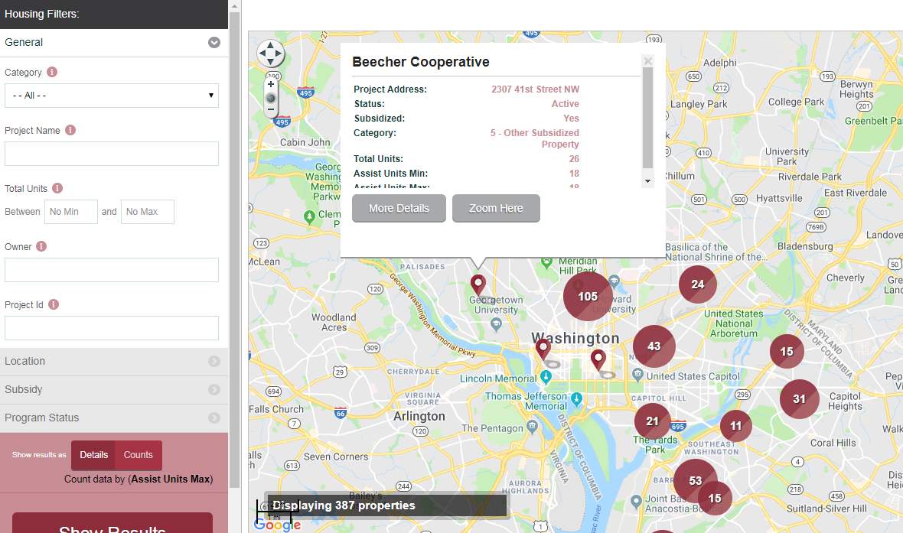
Monitor at-risk projects by compiling, linking and sharing relevant data
Notes:
Monitor projects that are at risk of losing their affordable status and work to preserve affordability
The Network maintains a database of approximately 35,000 assisted affordable rental units through one or more federal or local housing subsidy programs and meets monthly to review those properties that may be at risk of losing affordability.
Dozens of overlapping programs (Section 8, tax credit, DC gov, etc.), data aren’t centralized
Includes Informal knowledge of technical assistance providers
***
Data fields: property name, location, owner, manager, and physical condition.
various subsidies that contribute to a property's affordability, including each subsidy's effective expiration dates, the number of income-restricted units, the income level at which the property is affordable

Slide 20
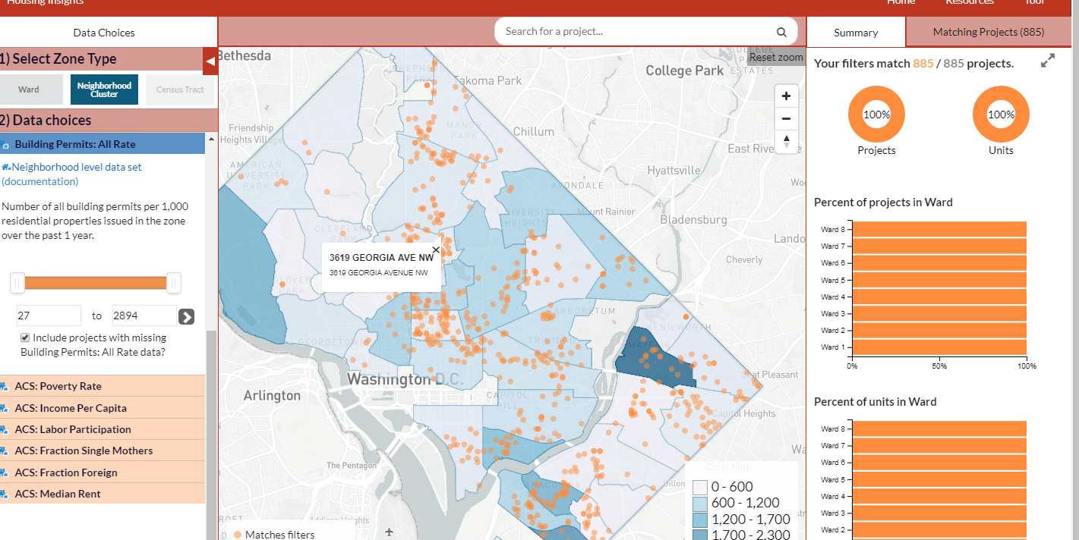

Informed decisions require property data and neighborhood context
Notes:
The DC Preservation Network – had been meeting monthly and discussing high-risk properties for more than a decade but recognized that more strategic decisionmaking was needed.
They developed a set of preservation goals and priorities to help direct efforts and limited resources. To help operationalize the strategy- developed a new website – HousingInsights.org to bring together data from the preservation catalog with information about neighborhoods and city investments.
Neighborhood info is relevant – demographics, transit locations, nearby economic development, other affordable options in the neighborhood.
City-wide analysis can reveal tradeoffs not apparent at building level.
In addition to preserving the affordability on individual properties, The DC Preservation Network’s strategic thinking and actions have raised the profile of the issue locally and spurred the City to develop a preservation fund and a dedicated preservation officer to help coordinate efforts across agencies.

Slide 21
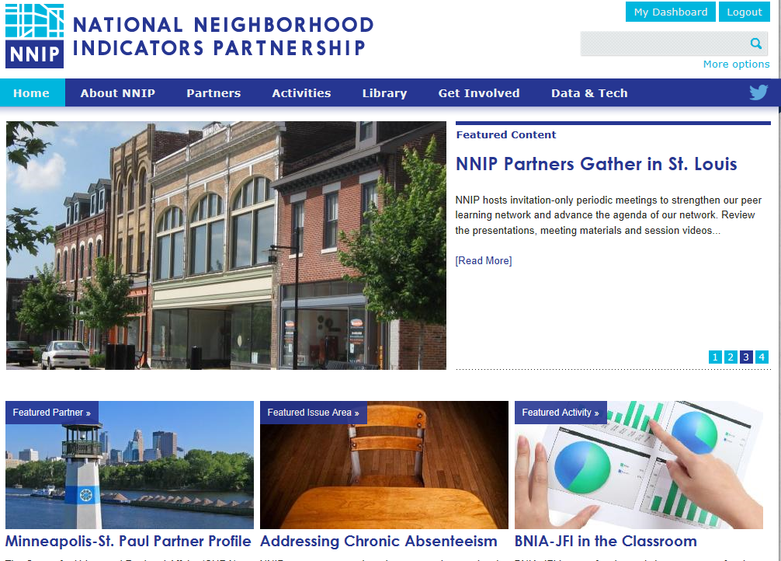
www.neighborhoodindicators.org

Slide 22
Follow us on Twitter @NNIPHQ or on NNIPNews Google Group
For more information about NNIP, visit www.neighborhoodindicators.org or
email Kathy Pettit at kpettit@urban.org

