Slide 1
Using Data for Community Action
Kathy Pettit
Delivering Outcomes for Community Training
May 11, 2016
Notes:
Introduce myself – thank you for inviting me.

Slide 2
Urban Institute
Urban is dedicated to elevating the debate
on social and economic policy through
rigorous research and engagement.
We believe in the power of evidence to improve lives by
Reducing hardship amongst the most vulnerable
Expanding opportunities for all people
Strengthening the effectiveness of the public sector
Notes:
Urban Institute is a nonprofit policy research organization. Today, we do a broad array of original research for governments and foundations.
Motivation for all of our work is to share insights for better public policy, particularly around helping low-income households and communities.
10 centers – health, justice, tax policy, etc.

Slide 3
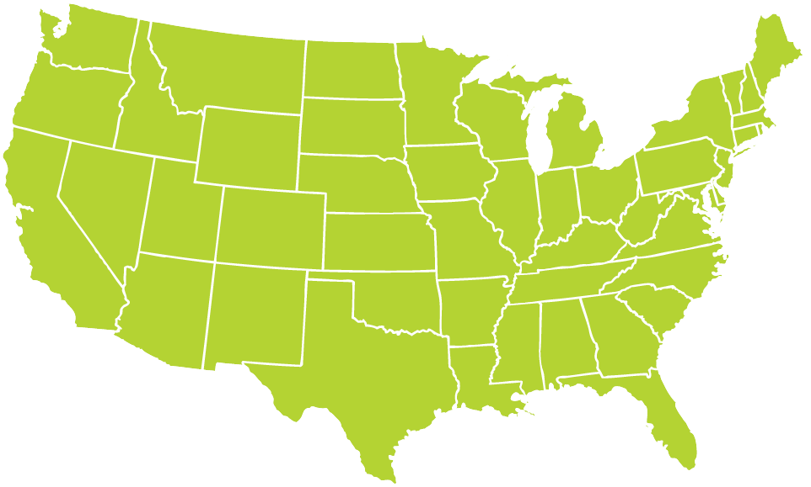
National Neighborhood Indicators Partnership
Better Data. Better Decisions. Better Communities.
Notes:
At the Urban Institute we coordinate the National Neighborhood Indicators Partnership (NNIP), which is a peer-learning network of independent local data organizations in 30 cities. NNIP partners collect and organize neighborhood data and help local actors use them to improve communities through policy, planning, and advocacy. At Urban, we also help new cities get started.
My talk today is based on the 20 years of experiences of our partners, but I won’t cover much about the NNIP model itself. I’m happy to answer questions about the network after the session.

Slide 4
Advice from NNIP Experience
Notes:
Start with some general observations and assumptions ….

Slide 5
Key Principles
Build local, multipurpose institutional capacity for the long-term.
Use short-term projects to advance long-term vision and relationships.
Bring talent from across organizational sectors and issue silos to the table to understand and address issues together.
Be a voice for equity and empowering low-income neighborhoods.
Notes:
Our principles have stood the test of time and guide our outlook.
Local capacity is the core of NNIP – investing in the local organizations ability to collect and use data has dividends beyond any one project. We think its key to have trusted and engaged institutions as the messenger and helper.
2. Most of our partners funding (70%) comes from projects, but they weave the work together to fulfill their larger mission.
3. NNIP partners have used data to bridge sectors from the very beginning. We are generally working on long-term problems that need all perspectives to figure out solutions. More recently, we had a cross-site project on “NNIP and open data” which expanded our horizons to explicitly include civic tech groups.
4. Finally, we focus on leveling the playing field – making sure that groups that have not traditionally had the data or skills to use it have access and illuminating disparities that exist in ngh conditions within a city.

Slide 6
Coaching Local Actors to Innovate
Suggest a structure for brainstorming together.
Help them problem-solve and think about how to surmount hurdles.
Inspire collaboration through examples that may resonate with local circumstances.
Notes:
We are coaches to our local partners – just as you can coach your local grantees.
We act as a sounding board. We question their assumptions and share how things have worked in other cities. Just knowing that things are different in other places can open up possibilities. Even the most sophisticated partner wants to be more effective & keep learning.
There is a tricky balance between showing them the most-sophisticated, developed partnership and project to inspire them with more advanced examples, or sharing something smaller-scale so it seems feasible given their circumstances.

Slide 7
What kind of help do your grantees need?
Steps | Examples
1. Collect Raw Data | Administrative Data Open Data Household/ Property Survey
2. Enhance Data | Integrated Data Systems Neighborhood Indicators
3. Interpret Data | Analysis Local Knowledge
4. Communicate Data | Visualization Storytelling
5. Build Capacity to Use Data | Training Technical Assistance
6. Engage with Data | Organizing and Advocacy Policy and Planning
7. Measure Impact | Interim Outcomes Community Change
Notes:
Just a blanket statement about the lack of data and tech is not enough – what exactly are you going to do with the data and tech and what goals are you trying to achieve?
Not going to go through all of these today (mention handout), but these are the steps to go from raw data to getting them used in decisionmaking. From the inputs of high-quality data to using the data, and circling back to measuring impact.
You may see the steps differently, but it’s just to jog ideas about what pieces are needed to achieve your goals, what capacities your grantees have in-house and what gaps need to be filled.

Slide 8
Environmental Scan
Local governments
Civic tech and data networks
National networks and programs focused on local governments
Higher education/ and anchor institutions
Local and community foundations
Code academies, incubators
Notes:
Once you know what you are looking for, you can tailor your environmental scan to find potential partners and identify assets in the community.
Note handout about the institutional players.
Identification is the first step that you will try today. On the ground, even if the institutions are present, there still may be barriers to short-term collaboration – politics, funding, capacity, mission-conflicts. But things change over time and mapping out the potential players and being aware of their activities is useful in any case.
And while you may go through the exercise today starting from scratch, your local grantees will have information about some of these types of contacts.

Slide 9
Civic Tech and Data Collaborative Cross-site Project
Data and tech can be used to their full potential when an ecosystem of players pool their talents intentionally over time to address pressing local issues.
Three local pilots and four learning sites
Notes:
One of Urban’s roles is to lead cross-site projects. This one is particularly relevant for our topic today.
Partnership among NNIP, LC, CfA, supported by the John D. and Catherine T. MacArthur
We came together at the national level because we saw capacities that weren’t being connected in our cities.
We have 7 cities working with us at different levels.

Slide 10
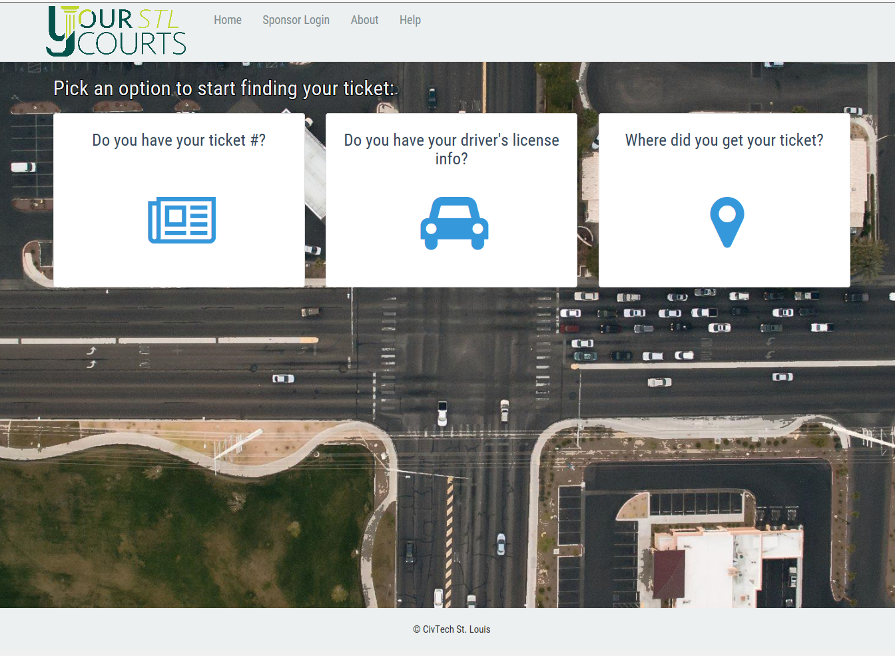
CivTech St. Louis http://www.civtechstl.com/
Notes:
In St. Louis, one of the pilot sites, a coalition of organizations are working on ways to improve the users’ experience with the court systems. Their current project is a system (prototype shown here) to allow citizens to find their ticket information, alternative ways to resolve their case, and payment options. Happy to share more information offline.

Slide 11
Using Data and Tech to Support Youth in Boston
Notes:
We asked several sites to apply and suggest a community issue that the NNIP organization, the code for America brigade, and the local govt could work on together.
I’ll go through our second pilot site in Boston in more detail.
Give credit to Shari Davis, Executive Director of Youth Engagement and Employment and staff at Metropolitan Area Planning Agency for help with the slides.

Slide 12
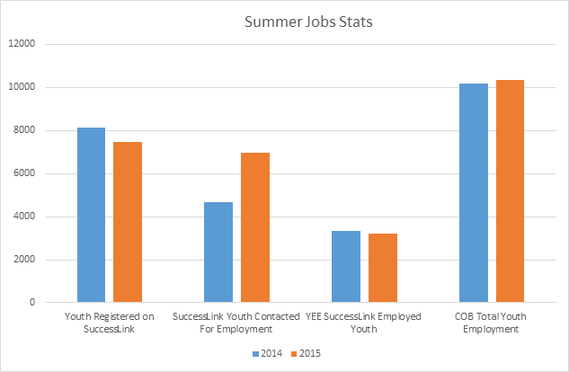
About 3,200 youth placed in 2015;
Mayor’s goal to place 10,000 youth
Notes:
In 2015, the city of Boston’s summer youth employment system placed about 3200 youth out of 8000 that applied.
They know more youth need access to jobs to get experience and help them on their career ladder. Boston Mayor Marty Walsh set a city-wide goal to increase the number of youth job applicants to 10,000 annually, and also seeks to increase the success rate of youth job placement.

Slide 13
Operational challenges prevent spending more time on programs
Antiquated application process creates barriers for many youth.
Manual process for matching youth to jobs and notifying youth by phone takes weeks of staff time.
Notes:
Currently, the technology and processes for registration, communication and job placement doesn’t meet the needs of the youth, or the needs of city program managers.
Application process: These involve varying degrees of manual processes, browser-based form applications and in-person outreach.
After applications are submitted, the matching process is entirely manual and based on city staffers’ knowledge of Boston geography and the available jobs, and each of the 8000 youth with potential matches were notified by individual phone calls.

Slide 14
Boston Team: NNIP Partners, City Agencies, Civic Tech and Private Sector
Notes:
So an amazing set of organizations came together to tackle this problem.
NNIP partner
Metropolitan Area Planning Council
Manages the project and leads the collaborative development of the new systems.
Boston Foundation’s Boston Indicators Project
Review uses of the youth employment program data and advise on how analysis can strengthen the program.
City Agencies
Dept. of Youth Engagement & Employment
Provides information about the processes and requirements and connections to youth.
Dept .of Innovation and Technology
Helps with technology choices, following the city’s policies
Civic Tech and Private Sector
Code for Boston
Assist in coding the application interfaces, working with MAPC developer
BNY Mellon
Private sector bank provides match funding

Slide 15
Project Goals
Reduce staff time spent on manual processes.
Improve youths’ quality of experience in the jobs program.
Provide better job matches by systematically balancing different factors.
Increase the number of applicants receiving paid jobs through existing programs.
Notes:
Together the team set common goals.
Developing technology that automates assignment and the job placement notification system could free up thousands of hours of staff time. The staff could spend on much-needed outreach and program promotion. A revamped system will also make it easier for youth to apply and get matched in ways that systematically balances different factors.
The team believes these first 3 changes will lead to further program growth and overall increase in youth employment.

Slide 16
The Quest for Summer Employment!
March:
Wait
July:
Work Begins
May:
More Docs
February:
Apply
September:
Back to School
April:
Submit Docs
May:
Matching
June:
Pick a Program
August:
Work Ends
“Does it really take all of this for a CHANCE at a summer job?”
- Yves , Age 15.
Notes:
Here’s the timeline for the program, which runs from Feb – Sept, including the waiting time for youth and emplouers, so the team is working under tight constraints.

Slide 17
DESIGN WITH
mentorship
Youth learn research & design skills
practice
Youth apply learned skills
co-design
Youth design the service they use
Notes:
The team also agreed from the start to involve youth in all parts of the project.
Building skills of the specific youth involved in this project fulfills the core mission of the city dept PLUS their perspective will result in products that serve all youth better.

Slide 18
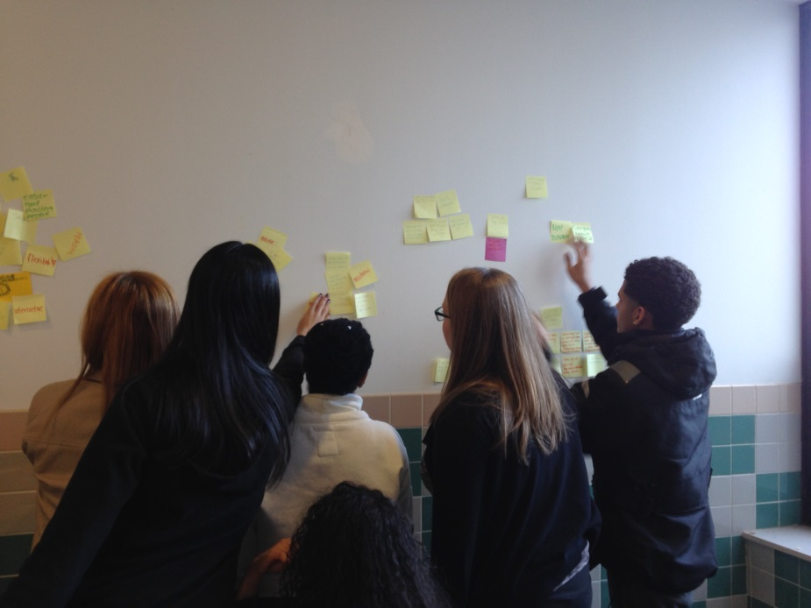
Step 1: Improve matching program
MIT expert helped adapt school lottery algorithm for matching youth to jobs.
Youth met weekly to discuss match inputs and design the user experience.
Team will quantify savings in operations and match quality.
Notes:
The first challenge the team took on is automating the process for matching youth to summer jobs.
Twelve youth have met weekly to design the user experience for the initial prototype based on a “user centered design process”. Youth made decisions that impacted the several inputs into the data model, most significantly the youth interest score.
Matched applicants will be notified through a new email notification system (also designed with the input of youth workers) with a one-click response option.
Team plans to quantify savings in operations and match quality using a comparison group.
The first batch was matched just this week, and they’ll be examining results and refining the process for the next month.
Background: The matching algorithm at the heart of this applications seeks to balance a variety of factors, including applicant interest, transit pass availability, commute time, and geographic equity of opportunity.
Youth have been hired through the city’s Youth Jobs program

Slide 19
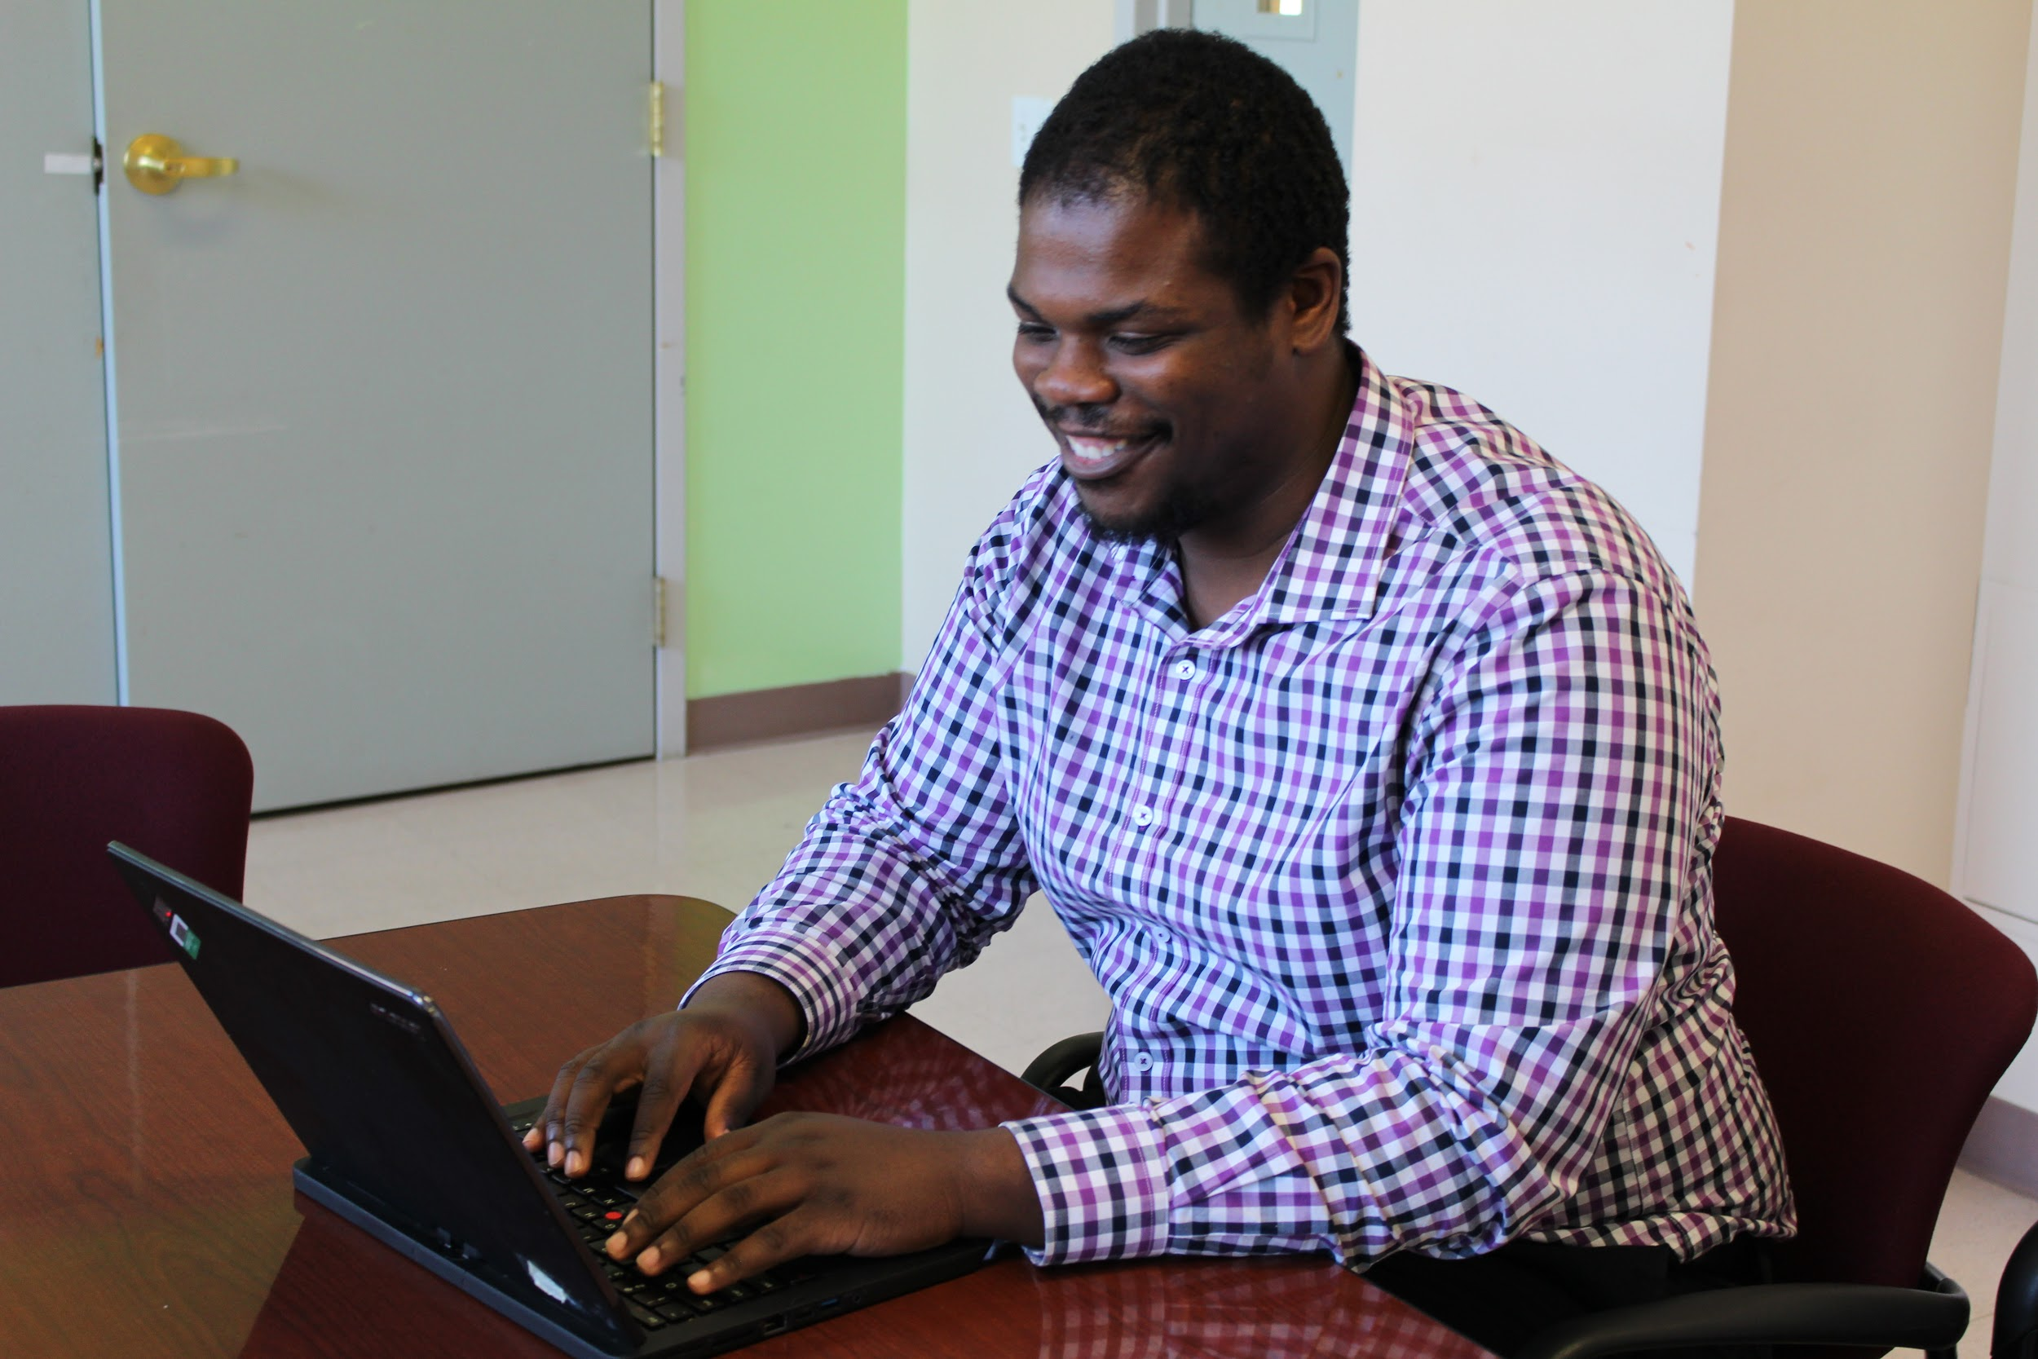
Step 2: Improve application interface
Create youth-centered design.
Make mobile friendly.
Create API for data to flow into matching process.
Notes:
Step 2 of the project is to tackle the application process before the 2017 application season starts.
They already did some assessments of the youth and the administrators needs by watching and documenting the 2016 application process.
The new system will incorporate the youth perspective and be designed for mobile use. The plan also includes thinking about storing the application and job data in a way that’s more accessible for city staff.

Slide 20
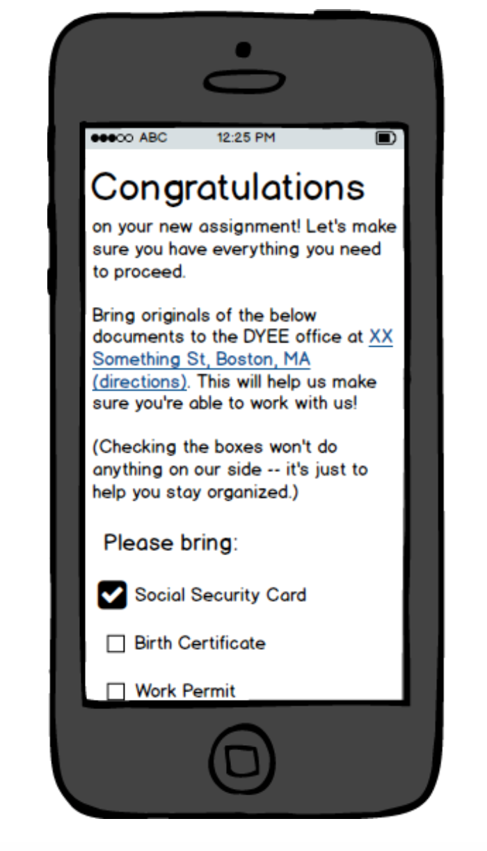
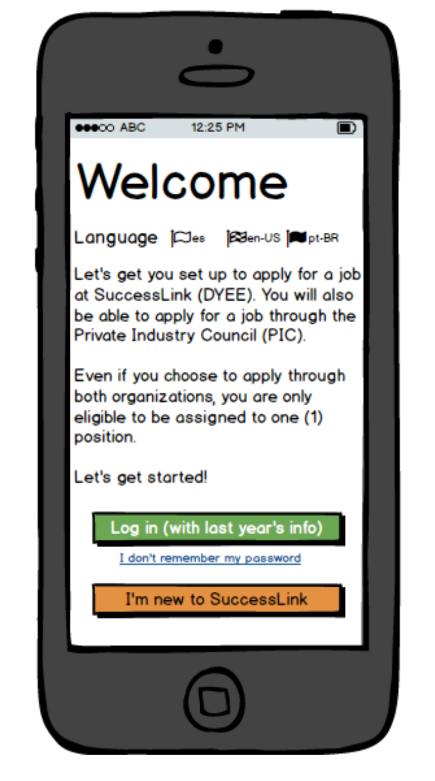
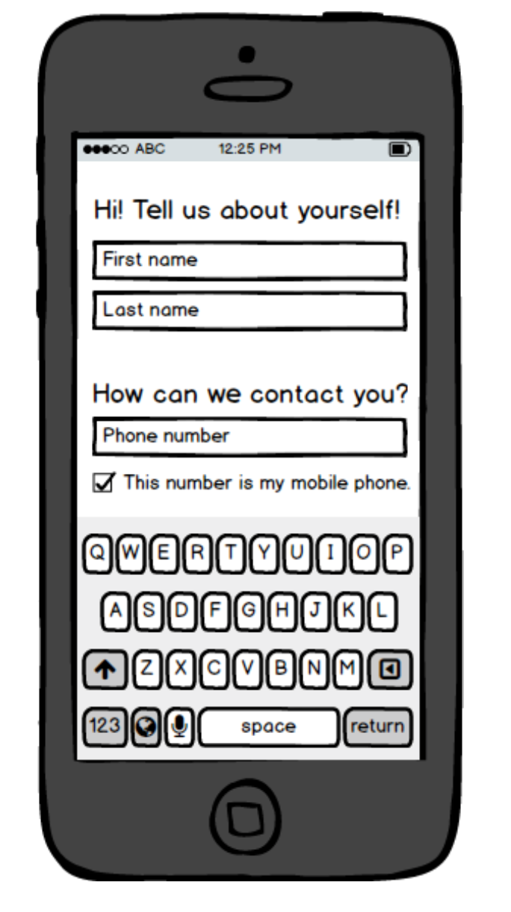
EARLY CONCEPT
Notes:
Here’s an early concept of the new application
Background: The work will start in earnest after the matching is completed for 2016. The application needs to be developed and testing to be ready for the 2017 application season starting next Feb.

Slide 21
Long-term aspirations
Share matching and application technology with other cities in Boston area and elsewhere.
Streamline processes among three siloed youth employment programs in Boston.
Evaluate program by linking to youth outcomes in K-12, higher education, and employment.
Notes:
The short term benefits are obvious, but the team hopes it leads to farther-reaching developments
- share technology and methods with other cities
- work with Bostons’ 2 nonprofit summer youth jobs programs to see if there’s ways to coordinator
- Take advantage of more easily stored data to link to outcomes in secondary schools, college and jobs to understand the benefits of the program.

Slide 22
Lessons so far
Be flexible and patient. The team needed to adjust initial plans for staffing and for timing.
Think about realistic roles for each actor.
Leverage diverse groups at the table to help overcome stumbling blocks.
Think early about what will happen to work after initial project has ended.
Extra time for collaboration is worthwhile!
Notes:
This is still a story in progress, but we have early lessons for anyone trying to do civic data and tech collaboration
1. There was unexpected delays in starting the grant and staff turnover – the team had to readjust its timing to do the match process first.
Realistic roles - how much can volunteers take on, need to build in the relationship-building time into on-staff technologists’ job positions. How to be respectful of the city staff who are trying to run the operation.
Leverage skills – The brigade members and city dept of innovation helped with figuring out a reasonable answer to the tech development and with recruiting.
Thinking already about how this will be housed/maintained after the project is done since this is running such an impt core govt programs.. In some cases this is less impt if the primary goal of working together is more about community-or skill-building.
It is all hard work, but with a lot of payoff for this and other projects these groups can address together in the future.

Slide 23
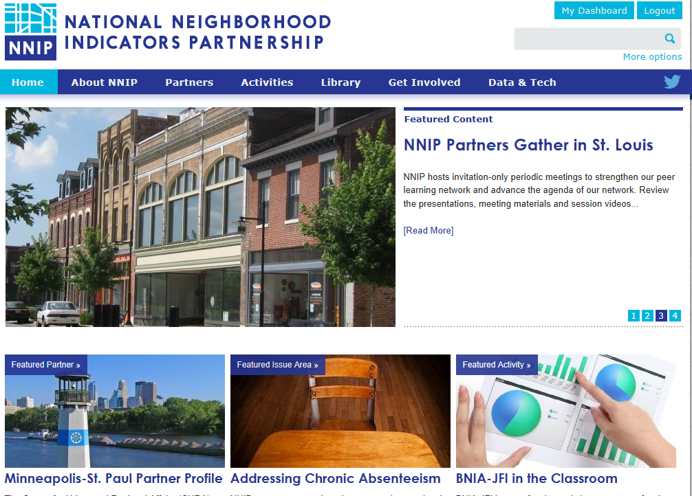
www.neighborhoodindicators.org
Notes:
Mention listserve and Twitter
Mention handout

Slide 24
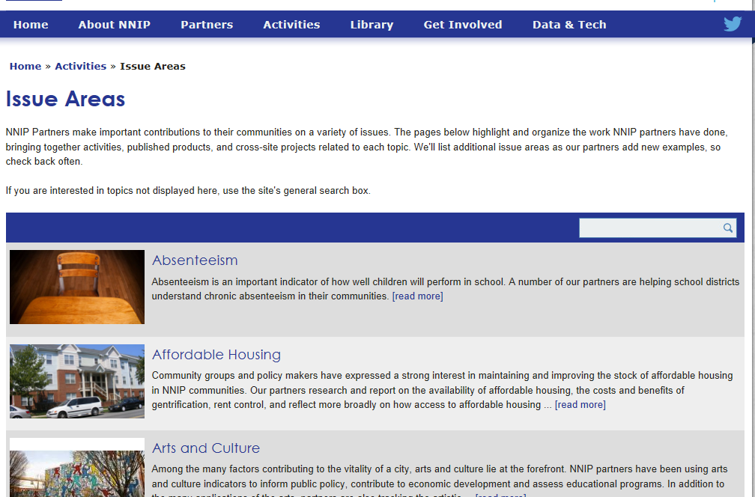

Slide 25
Follow us on Twitter @NNIPHQ or on NNIPNews Google Group
For more information about NNIP, visit www.neighborhoodindicators.org or
email Kathy Pettit at kpettit@urban.org

Slide 26
Resources
Notes:
A few comments just accessing the data
Raw data can come from government, academic, nonprofit, community. Often too much focus on the first step, having the data in hand is not enough.

Slide 27
Get started with national data and tools
National data and mapping websites
PolicyMap
Community Commons
Diversity Data
Tackle the data yourself or with your local data/research partners
Small-Area Data List includes housing, employment, environment, etc.
Notes:
We are going to spend most of the day on local data, but I want to flag that there’s a number of national mapping websites, data and tools that can be accessed to get started.

Slide 28
Advancing to local data
NNIP Lessons on Local Data Sharing
Advice for negotiating data agreements
Catalog of Administrative Data Sources for Neighborhood Indicators (Claudia Coulton)
List of available local data and sample indicators
PZ Core indicators and data sources inventory
Summary of current NNIP data holdings
Notes:
The core of NNIP is local neighborhood data, and Spike and I have a lot of experience in how to access and use it – here’s 2 of the resources we have.
Local data – usually more-fine-grained geography, more recent, more topics.

Slide 29
Resources on Data-Related Events
Guide to CityCamp
List of Data Days
Presentation on Austin Community Summit (notes included)

