Slide 1
Federally Qualified Opportunity Zones: an Opportunity for Natural Experiments on Place-based Programming and Neighborhood Change
Jana A. Hirsch, Yuzhe Zhao, Usama Bilal, Kathryn M. Neckerman, Yvonne L. Michael

Slide 2
Background: Tax Cuts and Jobs Act
December 22, 2017
Qualified Opportunity Zones (QOZ)
Census tract boundaries
Since passage: 8700+ QOZ
12% of U.S. tracts
All 50 states, DC, and five US possessions
Provides a tax benefit to investors who invest eligible capital into QOZ

Slide 3
QOZ Eligibility:
Eligible Tracts
Adjacent Eligible Tracts
Low Income:
Poverty rate of at least 20%
Median family income no greater than 80% of the state median for nonmetropolitan tracts or the state or metropolitan-area median (whichever is higher) for metropolitan tracts
Adjacent to qualifying low-income tracts if median family income did not exceed 125% of the median family income of the adjacent qualifying tract
Uses ACS 2011-2015 data

Slide 4
Law uses three mechanisms to incentivize investment within QOZ*:
1. Temporary deferral of taxes on previously earned capital gains that are invested in a QOZ
2. Reduction in taxes on previously earned capital gains, if assets in the QOZ are held long enough
3. Permanent exclusion of taxes on any new capital gains earned on assets in the QOZ.
*Incentive only applies to those with previously earned capital gains who put these into Qualified Opportunity Funds (QOF) to spend within QOZ

Slide 5
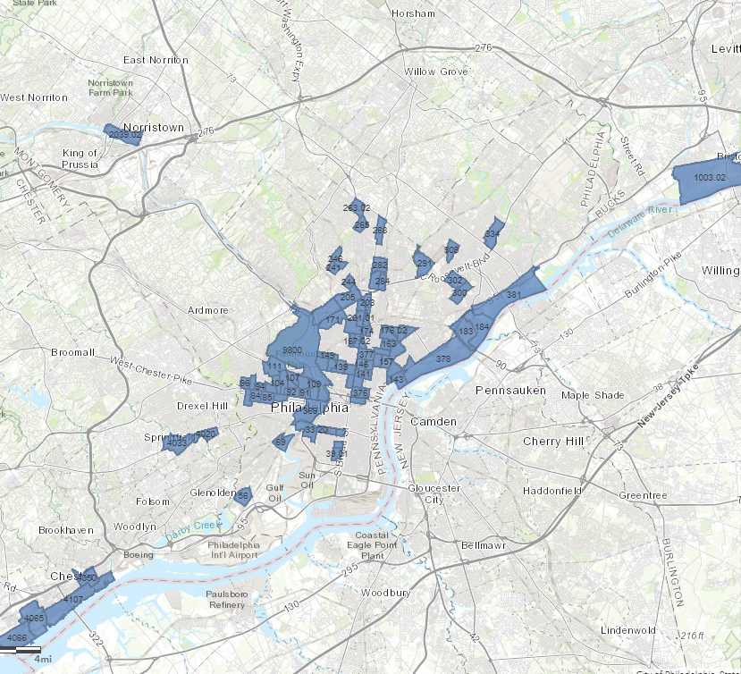
QOZ here in Philadelphia
Explore more at: http://dced.maps.arcgis.com/home/webmap/viewer.html?webmap=b0bd4d703ddc498fb0a993a00d77ed4c

Slide 6
Potential Public Health Impacts
Shifting neighborhoods
Investments in new businesses
Changing the physical or retail environment
Potential for displacement (and worsening health disparities)
Different impacts by population
Casita Triste (Art project in Dallas)
Notes:
Investments in new businesses
Create jobs
Raise income
Changing the physical or retail environment
Nutrition/PA from built environment change
Potential for displacement (and worsening health disparities)
Stress/mental health/social cohesion
Substance use outcomes
Different impacts by populations
youth/older adults
Race/ethnicity
Income groups

Slide 7
New Paper out 1/16:
Health and Health-Related Resources in Newly
Designated Federally Qualified Opportunity Zones:
United States, 2012–2016

Slide 8
Describing conditions at baseline is imperative for assessing public health policy impacts
AIM: To compare health and healthy resources in newly designated QOZ, eligible but not designated tracts, and ineligible tracts in large U.S. cities.
All U.S. Census Tracts
Eligible Tracts
Designated Tracts
Tracts in largest cities

Slide 9
Data Sources
24,409 contiguous U.S. census tracts
U.S. Census Bureau 2016 TIGER Line Geodatabase files representing 2010 geographies. ACS 2012-2016.
NETS data from RECVD (businesses) (https://sites.google.com/view/recvd-team-project-site/home)
500 Cities health dataset*(health/behaviors) (https://www.cdc.gov/500cities/index.htm)
U.S. Dept Treasury (QOZ designations as of 12/14/2018) (https://www.cdfifund.gov/Pages/Opportunity-Zones.aspx)
USA LEEP data (https://www.cdc.gov/nchs/nvss/usaleep/usaleep.html)
*The city boundaries used for the 500 Cities dataset were delineated by block rather than tract. Therefore, tracts were also excluded if less than 80% of their population was covered by the 500 Cities dataset (calculated as population from 500 Cities dataset compared to population from Census 2010).

Slide 10
RECVD Project Data Included in Manuscript
Healthcare facilities
all clinical treatment, hospitals and inpatient care, ambulatory care, kidney centers, physical therapist, residential facilities with health care, all pharmacies and drug stores
Physical activity resources
all physical activity facilities, multi-use facilities, walkable destinations for daily living, greenness (from NLCD)
Food stores
all food stores, healthy food sales, all unhealthy food sources, all fast food
Other health-related businesses
cognitive enrichment destinations, frequent social destinations, individual and family social services, bars and nightclubs serving alcohol, liquor stores)

Slide 11
Health Data Included (model-based estimates from 500 Cities & USALEEP)
unhealthy behaviors
physical inactivity, drinking, smoking, sleeping, obesity
health outcomes
poor physical health, poor mental health, stroke, coronary heart disease, cancer, arthritis, diabetes, high cholesterol, high blood pressure, adult asthma, chronic obstructive pulmonary disease, chronic kidney disease, all teeth lost, life expectancy at birth (USALEEP)
prevention practices
current lack of health insurance, clinical preventive services, routine checkups, dental visits, cholesterol screening, blood pressure medication, colonoscopy, mammography, pap smear

Slide 12
Analyses aimed to describe baseline conditions
Means and standard deviations (SD) across QOZ categories
Repeated by state
Differences between designated QOZ and eligible but not designated tracts (adjusting for total disparity)
Notes:
Calculated means and standard deviations (SD) across QOZ categories
Repeated analyses for each state to supplement efforts to track how QOZ play out across the country
Calculated differences between designated QOZ and eligible but not designated tracts
To tease apart differences due to overall disparities from differences due to targeting more distressed communities, we calculated residuals of a regression of the difference between designated and eligible and the coefficient of variation (total disparity).
NOTE: this study aims to describe baseline conditions rather than assess causality. We do not formally test any hypotheses.

Slide 13
Example map

Slide 14
Example difference adjusting for total disparity
Difference between the mean value of proportion poor physical health (2016) in tracts designated as QOZ compared to eligible, not designated tracts by state plotted against the coefficient of variation (total disparity). For “negative outcomes” such as this (i.e. where we expect targeted designation to mean more positive differences), states above the line are doing best and states below the line are doing worse at targeting tracts that need investment.

Slide 15
Online Dashboard of Results
https://neighborhooddata.shinyapps.io/FQOZ_Benchmark/
Notes:
To allow for a better understanding of the specific differences in health outcomes and health-related resources by state, we also present our results in an interactive online dashboard

Slide 16
Verbal/written results: NETS
Eligible but not designated and ineligible tracts, on average QOZ had smaller, younger, and more racially/ethnically diverse populations
QOZ and eligible tracts had lower socioeconomic status (SES) than ineligible tracts
Designated QOZ had lower overall clinical treatment facility density, primarily driven by less ambulatory care
Higher density of hospitals and inpatient care and pharmacies or drug stores
QOZ had substantially lower density of physical activity resources, including multi-use facilities and proportion green, than ineligible tracts but were similar to eligible tracts across these resources.
QOZ had a higher density of walkable destinations for daily living than other eligible or ineligible tracts
QOZ had more food stores, primarily driven by a higher density of unhealthy food sources, including fast food.
Consistent with their higher walkability, QOZ had more social destinations and social services.
QOZ and other eligible tracts had a much higher density of liquor stores than ineligible tracts.

Slide 17
Verbal/written results: Health
Prevalence of all unhealthy behaviors except binge drinking was highest in QOZ, intermediate in other eligible tracts, and lowest in ineligible tracts
Binge drinking showed a reverse pattern, with ineligible tracts having the highest prevalence
Designated QOZ had the poorest health outcomes across all measures except cancer
Prevention practices were less consistent;
While QOZ had a higher proportion without health insurance and a lower proportion up-to-date on clinical preventive services, cholesterol screening, colonoscopy and visits to the dentist
Also had higher prevalence of visits to the doctor for routine checkup. There was no difference in proportions with blood pressure medication, mammogram, and Papanicolaou smear use
The difference in life expectancy in QOZ was 6.3- and 2.3-years compared to ineligible and eligible but not designated areas, respectively

Slide 18
Discussion of Findings
Residents of QOZ had poorer health, health behaviors, and prevention practices
Previous research on place-based policies is limited
Need for evaluation
Contradictory impacts
QOZ could improve access to jobs and health resources in high-need areas
Gains could be negated by gentrification and displacement of low-income residents
QOZ may become a transformative force for health within our communities if tracked, assessed, and managed carefully
Notes:
Although health was not a criterion for QOZ eligibility or designation, residents of QOZ had poorer health, health behaviors, and prevention practices than other eligible or ineligible tracts
Evaluation of the effects of QOZ on health is important because previous research linking place-based policies such as QOZ to health is limited
While QOZ could improve access to jobs and health resources in high-need areas, these gains could be negated by gentrification and displacement of low-income residents

Slide 19
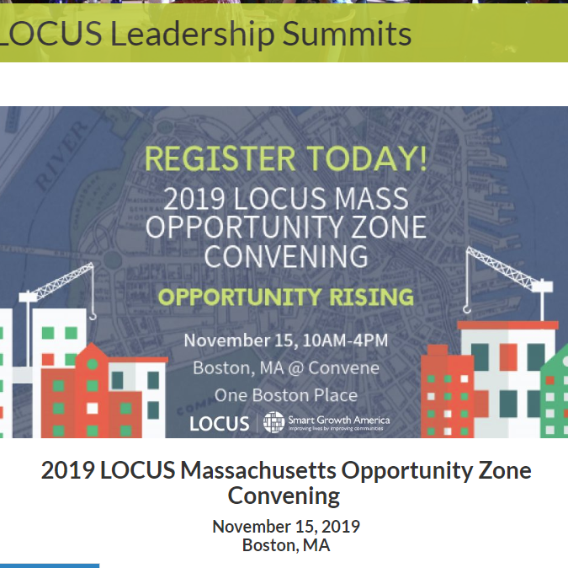
QOZ As A Unique Policy to Study
Compared to other programs:
No business assistance, infrastructure spending, and job training
Unclear tax incentives alone will produce the same effects
Differential designation by states
Policy does not ensure equal (or any) investment across all QOZ
Different policy impacts for different investment assets
No system to track QOF-QOZ spending
Notes:
Other programs bundled tax incentives with business assistance, infrastructure spending, and job training; it is unclear that tax incentives alone will produce the same effects
Policy does not ensure equal (or any) investment across all QOZ
Some predict that just 10 to 15 percent of the “hottest” QOZ could capture a majority of investment
Different policy impacts for different assets
No system to track QOF spending; the only check on investments would be a federal tax audit by the Internal Revenue Service

Slide 20
Future evaluation efforts
Facilitate evaluation
Broad eligibility criteria and only modest targeting
Ample numbers of comparison tracts similar to QOZ tracts receiving the policy “treatment”
Selection of QOZ across multiple contexts
Consideration of the moderating effects of geographic and policy context
State variation in the extent of targeting provides a natural experiment
Challenges
nonrandom selection of QOZ
very limited monitoring and transparency
difficulty of documenting displacement of existing residents

Slide 21
What Public Health will need to track
1) Distribution of investments (both from QOF and other private investors) into QOZ and other tracts
2) Changes that may occur in the built and social environment using data similar to that benchmarked in this report
3) Population dynamics in census tracts, with a special focus on displacement
4) Changes in health behaviors and outcomes at the individual and neighborhood level

Slide 22
Strategies for local jurisdictions
Local Transparency: add tracking of QOF investments to land use variance forms, building permits, or other related transactions
Affordable housing incentives: inclusionary zoning that incentivizes or subsidizes affordable housing to remediate displacement and increase benefits for existing residents
Zoning: Zone land uses for health-promoting resources or create potential development incentives. Public space requirements, landscapes that facilitate green space, local art, street scale for walkability, and other similar features
Pair public investment with private investment: Build new parks, trails, bike lanes, transit, or other amenities in QOZ. Spur returns on investments for QOF and thus increase the attractiveness of that QOZ compared to a tract without public investment. Requirements on private investments for neighborhood amenities (e.g. public art, green space) may have similar affects.
Disparities: Attention in future evaluations must be paid to changes in disparities at the state or city level.
Local Engagement: Identifying existing community health strengths that could appeal to QOF investment. Mapping neighborhood health-related gaps that might be filled through additional investment. Requiring and performing health impact assessments for all developments in QOZ may clearly articulate potential outcomes of individual QOF investment.
Notes:
Despite limited federal transparency for investments, local jurisdictions may add tracking of QOF investments to land use variance forms, building permits, or other related transactions
Ensure that QOZ locations have inclusionary zoning that incentivizes or subsidizes affordable housing to remediate displacement and increase benefits for existing residents
Zone land uses in QOZ for health-promoting resources or create potential development incentives for health-promoting businesses. Similarly, ensure design, form, and function of spaces remain health focused.
Public space requirements, landscapes that facilitate green space, local art, street scale for walkability, and other similar features
Pair public investment with private investment to foster the largest benefit
Build new parks, trails, bike lanes, transit, or other amenities in QOZ
Spur returns on investments for QOF and thus increase the attractiveness of that QOZ compared to a tract without public investment
Alternatively, requirements on private investments for neighborhood amenities (e.g. public art, green space) may have similar affects
Given the potential of QOZ designation to either improve or worsen health disparities, special attention in future evaluations must be paid to changes in disparities at the state or city level.
QOZ designation may be a key time for local engagement and mobilization
identifying existing community health strengths that could appeal to QOF investment
mapping neighborhood health-related gaps that might be filled through additional investment
requiring and performing health impact assessments for all developments in QOZ may clearly articulate potential outcomes of individual QOF investment

Slide 23
Activity: Leveraging for UHC research
Things that could be leveraged:
Broad, nationally-relevant
Easy to link to cohorts (tracts)
States designated them differently
Local concentration in Philadelphia
Seeking:
Collaborations
Suggestions of funding
Creative study designs

