Slide 1


ESTIMATING THE PREVALENCE AND PROBABILITY OF YOUTH EXPERIENCING HOMELESSNESS
CENTER ON POVERTY AND COMMUNITY DEVELOPMENT
MANDEL SCHOOL OF APPLIED SOCIAL SCIENCES
Michael Henderson, PhD

Slide 2


    INTRODUCTION AND PROJECT OVERVIEW
    METHODOLOGICAL APPROACH
    PRELIMINARY FINDINGS
    CONTEXT AND ONGOING ANALYSIS
    QUESTIONS

Slide 3

PROJECT OVERVIEW
  U.S. Department of Housing and Urban Development (HUD)
  Why youth and young adults?
  What: leverage regional integrated data systems (IDS) for a more comprehensive count of youth (aged 13 – 25) facing homelessness to guide local community planning.
  How: community-informed understanding of local administrative IDS and analytical methods.

Slide 4

METHODOLOGICAL APPROACH

Slide 5

Primary approach
HMIS
SNAP
Foodbank
Provider Interviews (Metadata)
By-Name List
McKinney Vento (schools)
Contextualize and Analyze Administrative Data
Linked Administrative Data
Address Listing Complement

Slide 6
ADMINISTRATIVE DATA
Homeless Services
3748
School Administrative Data
4195
Address list (SNAP; Food Bank; Dept. of Child & Family Services; Juvenile Delinquency)
3033
      Pool of 413,180 youth in integrated administrative data system aged 13-25 in 2017-2019
      12,821 youth flagged as experiencing homelessness or housing instability from 2017-2019

Slide 7

ADDRESS LIST COMPLEMENT
  Scanned local administrative records
    SNAP
    Cleveland Food Bank
    Department of Child and Family Services
    Juvenile delinquency records
  Flagged addresses of potential homeless locations
    Hotel/motel
    Known shelter locations
    Street card created by a local outreach organization
    United way 211 listings

Slide 8

METADATA: PROVIDER INTERVIEWS
  Seven semi-structured interviews with fifteen data managers
  Transcribed and thematically summarized

Slide 9



PURPOSE
Provider Interview Findings
Providers are focused on improving client access, experience with their services, and reporting. Data on homeless experiences are typically incidental, not focal.
INHERENT FLAWS
All administrative data systems have flaws. Some overwrite data or keep no historical data to trace backward in time. Definitions of homeless status matter for homeless services organizations but not broad social service providers.
CHANGE
DATA COLLECTION
Provider changes make significant differences in the structure, entry, access, and management of data. Changes can be to individuals (staff join or leave) or to entire data systems.
Nuance in data collection were largely practical, tied to client and funder outcomes. Sometimes these are artifacts of youth experience, such as not going to Coordinated Intake directly.

Slide 10

DATA PROVIDER CHALLENGES
  Technical/data
      Pandemic challenges and loss of long-standing employee knowledge
      Desire to capture data on homelessness but limitations within the data systems
  Organizational
      Incomplete reflection of system-touching youth
  Program thinking versus systems thinking

Slide 11



CONTEXT
AND ONGOING ANALYSIS

Slide 12
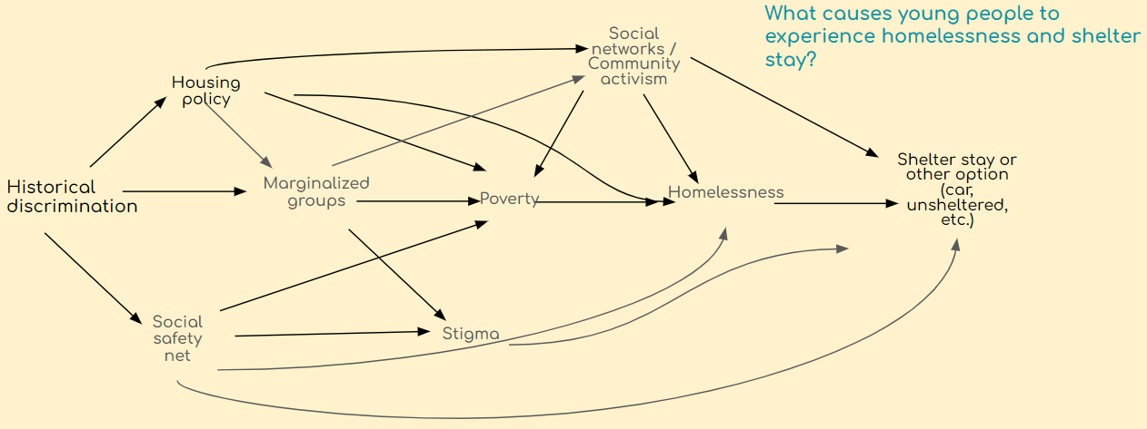
DGP LEVERAGE EXPERIENTIAL KNOWLEDGE
  Data intake process could be geared to connecting people to services and protecting most vulnerable in shelter.
  Youth avoid shelter if they feel unsafe.
  “Shelter’s gotta be safe for everyone. I done seen a lot of fights at the shelter, and they just let it happen, because who wants to get hit?”

Slide 13
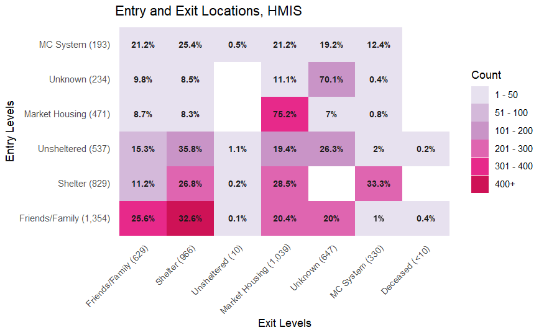
TRANSITIONS IN HMIS/BNL

Slide 14
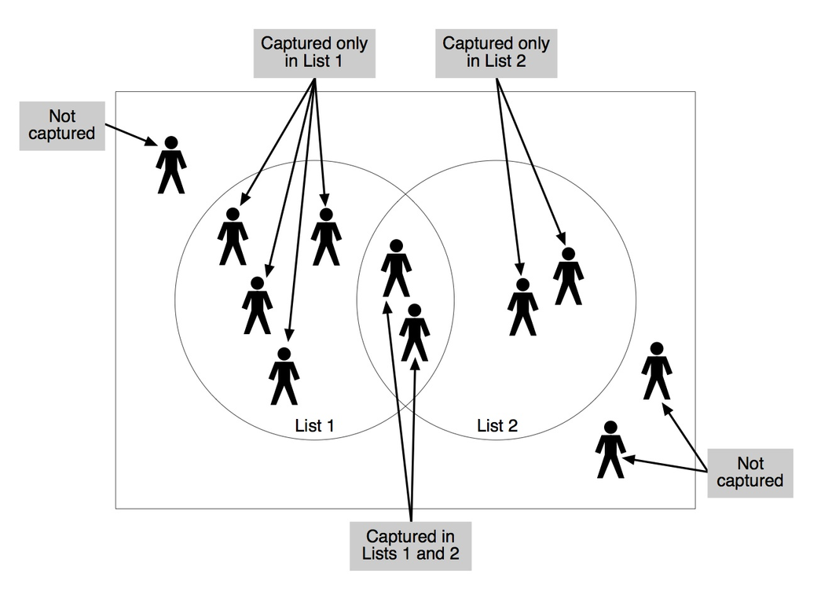
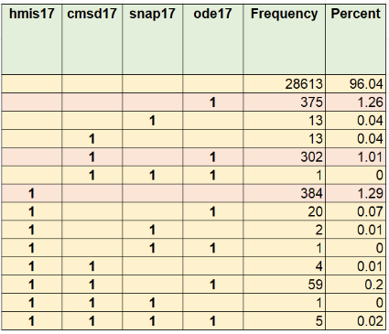
MULTIPLE SYSTEMS ESTIMATION
  Estimate of non-listed youth based on available list data
  Stratified analysis: year (2017), age (13-18), GI (F), RI (NW) : 1,180
  Benchmark with doubled-up ACS estimate*
CHAN ET AL. 2019. MSE FOR SPARSE CAPTURE DATA. INFERENTIAL CHALLENGES WHEN THERE ARE NON-OVERLAPPING LISTS.
*RICHARD, M.K., DWORKIN, J., RULE, K.G., FAROOQUI, S., GLENDENING, Z., & CARLSON, S. (2022). QUANTIFYING DOUBLED-UP HOMELESSNESS: PRESENTING A NEW MEASURE USING U.S. CENSUS MICRODATA. HOUSING POLICY DEBATE.

Slide 15

QUESTIONS?
THANK YOU!
FRANCISCA GARCÍA COBIÁN RICHTER
FRANCISCA.RICHTER@CASE.EDU
MEAGAN RAY-NOVAK
MEAGAN.RAY@CASE.EDU
MICHAEL HENDERSON
MICHAEL.J.HENDERSON@CASE.EDU

