Slide 1




Data Talks
Learning how to use local data to inform housing policy
Claudia Aiken
NNIP Detroit | September 23-25, 2024

Slide 2

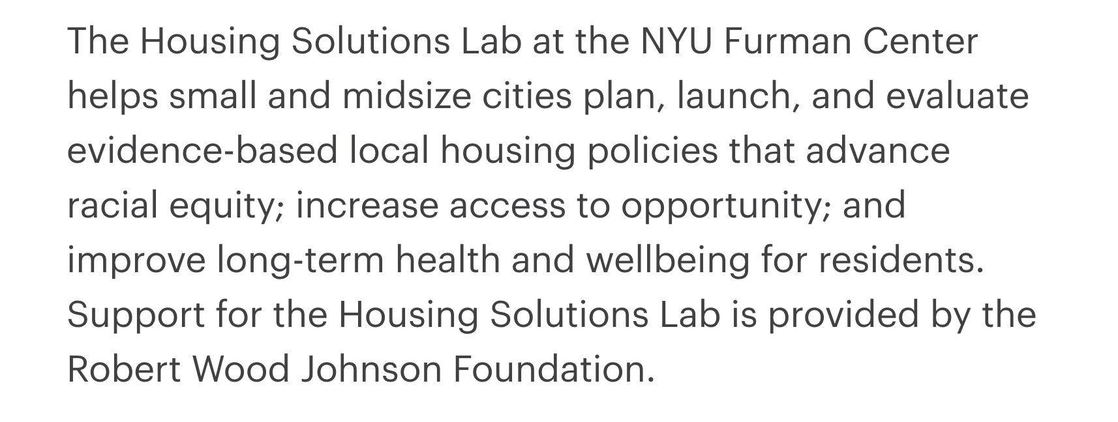
Notes:
If you’re not familiar with the Housing Solutions Lab, we’re based at the NYU Furman Center, and our mission is to help small and midsize cities plan, launch, and evaluate housing policies, with the goal of advancing racial equity, health, and wellbeing.

Slide 3

Data Talks
Goals
In November 2023, we launched Data Talks to:
Respond to the frustration with national data limitations among cities in our network
Create a low-barrier resource for local policymakers and practitioners
Build capacity to work with local data and maybe even lay the ground for future research

Slide 4
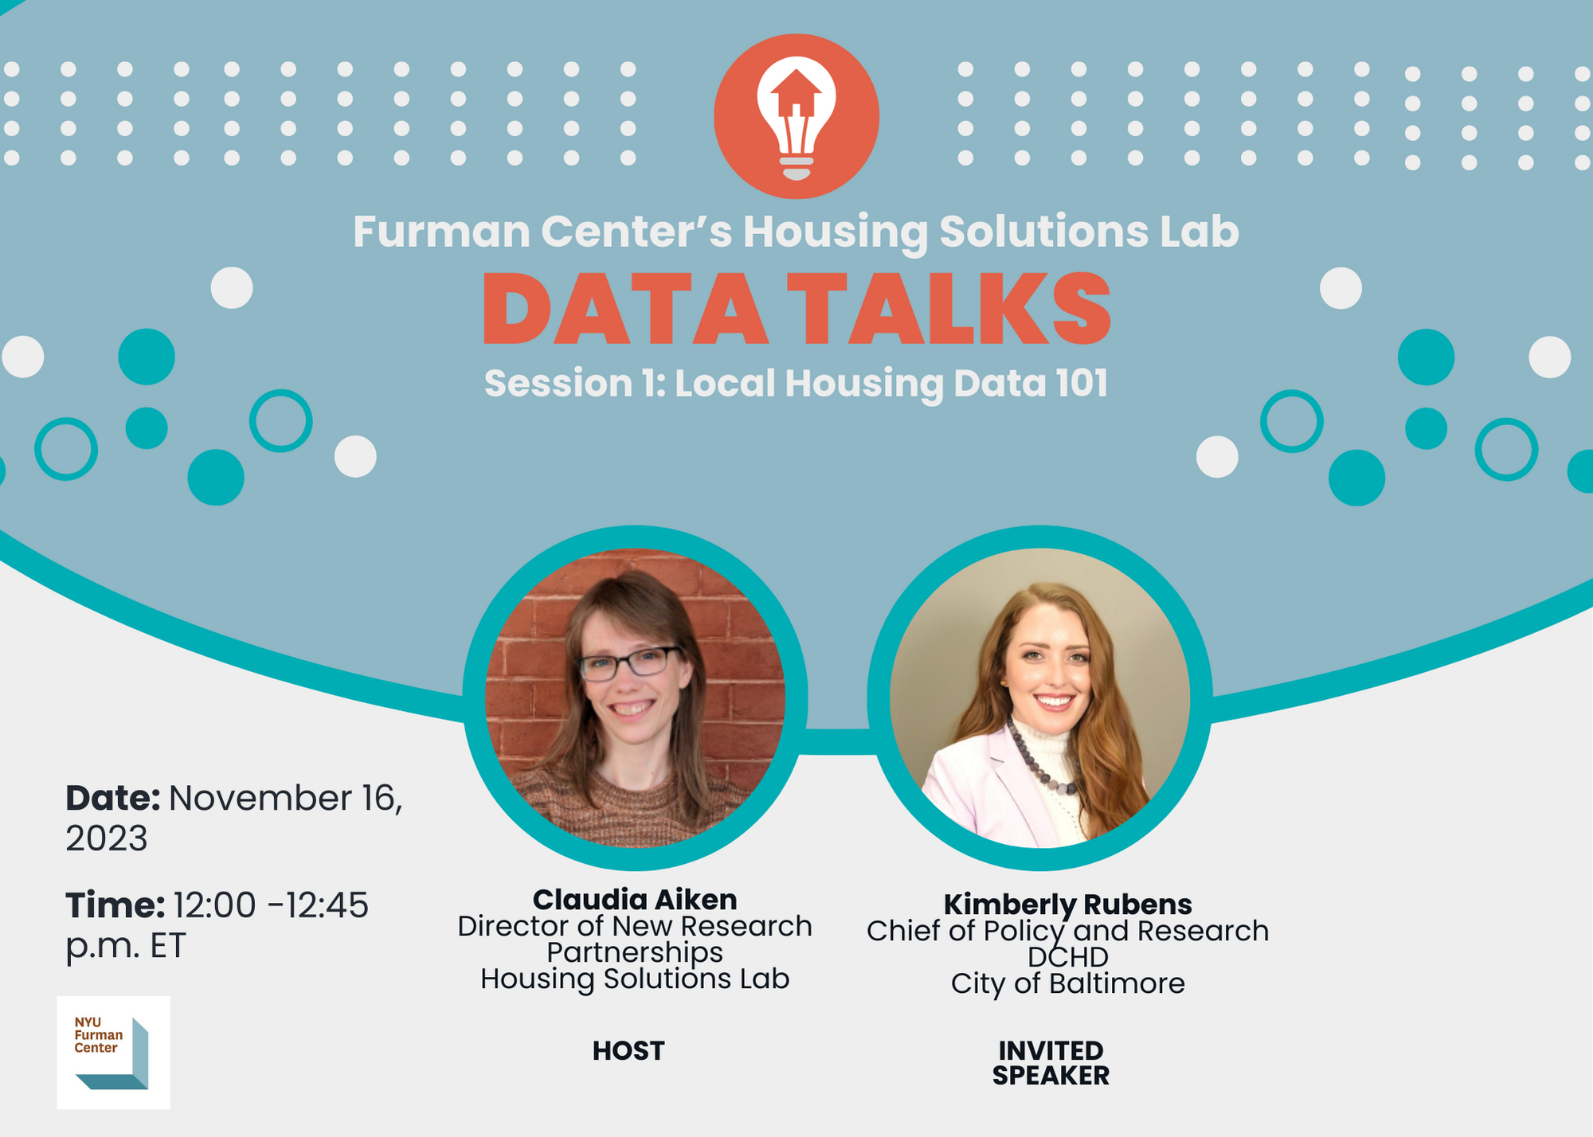




Topics to Date
Local Housing Data 101
Learning About Rental Properties
Surveying Residents About Housing Needs
Building a Real-Time Homelessness Data System
Understanding
Housing Quality

Slide 5




Data Talks
Structure
Data Talks have three main parts, lasting about 15 minutes each:
A short presentation introducing a particular local data topic
A fireside chat with a local practitioner with first-hand experience
Q&A with participants

Slide 6

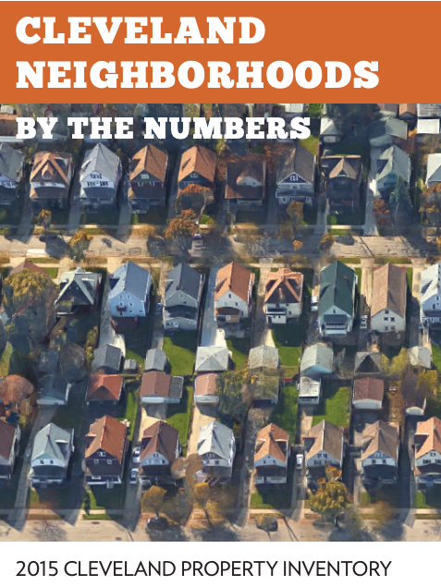
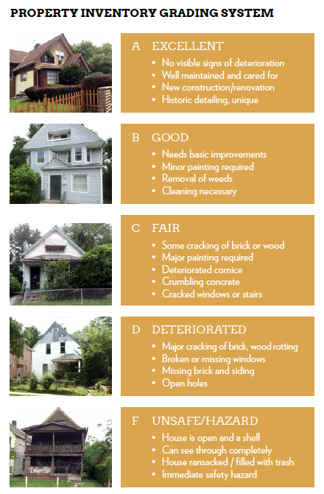
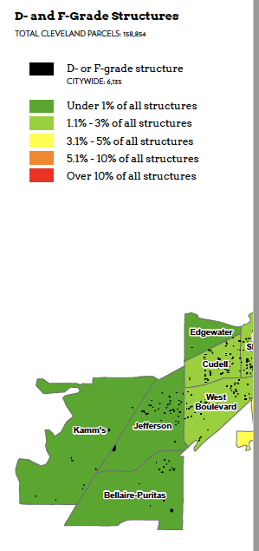
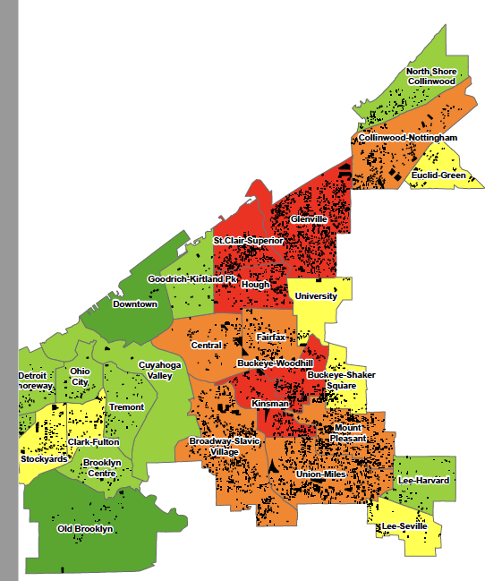
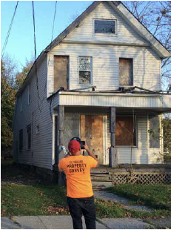
LINK
Conducting a full property inventory
Cleveland, OH
Notes:
And finally - I don’t want to spend too much time on this, since Isaac is the expert - but here’s an example of a property inventory
Cleveland faces persistent challenges related to vacant and run-down housing. But in order to act, the city needed more information about the location and conditions of problem properties.
In 2015, 2018, and most recently in 2023, the city has partnered with a local nonprofit, the Western Reserve Land Conservancy, to conduct a property inventory. In teams of two, 30 surveyors are trained to use a mobile app to grade each property on an A to F scale based on visual inspection, utilities data, and local property data.
They determine whether the structure is occupied and record information about illegal dumping, sidewalk conditions, and ADA accessibility.
This inventory is then used to target demolitions and rehab investments, inform programs to help residents adopt vacant lots as side-yards, and most recently, identify likely lead paint hotspots. Since they do it every few years, you can also see how quickly C-rated properties tend to become D’s & F’s, for example, which helps predict future needs.

Slide 7








Data Talks Guests to Date
KIMBERLY RUBENS
Baltimore, MD
ALLISON PRETTO
Oakland, CA
MONTANA JAMES
Missoula, MT
MACKENZIE KELLY
Chattanooga, TN
JODIE LEGG
Chattanooga, TN
ADAM RUEGE
Columbus, OH
ISAAC ROBB
Cleveland, OH
RICO RAZO
Detroit, MI

Slide 8
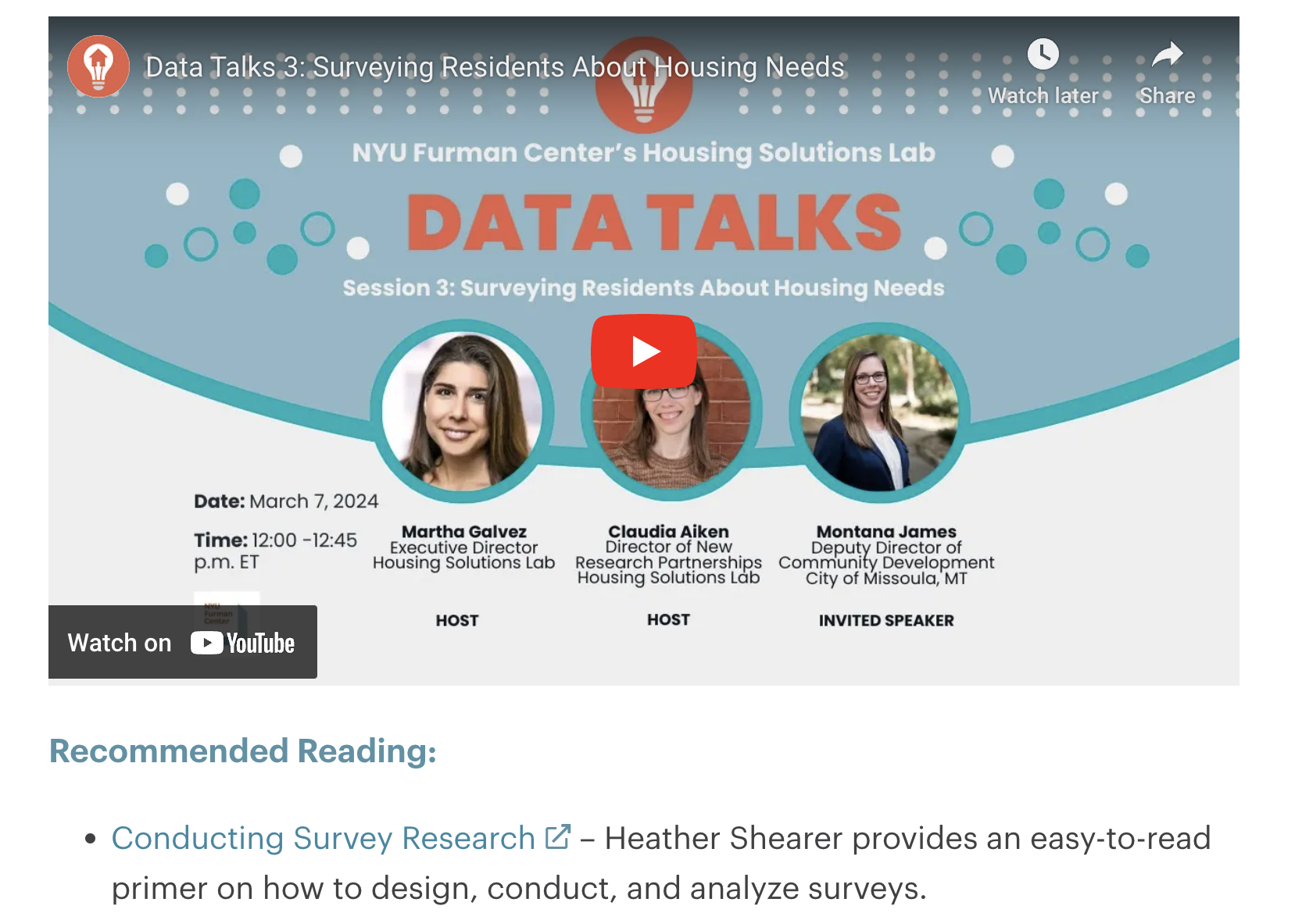
Data Talks
On our website
Users can visit our website to:
View past episodes, including a primer on local housing data and episodes discussing rental registries, resident surveys, and homelessness data
Access recommended reading
Register for upcoming episodes, including on in August on storytelling with local data
Join our mailing list

Slide 9
Metrics
Avg. registrants per episode: 330
Avg. attendees per episode: 160
Avg. audience Qs posed: 25
Avg. YouTube views: 155
Data Talks webpage visits: 1,205 (since Jan 1)
Our audience has been primarily representatives of small cities across the country (planners, housing agency members, elected officials). We also usually see HUD officials, state agency staff, housing and housing service providers (both national and local), and housing-focused researchers

Slide 10
Survey Results
Fielded after the first Data Talks episode, yielded 21 responses
90% were very (10) or somewhat (9) likely to recommend the series to a colleague or friend
100% said they planned to tune in for another episode
Respondents found the presentation portion most helpful, but also valued the fireside chat and Q&A
61% would not change the current format; the second most popular response (28%) was to add more discussion of concrete examples
Homelessness data, data-sharing best practices, and eviction data were popular options for future topics

Slide 11
How Data Talks Fits In
It’s one more way to keep our current and alumni cities engaged, and reach cities that we haven’t worked with yet
It can be a way to test the Lab’s work on a topic (like our deep dive into rental registries) with our target audience
A great way for us to learn about and lift up innovative local data collection and analysis approaches
It’s part of our larger charge to build capacity for rigorous research and evidence-based policy-making among small and mid-sized cities

Slide 12
Lessons Learned
Things get easier once the initial set-up work is done
Invest time in promotion & be intentional about follow-up
Be open to collaboration
Examples, examples, examples
Don’t forget to hit “record”!

Slide 13
Data Talks
A New Year
For the 2024-2025 year, we plan to continue the series and focus more explicitly on using local data for creating more equitable housing policy, with potential episodes on:
Crowd-sourcing data to inform fair housing rules and enforcement
Data-sharing between health, housing, and criminal justice systems
Equitable data storytelling

Slide 14
Ideas for Growth
Creating an events calendar for the Lab; doing more cross-promotion
Publishing edited, enhanced versions of the fireside chats
“Work in progress” talks
More?

Slide 15

Thank you!
Claudia Aiken, Director of New Research Partnerships
claudia.aiken@nyu.edu
housingsolutionslab.org

