Slide 1
Turning the Corner: MONITORING NEIGHBORHOOD CHANGE TO PREVENT DISPLACEMENT
Mychal Cohen
Urban Waters Learning Network Webinar
June 5, 2019
Notes:
I will discuss a bit about why monitoring neighborhood change is important and then I will describe the Turning the Corner project briefly and share a few takeaways from the briefs we published last week.

Slide 2
Why Monitor Neighborhood Change?
Notes:
Broad Context Setting
So why do this at all? Why collect data, why study neighborhood change? A common response from folks, particularly in areas that are rapidly gentrifying, is what value does data add? People’s lived experiences tell them that areas are gentrifying, neighbors are being displaced. The call for data can often feel like an invalidation of that.

Slide 3
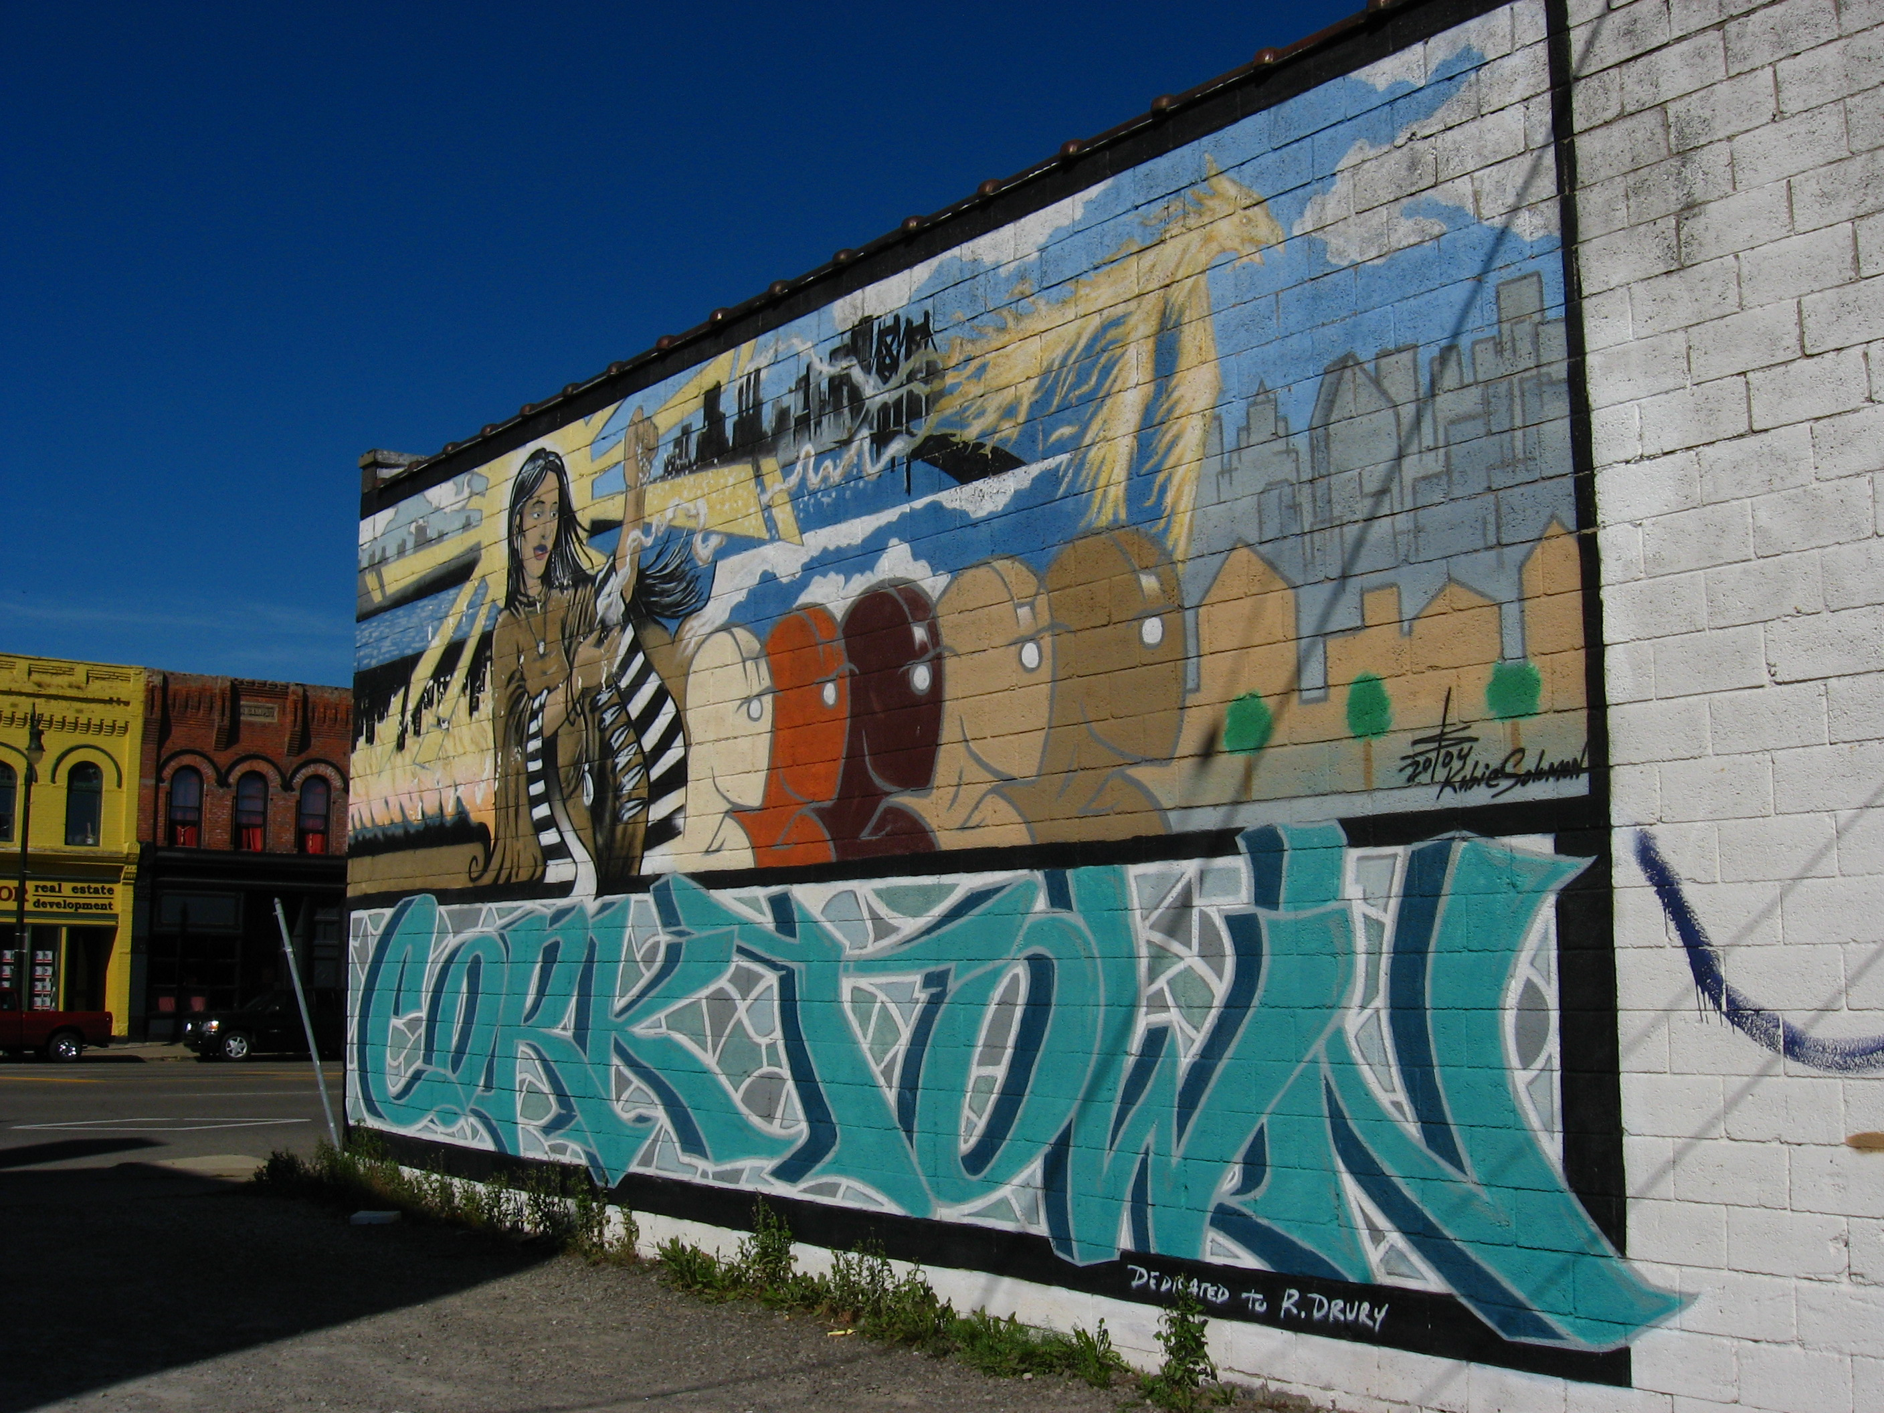
Residents can leverage data to have a voice in decisionmaking
Photo courtesy of Data Driven Detroit
Notes:
A central part of how we recommend neighborhood change data be used is in collaboration with communities. Supporting and uplifting stories and lived experiences with data, rather than utilizing data as the full or even primary story.
The Turning the Corner project that I will discuss in greater detail shortly, required each site to have community input
It matters who has access to the data – we need to get the data out to the longer-term residents to have them interpret the changes and strengthen their ability to advocate for themselves and participate in decisions
In Twin Cities – In Near North/Jordan stakeholders suggested that resident access to data would position them to better take advantage of neighborhood improvements.

Slide 4
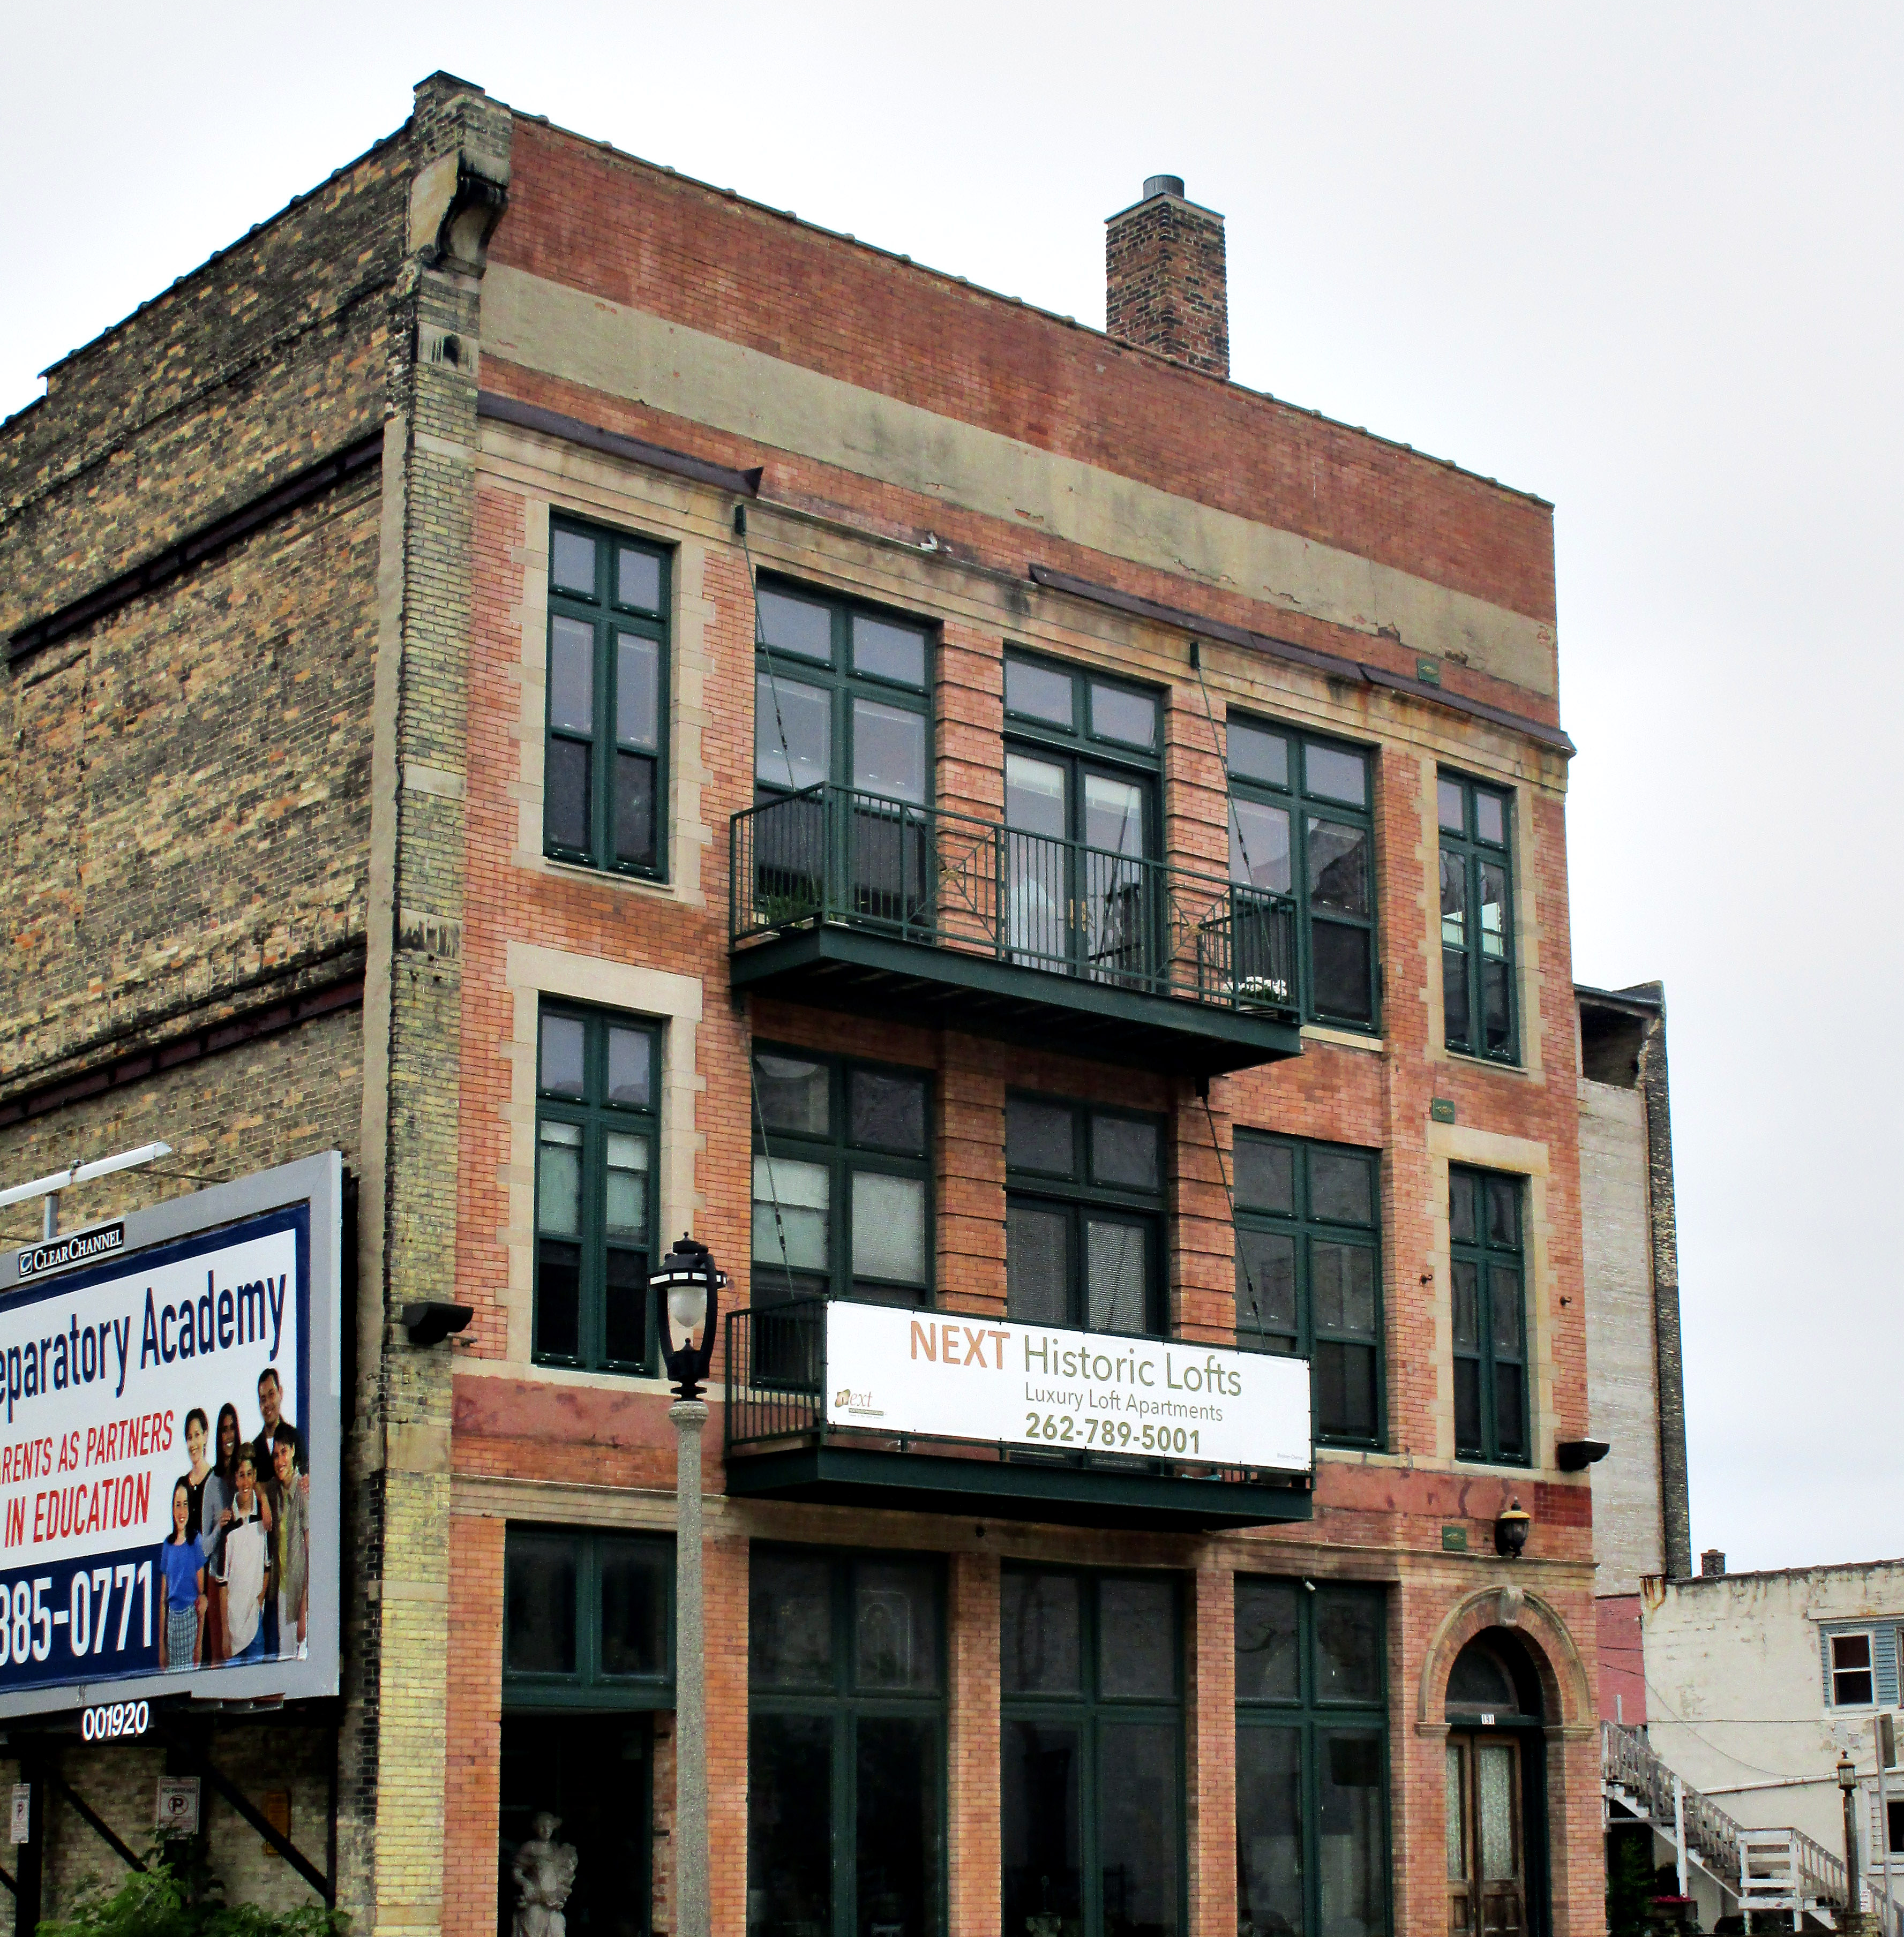
Displacement risk is not the same everywhere
Photo courtesy of Cassandra Leopold
Notes:
Data can be particularly useful in smaller cities. Where displacement may coexist with disinvestment. The numbers can help demonstrate changes and encourage people to think proactively about displacement risk.
Sites found that the neighborhood trends and resident perceptions differed from the common narrative of rampant gentrification in hot market cities.
First we saw that there were different baseline conditions that shaped the nature of the displacement risk
Milwaukee neighborhoods
Walker’s Point (pictured here) more industrial with many vacant lots, so there was some concern about future displacement of residents looking ahead, but it wasn’t the dominant issue.
Brewer’s Hill more residential, and historically black, showing stronger signs of displacement with a large increase share and number of white residents
Concerns about displacement and gentrification were not mutually exclusive with concerns about lack of investment and services. Residents in some neighborhoods were concerned with both at the same time. There’s many explanations for this:
sometimes the market pressures were uneven across the neighborhood,
or because they were looking at the market changes in adjacent areas and foreseeing the spillover,
And because some residents and their neighbors were still experiencing hardship, not helped by the neighborhood’s housing market.
Also trajectories - pacing when slow may allow for more time to respond and intervene.

Slide 5
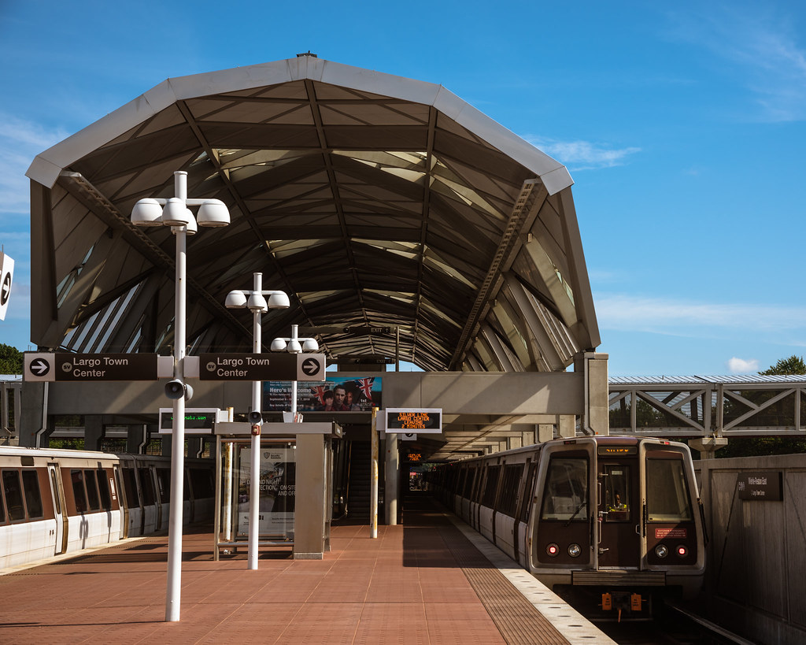
Large-scale investments can increase displacement pressures
"Wiehle-Reston East Metro Station" by kyle.anderson2
Notes:
Infrastructure investments, public works, transit, big shiny new developments all have the potential (highlight) to increase displacement pressures
That means responsible development should include plans to study the effects on neighborhoods, particularly for longer-term or economically vulnerable residents.
My amazing colleague Somala will talk a bit more about what this might look like in practice.

Slide 6
Turning the Corner – Project Description

Slide 7
Turning the Corner National Organizations
http://www.neighborhoodindicators.org/turningthecorner
Notes:
The project was guided by the Urban Institute’s National Neighborhood Indicators Partnership and the Federal Reserve-Philanthropy Initiative, a collaboration between the Restoring Prosperity in Older Industrial Cities Working Group of the Funders’ Network for Smart Growth and Livable Communities and several Federal Reserve district banks. Funded by Kresge Foundation.
Coordinated by the Urban Institute, the National Neighborhood Indicators Partnership (NNIP) consists of independent organizations in 32 cities that share a mission to help community stakeholders use neighborhood data for better decisionmaking, with a focus on working with organizations and residents to advance equity in communities.
The project was launched in 2016
Goals were:
Pilots a research to action model of monitoring neighborhood change and preventing displacement – focus on supporting local advocacy and decisionmaking
Shed insights on displacement risk on areas in recovering and moderately strong housing markets
Document the effects on longer-term residents; we considered cultural and commercial as well as residential displacement.

Slide 8
Local Research Partners and Funders
Buffalo
University of Buffalo’s Center for Urban Studies, the City of Buffalo
Community Foundation for Greater Buffalo, Ralph C. Wilson, Jr. Foundation
Detroit
Data Driven Detroit
Community Foundation for Southeast Michigan; Hudson-Webber Foundation, The Skillman Foundation, John S. and James L. Knight Foundation
Milwaukee
Data You Can Use
Greater Milwaukee Foundation; Northwestern Mutual Foundation; Zilber Family Foundation
Phoenix
LISC Phoenix, Arizona State Univ.
Vitalyst Health Foundation, Arizona Community Foundation
Twin Cities
Federal Reserve Bank of Minneapolis, LISC Twin Cities, Wilder Research Group, University of Minnesota’s Center for Urban and Regional Affairs
McKnight Foundation
Notes:
There’s innumerable people to thank as you can see by this crowded slide listing the research partners and the local funders.
As you can see by this list of cities, we were particularly interested in recovering cities. Places folks may not be thinking about neighborhood change in the way that some larger cities with hot markets might.
We asked each local team to
Develop local advisory group
Conduct quantitative research as well as focus groups and interviews of residents and business owners
Choose 2-4 focus neighborhoods – total of 14
Most were early in the process of revitalizing
The neighborhoods as a group are diverse racially and ethnically: for 11 of them were predominately people of color – African-American or Latinx and one Asian.
For nine of them, more than ½ the HH had incomes o $35K or less.
Our project overview publication describes their neighborhoods and details their activities and findings. We have a full list of the local publications on the Project website – some of them are still in the process of being wrapped up.
Some highlights of site activities
Buffalo - Windshield survey – census block level
properties, home sales, and speculator owned properties
Milwaukee - Business owner and policymaker interviews
Phoenix - Google street view survey of small businesses
Twin Cities – Conducted online resident survey

Slide 9
Key Themes from the Sites

Slide 10
Perceptions of community safety varied
Notes:
Safety came up alot. And not in the way that people often think about gentrification and safety.
Sometimes the assumption is made that places get safer as a community changes. We actually found a much more nuanced conversation was happening. This is informed by the fact that many of the neighborhoods that are seeing influxes of new, wealthier residents, have histories of racial segregation, redlining and disinvestment.

Slide 11
Perceptions of community safety vary
Neighborhood change may shift the mix of crimes
Changing neighborhoods face changing norms around policing
Sense of safety is tied to social connections
Notes:
In some neighborhoods, there was a perception in some neighborhoods that changes in nightlife drew different types of crime into the neighborhood, perceived to be driven from people outside the neighborhood
In Detroit (SW) and Milwaukee (Walker’s Point) residents associated new restaurants and clubs with an increase in property crime like theft.
In the Milwaukee neighborhood of Brewer’s Hill, residents felt that a perception of increase safety in the neighborhood led to an increase in people coming into the neighborhood to buy drugs.
Many of the Neighborhoods expressed concern about how neighborhood change aligned with changes to community norms around calling the police, and policing tactics.
In Buffalo a new Medical Center is being built. Residents expressed concern with increased policing occurring in their neighborhoods.
One of the most interesting things we heard was how expansively residents were thinking about safety. Much of the research on change, partially because of the availability of data, partially because of long-standing focus on policing for crime prevention, focuses on data on reported crimes.
Residents in many of the sites expressed concerns about safety that were much broader. Across sites, longer-term residents mentioned lack of connections with newer neighbors as a safety issue. As mentioned earlier, the changing norms around calling the police was expressed as a significant safety concern. In Detroit’s Southwest neighborhood – Latinx residents increasingly felt unsafe in certain parts of the neighborhood due to fear of police interactions.
This point was one of our largest takeaways. These experiences complicate the notion that gentrification leads to a less crime.

Slide 12
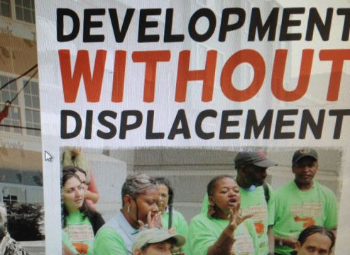
Recommendations on community safety
Expand the definition of safety.
Contextualize data with resident insights and neighborhood history.
Be proactive!
Notes:
So what should you do if you are starting to monitor neighborhood change, or think about the effect a project might have on the surrounding neighborhood?
Community members define safety in many different ways. When discussing neighborhood change, our understanding of safety has to expand beyond just crime data.
Much neighborhood change occurs in center cities that have histories of neglect, racism, and de facto segregation. Solely monitoring crime data without documenting the underlying conditions can further stigmatize neighborhoods. Additionally, interpretations of changes in crime data or 311 calls should include neighborhood context that can help accurately portray these shifts.
Stakeholders should be proactive in anticipating potential changes and organizing around responses to protect longer-term residents. Particularly in neighborhoods that are shifting from predominately people of color, coming changes to policing, policing tactics, and norms around calling the police should be addressed proactively.

Slide 13
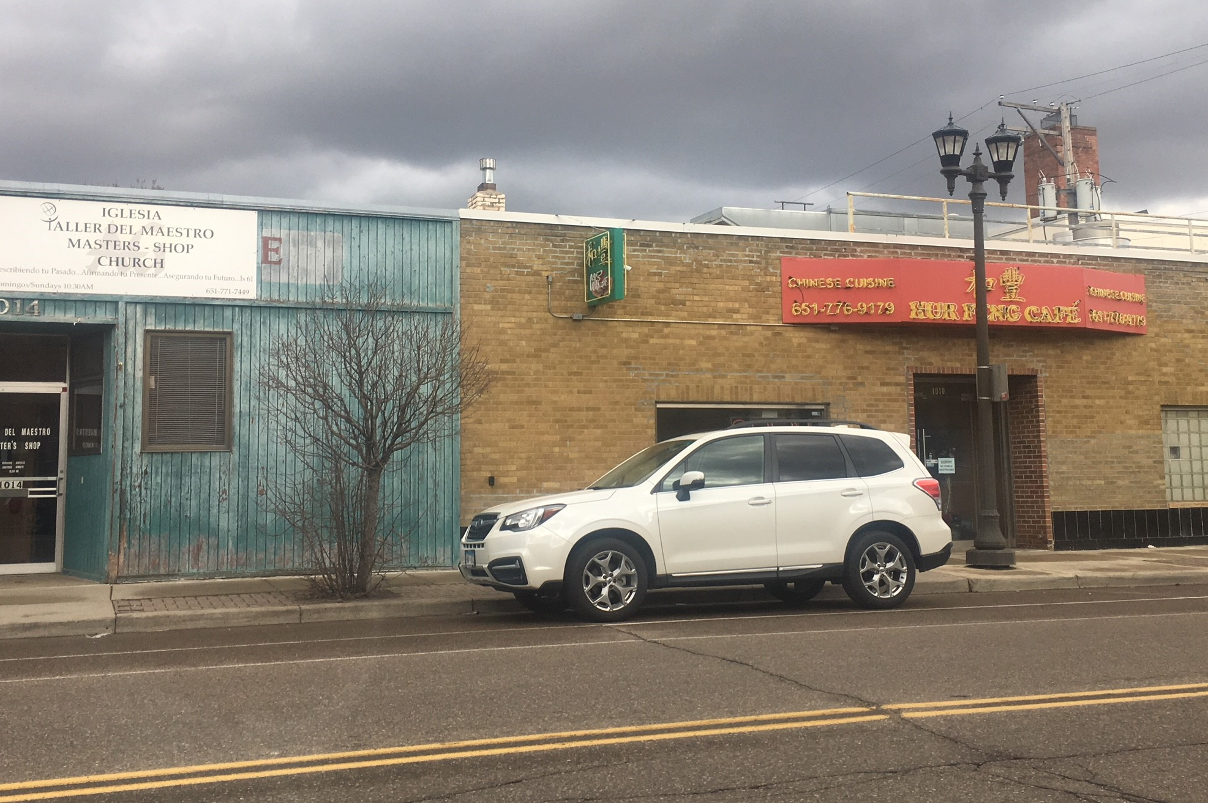
Neighborhood change creates risks and opportunities for small businesses
Notes:
TtC included a focus on small, local businesses from the beginning because of the important economic and social roles they can play in neighborhoods.
The business sector sometimes is overlooked in discussions about neighborhood revitalization and displacement but rising rents, loss of clientele and changing regulatory regimes can all endanger longer-term small businesses.
Partners in several sites interviewed longer-term small-business owners to learn about their experiences and perceptions of neighborhood change. We highlight three points drawn from TtC partner reports.

Slide 14
Neighborhood change creates risks and opportunities for small businesses
Rising rents and loss of clientele can threaten longer-term small businesses
New investments also can create opportunities for longer-term small businesses
New businesses may not provide services desired by longer-term residents
Notes:
Businesses that rent rather than own their work place face greater displacement risks than those that own their space in neighborhoods where commercial rents are increasing. Our Milwaukee partner heard this concern from businesses in the Walker’s Point neighborhood.
In the Twin Cities, business owners in the Whittier neighborhood talked about the turnover they’ve seen especially among formerly successful immigrant and people-of-color owned businesses, as more upscale businesses entered the area.
Displacement of longer-term residents plays into the risk businesses face when customers no longer live nearby.
The second point is that increasing investments can lead to expanded opportunities for existing businesses.
If longer-term businesses are supported as a neighborhood changes, and longer-term residents are not displaced, then change can be positive.
Business owners in Milwaukee’s Brewer’s Hill indicated that investment brought opportunities for new and existing service providers. For example, businesses like grocery stores and barbershops maintained existing customers while also providing services for newer residents.
But increasing investment can be a mixed bag for residents who patronize local businesses. As newer businesses move into changing neighborhoods longer-term residents may feel that they are no longer being served.
Business owners in Milwaukee and residents from Detroit indicated that new businesses focus on clientele from other parts of the city rather than neighborhood-based customers. As one person said, “there’s a huge disconnect between what a community wants and what they’re getting.”

Slide 15
Recommendations on small business
Ensure equitable access to resources and support for small businesses
Develop accurate data on small businesses
Leverage resident voices to influence development
Photo courtesy of Cassandra Leopold
Notes:
City resources to support small businesses must be equitably accessible for small businesses, particularly for poc- and immigrant-owned small businesses for whom there’s a history of inequitable access and lower wealth. Business owners and community groups can look at information on publicly provided support, such as small business grants and technical assistance, to see if such support is provided equitably and targeted to areas and businesses with most need. And check that assistance is available in multiple languages. Addressing any barriers to resource access can help longer-term businesses take advantage of new opportunities and lower the associated risks of neighborhood change.
Developing accurate data on existing small businesses may be the first step in some communities. Our partner in Phoenix created a google street view survey to track small businesses with fewer than 4 employees, which are not included in a local government data source. In some areas they found double the number of businesses. Developing accurate data on small business, including demographic data on owners will help identify business that might benefit from public resources and can help track displacement of businesses.
Development decisions can seem beyond the reach of community members. Residents and community based organizations should look for opportunities to leverage their voices, such as when cities are selling or turning land over to developers, or when developers are asking for zoning adjustments.

Slide 16
Turning the Corner - Resources for Community Research
Guide to Measuring Neighborhood Change to Understand and Prevent Displacement - https://urbn.is/2UPU0iR
Turning the Corner Qualitative Toolkit on Neighborhood Change - https://www.neighborhoodindicators.org/library/catalog/turning-corner-twin-cities-qualitative-protocols
Turning the Corner Literature Catalog - https://www.neighborhoodindicators.org/library/catalog/turning-corner-literature-catalog
Notes:
Starting to monitor neighborhood change or think about equity in your project can feel like huge daunting thing. So, I wanted to leave you with some resources to get started.

Slide 17
http://www.neighborhoodindicators.org/turningthecorner
Follow us on twitter @NNIPHQ

