Slide 1
NNIP Strategic Framework and 2023-2024 Planning
Town Hall
June 22, 2023
Notes:
To inform the details of the strategic plan…
This framework shows where we’re headed. It’s the beginning of our map.

Slide 2
Goals for the meeting
Update partners on strategic planning progress.
Share components of mission & vision with opportunity to discuss later.
Solicit initial ideas for implementation to operationalizing our strategies and advance our goals in 2023-2024.
Notes:
It’s a lot – we will sharing it all in writing. Lots of time over the next months to dive into what things mean.

Slide 3
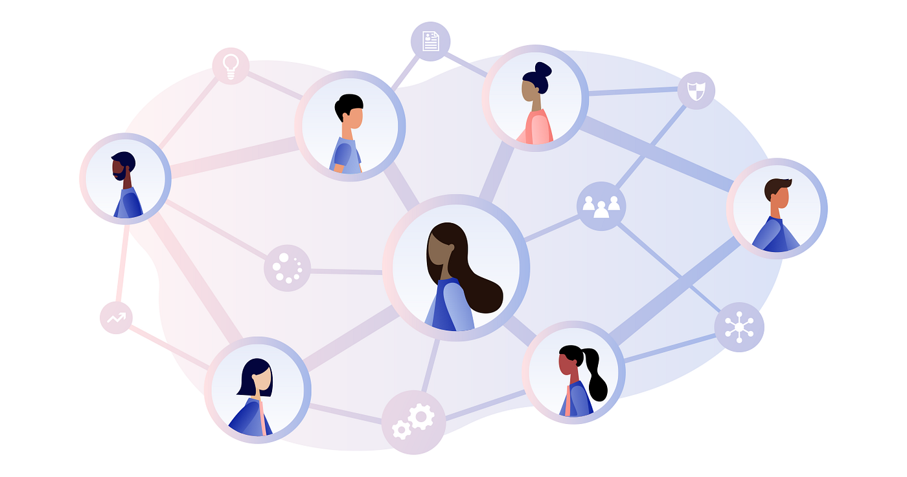
Put on a “network” hat! What can we accomplish together?

Slide 4
Assume abundance – What could the Network accomplish with 10x more resources?

Slide 5
Agenda for today
Background and Mission/Vision (5 minutes)
Goals and Strategies (15 minutes)
Small group discussion (25 minutes)
Report out and next steps (15 minutes)

Slide 6
Motivation
We’ve cultivated a robust and supportive peer learning network for two decades with deep and broad local knowledge.
NNIP has always aspired to sharing our network insights and values for broader influence – this strategic plan offers us a path to get there.
Notes:
https://www.neighborhoodindicators.org/library/catalog/summary-findings-csr-discovery-phase

Slide 7
Process
Iterative meetings with consultant, Leah/Kathy, strategic planning and executive committees
Thank you to committee members!
Katie Pritchard (Milwaukee-alumna)
Amy Carroll-Scott (Philadelphia)
Lamar Gardere (New Orleans)
Noah Urban (Detroit)
Victor Amaya (Milwaukee)
Toni Smith (Memphis)
Geoff Smith (Chicago)
Mariko Toyoji (Seattle)

Slide 8
Draft Vision: All neighborhoods and cities across the U.S. are places where people thrive and prosper.

Slide 9
Draft Mission Our national network combines data analysis and local knowledge to inform decisionmaking and elevate strategies to eliminate inequities. Our evidence base comes from partners in 31 cities who connect people to data and assistance with using information to benefit their communities.
Notes:
Better describe what the network does separately from partners do
Does not imply changing the model or local missions
Express impact beyond peer learning network
Strengthen partners for greater partner city impact.
Also harness lessons to influence actors at the national level + across the nation towards the vision.
Emphasize collective value of the network as a whole (Urban + partners + alumni]

Slide 10
Goals for 2023-2026
National networks, organizations, and agencies actively promote and invest in the use of data influenced by NNIP values and examples.
Local actors make data-informed changes in policy and practice to distribute resources fairly and equitably across neighborhoods.
An expanded NNIP network supports influence and impact in NNIP cities and nationally.
Notes:
Note need wordsmithing
Goal 1 Example metrics:
Departments in two federal agencies with place-based programs invest in building local data capacity.
Ten groups, such as national foundations or nonprofits or associations of local nonprofits or governments, partner with NNIP and promote and/or invest in the use of data.
Goal 2 Example metrics:
Examples from NNIP - shared within network and more broadly - influence local actors in 30 places to adapt them for their communities.
The network develops plans for 4 new cross-site action projects and launches 2 of them.
Goal 3 Example metrics:
Strong, effective and engaged NNIP Partners are serving 40 cities and their regions.
Partners are in development in 10 additional cities.
The share of departing partner staff who become alumni when they leave the organization is increased by 30 percent.

Slide 11
Cross-cutting Strategies
Expand the roles and engagement opportunities of NNIP Network members.
Strengthen the exchange between the network and Urban Institute experts and offices.
Develop the infrastructure to transform NNIP and deliver on the three goals.
Increase understanding of the network’s approach and insights among target audiences.
Resource the plan with diversified funding.
Notes:
These support all the goals.
We'll spend our small group time today on the first one, but wanted you to see them all.

Slide 12
Cross-cutting strategies support all 3 goals
National promotion & investment in use of data
Impact on local policy & practice
Expanded NNIP network
Expanded roles and engagement of NNIP Network
Strengthen the exchange between NNIP & Urban Institute
Develop the infrastructure to transform NNIP.
Increase understanding of the network’s approach and insights.
Resource the plan with diversified funding.

Slide 13
What does this mean for partners?
Opportunities
More resources to support peer learning, partner innovation, and exchange with Urban experts
New process for faster development of more cross-site demonstration projects
Requests
Continue to share examples of local work
Opt-in engagement in specific issue areas
Participate in guidance and relationship-building with national actors
Note: Network would compensate for any significant time requests.
Notes:
This will be iterative, this will be a discussion over time among all of us.
Cut items: New language to describe network and model

Slide 14
Strategy 1: Expanded roles and engagement of NNIP Network
What are your new ideas on…
Next generation partner meetings (Kathy)
Process for cross site project development (Leah)
Peer exchange, training, technical assistance (Peter)
Notes:
Make the connection clear to the framework
Help us operationalize the plan – think about implementation

Slide 15
Report out
What excites you about the ideas shared?
What are you concerned about?
What are you uncertain about?

Slide 16
Next steps
Join us for special group office hours on July 7th 12:30 pm EDT –to discuss NNIP Values.
Share the goals and strategies with your colleagues.
We will:
incorporate ideas from today into plans for quick wins, implementation, and Oakland meeting planning.
refine strategic framework package for sharing more broadly.
work on initial messaging/implementation plan with consultant.
Notes:
– to Urban executive office, Casey/RWJF, close allies.

Slide 18
Discarded slides

Slide 19
Values - Examples
Data can be a powerful tool for action to benefit communities.
People can use data to achieve their own aspirations.
Place matters.
Quality data requires people.
Collaboration is essential.

Slide 20
Working differently – local actors make changes for fairness/equity
Publish/disseminate story on Impact award winner IHS/Chicago on affordable housing preservation.
Hold session IHS and DC with NNIP Partners AND their local housing & preservation stakeholders.
Engage with national housing groups (NLIHC, LISC)
Publish brief and essay in HUD Cityscape volume covering several NNIP examples.
If interest, convene to develop cross-site project idea(s).
Notes:
We thoughLocal actors make data-informed changes in policy and practice to distribute resources fairly and equitably across neighborhoods.
How to reach the local actors to give them the idea?

