Slide 1
The White House Police Data Initiative
Clarence Wardell III, PhD
Presidential Innovation Fellow
@cwardell

Slide 2
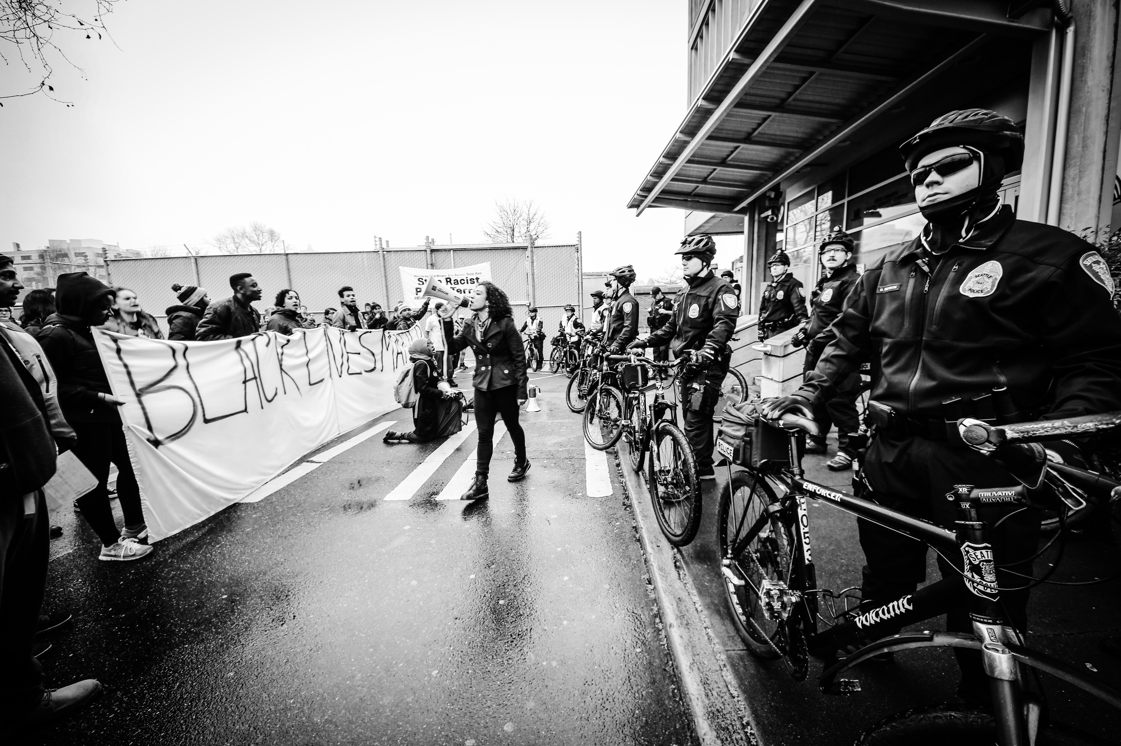

Slide 3
How might we build trust between police officers and citizens?

Slide 4
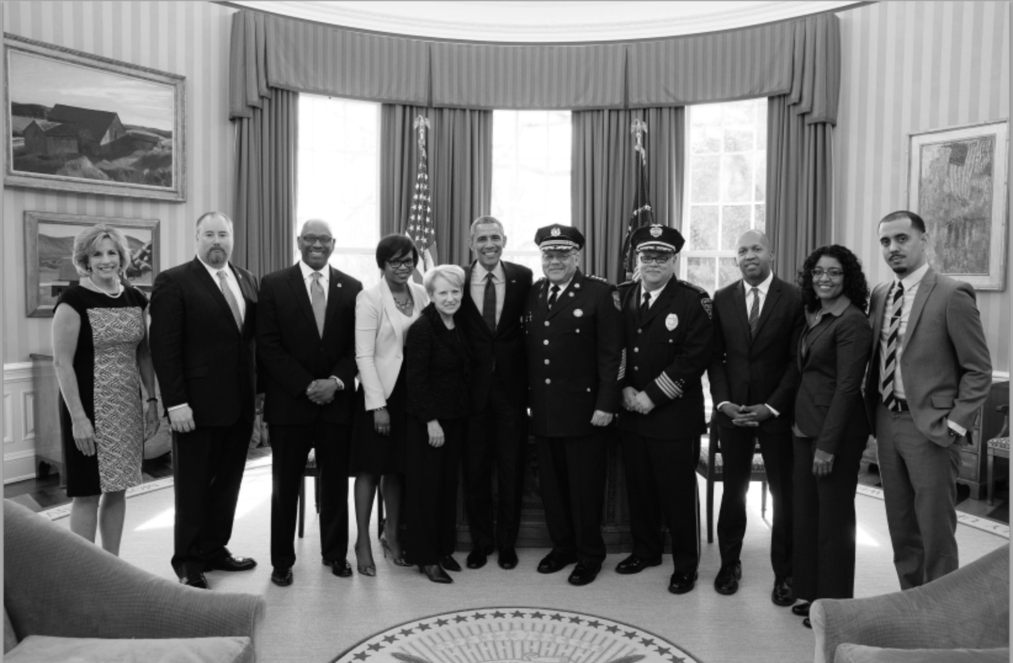

Slide 5
59 recommendations 14 focused on tech/data/ transparency 2 key challenges

Slide 6
A lack of transparency around policing.

Slide 7
A lack of data analysis to improve policing and accountability.

Slide 8
In both instances, significant barriers to improvement exist, including cultural, technical, and financial.

Slide 9
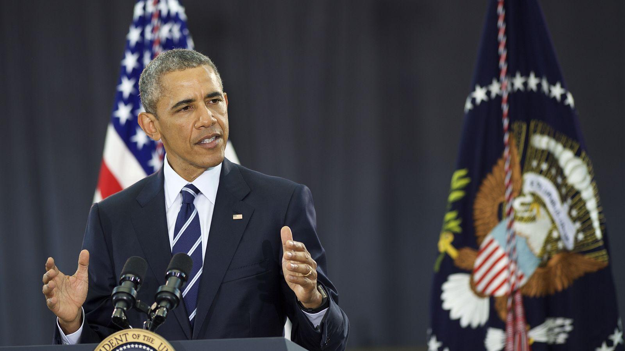
“We’ve launched a Police Data Initiative that’s helping Camden and other innovative cities use data to strengthen their work and hold themselves accountable by sharing it with the public.”
- May 18th, 2015

Slide 10
PDI Key Activities
Find, share, and encourage replication of innovative work already underway across the country.
Connect city and county leaders with technologists, researchers, data scientists and design experts.
Host community-based events to develop, test, and validate new ideas and tools with all stakeholders.
Create platforms, resources, and mechanisms to share best practices and lessons learned.

Slide 11
Open Data and Policing

Slide 12
The act of voluntary and consistent open data release to the public will help to build and sustain trust in the communities that law enforcement agencies serve.

Slide 13
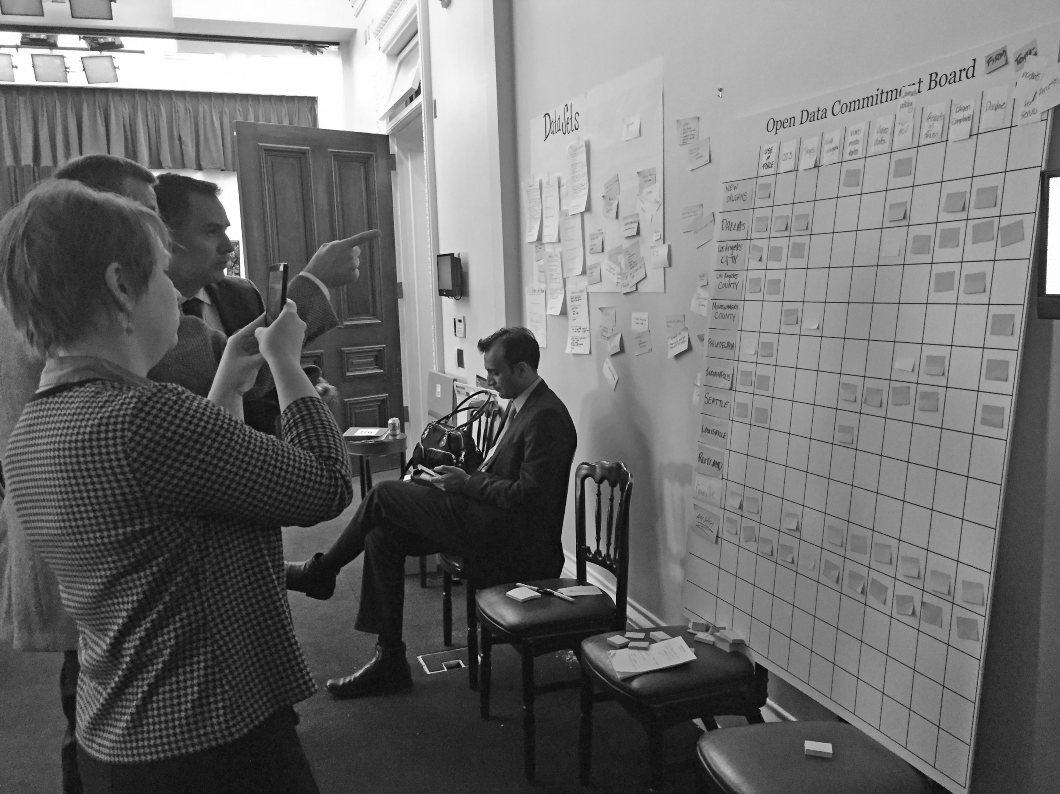

Slide 14
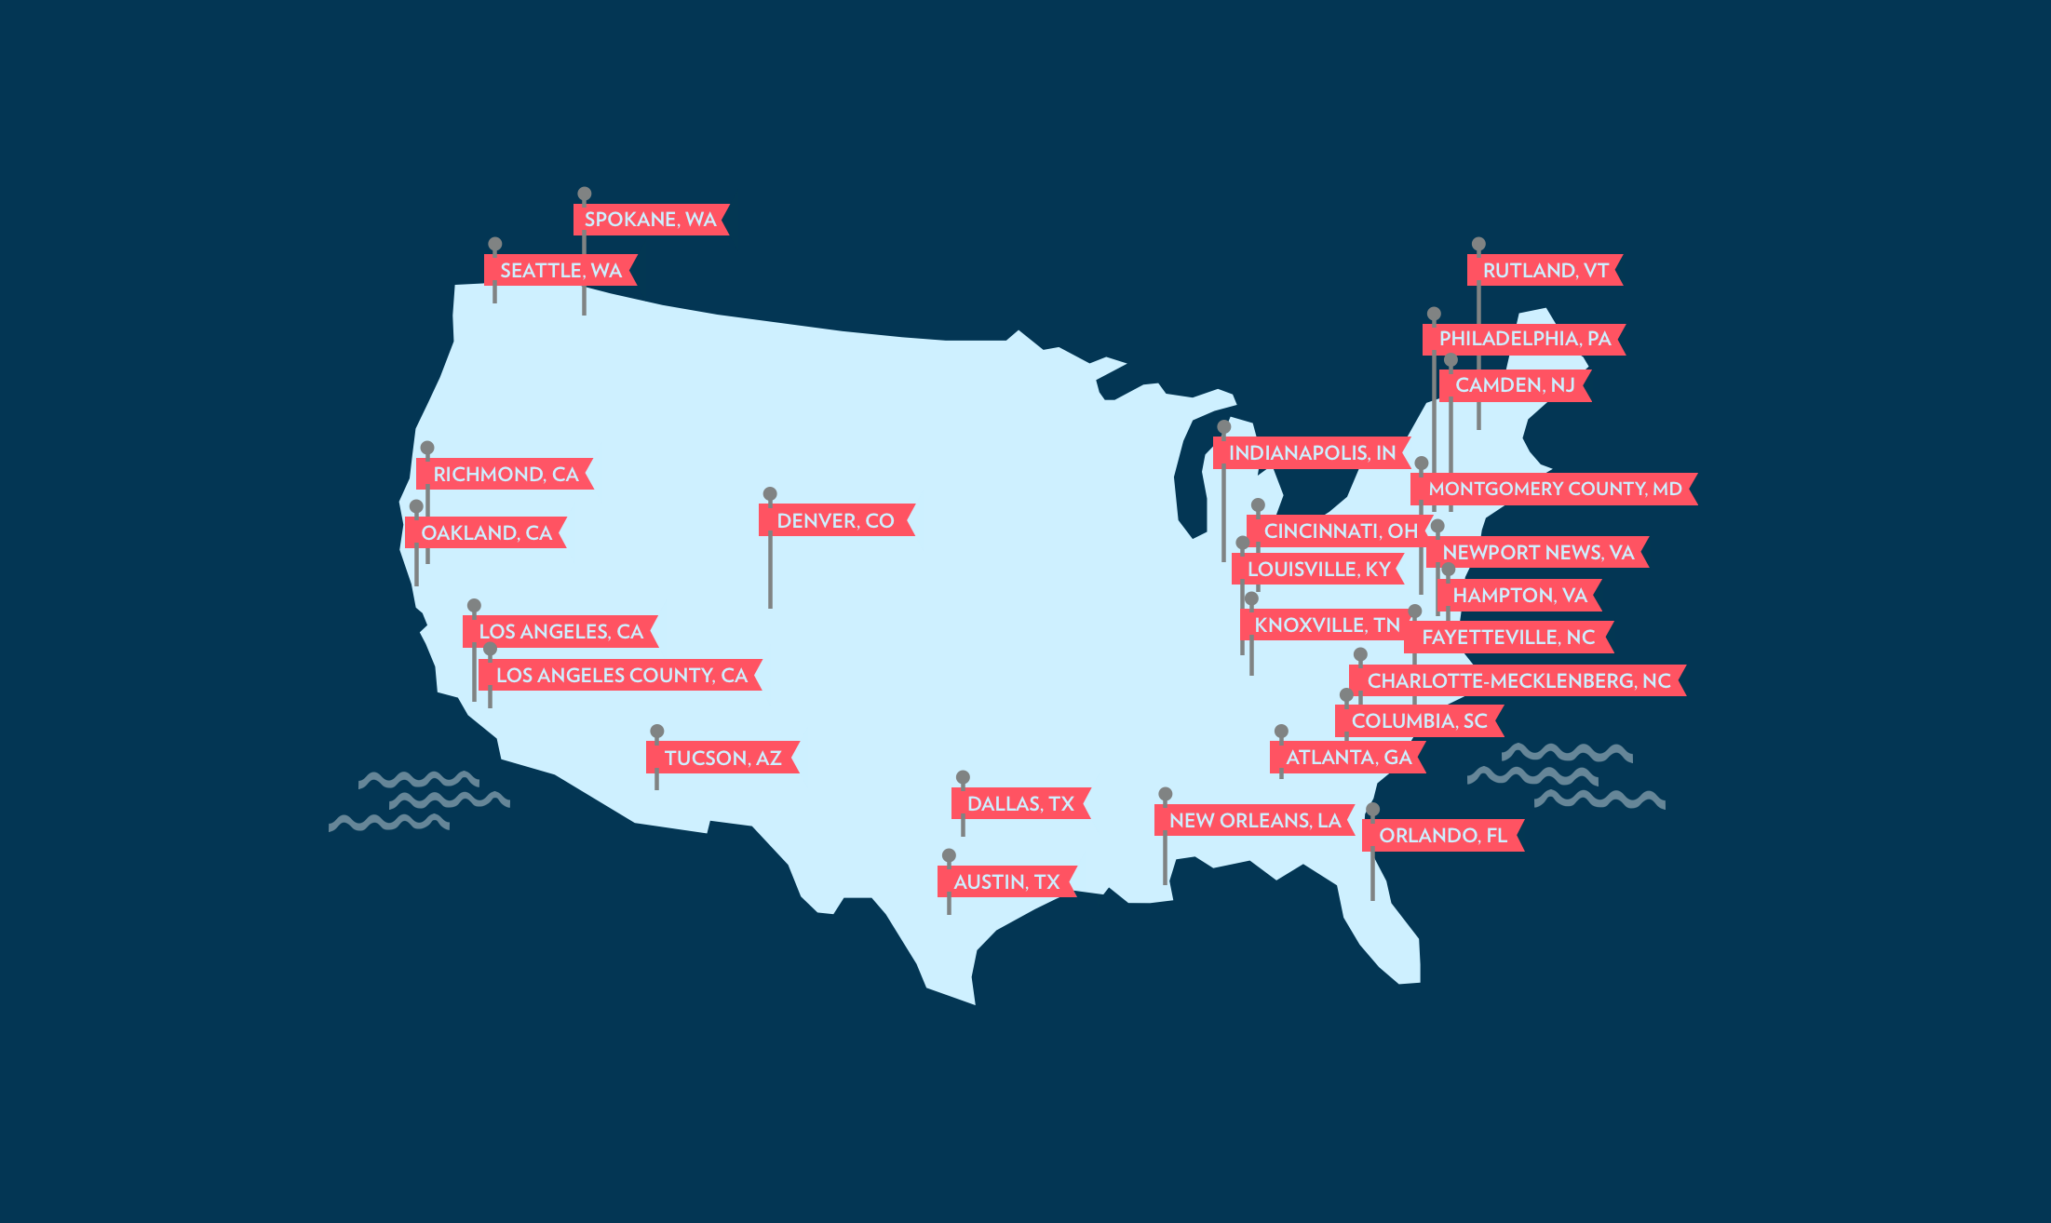

Slide 15
The Data…
Use of Force Officer Involved Shootings Assaults on Officers Calls for Service Crime Incidents
Citations and Traffic Stops
Citizen Complaints
Employee Characteristics
Body-worn Camera Metadata
Community Engagement

Slide 16
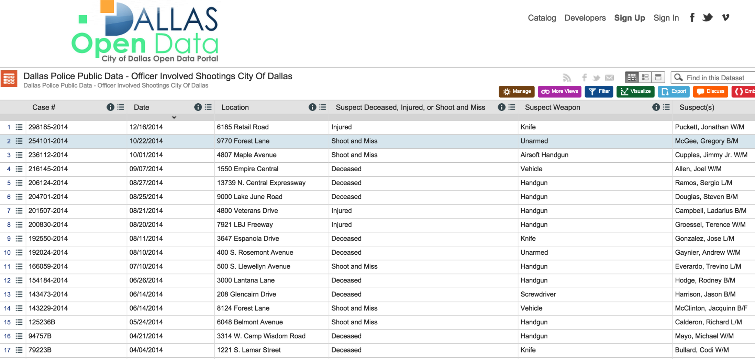
http://www.dallaspolice.net/ois/ois.html

Slide 17
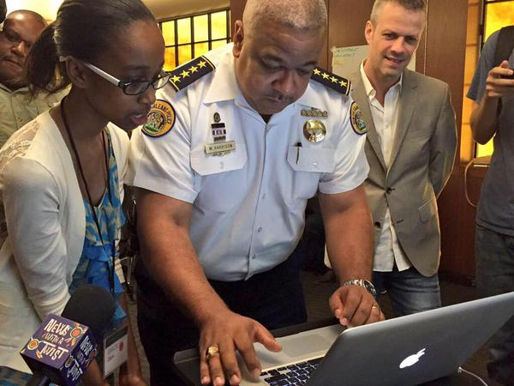
Community
Engagement:
New Orleans
Police Dept.
And
Operation
Spark

Slide 18
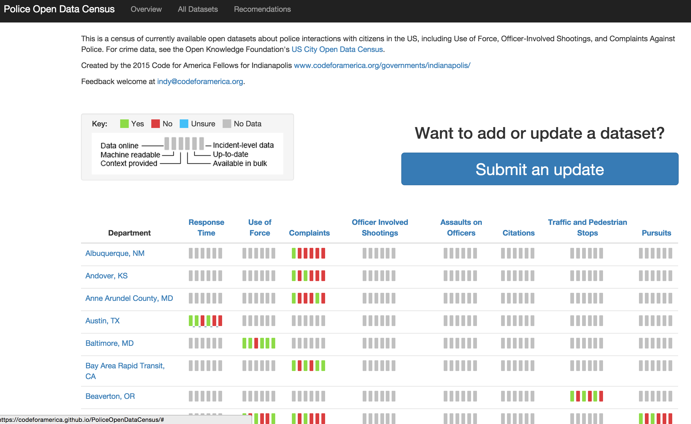

Slide 19
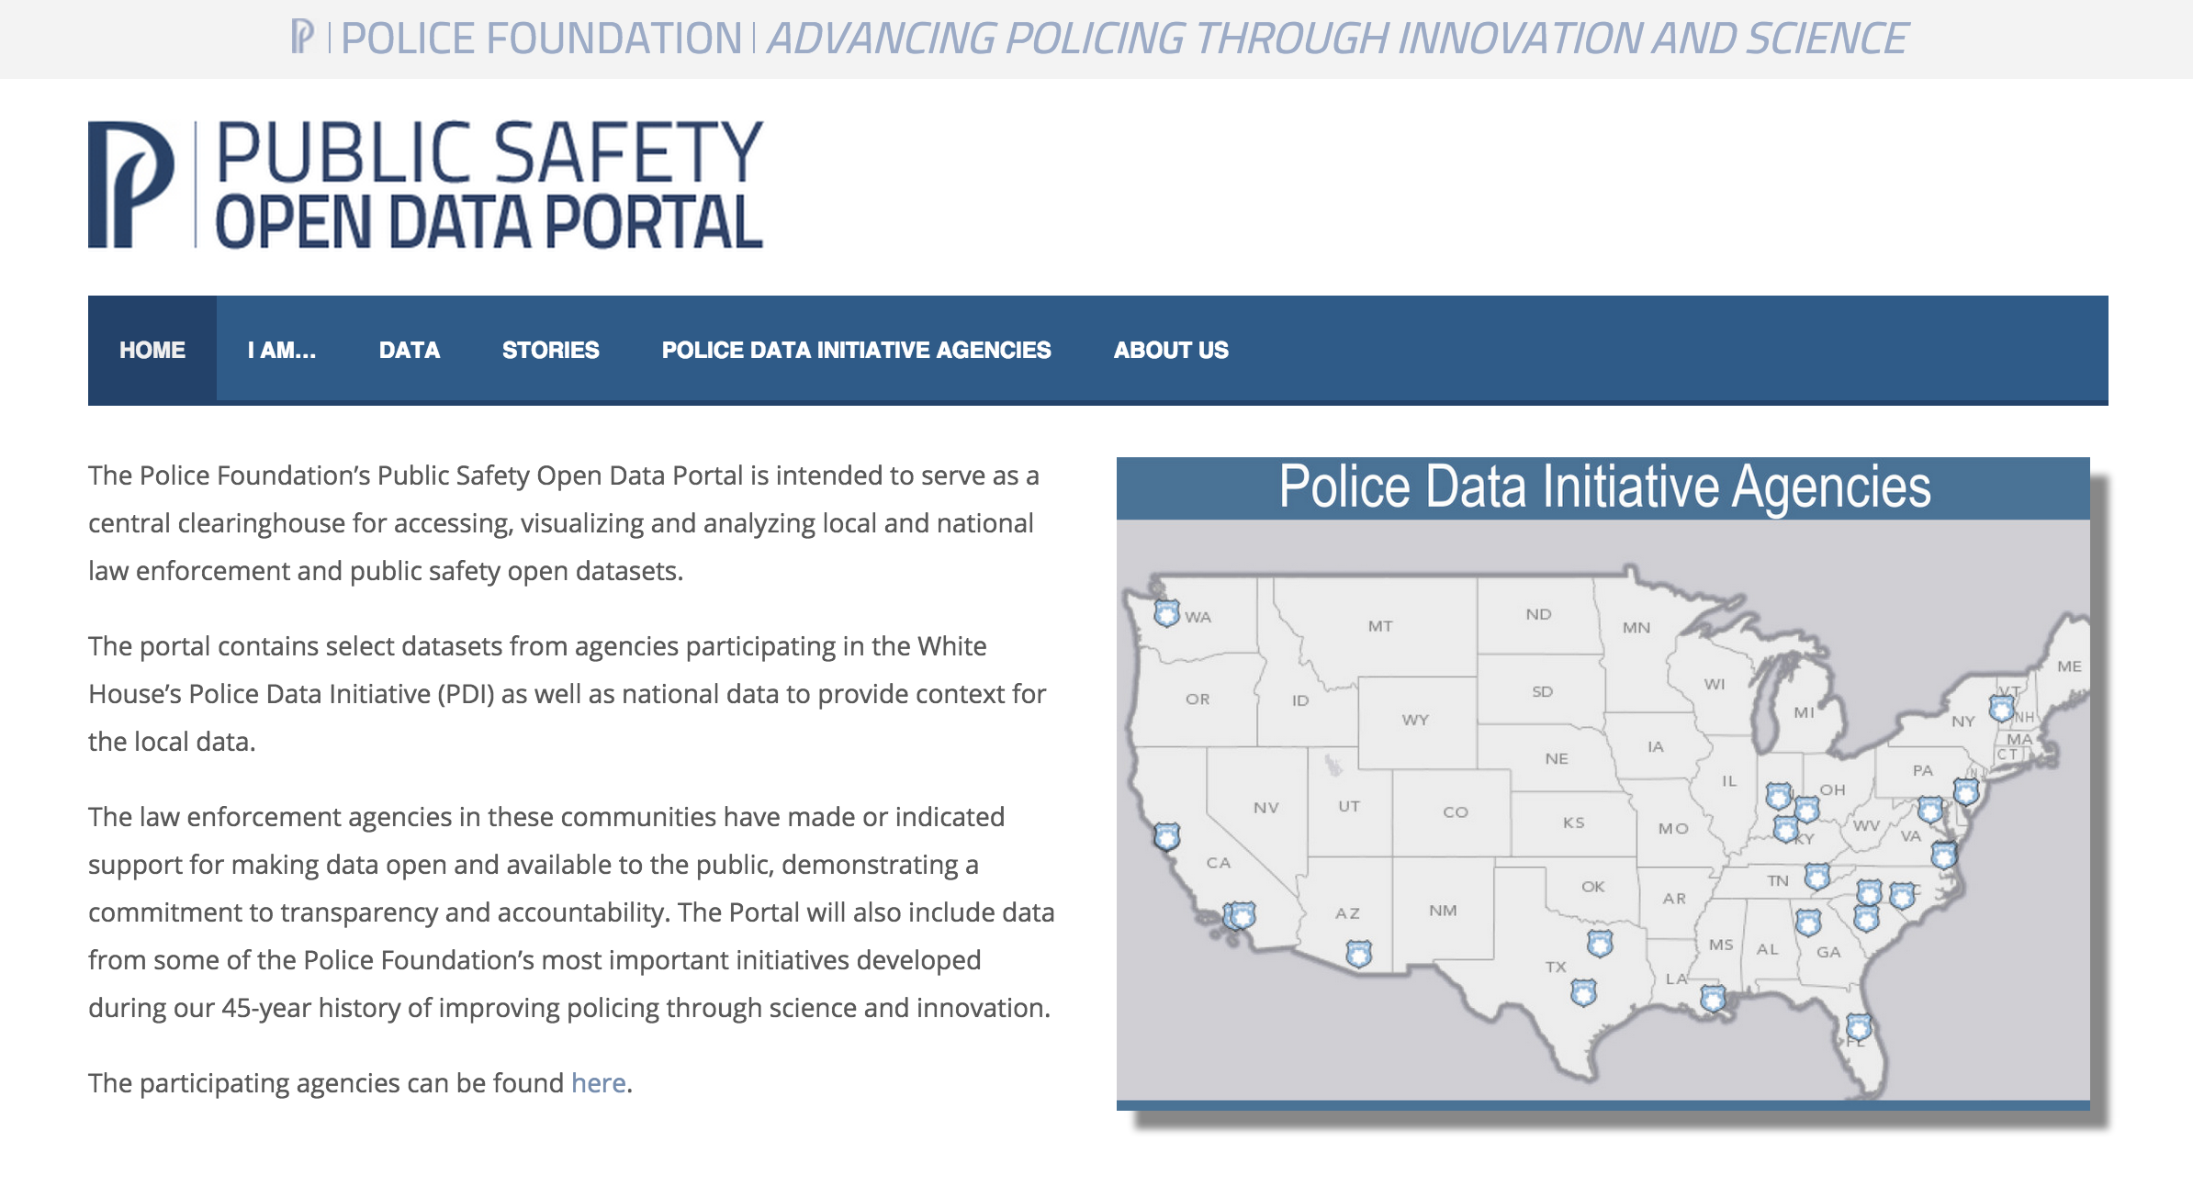
http://publicsafetydataportal.org/

Slide 20
Civic technologists, community members, and other stakeholders are a crucial part of the supporting ecosystem, as they can use the data to build value-enhancing tools that provide productive pathways for feedback, accountability, and engagement between police and citizens.

Slide 21
How can we work together?
clarence.wardell@gsa.gov pdi@policefoundation.org http://publicsafetydataportal.org/

