Slide 1
The Odyssey of Policing Data in Detroit
Erica Raleigh, Data Driven Detroit
October 2015
Notes:
Noah’s notes – I framed this as a journey that’s led to better data, and is leading to even better data than that. Feel free to insert/modify/switch around as needed to match your presenting goal, but hopefully it helps provide some visuals to talk to at least!

Slide 2
Public Safety Data in Detroit – A History
Notes:
Noah’s Notes – you can use this slide to talk about the general difficulties we’ve had in obtaining data in the past – there are some successes, but quite a few more failures

Slide 3
Historical Challenges to Obtaining Data
Notes:
Noah’s Notes: Here’s a chance to talk about the wonderful organizational structure of DPD that’s frustrated many of our efforts to get the data in the past

Slide 4
Public Safety Data in Detroit – The Present
Notes:
Noah’s Notes: Here you can talk about how much better things are becoming – we have crimes on the Open Data Portal, now!

Slide 5
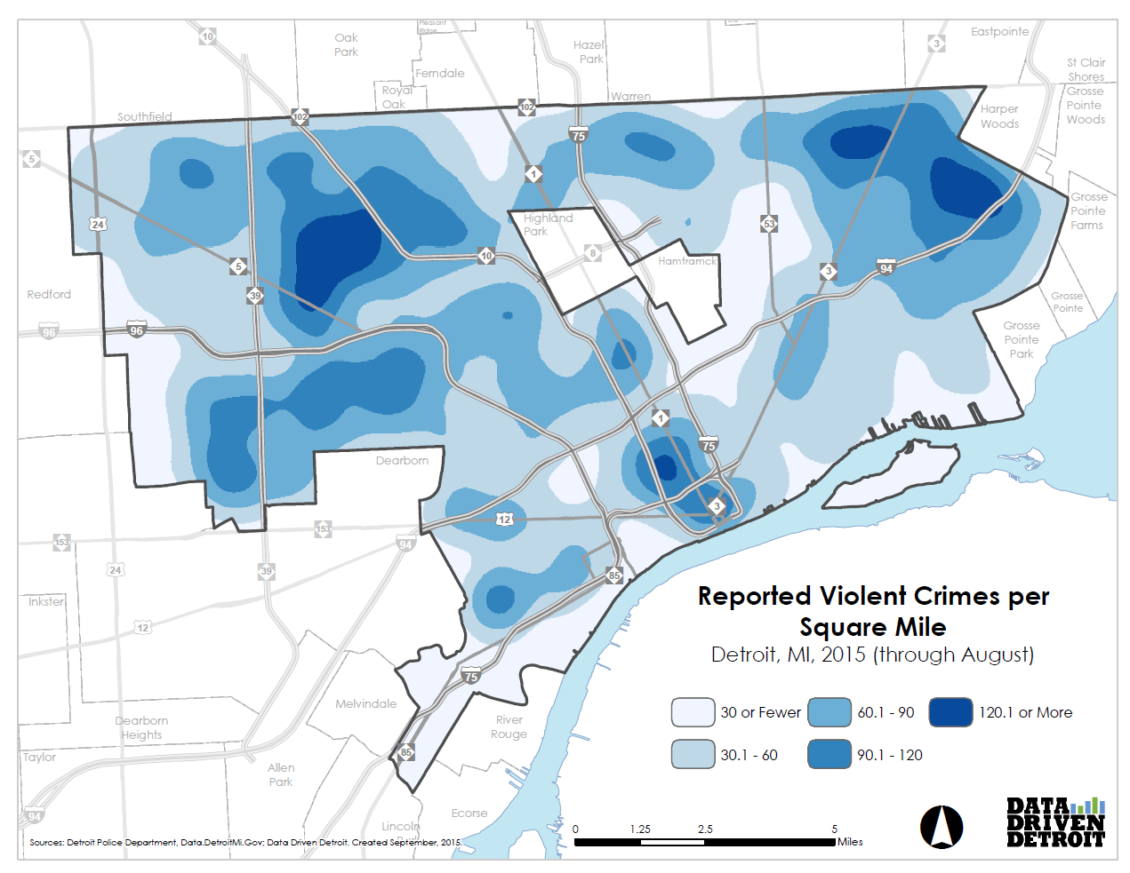
Notes:
Noah’s Notes: Here you can keep talking about how much better things are, and we’re now able to make friendly and informative data visualizations for people – but the data are still limited

Slide 6
Supporting DPD
Notes:
Noah’s Notes: Here you can talk about how we also help DPD with some of their projects, such as digitizing data for Angel’s Night, and answering other miscellaneous requests. Good to highlight a much stronger relationship with the City dpmt of technology in general

Slide 7
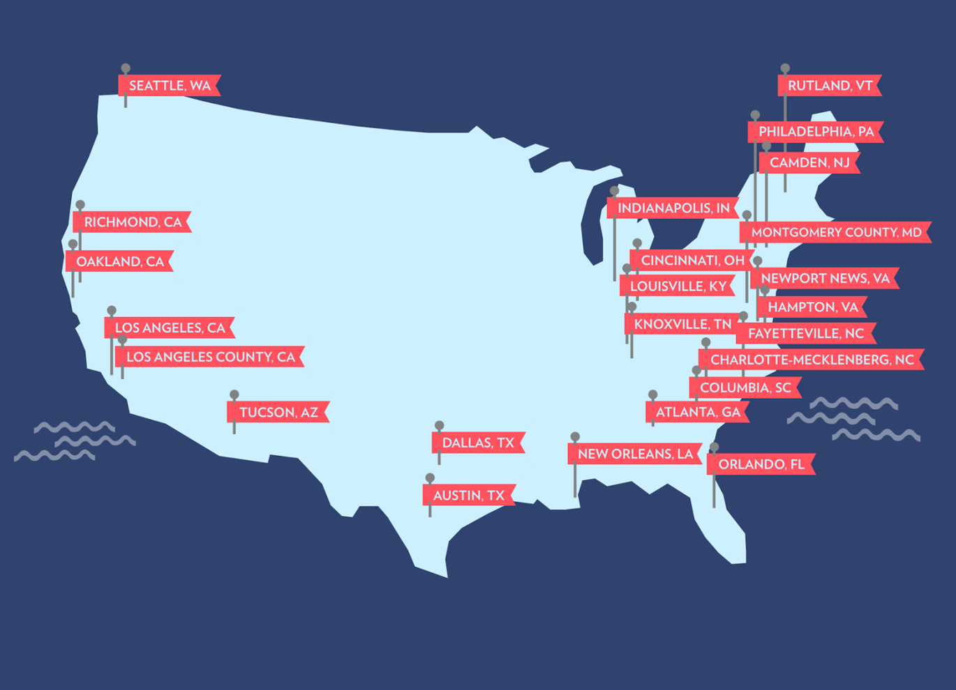
Strategizing for the Future
Notes:
Noah’s Notes: Here we can start to talk about Alexis’s project an d how she started working to implement the PDI in different cities

Slide 8
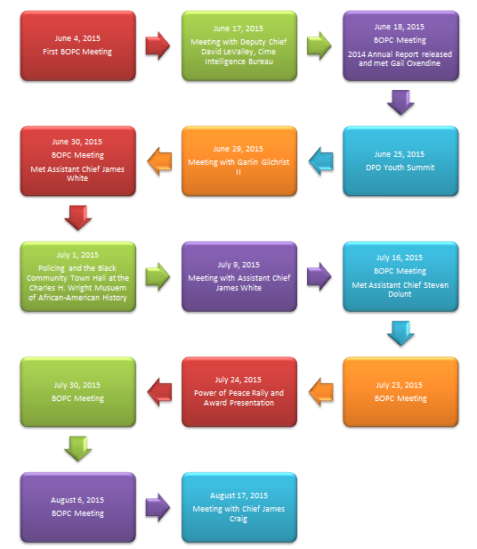
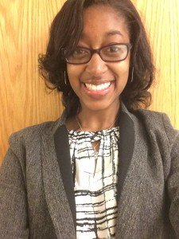
Working to Implement the Police Data Initiative
Notes:
Noah’s Notes: Here, you can talk about Alexis’s journey through DPD to try to get the initiative implemented in Detroit

Slide 9
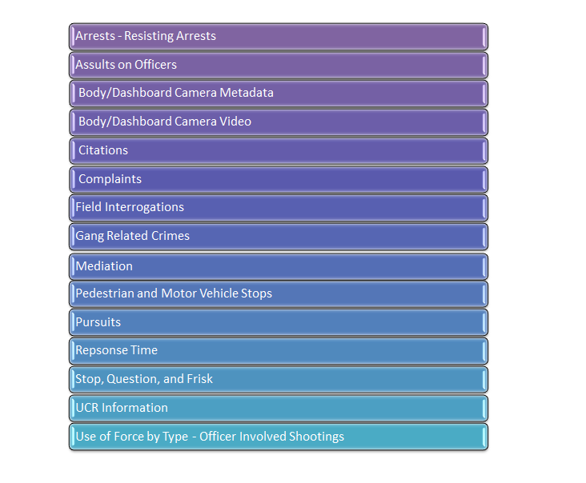
Potential Datasets for Release
Notes:
Noah’s Notes: Here are some potential datasets that could be released – none of them is currently available

Slide 10
Strategies for Success – No Matter the Stage
Approach from a place of collaboration and helpfulness
Share examples of positive results in other places
“Best Practices”
Return value, however small
Interns can bring a fresh perspective
Notes:
Noah’s notes – list some recommendations you’d like them to take away here!

Slide 11
www.DataDrivenDetroit.org
@D3Detroit
AskD3@DataDrivenDetroit.org
TechTown
440 Burroughs #330
Detroit, Michigan 48202
Notes:
We’ve posted the products for all of the interns, as well as some video and materials documenting the first year on our website (datadrivendetroit.org). Be sure to visit it, and let us know if you have any questions about how we implemented and/or evaluated the program!

