Slide 1
Developing a Data Driven System to Address Racial Profiling

Slide 2
Quick Facts
On average, Connecticut law enforcement agencies conduct approximately 700,000 traffic stops a year. Traffic stops are the most common encounter police have with the public.
On average, approximately 25 racial profiling complaints are investigated annually in Connecticut.
In 2012, only 27 law enforcement agencies were collecting and submitting traffic stop information to the African American Affairs Commission.
This project is currently funded through a $1.2 million federal grant from the National Highway Traffic Safety Administration.

Slide 3
New Law Took Effect on October 1, 2013
106 Agencies are required to collect data on all traffic stops and electronically report to a centralized database on a monthly basis.
Multiple electronic data collection and reporting options were designed and offered to law enforcement agencies.
State law requires an analysis of data on an annual basis.
State law also required the development of an on-line database to be available to the public.

Slide 4
http://ctrp3.ctdata.org

Slide 5
http://ctrp3.ctdata.org

Slide 6
Annual Analysis of Data
Guiding Principles for Statistical Analysis
Principle 1: Acknowledge that statistical evaluation is limited to finding racial and ethnic disparities that are indicative of racial and ethnic bias but that, in the absence of a formal procedural investigation, cannot be considered comprehensive evidence.
Principle 2: Apply a holistic approach for assessing racial and ethnic disparities in Connecticut policing data by using a variety of approaches that rely on well-respected techniques from existing literature.
Principle 3: Outline the assumptions and limitations of each approach transparently so that the public and policy makers can use their judgment in drawing conclusions from the analysis.

Slide 7
Descriptive Statistics and Intuitive Measures
4 Intuitive Measures were used:
Statewide Average Comparison
Estimated Driving Population
Resident Stops
Peer Groups

Slide 8
Veil of Darkness
If racial bias is driven by the ability of officers to observe the race of drivers before making a stop, then we should observe a statistical disparity between the rate of minority stops occurring in daylight vs. darkness.
Developed by Jeffery Grogger (U. Chicago) and Greg Ridgeway (U. Penn and NIJ) in 2006
Restricts sample to intertwilight window
Control statistically for a number of factors that could change risk-set
Time of the day, day of the week, state traffic volume, police department, time of day*department fixed effects, day of the week*department fixed effects, and volume*department
Estimates are for several minority definitions
Considered by CERC/IMRP to be the strongest and most accurate test

Slide 9
KPT Hit Rate Analysis
If drivers and motorists behave rationally and optimize behavior, in equilibrium they are expected to have equal hit rates across races i.e. guilt/searches.
Developed by Knowles (IZA) Persico (NYU) and Todd (U. Penn) in 2001
Utilizes only post stop data and restricts sample to discretionary searches
Estimated across several minority definitions and compared to control group
Has known shortcomings but can be used to confirm other tests

Slide 10
Results of April 2015 Analysis
As a result of our first statewide analysis, we identified 11 departments with significant racial and ethnic disparities that warranted additional analysis.
Forums were held in each town identified to discuss with the results with the community.
Several meetings have been held with law enforcement administrators.
Fair and Impartial Policing Training has been conducted to over 1,000 officers since the report was published.

Slide 11
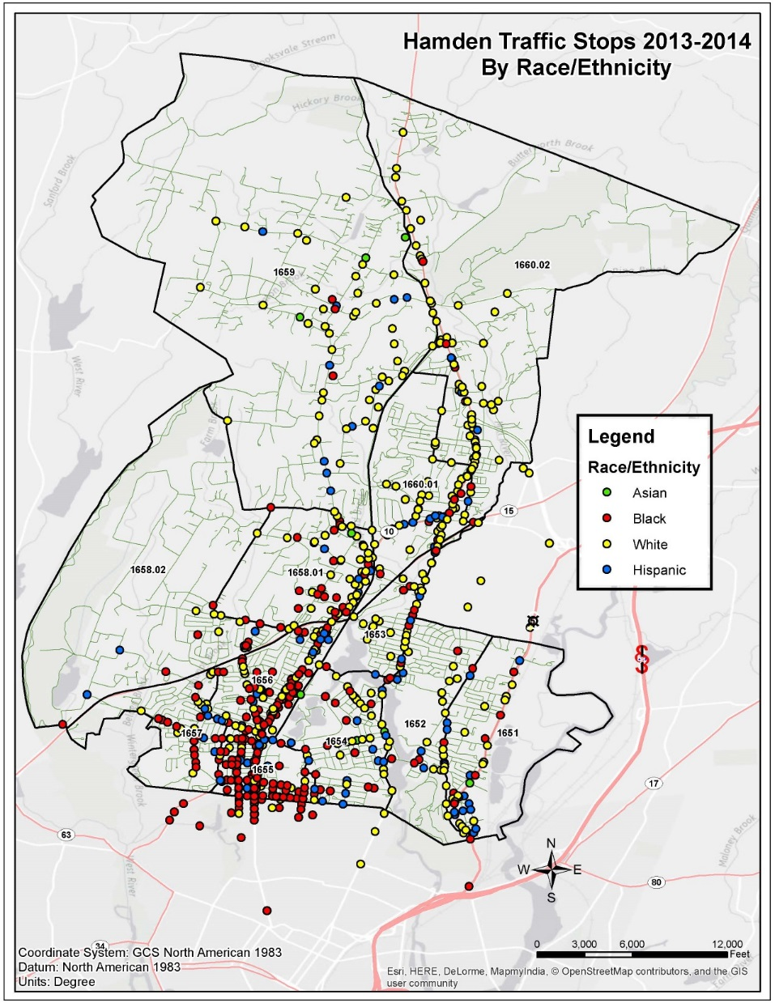
Mapping Traffic Stop Data for Follow-Up Analysis

Slide 12
Public Use of Data
Several media outlets have used the traffic stop data to develop their own analysis
“Police being kinder, gentler to drivers in Connecticut”
“Who gets off with a warning after a traffic stop in Connecticut”
“What time of day drivers get ticketed most in Connecticut”
“Interactive: Racial Profiling, By Town”
“Data: Minority Motorists Still Pulled Over, Ticketed at Higher Rates than Whites”

