Slide 1
SMALL-DOLLAR MORTGAGES
The role of small-dollar mortgages in Detroit’s housing market

Slide 2
About DFC
About DFC
DFC is a nonprofit founded in 2015 charged with catalyzing the implementation of the DFC Strategic Framework, a 50-year vision for the City of Detroit developed with input from more than 100,000 Detroiters.
We do this work through:
Research
Policy and advocacy
Leading cross-sector collaborations
Fostering equitable, inclusive, and sustainable economic growth in Detroit
Notes:
DFC is a nonprofit, founded in 2015. We are charged with catalyzing the implementation of the DFC Strategic Framework, a 50-year vision for the City of Detroit.
We are enhancing our work with a strong focus on research, policy and advocacy, leading cross-sector collaborations, and fostering equitable, inclusive, and sustainable economic growth in Detroit.

Slide 3
Our strategic focus
Grow the number of resilient, thriving neighborhoods that attract and retain residents of diverse incomes and backgrounds.
Disrupt systemic racism, poverty, and other inequities to grow household income and wealth for Black Detroiters and other Detroiters of color.

Slide 4
Detroit’s population growth and decline 1900-2022
620,000 in 2022
Source: US Census

Slide 5
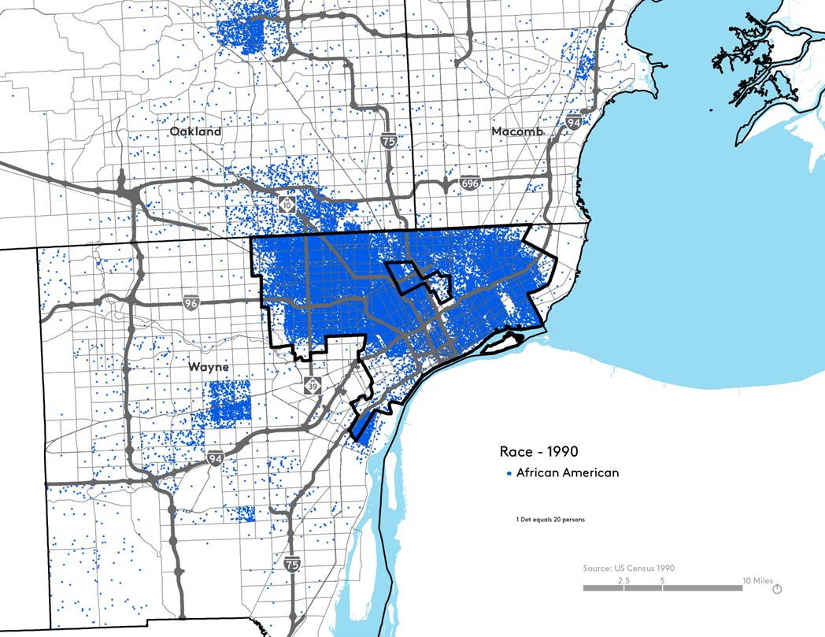
Detroit’s Black Population - 1990
Notes:
Detroit is a predominantly black city

Slide 6
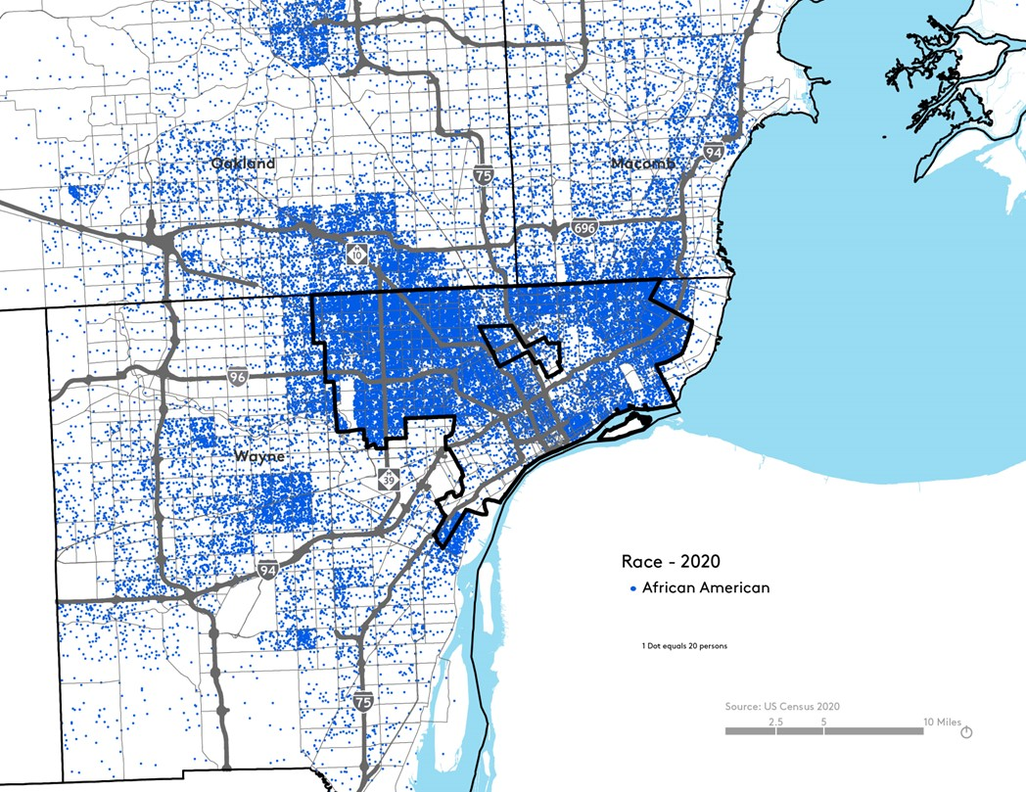
Detroit’s Black Population - 2020
Notes:
Detroit is a predominantly black city

Slide 7
50% Homeownership rate
$36,453 Median household income (2022)
$30,000 Median sales price
(2020-2021)

Slide 8
85% of home sales in Detroit were between $500-$100,000
Notes:
26,286 total transactions over $500, 23,129 under $100,000 (88%)
For decades, Detroit has seen residential properties lose value due to economic decline and foreclosure crises. Despite rising values since its 2013 bankruptcy, housing prices in Detroit remain very low. In 2021, the city recorded the lowest median home values among the 50 most populous U.S. cities.
As Detroit seeks to grow, attract, and retain Black middle-class households and work towards a more economically equitable future, increasing homeownership through mortgage lending at a diversity of price points is key.

Slide 9
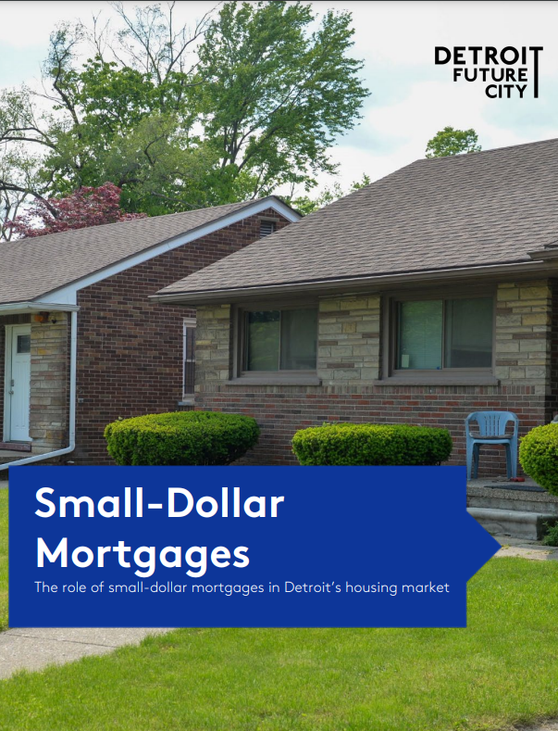
Notes:
Without small-dollar lending, many Detroiters may not have opportunities for homeownership at a price range that is affordable for their current incomes. Additionally, low-cost homes that could be a source for affordable homeownership may sit vacant or end up in the hand of speculators. In terms of neighborhood wealth, increased levels of small-dollar lending could also help drive demand, develop comparable sales (comps), stabilize neighborhoods, and increase housing values.
A mortgage loan is more than just a pathway to homeownership, it is a building block of economic equity, neighborhood stability, and wealth-building, especially for African Americans. While there is debate about whether homeownership is always the best wealth-generation strategy for a household, at a minimum, housing is a basic need, and increasing affordable homeownership opportunities is one way of meeting that need.
While mortgage demand in Detroit has increased, mortgage lending is still relatively low; in the region, only one in five mortgage applications by a Black homebuyer is in Detroit.
Goal: Better understand the demand for and barriers to small-dollar mortgages ($30,000-$100,000) using available data and interviews.

Slide 10
Funder thank you
with support from Bloomberg Philanthropies’ Greenwood Initiative
Notes:
Black Wealth Data Center, with support from Bloomberg Philanthropies

Slide 11
Shoutout to the report author, Kendall Nash

Slide 12
Project Overview
Data:
- Home Mortgage Disclosure Act (HMDA) (2020-2021)
- Wayne County Register of Deeds (2020-2021)
- Decennial Census (2010 and 2020)
Literature Review
Case studies of 3 neighborhoods
Interviews with a community organization in each neighborhood and local CDFIs and credit unions.

Slide 13
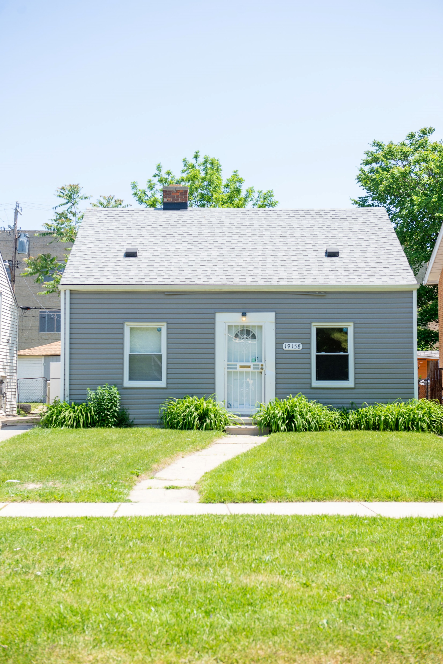
Challenges around small-dollar mortgages
Profitability of loans
High fixed costs
Lending regulations
Appraisal gaps

Slide 14
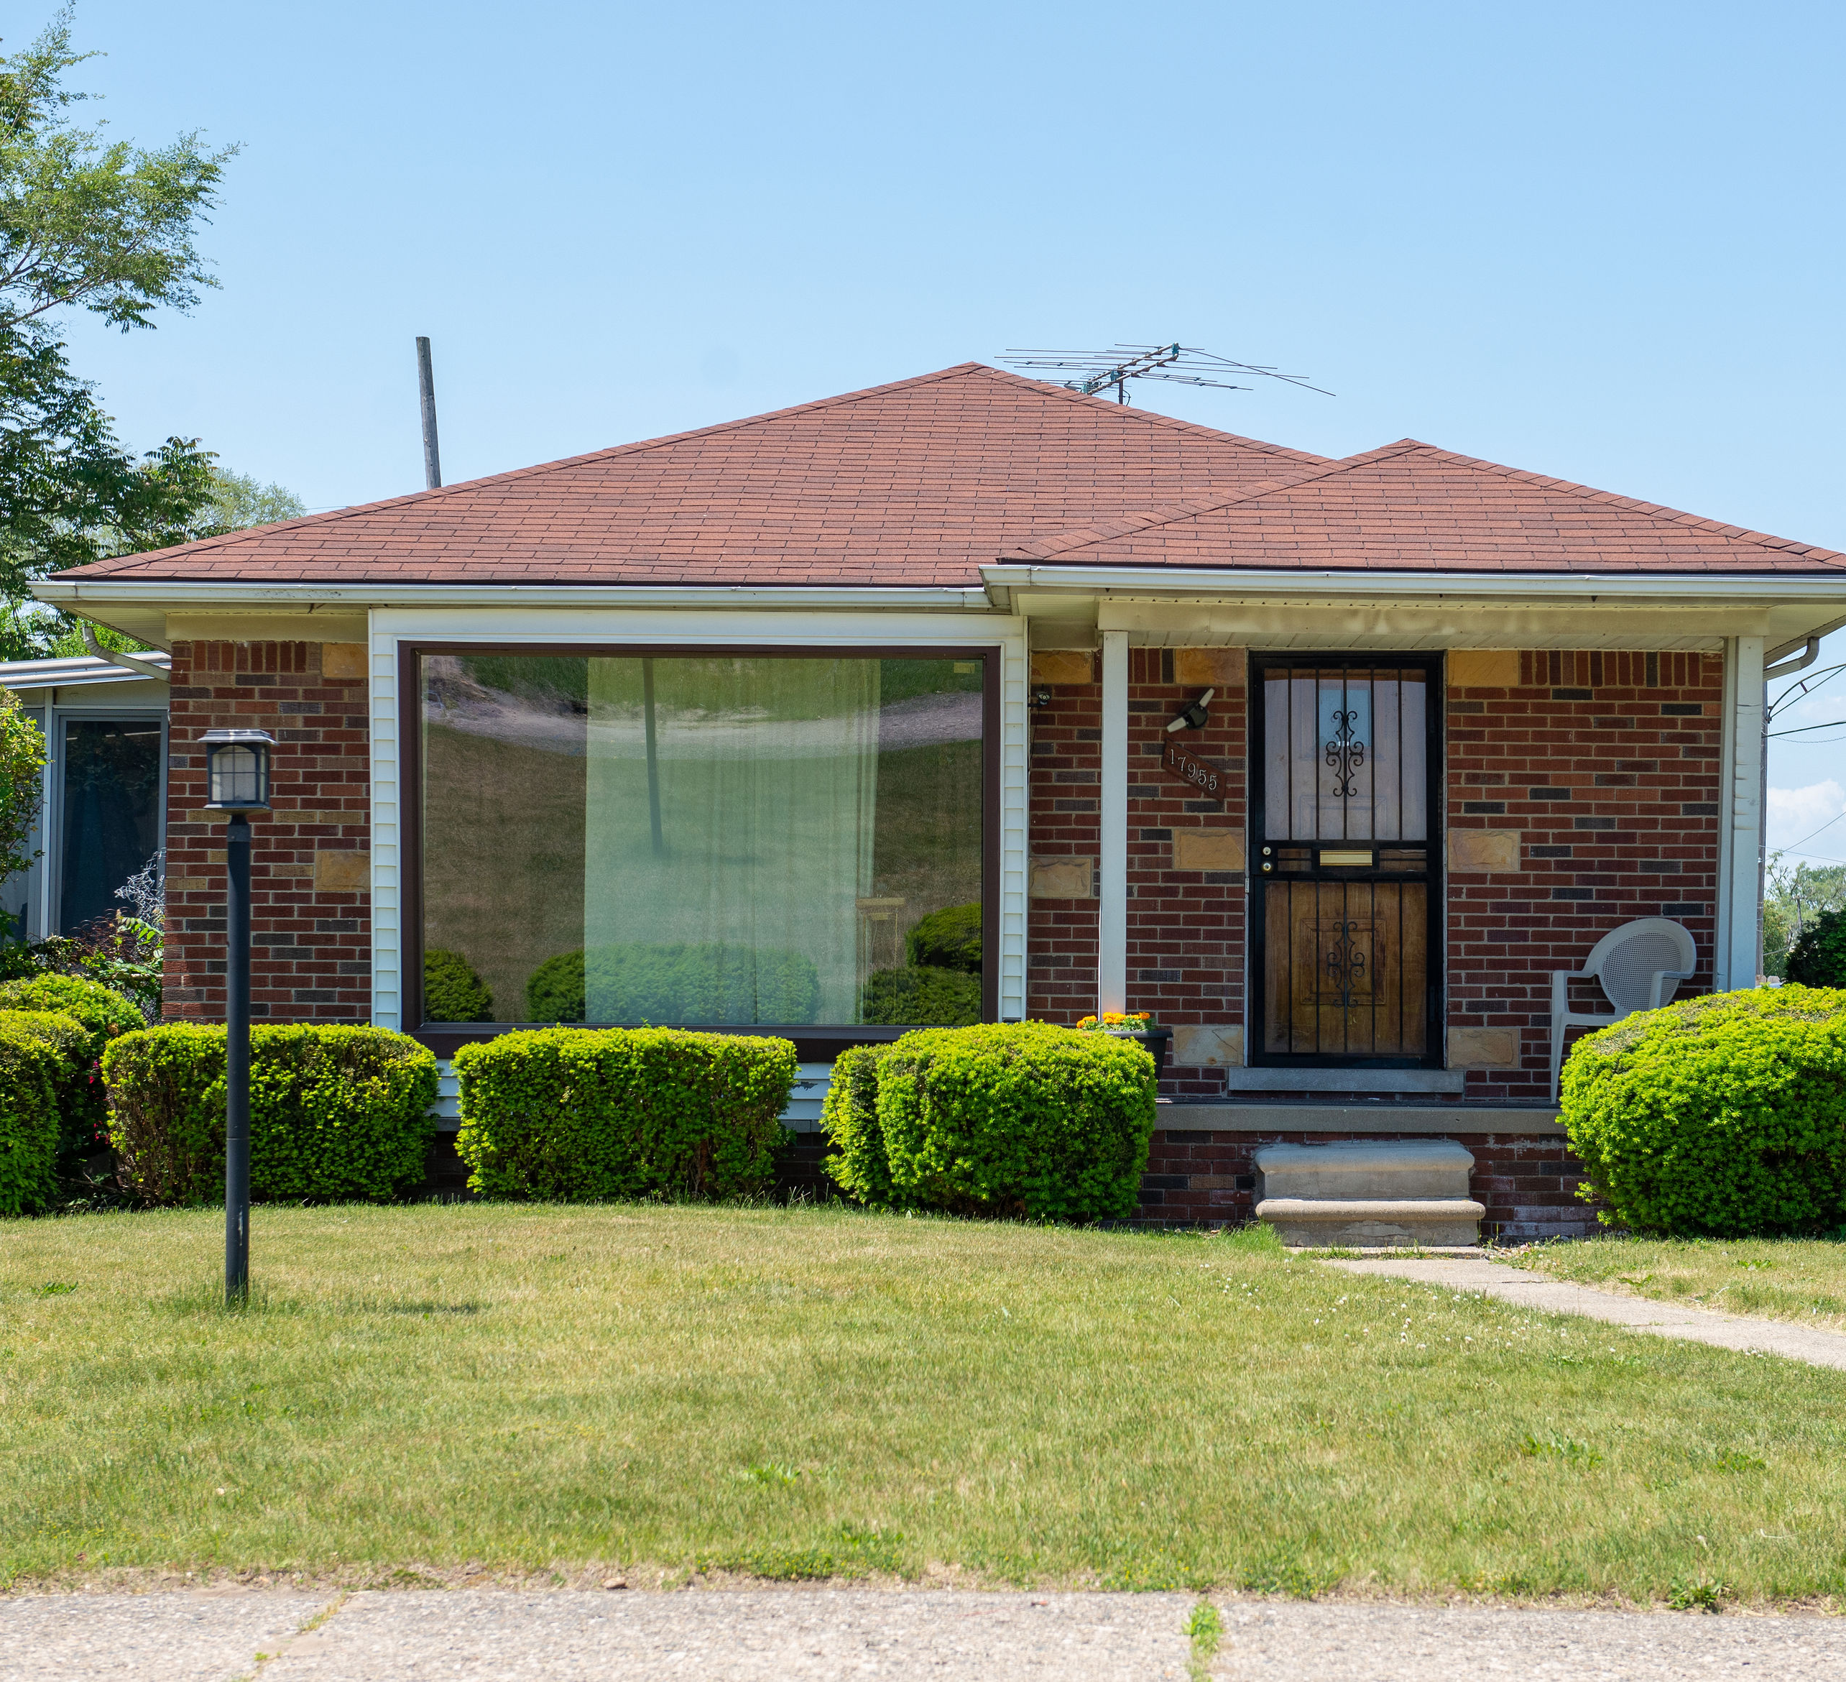
47% of small-dollar mortgage applications in Detroit were originated
Notes:
47% of applications were ultimately originated across the board

Slide 15
26,286 home sales transactions
Other transactions
Other
Small dollar mortgages
Mortgages
Source: Analysis of Home Mortgage Disclosure Act and Wayne County Register of Deeds data, 2020-2021
Notes:
Total of 26,286 total transactions

Slide 16
Other transactions
Other
Small dollar mortgages
Mortgages
Source: Analysis of Home Mortgage Disclosure Act and Wayne County Register of Deeds data, 2020-2021
Notes:
Total of 26,286 total transactions

Slide 17
Other transactions
Other
Small dollar mortgages
Mortgages
Source: Analysis of Home Mortgage Disclosure Act and Wayne County Register of Deeds data, 2020-2021
Notes:
35% of all transactions with a mortgage would be considered small-dollar mortgages. Overall, this represents about 6.5% of all transactions.
About half of these small dollar morgages were going to black buyers, although we should note that race wasn’t noted for about 20%.

Slide 18
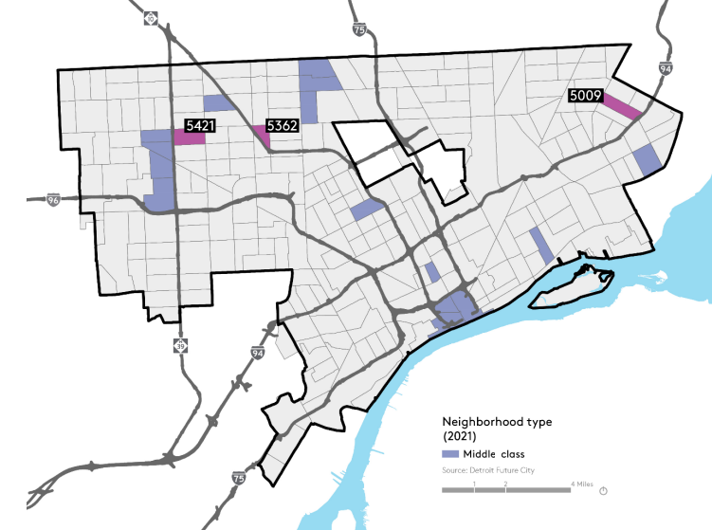

Slide 19
Themes from case studies
Neighborhood trajectory is tied to demand for mortgages
Geography influences neighborhood trajectory
A steady supply of quality homes is crucial
Notes:
Since homeownership is often considered a financial asset or investment in the United States, buyers who purchase a house with a mortgage are not only using a financing tool to make the costs of homeownership more manageable but also betting that the property and neighborhood they are purchasing in will continue to appreciate, enabling them to build equity
There exists a notable difference in small-dollar mortgages between the two northwest side tracts, Tract 5421 and Tract 5362, and the eastside neighborhood of Tract 5009. Despite recording the highest level of small-dollar transactions, Tract 5009 has the lowest number of small-dollar mortgages. A key difference between these two geographies is that the census tracts on the northwest side are both near traditionally stable middle-class neighborhoods (University District, Grandmont Rosedale, etc.), whereas Tract 5009 is not as close to the eastside’s more stable neighborhoods. I
While not explicitly reflected in the data, many of the interviews for this project, particularly with lenders active in the small-dollar mortgage space, noted a lack of move-in-ready homes available to buyers looking in this price range. A While it may have been common to find a move-in-ready home in the $30,000–$100,000 price range in a desirable neighborhood five to 10 years ago, those properties are becoming few and far between as Detroit’s property values continue to increase.

Slide 20
Solutions

Slide 21
Support nonprofit lenders, Community Development Financial Institutions (CDFIs), and credit unions.
Develop specialized lending tools.
Holding property to allow time for mortgage process
Availability of loan products and consumer knowledge
Notes:
Support nonprofit lenders, Community Development Financial Institutions (CDFIs), and credit unions who can evaluate buyers on a case-by-case basis and connect them to any relevant lending products and services.
Lenders should continue to develop specialized tools, such as Special Purpose Credit Programs, that can target buyers at certain income levels with more favorable criteria and loan terms.
The community and economic development system should explore models for community land trusts that can hold homes while buyers get their finances organized, since following the mortgage process can take much longer than purchasing a house with cash.

Slide 22
Increase the supply of affordable, move-in-ready homes
Continue to invest in the repair needs of Detroit’s existing homeowners.
Continue to invest in Detroit’s neighborhoods
Buyer demand and housing quality

Slide 23
Ashley Clark
aclark@detroitfuturecity.com

