Slide 1
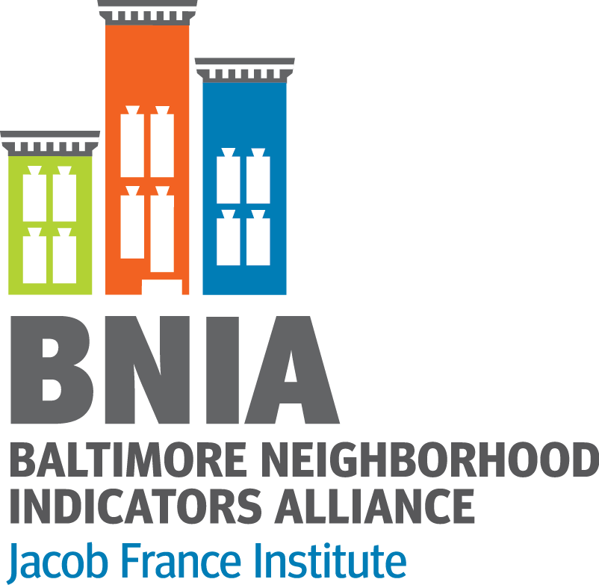
Data Contexts Neighborhood Indicators, Social Histories, and the Limitations of Data
Amanda Phillips de Lucas, PhD
aphillipsdelucas@ubalt.edu
www.bniajfi.org
@bniajfi
Notes:
Greetings and welcome to the 14th Annual Baltimore Data Day.
Ralph – welcome to the University of Baltimore and thank you for your kind remarks this morning.
My name is Amanda Phillips de Lucas. I took over the helm of BNIA in March of this year and I can honestly say that the enthusiasm for this event has truly blown me away. My longer biography is provided in the packet of information in the event you want to learn more about my background.
The short of it, and most relevant to our time today, I’ve spent close to a decade studying how people have used scientific and technical data to advocate for change in their communities. During my past five years in Baltimore, I’ve had the great privilege to meet many of the amazing people and groups doing this work. While I have met some of you in this auditorium already, I look forward to getting to know everyone in the room today. I can’t wait to listen, understand how you use data, and learn how BNIA’s tools, indicators, and resources can better serve your needs.

Slide 2
NNIP Racial Equity Goal
We strive to be transparent about the biases and limitations in the data and document the contexts in which the data were created.

Slide 3
Technological Change

Slide 4
Technological Change
Social Context

Slide 5
Technological Change
Social Context
Data Creation

Slide 6
Notes:
If the mid 20th century promised ‘Better Living Through Chemistry’, the concluding decades promised ‘Better Living Through Computation.’ It’s challenging to overstate the optimism that accompanied the rise of the internet, personal computing, and with it, greater access to tools and technology that aided decision making, expanded social networks, and the emergence of digital public life.

Slide 7
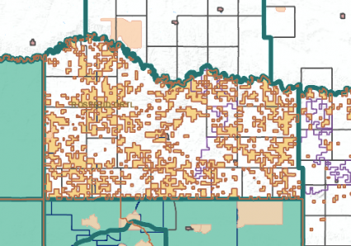
Technological Change
TIGER files
Notes:
Address-matching may well have been the most critical ingredient in the new mix. It became possible with the advent of the U.S. Bureau of the Census’ TIGER (Topologically Integrated Geographic Encoding and Referencing) system during the 1980s—the output of the joint efforts of the Bureau and the U.S. Geological Survey to
digitize patterns of streets and other geographic features nationwide (U.S. Bureau of the Census,
1985). If you have a copy of the relevant TIGER files (or more recent updates) and appropriate
hardware, you can print an accurate map of any city, showing the street pattern, the boundaries of
census block groups and tracts, and other physical features

Slide 8
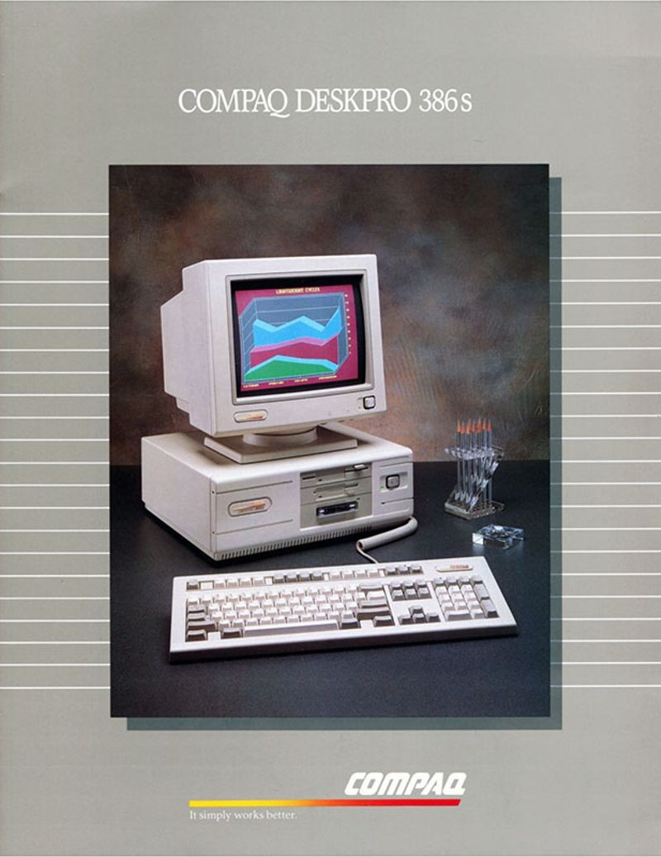
Technological Change
TIGER files
Affordable, Personal Computers
Notes:
. Address-matching may well have been the most critical ingredient in the new mix. It became possible with the advent of the U.S. Bureau of the Census’ TIGER (Topologically Integrated Geographic Encoding and Referencing) system during the 1980s—the output of the joint efforts of the Bureau and the U.S. Geological Survey to
digitize patterns of streets and other geographic features nationwide (U.S. Bureau of the Census,
1985). If you have a copy of the relevant TIGER files (or more recent updates) and appropriate
hardware, you can print an accurate map of any city, showing the street pattern, the boundaries of
census block groups and tracts, and other physical features

Slide 9
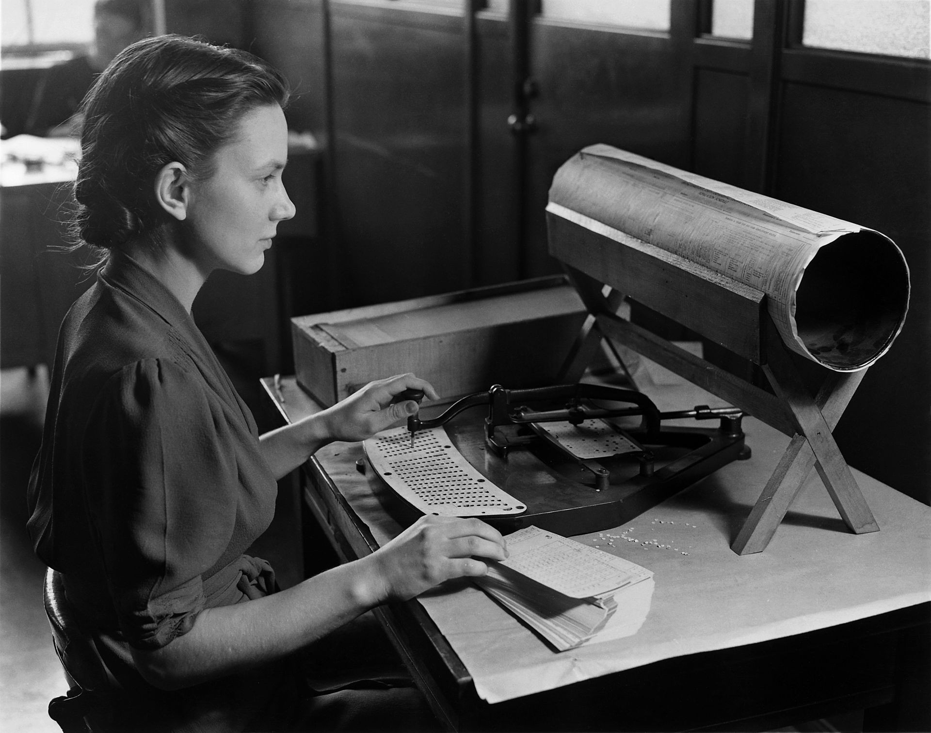
Technological Change
TIGER files
Automation
Affordable, Personal Computers
Notes:
. Address-matching may well have been the most critical ingredient in the new mix. It became possible with the advent of the U.S. Bureau of the Census’ TIGER (Topologically Integrated Geographic Encoding and Referencing) system during the 1980s—the output of the joint efforts of the Bureau and the U.S. Geological Survey to
digitize patterns of streets and other geographic features nationwide (U.S. Bureau of the Census,
1985). If you have a copy of the relevant TIGER files (or more recent updates) and appropriate
hardware, you can print an accurate map of any city, showing the street pattern, the boundaries of
census block groups and tracts, and other physical features

Slide 10
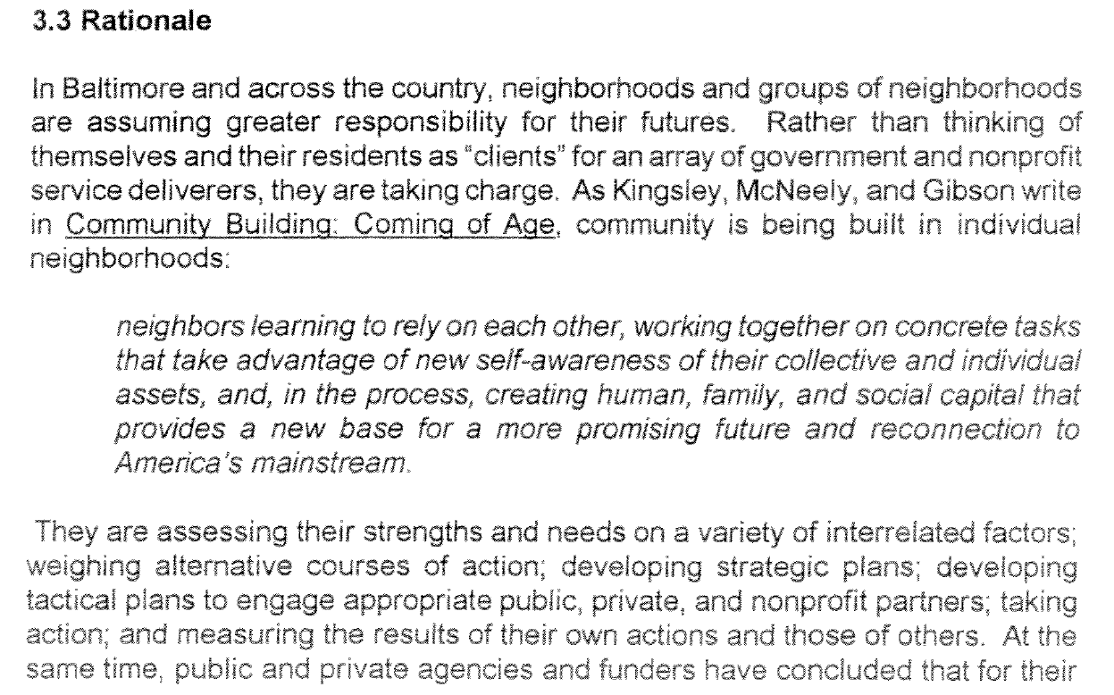

Slide 11
Social Change
Tools for Community Decision Making

Slide 12
Social Change
Tools for Community Decision Making
Urban Quality of Life

Slide 13
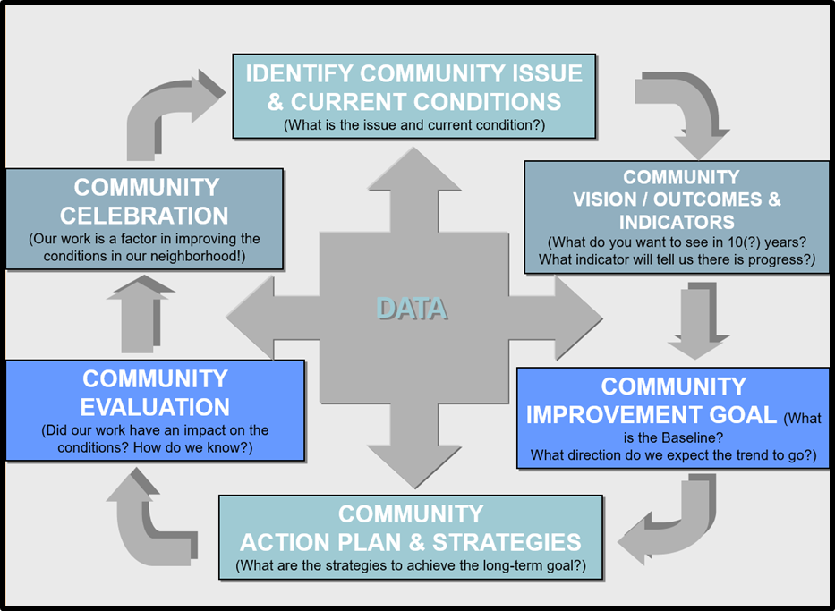
Social Change
Access to data
Tools for Community Decision Making
Urban Quality of Life

Slide 14
The Birth of An Indicator
Part I Crime Data
Equivalence
Violent Crime
Property Crime
Categories
Homicide
Aggravated Assault
Burglary
Auto Theft
Phenomena
Notes:
We can only develop indicators by using the data classifications provided to us.

Slide 15
Thank you!
Amanda Phillips de Lucas, PhD
aphillipsdelucas@ubalt.edu
www.bniajfi.org
@bniajfi
Notes:
The short of it, and most relevant to our time today, I’ve spent close to a decade studying how people have used scientific and technical data to advocate for change in their communities. During my past five years in Baltimore, I’ve had the great privilege to meet many of the amazing people and groups doing this work. While I have met some of you in this auditorium already, I look forward to getting to know everyone in the room today. I can’t wait to listen, understand how you use data, and learn how BNIA’s tools, indicators, and resources can better serve your needs.

